Slide 1


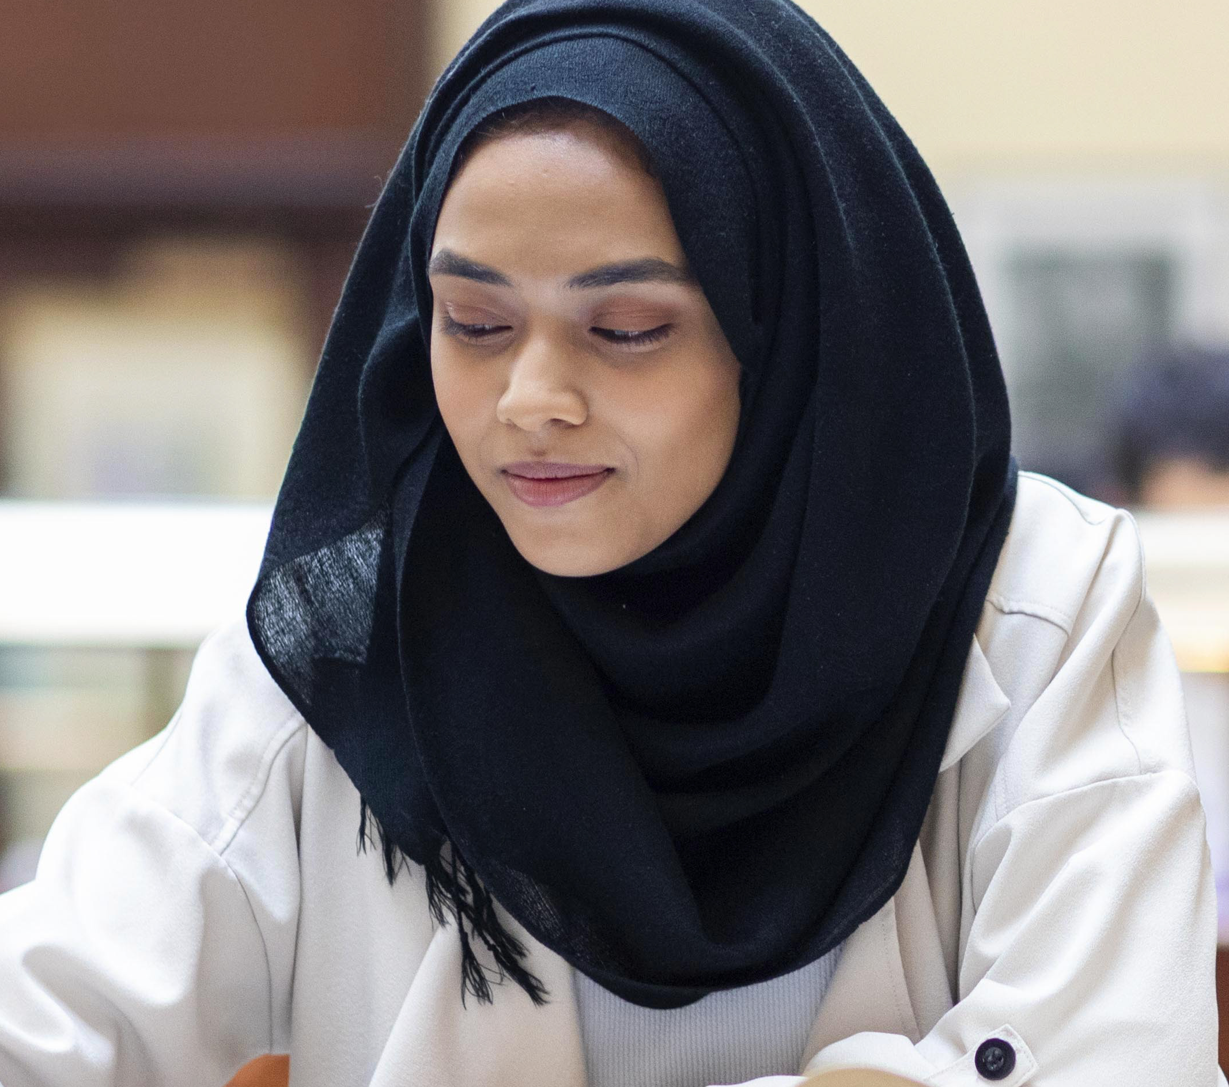


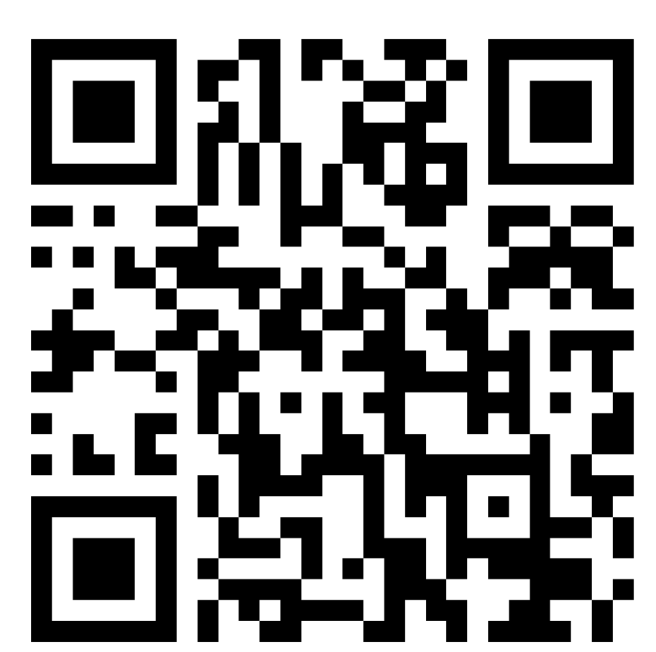
Levelling Up:
Computer Science
Programme
For Year 11–12 female and non‑binary students
Join the Next Generation of Inclusive Innovators
Program
Sessions: 5 accessible sessions on advanced computer science topics led by students
Dates: 29 Jun, 30 Jun and 1 Jul 2026
Venue: City St George's, University of London, Northampton Square, EC1V 0HB
Topics
AI & Machine Learning
Creative Coding
Cyber Security & Digital
Forensics
Data Science & Environmental Modelling
Human–Computer Interaction
Opportunities
BCS‑approved, up‑to‑date CS content
University visits
Interactive tutoring sessions
Confidence‑boosting mentoring
AI hackathon competition and prizes
Scan to sign up:
https://forms.office.com/e/80qGmdHWaJ

