Slide 1


Slide 2
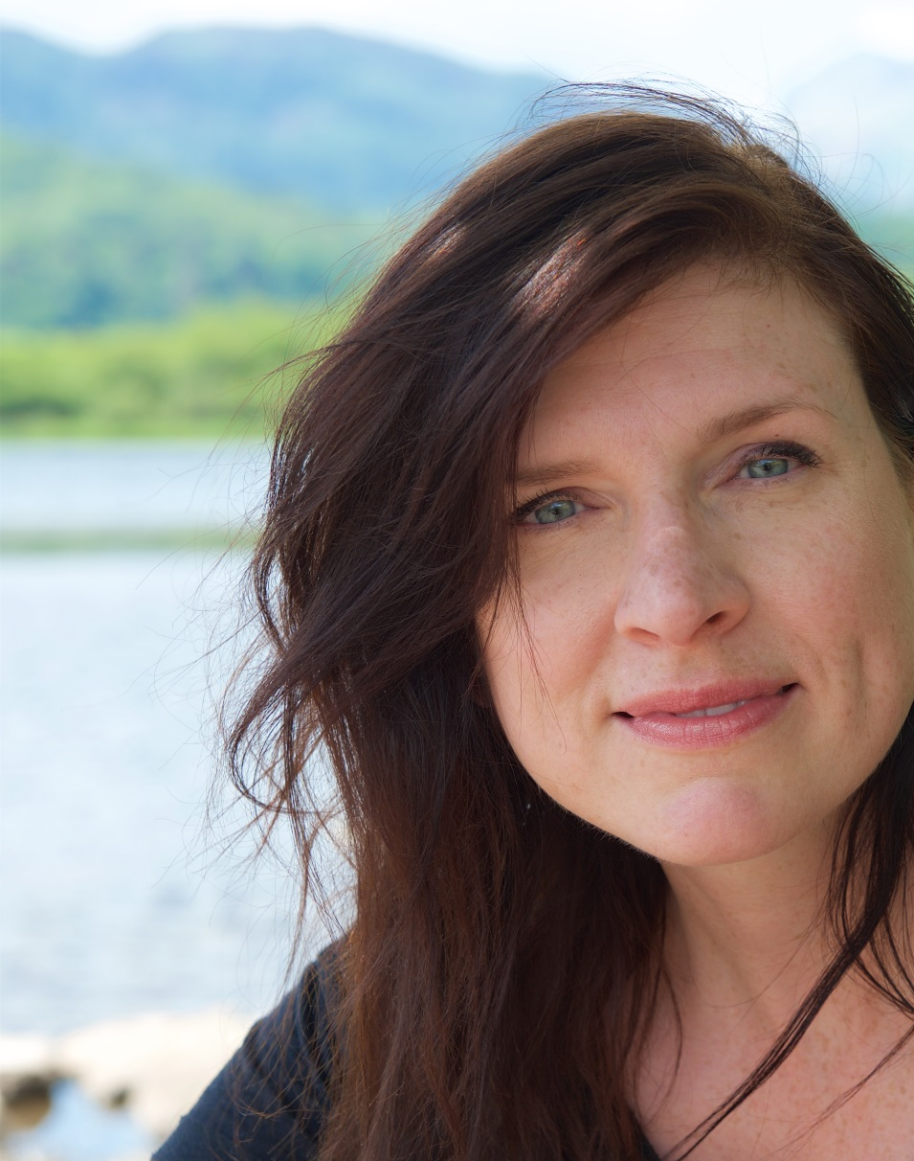
Thank you, Christine Farion.
Your research into
memory and the
development
of digital bags
that help us
keep track of
things won’t
be forgotten.
Find out
about
Christine’s
research.
#IAmAComputerScientist
With kind permission of Christine Farion.

Slide 3
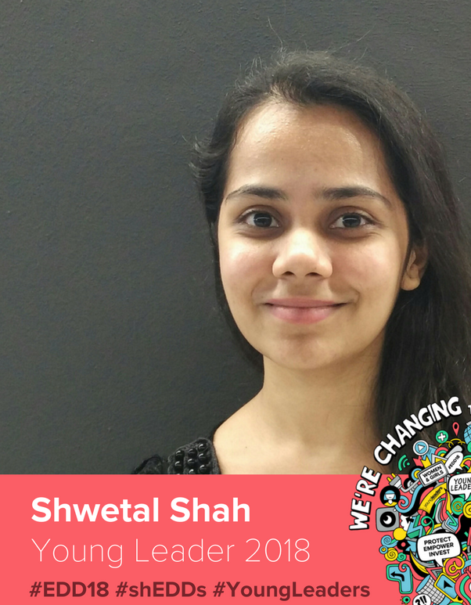
Thank you, Shwetal Shah.
For representing young
women in technology
with governments
and multinationals
and championing
creativity in
computing.
What cat-themed game
that teaches programming
did Shwetal work on?
#IAmADigitalActivist
With kind permission of Shwetal Shah

Slide 4
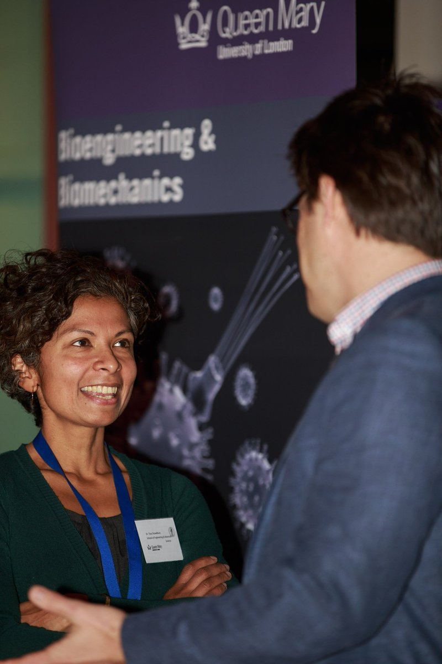
Thank you, Tina Chowdhury.
Your work helps babies survive
and gives mobility to those with osteoarthritis by combining biology,
medicine, engineering
and computer science
with technology.
Find out how gaming and bioengineering are used in QMUL Virtual Science Lab.
With kind permission of Tina Chowdhury
#IAmAComputerScientist

Slide 5
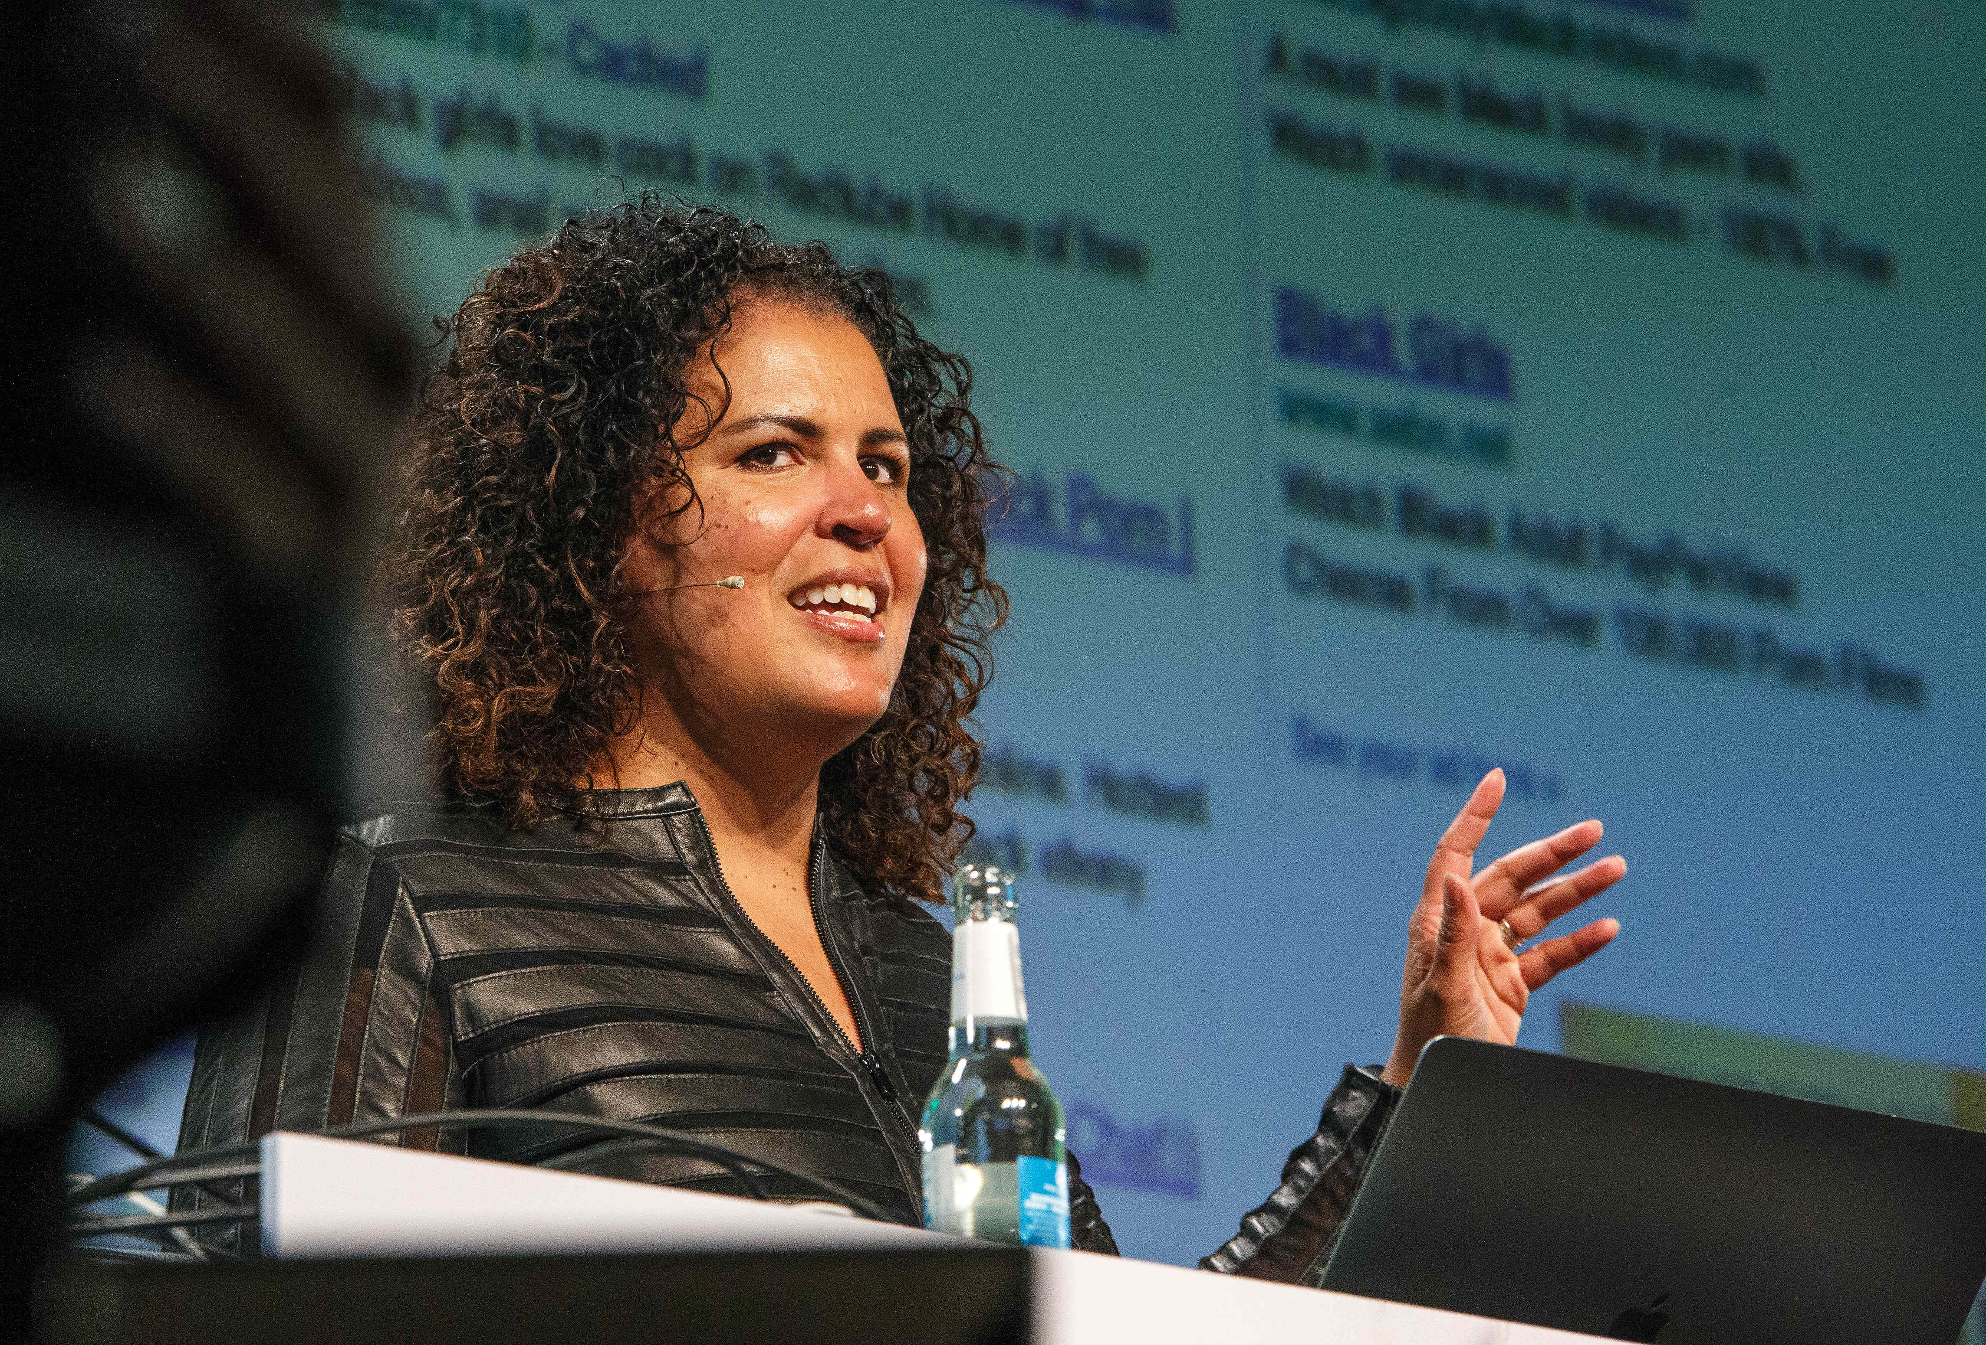
Thank you, Safiya Umoja Noble.
Your work on ethics and the design of digital media platforms reminds us that search engines can reinforce racism and that algorithms can have gender bias.
Find out about data science and ethics.
#IAmADigitalResearcher
https://www.flickr.com/photos/re-publica/41809675342/ Attribution-ShareAlike 2.0 Generic (CC BY-SA 2.0)

Slide 6
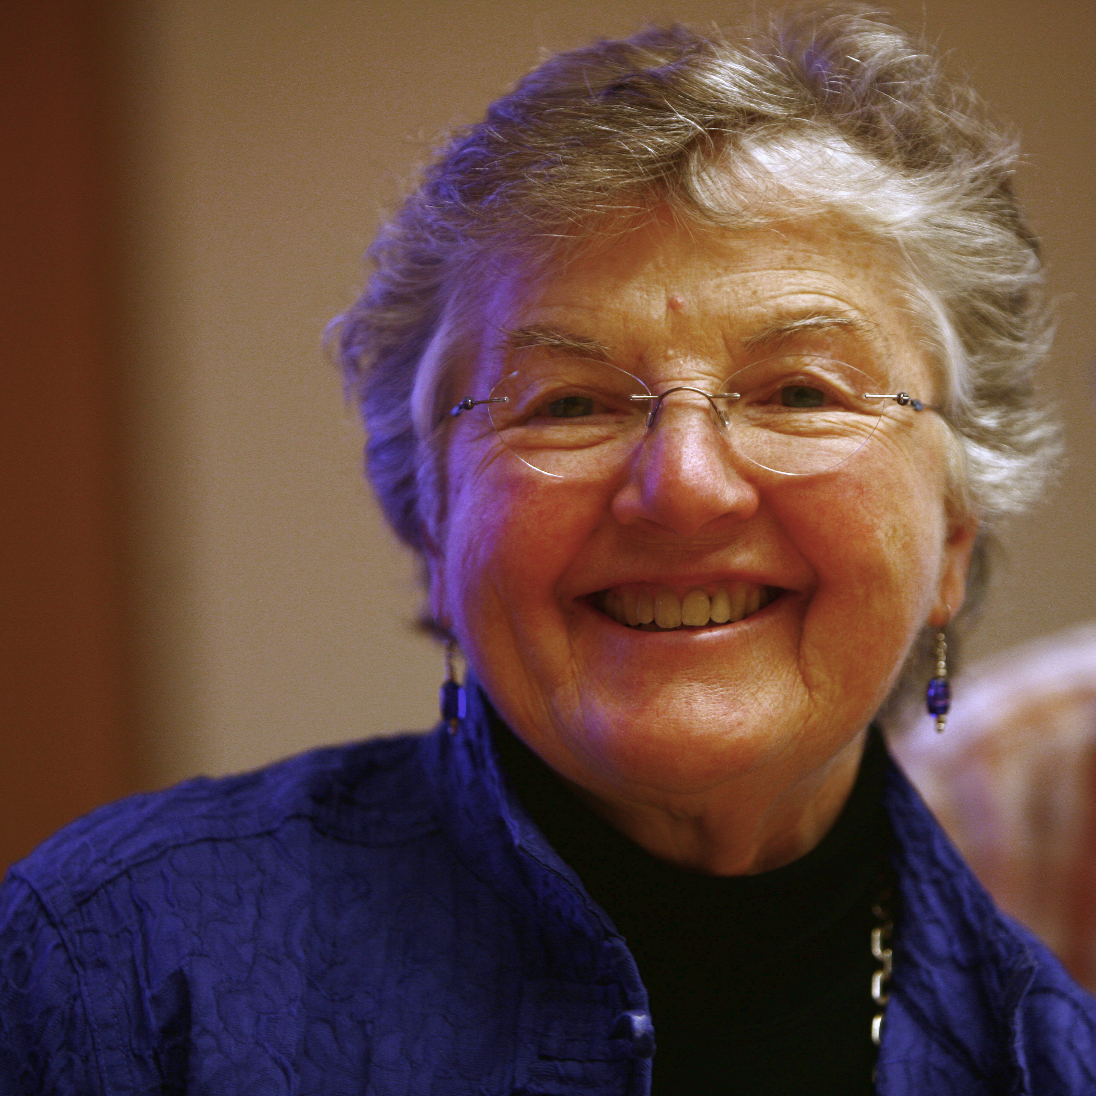
Thank you, Fran Allen.
If you had not worked out how compilers could make code faster we would have slow programs and harder to read code.
Find out about the Turing Award that Fran won.
#IAmAComputerScientist
Rama CC BY-SA 2.0 fr

Slide 7
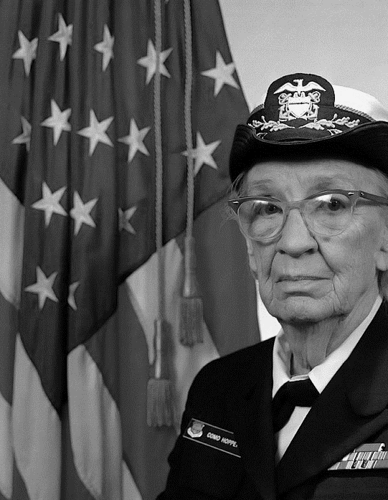
Thank you, Grace Hopper.
Without your idea, to use English language words
rather than obscure codes
in programming languages, coding would be a lot more complicated.
What bug did Grace famously find?
#IAmAProgrammer
James S. Davis
Notes:
.

Slide 8
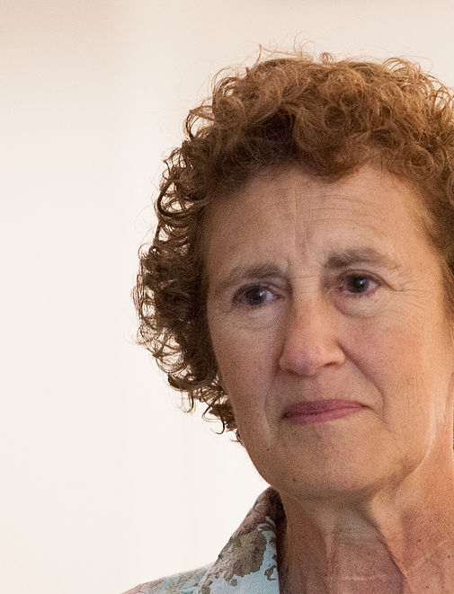
Thank you Barbara Liskov.
You design programming languages.
We would not
have Object
Oriented
Programming
(OOP)
without you.
Congratulations
on the Turing
Award.
Find out about OOP.
#IDesignProgrammingLanguages
Kenneth C. Zirkel CC BY-SA 3.0

Slide 9
Thank you, Juliana Rotich.
You co-developed a platform that saves lives and supports democracy across the world.
Find out who provides the data
for Ushahidi.
By usbotschaftberlin - Family photo of the panelists before the discussion at the W20 Conference, Public Domain, https://commons.wikimedia.org/w/index.php?curid=67607408
#IAmAComputerScientist

Slide 10
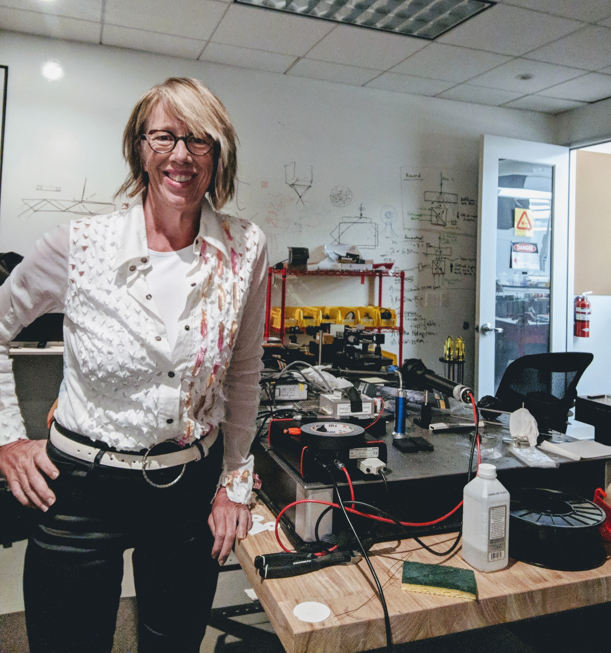
Thank you, Mary Lou Jepsen.
Your inventions in displays and imaging are all around us, head mounted displays, live walls, VR and holography.
Find out about Mary Lou’s work at Google, Facebook, MIT and her own companies.
#IAmAComputerScientist
By Maryloujepsen - Own work, Public Domain, https://commons.wikimedia.org/w/index.php?curid=71035848

Slide 11
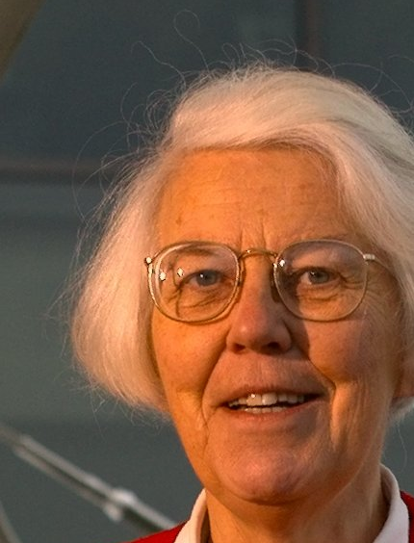
Thank you, Karen Spärck Jones.
For THE ALGORITHM that search engines use to help us retrieve what is most relevant.
What is Karen’s
famous quote about men and computing?
#IAmAComputerScientist
University of Cambridge CC BY 2.5

Slide 12
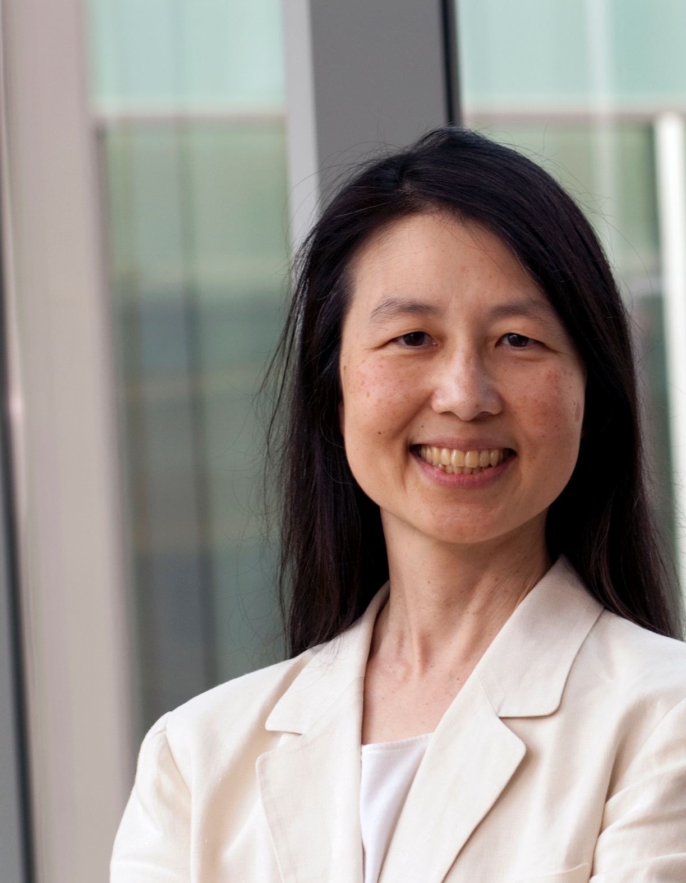
Thank you, Jeannette Wing.
For putting Computational
Thinking on the map.
How abstract is that?
Find out about
decomposition
and algorithmic
thinking.
#IAmAComputerScientist
Columbia University

Slide 13
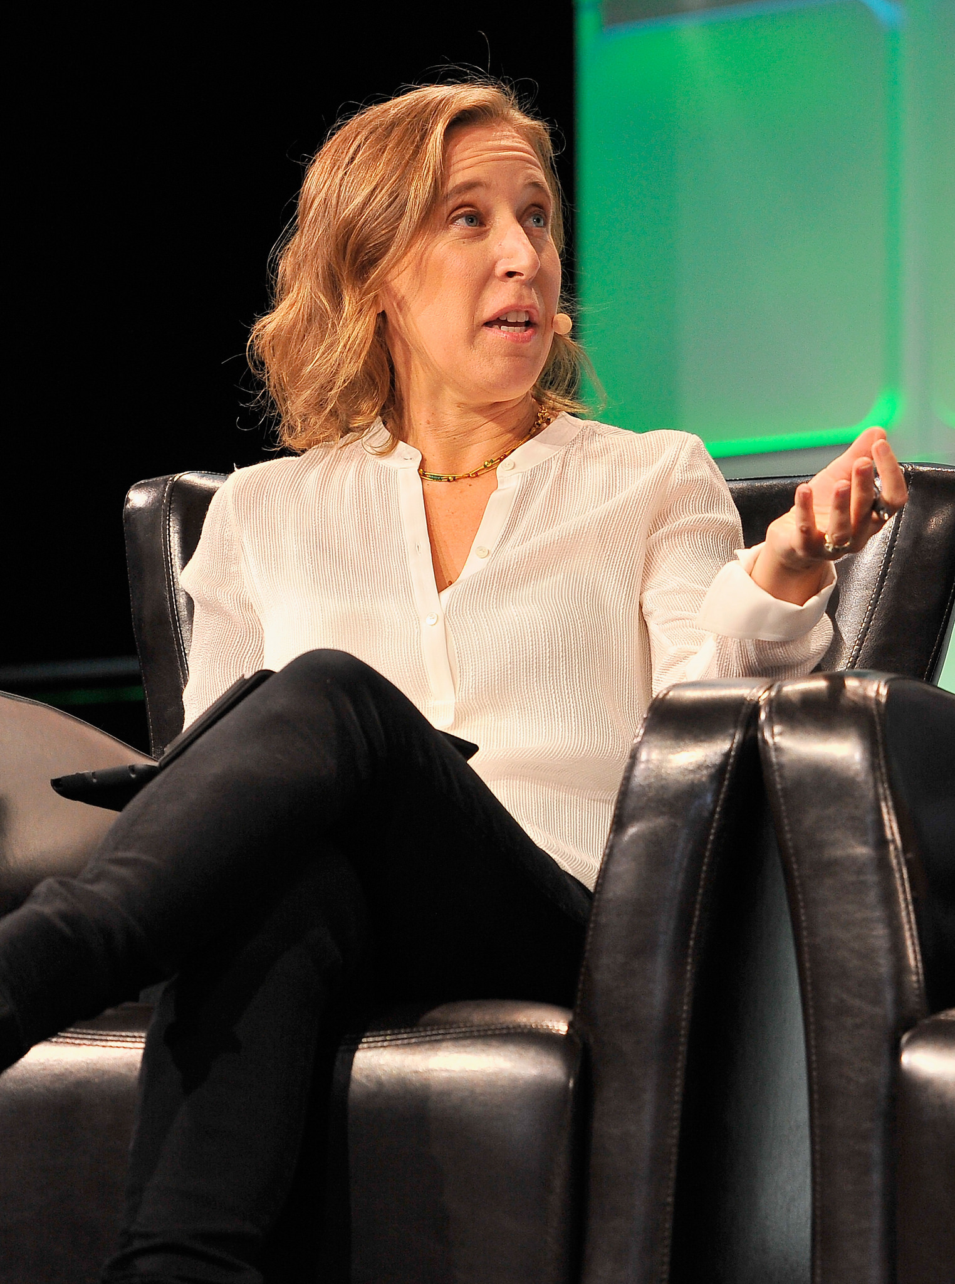
Thank you, Susan Wojcicki.
Named “the most important person in advertising”, your tech executive marketing skills drove Google’s rise.
Find out about Susan's early involvement with Google.
By Steve Jennings / TechCrunch - https://www.flickr.com/photos/techcrunch/29684662515/, CC BY 2.0, https://en.wikipedia.org/w/index.php?curid=56232436
#IAmATechExec

Slide 14
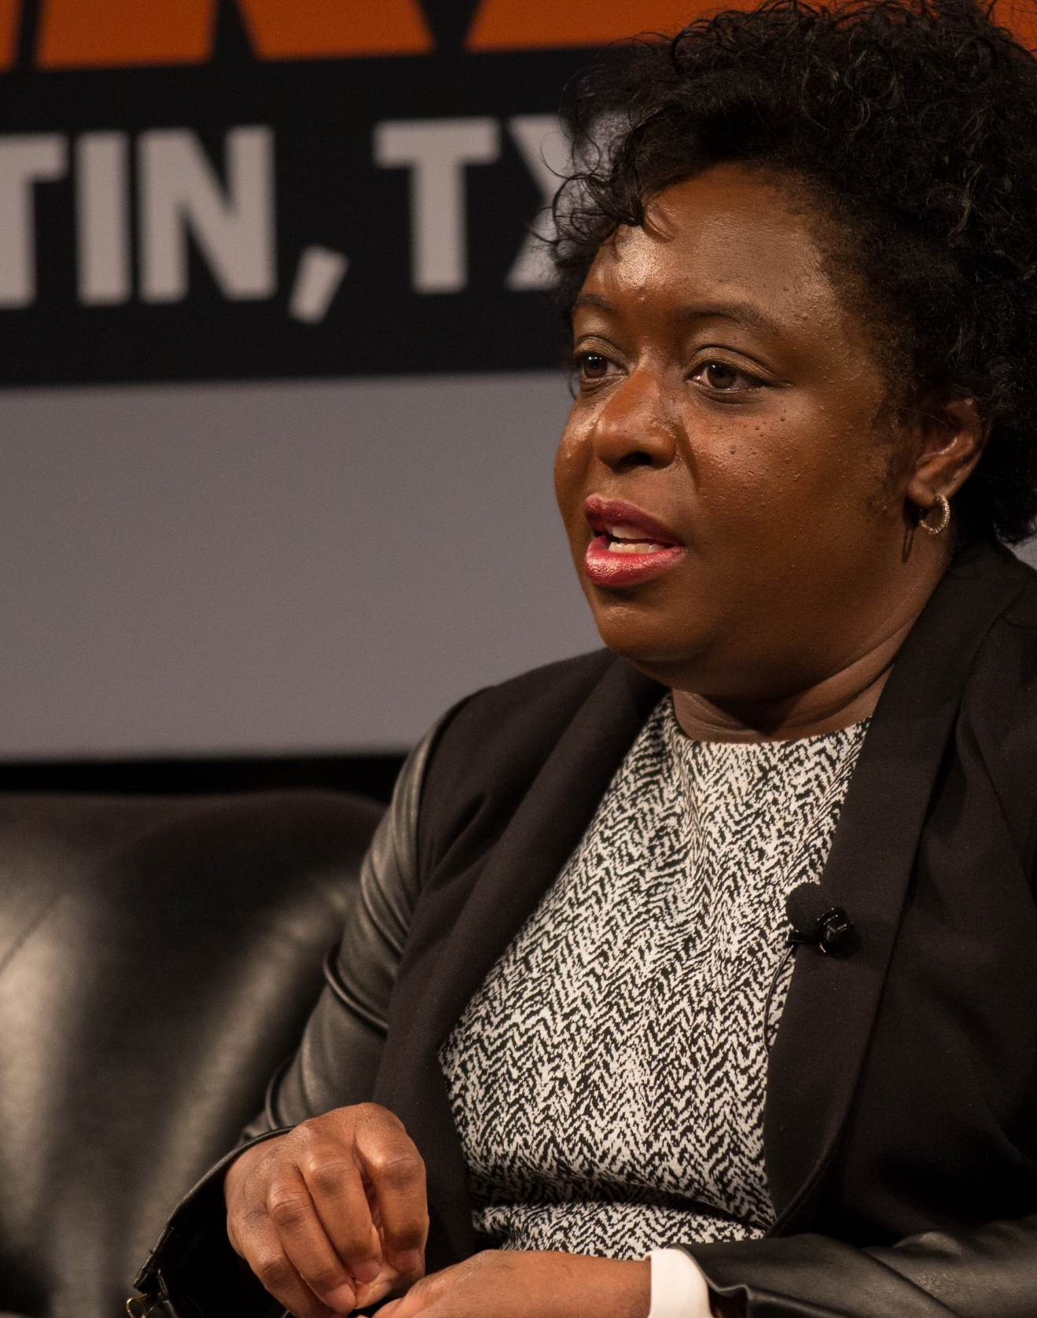
Thank you, Kimberly Bryant.
As an electronics engineer who also worked in pharmaceuticals & biotech, you figured we needed action for tech inclusion and created a non profit foundation.
What is the name of the foundation that
Kimberly set up?
By Ståle Grut / nrkbeta - Kimberly Bryant, Black Girls Code @ SXSW 2016, CC BY-SA 2.0, https://commons.wikimedia.org/w/index.php?curid=47848267
#IAmAnElectronicsEngineer

Slide 15
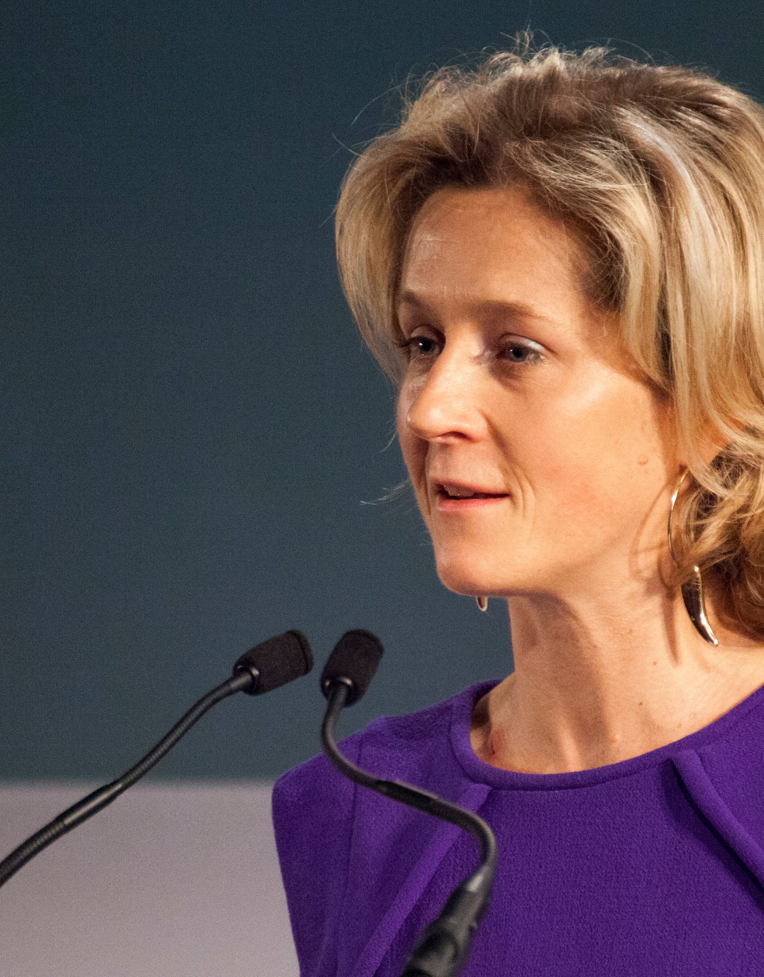
Thank you, Martha Lane Fox (CBE).
Appointed as the youngest female member of the House of Lords as the Digital Inclusion Champion, you campaign for responsible technology.
Find out what website Martha co-founded.
By gdsteam - https://www.flickr.com/photos/gdsteam/12208228633/, CC BY 2.0, https://commons.wikimedia.org/w/index.php?curid=66248604
#IAmADigitalActivitst

Slide 16
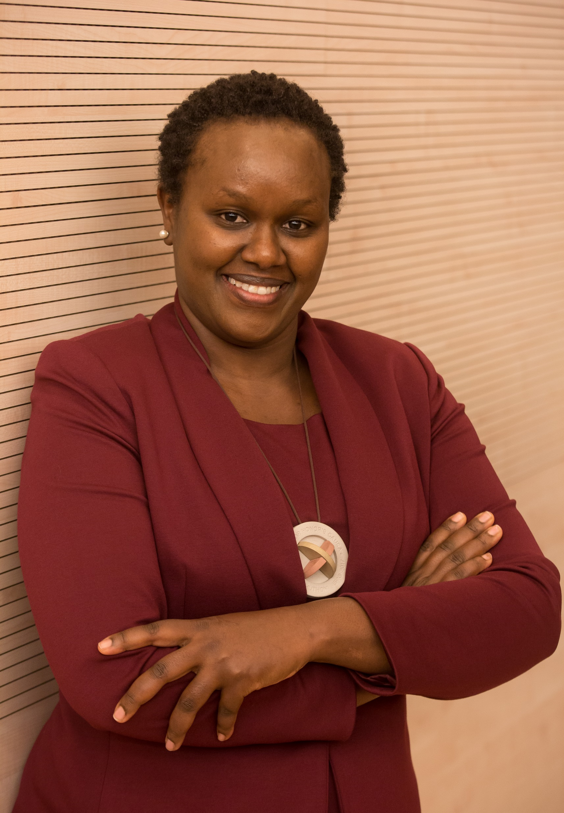
Thank you, Dorcas Muthoni.
By founding a mentoring program for women in computing and working with governments & international groups you are driving change transform African lives.
Where did Dorcas
study and what
were her
specialisms?
By Steve Jennings / TechCrunch - https://www.flickr.com/photos/techcrunch/29684662515/, CC BY 2.0, https://en.wikipedia.org/w/index.php?curid=56232436
#IAmAComputerScientist

Slide 17
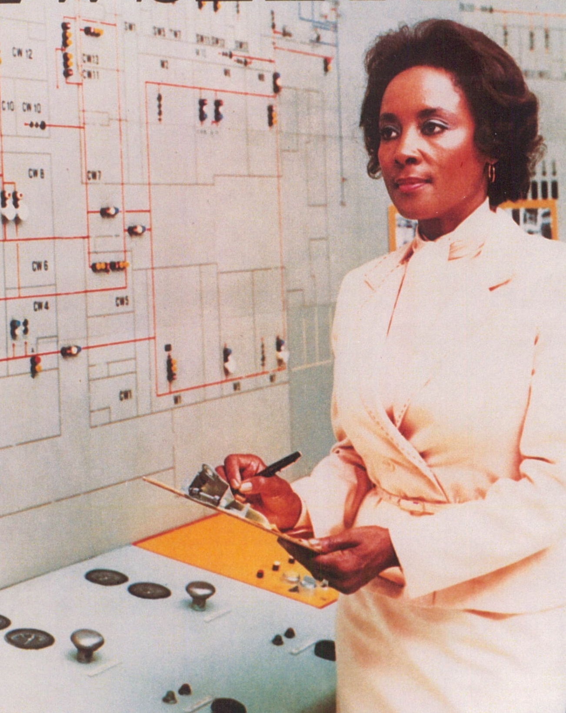
Thank you, Annie Easley.
Your code was used to fly rockets and laid the foundations for space shuttle launches.
Find out about Annie’s
work in the 1960’s
#IAmAComputer Scientist
By NASA Science and Engineering Newsletter - Fagowees, Public Domain, https://commons.wikimedia.org/w/index.php?curid=30060646
Notes:
.

Slide 18
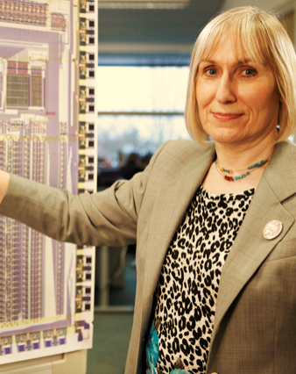
Thank you, Sophie Wilson.
95% of smartphones have the chip that you designed the code for.
What prototype computer did Sophie develop?
By Chris Monk - https://www.flickr.com/photos/101251639@N02/9669448671, CC BY 2.0, https://commons.wikimedia.org/w/index.php?curid=68622523
#IAmAComputerScientist

Slide 19
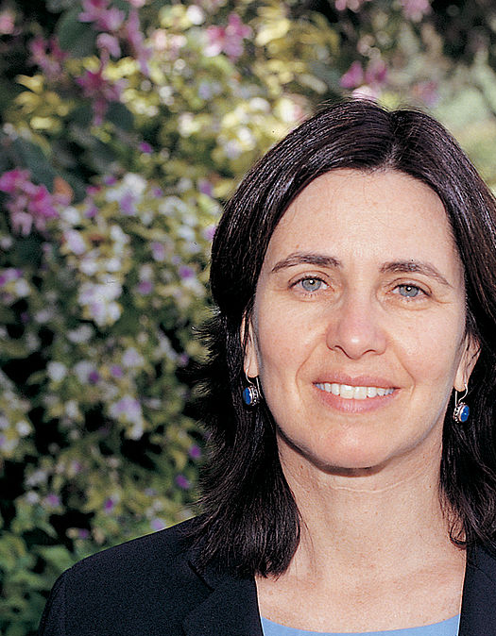
Thank you, Shafi Goldwasser.
Without your work on algorithms and maths used in encryption
we would not be as safe online.
Congratulations on
the Turing Award.
Find out about the
ball method of
explaining zero
knowledge proofs.
#IAmAComputerScientist
Weizmann Institute of Science

Slide 20
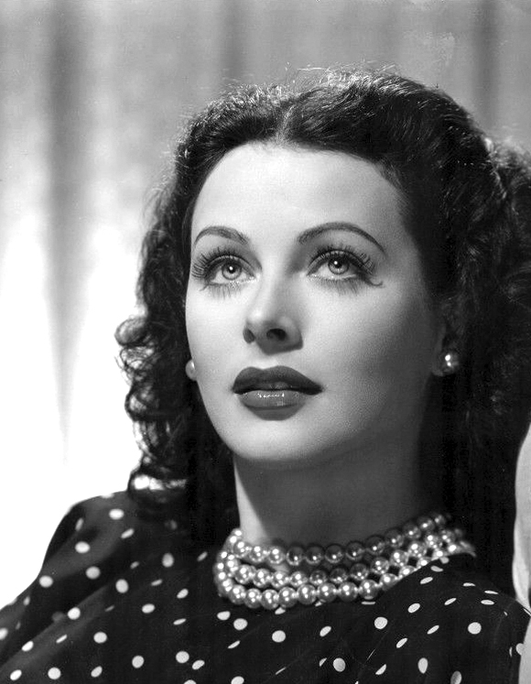
Thank you, Hedy Lamarr.
We would not have Bluetooth or WIFI if it was not for your invention of frequency hopping.
What else
was Hedy
famous
for?
#IAmAnInventor

Slide 21
Thank you, Evelyn Boyd Granville.
Your maths & computing
work on aviation &
Space programs
helped catapult
rockets to the moon.
What job brought you back down to earth?
This photo was provided courtesy of the National Visionary Leadership Project.
#IAmAMathematician

Slide 22
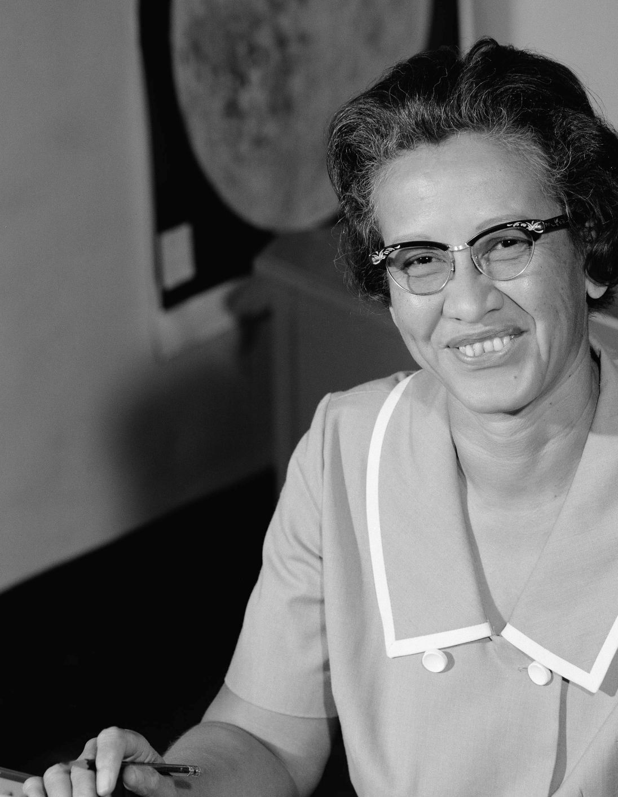
Thank you, Katherine Johnson.
You computed launch windows, emergency return paths and worked on the Space Shuttle program & Mission to Mars plans.
Congratulations on the Presidential Medal of Freedom.
Find out what John Glenn needed Katherine to do before his 1962 mission.
By NASA; restored by Adam Cuerden - http://www.nasa.gov/sites/default/files/thumbnails/image/1966-l-06717.jpeg, Public Domain, https://commons.wikimedia.org/w/index.php?curid=47431407
#IAmAMathematician
Notes:
.

Slide 23
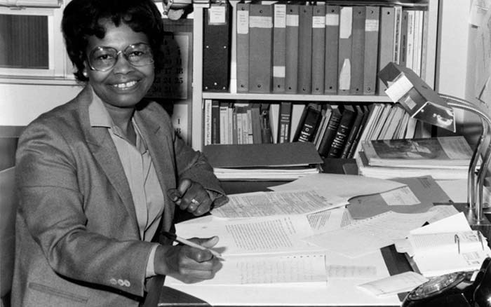
Thank you, Gladys West.
Without your contribution our world would not be the same, laptops, smartphones, cars all use GPS.
Find out about Gladys’s work on weather satellites..
#IAmAMathematician

Slide 24
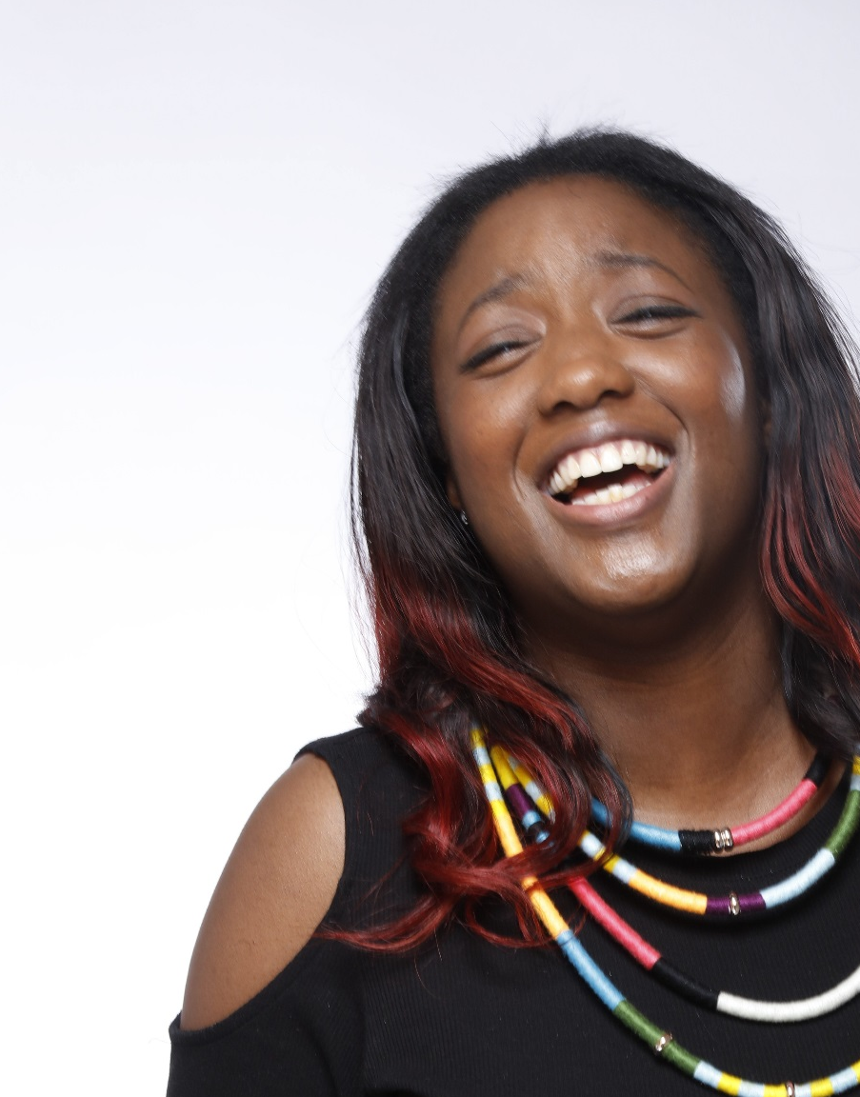
Thank you, Anne-Marie Imafidon.
You have created a social
enterprise which runs
hackathons,
mentoring and
an online platform.
Find out about
the Stemettes.
#IAmAComputerScientist
With kind permission of Anne-Marie Imafidon

Slide 25
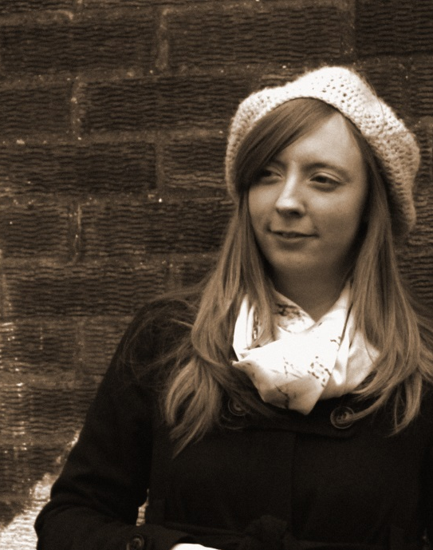
Thank you, Carrie Anne Philbin.
As a pioneering computer
science teacher and
Raspberry Pi Director
you have championed
inclusion and diversity
in computing education.
Find out about the
Geek Gurl Diaries.
With kind permission of Carrie Anne Philbin
#IAmAComputerScientist

Slide 26
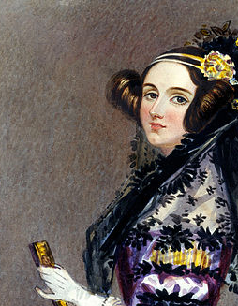
Thank you, Ada Lovelace.
For being ahead of your
time and predicting that
computers would work
with music and not
just numbers.
Find out how Ada helped
Charles Babbage.
#IAmAProgrammer
Science & Society Picture Library

Slide 27
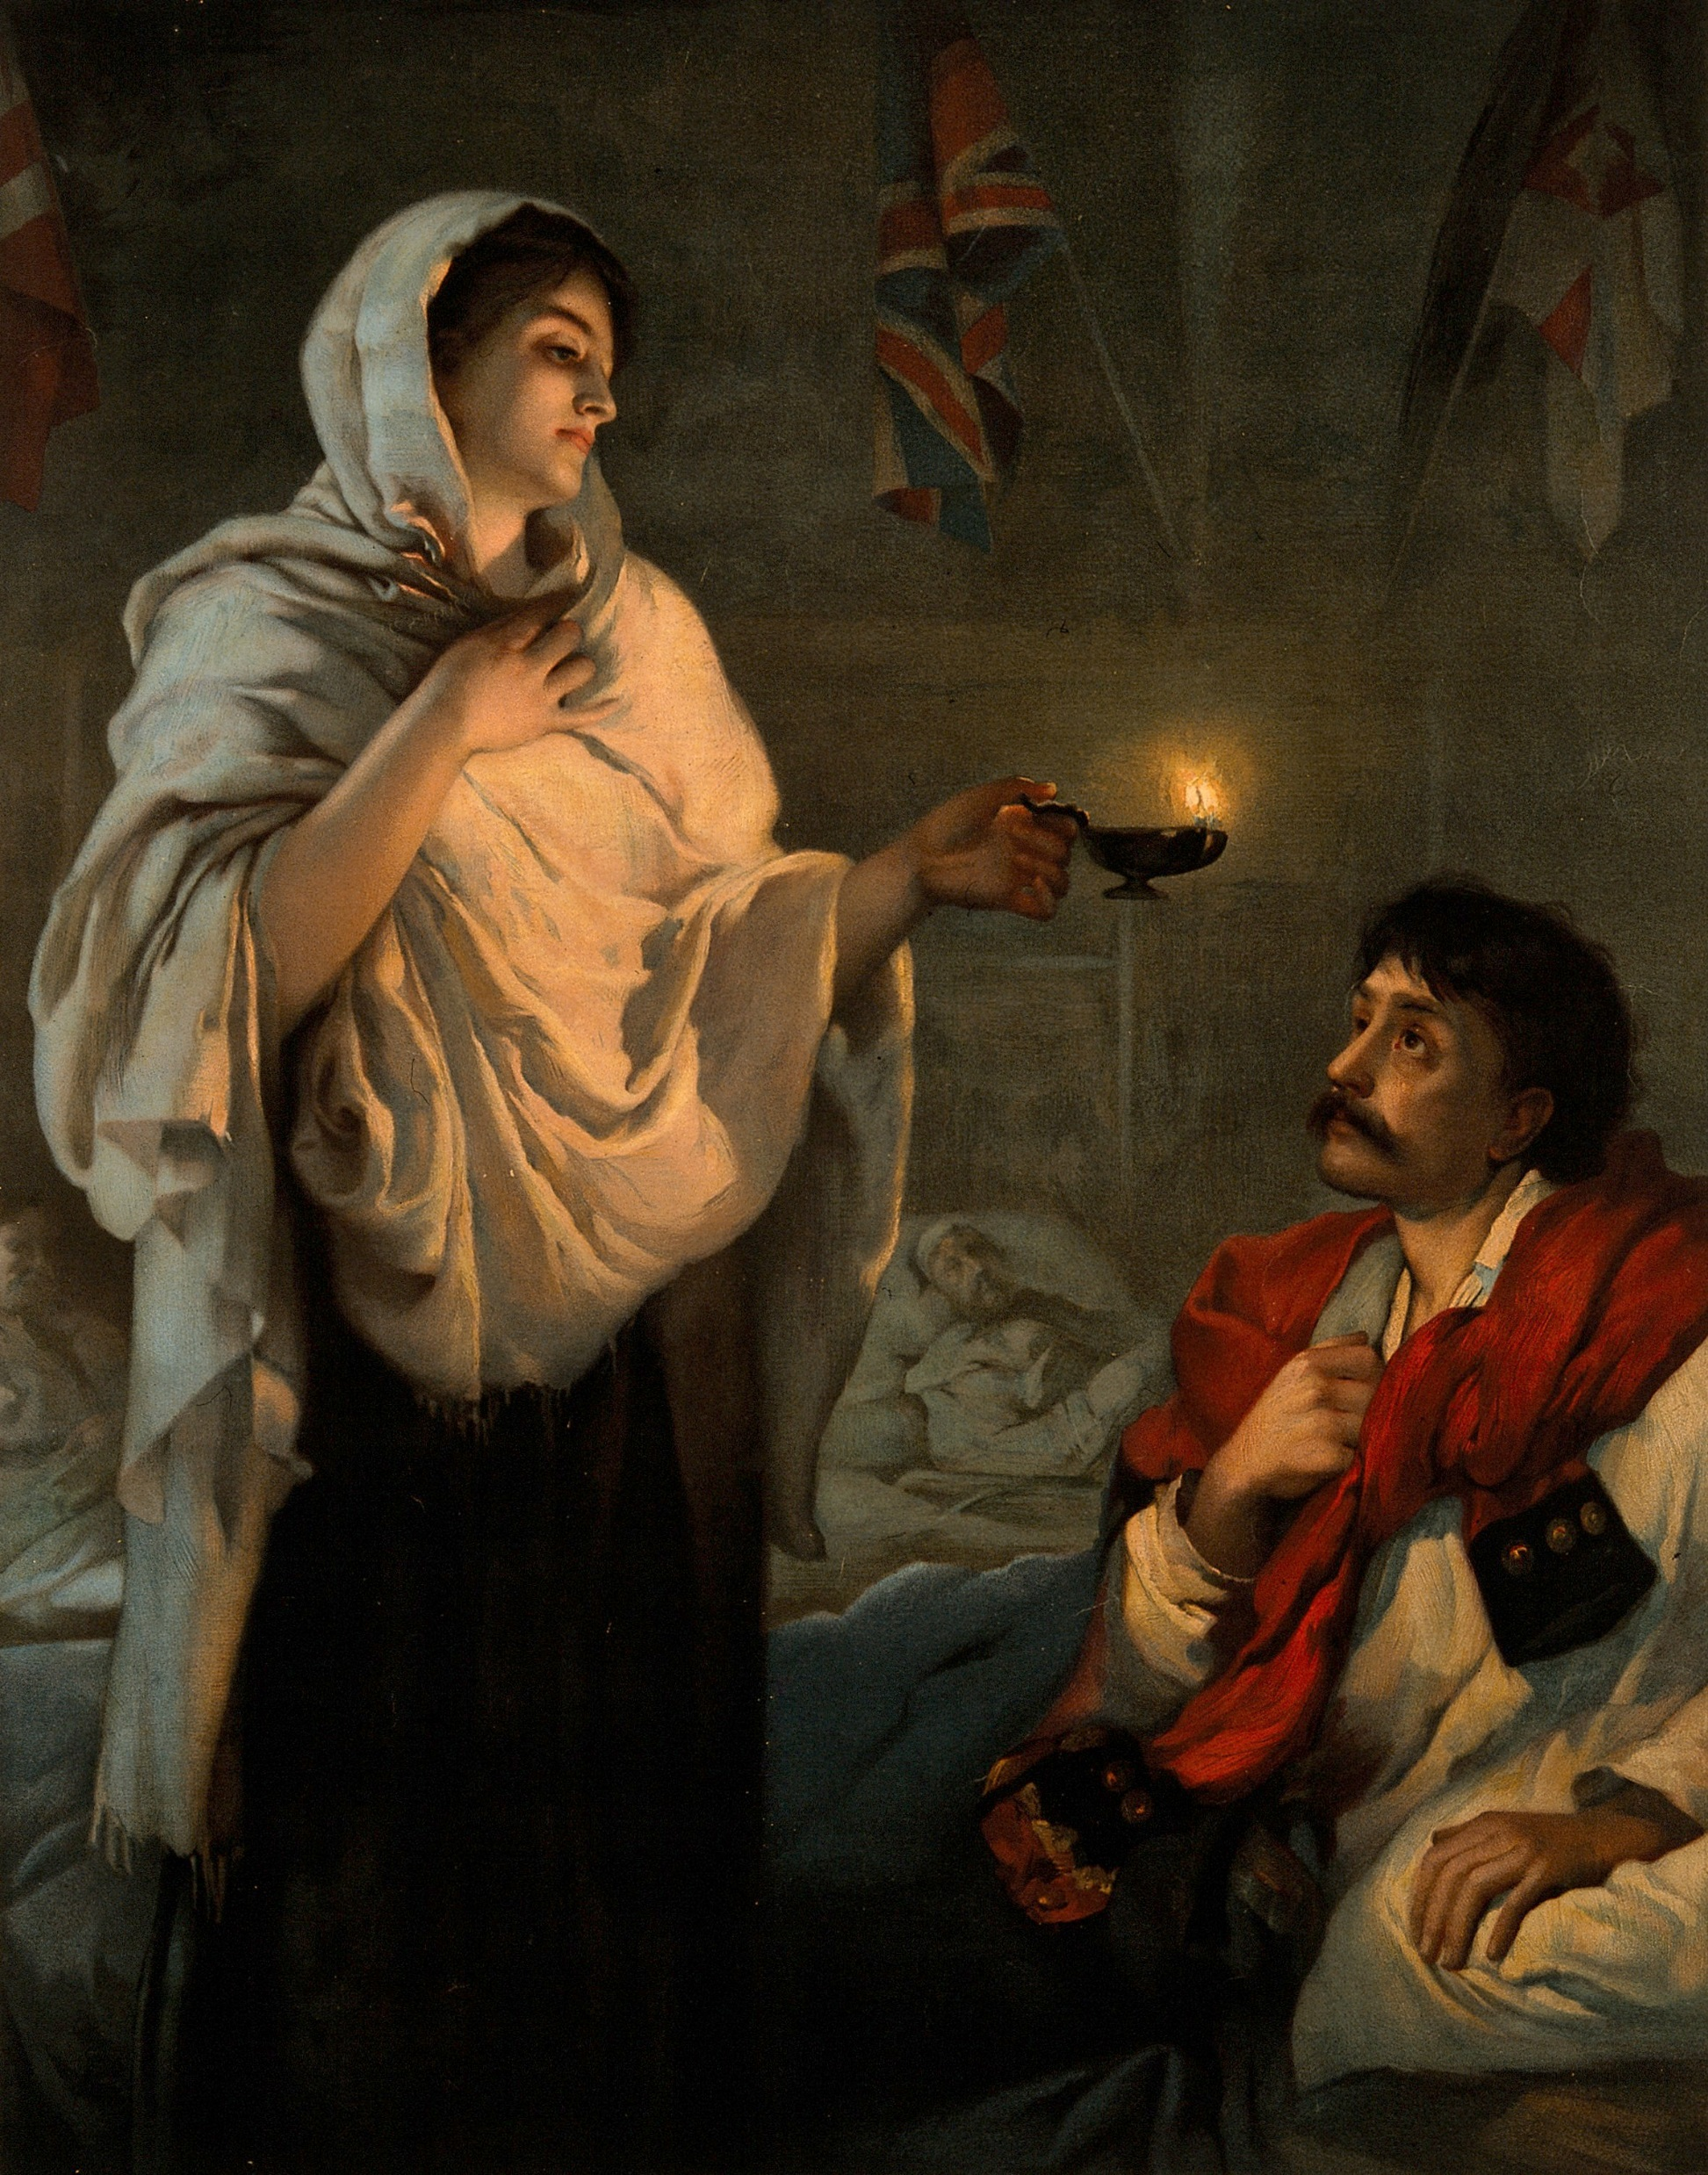
Thank you, Florence Nightingale.
For persuading Parliament to save lives by creating
infographics that could
not be ignored.
Find out what the infographics were about
and make your own.
After Henrietta Rae - https://wellcomeimages.org/indexplus/image/V0006579.htmlWellcome Collection gallery (2018-03-29): https://wellcomecollection.org/works/zggypp55 CC-BY-4.0, Public Domain, https://commons.wikimedia.org/w/index.php?curid=31233676
#IAmADataVisualisationAnalyst

Slide 28
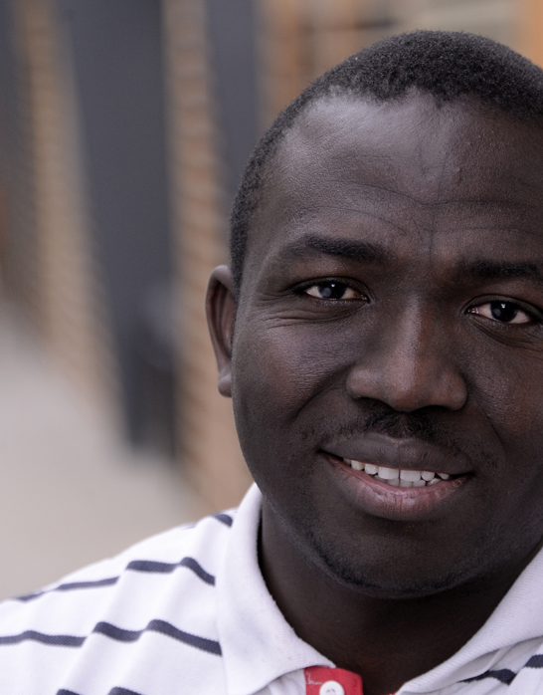
Thank you, Segun Fatumo.
You are saving lives by using your computer science expertise in genetic research.
Find out about bioinformatics.
#IAmAComputerScientist
Photo provided by kind permission of Segun Fatumo.

Slide 29
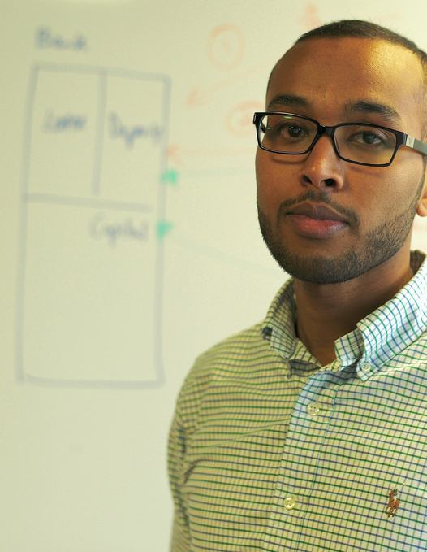
Thank you, Abdigani Diriye.
Your work on data mining and visualising information help us see things more clearly.
Find out about Abdigani’s Somali and Somaliland boot camps.
#IAmAComputerScientist
Photo provided by kind permission of Abdigani Diriye

Slide 30
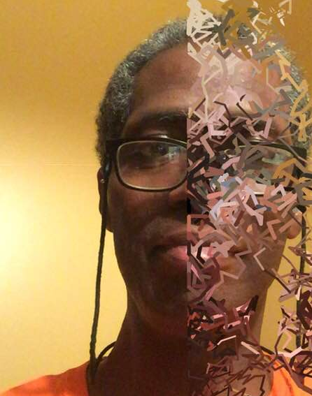
Thank you, John Henry Thompson.
You developed a programming language that displays images - Lingo.
This work has helped combine art and tech in web design, animation, graphics and video games.
Try a drawing app or processing.js
Photo provided by kind permission John Henry Thompson
With kind permission on John Henry Thompson
http://www.johnhenrythompson.com
#IAmAComputerScientist
Notes:
.

