Slide 1



bit.ly/CS4FNlunch
Lunch and Learn:
increasing the representation of diversity in computer science teaching
in UK schools, through CS4FN.
Jo Brodie
Public Engagement Co-ordinator
School of Electronic Engineering & Computer Science
QMUL
cs4fn @ eecs.qmul.ac.uk
Posters
Website & blog articles
Magazine
School & public talks
Portals

Slide 2
bit.ly/CS4FNlunch
Summary
Curriculum gaps
Diversity gaps
Teachers are very busy
How can we (CS4FN) help them?
School computing curriculum doesn’t particularly focus on the people involved, it’s more on the technical than ‘socio-technical’. Teachers are also keen to engage their students, making lessons relevant for all pupils.
Decisions about subjects and future careers are made at a young age.
Teachers have high workload (primary teachers often teach all subjects) and there are a lot of resources for them to wade through.
We aim to make things easier for teachers with good quality resources, ready-to-use activities, ideas for classroom discussions, non-fiction reading material for younger pupils etc.

Slide 3
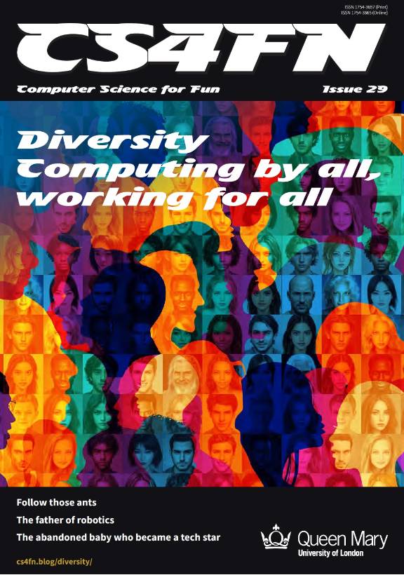
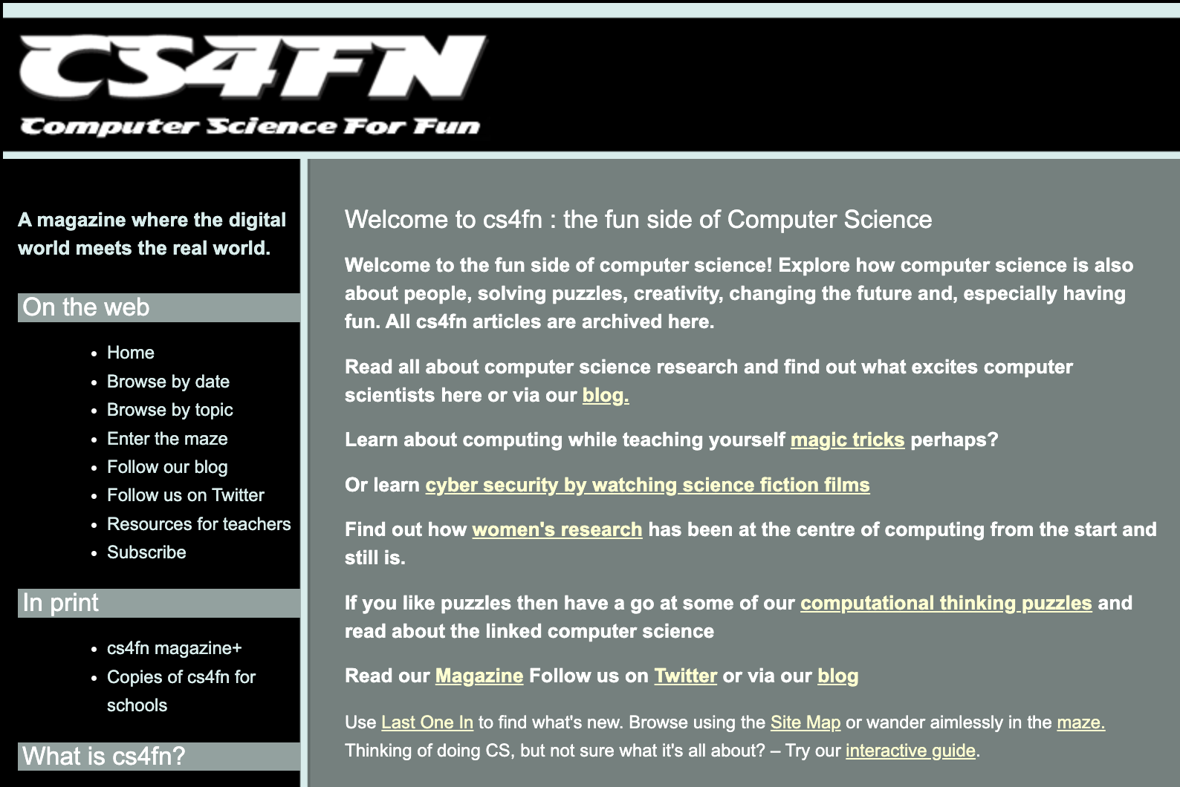
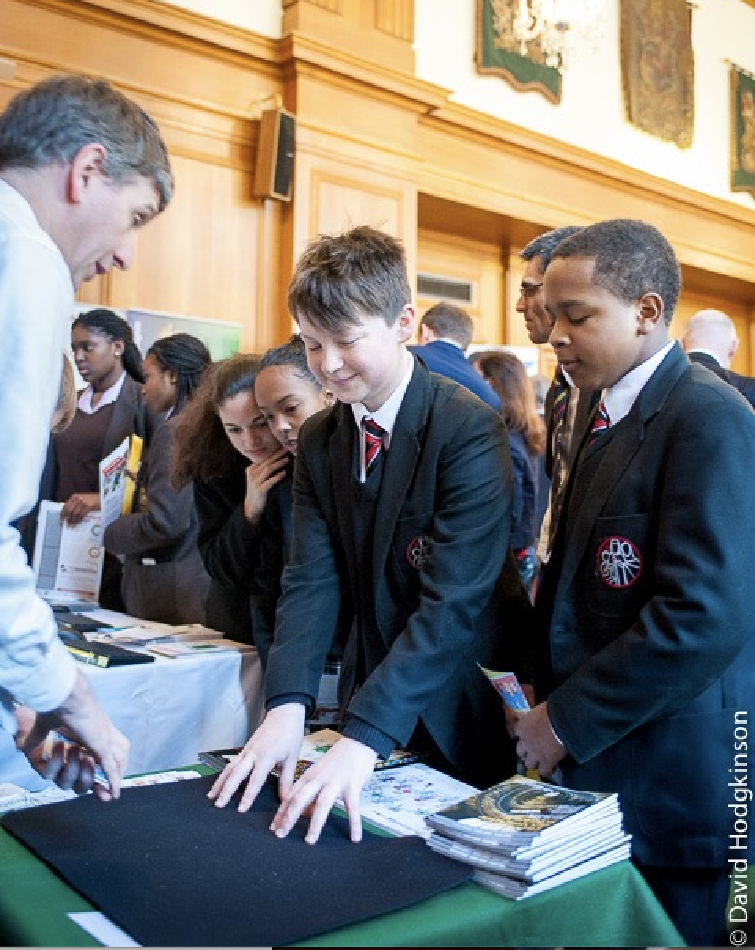
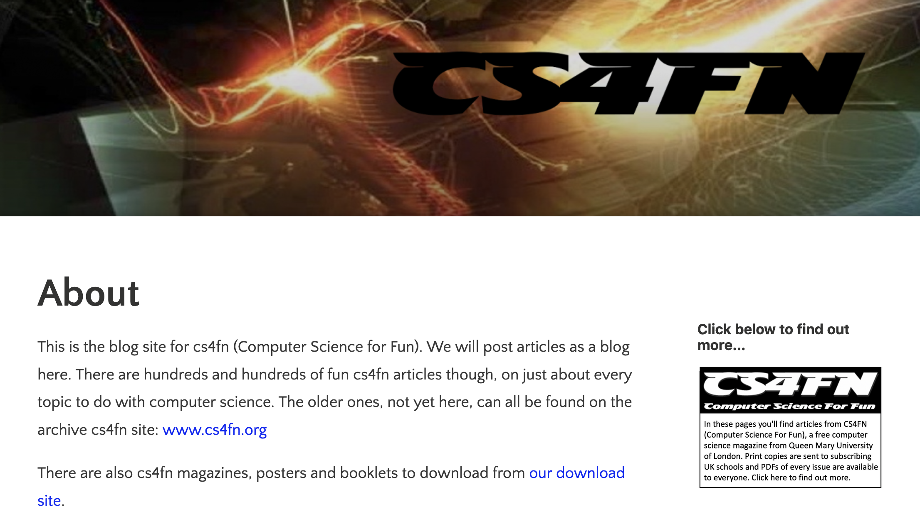
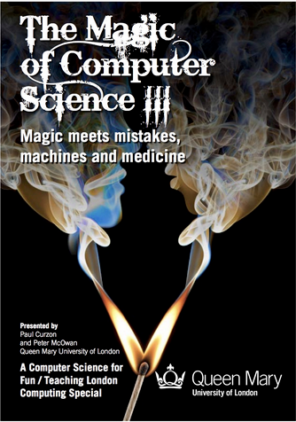
bit.ly/CS4FNlunch
The CS4FN project – a potted history
Computer Science For Fun
Co-founded in 2005 by Paul Curzon and Peter McOwan.
Aim = fun resources to inspire kids and teachers about computing.
Magazine & booklets
Website / blog articles
School talks / live shows
Website & blog articles
Magazine
School & public talks

Slide 4

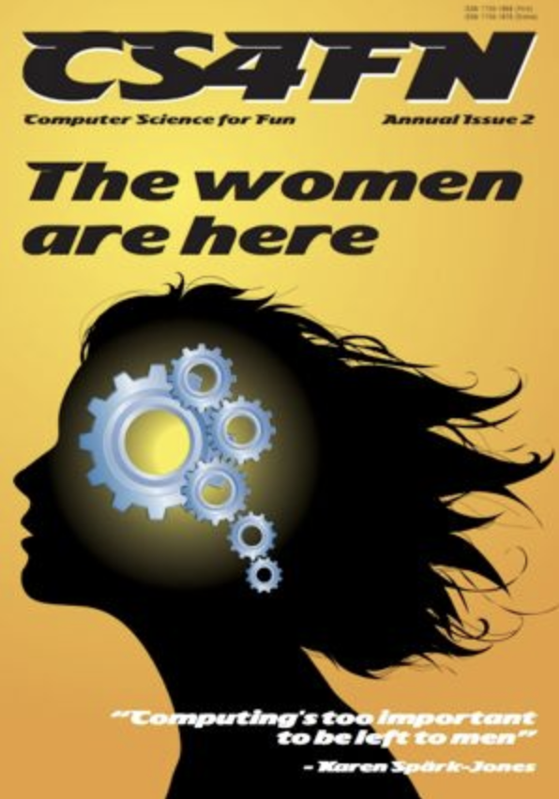
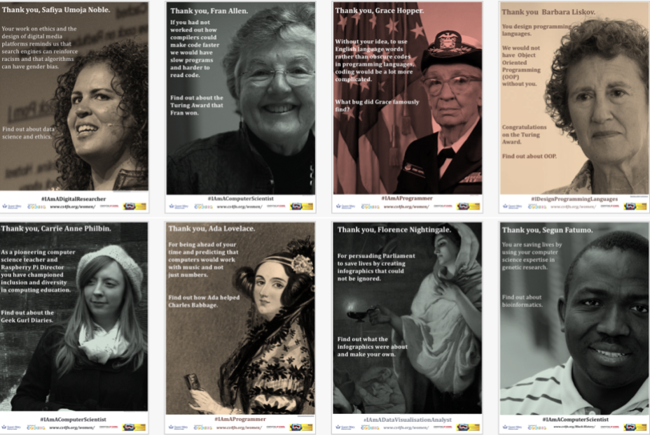
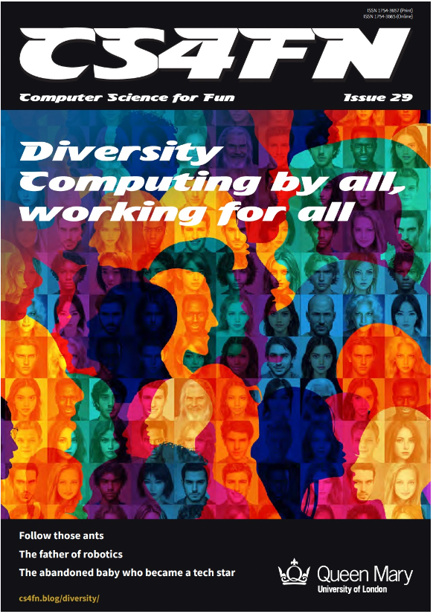
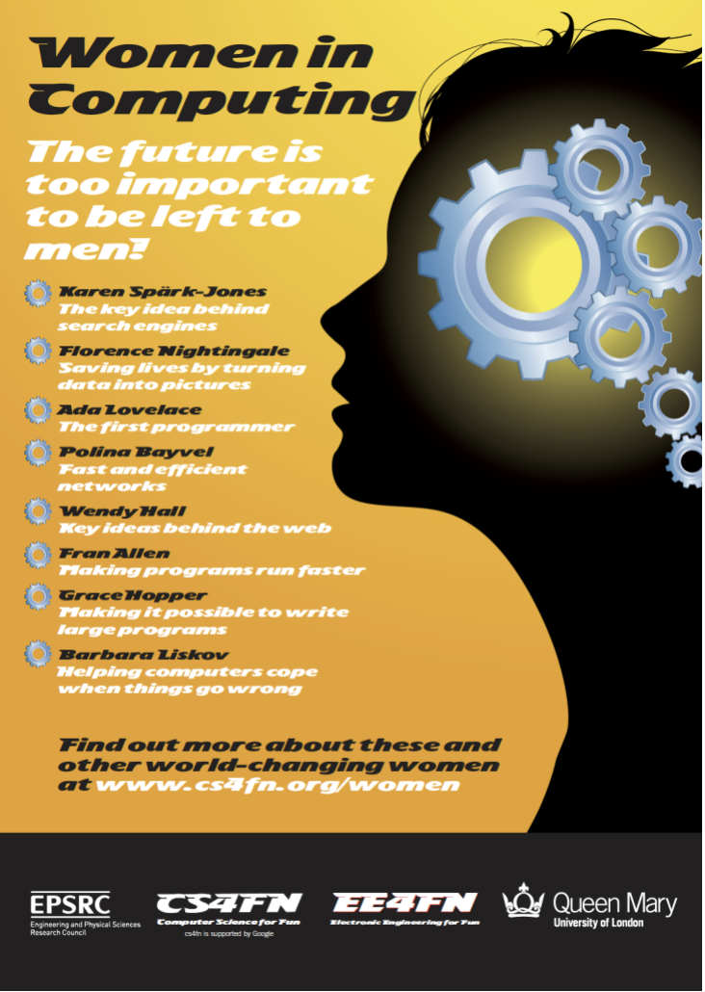
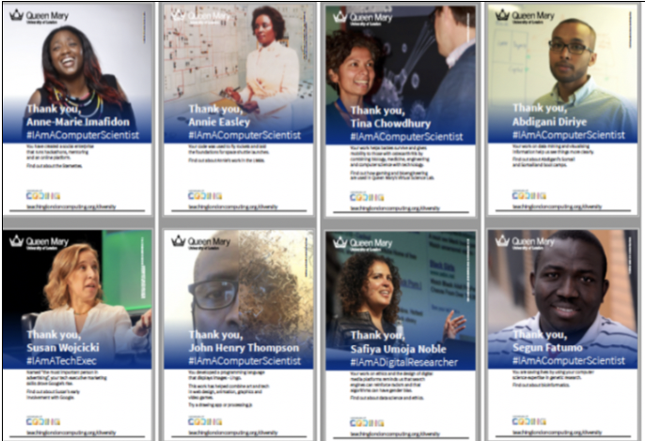
School
talks
Women in Computing
Broadening diversity
Posters

Slide 5
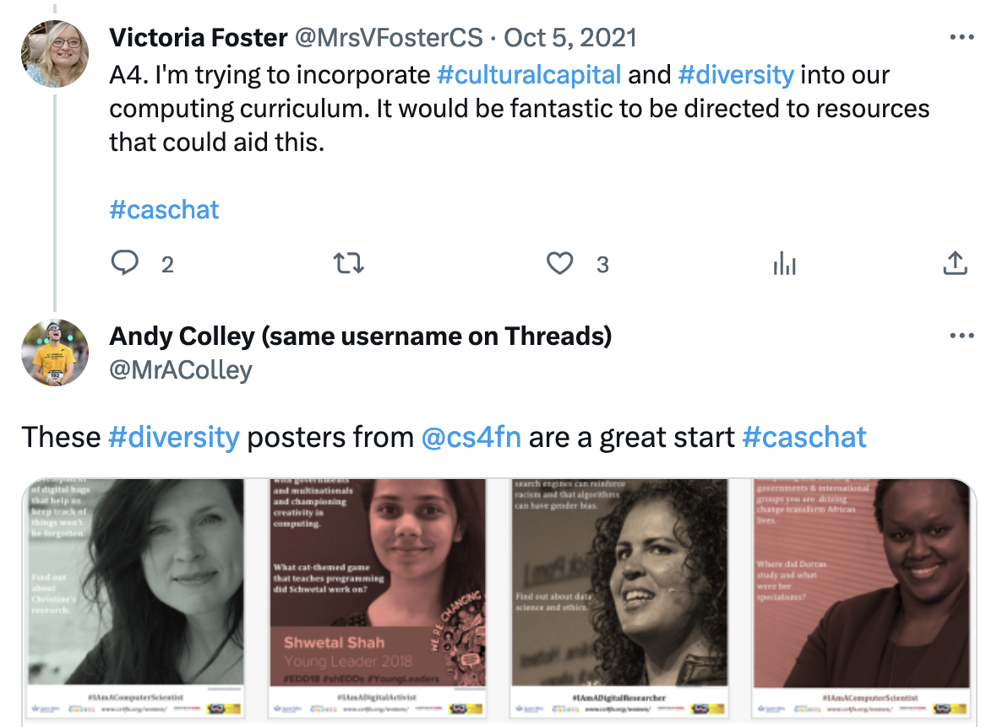
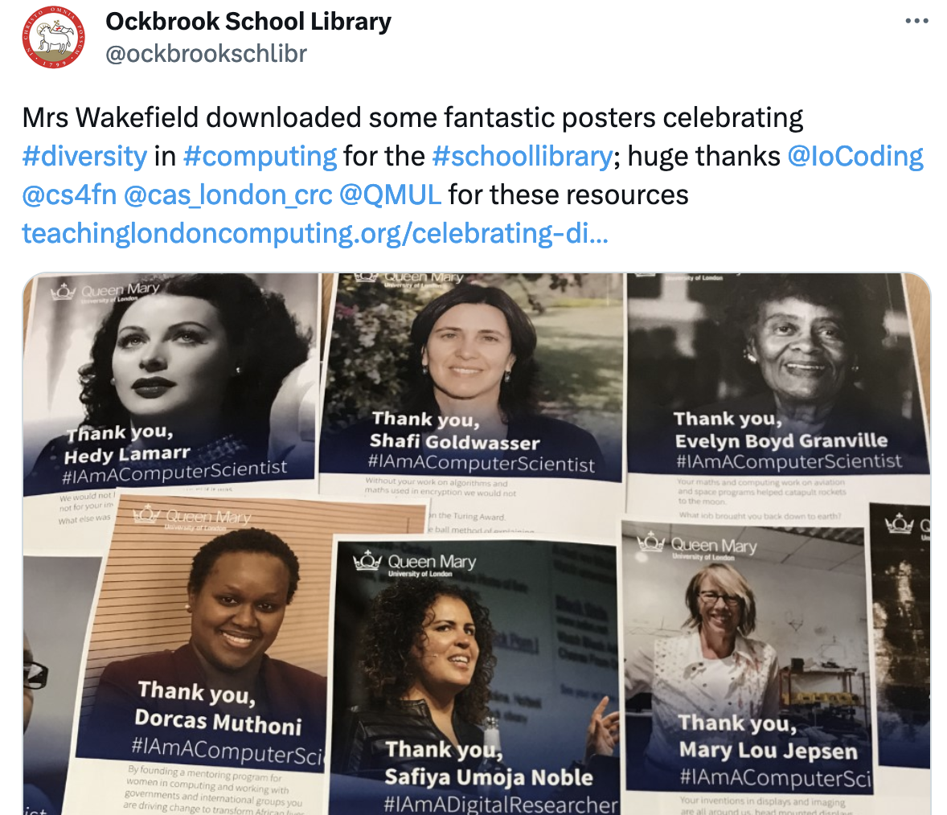


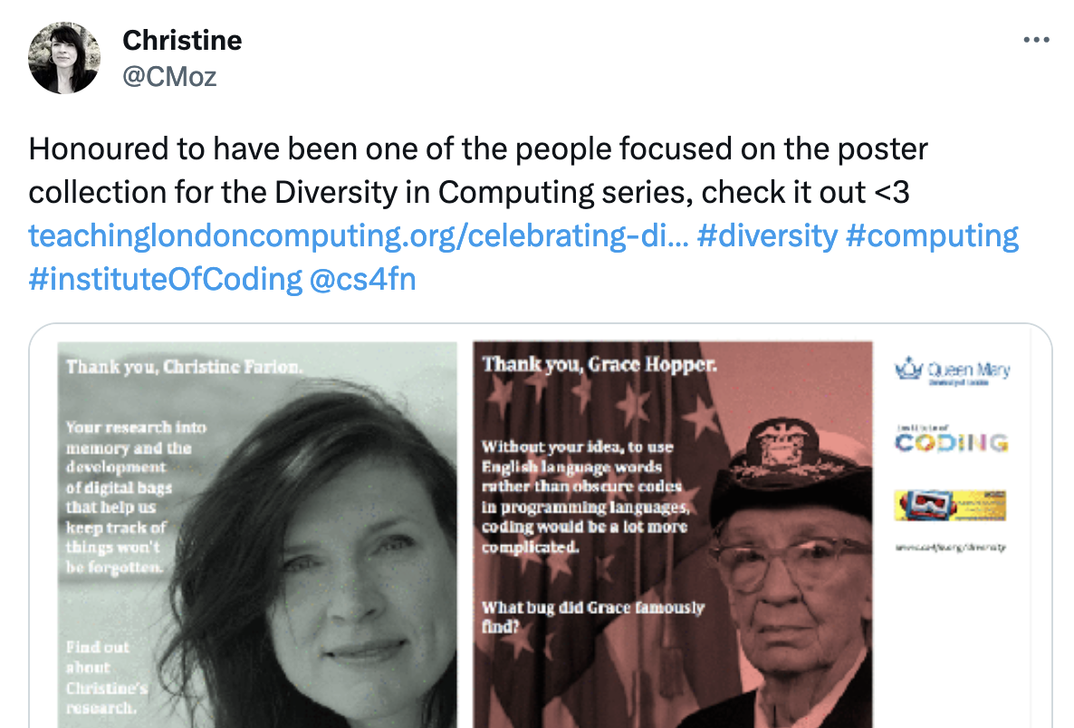
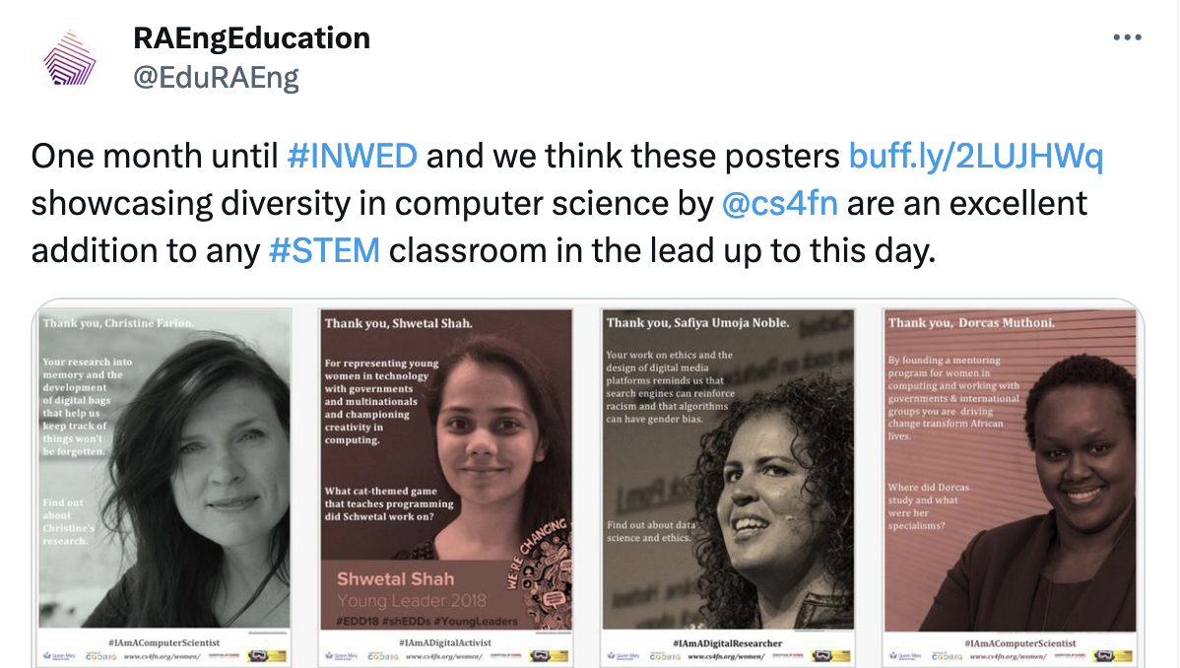


Slide 6
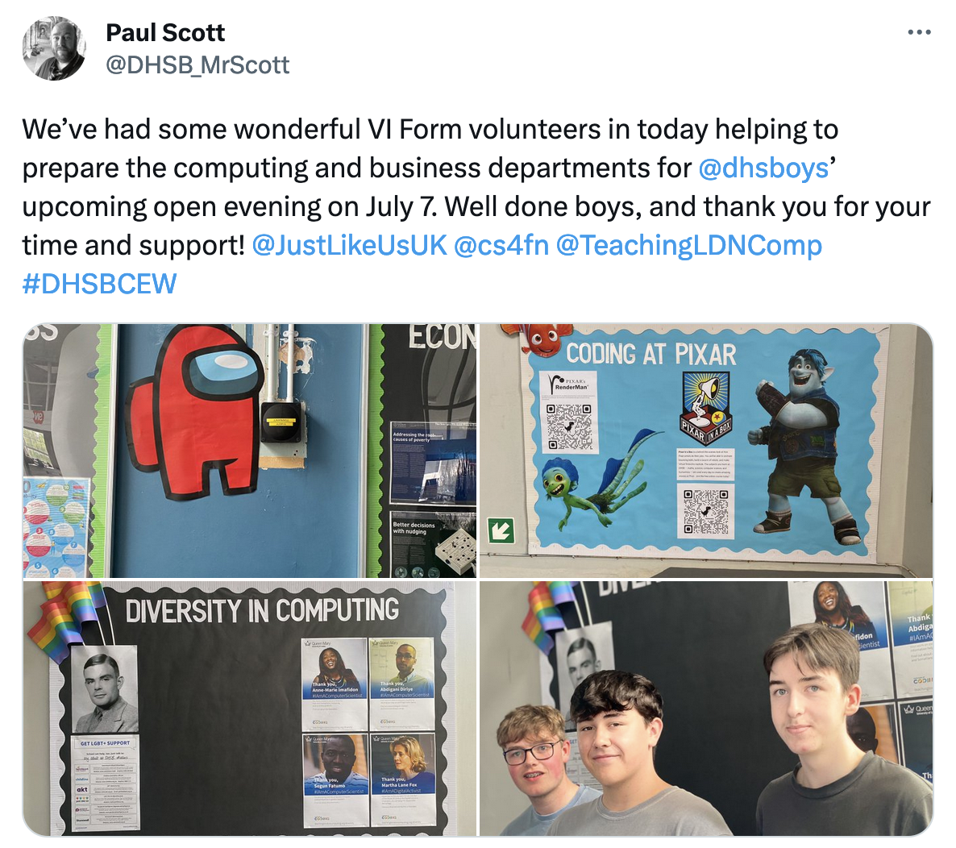
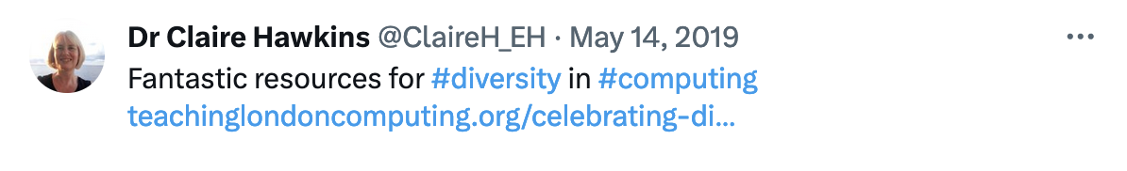


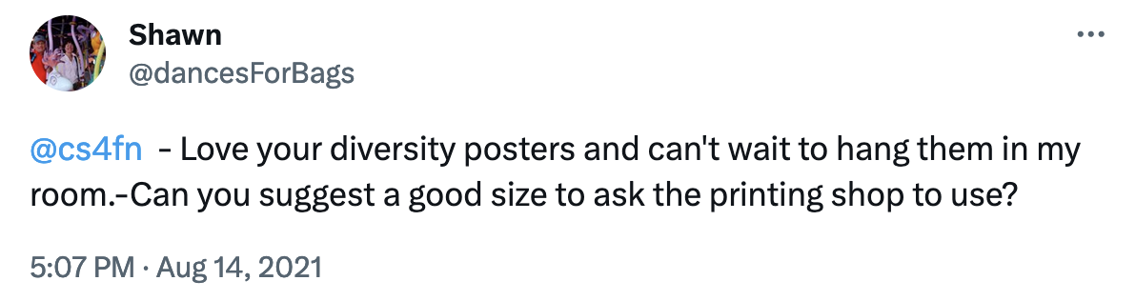

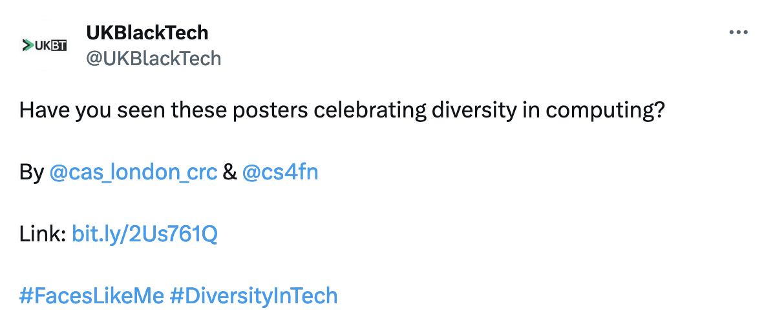

Slide 7

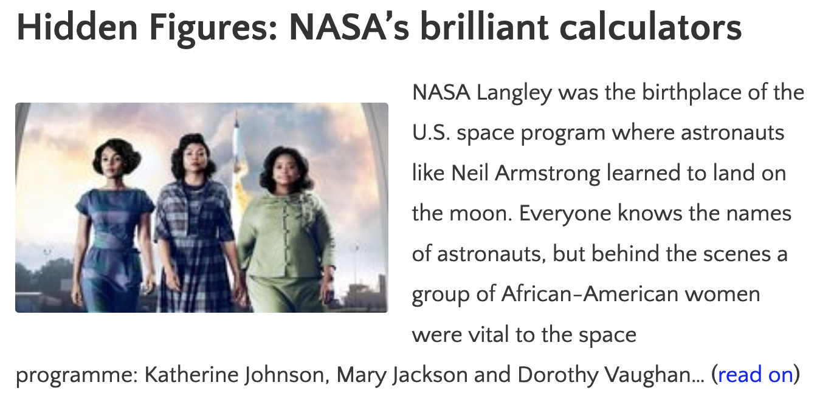
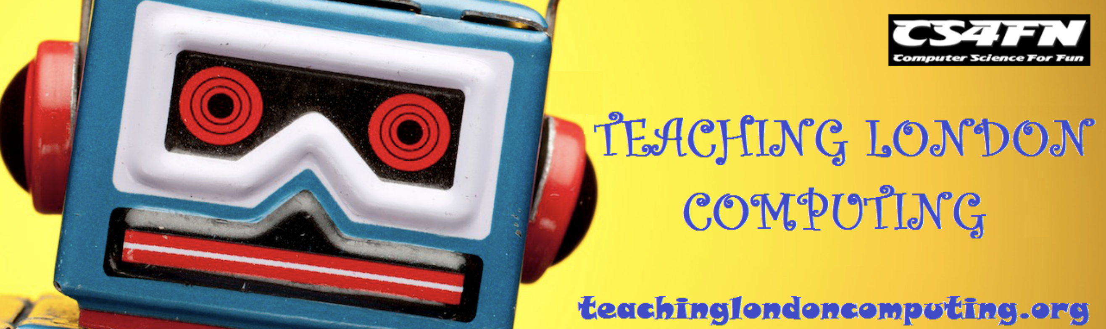
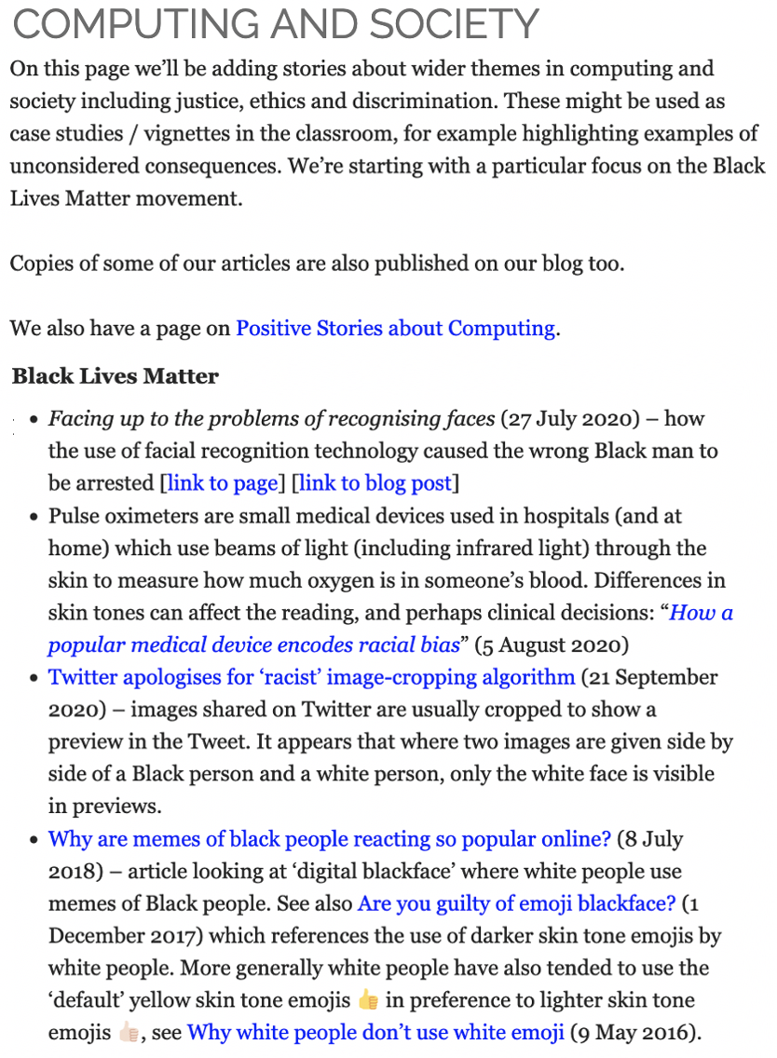
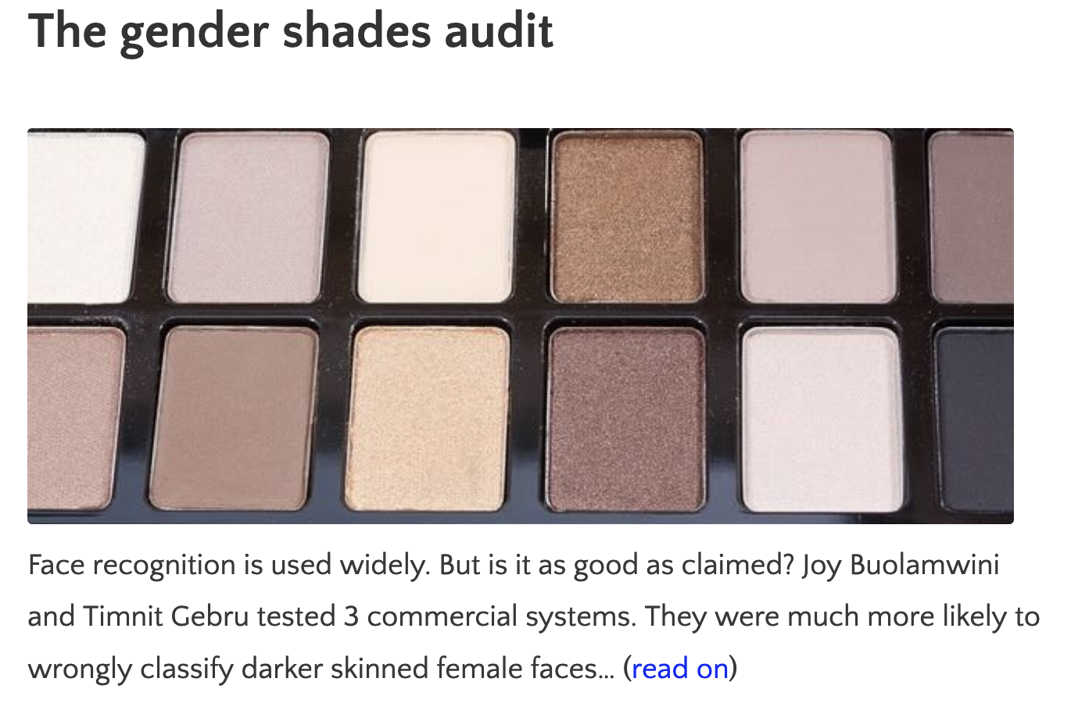
Website & Blog articles

Slide 8

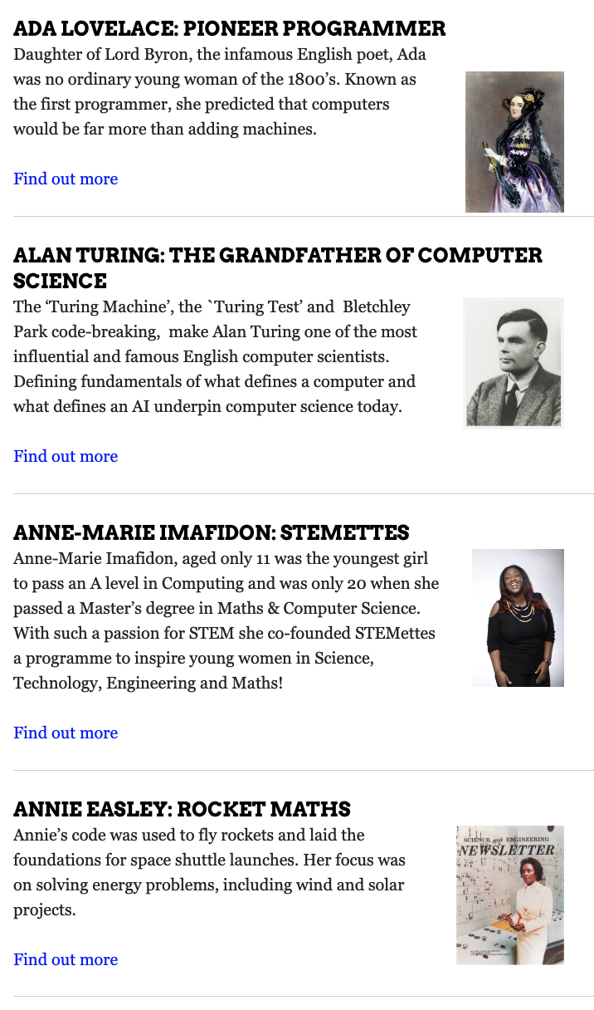
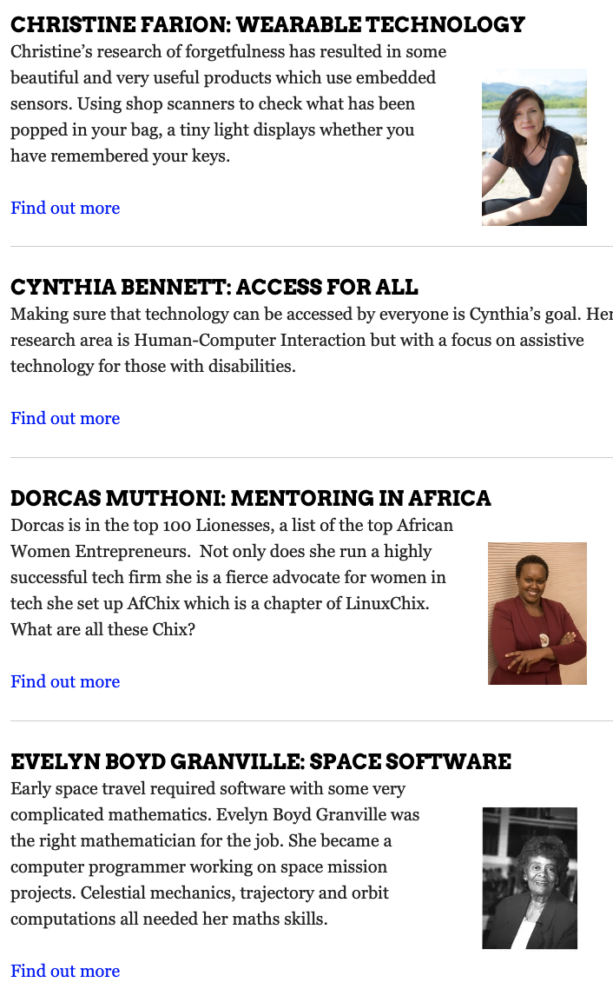
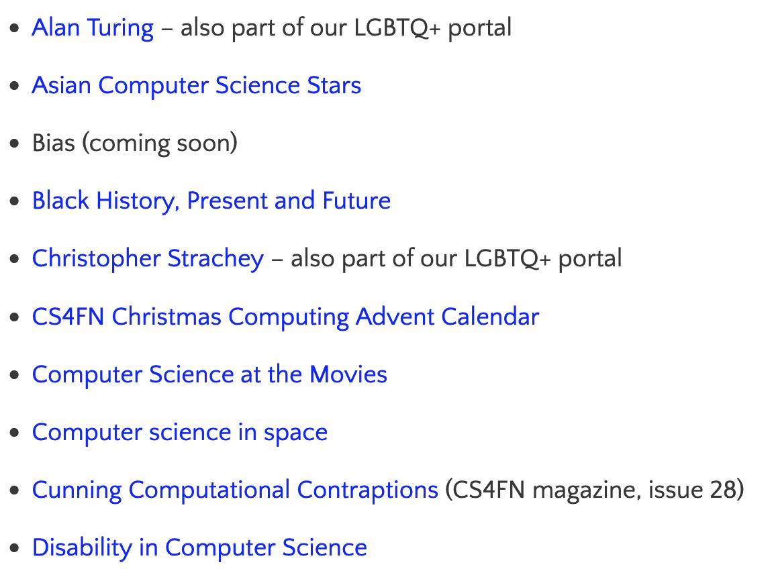
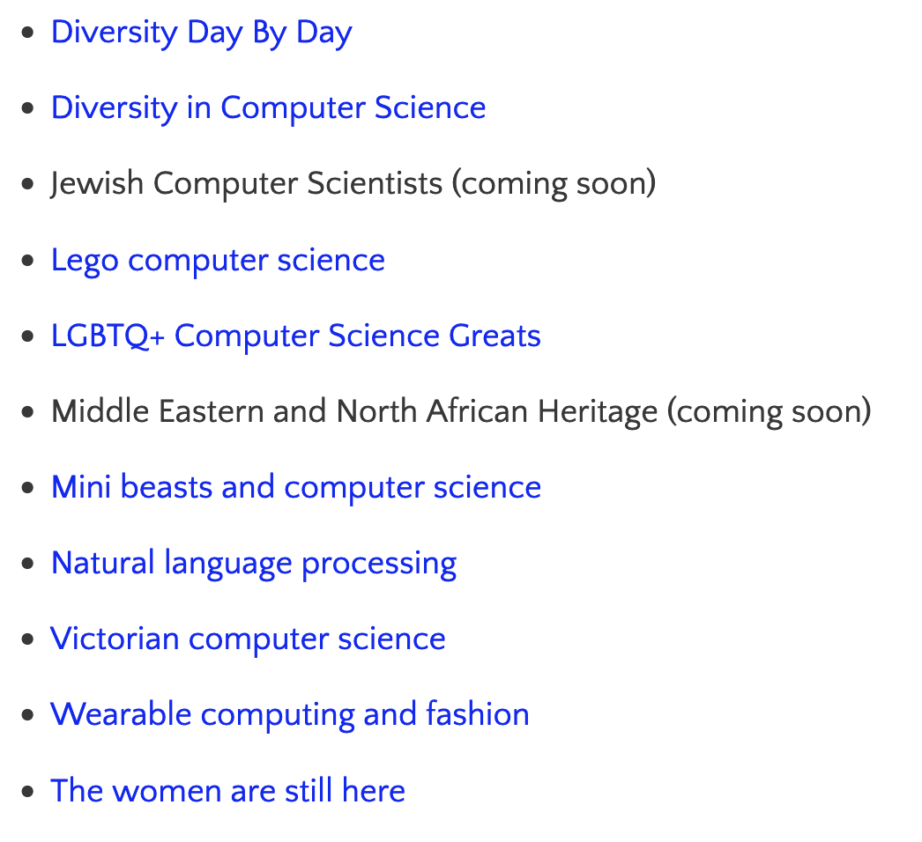
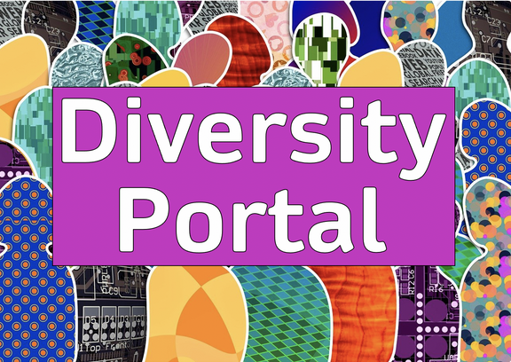
Portals

Slide 9
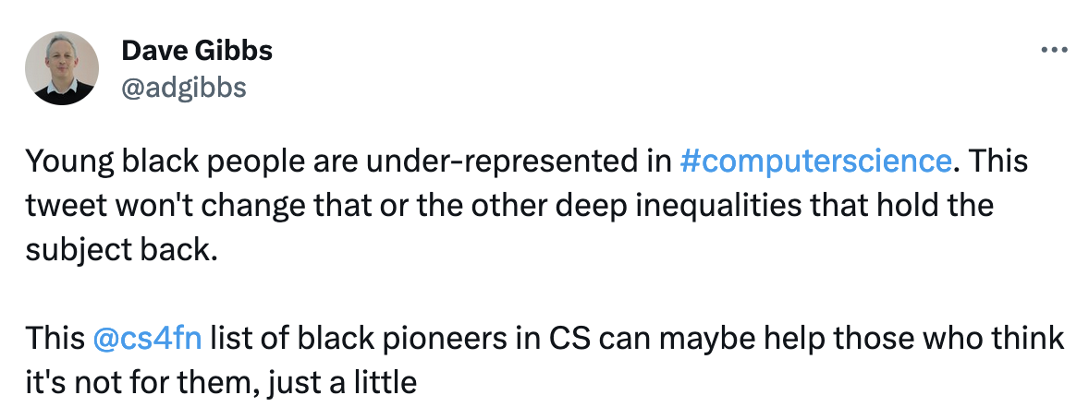
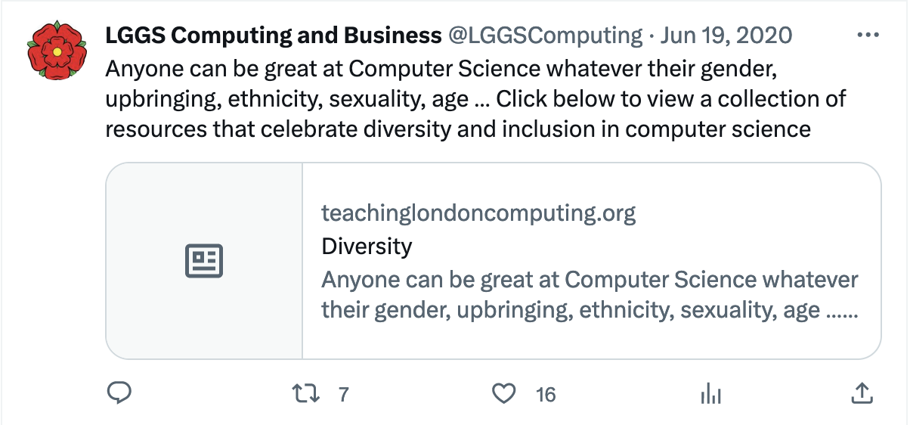

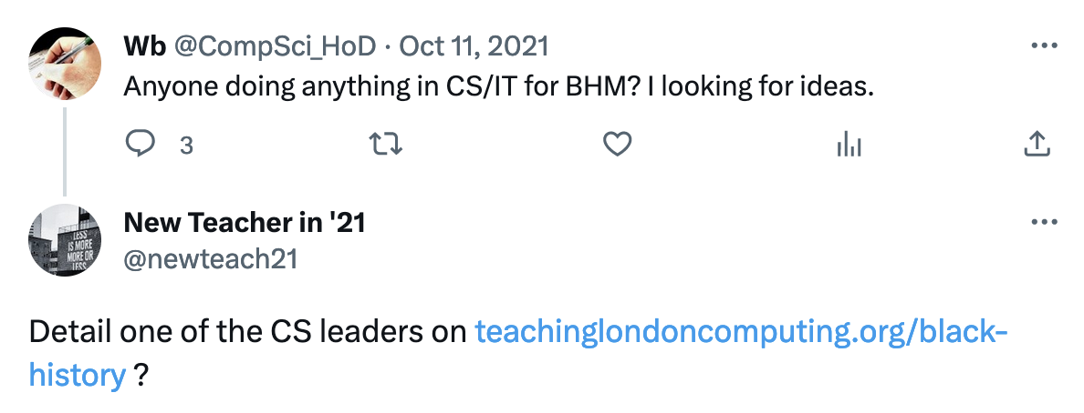
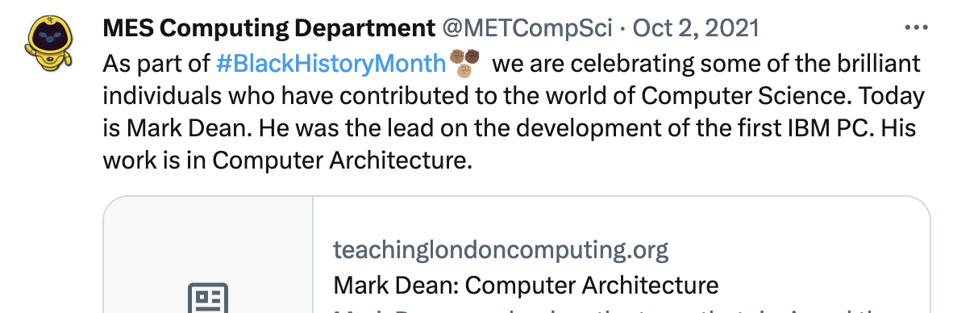
bit.ly/CS4FNlunch

Slide 10
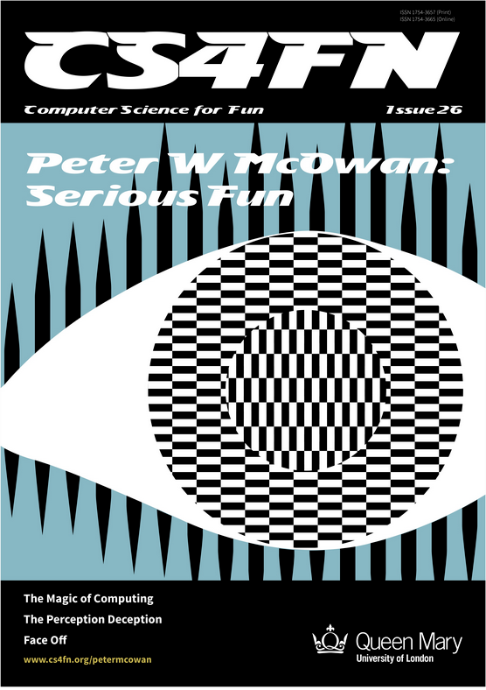
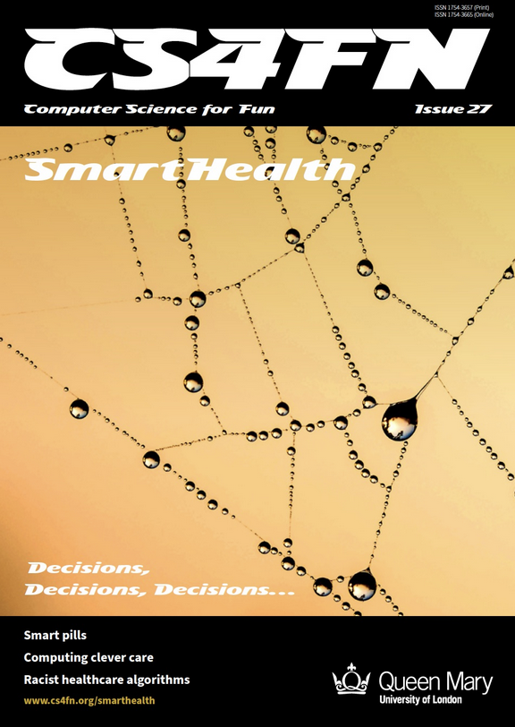
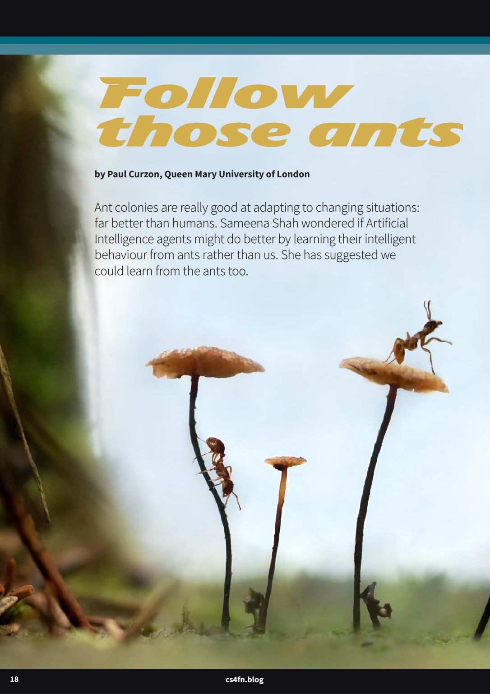
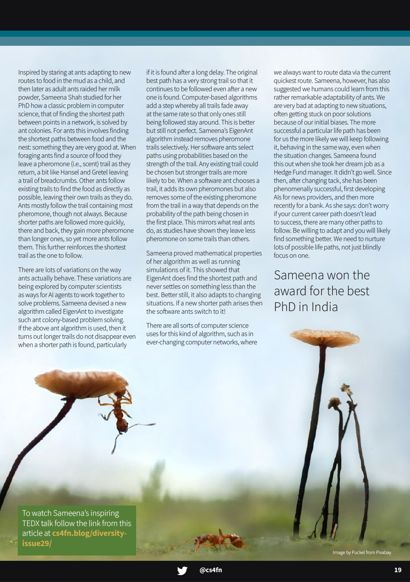
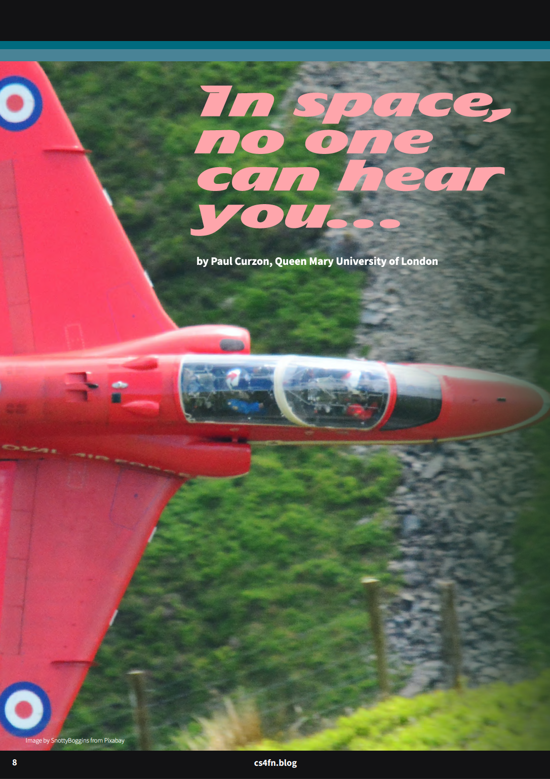
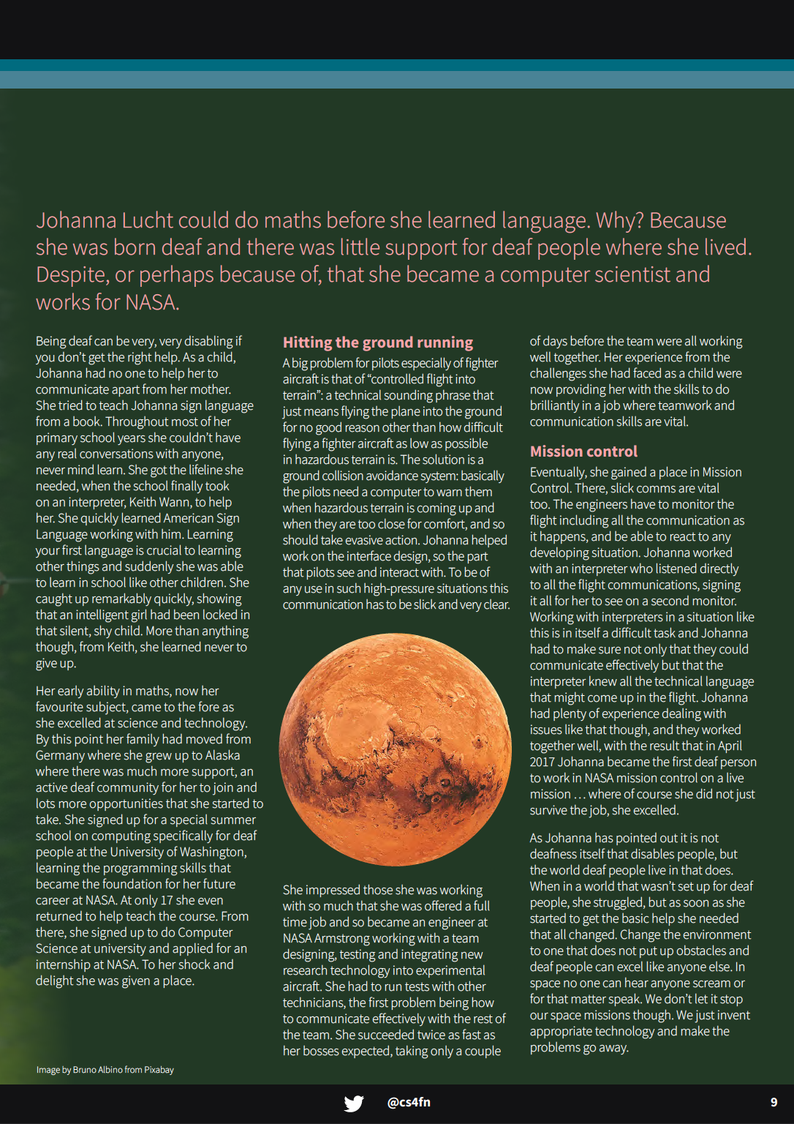
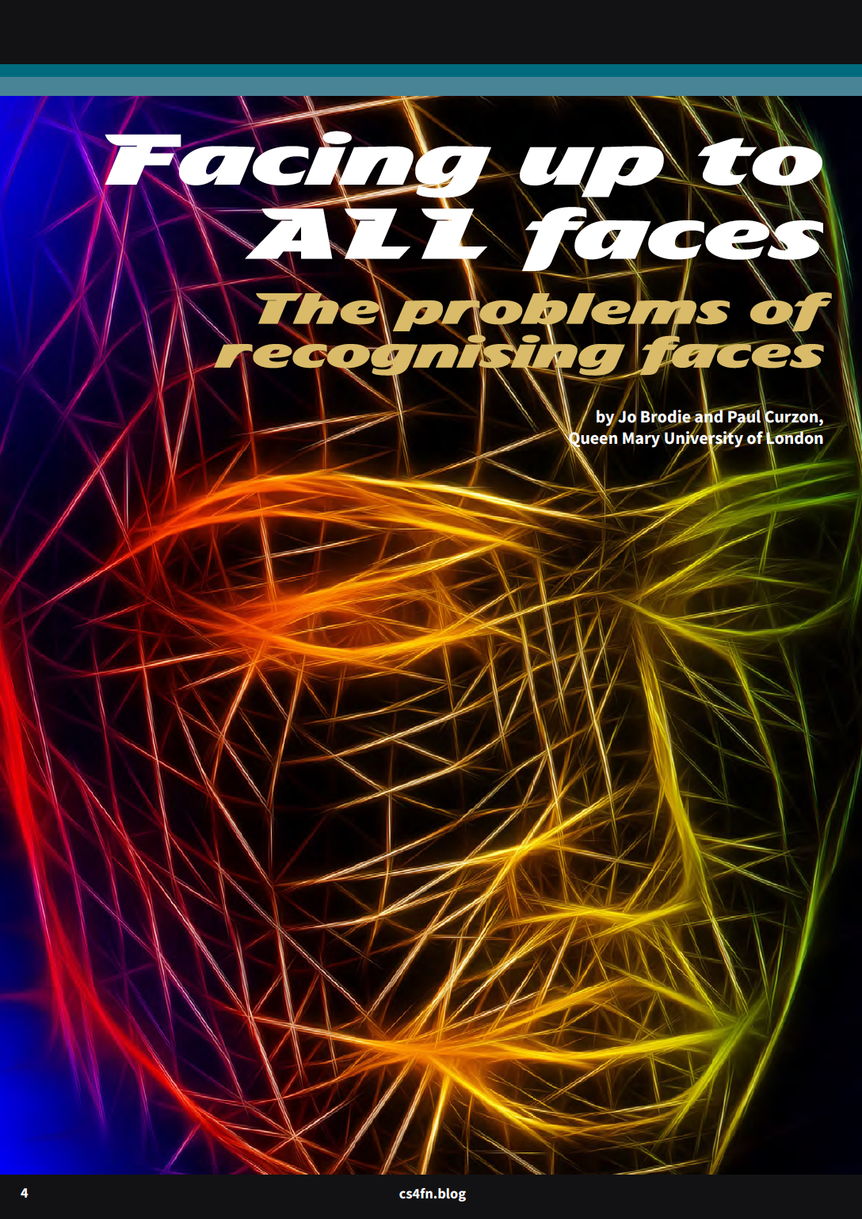
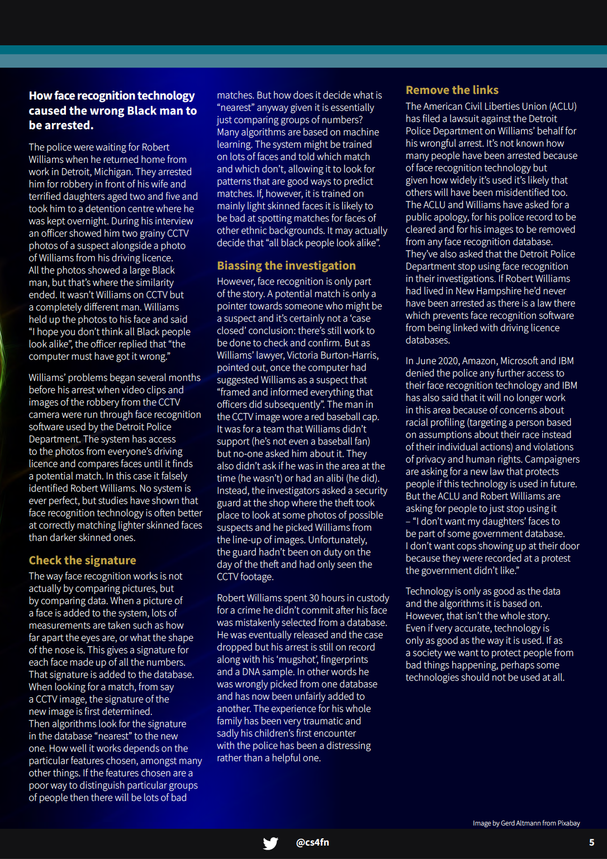
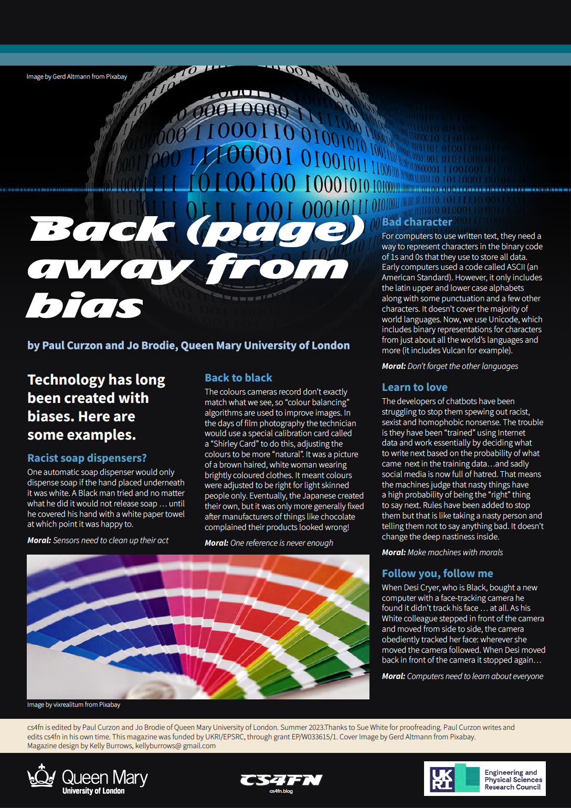
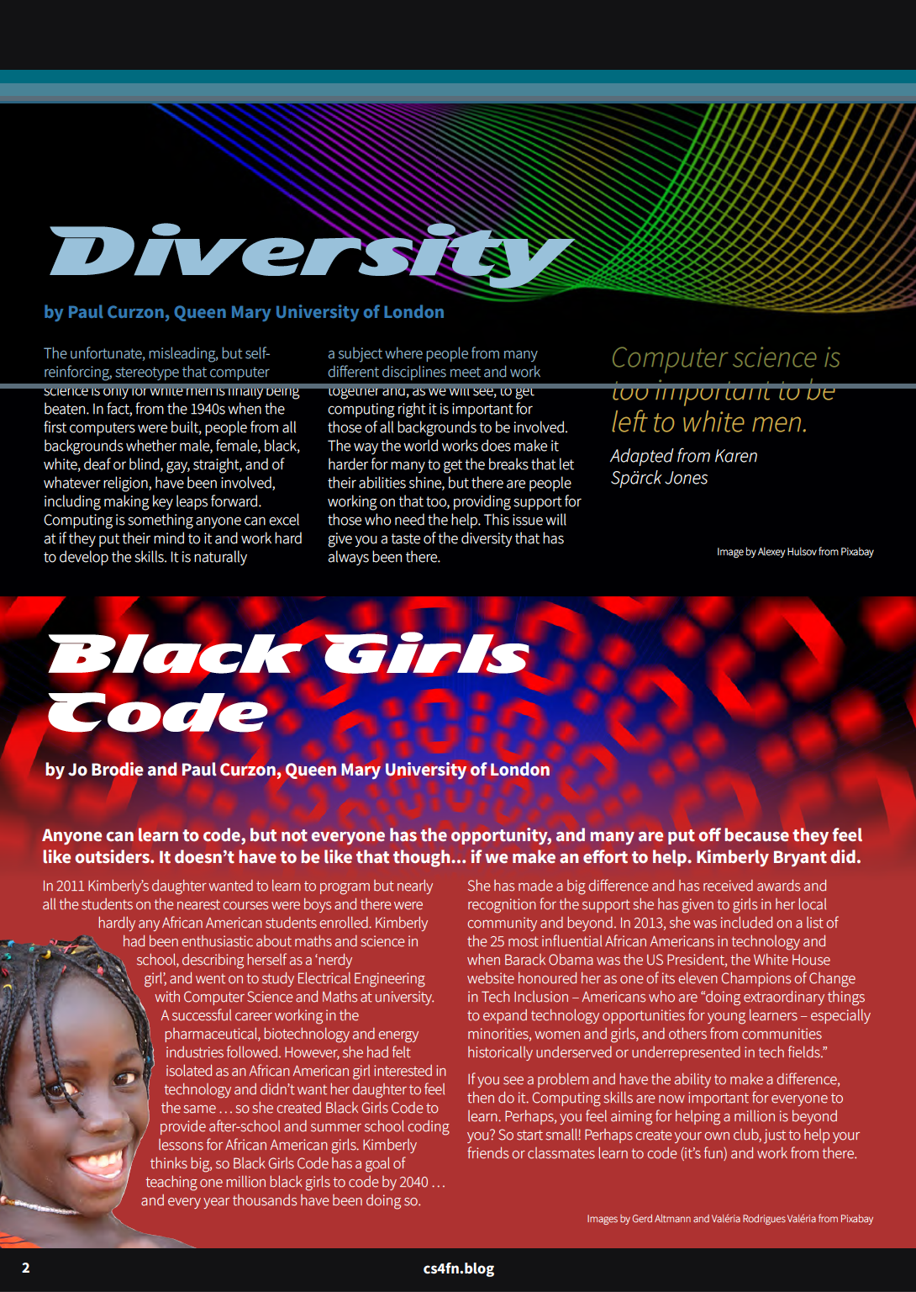
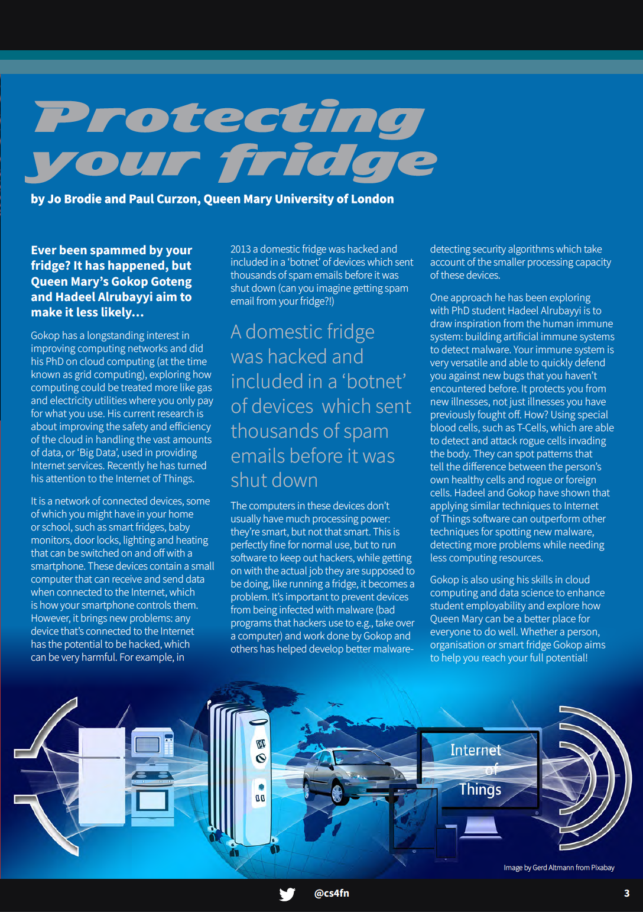
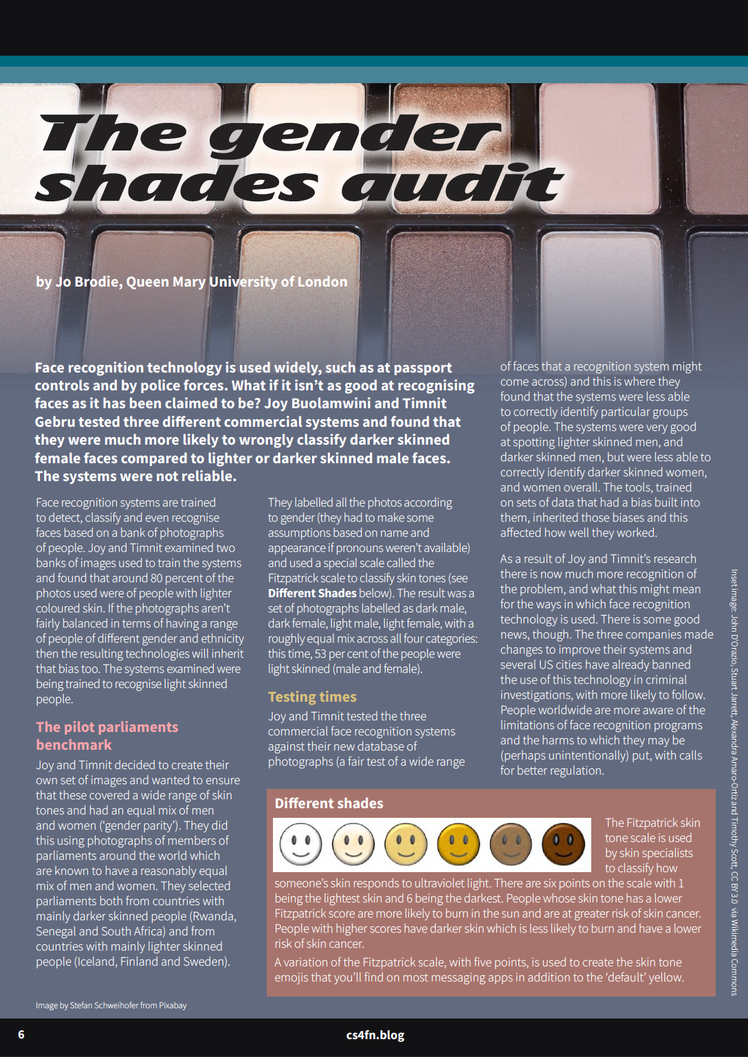
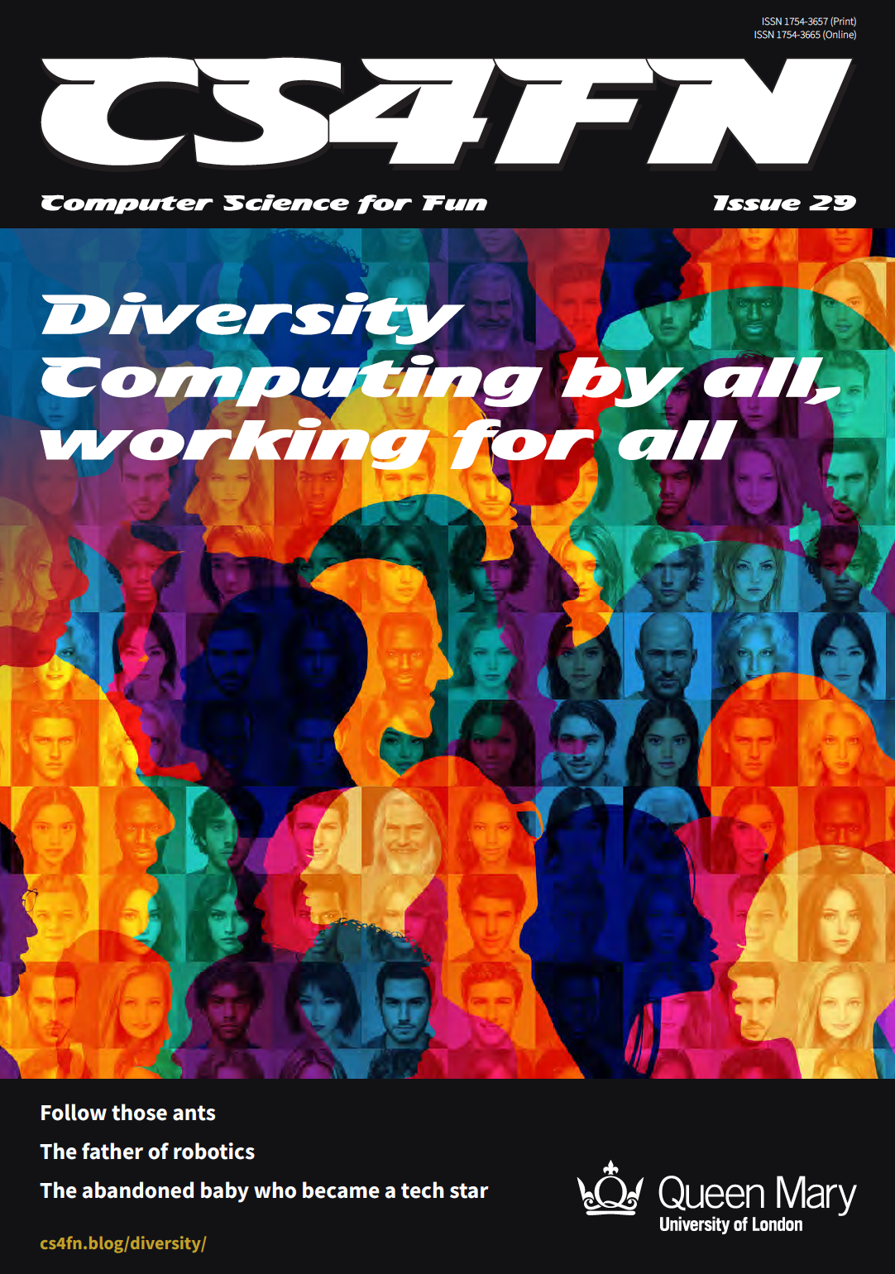
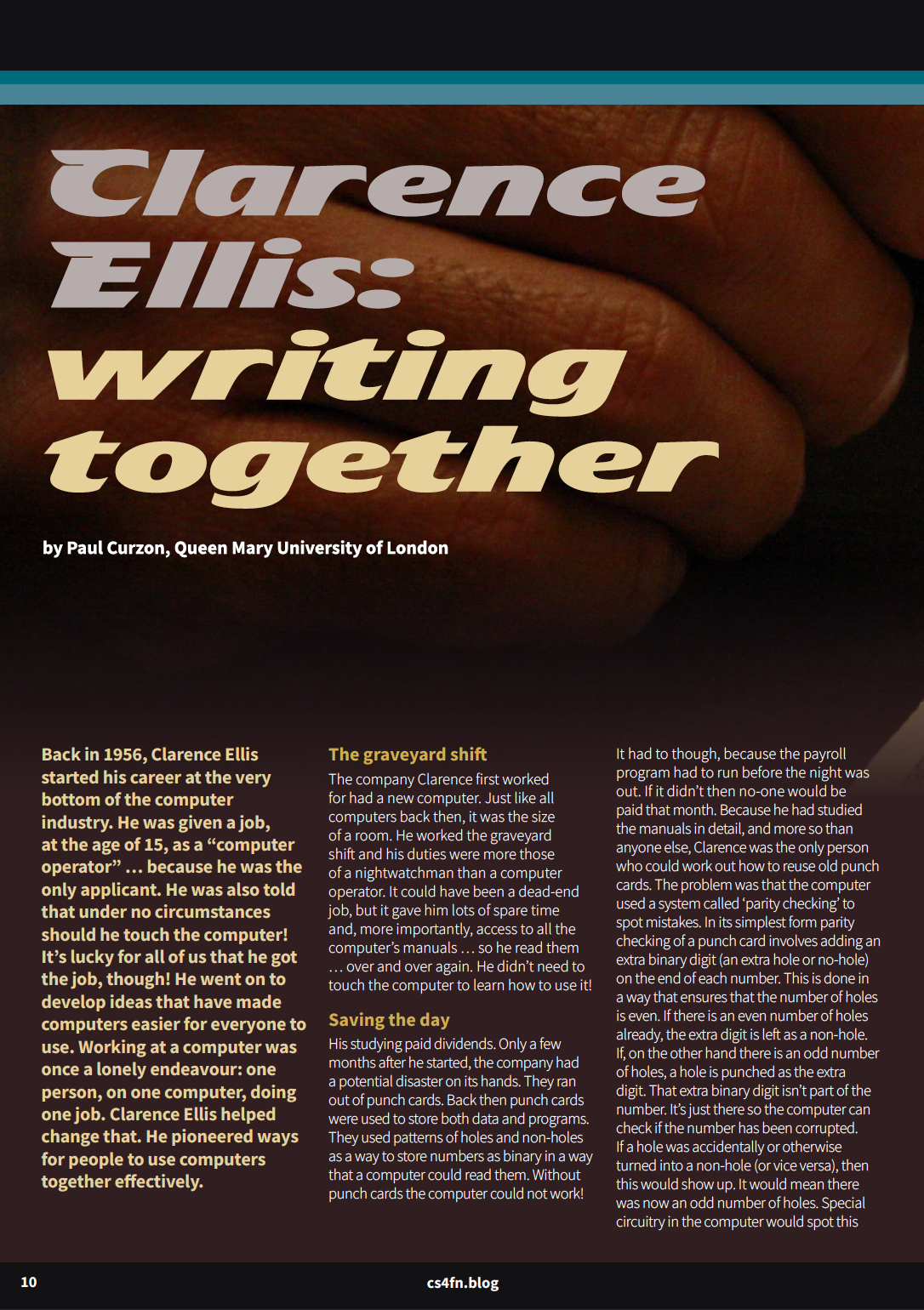
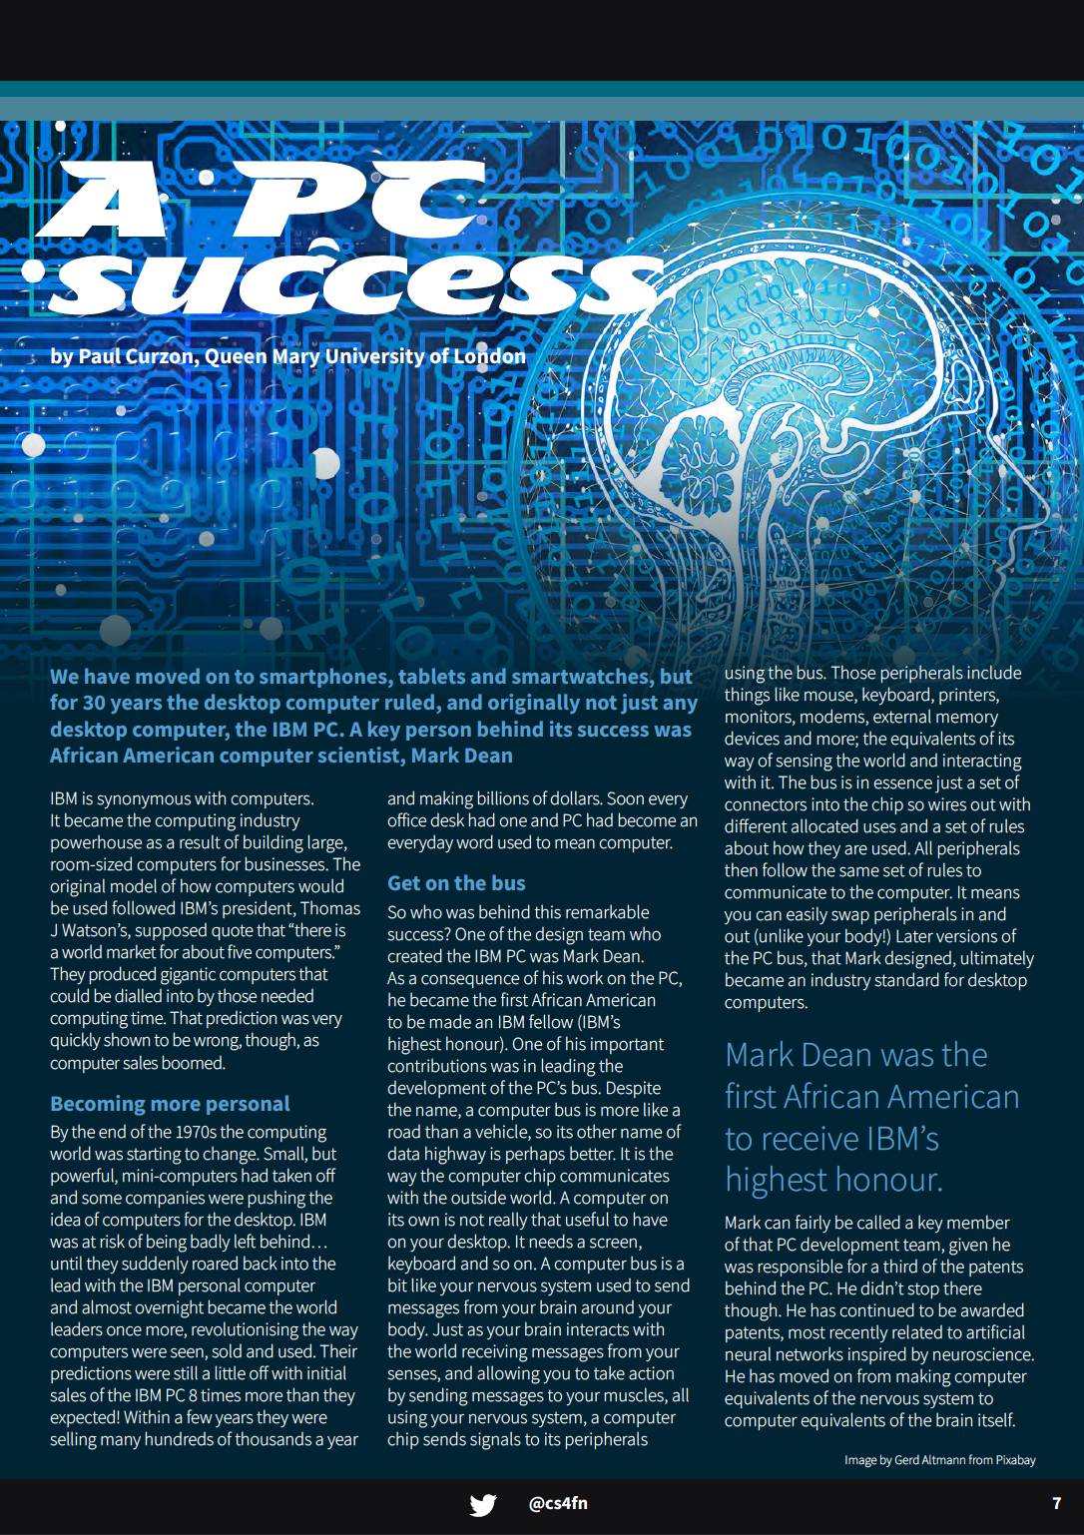
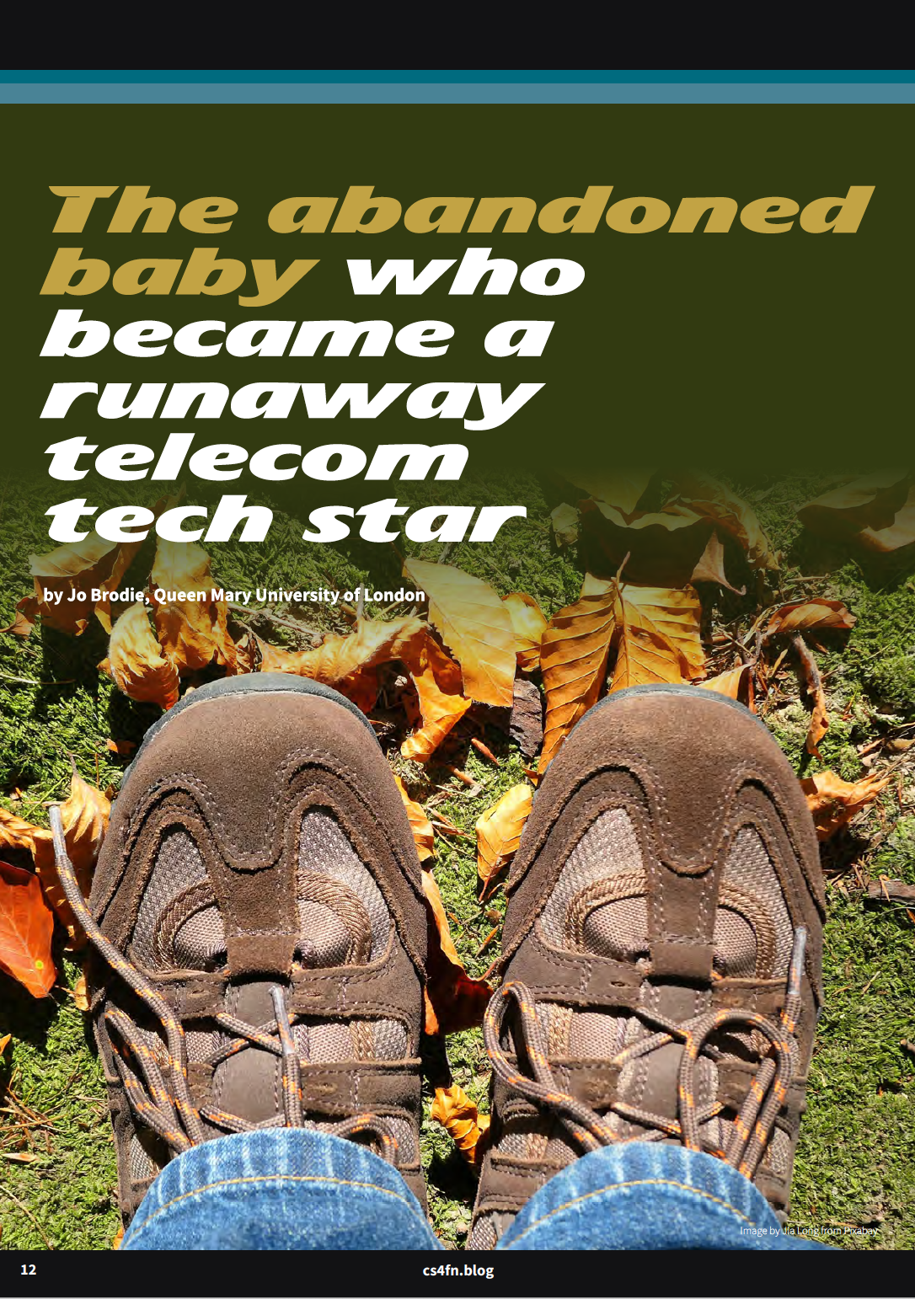
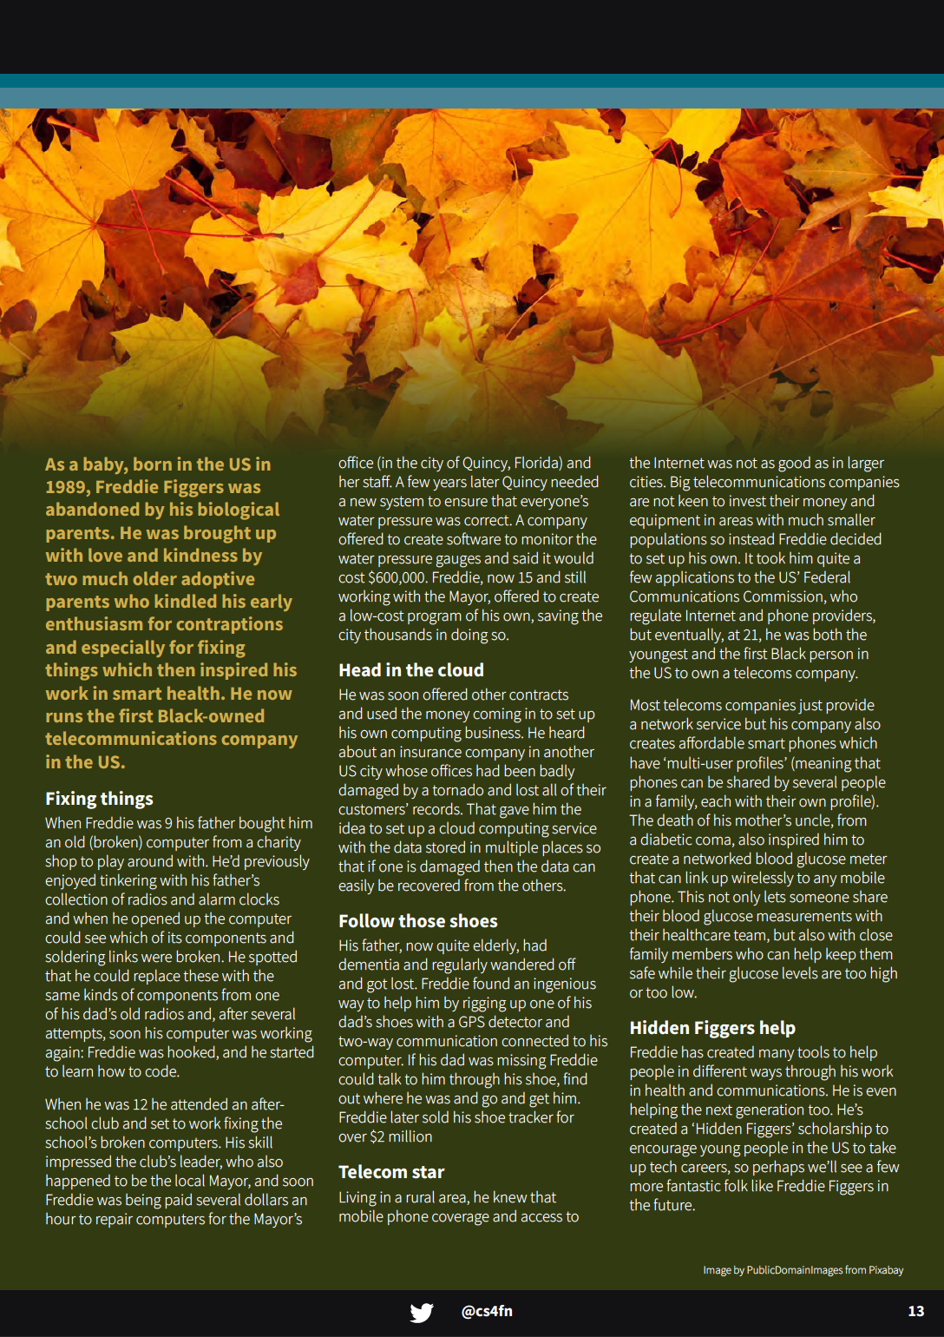
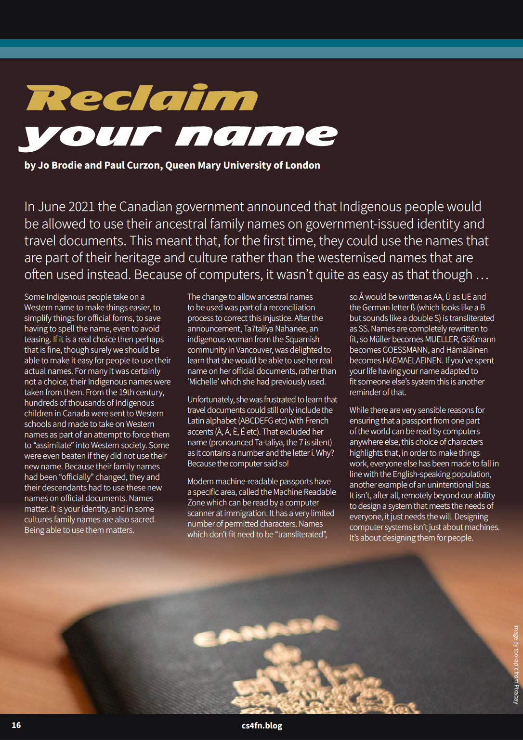
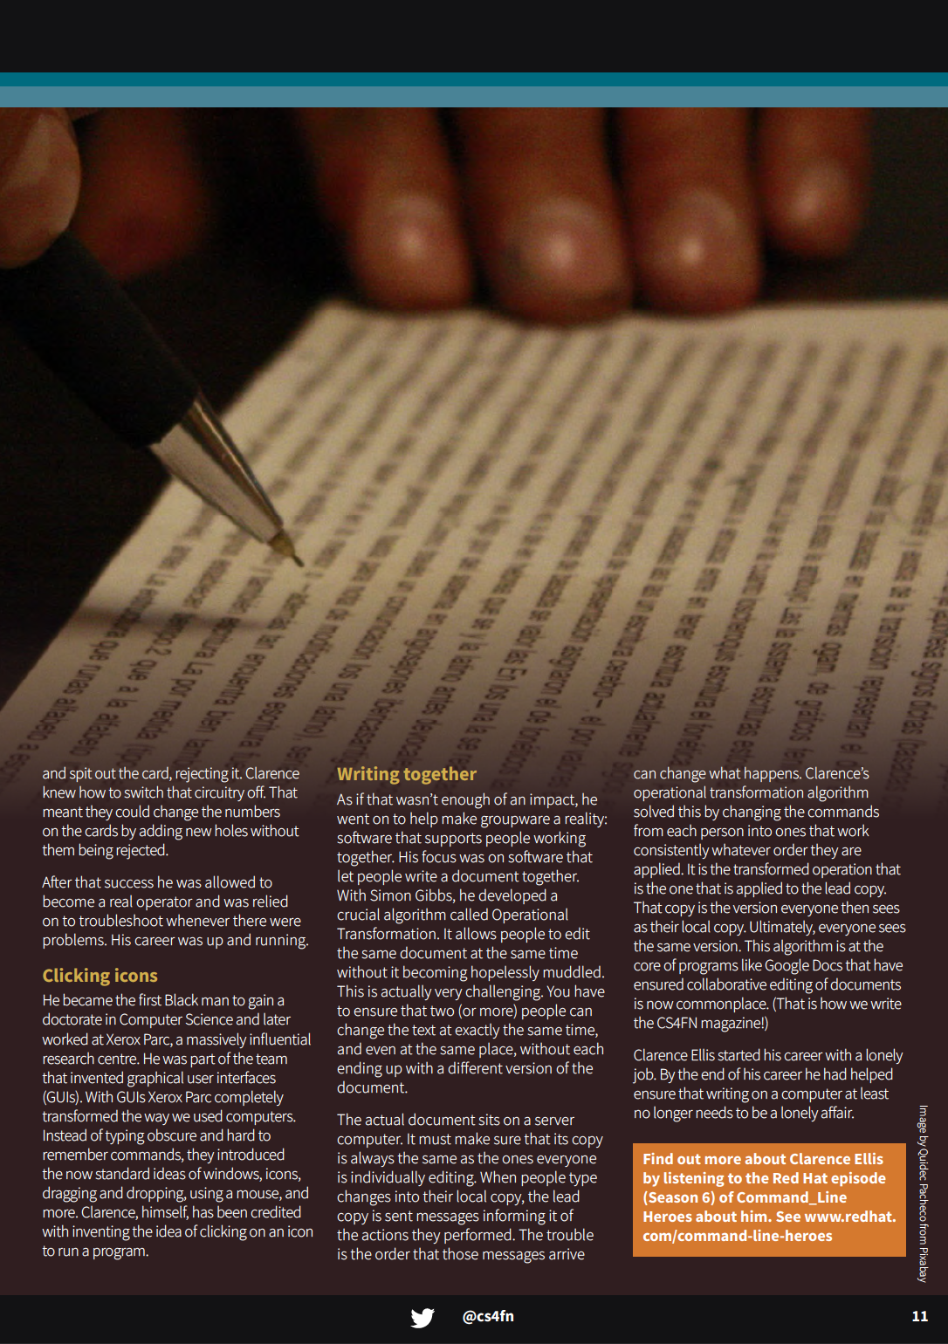





Magazine

Slide 11





Slide 12
Some future work
Resharing our material
Creating new articles
Creating new diversity posters
Creating new posters and cartoons for primary audiences
Tweeting links to our articles, magazines, portals and also sharing through our newsletter and via Computing At School. We will add some items to the TES website.
We are writing new articles for Black History Month. Paul has run “writing for young people” workshops with EECS postgraduate students, encouraging them to write about diversity.
We’ve already added more people to our list of Black History (past and present) computer scientists and it would be nice to have them in poster form too.
Paul is working with an artist to create images for posters suitable for a younger audience, though this will likely be for Black History Month 2024.

Slide 13










Slide 14
bit.ly/CS4FNlunch

