Slide 1
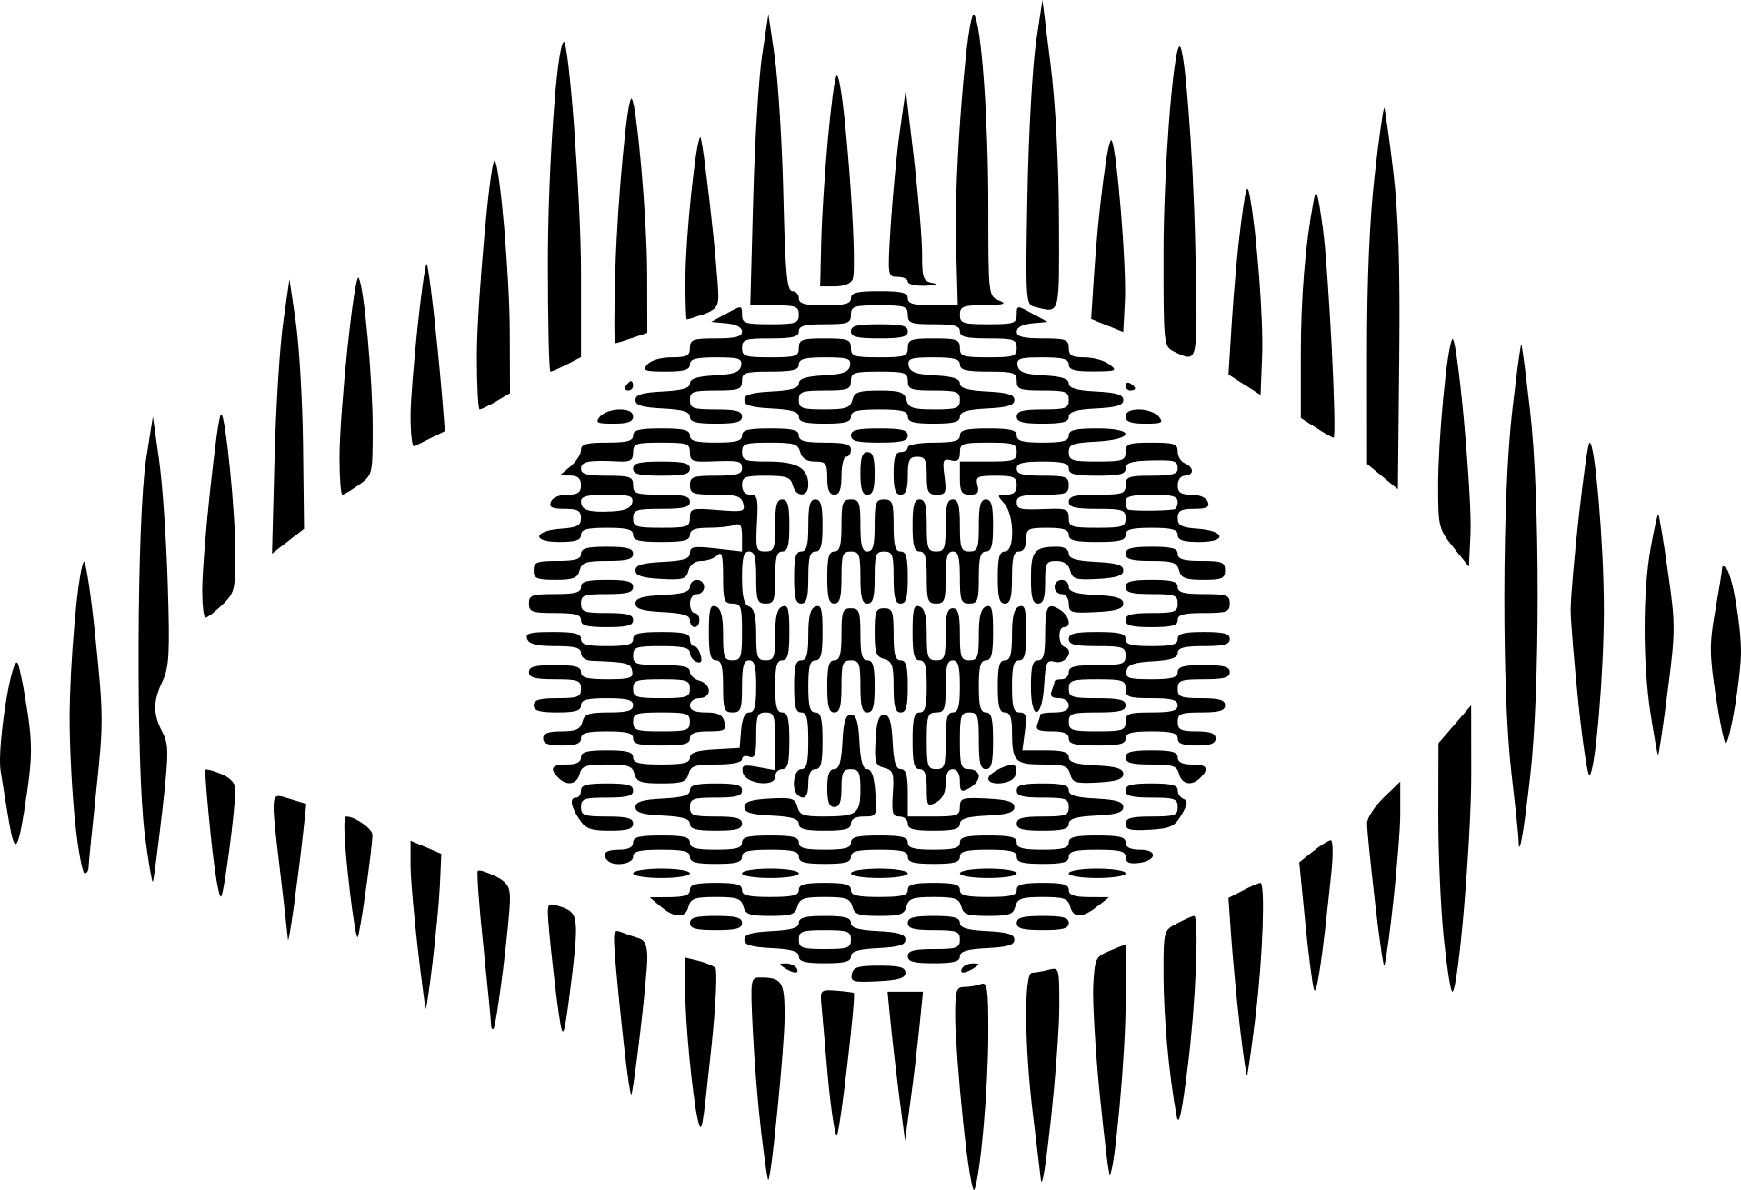

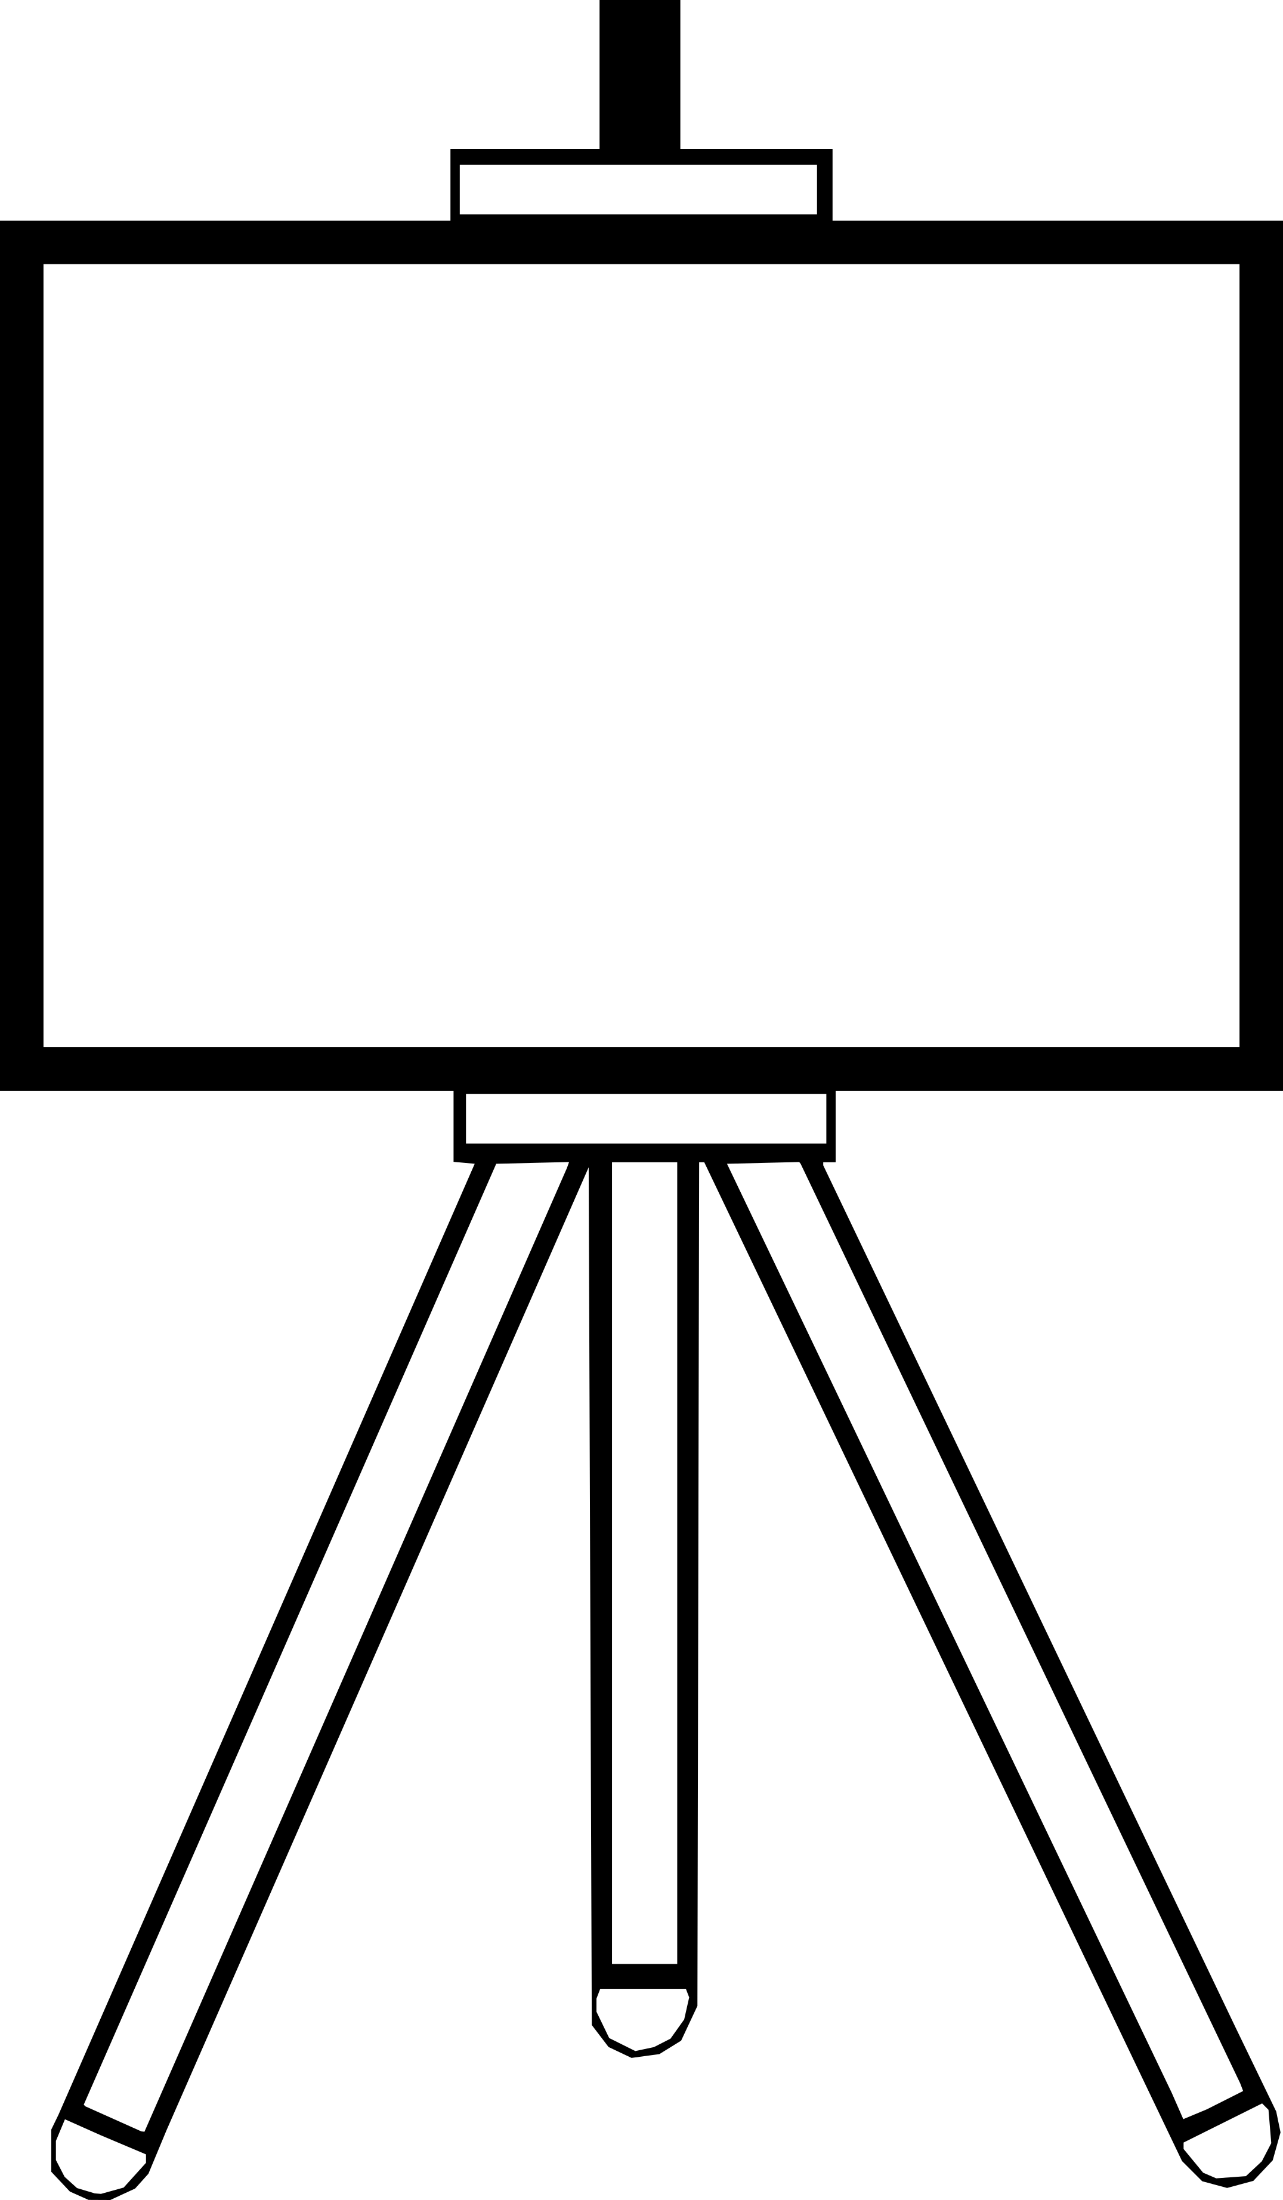
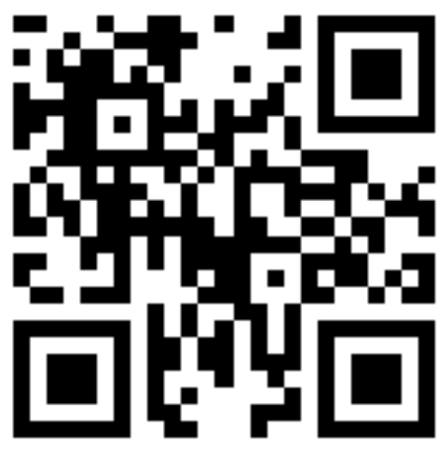
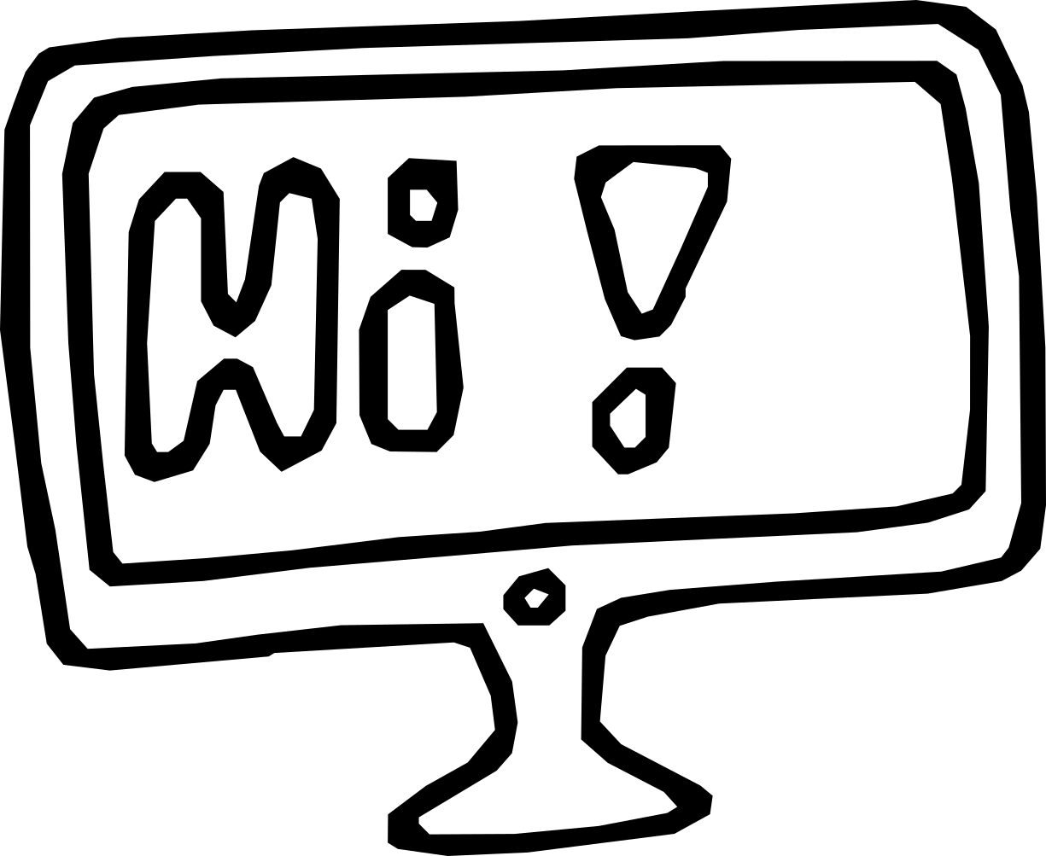
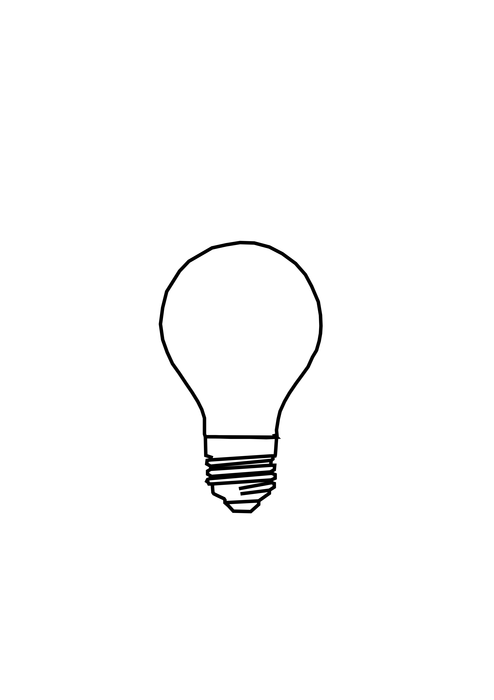
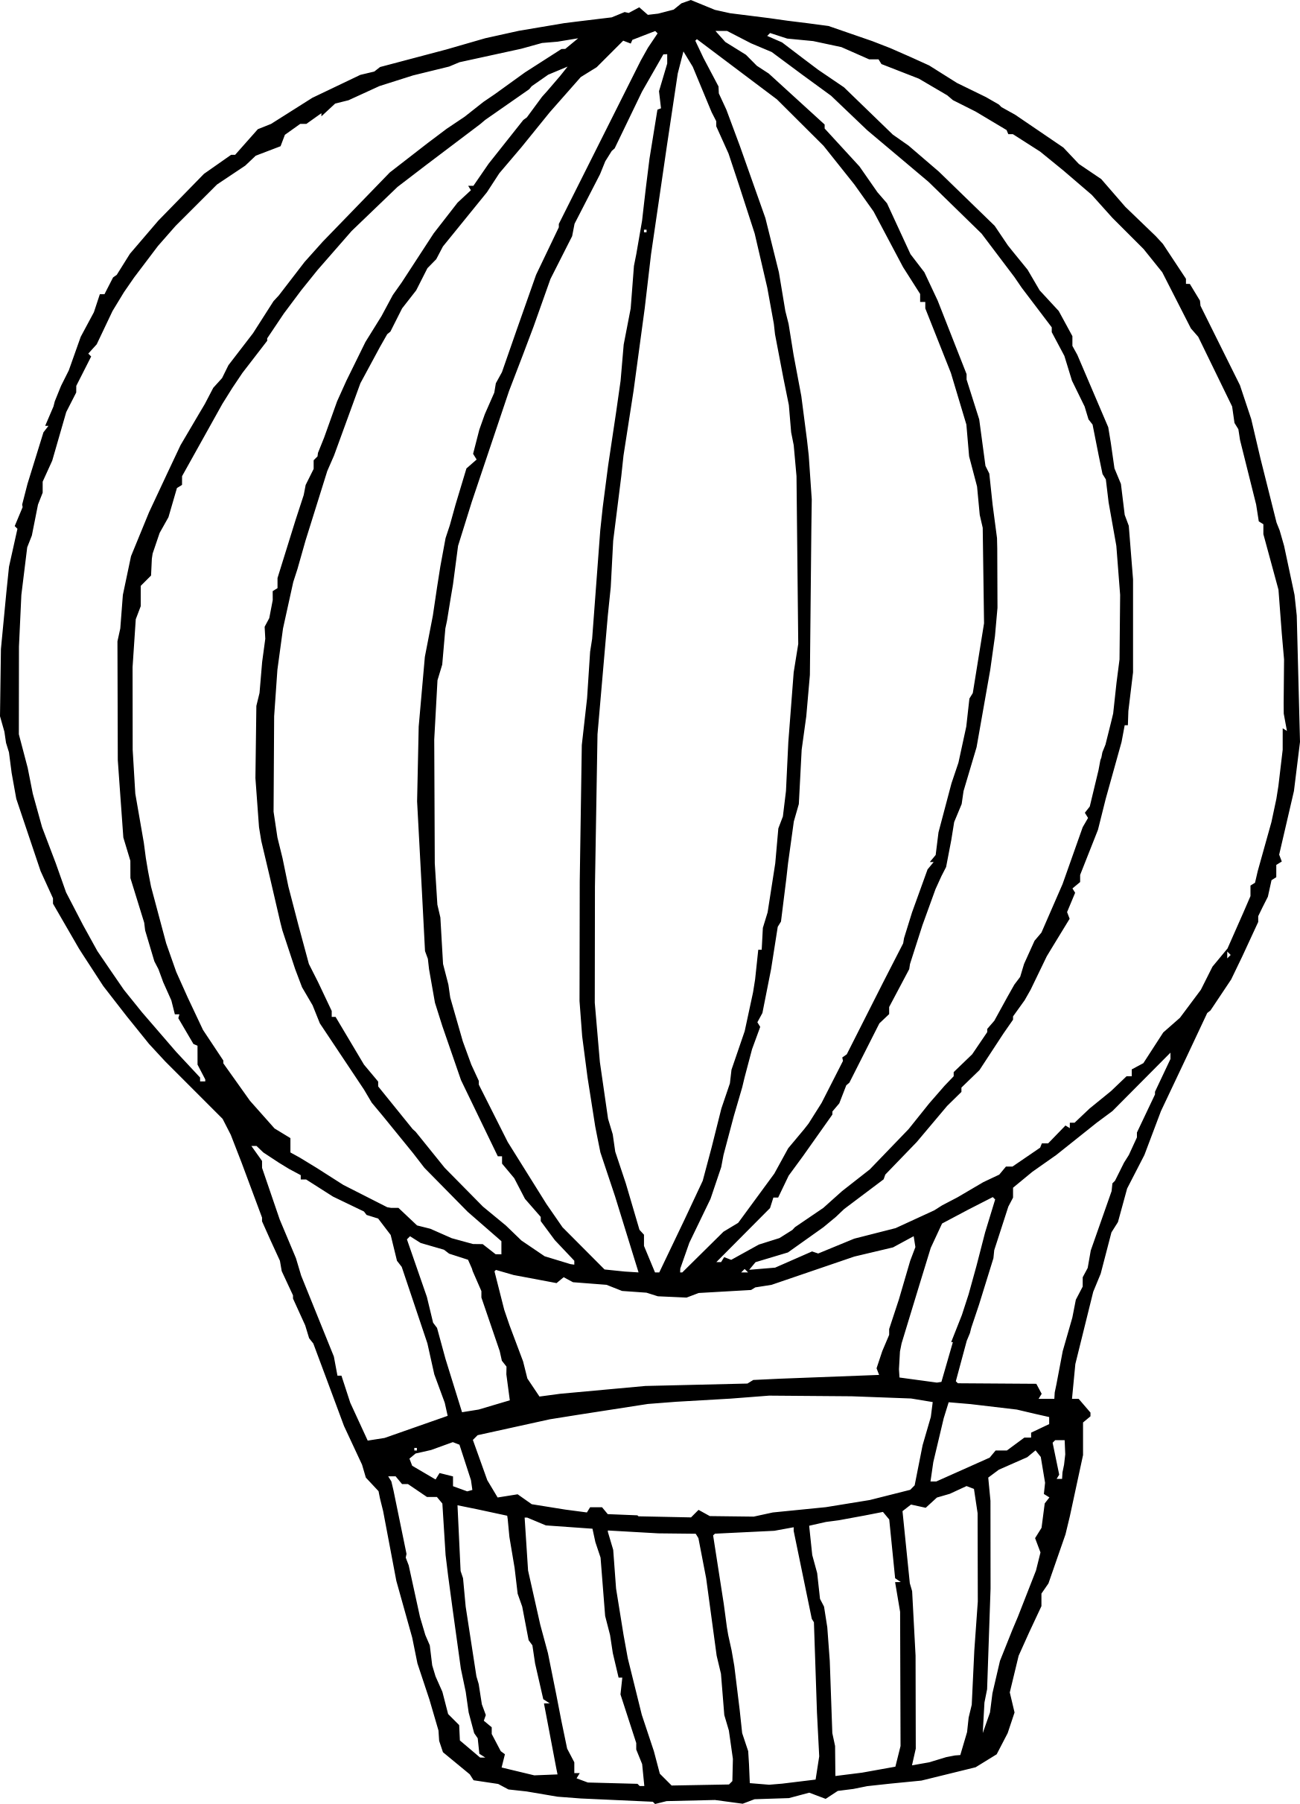
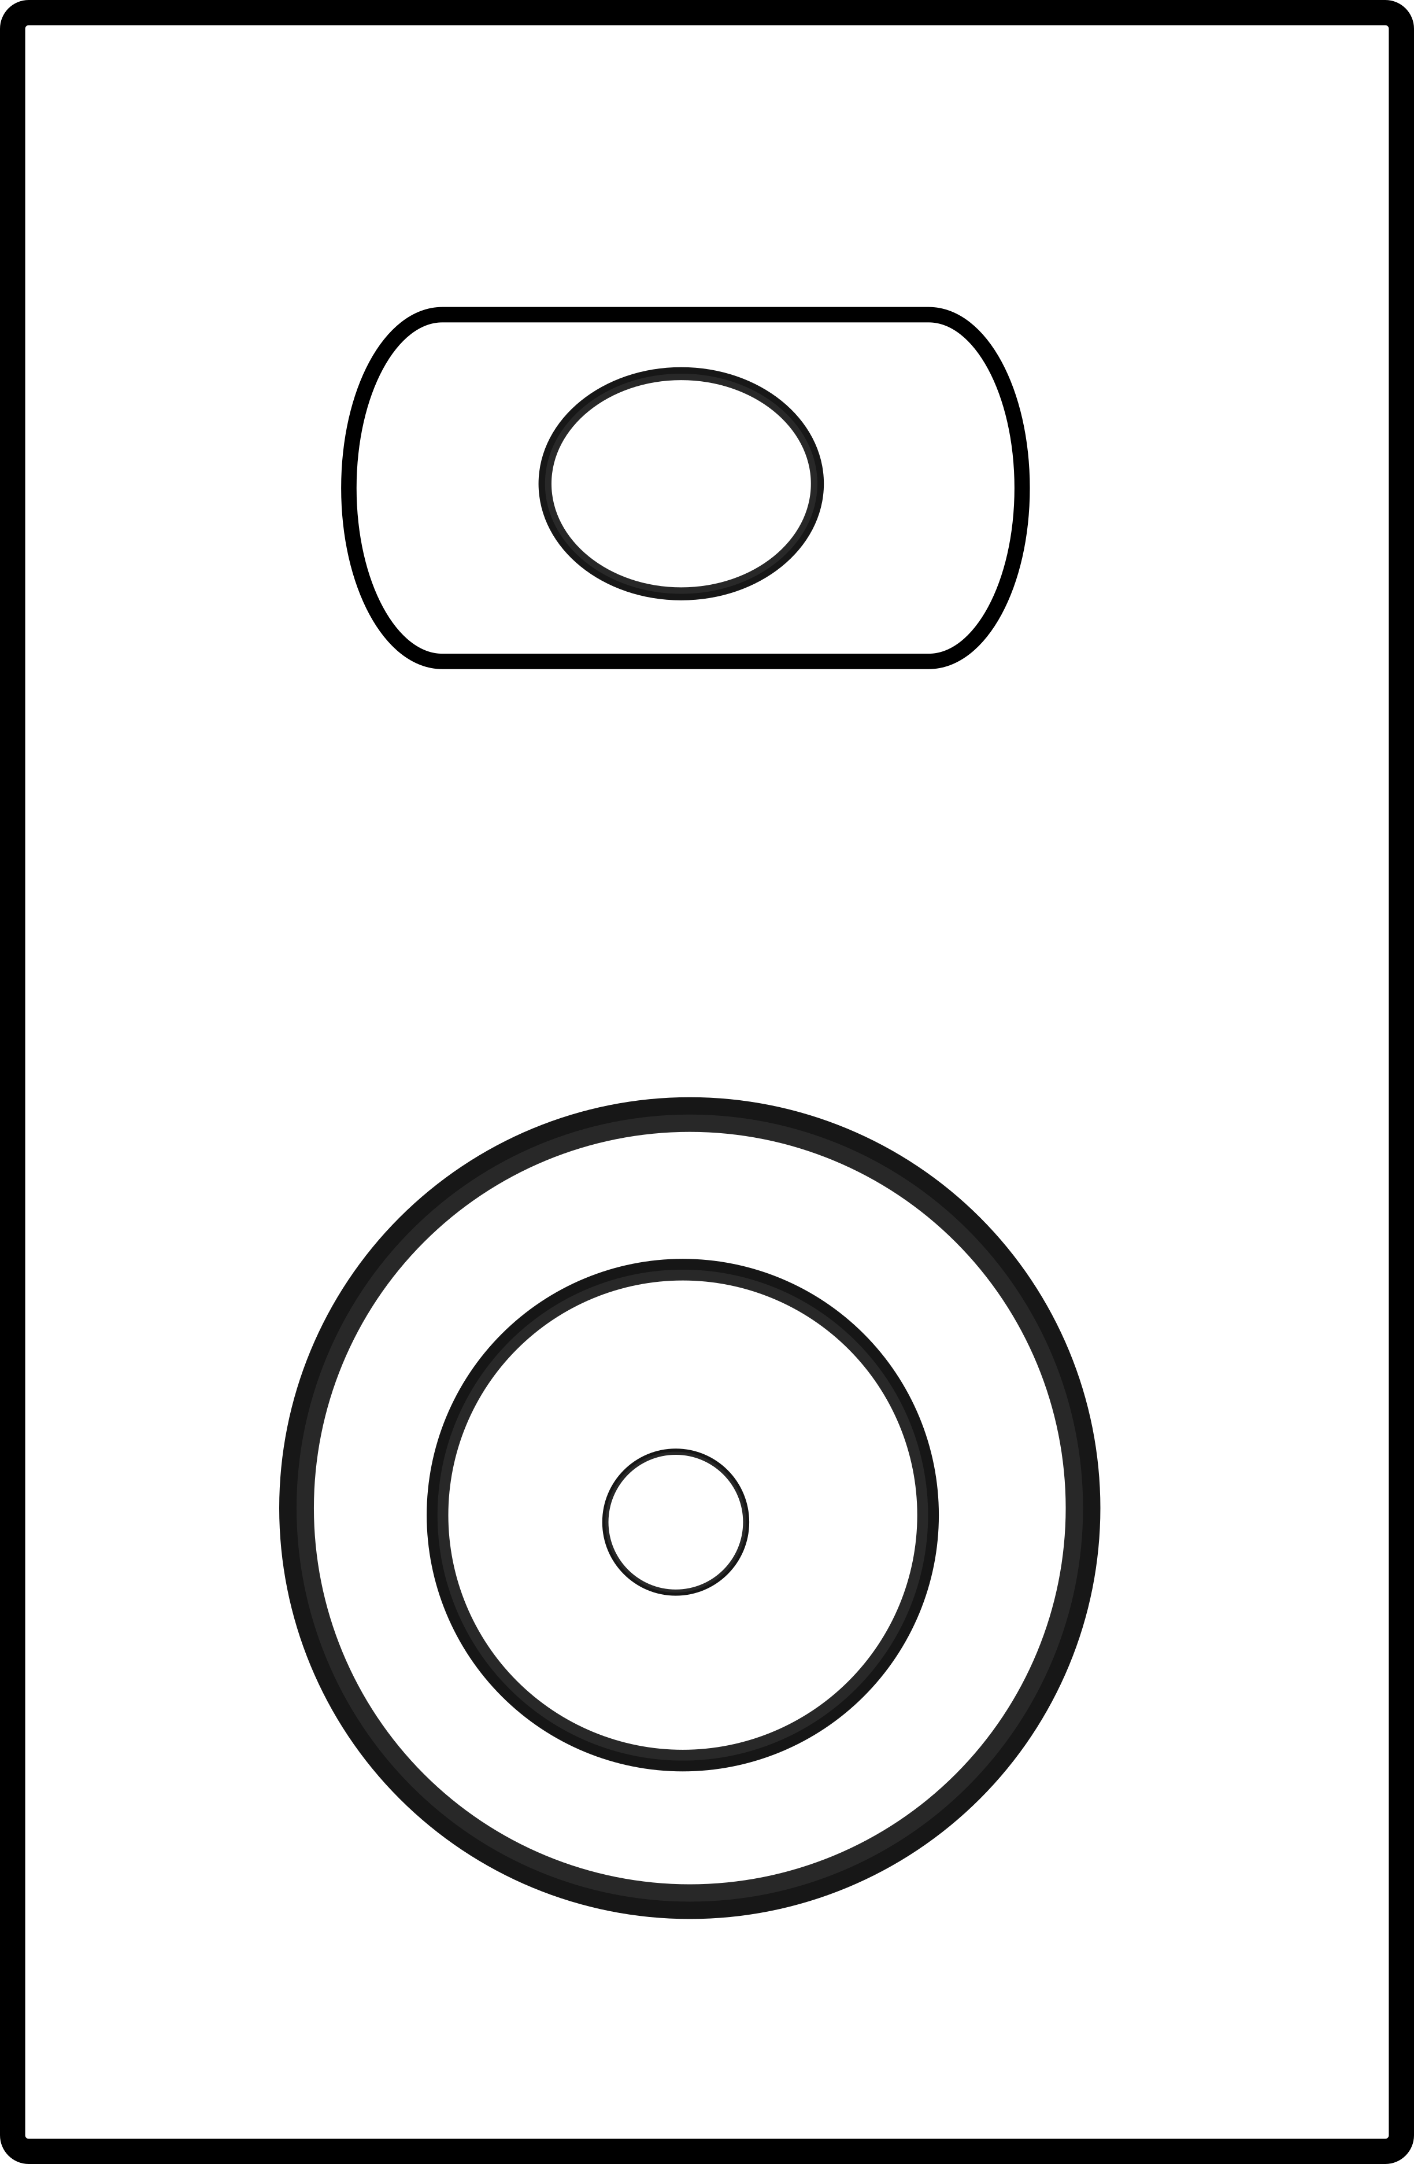
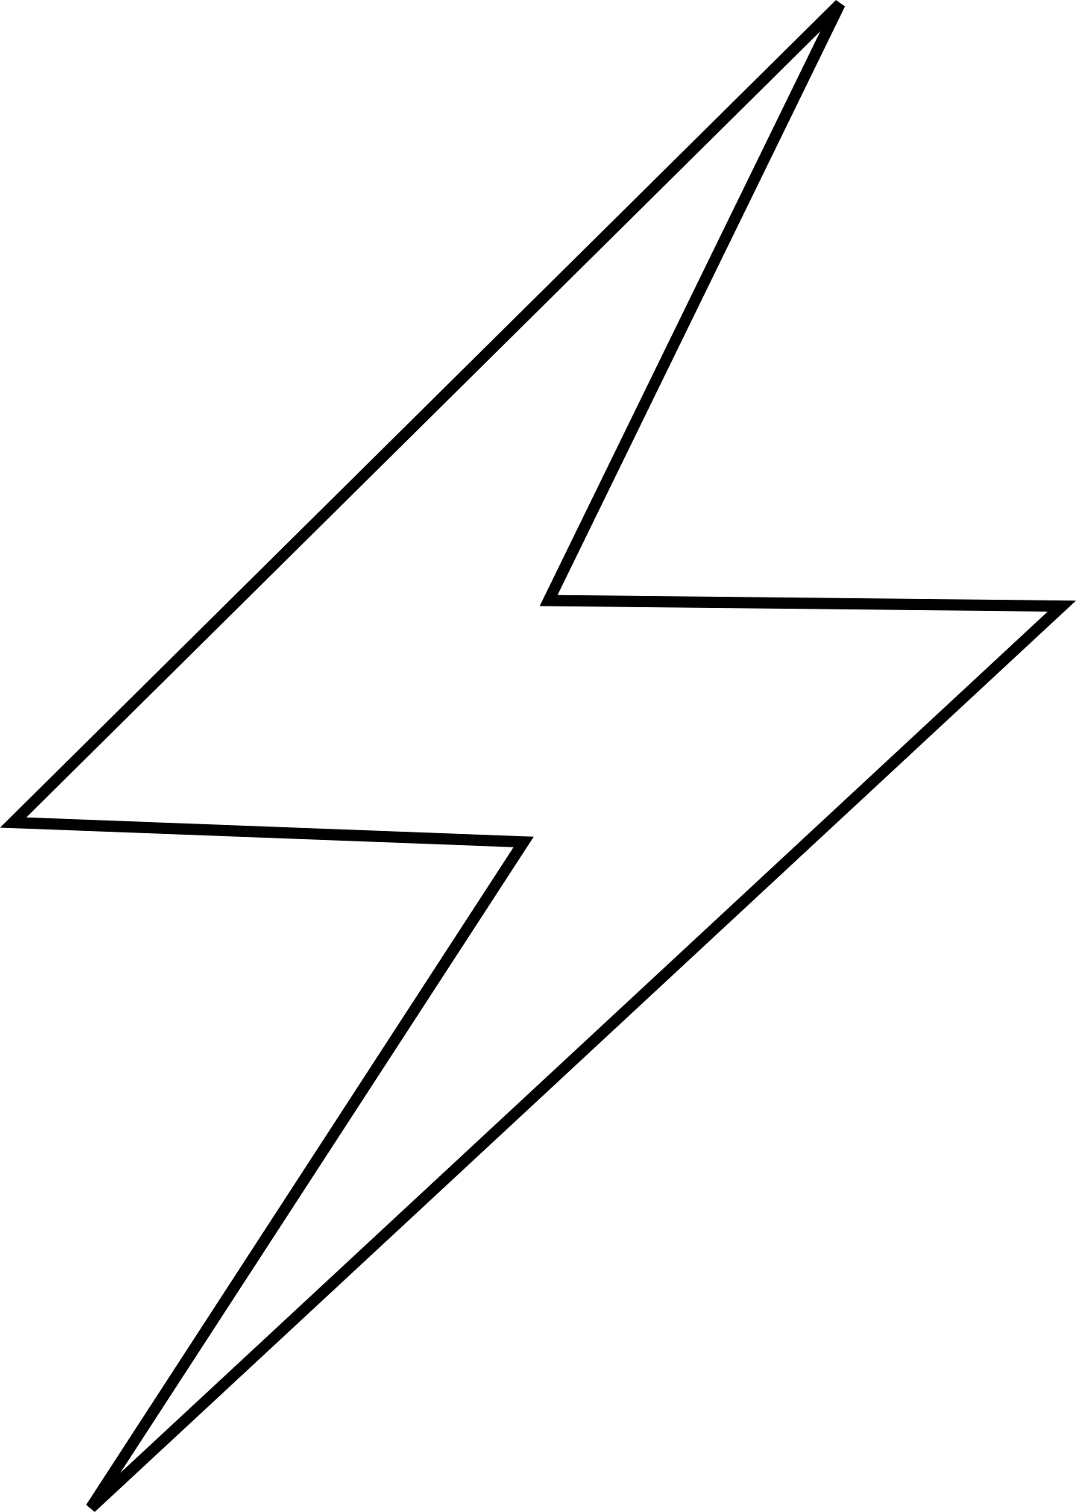

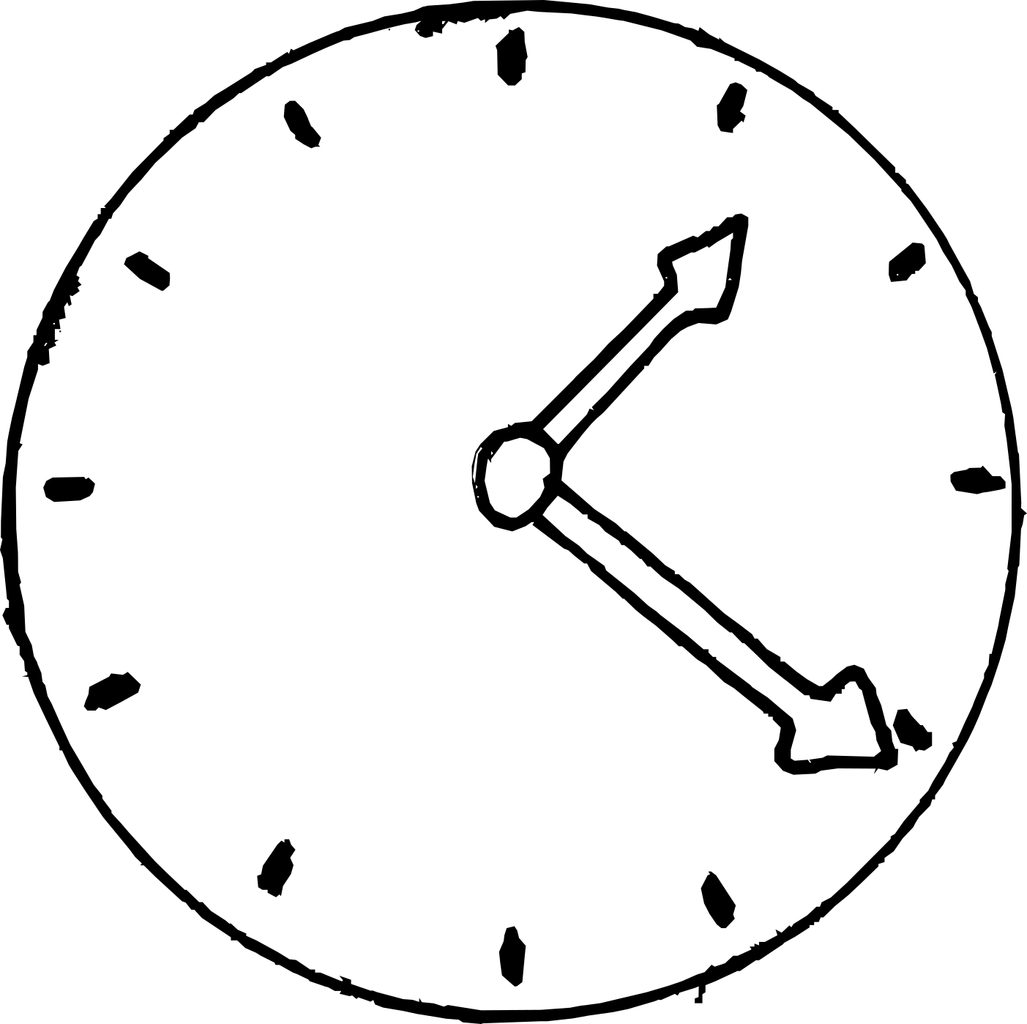

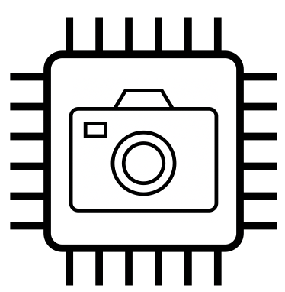
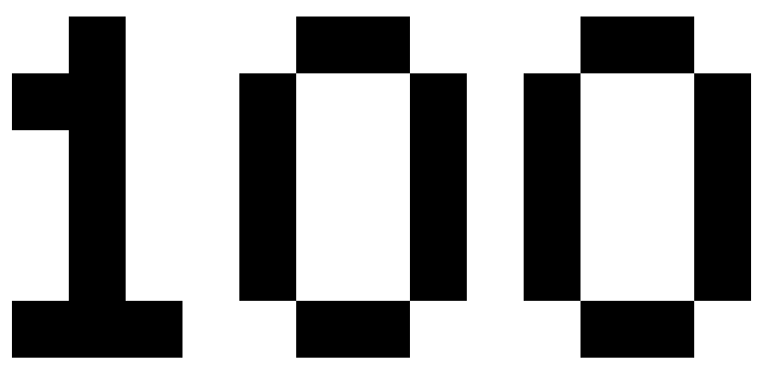
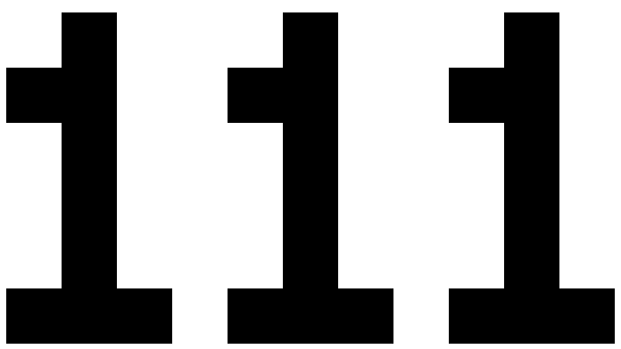
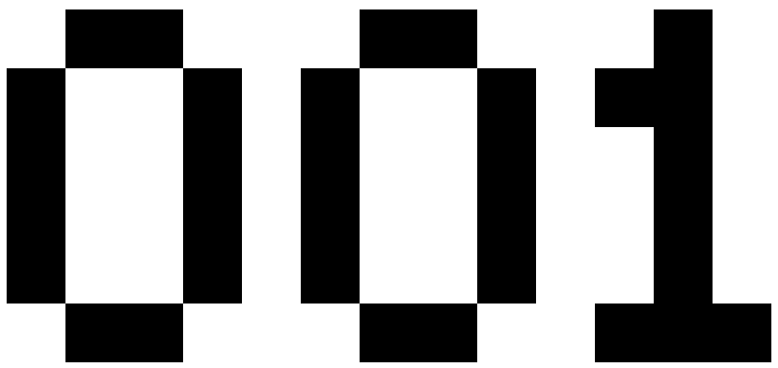

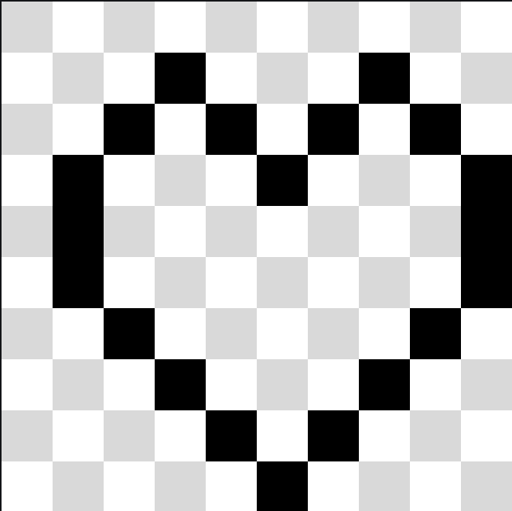
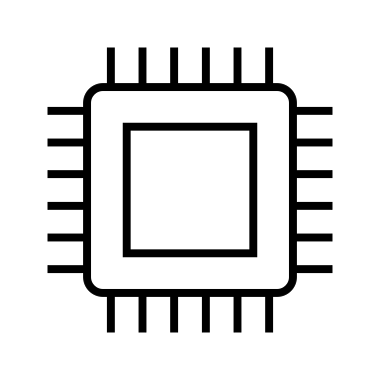

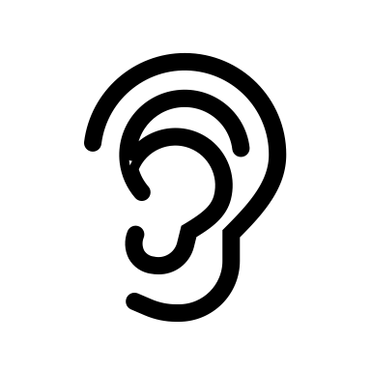


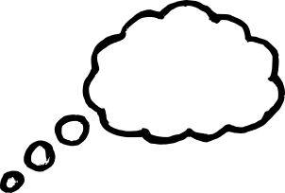
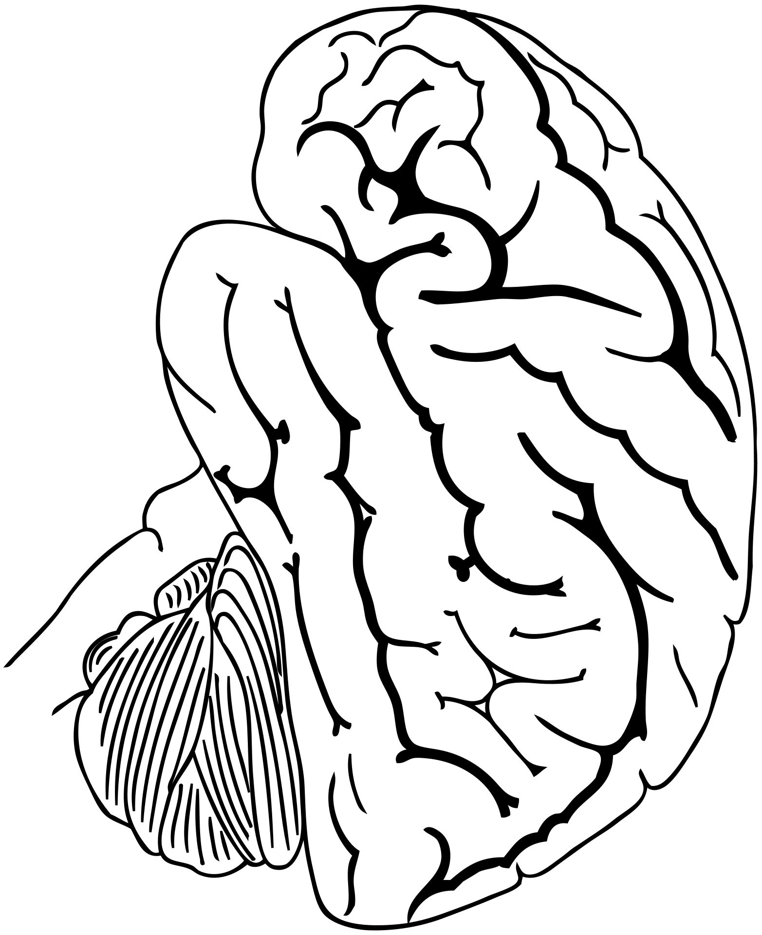
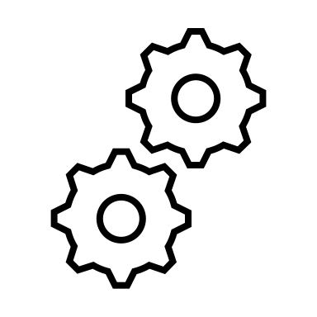
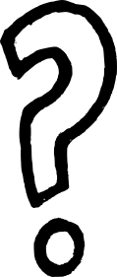
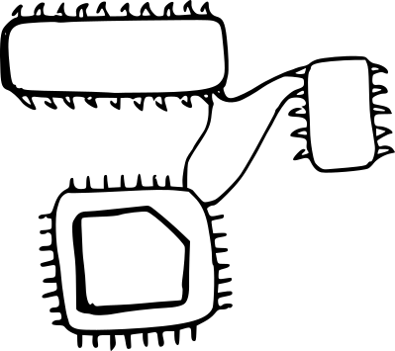
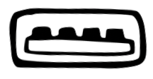

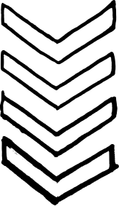
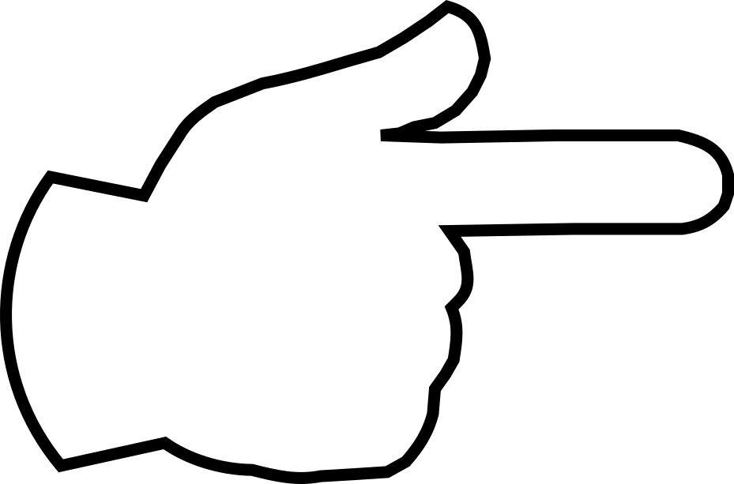
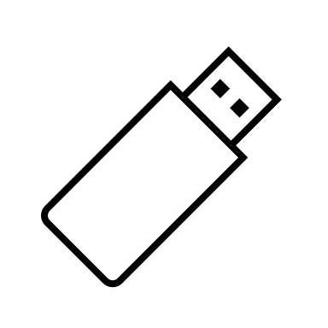

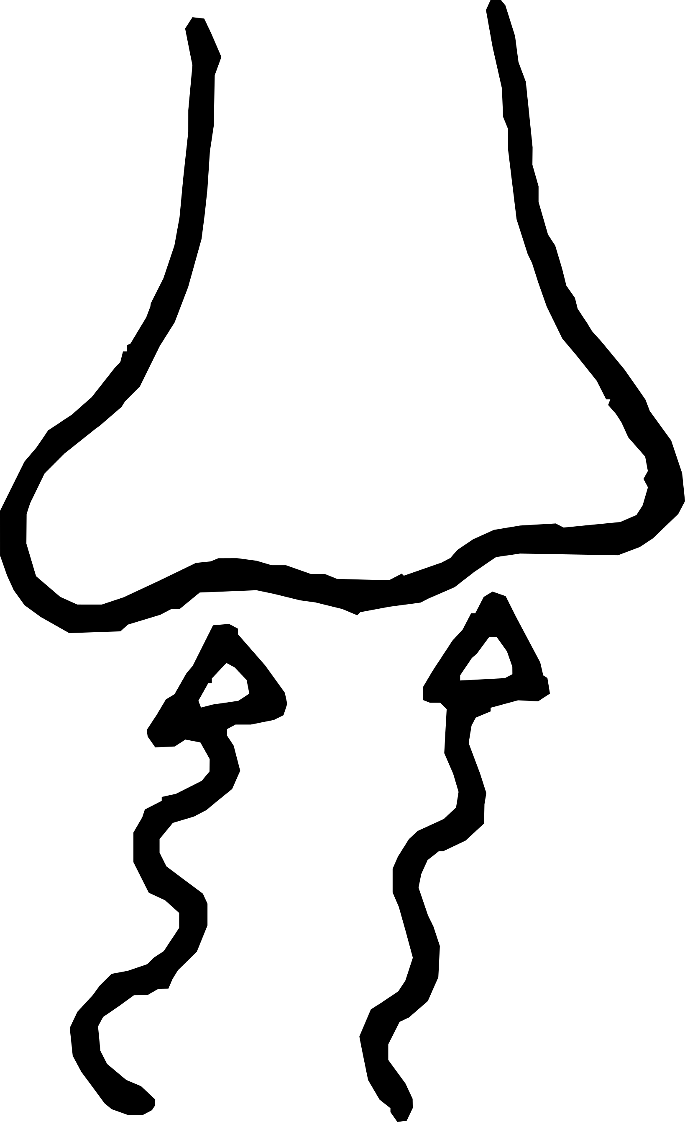
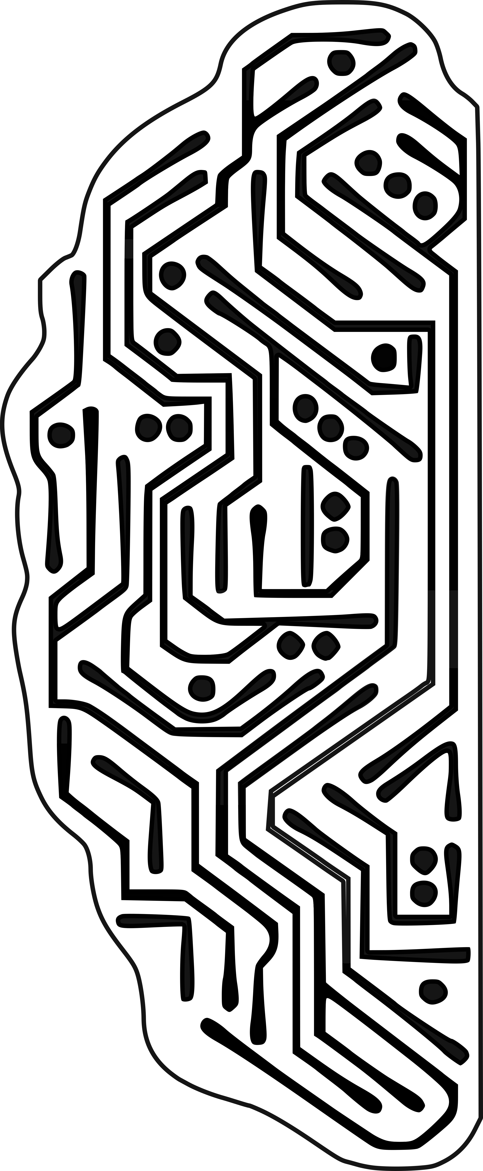
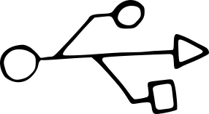
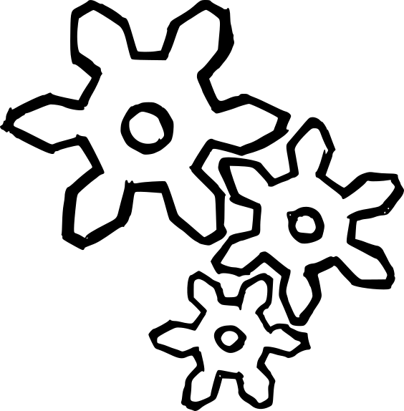
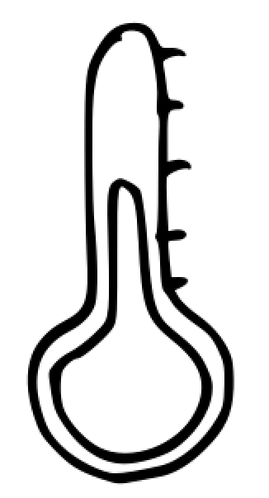
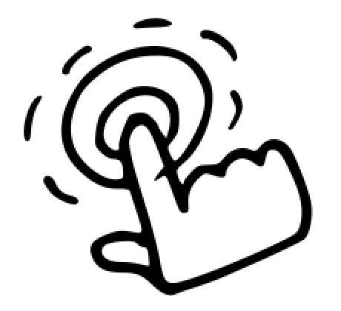
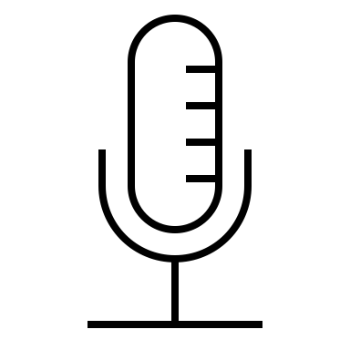


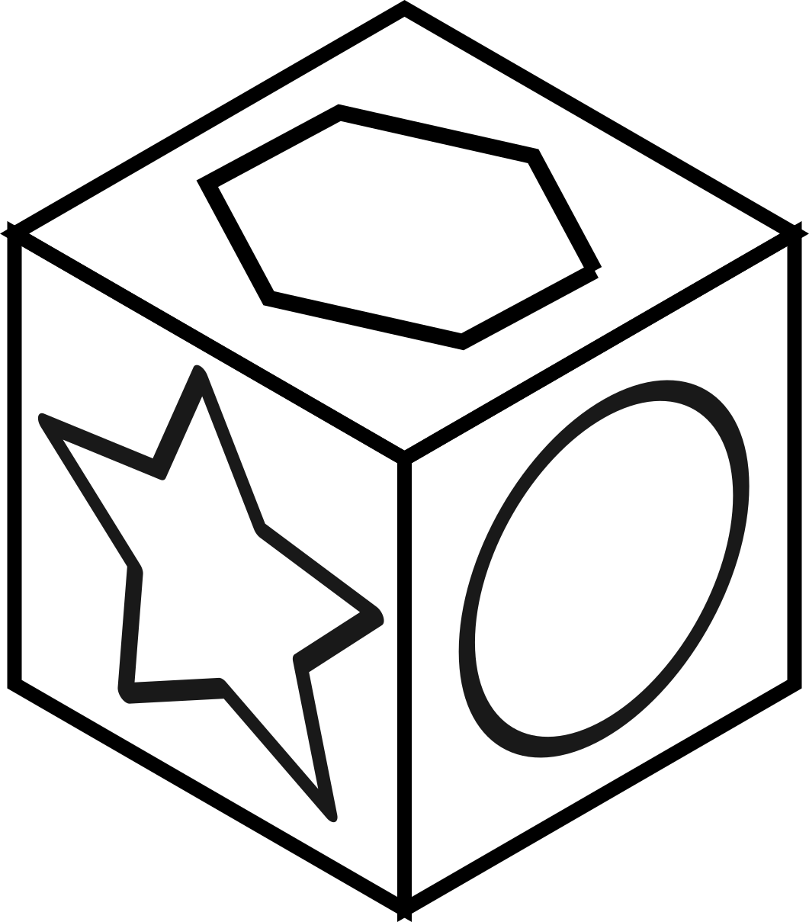
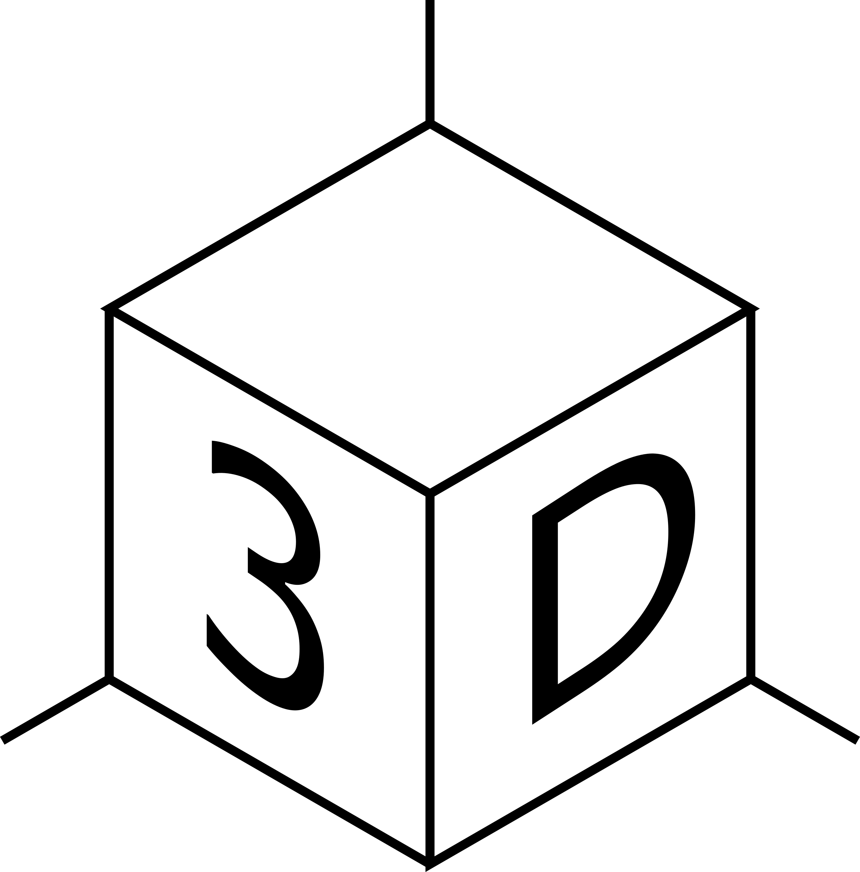
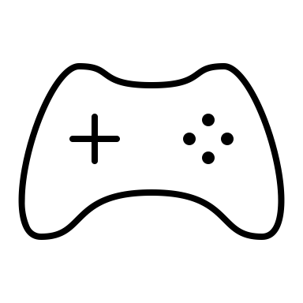
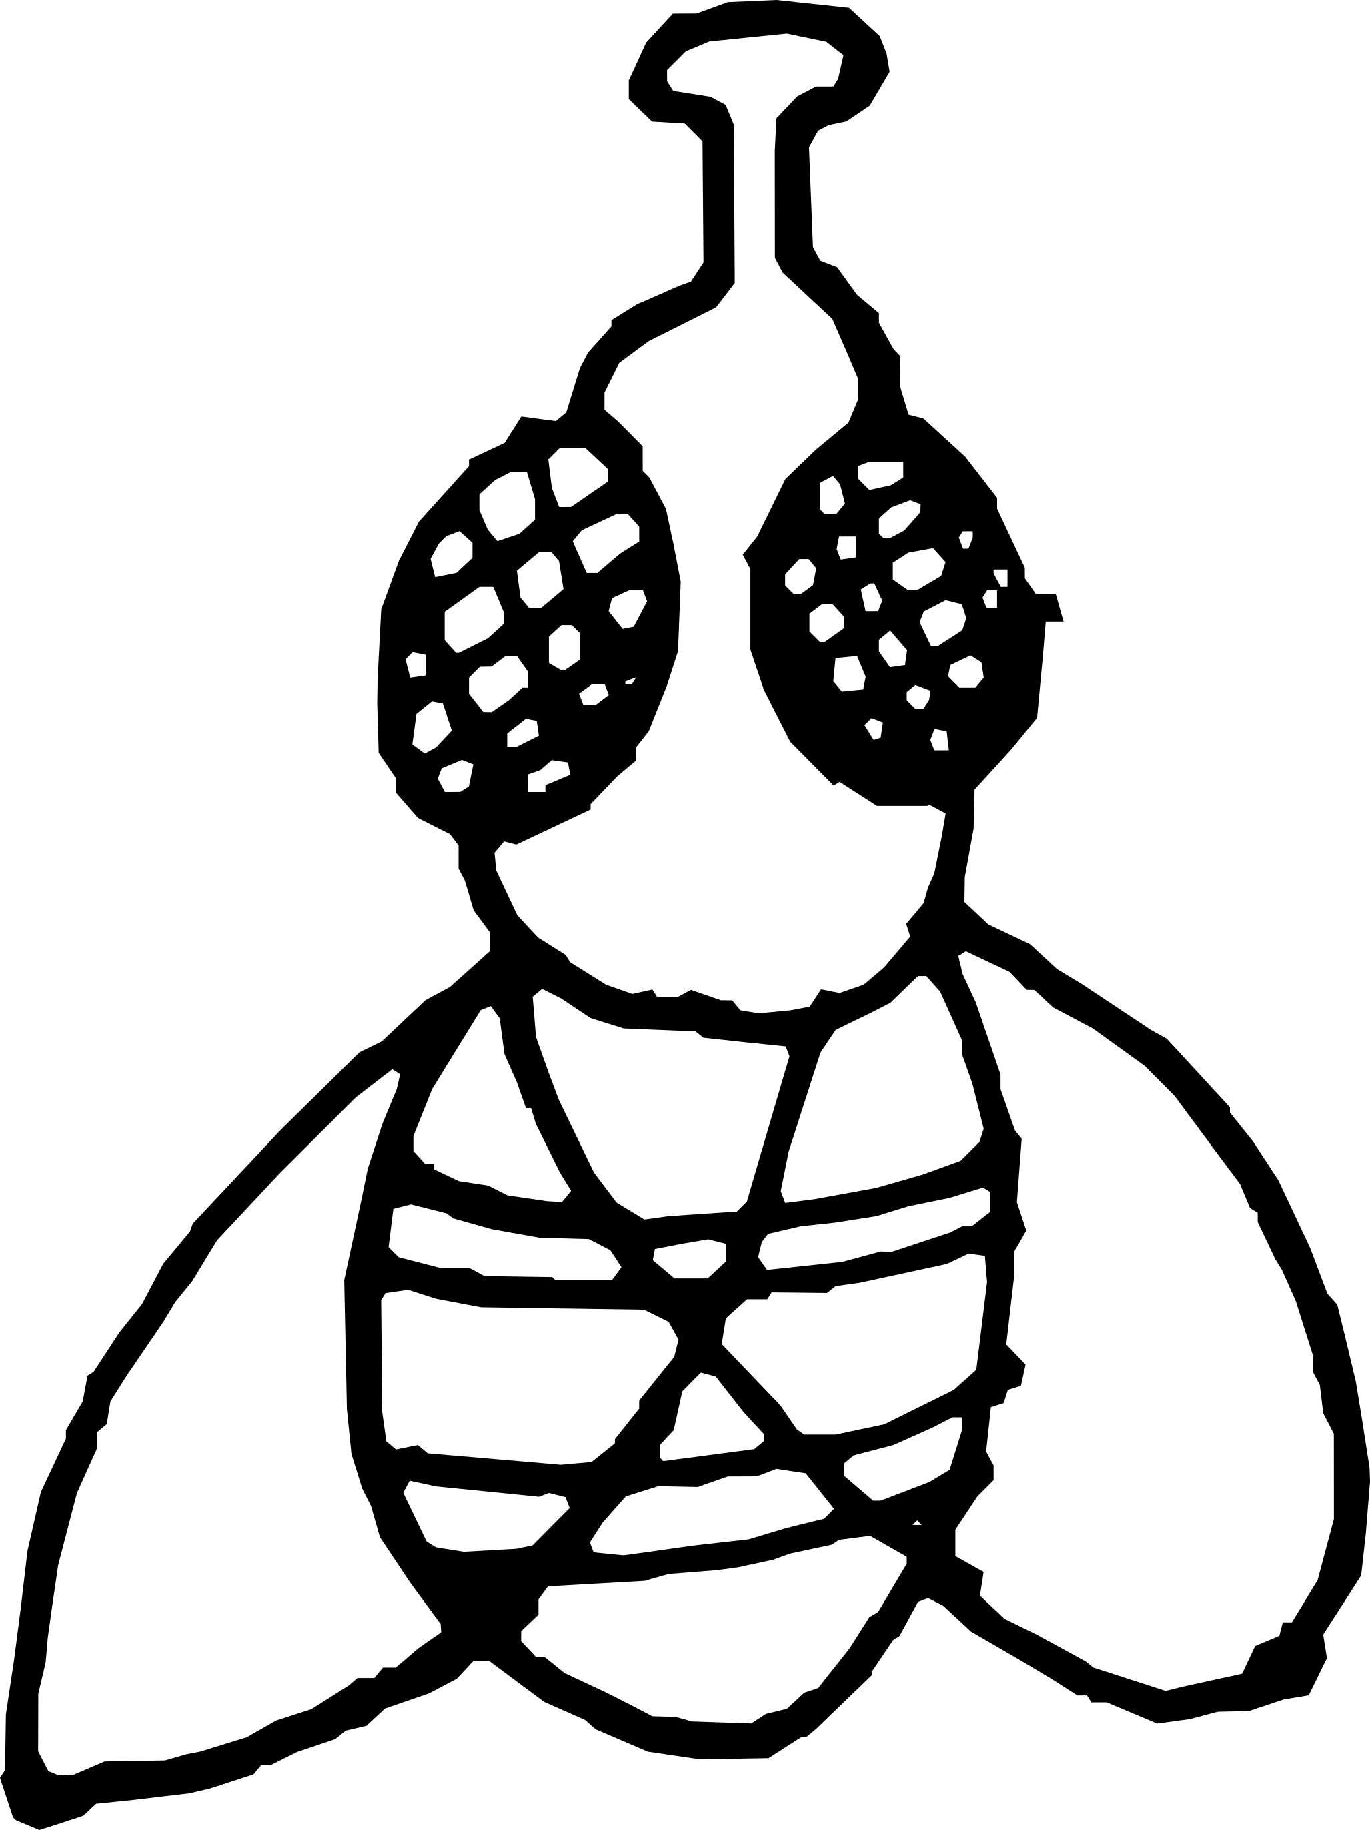

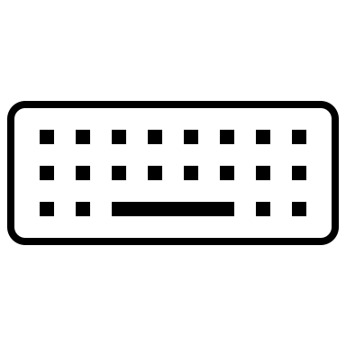
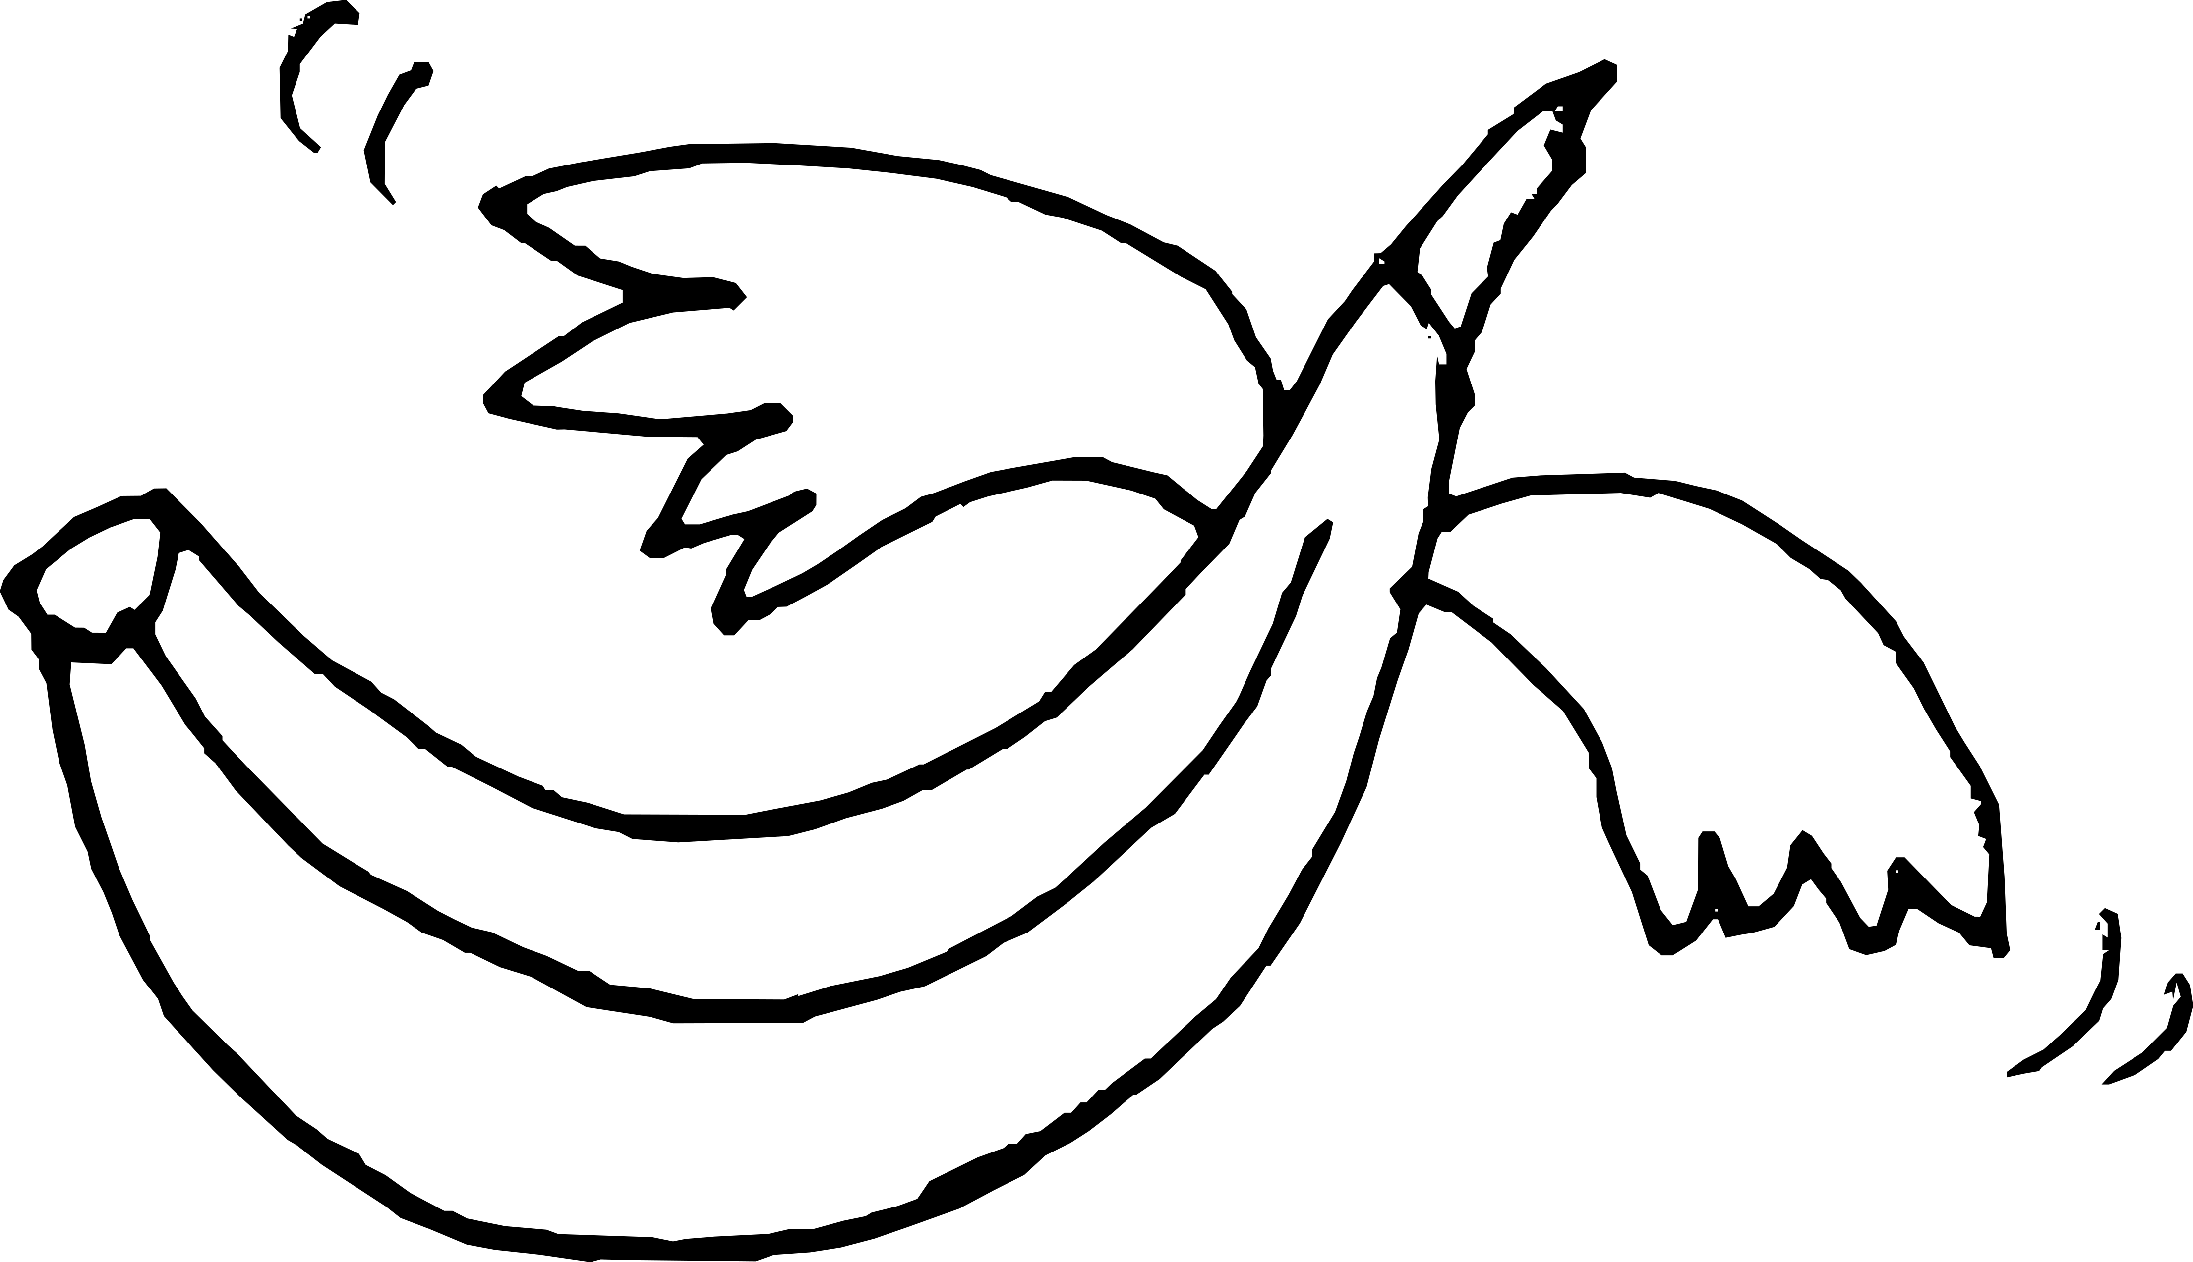

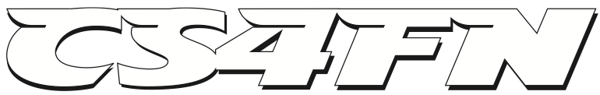
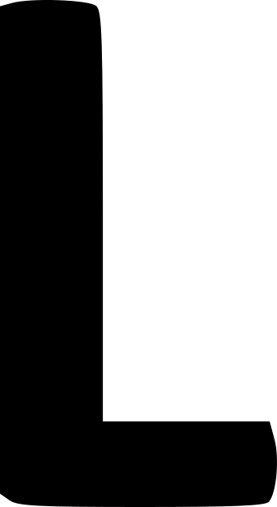


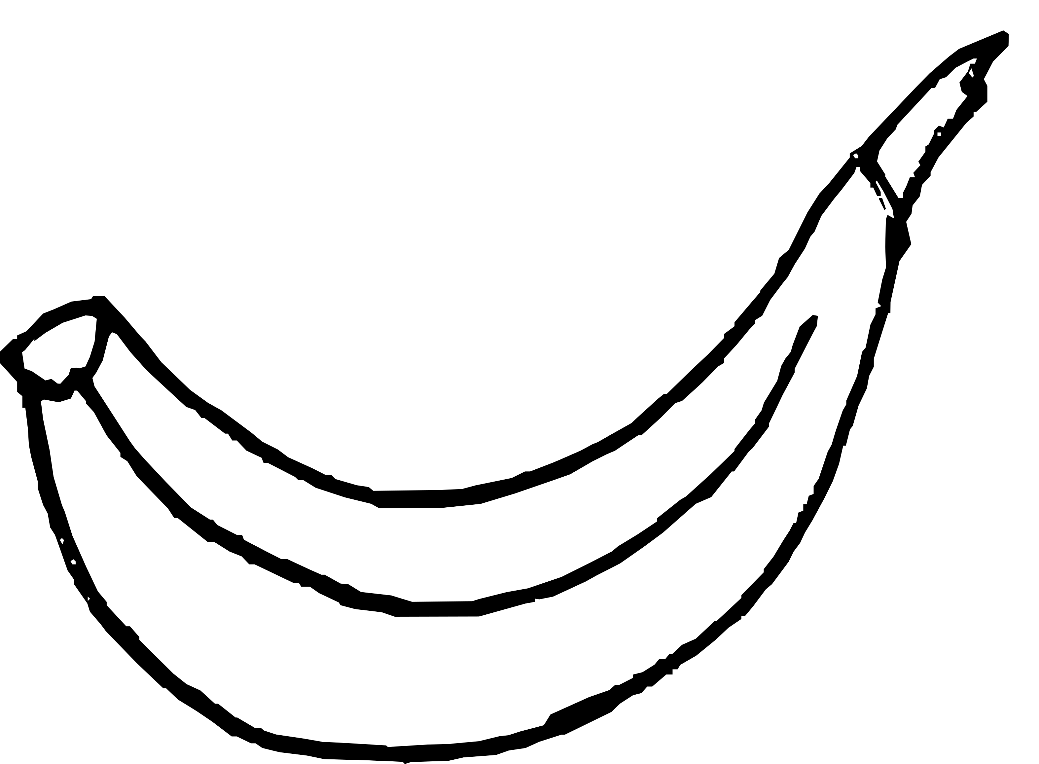
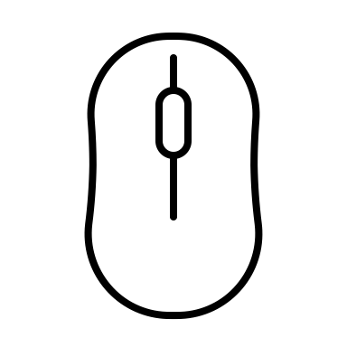
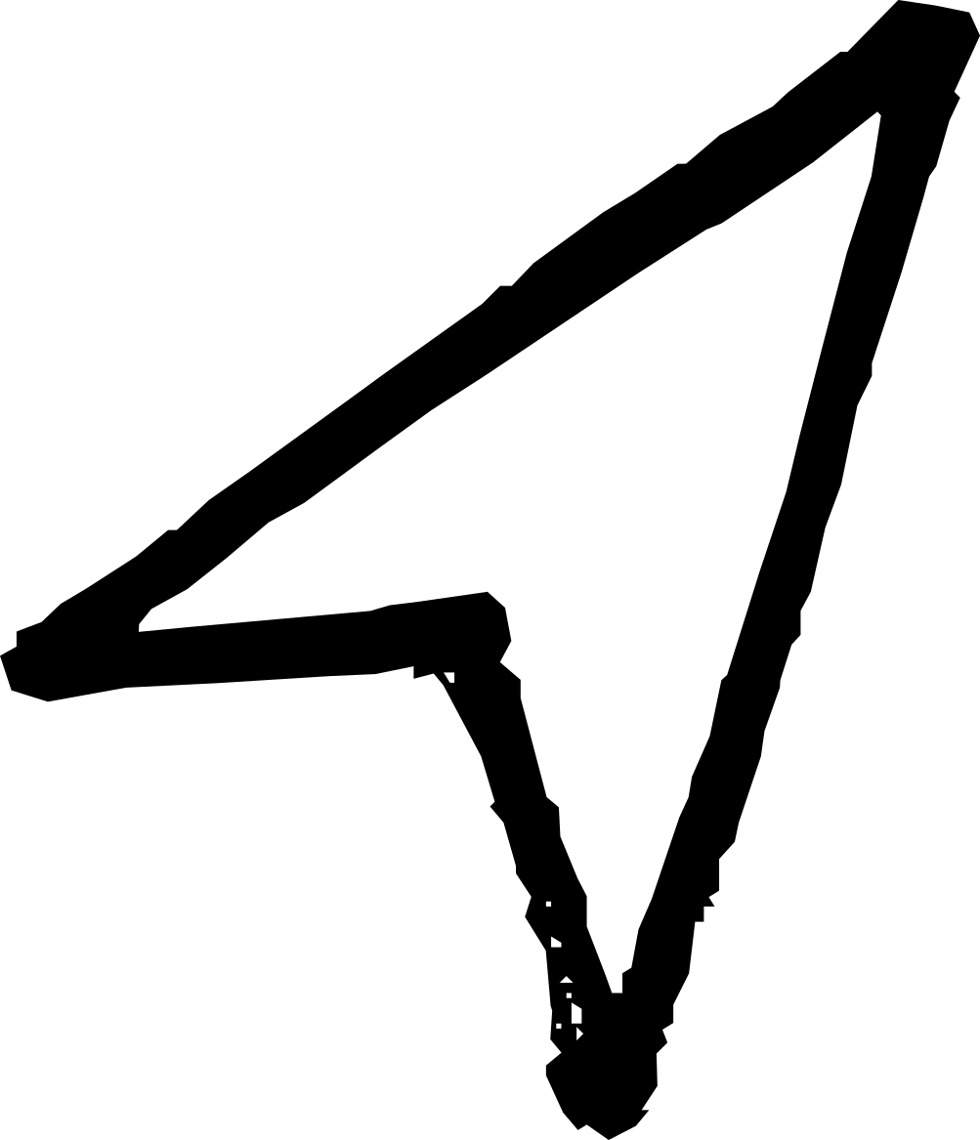
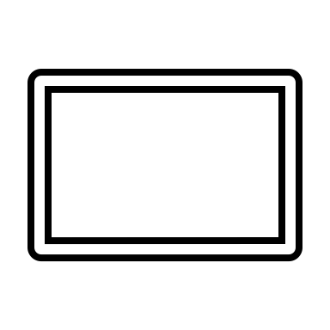
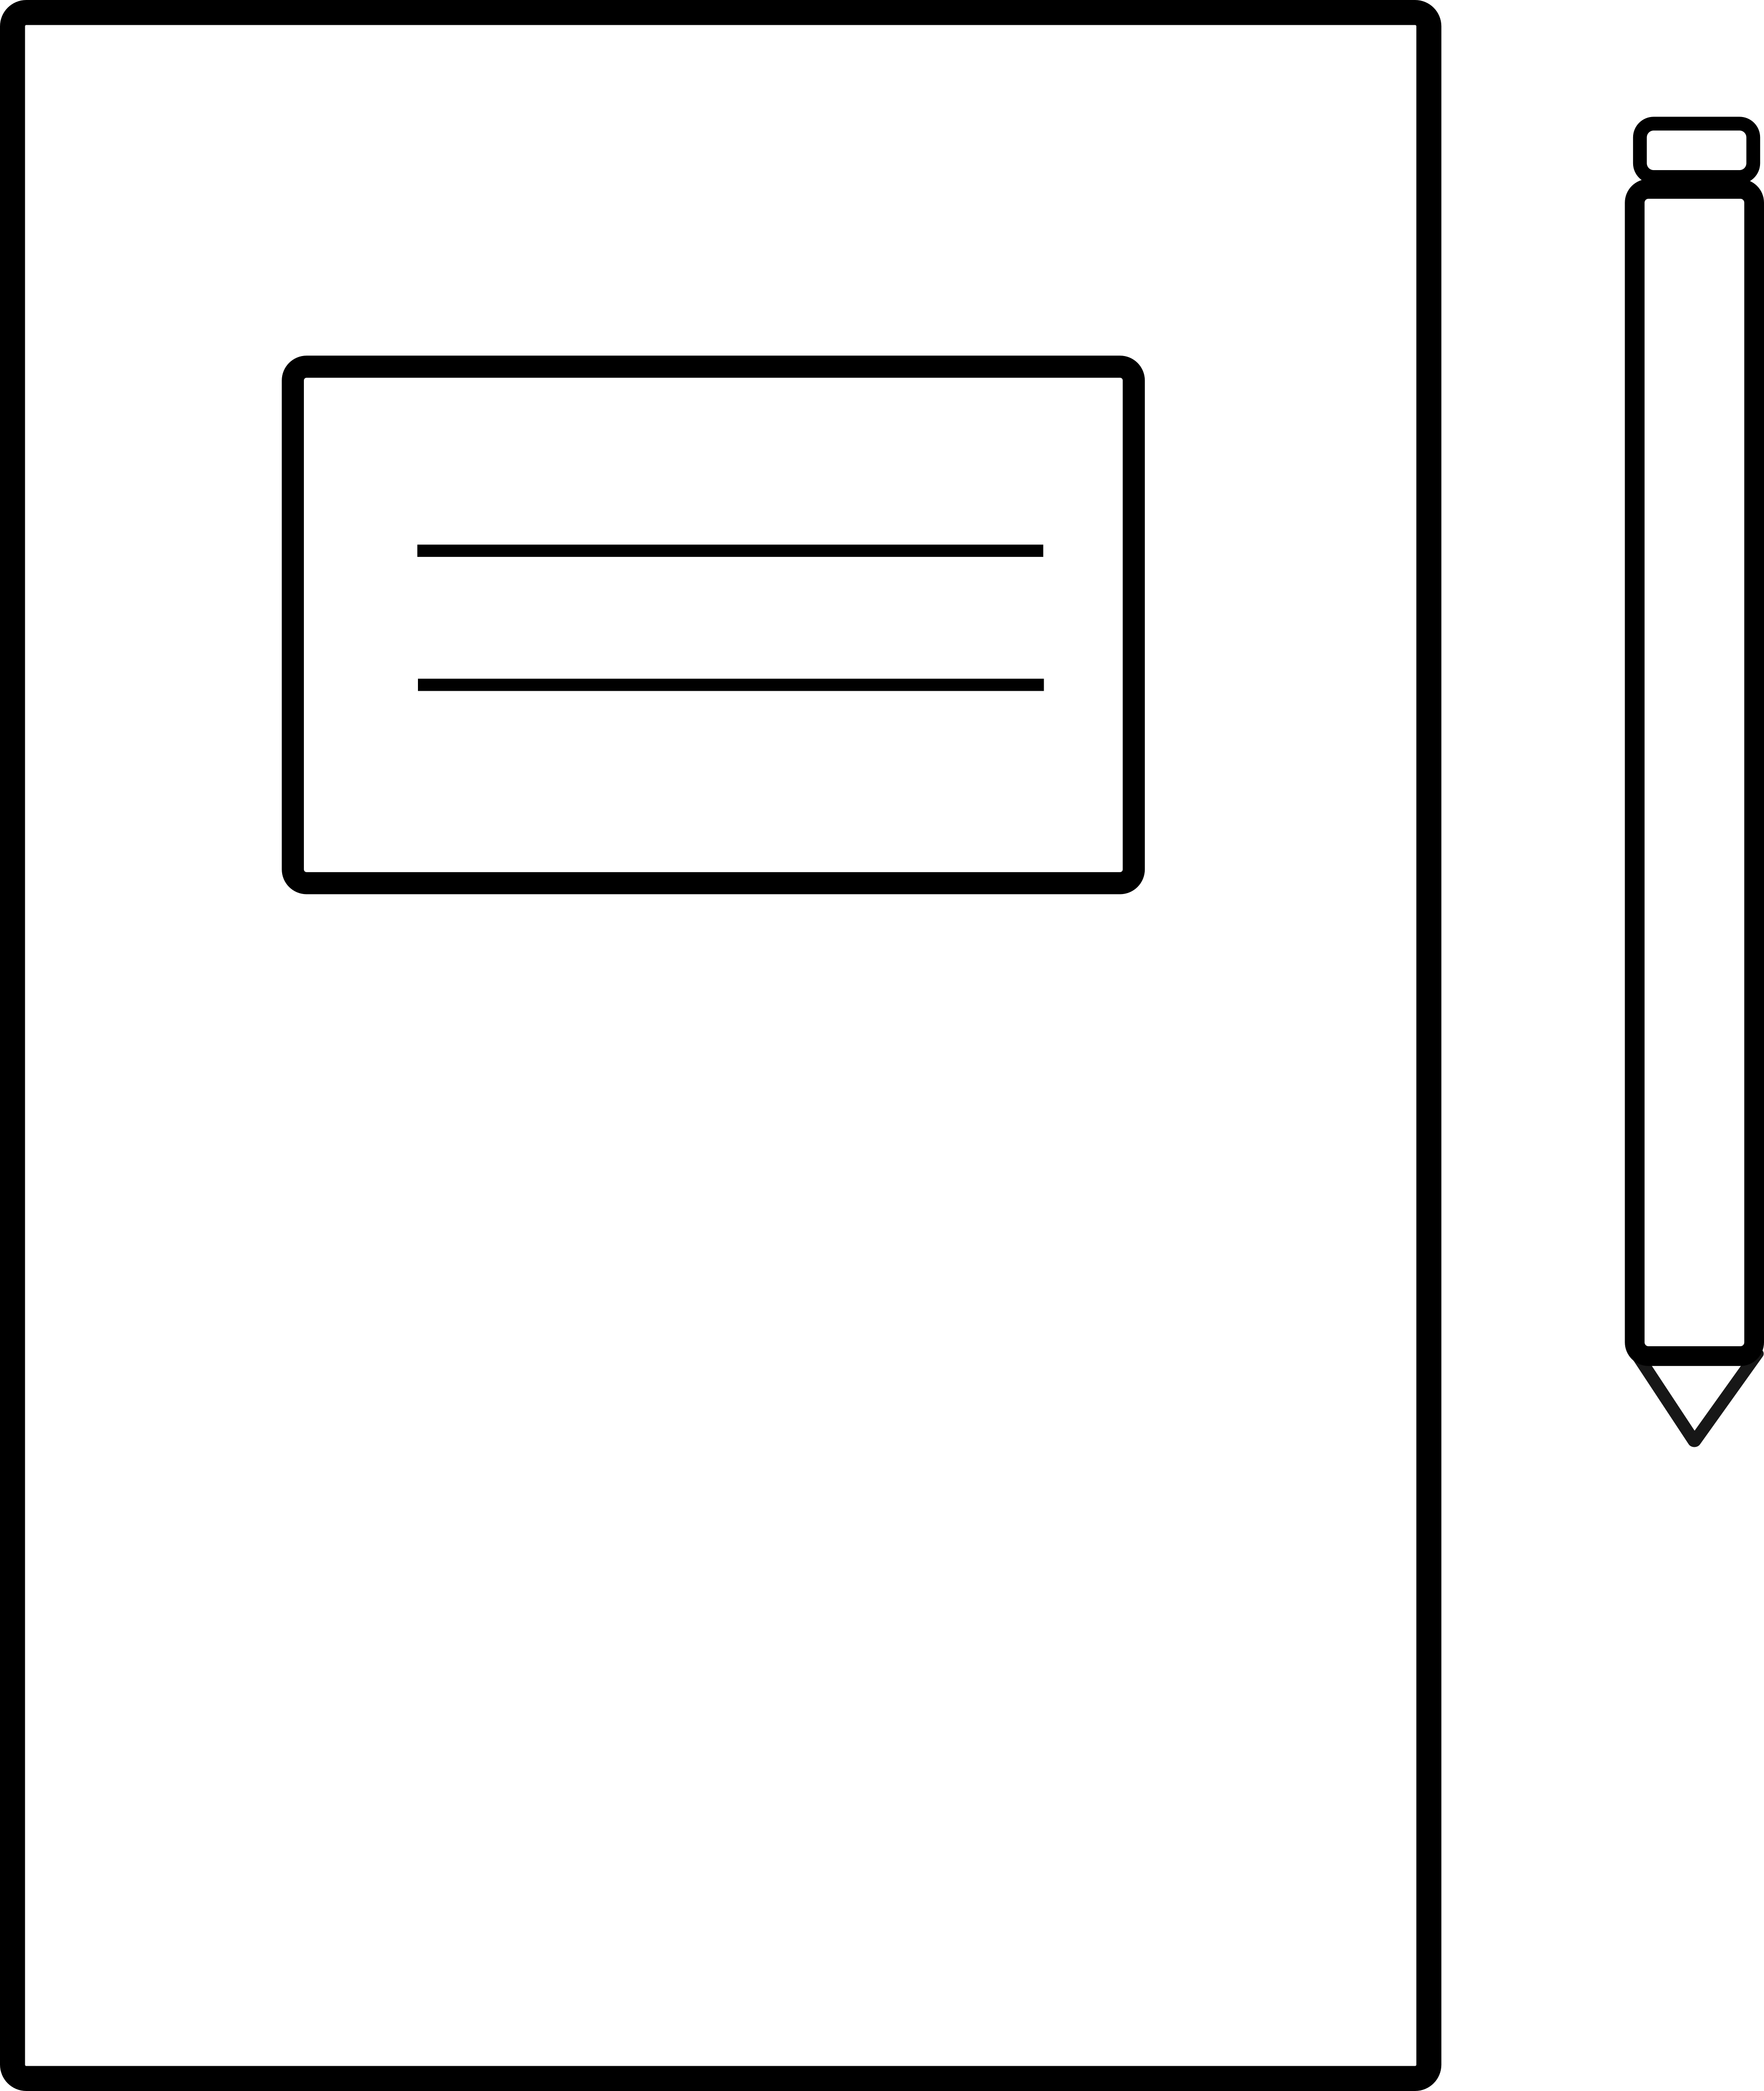



“Hatagon”
the paper hat that’s part human and part android.
FOLD
FOLD
Display screen
Creativity & personality
Art, music, language, logic, thinking, ideas, decisions…
Frontal lobe
Outputs
1. Colour in whatever you like
Frontal lobe
Press to
switch ‘ON’ ☺
2. Draw some connections
between the ‘chips’ and
the CPU so that the robot
brain will work beautifully
Telling time
Speakers
Frontal lobe
FOLD
Binary
Cut this line
Clock? Yes!
Watch? No
Pixels
FOLD
FOLD
Naming things
Cut this line
What the ‘chips’ look like
Senses & sense-making
Hearing, smelling, emotion, language, understanding…
Pre-motor area
Planning your next move(ment)
Short term storage
Memory
USB
Data
or
power
Add the date and make
up a brain serial number
O
This side
Human brain
port
Motor cortex
Moves opposite side of body!
Arithmetic Logic Unit
ALU
Infrared
3. Cut the thick black
dotted lines & fold the
thin ones (get an adult
to help you).
Idea adapted from ellenjmchenry.com/
brain-hemisphere-hat/
The CPU contains the ALU
Inputs
Sensory cortex
Senses opposite side of body!
sensor
This side
Robot / computer “brain”
Long term storage
Temporal lobe
J
Parietal lobe
Memory
Touch
Microphone
Temperature
CPU
Sensing sound
Central Processing Unit
4. Test the shape on
your head
Cut this line
Helps you know…
Processing
FOLD
FOLD
…which way is UP or DOWN
3D
Cut this line
*Fruit flies like a banana
Parietal lobe
Knows which is up and down
5. Tape tabs behind the next panel (get an adult to help you)
Switch your robot brain ON by pressing at the front.
Wernicke’s Area
*Helps us understand both meanings
Helps you recognise shapes
abitofcs4fn.org
Keyboard
FOLD
Making sense of what we see
FOLD
Inputs
/hatagon
Hippocampus
It’s shaped like a sea horse
Mouse
Temporal lobe
Navigation
Occipital lobe
FOLD
Touch
Memory
screen
6. Wear your hat everywhere, and
see if people with smartphone
cameras can use the QR code to
visit our website!
Cut
FOLD
Serial No.
Date
11/06/2022
Fold / bend
If a tab, tape It behind the next panel
Notes:
Mask with dotted line

