Slide 1
TechPathways
Teaching Networks
Day 1
Duncan Maidens & Jane Waite
https://teachinglondoncomputing.org/techpathways_teaching_networks/

Slide 2

What is TechPathways London?
Funded by the Mayor of London under the ‘Digital Talent’ programme.
Free CPD for educators of 11-24 year olds.
Short courses and Depth courses
Strong links to industry.
Partnership between London CLC and Queen Mary, University of London.

Slide 3
Days outline
Day- Session
9:30 – 9:45 | Arrival, registration, drinks
9:45 – 10:00 | Overview, housekeeping, fast introductions
10:00 – 11:00 | Part 1 Research, pedagogy, threshold concepts & misconceptions (30 mins)
 | Part 2 Binary Boxes part 1 (30 mins)
11:00 to 11:15 | Break
11:15- 12:45 | Part 2 Binary Boxes part 2 (90 mins)
12:45– 1:30 | Lunch (please bring your own)
1:30 – 2:30 | Part 3 Using Simulations (60 mins)
2:30 – 2:45 | Break
2:45 – 3:45 | Part 3 Using Simulations (60 mins)
3:45 - 4:30 | Part 4 Pedagogy review, career resources and next steps (45 mins)

Slide 4
Introductions
1 mins each only!
Name
School
What you want to get out of the day

Slide 5
About you

Slide 6
Resources & Planning

Slide 7
Confidence

Slide 8
TechPathways
Teaching Networks
Session 1
Research and Pedagogy for teaching networks
Jane Waite

Slide 9
Objectives of this session
Handout 1
With regard to teaching networks in KS3-KS5:
Know the current research
Know and evaluate relevant pedagogy
Know and apply instructional approaches to teach threshold concepts
Know some common misconceptions
Know the problems with using analogies and role play
RAG your confidence of current knowledge and skills

Slide 10
Research
Very limited classroom context research on teaching networks
Unplugged (Gibson & Bell, 2013, Cutts et al. 2007)
Packet Attack -protocol knowledge (Jarman & Bell, 2014) (link on course page)
Novice and Expert knowledge structures (DiCerbo,2007)
Teacher Planning (Stoffers & Diethelm, 2011, Mesaros & Diethelm, 2012)
Building the real thing ( Feaster, 2013, Feinburg,2010 (Uni))
Tracing packets (Matthews, 2005)
Using simulators (Zengin &Sarj, 2010,Pullen,2018 (Uni))
Using services (email) (Gramm Homung, 2012)

Slide 11
Research
Themes from Research
Using Games to teach concepts
Using Unplugged activities to teach concepts
Using Simulations to teach concepts and skills
Using Real World networks to teach concepts and skills
Understanding of Concepts
Role play
Packet tracing
Analogies
Building a simplified network
Stories
Using services
Notes:
PCK elements
What to teach (learning objectives etc)
How to teach (instructional approaches)
How children learn
How to assess

Slide 12
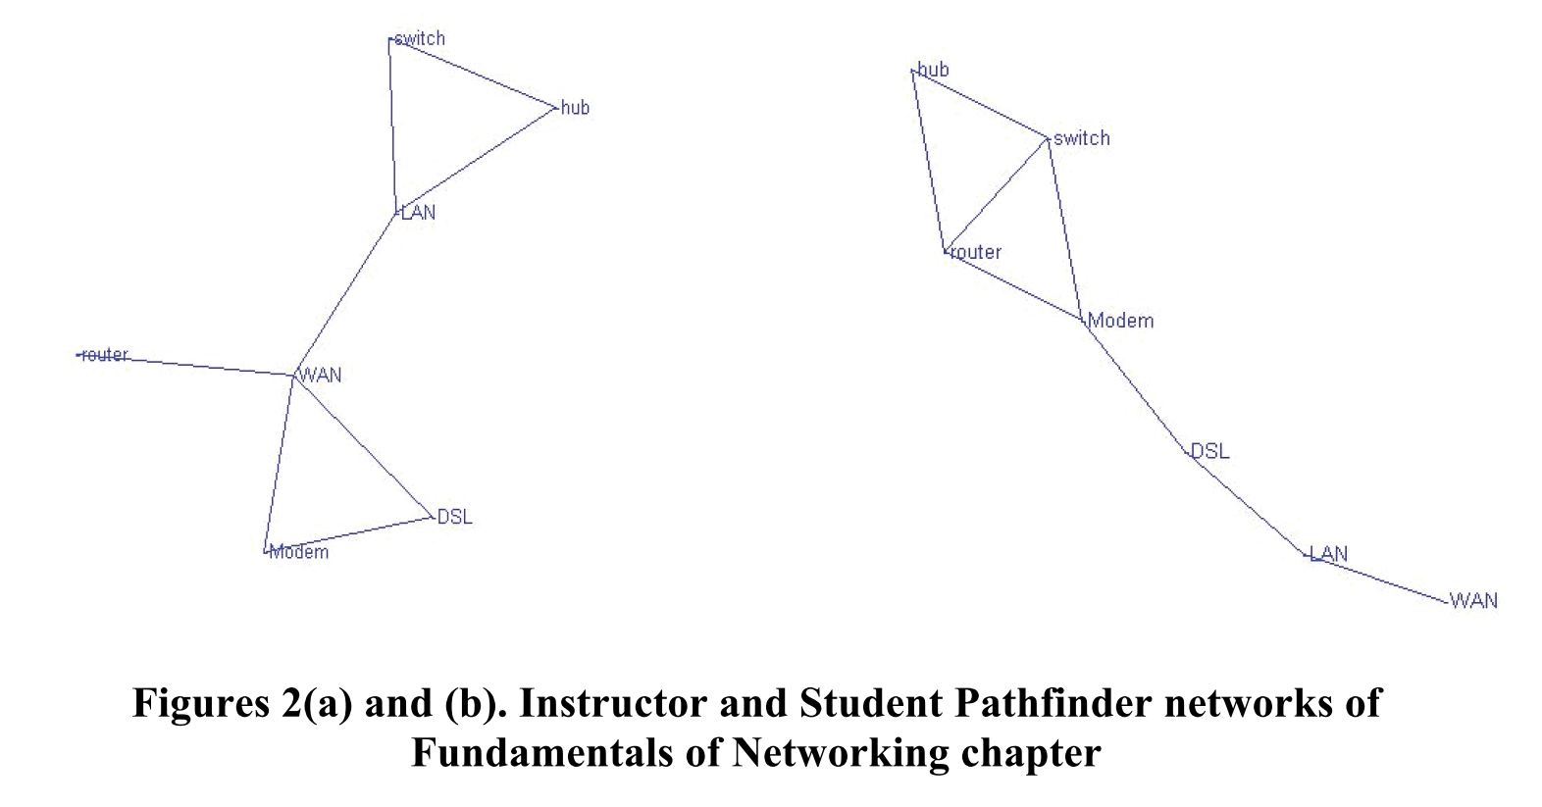
A
B
Handout
Network knowledge structures (DiCerbo,2007)
Notes:
A is teacher
B is student

Slide 13
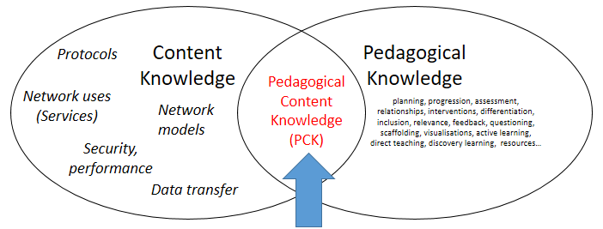
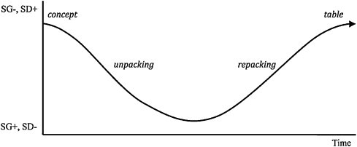
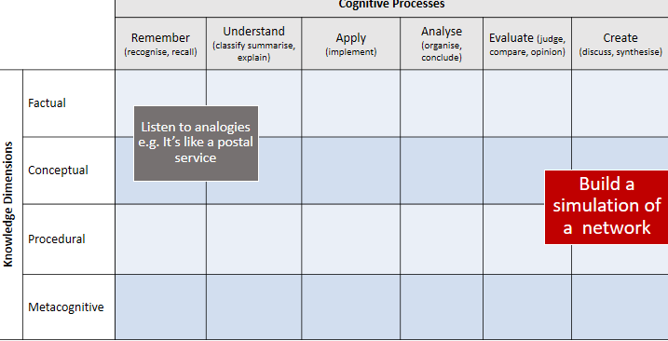
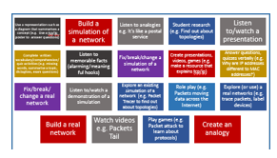
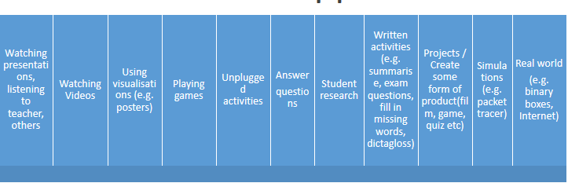
Four mental models for reflecting on teaching
PCK
Semantic Waves
Bloom’s knowledge dimension
Instructional approaches

Slide 14
In order to teach networks
Content
Knowledge
Pedagogical
Knowledge
Protocols
Pedagogical Content Knowledge
(PCK)
Network uses (Services)
Network models
planning, progression, assessment, relationships, interventions, differentiation, inclusion, relevance, feedback, questioning, scaffolding, visualisations, active learning, direct teaching, discovery learning, resources…
Security, performance
Data transfer
Working walls
Adapted version of pedagogical content knowledge (PCK) (Shulman, 1986)
Notes:
What are the 4 components of PCK
Goals (LO, threshold concepts)
Assessment
Instructional Approaches
How children learn (misconceptions)

Slide 15
Semantic Waves
Technical vocab, no context
Technical vocab, no context
Everyday vocab, specific context
Example of a semantic wave in Biology teaching (Maton, 2013)
Density – meaning – from technical (packed) to everyday meaning
Gravity – context - from theory to practical/personal context

Slide 16
Instructional approaches(from pre-course survey)
Powerpoint (most popular response) Videos Handouts role play - forming the topologies, acting out how they perform/features , analogies of: transport network, comparing webpages to pages of their file, website with their file, WWW with my whole library and so on
simulation software which is outdated
making physical networks out of string etc
Pupil research
teacher talk diagrams lots of independent work

Slide 17
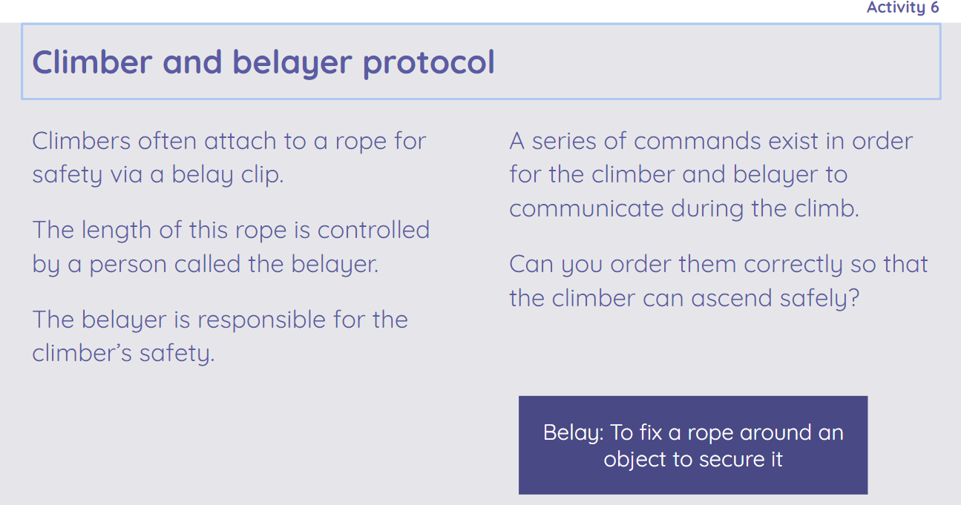
(NCCE, Year 7, Lesson activity)

Slide 18
Watch videos e.g. Packets Tale
Play games (e.g. Packet attack to learn about protocols)
Listen to analogies e.g. It’s like a postal service
Answer questions, quizzes verbally (e.g. Why are IP addresses different to MAC addresses?)
Explore an existing simulation of a network (e.g. Packet Tracer to find out about topologies)
Build a real network
Complete written vocabulary/comprehension/quiz activities (e.g. missing words, summarise a topic, dictagloss, exam questions)
Role play (e.g. Packets moving data across the Internet)
Listen to memorable facts (alarming/meaningful hooks)
Listen to/watch a presentation
Student research (e.g. Find out about topologies)
Explore (or use) a real networks (e.g. trace packets, label devices)
Create an analogy
Fix/break/change a simulation of a network
Build a simulation of a network
Use a representation such as a diagram that summarises a concept (e.g. Use a tcp/ip poster to answer questions)
Listen to/watch a demonstration of a simulation
Fix/break/ change a real network
Create presentations, videos, games (e.g. make a resource that explains tcp/ip)
Notes:
Sorting activity

Slide 19
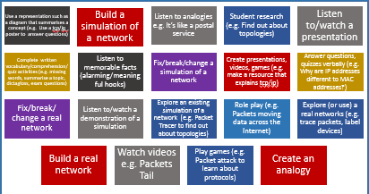
Instructional approaches
Sort them by….
Most scaffolded to least scaffolded
Add any missing ones (postits)
Evaluate the effectiveness

Slide 20
 |  | Cognitive Processes
 |  | Remember (recognise, recall) | Understand (classify summarise, explain) | Apply (implement) | Analyse (organise, conclude) | Evaluate (judge, compare, opinion) | Create (discuss, synthesise)
Knowledge Dimensions | Factual
 | Conceptual
 | Procedural
 | Metacognitive
Listen to analogies e.g. It’s like a postal service
Build a simulation of a network
Revised Bloom’s Taxonomy Table (Anderson & Krathwohl, 2001)
Notes:
To situate learning objectives
To situate instructional approaches
Print A3

Slide 21
Instructional approaches
Playing games
Unplugged activities
Simulations (e.g. packet tracer)
Real world
(e.g. binary boxes, Internet)
Written activities (e.g. summarise, exam questions, fill in missing words, dictagloss)
Watching presentations, listening to teacher, others
Watching Videos
Answer
questions
Student research
Using visualisations (e.g. posters)
Projects / Create some form of product(film, game, quiz etc)
What is missing? Is the order useful?
Handout

Slide 22
A Factual Knowledge is knowledge that is basic to specific disciplines. This dimension refers to essential facts, terminology, details or elements students must know or be familiar with in order to understand a discipline or solve a problem in it.
  Aa. Knowledge of terminology Ab. Knowledge of specific details and elements
B Conceptual Knowledge is knowledge of classifications, principles, generalizations, theories, models, or structures pertinent to a particular disciplinary area.
  Ba. Knowledge of classifications and categories Bb. Knowledge of principles and generalizations Bc. Knowledge of theories, models, and structures
C Procedural Knowledge refers to information or knowledge that helps students to do something specific to a discipline, subject, or area of study. It also refers to methods of inquiry, very specific or finite skills, algorithms, techniques, and particular methodologies.
  Ca. Knowledge of subject-specific skills and algorithms Cb. Knowledge of subject-specific techniques and methods Cc. Knowledge of criteria for determining when to use appropriate procedures
D Metacognitive Knowledge is the awareness of one’s own cognition and particular cognitive processes. It is strategic or reflective knowledge about how to go about solving problems, cognitive tasks, to include contextual and conditional knowledge and knowledge of self.
  Da. Strategic knowledge Db. Knowledge about cognitive tasks, including appropriate contextual and conditional knowledge Dc. Self-knowledge
Revised Bloom’s Taxonomy Structure of Knowledge Dimension (Anderson & Krathwohl, 2001)
Handout

Slide 23
 |  | Cognitive Processes
 |  | Remember (recognise, recall) | Understand (classify summarise, explain) | Apply (implement) | Analyse (organise, conclude) | Evaluate (judge, compare, opinion) | Create (discuss, synthesise)
Knowledge Dimensions | Factual
 | Conceptual
 | Procedural
 | Metacognitive
Handout
Revised Bloom’s Taxonomy Table (Anderson & Krathwohl, 2001)
Notes:
To situate learning objectives
To situate instructional approaches
Print A3

Slide 24
Concepts & Threshold concepts(T)
Data packets transfer data over the internet (T) x3 , packet switching(T) x3
Layers (T) x 2 , how layering is used to send messages over a network (T)
network protocols x 4 (T) different protocols and their roles (T) ,
Network security (T)
Network, Connection, Port Types of network - LAN, WAN, The Internet, vs www, hosting, the cloud Factors effecting performance Transmission media - wired networks, ethernet, fibre optic, copper, wifi, wireless networks, frequency, Roles of computers – client/server peer to peer, Router , Hub, Switch, wireless access points IP addressing, MAC addressing, DNS, Network Interface, Default Gateway,
Protocols, HTTP, FTP, TCP/IP, POP, IMAP, SMPT, WAP
Firewall, VPN, encryption, forms of attack, preventing vulnerabilities
all listed on specification OCR
too many to list

Slide 25
Threshold concepts
Networks connect devices
Network layers and the tcp/ip stack
Data is broken into packets and transferred over the Internet using packets
A DNS server resolves domain names and IP addresses
The differences between an IP address and a MAC address and why both are necessary
Handout
(William Lau, June 2019)

Slide 26
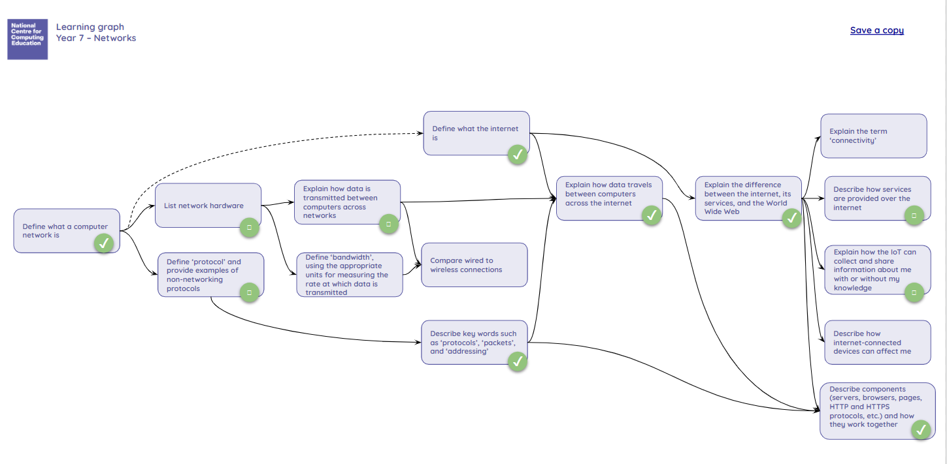
Mark Dorling https://teachinglondoncomputing.org/techpathways_teaching_networks/

Slide 27
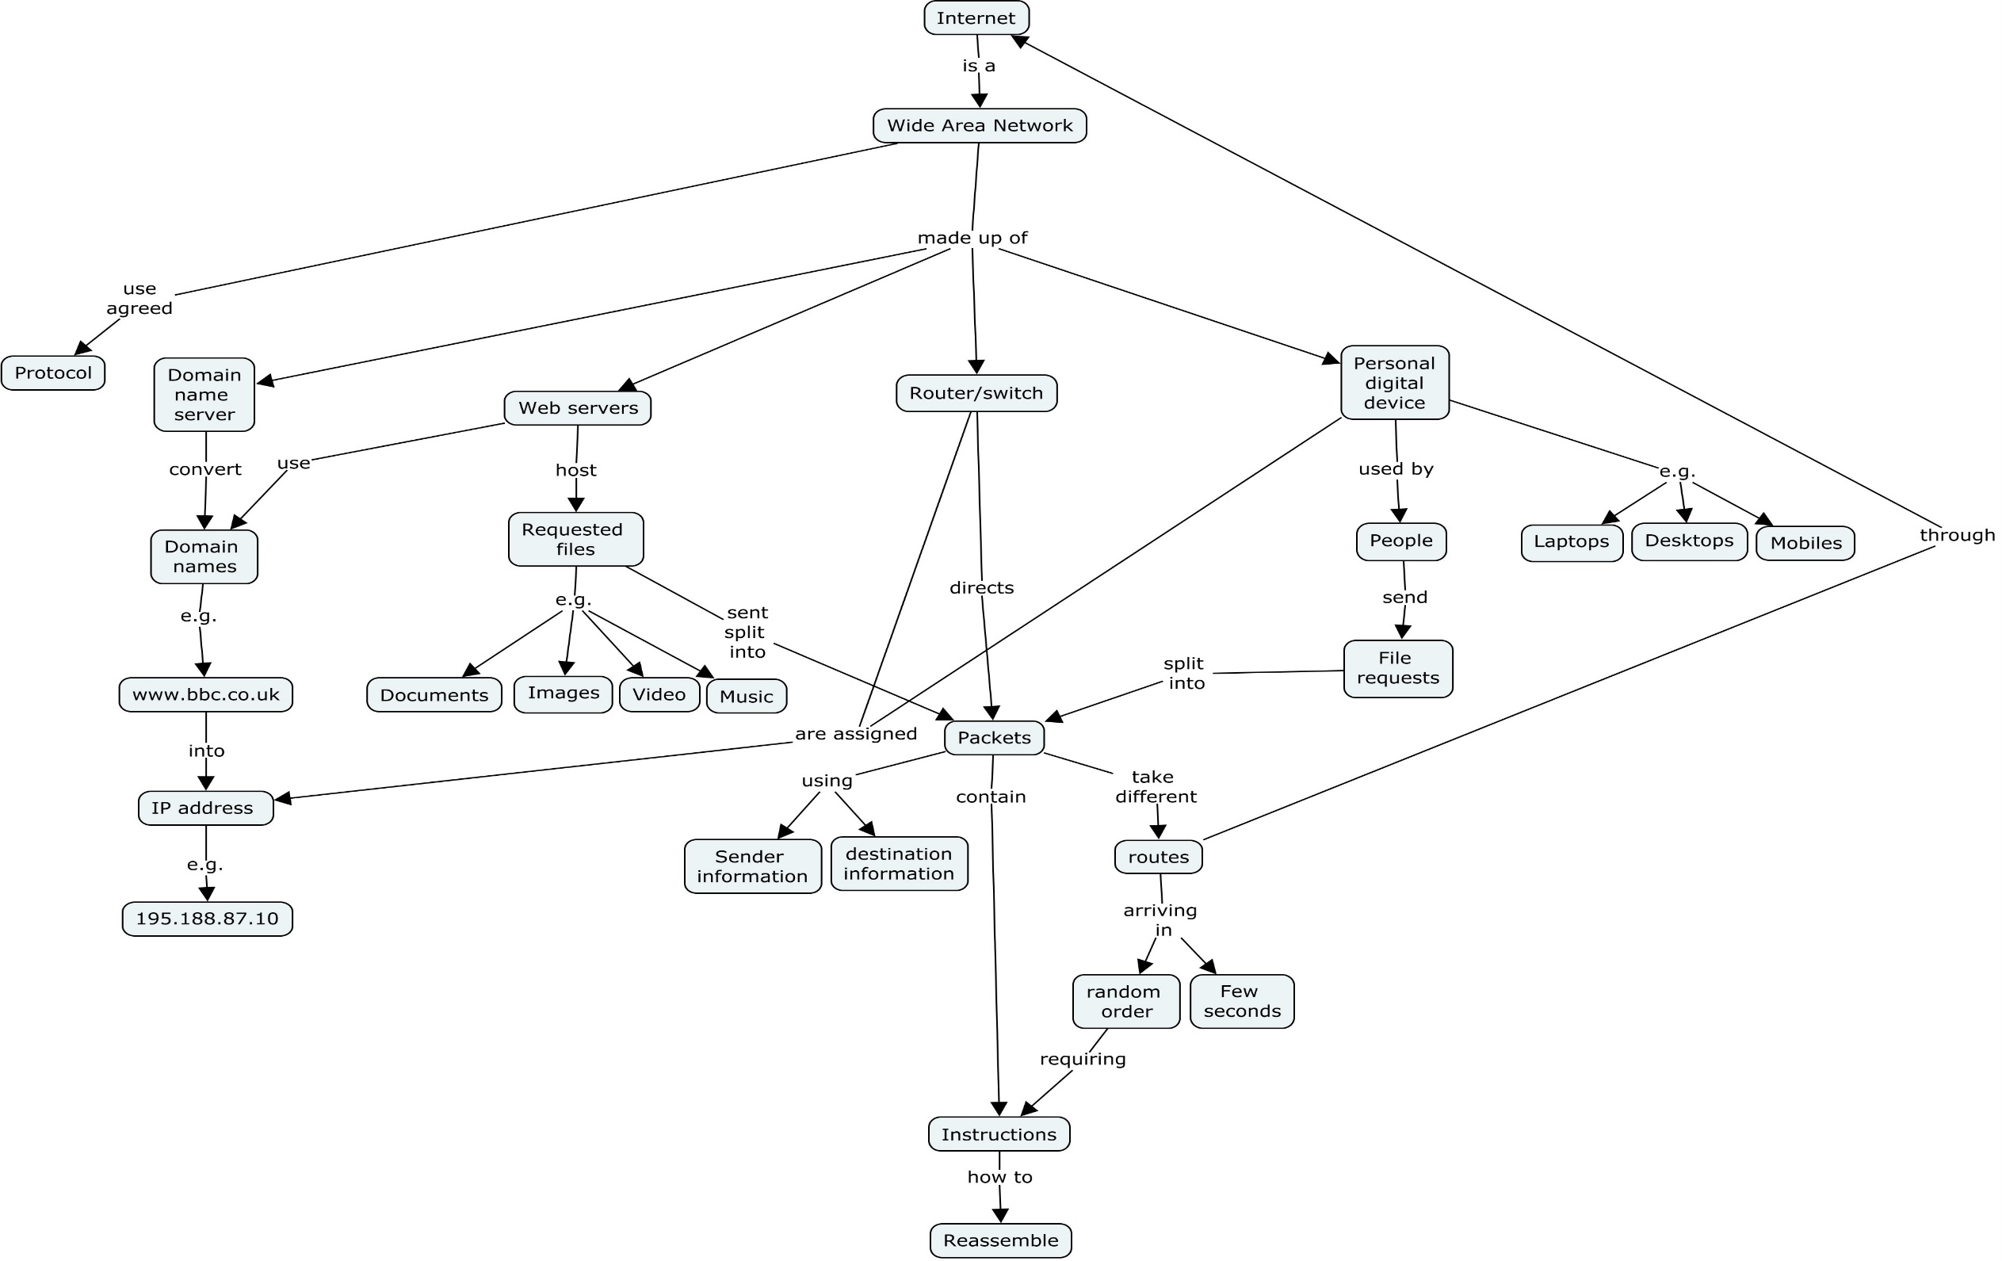
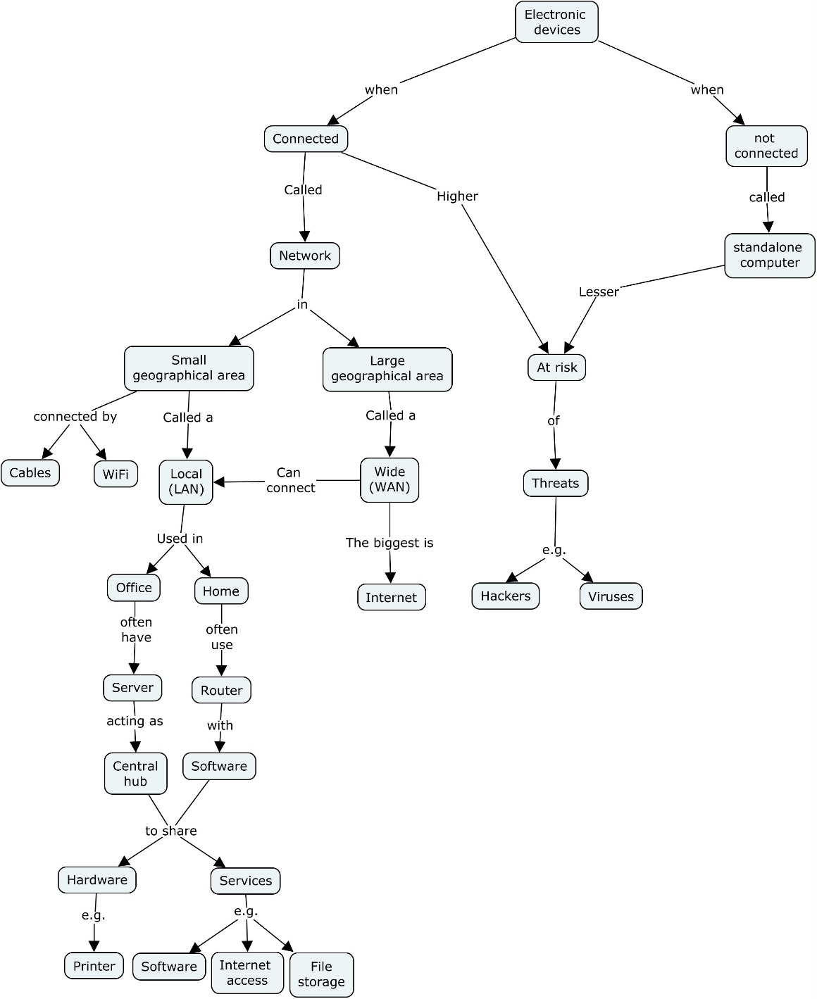
https://teachinglondoncomputing.org/techpathways_teaching_networks/

Slide 28
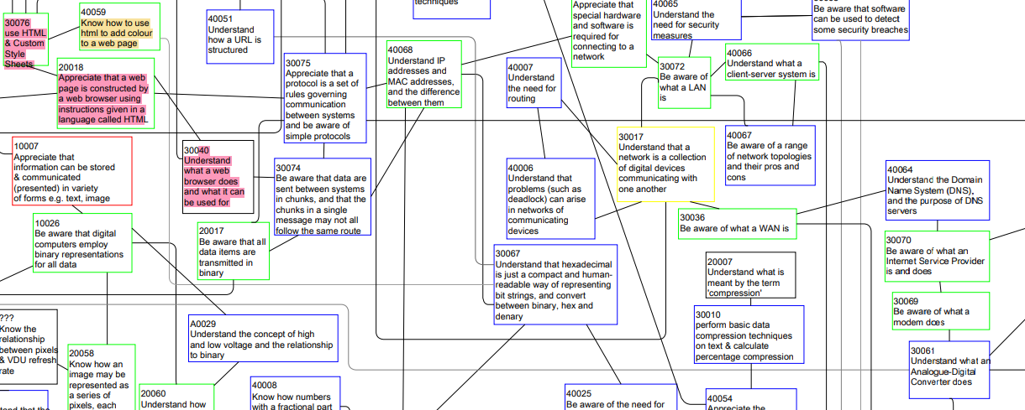
Mark Dorling’s Curriculum Map
https://teachinglondoncomputing.org/techpathways_teaching_networks/

Slide 29
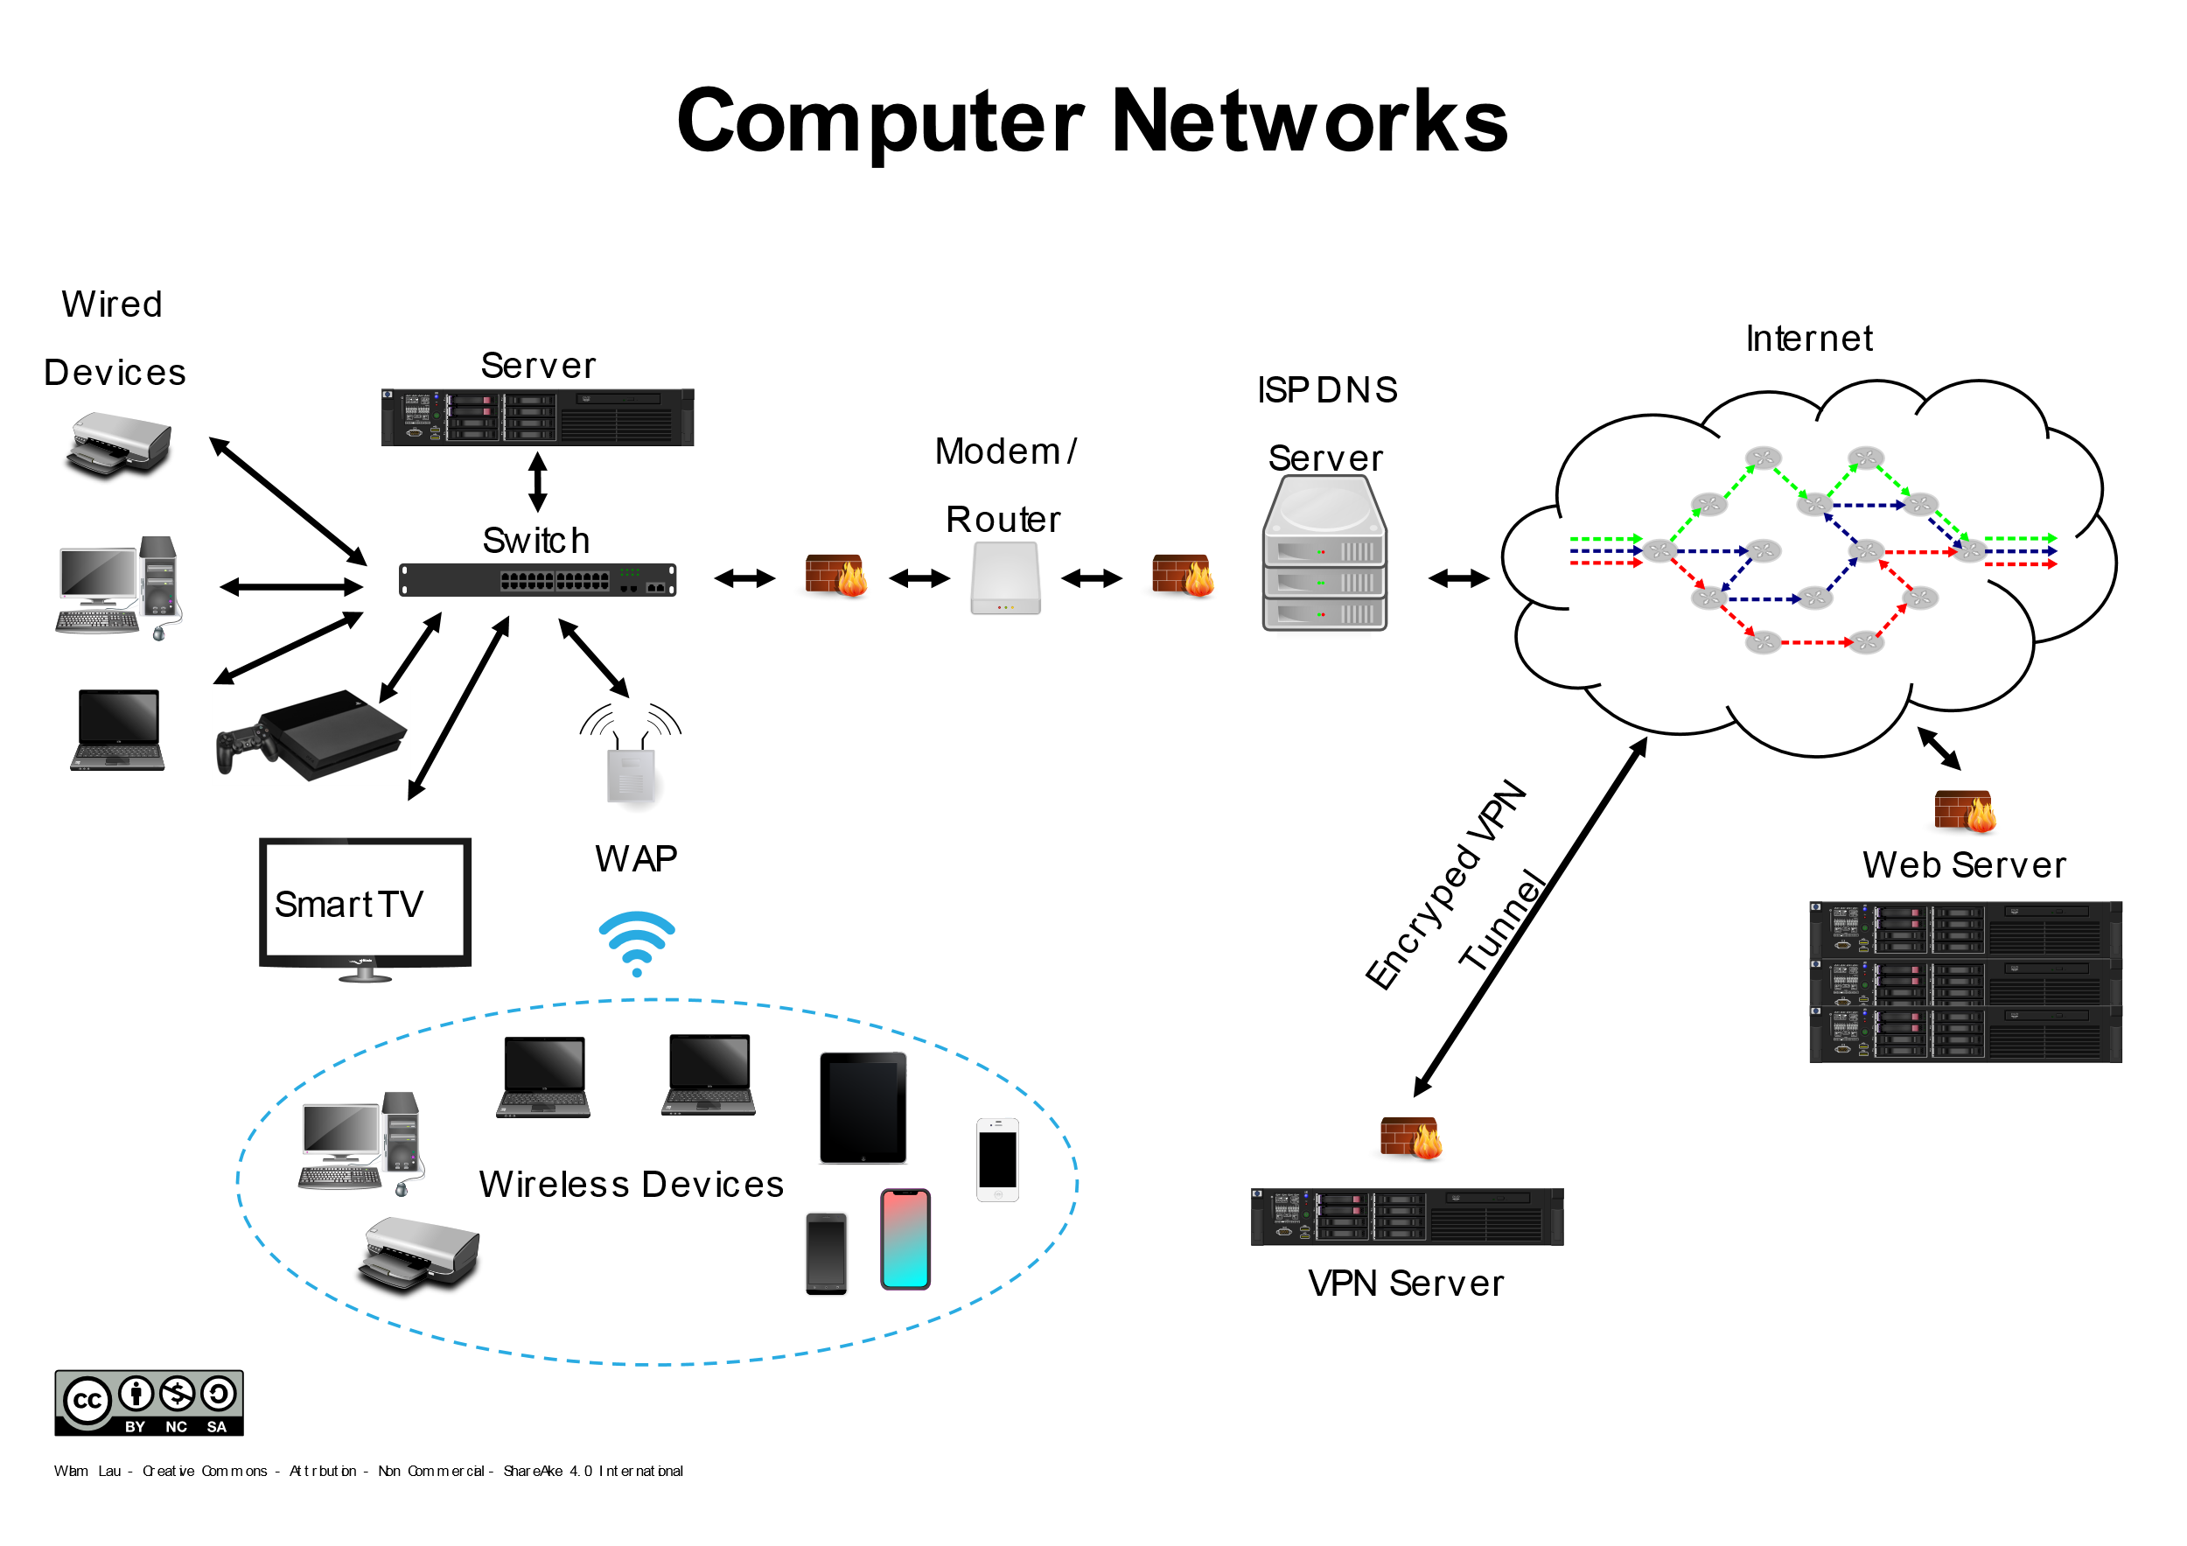

https://commons.m.wikimedia.org/wiki/File:Computer_Networks_anchor_chart.svg

Slide 30
Misconceptions (from pre-course survey)
Protocols work individually,
switch vs router, and the purpose of the router in a network
IP addresses uniquely identify a device overcome by explaining the differences between IP and MAC addresses,
Internet and Network Layer and internet vs WWW,
client server and peer –to peer networks and server vs client,
virtual network never relies on physical connections overcome by examples of virtual networks sharing a switch.
web browser vs search engine,
Most students I've taught do not actually know what "the cloud" is,
The process of sending and receiving of packets.
lots of misconceptions about how it works,
have visual representations of all of these, but it needs constant repetition

Slide 31
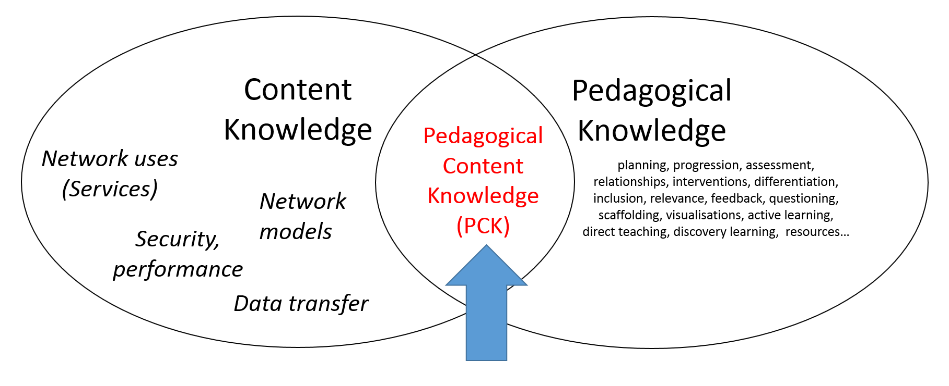
Misconceptions from others
WiFi connects you directly to the Internet…
WiFi is available everywhere
The class of an IP address dictates the subnet mask that must be used
Severs are big computers
Logical topology is the same as physical location of devices
Peer-to-peer = a network topology, rather than a virtual network implemented as software layers
(Cynthia Selby forum post on CAS, Last accessed June 2019 https://community.computingatschool.org.uk/resources/4725/single)
Notes:
Refer to PCK

Slide 32
Role Play
Transferring data using packets (William Lau’s version, Barefoot version, and many others)
Tablets of stone (story) (Cs Inside – version on CS Unlpugged)
Searching to speak (analogy) (cs4fn)
Routing & Deadlock (role play Csunplugged)
NCCE climbing (analogy)
What are the limitations of analogies and role play generally?
Notes:
Draw back to Role play

Slide 33
Limitations of analogies and role play
The effectiveness of the scaffolding and the learning itself is dependent on
the knowledge of the teacher and
the knowledge built into the task.
Which is dependent on understanding
The concepts, learning objectives and progression.
The teacher and the task act as the
more knowledgeable others to scaffold the transition across the ZPD
Zone of Proximal
Development (ZPD)
Zone of Proximal Development (Vygotsky, 1978)

Slide 34
Concepts, learning objectives and progression
Where do you get yours from?
Notes:
Discuss the lack of progression stud and need to do work on this and refer back to wall and IA.

Slide 35
Concepts
KS3-KS4 | A level
Client-server and peer to peer networks | The TCP/IP Stack and protocol layering
LAN and WAN | LANs and WANs.
Wired and wireless connectivity | Packet and circuit switching.
Network protocol (names and need for) | Network security and threats, use of firewalls, proxies and encryption.
TCP/IP and protocol layering | Network hardware
Network topologies: Bus, ring, star, mesh | Client-server and peer to peer
Firewalls | HTML, CSS and JavaScript
Cyberattacks of different forms | Search engine indexing, inc page rank algorithm
Cybersecurity methods | Server and client side processing.
IP addresses | Compression, Encryption and Hashing
WWW and components | Run length encoding and dictionary coding for lossless compression.
 | Symmetric and asymmetric encryption.
 | Hashing

Slide 36
Identifies the common components of a network
Describes how information is translated and communicated over a network (level of detail? Protocol?)
Models the components of a network
Identifies the capabilities of devices that are enabled through services (e.g. a wearable device stores fitness data in the cloud, a mobile device uses location services for navigation)
Remembers that devices have an address
Explains why devices are numbered/ labelled in networks (e.g. IP, MAC)
Explains the difference between physical (wired), wireless network
Lists common uses (services) of networks (including the internet)
Remembers the difference between the WWW and the Internet
Network Uses (Services)
Networks Devices
Data Transfer
Remembers that devices communicate using a network
Network Security and performance
Describes the need for authentication of users and devices at it related to access, permissions, privacy and security
Discusses common network vulnerabilities and associated responses
Identifies the protocols and standards in network communications
Describes different network topologies
Describes the role of different network devices (routers, switches, DNS Servers)
Remember the difference between a LAN and a WAN
Discusses the issues that impact network performance (e.g. latency, bandwidth, firewalls, server capacity)
Network Models
Remembers the network layer model
Remembers the difference between client-server and peer-to-peer models

Slide 37
Objectives of this session
Handout 1
With regard to teaching networks in KS3-KS5:
Know the current research
Know and evaluate relevant pedagogy
Know and apply instructional approaches to teach threshold concepts
Know some common misconceptions
Know the problems with using analogies and role play
Re-RAG your confidence of current knowledge and skills

Slide 38
Days outline
Day- Session
9:30 – 9:45 | Arrival, registration, drinks
9:45 – 10:00 | Overview, housekeeping, fast introductions
10:00 – 11:00 | Part 1 Research, pedagogy, threshold concepts & misconceptions (30 mins)
 | Part 2 Binary Boxes part 1 (30 mins)
11:00 to 11:15 | Break
11:15- 12:45 | Part 2 Binary Boxes part 2 (90 mins)
12:45– 1:30 | Lunch (please bring your own)
1:30 – 2:30 | Part 3 Using Simulations (60 mins)
2:30 – 2:45 | Break
2:45 – 3:45 | Part 3 Using Simulations (60 mins)
3:45 - 4:30 | Part 4 Pedagogy review, career resources and next steps (45 mins)

Slide 39
TechPathways
Teaching Networks
Session 2
Binary Boxes
Rohini Shah

Slide 40
Days outline
Day- Session
9:30 – 9:45 | Arrival, registration, drinks
9:45 – 10:00 | Overview, housekeeping, fast introductions
10:00 – 11:00 | Part 1 Research, pedagogy, threshold concepts & misconceptions (30 mins)
 | Part 2 Binary Boxes part 1 (30 mins)
11:00 to 11:15 | Break
11:15- 12:45 | Part 2 Binary Boxes part 2 (90 mins)
12:45– 1:30 | Lunch (please bring your own)
1:30 – 2:30 | Part 3 Using Simulations (60 mins)
2:30 – 2:45 | Break
2:45 – 3:45 | Part 3 Using Simulations (60 mins)
3:45 - 4:30 | Part 4 Pedagogy review, career resources and next steps (45 mins)

Slide 41
TechPathways
Teaching Networks
Session 3
Packet Tracer – A simulation tool
Duncan Maidens

