Slide 1




The Chocolate
Turing Machine
Paul Curzon
Queen Mary University of London
Twitter: @cs4fn

Slide 2
WHAT IS A TURING MACHINE?

Slide 3
A Turing Machine is a simple model of computation
It captures the essence of computation, so what computers can do.
A Turing machine can do any computation that any computer can do, now or in the future (just not as fast!)
Created before a working computer existed
Each Turing Machine does one fixed job like a gadget with an embedded, fixed program
Turing imagined a human ‘computer’ slavishly working it

Slide 4
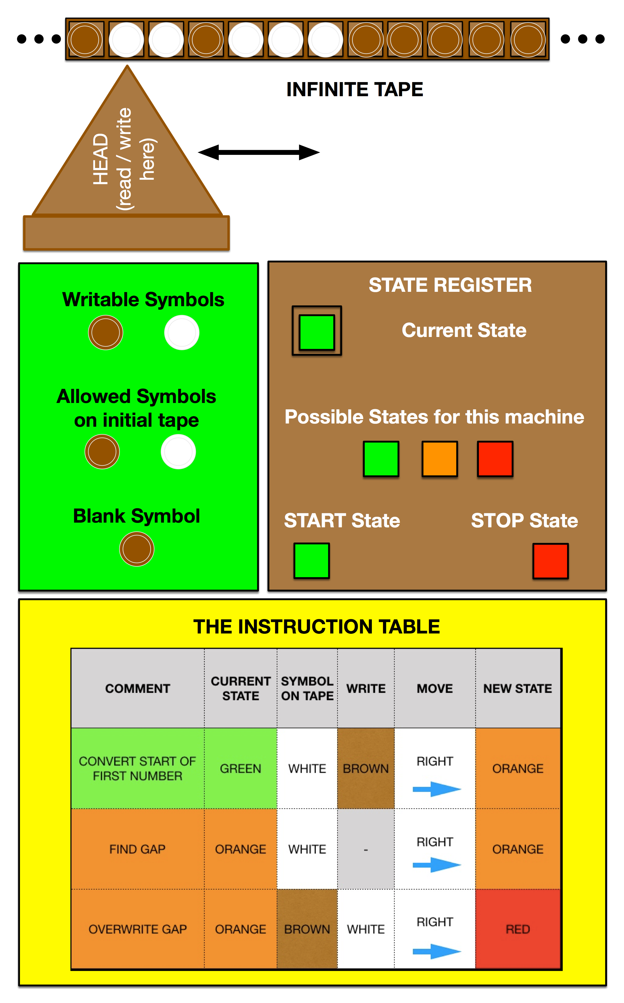
What does a Turing Machine consist of?
Make it from chocolate

Slide 5
It consists of…
An infinite tape (its memory) containing symbols
Symbols that can be written on to the tape (eg 0, 1)
Symbols that can appear on the original tape, including a BLANK symbol
A read/write head (the one point it can change values)
A finite set of possible states.
A state register (to keep track of the state)
  The current state from a fixed set (its “state of mind”)
  A START state and a STOP state (if the machine enters this state it stops)
A finite table of instructions (the program)

Slide 6
Input-Output
You can think of a Turing Machine as following the input-process-output pattern
INPUT: the initial tape
PROCESS: the operation of the machine
OUTPUT: the final tape once it STOPs

Slide 7
Health Warning
The details of how a Turing Machine is described can vary in lots of small ways that have no real bearing on what it does…
    eg
      the tape may be infinite in both directions OR just in one…
      the tape may move OR the head may move
CHECK EXACTLY WHAT YOUR EXAM BOARD EXPECTS

Slide 8
IN PRACTICE

Slide 9
Made of chocolate?
It is a mathematical model but it can be thought of as an actual machine you can build.
Computation can happen anywhere…not just on silicon
Computation is about manipulating symbols
  Symbols can be anything
My version is made of chocolate…

Slide 10
Number Representation
We need a way to represent numbers
We can use ANY representation we like
To keep our first program simple we will use the earliest number representation used by ancient shepherds to count goats! UNARY
  eg 5 is represented as ooooo
A more sophisticated program could use binary, base 10 or even roman numerals - just different tape symbols.

Slide 11
To ADD
two unary numbers…
eg with a starting tape:
              …_oo_ooo_ _ _ …
Blank the first symbol (at start of first number)
Write an o symbol in the gap between the numbers
Assumes the numbers are separated by a single blank

Slide 12

An Instruction Table
COMMENT | CURRENT STATE | SYMBOL ON TAPE | WRITE | MOVE | NEW STATE
CONVERT START OF FIRST NUMBER | GREEN | WHITE | BROWN | RIGHT | ORANGE
FIND GAP | ORANGE | WHITE | - | RIGHT | ORANGE
OVERWRITE GAP | ORANGE | BROWN | WHITE | RIGHT | RED

Slide 13
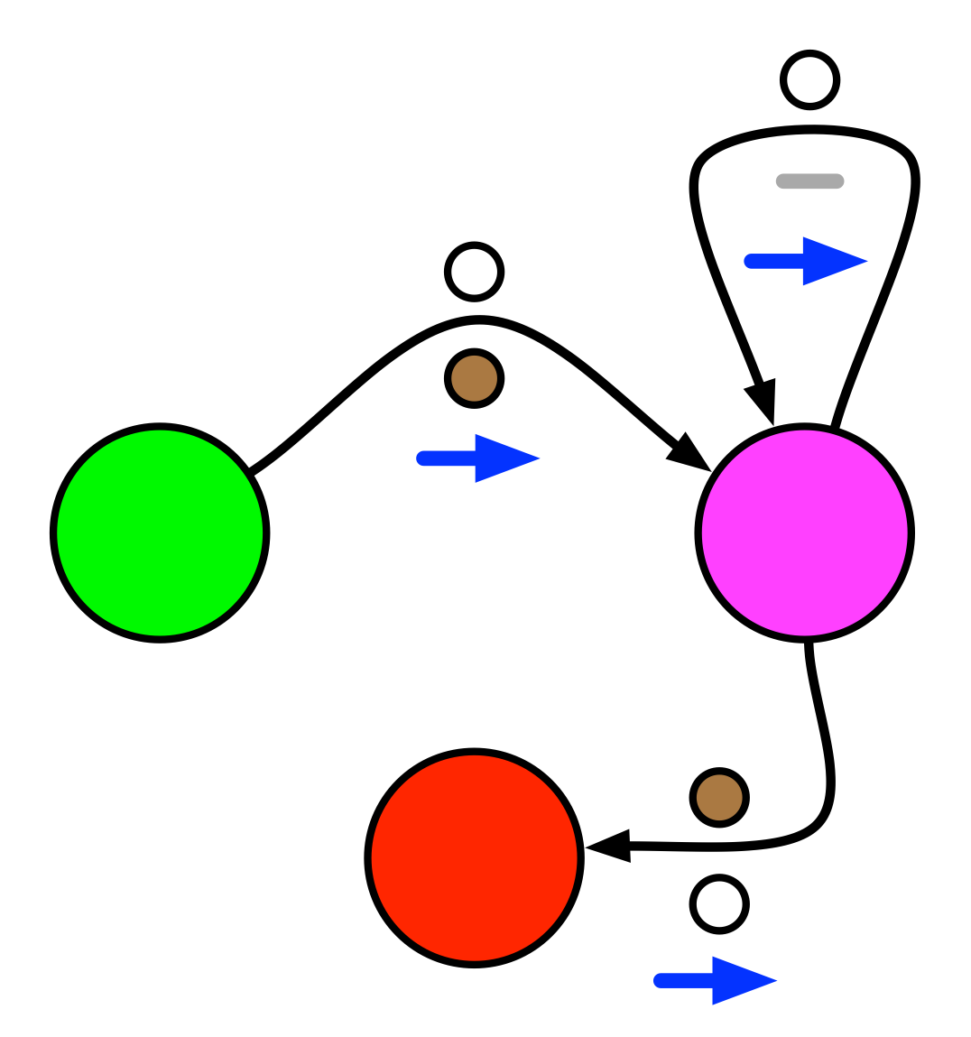
Instruction Tables can be thought of as State Transition Diagrams

Slide 14
Make it from chocolate…
Or role play it…
Have one person for each tape position
  eg holding a sheet with the symbol at that tape position
Someone else is the tape head
A final person acts as the state
  different coloured hats for different states

Slide 15
Another way
To ADD two unary numbers
This time leaving it in the starting from the same position
eg with a starting tape:
              …_oo_ooo_ _ _ …
Blank the LAST symbol (at end of second number)
Write an o symbol in the gap
Assumes the numbers are separated by a single blank

Slide 16
Another way to do the same thing:
Adding to the other end of the number
COMMENT | CURRENT STATE | SYMBOL ON TAPE | WRITE | MOVE | NEW STATE
TRAVERSING FIRST NUMBER | GREEN | WHITE | - | RIGHT | GREEN
 | GREEN | BROWN | - | RIGHT | PURPLE
TRAVERSING SECOND NUMBER | PURPLE | WHITE | - | RIGHT | PURPLE
 | PURPLE | BROWN | - | LEFT | BLUE
CONVERTING END OF SECOND NUMBER | BLUE | - | BROWN | LEFT | ORANGE
MOVING BACK TO GAP | ORANGE | WHITE | - | LEFT | ORANGE
FILL GAP AND STOP | ORANGE | BROWN | WHITE | LEFT | RED

Slide 17
Exercises
Work out a Turing Machine to Add 2 to a unary number
  It should add it to the right-hand end of the number leaving the number starting in the same place
  Extension …
    The Head should be left at the right hand end of the number, where it started.
Work out a Turing Machine to DOUBLE a binary number
  The Machine can have three symbols (BLANK, 1 and 0)

Slide 18
SOLUTIONS

Slide 19
An Add 2 Instruction Table
COMMENT | CURRENT STATE | SYMBOL ON TAPE | WRITE | MOVE | NEW STATE
MOVE TO END OF NUMBER | GREEN | WHITE | - | RIGHT | GREEN
ADD 1 | GREEN | BROWN | WHITE | RIGHT | ORANGE
ADD ANOTHER 1 | ORANGE | BROWN | WHITE | RIGHT | RED

Slide 20
Add 2, returning to the start
COMMENT | CURRENT STATE | SYMBOL ON TAPE | WRITE | MOVE | NEW STATE
MOVE TO END OF NUMBER | GREEN | WHITE | - | RIGHT | GREEN
ADD 1 | GREEN | BROWN | WHITE | RIGHT | ORANGE
ADD ANOTHER 1 | ORANGE | BROWN | WHITE | LEFT | PURPLE
HEAD BACK TO START | PURPLE | WHITE | - | LEFT | PURPLE
 | PURPLE | BROWN | - | RIGHT | RED

Slide 21
Binary Double, returning to the start
(just add a 0 on the end!)
COMMENT | CURRENT STATE | SYMBOL ON TAPE | WRITE | MOVE | NEW STATE
TRAVERSING NUMBER | GREEN | 0 | - | RIGHT | GREEN
 | GREEN | 1 | - | RIGHT | GREEN
ADD A 0 AT THE START | GREEN | BLANK | 0 | LEFT | ORANGE
RETURN TO START POSITION | ORANGE | 0 | - | LEFT | ORANGE
 | ORANGE | 1 | - | LEFT | ORANGE
 | ORANGE | BLANK | - | RIGHT | RED

Slide 22
THEORY

Slide 23
As powerful as is possible
Turing Machines can be programmed to do anything that any computer can do
  They can compute any computation that it is possible for a computer to compute!
Has sequence, selection & repetition
You create a bespoke Turing Machine to do the computation you need to be done.

Slide 24
Towards a
Universal Turing Machine
It is possible to write a program to simulate Turing Machines on a modern computer
  NB the infinite tape is a problem though!
Use that idea to see Turing’s idea of a Universal Turing Machine
You can create one Turing Machine (called U or UNIVERSAL) that can simulate any/all other Turing Machines
  just need to write the simulation program

Slide 25
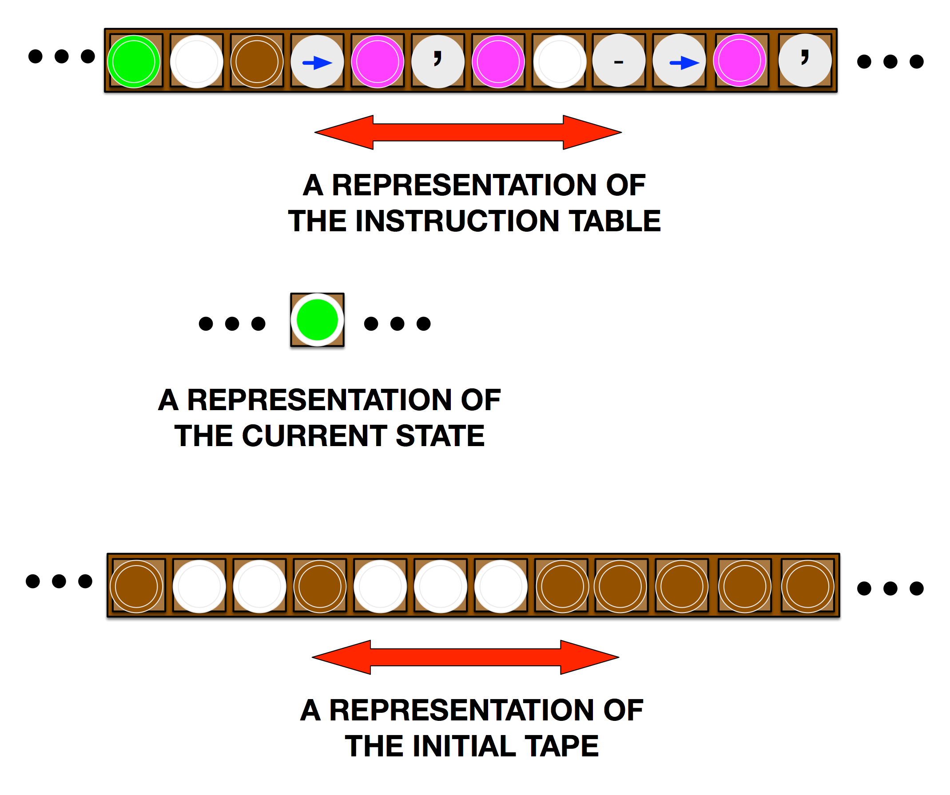
A Universal Turing Machine
Give UNIVERSAL the description of the Turing Machine you want to simulate as data on its tape
    … the instruction table (program), the initial state, data on initial tape etc in different areas of UNIVERSAL’s tape

Slide 26
A Universal Turing Machine
UNIVERSAL’s instructions tell it how to interpret that description (eg following a fetch-decode-execute cycle)
UNIVERSAL’s instructions change the areas of its tape (ie current state and data area) based on what it finds in the instruction table area

Slide 27
A fundamental breakthrough
The idea of a Universal Turing Machine is the basis for a
general-purpose computer
  that can do anything
because it is controlled by a stored program that tells it what to do.
A fundamental theoretical breakthrough
in computer science

Slide 28
Summary
A Turing Machine is just a simple model of what it is possible for computation to do
Turing Machines can compute anything any real computer can compute
You can make a UNIVERSAL Turing Machine that can simulate all other Turing Machines
  The description of the Turing Machine is just the data on UNIVERSAL’s initial tape

Slide 29
Isaac Computer Science
Isaac Computer Science has detailed resources on Turing Machines
See
        isaaccomputerscience.org/topics/
        -> Theory of computation (AQA)
        -> Turing Machines

Slide 30
Thank You
Our resources at
teachinglondoncomputing.org/turingmachine/
Twitter: @cs4fn

