Slide 1
Digital Art and Design
Karen Shoop

Slide 2
Art informing Computer Science Education
Geraint Wiggins, The previous head of QM's School of Electronic Engineering and Computer Science wrote in the Times Higher Ed (2012):
"The norm in computer science departments is to choose a programming language (often only one) and then define its syntax, repeatedly demonstrating the behaviour of each construct, often with simple, disparate examples. What we mostly fail to do is address what programmers starting out really need: the cognitive skills to imagine abstract processes applied to abstract objects, and to imagine problems in these terms… For my part, I have for a few years now been promoting the idea of teaching programming using techniques from the arts and design, focusing on the development of creative practice, per se. "

Slide 3
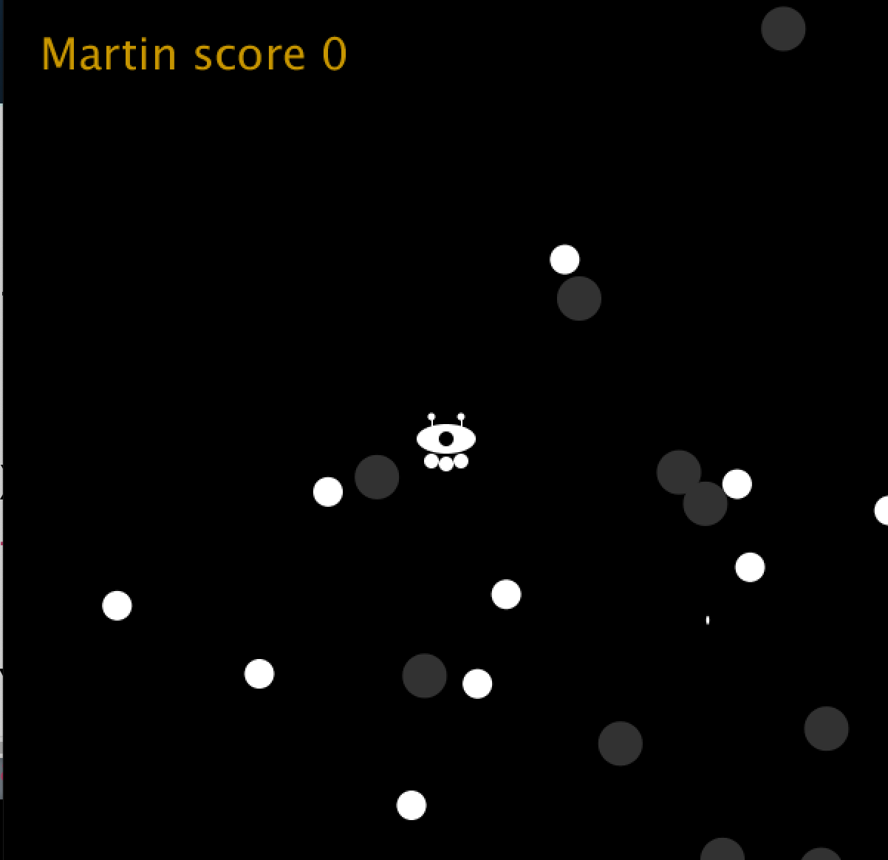
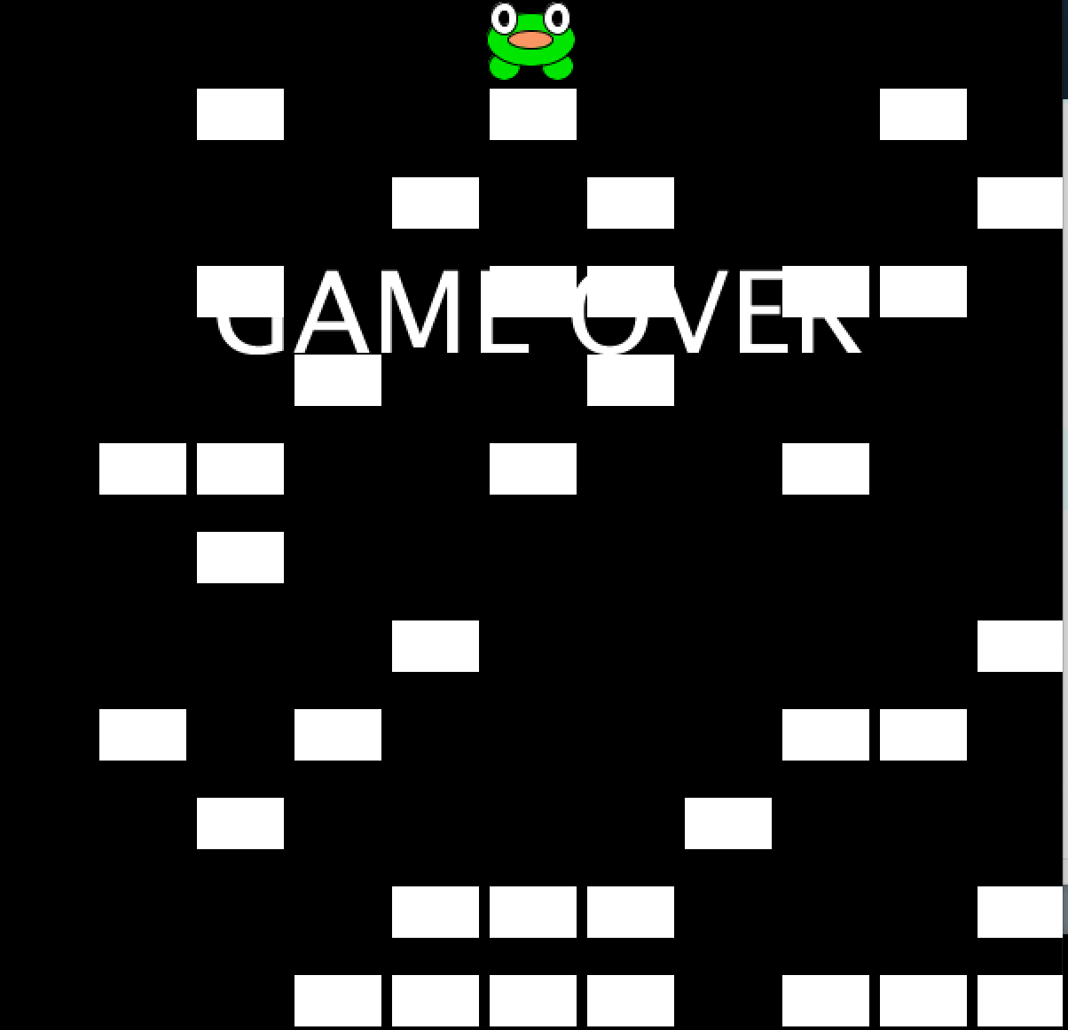


Coding is an activity that many students discover and importantly they practise outside the classroom: "if this can be done in Processing…what would I do in Python, JavaScript etc…". "what is the word, notation etc. used in XXX"…they can also help spot errors and support their fellow students.
Notes:
With programming, students are a vital resource as they may have used or know about other languages.

Slide 4

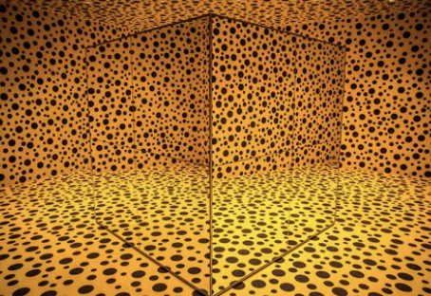
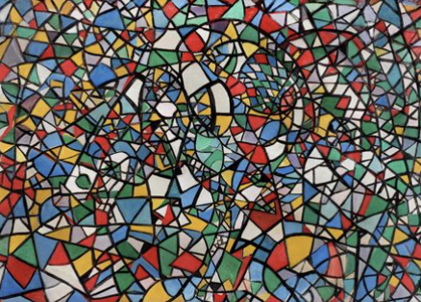
Bridget Riley
Peter Doig
Sonia Boyce
Chris Ofili
Mira Schendel
Piet Mondrian
Annie Albers
Andy Warhol
Yayoi Kusama
Fahrelnissa Zeid
Jasper Johns
Robert Rauschenberg

Slide 5





Slide 6
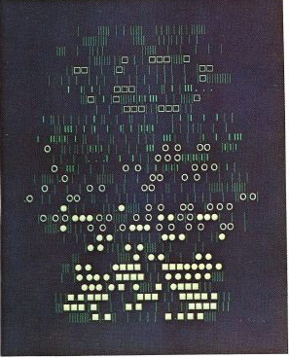
Esther Rolinson
Colette & Charles Bangert
Damien Borowik
Fabrizio Augusto Poltronieri
Aaron Marcus
Georg Nees
Frieder Nake
A.Michael Noll

Slide 7
Thinking like a coder:
Doing: using ready-made functions (verbs)
  code order matters
Using things: variables (nouns)
  help you control/change
Interaction & animation
Conditions: if/else
Repetition: while (for)
But why??
explore marks, shapes, colour – before painting, drawing? alongside? instead of?
  do not have to commit
make lots of things, maybe slightly change them
creative interaction/animation: move/grow/change with the cursor, key, randomly, by itself
  if this happens then do that
respond to data – to help people explore (visualisation) or as early inspiration (data art)
Notes:
Richter (Reich Richter)

Slide 8
MARK MAKING
Precursor to screen art: Texture and pattern using a typewriter
combination of characters
how to display on the screen
change character ✔️
change colour ✔️
interaction ✔️
repetition ✔️
change spacing ✔️
alternate lines ✔️
Annie Albers

Slide 9

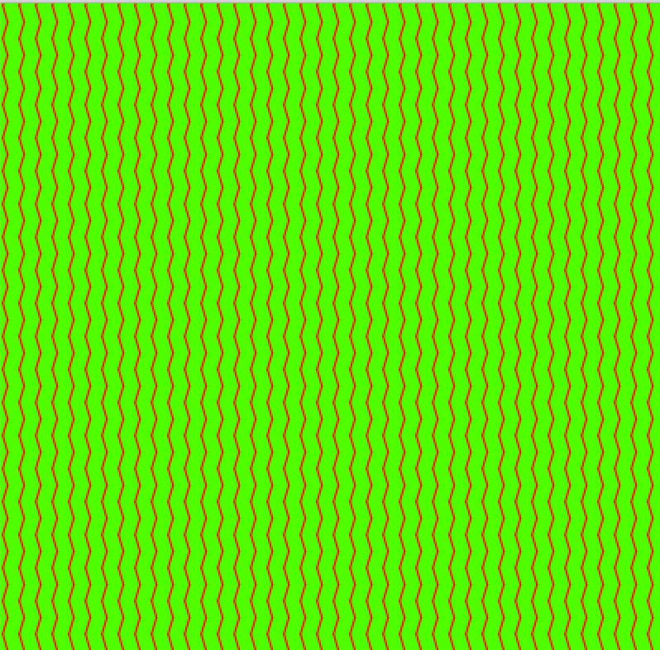
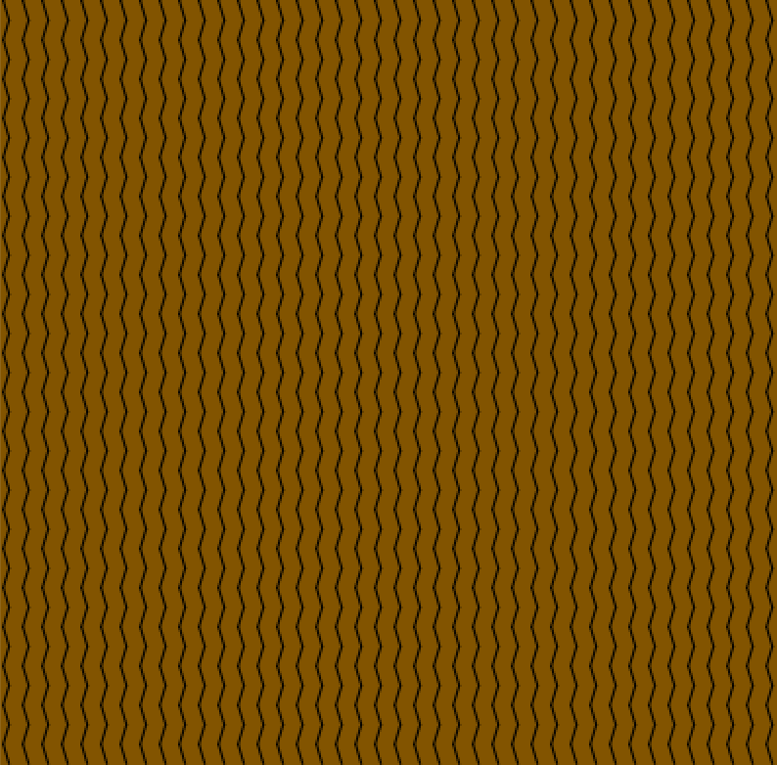

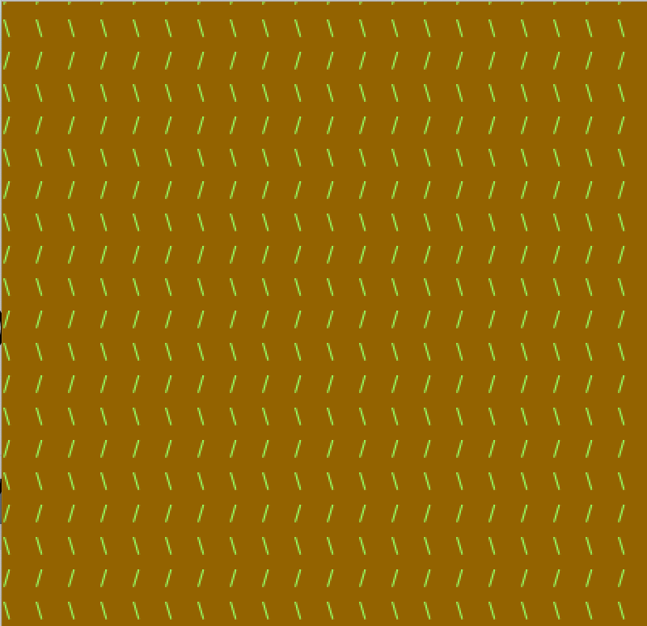
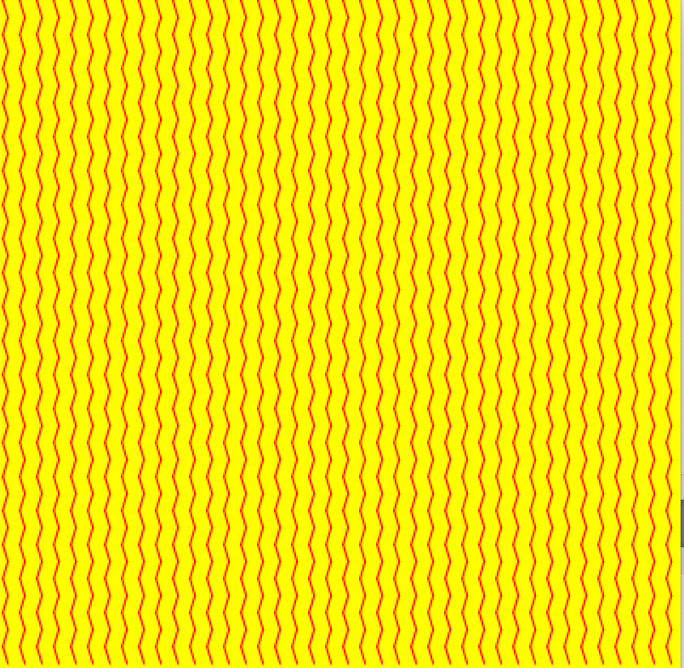
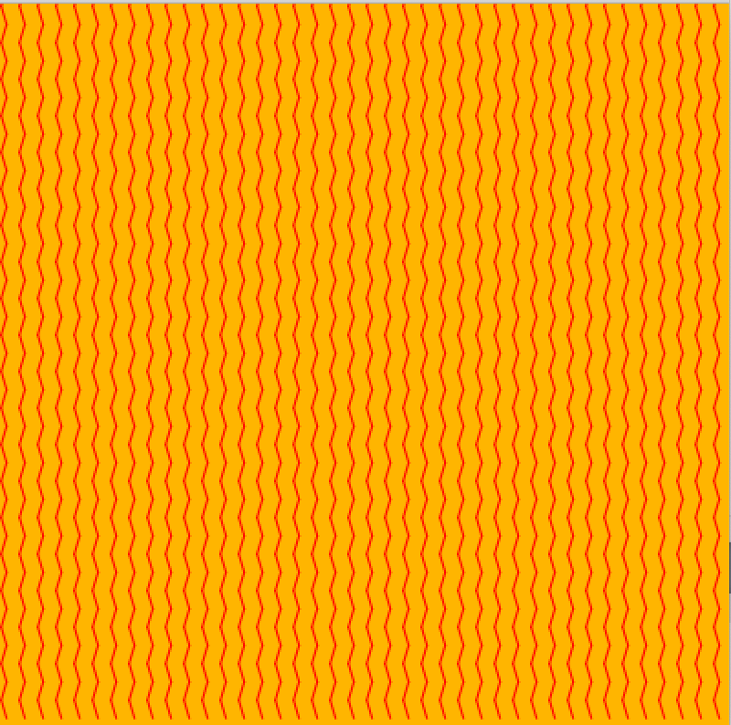
Using the keyboard: \ / on alternate row
colour changes as the cursor moves
text("…", xLoc, yLoc);
this looks nicer when the code runs

Slide 10
  int d;
  void setup() {
  size(400, 400);
  d=10;
  }
  void draw() {
  background(mouseX, mouseY, 0);
  fill(200,200,250);
  for (int j=0; j<height; j+=d) {//controls rows
  for (int i=0; i<width; i+=d) {//controls shifting x-coords
  if (j/d%2==0) {
  text("/", i, j);
  } else {
  text("\\",i,j);
  }
  }
  }
  }
the draw function is called approx 60 times per second (framerate) – animation & interaction
Python: no semi-colons; blocks controlled by indentation not by curly brackets
JavaScript: semi-colons optional
Notes:
bold – standard coding
blue – controlling display
pink - interaction

Slide 11
Concept#1: Variable
Explanation: thing (noun) that can change their value. It has a:
type: number? whole or decimal? textual string? just one character?
name: a, b, c? diameter/diam/d? title?
value: otherwise you can't use it
Python or JavaScript: creating variables is different in these languages. There is no need to set the type (dynamic typing)

Slide 12
Open a sketch window, copy, but do not press the run/play arrow (compile & run):
  size(400,400);
  fill(0);
  ellipse(width/2, height/2, 80,80);
  ellipse(0,0,40,40);
  fill(255);
What do you think will be displayed?
Now press the run arrow: is anything unexpected?
Explore: any corrections? change the values inside fill etc.
Now make the first ellipse larger and ensure that the second's width is still half the size of the first
  How many values do you need to change?
Notes:
what are zero and 255? greyscale
code order
origin at top left
grey background

Slide 13
Modify the code:
int diam=80;//this is a variable
//this is a comment – computer/compiler will ignore the text
  size(400,400);
  fill(0);
  ellipse(width/2, height/2, diam,diam);
  fill(255);//moved to above 2nd ellipse – code order
  ellipse(0,0,diam/2,diam/4);
What do you think will be displayed?
Now press the run arrow: any changes or observations?
Explore: change the value of diam. Use a decimal number – what happens?
if your code gets messy (irregular indentation) press ctrl/cmd+t
Notes:
black outline
2nd is an ellipse not circle

Slide 14
int diam=80;
it has a type: int
(primitive) datatype provided by Processing: whole number
and a name: diam – this makes more sense to read than a, b, c etc.
and has been assigned a value using equals (single =): 80
…and we could change this value
->Variables are the nouns/properties/things in your system that can change value
Other useful types: float (decimal), char (character):
float f=2.3;
char c = 'a'; char c2 = '|'; char c3='7';

Slide 15
Previous code: written directly into the sketch
one line of code -> shape (circle/rectangle/line…)
two lines of code -> colour + shape etc.
Future examples will put our code inside two code blocks setup()…called once at the start
draw()…called repeatedly (frames) – interaction/animation

Slide 16
Once you have a variable you can use code to change values
  int diam=80;
  int speed=2;
  void setup() {
  size(400, 400);
  background(255);//??
  }
  void draw() {
  fill(255, 255, 0);//secondary colour
  ellipse(width/2, height/2, diam, diam);
  diam+=speed;//or diam=diam+speed;
  }

Slide 17
  int diam=80;
  int speed=2;//higher numbers -> faster
  int posX=2*diam;//use * not x for multiply
  void setup() {
  size(400, 400);
  background(255);
  }
  void draw() {
  fill(255, 0, 255);//different secondary colour
  ellipse(posX, height/2, diam, diam);
  posX+=speed;//or posX=posX+speed;
  }
Notes:
shows trail: need to add background to top of draw()
also: can't write 2d have to write 2*d

Slide 18
int diam=80;
int speed=1;//higher numbers -> faster
int pos=2*diam;//* not x for multiply
void setup() {
size(400, 400);
background(255);
}
//the trail works well here
void draw() {
fill(255, 0, 255);//different secondary colour
ellipse(pos, height/2, diam, diam);
fill(0,255,255,150);
ellipse(width/2, pos, diam, diam);
pos+=speed;//or posX=posX+speed;
}
now two circles

Slide 19
int diam=80;
int speed=1;//higher numbers -> faster
int pos=2*diam;//* not x for multiply
void setup() {
size(400, 400);
background(255);
}
void draw() {
background(250,250,240); //can comment out to get the trail back
fill(255, 0, 255);//different secondary colour
ellipse(pos, height/2, diam, diam);
fill(255, 200, 255, 100);//different secondary colour
ellipse(pos, diam+height/2, diam, diam);
fill(200, 200, 255, 100);//different secondary colour
ellipse(pos, height/2-diam, diam, diam);
fill(0,255,255,150);
ellipse(width/2, pos, diam, diam);
fill(200,255,255,150);
ellipse(diam+width/2, pos, diam, diam);
fill(200,255,200,150);
ellipse(width/2-diam, pos, diam, diam);
pos+=speed;//or posX=posX+speed;
}
But it's starting to get difficult to manage. What if I want 10 circles? 100? 1000?
and the shapes disappear – can they reappear? bounce? stop at the edge? Other shapes?

Slide 20
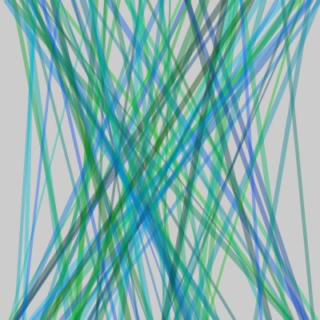
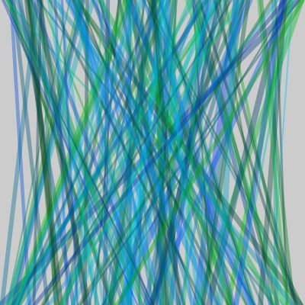
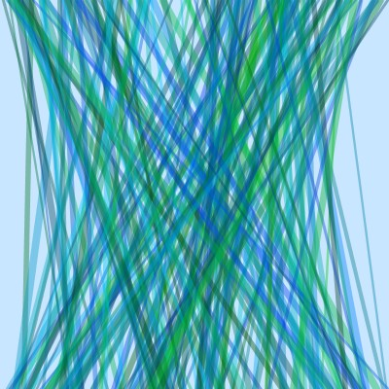
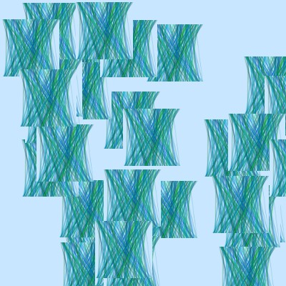
void setup(){
size(400,400);
background(200,230,255);
}
void draw(){
float thickness=random(2,8);
strokeWeight(thickness);
float blue = random(255);
float green = random(50,200);
stroke(0,green,blue,100);
float startX=random(width);
float endX = random(width);
line(startX,0, endX,height);
if(keyPressed){
if(key=='p'){
saveFrame("###.jpg");
}
}
}
PImage pic;
void setup(){
size(400,400);
background(200,230,255);
pic=loadImage("pic.jpg");
pic.resize(80,80);
frameRate(2);//slows down
}
void draw(){
float startX=random(width);
float startY = random(height);
image(pic,startX,startY);
if(mousePressed){
saveFrame("###.jpg");
}
}
need to save the sketch tp automatically create a folder for the jpg files that are produced
I first saved this sketch, then copied one of the jpg files from the previous sketch, renamed pic.jpg

Slide 22
int diam;
float posX;
float speed;
void setup(){
size(400,400);
diam=20;
posX=width/2;
speed=1.5;
noStroke();
}
void draw(){
background(posX/2,0, 200);
fill(posX/2, 200,width-posX);
ellipse(posX,height/2, diam,2*diam);
posX+=speed;
if(posX>=width+diam/2){
posX=-diam/2;
}
}
In the afternoon:
how might your images/shapes/colours change according to certain conditions
  [games: collision detection, items going off the window]
multiples without writing lots of lines
moving with the cursor

Slide 23
Lunch

Slide 24
Digital Art and Design
Karen Shoop

Slide 25
Response: what do you want to happen
Animation?
if it's in that area the colour changes to xxxx
If the ball goes off the edge it reappears the other side
if it hits xxxxx it bounces
Interaction?
If my cursor moves…
If I press..
If I click the mouse
Rules
If the variable is greater than xxxx change colour/size

Slide 26
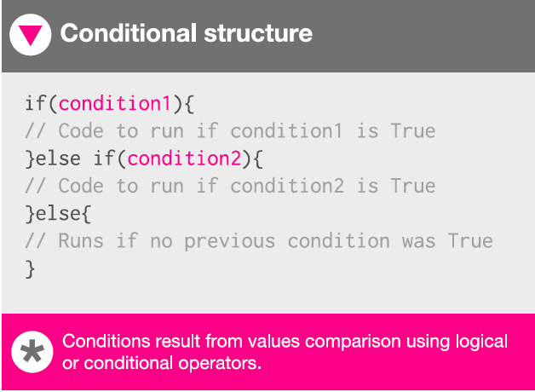
Concept#2: conditional statements (if/else)
Concept:
if/else: if (this condition in the brackets is true) THEN execute the code in the following block OTHERWISE execute the code in the next block
if(x==5){//make red circle}
else {//make orange square}
if(condition1){
//code to execute if condition1 is true
}
else if(condition2){
//code to execute if condition2 is true
}
else{
//will run if no previous condition is true
}
Notes:
conditional operators & logical operators (&& || !)

Slide 27
void setup(){
size(400,400);
noStroke();
}
void draw(){
if(mouseX>width/2){
fill(200,255,50); ellipse(mouseX,mouseY,50,50);
}
else{
fill(50,255,200);
ellipse(mouseX,mouseY,20,50);
}
}
void setup(){
size(400,400);
noStroke();
}
void draw(){
if(mouseX>width/2){
fill(200,255,50);
}
else{
fill(50,255,200);
}
ellipse(mouseX,mouseY,50,50);
}

Slide 28
void setup(){
size(400,400);
noFill();
}
void draw(){
if(mouseX>width/2){
background(200,255,50);
}
else{
background(50,255,200);
}
ellipse(mouseX,mouseY,20,50);
}
void setup(){
size(400,400);
noFill();
}
void draw(){
if(mouseX>width/2){
background(mouseX-200,255,50);
}
else{
background(mouseY,255,200);
}
ellipse(mouseX,mouseY,20,50);
//ellipse(mouseY,mouseX,50,20);
}

Slide 29
if(mouseX>width/2){then run these instructions}
if(mouseY<=50)
float rand=random(7);
int x =int(rand);
if(rand==3)…if(rand!=3)…if(rand>=5)
things I want to check:
if (this is an even number)
if (this circle overlaps with that circle)
if (this block collides with that one)
if (the circle has hit the edge)
if (the circle has disappeared off the edge)
if (I press UP/DOWN etc. .mouse..)
what might your students want to do

Slide 30
int d;
void setup () {
size(400, 400);
background(255, 200, 200);
rectMode(CENTER);
noFill();
d=50;
}
void draw() {
if (keyPressed) {
if (key=='e') {
ellipse(mouseX, mouseY, d, d);
} else if (key=='r') {
rect(mouseX, mouseY, d, d);
} else if (key=='s') {
arc(mouseX, mouseY, d, d, 0, PI);
}}}
Notes:
draw lots of individual circles, squares, but also drawing with

Slide 31
Concept#3: while command
Concept:
while (the condition in the brackets is true) THEN execute the code in the following block
RISK: this loop might never terminate! Need to modify

Slide 32
int w;
int x;
void setup(){
size(600,400);
w=20;
x=0;
}
void draw(){
while(x<width){
rect(x,0,w,height);
x=x+w;
}
}

