Slide 1
TechPathways
Teaching Games Development
WASH UP
Day 2
Estelle Ashman & Jane Waite
https://teachinglondoncomputing.org/techpathways_games_dev
#AllyPallyGamesDev
Notes:
Say thank you to all the sponsors

Slide 2
Day 1 | BAFTA/ YGD Games Design – concept workshop OCR - iMedia delivery and good practise BAFTA/ YGD/ Ubisoft - Industry talks
Day 2 | QMUL - Pedagogy themes Digital School House/ Scirra - Games Development with Construct 3.
Optional | QMUL Support for School Case Studies and Writing up QMUL/ BAFTA/Digital School House – Industry visits

Slide 3
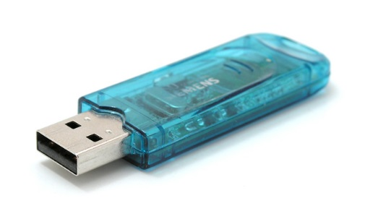
1. Working walls review
2. Next Steps (post course aftercare)
  Post Course Survey
      Request an industry volunteer
      Ask to take part in a case study
      Help us improve the course
      Research element
  Collaborative Google Doc
  Webpage with resources
      Construct 3 licences/ lesson planning
      Further reading and research
3. Questions & Answers
This Photo by Unknown Author is licensed under CC BY-SA

