Slide 1
TechPathways
Teaching Games Development
Day 2
Estelle Ashman & Jane Waite
https://teachinglondoncomputing.org/techpathways_games_dev
#AllyPallyGamesDev
Notes:
Say thank you to all the sponsors

Slide 2
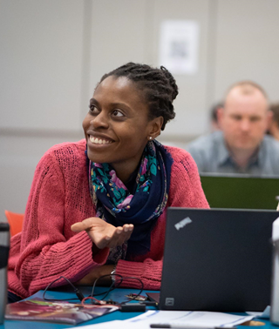
What is TechPathways London?
Funded by the Mayor of London under the ‘Digital Talent’ programme.
Free CPD for educators of 11-24 year olds.
Short courses and Depth courses
Strong links to industry.
Partnership between London CLC and Queen Mary, University of London.

Slide 3
Day 1 | BAFTA/ YGD Games Design – concept workshop OCR - iMedia delivery and good practise BAFTA/ YGD/ Ubisoft - Industry talks
Day 2 | QMUL - Pedagogy themes Digital School House/ Scirra - Games Development with Construct 3.
Optional | QMUL Support for School Case Studies and Writing up QMUL/ BAFTA/Digital School House – Industry visits

Slide 4
Days outline
Day- Session
10:30 – 11:00 | Arrival, registration, drinks
11:00 – 11:30 | Overview and Pedagogy themes
11:30 – 12:30 | Digital Schoolhouse Introduction to Construct 3, classroom set-up and creation of a basic game
12:30 – 1:00 | Lunch (now provided – so shorter time!)
1:00 – 2:15 | Creation of a more advanced game with details of how this links to the iMedia course
2:15 – 2:30 | Break
2:30 – 3:10 | More creation of advanced games
3:10- 4:00 | Review of pedagogy, next steps and Q&A

Slide 5
Research and pedagogy
themes for teaching games development
Jane Waite

Slide 6
Objectives of this session
Aim: Introduce pedagogical themes that will be useful for the teaching of games development and particularly that will be exemplified in the next session
Learning objectives:
  Know about Pedagogical Content Knowledge (PCK)
  Know about Semantic Waves
  Know about PRIMM (and the underlying theories)
  Start to think about alternative instructional approaches
  RAG your current knowledge of each.

Slide 7
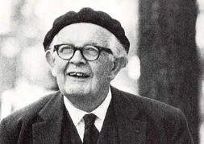
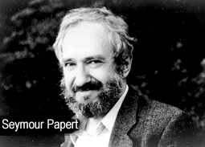
Teaching Games Development in Schools
Limited research
A recurrent theme across studies was a tension between
constructivist exploration
constructionist making
and a controlled progression of teaching
Jean Piaget
There is concern about focusing on just one theory.
Controlled teaching |  |  | Exploration
A blended approach is suggested from studies across contexts.
(Waite, 2017)

Slide 8
In order to teach game development
Content
Knowledge
Pedagogical
Knowledge
Assets
Pedagogical Content Knowledge
(PCK)
Interactions, events and actions
Using algorithms
planning, progression, assessment, relationships, interventions, differentiation, inclusion, relevance, feedback, questioning, scaffolding, visualisations, active learning, direct teaching, discovery learning, resources…
Game play controls
Hardware and peripherals
Semantic waves, PRIMM….
Adapted version of pedagogical content knowledge (PCK) (Shulman, 1986)
Notes:
What are the 4 components of PCK
Goals (LO, threshold concepts)
Assessment
Instructional Approaches
How children learn (misconceptions)

Slide 9
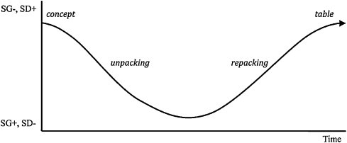
Semantic Waves
Summary statement
Example of a semantic wave in Biology teaching (Maton, 2013)
Density – meaning – from technical (packed) to everyday meaning (unpacked)
Gravity – context - from theory to practical/personal context

Slide 10
Predict Run Investigate Modify Make
Code reading
Levels of Abstraction
Block Model
Examples…
Use Modify Create

Slide 11
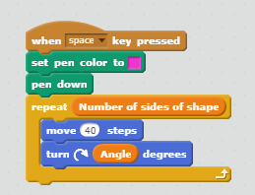
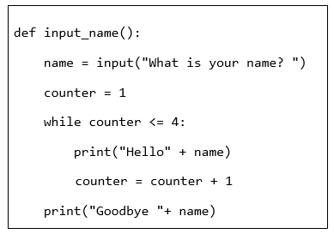
Code reading, code tracing
From university studies, code tracing is a pre-cursor to being able to write code.
There is evidence that novices must be able to read 50% of their code (tracing code accuracy) before they can independently write code with confidence. (Lister, 2011)

Slide 12
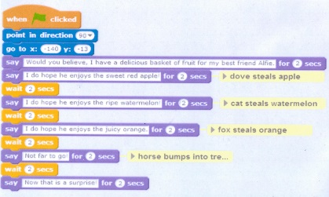
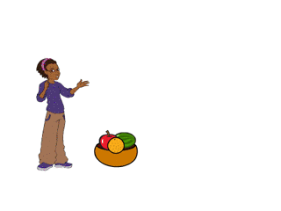
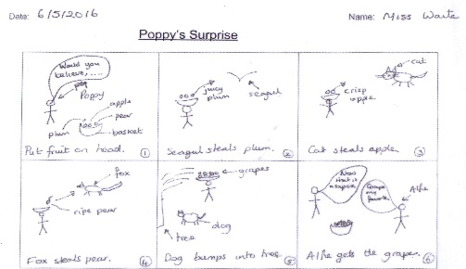
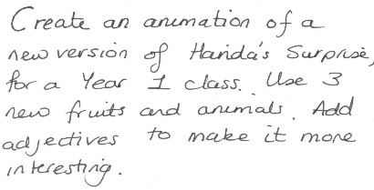
A
B
C
D

Slide 13
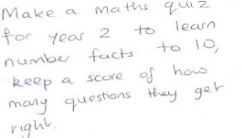
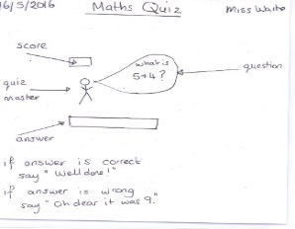
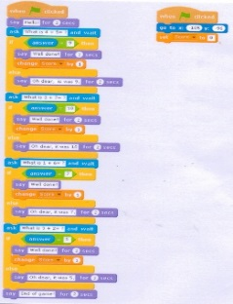
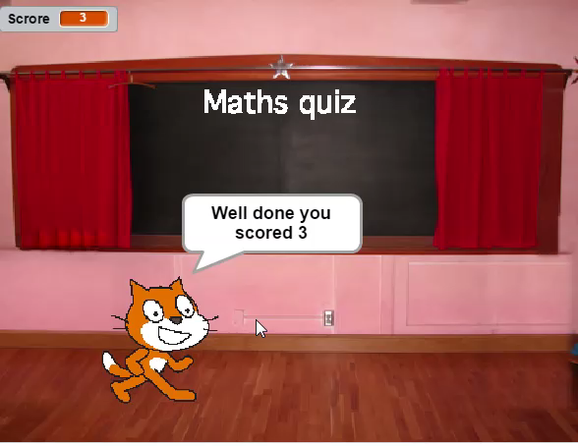


Levels of Abstraction
Task
(problem)
Design
(including the algorithm)
Primary levels of abstraction framework
(Adapted from Perrenet et al., 2005, Armoni, 2013 & Cutts et al. 2011, by Waite, Curzon, Marsh & Sentance, 2016, 2018)
Code
Running the Code
(execution)

Slide 14
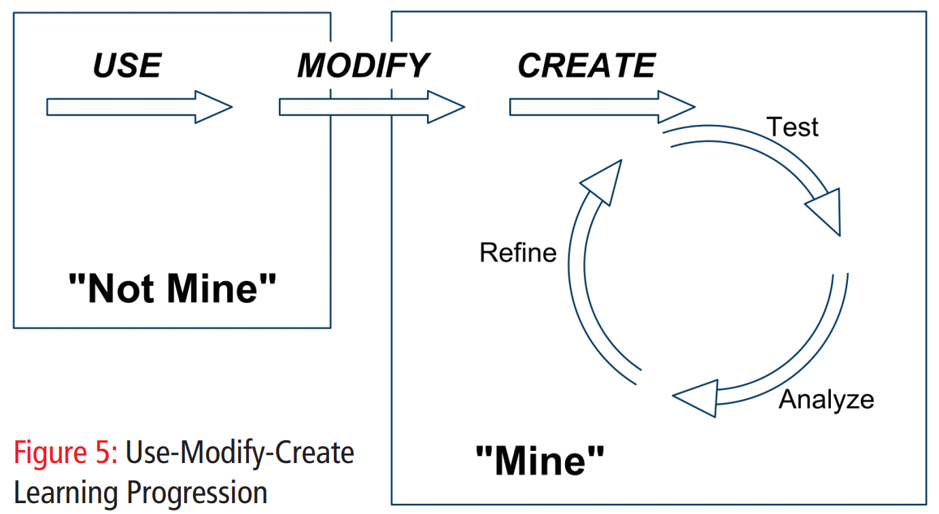
Use-Modify-Create learning progression (Lee et al., 2011)

Slide 15
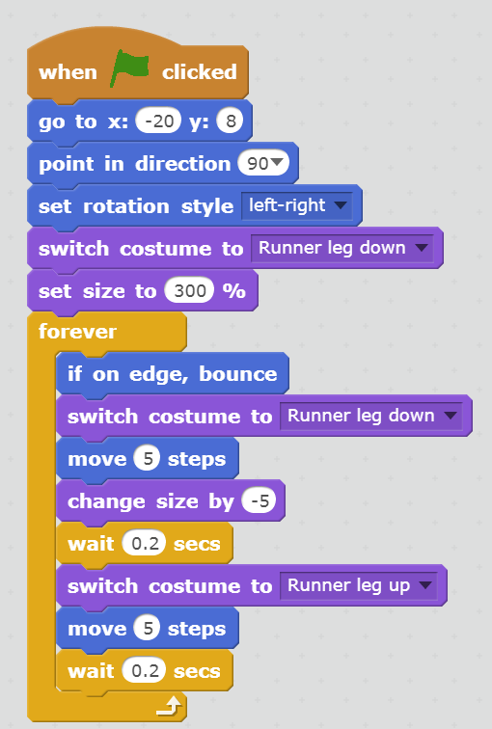
Predict
Predict
Run
Investigate
Modify
Make

Slide 16
Run
https://scratch.mit.edu/projects/164555770/#player
Predict
Run
Investigate
Modify
Make

Slide 17
Investigate
What type of loop is being used?
What happens if you change the
rotation style?
What will happen if you change the ‘move 5’ to ‘move 500’?
What if you change the ‘change size’ to a positive number? What might this link to?
Predict
Run
Investigate
Modify
Make

Slide 18
Modify
1. Make the sprite appear from very far away move towards you.
2. Change the animal and its movement.
Predict
Run
Investigate
Modify
Make

Slide 19
Make
Task: Make a nocturnal animal scene.
Task: Make a scene about your favourite animal’s habitat
Task: Make a scene about your favourite animal
Predict
Run
Investigate
Modify
Make

Slide 20
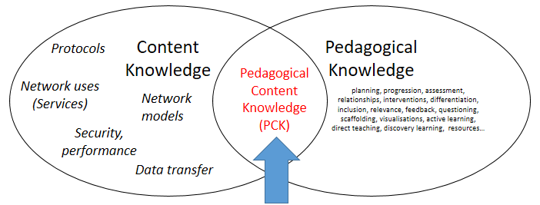



Four models to situate next session
PCK
Semantic Waves
PRIMM
Other instructional approaches
Predict
Run
Investigate
Modify
Make
Guided
exploration
Direct instruction
Unplugged

Slide 21

Controlled teaching |  |  | Exploration
Direct instruction
PRIMM

Slide 22
Objectives of this session
Aim: Introduce pedagogical themes that will be useful for the teaching of games development and particularly what will be exemplified in the next session
Learning objectives:
  Know about Pedagogical Content Knowledge (PCK)
  Know about Semantic Waves
  Know about PRIMM (and the underlying theories)
  Start to think about alternative instructional approaches
  RAG your current knowledge of each.

Slide 23
References and further reading
Armoni, M., 2013. On Teaching Abstraction in Computer Science to Novices. Journal of Computers in Mathematics and Science Teaching, 32(3), pp.265–284.
Cutts et al., 2012. The abstraction transition taxonomy: developing desired learning outcomes through the lens of situated cognition. In Proceedings of the ninth annual international conference on International computing education research. ACM, pp. 63–70. Available at: https://doi.org/10.1145/2361276.2361290.
Lee, I. et al., 2011. Computational thinking for youth in practice. ACM Inroads, 2(1), pp.32–37. Available at: https://doi.org/10.1145/1929887.1929902.
Lister, R., 2011. Concrete and other neo-Piagetian forms of reasoning in the novice programmer. In Proceedings of the Thirteenth Australasian Computing Education Conference-Volume 114. Australian Computer Society, Inc., pp. 9–18.
Maton. K., 2013. Making semantic waves: a key to cumulative knowledge-building. Linguistics and Education 24, 8-22 (2013).
Papert, S., 1980. Mindstorms: Children, computers, and powerful ideas, Basic Books, Inc.
Perrenet, J., Groote, J.F. & Kaasenbrood, E., 2005. Exploring students’ understanding of the concept of algorithm: levels of abstraction. ACM SIGCSE Bulletin, 37(3), pp.64–68. Available at: https://doi.org/10.1145/1151954.1067467.
Piaget, J., Cook, M. & Norton, W., 1952. The origins of intelligence in children, International Universities Press New York.
Sentance, S. & Waite, J., 2017. PRIMM: Exploring pedagogical approaches for teaching text-based programming in school. In Proceedings of the 12th Workshop on Primary and Secondary Computing Education. ACM, pp. 113–114.
Sentance, S., Waite, J. & Kallia, M., 2019. Teachers’ Experiences of using PRIMM to Teach Programming in School. In Proceedings of the 50th ACM Technical Symposium on Computer Science Education. ACM, pp. 476–482.
Shulman, L.S., 1986. Those who understand: Knowledge growth in teaching. Educational researcher, 15(2), pp.4–14.
Waite, J. et al., 2016. Abstraction and common classroom activities. In Proceedings of the 11th Workshop in Primary and Secondary Computing Education. ACM, pp. 112–113. Available at: https://doi.org/10.1145/2978249.2978272.
Waite. J,. 2017. Pedagogy in teaching Computer Science in schools: a literature review (After The Reboot: computing education in UK Schools). Online. (November 2017). Retrieved July 24, 2019 from https://royalsociety.org/-/media/policy/projects/computing-education/literature-review-pedagogy-in-teaching.pdf
Waite, J., Curzon, P., Marsh, D., et al., 2018. Abstraction in action: K-5 teachers’ uses of levels of abstraction, particularly the design level, in teaching programming. International Journal Of Computer Science Education In Schools.

