Slide 1
TechPathways
Digital Art and Design for Secondary Schools
Karen Shoop, Jane Waite,
Kevin Mathieson & Ged Gast
https://teachinglondoncomputing.org/digital-art-design-with-processing-course/
@TechPathwaysLdn
@cas_London_crc
#DigitalArtDesign
Notes:
Say thank you to all the sponsors

Slide 2
Days outline
Day- Session
9:30 -9:45 | Arrival, registration, drinks (Jane bringing croissants)
9:45 – 9:55 | Welcome from Headteacher (10 mins)
9:55 – 10:35 | Days Outline, introductions and research/pedagogy themes (40 mins) (Jane)
10:35 – 12:30 | Digital Art and Design 1 (1 hour 40 mins) (Karen) (including break at 11:15)
12:30 – 1:10 | Lunch (45 mins)
1:15 – 1:30 | School tour with Headteacher (15 mins)
1:30 – 3:15 | Digital Art and Design 3 (1 hour 30 mins) Karen (including break at 2:30)
3:15 – 3:30 | Pedagogy wash up / industry and case studies (15 mins) (Jane)
3:30 – 4:20 | Next steps in schools – landscape/ challenges/ opportunities (Kevin) (40 mins)
4:20 – 4:30 | Q&A All (10 mins)

Slide 3
Introductions
Jane Waite

Slide 4

What is TechPathways London?
Funded by the Mayor of London under the ‘Digital Talent’ programme.
Free CPD for educators of 11-24 year olds.
Short courses and Depth courses
Strong links to industry.
Partnership between London CLC and Queen Mary, University of London.

Slide 5
Research and pedagogy
themes for teaching digital art and design
Jane Waite

Slide 6
Working Walls
  Start to capture
  Topic ideas (opportunities)
  Key Concepts/Learning objectives
  Misconceptions
  Challenges

Slide 7
Objectives of this session
Aim: Introduce pedagogical themes that will be useful for the teaching of art and design using programming and particularly that will be exemplified in the next session
Learning objectives:
  Know about Pedagogical Content Knowledge (PCK)
  Know about Semantic Waves
  Know about PRIMM (and some of the underlying theories)
  RAG your current knowledge of each.
Handout 1

Slide 8
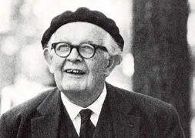
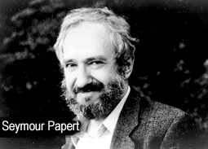
Teaching Programming in Schools
Limited research
A recurrent theme across studies was a tension between
constructivist exploration
constructionist making
and a controlled progression of teaching
Jean Piaget
There is concern about focusing on just one theory.
Controlled teaching |  |  | Exploration
A blended approach is suggested from studies across contexts.
(Waite, 2017)

Slide 9
Teaching art and design through programming in Schools
Research –based in university contexts or informal learning settings where teaching computing (rather than art and design).

Slide 10
In order to teach programming in art and design
Content
Knowledge
Pedagogical
Knowledge
Pedagogical Content Knowledge
(PCK)
Art and Design knowledge
planning, progression, assessment, relationships, interventions, differentiation, inclusion, relevance, feedback, questioning, scaffolding, visualisations, active learning, direct teaching, discovery learning, resources…
Programming
knowledge
Semantic waves, PRIMM….
Adapted version of pedagogical content knowledge (PCK) (Shulman, 1986)
Notes:
What are the 4 components of PCK
Goals (LO, threshold concepts)
Assessment
Instructional Approaches
How children learn (misconceptions)

Slide 11
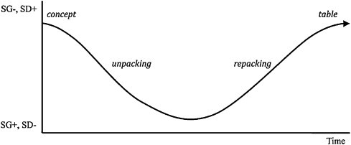
Semantic Waves
Example of a semantic wave in Biology teaching (Maton, 2013)
Density – meaning – from technical (packed) to everyday meaning (unpacked)
Gravity – context - from theory to practical/personal context

Slide 12
Predict Run Investigate Modify Make
Code reading
Levels of Abstraction
Examples…
Use Modify Create

Slide 13
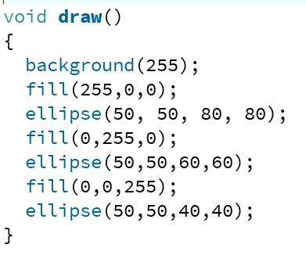
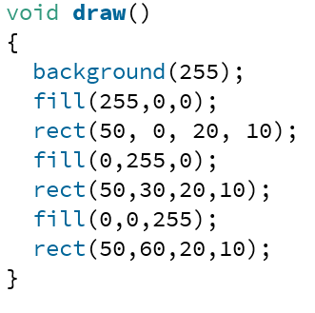
Code reading, code tracing
From university studies, code tracing is a pre-cursor to being able to write code.
There is evidence that novices must be able to read 50% of their code (tracing code accuracy) before they can independently write code with confidence. (Lister, 2011)

Slide 14
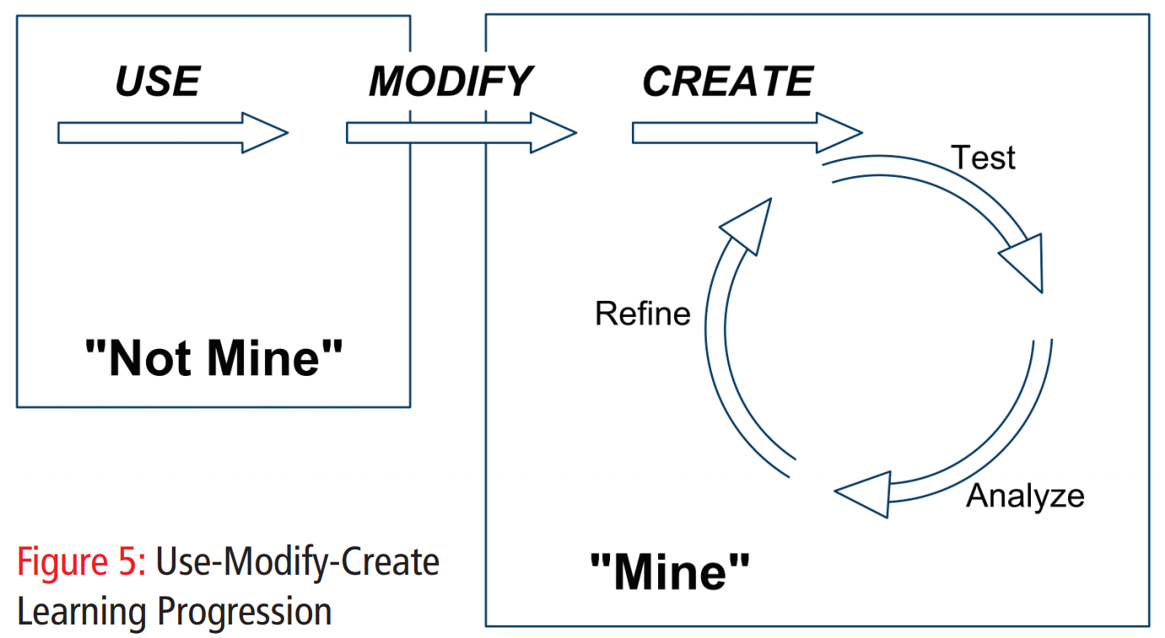
Use-Modify-Create learning progression (Lee et al., 2011)

Slide 15
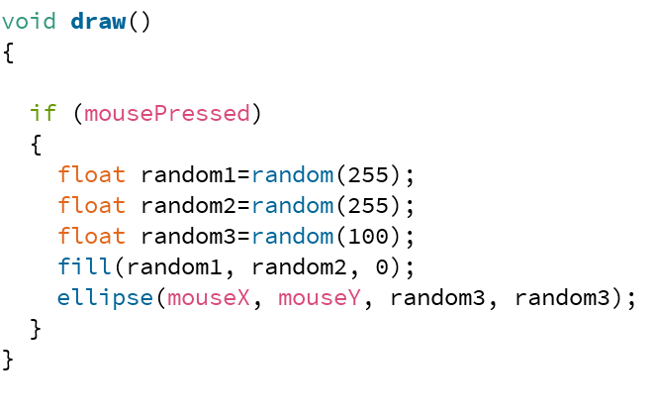
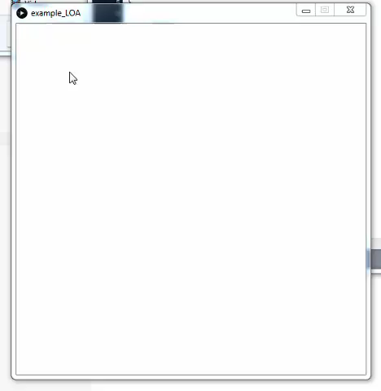
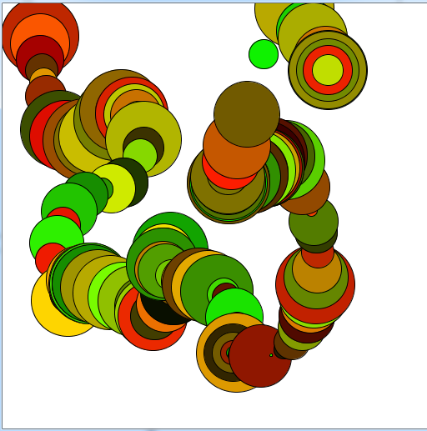
A
B
When the mouse is moved a trail of coloured shapes is left
The colours randomly change from reds to greens.
D
E
C
Create a digital product to explore movement and colour
Handout 2

Slide 16
Create a digital product to explore movement and colour
Task
(problem)
When the mouse is moved a trail of coloured shapes is left
The colours randomly change from reds to greens.
Design
(including the algorithm)
Art and design
terms
Programming
terms
Code
Running the Code
(execution)

Slide 17
Predict
Predict
Run
Investigate
Modify
Make
Handout 3

Slide 18
Run
C:\Users\jane\Desktop\CodeReading1
Predict
Run
Investigate
Modify
Make

Slide 19
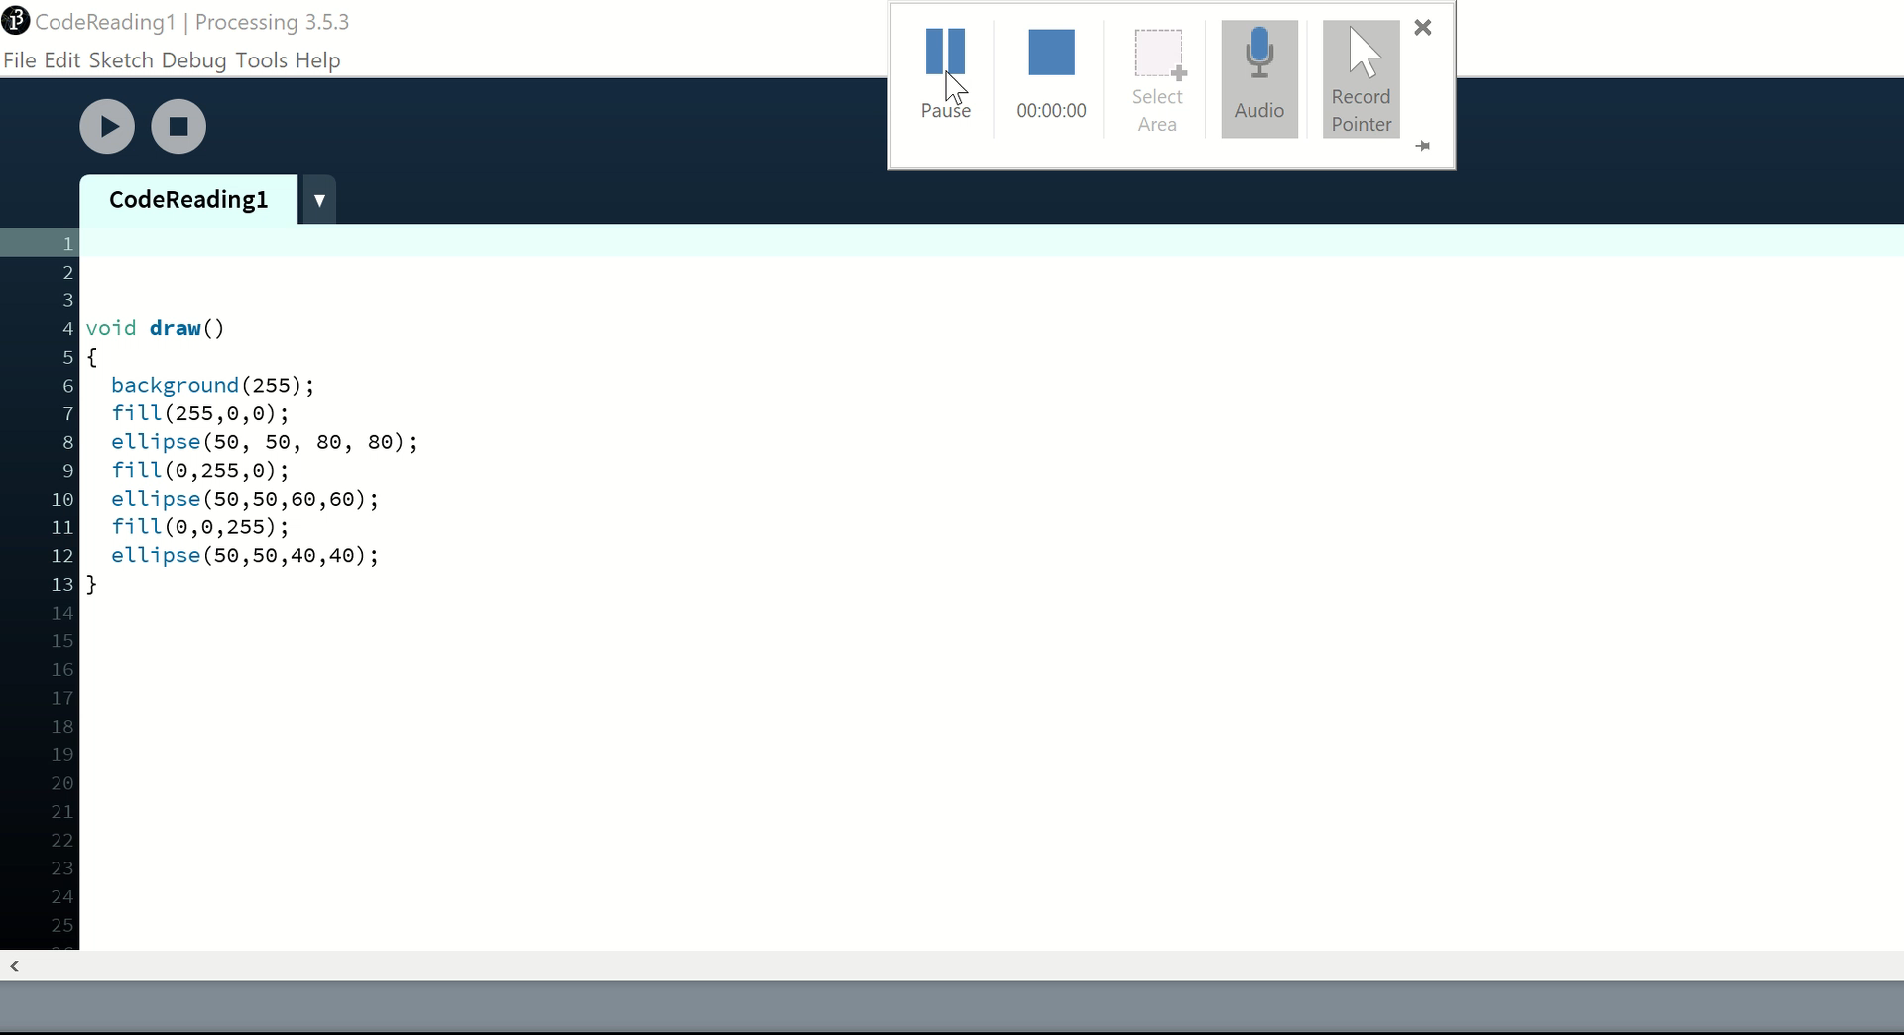
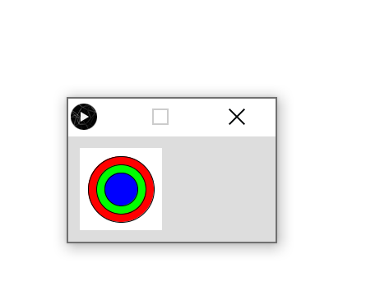
Run
Predict
Run
Investigate
Modify
Make

Slide 20
Investigate
What happens if you change the fill parameters.
What happens if you change the 50,50 parameters of the ellipse lines?
What might the 3rd and 4th parameters of the ellipse commands be?
Predict
Run
Investigate
Modify
Make

Slide 21
Make
Task: Make a new shape picture combining rectangles and ellipses.
(Hint rect (1,2,3,4);)
Predict
Run
Investigate
Modify
Make

Slide 22
Modify
1. Draw a series of separate ellipses of different colours.
Predict
Run
Investigate
Modify
Make

Slide 23



Four models to situate next session
PCK
Semantic Waves
PRIMM
Other instructional approaches
Predict
Run
Investigate
Modify
Make
Guided
exploration
Direct instruction
Unplugged

Slide 24
Objectives of this session
Aim: Introduce pedagogical themes that will be useful for the teaching of games development and particularly what will be exemplified in the next session
Learning objectives:
  Know about Pedagogical Content Knowledge (PCK)
  Know about Semantic Waves
  Know about PRIMM (and the underlying theories)
  RAG your current knowledge of each.

Slide 25
Digital Art and Design
Karen Shoop

Slide 26
Lunch

Slide 27
Digital Art and Design
Karen Shoop

Slide 28
Pedagogy Washup and …
Jane Waite
After care | Post course survey https://www.surveymonkey.co.uk/r/ArtDesignCPD Industry visits Case Studies Presentations and links https://teachinglondoncomputing.org/digital-art-design-with-processing-course/

Slide 29
Next Step in Schools
Kevin Matheson & Ged Gast

Slide 30
Q&A
All

Slide 31
References and further reading
Armoni, M., 2013. On Teaching Abstraction in Computer Science to Novices. Journal of Computers in Mathematics and Science Teaching, 32(3), pp.265–284.
Cutts et al., 2012. The abstraction transition taxonomy: developing desired learning outcomes through the lens of situated cognition. In Proceedings of the ninth annual international conference on International computing education research. ACM, pp. 63–70. Available at: https://doi.org/10.1145/2361276.2361290.
Lee, I. et al., 2011. Computational thinking for youth in practice. ACM Inroads, 2(1), pp.32–37. Available at: https://doi.org/10.1145/1929887.1929902.
Lister, R., 2011. Concrete and other neo-Piagetian forms of reasoning in the novice programmer. In Proceedings of the Thirteenth Australasian Computing Education Conference-Volume 114. Australian Computer Society, Inc., pp. 9–18.
Maton. K., 2013. Making semantic waves: a key to cumulative knowledge-building. Linguistics and Education 24, 8-22 (2013).
Papert, S., 1980. Mindstorms: Children, computers, and powerful ideas, Basic Books, Inc.
Perrenet, J., Groote, J.F. & Kaasenbrood, E., 2005. Exploring students’ understanding of the concept of algorithm: levels of abstraction. ACM SIGCSE Bulletin, 37(3), pp.64–68. Available at: https://doi.org/10.1145/1151954.1067467.
Piaget, J., Cook, M. & Norton, W., 1952. The origins of intelligence in children, International Universities Press New York.
Sentance, S. & Waite, J., 2017. PRIMM: Exploring pedagogical approaches for teaching text-based programming in school. In Proceedings of the 12th Workshop on Primary and Secondary Computing Education. ACM, pp. 113–114.
Sentance, S., Waite, J. & Kallia, M., 2019. Teachers’ Experiences of using PRIMM to Teach Programming in School. In Proceedings of the 50th ACM Technical Symposium on Computer Science Education. ACM, pp. 476–482.
Shulman, L.S., 1986. Those who understand: Knowledge growth in teaching. Educational researcher, 15(2), pp.4–14.
Waite, J. et al., 2016. Abstraction and common classroom activities. In Proceedings of the 11th Workshop in Primary and Secondary Computing Education. ACM, pp. 112–113. Available at: https://doi.org/10.1145/2978249.2978272.
Waite. J,. 2017. Pedagogy in teaching Computer Science in schools: a literature review (After The Reboot: computing education in UK Schools). Online. (November 2017). Retrieved July 24, 2019 from https://royalsociety.org/-/media/policy/projects/computing-education/literature-review-pedagogy-in-teaching.pdf
Waite, J., Curzon, P., Marsh, D., et al., 2018. Abstraction in action: K-5 teachers’ uses of levels of abstraction, particularly the design level, in teaching programming. International Journal Of Computer Science Education In Schools.

Slide 32
References and further reading
Armoni, M., 2013. On Teaching Abstraction in Computer Science to Novices. Journal of Computers in Mathematics and Science Teaching, 32(3), pp.265–284.
Cutts et al., 2012. The abstraction transition taxonomy: developing desired learning outcomes through the lens of situated cognition. In Proceedings of the ninth annual international conference on International computing education research. ACM, pp. 63–70. Available at: https://doi.org/10.1145/2361276.2361290.
Lee, I. et al., 2011. Computational thinking for youth in practice. ACM Inroads, 2(1), pp.32–37. Available at: https://doi.org/10.1145/1929887.1929902.
Lister, R., 2011. Concrete and other neo-Piagetian forms of reasoning in the novice programmer. In Proceedings of the Thirteenth Australasian Computing Education Conference-Volume 114. Australian Computer Society, Inc., pp. 9–18.
Maton. K., 2013. Making semantic waves: a key to cumulative knowledge-building. Linguistics and Education 24, 8-22 (2013).
Papert, S., 1980. Mindstorms: Children, computers, and powerful ideas, Basic Books, Inc.
Perrenet, J., Groote, J.F. & Kaasenbrood, E., 2005. Exploring students’ understanding of the concept of algorithm: levels of abstraction. ACM SIGCSE Bulletin, 37(3), pp.64–68. Available at: https://doi.org/10.1145/1151954.1067467.
Piaget, J., Cook, M. & Norton, W., 1952. The origins of intelligence in children, International Universities Press New York.
Sentance, S. & Waite, J., 2017. PRIMM: Exploring pedagogical approaches for teaching text-based programming in school. In Proceedings of the 12th Workshop on Primary and Secondary Computing Education. ACM, pp. 113–114.
Sentance, S., Waite, J. & Kallia, M., 2019. Teachers’ Experiences of using PRIMM to Teach Programming in School. In Proceedings of the 50th ACM Technical Symposium on Computer Science Education. ACM, pp. 476–482.
Shulman, L.S., 1986. Those who understand: Knowledge growth in teaching. Educational researcher, 15(2), pp.4–14.
Waite, J. et al., 2016. Abstraction and common classroom activities. In Proceedings of the 11th Workshop in Primary and Secondary Computing Education. ACM, pp. 112–113. Available at: https://doi.org/10.1145/2978249.2978272.
Waite. J,. 2017. Pedagogy in teaching Computer Science in schools: a literature review (After The Reboot: computing education in UK Schools). Online. (November 2017). Retrieved July 24, 2019 from https://royalsociety.org/-/media/policy/projects/computing-education/literature-review-pedagogy-in-teaching.pdf
Waite, J., Curzon, P., Marsh, D., et al., 2018. Abstraction in action: K-5 teachers’ uses of levels of abstraction, particularly the design level, in teaching programming. International Journal Of Computer Science Education In Schools.

