Slide 1
CAS London
3rd July get together
CoP meeting
Jane Waite
All resources available at
https://teachinglondoncomputing.org/CASLondon/
@janewaite @cas_London_crc

Slide 2
Timings & Housekeeping
17:30 Registration and Refreshments
18:10 Jane’s very informal update.
18:15 Teach meet style presentations
19:25 & Finally…
19:30 Close

Slide 3

Objectives of this event
Gather ideas for the CAS London Conference – Feb 2020
Share ideas and show it has NOT all stopped - continue/start/restart collaborations

Slide 4
Jane’s update – personal view….
BAU - LGFL, DSH, Katy Potts, Camden CLC, London CLC, Ada, 3BM etc
NCCE is now up and running!
CAS has a new structure of regional support staff who are coordinating CoPs
  Old CAS Hubs are now CoPs - CAS London is a CoP
  Roehampton is the new London Regional Partner - loads of NCCE CPD
  School Hubs will replace the Regional Centres/Regional Partners
  Master teachers are still master teachers – and many are CoPs

Slide 5
 | Who | What | Mins | Slide? | Conf
1 | William Lau lauwailap@gmail.com | Stories, language and memory | 3 | Yes | Yes
2 | mwimpenny-smith@headingtonschool.com | Primary computing | 1 | N/A | yes
3 | tina@ada.ac.uk | All about the BTEC Computing qualification | 3 | Yes | Yes
4 | Yvonne Walker yvonne.walker@computingatschool.org.uk | Assessment of computing | 1 | N/A | Yes
5 | D.murphy@abercornschool.com | Seesaw for Learning Journals | 3 | NO | Yes
6 | Michelle Ainley Mainley@naimajps.co.uk | Turing Tumble/resources I have found useful recently | 1 | N/A | Yes
7 | Colin Hamilton | Lessons learned from flipped learning | 3 | Yes | Yes
8 | Biruk Bayeh Biruk.bayeh@rokeby.newham.sch.uk | Assessment | 1 | N/A | ??
9 | Mark Campbell markcampbell@ada.ac.uk | Primary CS Masterclasses | 3 | Yes | Yes
10 | JI HYUN KIM , klovejenny97@gmail.com | Computing school in Korea | 1 | N/A | ??
11 | Mike Bain | Agile | 3 | Yes | Yes
12 | Michel Wermelinger michel.wermelinger@open.ac.uk | From problems to programs | 3 | Yes | Yes
13 | Nic Hughes - duckstar@gmail.com | Machine Learning for Kids | 3 | Yes | Yes
14 | Camaran | AR VR CO spaces | 3 | Yes | Yes
15 | Richard Millwood richardmillwood@mac.com | Programming Oracy, or how do we speak a computer program? | 3 | Yes | Yes
16 | Mike Skells | Working in Schools | 3 | Yes | Yes
17 | Miles Berry | Regional training at Roehampton | 3 | NO | Yes
18 | Wendy MacLeod wendy.macleod@bcs.uk | CAS NEWS | 3 | Yes | Yes

Slide 6
 | Who | What | Mins
0 | Jane Waite | @QMUL | 1
1 | William Lau | Stories, language and memory | 3
2 | Mathew Wimpenny-Smith | Primary computing | 1
3 | Tina Gotschi | All about the BTEC Computing qualification | 3
4 | Yvonne Walker | Assessment of computing | 1
5 | Darren Murphey | Seesaw for Learning Journals | 3
6 | Michelle Ainley | Turing Tumble/resources I have found useful recently | 1
7 | Colin Hamilton | Lessons learned from flipped learning | 3
8 | Biruk Bayeh | Assessment | 1
9 | Mark Campbell | Primary CS Masterclasses | 3
10 | JI HYUN KIM | Computing school in Korea | 1
11 | Matt Bain | Agile | 3
12 | Michel Wermelinger | From problems to programs | 3
13 | Nic Hughes | Machine Learning for Kids | 3
14 | Camaran | AR and VR co spaces | 3
15 | Richard Millwood | Programming Oracy, or how do we speak a computer program? | 3
16 | Mike Skells | Working in Schools | 3
17 | Miles Berry | Regional training at Roehampton | 3
18 | Wendy MacLeod | CAS NEWS | 3

Slide 7
Jane Waite (QMUL)
@QMUL what is happening
1 min
2

Slide 8




@QMUL
Games design and development with Construct 3 for iMedia
2nd & 3rd October or 2nd & 4th October 2019
Digital Art with Processing
1st November 2019

Slide 9
William Lau (Greenwich Free School)
3 min
Stories, language and memory
1

Slide 10
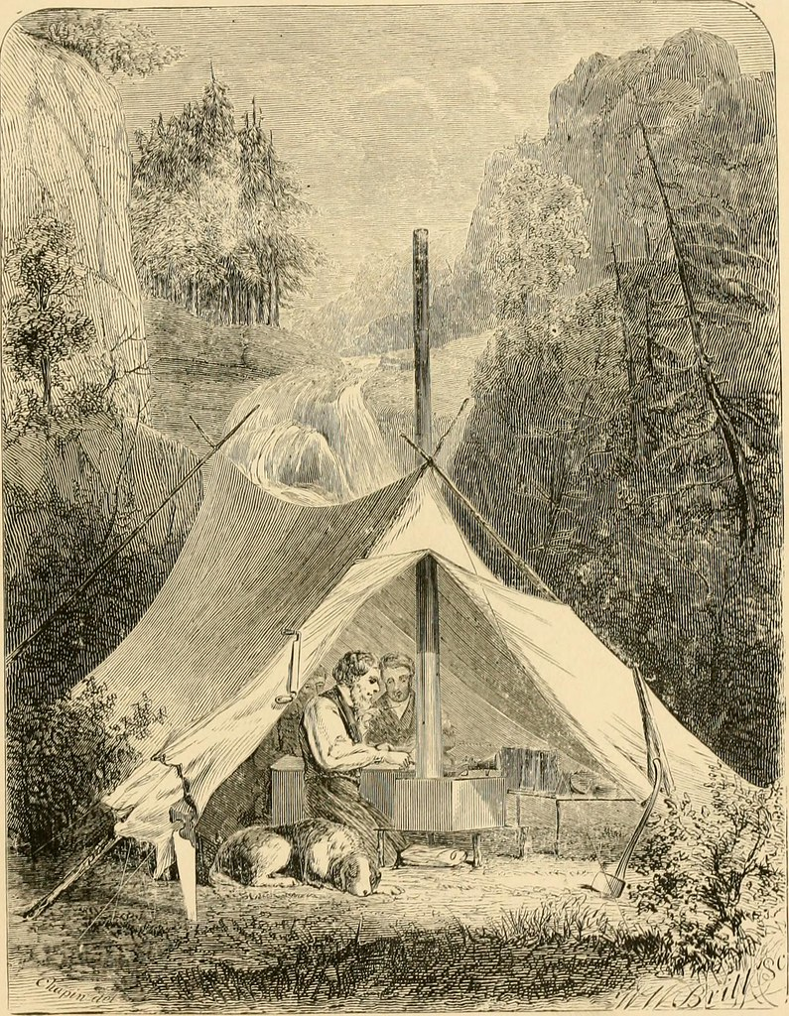
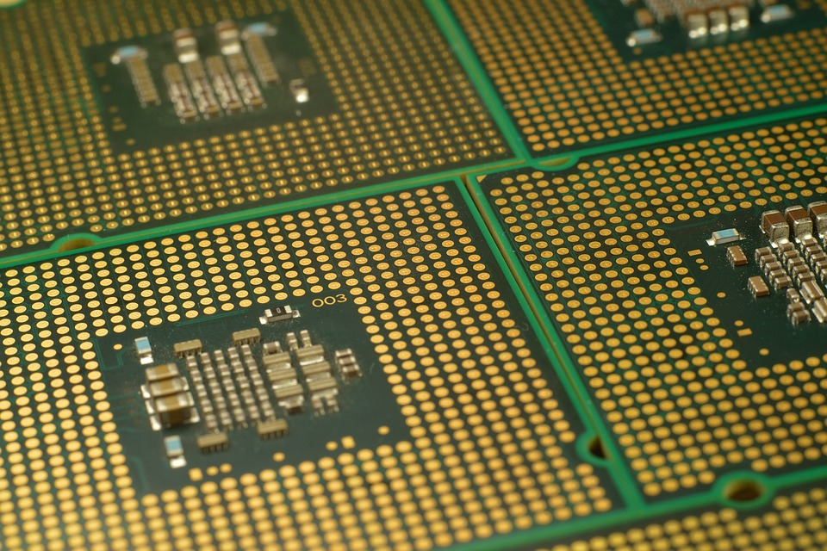
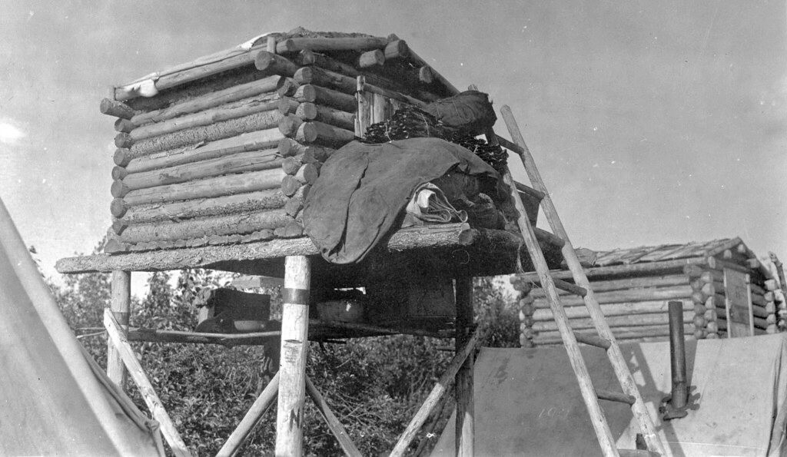
Binary
Iteration
Computer
Bus
Polymorphism

Slide 11
Mathew Wimpenny-Smith (Headington Pre School)
Primary Computing
1 min
2

Slide 12
Tina Götschi (Ada College)
3 min
All about the BTEC Qualification
3

Slide 13


Computer Science
BTEC @Ada
1
Notes:
What is this session really about?

Slide 14
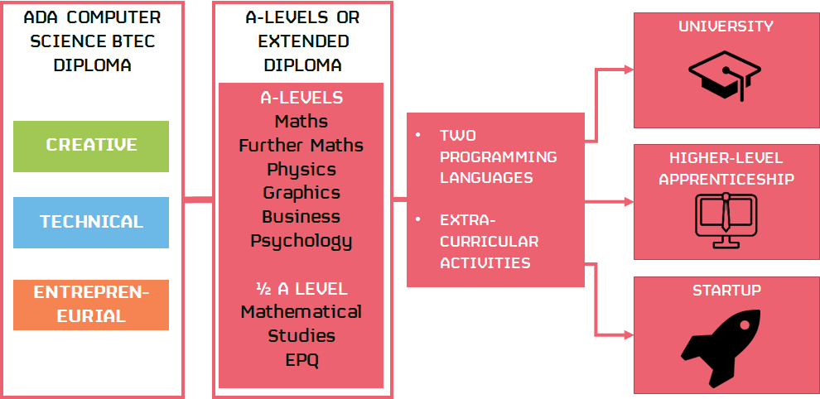
Notes:
Keep it short and sharp.
Asking questions with this kind of slides seems to work well, as it gives students something to wonder.
Even better if the question is framed in a slightly provocative way, eg: will robots steal our jobs?

Slide 15


Slide 16
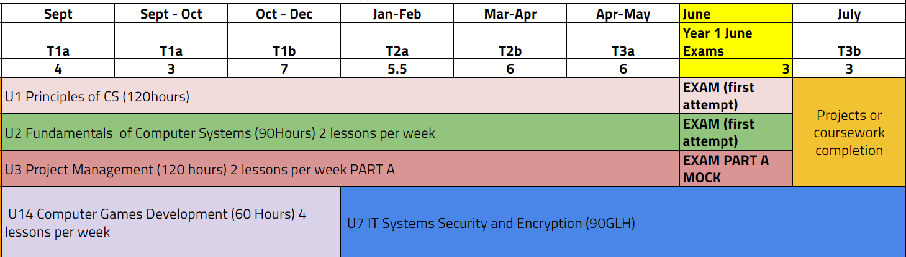
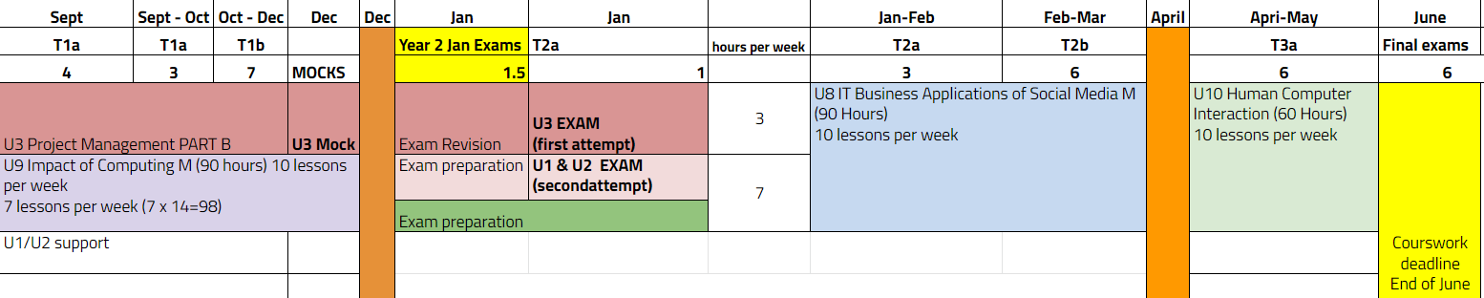

Slide 17
Yvonne Walker (BCS)
Assessment of computing
1 min
4

Slide 18
QuickStart Computing: A guide to transition across the Key Stages
A QuickStart style handbook on transition issues from early years through to post-16/university.
The needs of: early years; infants; junior; primary, secondary; key stage 4; post-16; universities.
Aims to enable/enhance better data sharing and understanding of the issues.
Guidance on approaches to curriculum, progression (pathways), assessment, recording, reporting and social development.
Examples of assessment, recording and reporting (to parents, colleagues, learners, the transition partner)
Strategies to support inclusion around:
    Gender
    SEND
    Ethnicity
    Deprivation
    Engagement with parents

Slide 19
Darren Murphey (Abercorn School)
3 min
Seesaw for Learning Journals
5

Slide 20
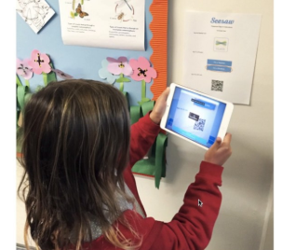

Slide 21
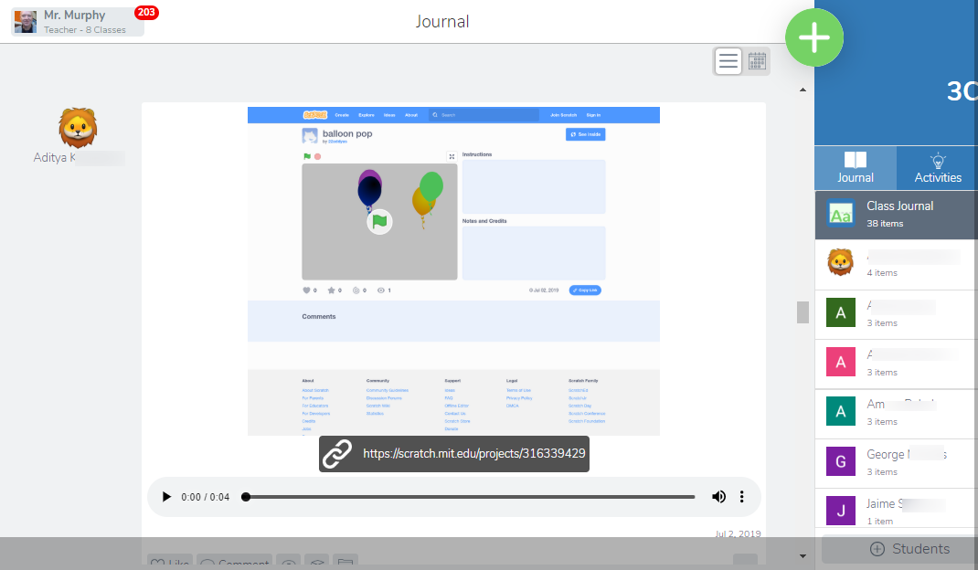

Slide 22
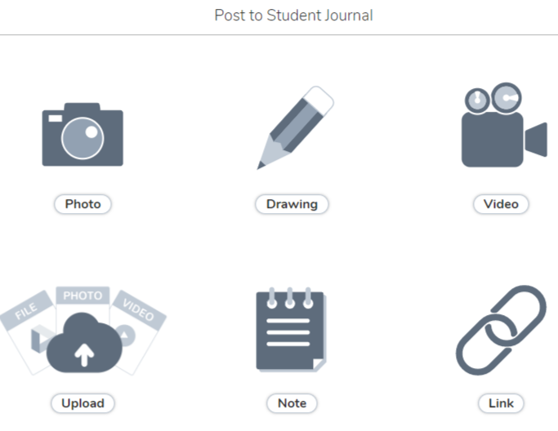

Slide 23
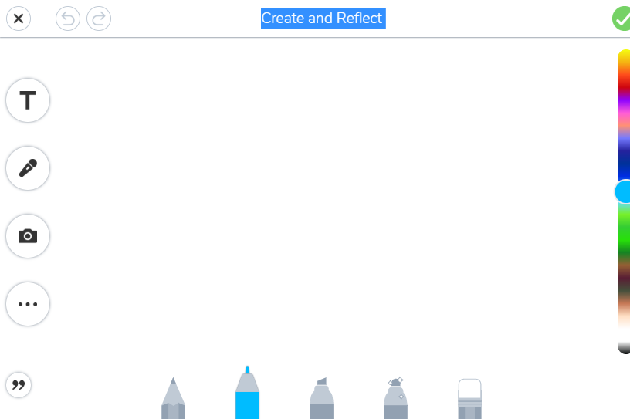

Slide 25
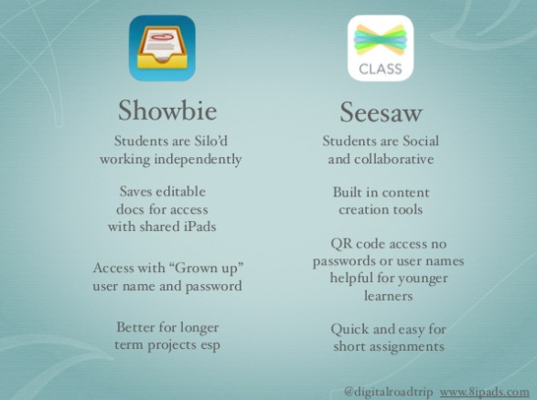

Slide 26
Sources
https://www.slideshare.net/juliancoultas/seesaw-v-showbie

Slide 27
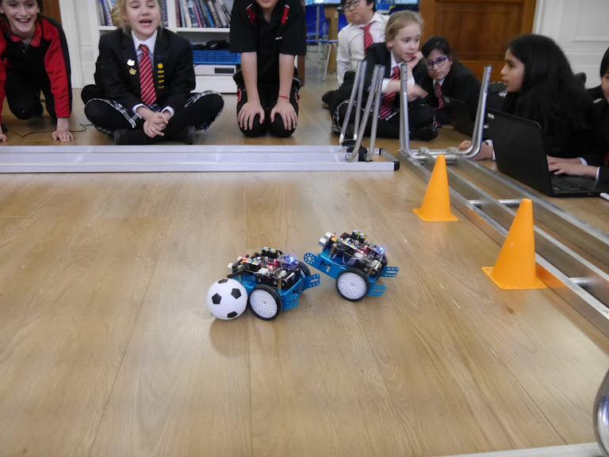

Slide 28
Michele Ainley (Naima Prep School)
Turing Tumble/resources I have found useful recently
1 min
6

Slide 29
Colin Hamilton (William Ellis School, Camden)
Lessons Learned from Flipping the Classroom
3 min
7

Slide 30

Lessons Learned from Flipping the Classroom
Evidence of watching video is required
Note taking needs to be structured
Teach them to take the notes
Space the learning
More time one to one in the classroom
Regular testing
Using the questions
It doesn’t work for all students

Slide 31
Biruk Bayeh (Rokeby School)
Assessment
1 min
8

Slide 32
Mark Campbell (Ada College)
3 min
Primary CS Masterclasses with RI and Ada
9

Slide 33

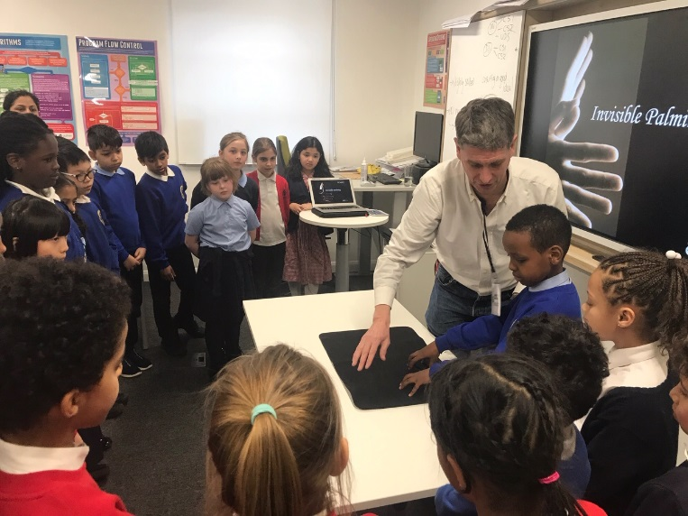
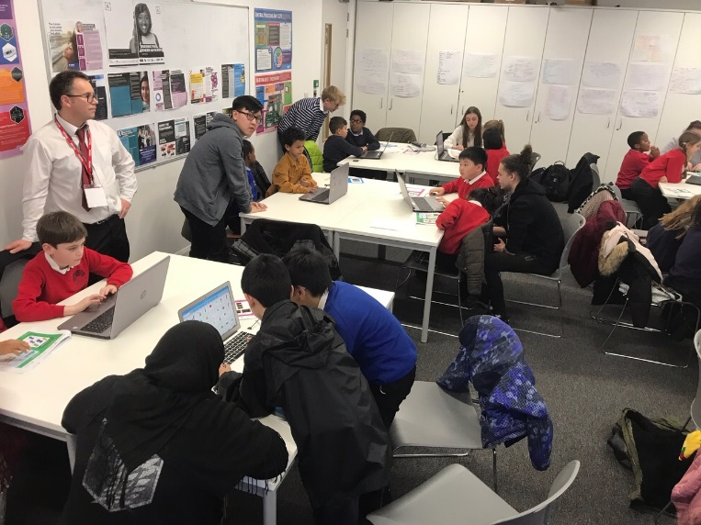
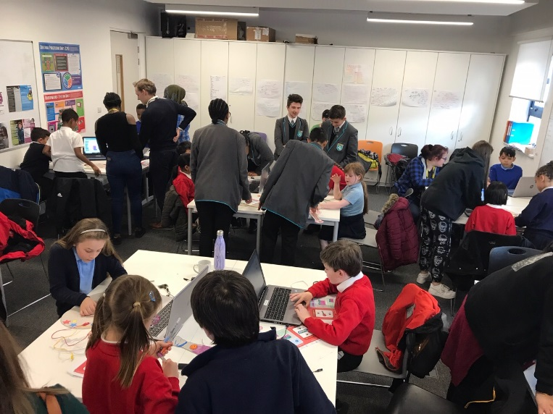
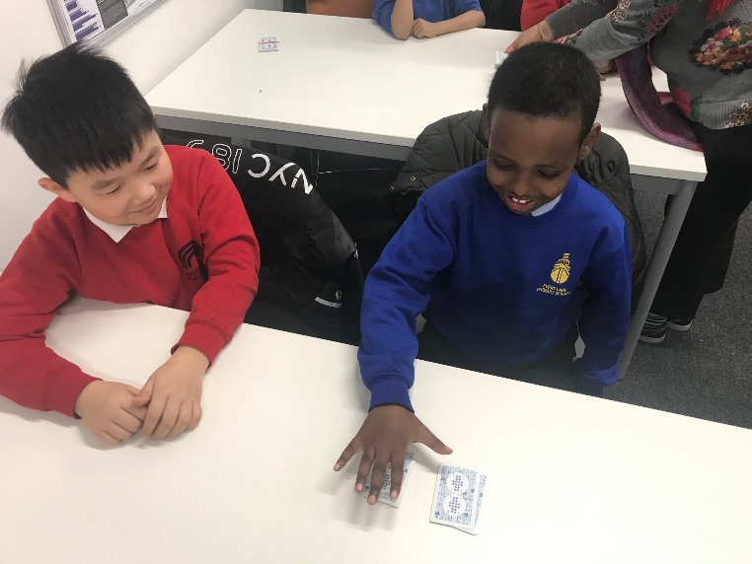
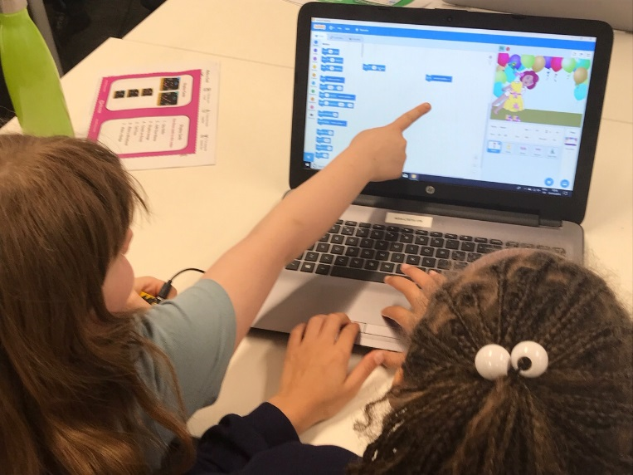
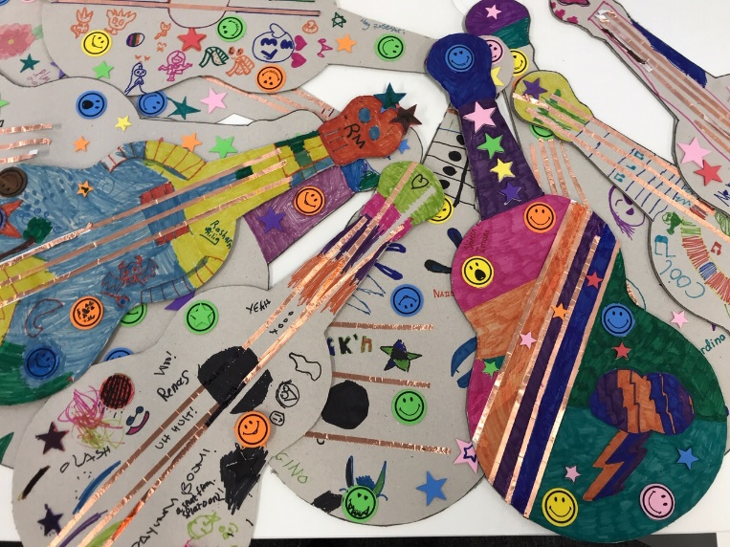
Primary Computer Science Masterclasses
A Pilot Programme with 24 Year 4's over three weekly sessions
Royal Institution in partnership with Ada College
Week #1
Week #2
Week #3

Slide 34
JI HYUN KIM (Korea)
Computing in Korea
1 min
10

Slide 35
Matt Bain (Morgan Stanley)
3 min
Agile in industry
11

Slide 36
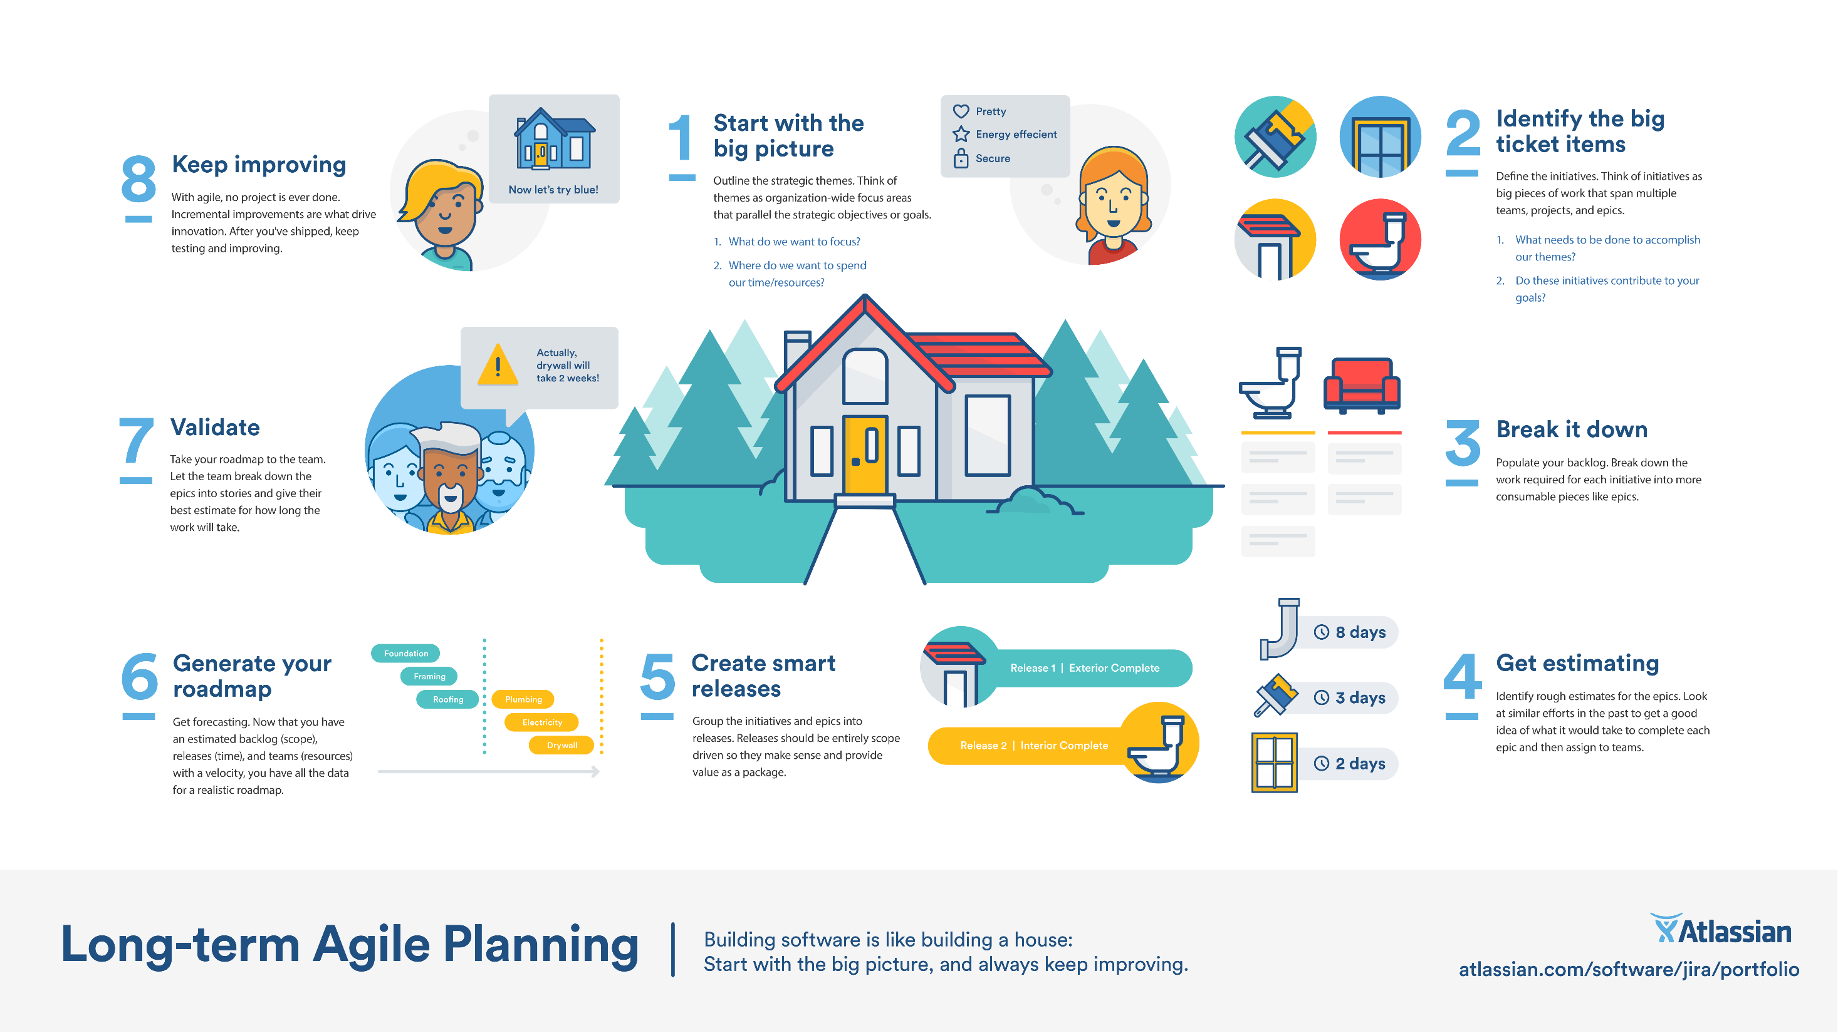

Slide 37
Michel Wermelinger (Open University)
3 min
From problems to programs
12

Slide 38


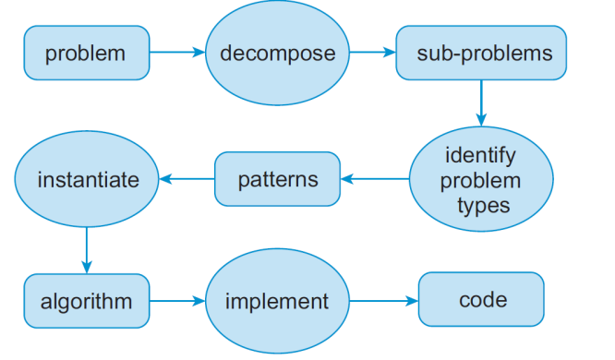
From problems to programs
Michel Wermelinger http://tiny.cc/prob2prog
Abstraction is hard: give patterns
Patterns/algorithms in English
Patterns are thinking scaffold
Patterns show variable roles
Patterns show problem similarity
Problem: sum of list Type: reduction/summary
Pattern:
initialise the input list
initialise the summary with a suitable value
for each item in the list:
  update the summary according to the item
output summary
Algorithm:
initialise the input list numbers
set sum to zero
for each number in numbers:
  increment the sum by number
output sum

Slide 39
Nick Hughes (Latymer Prep)
3 min
Machine Learning for Kids
13

Slide 40
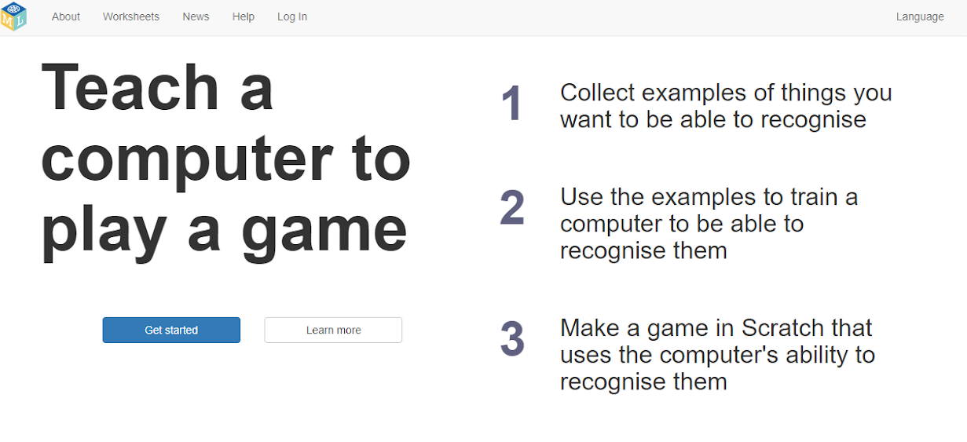

Slide 41

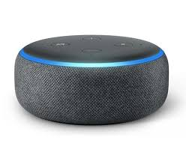
Create your own Alexa...
Turn on the Light….

Slide 42
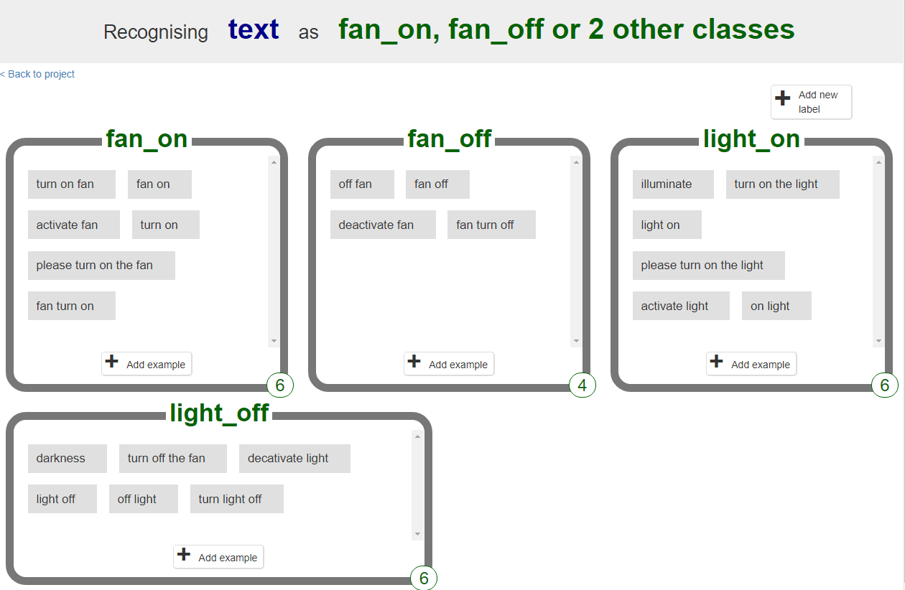

Slide 43
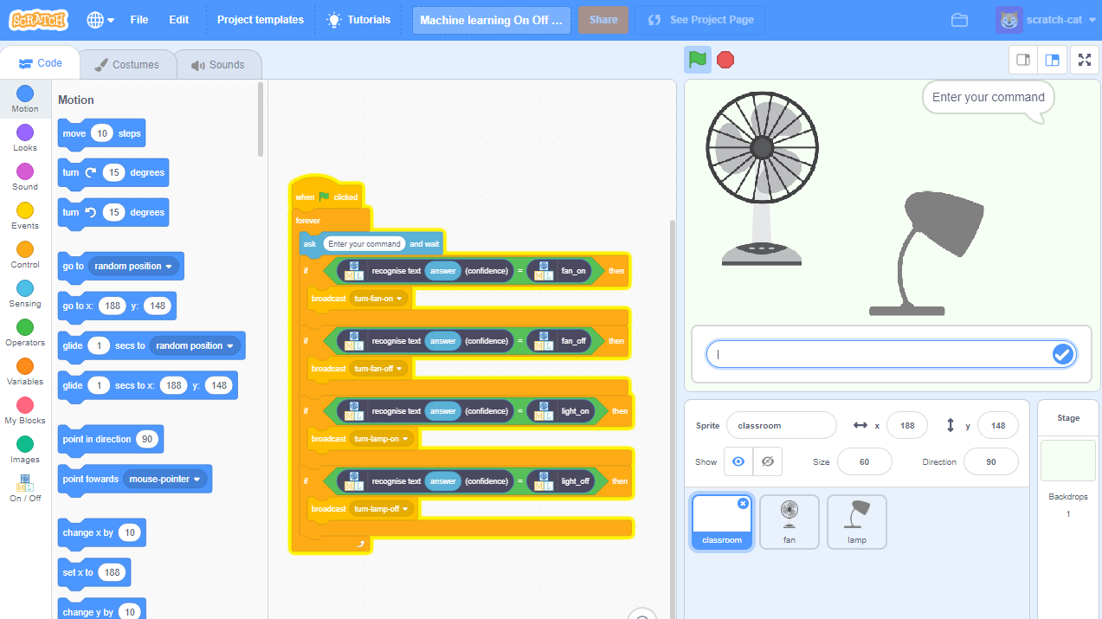

Slide 44
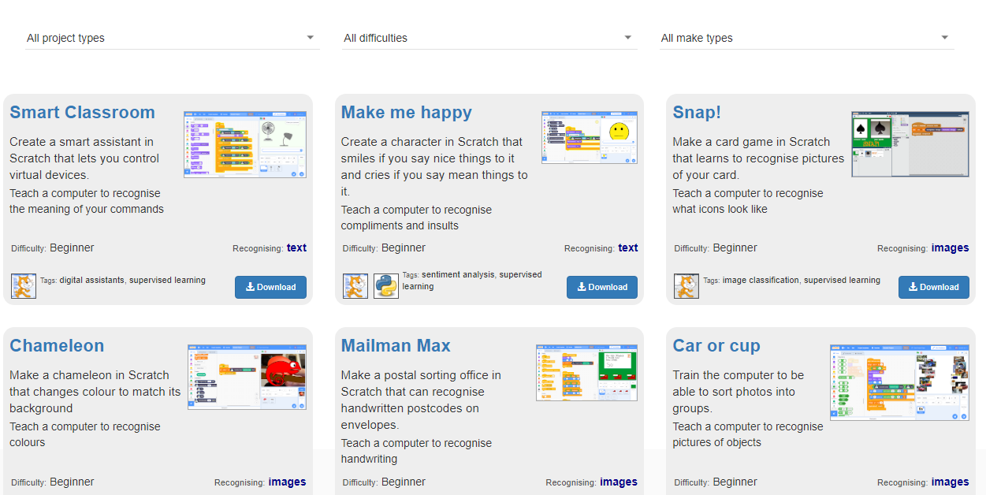

Slide 45
Camaran ()
3 min
AR and VR with Co Spaces
14

Slide 46


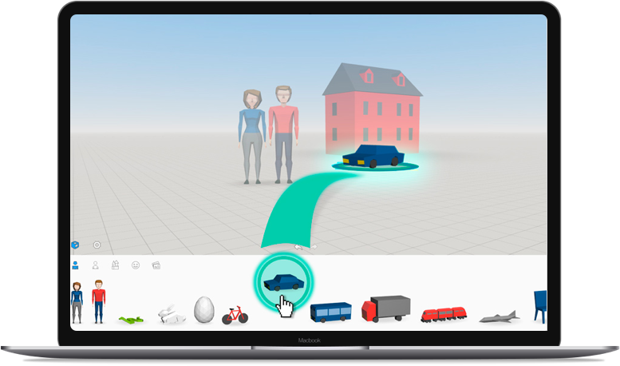
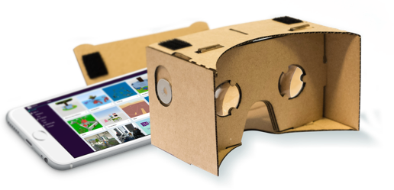
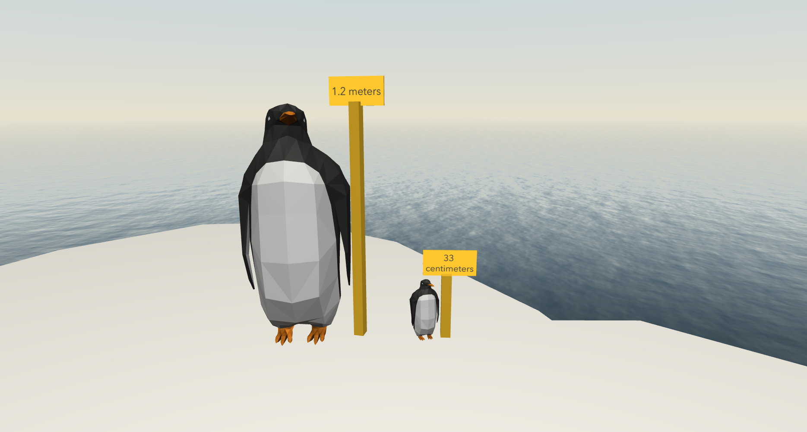
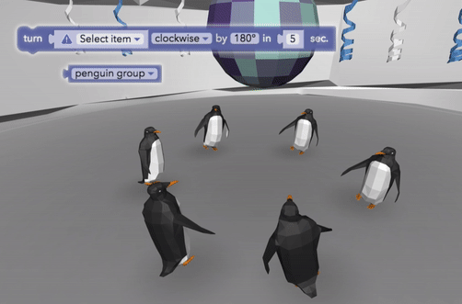
Co Spaces Edu
3 Dimensional (AR and VR) Creator
Enables Immersive Learning
Promotes Creativity
Can use on any platform/device
Continuous learning- home and school
Can integrate and apply anything
Any age can do Cospaces
Code objects with either Blockly or Javascript
You can control the Physics of objects
Create objects in TinkerCad and import them in
3D mode
gyroscope mode (360° mode)
VR mode

Slide 47
Richard Millwood (University of Dublin)
3 min
Programming Oracy, or how do we speak a computer program
15

Slide 48
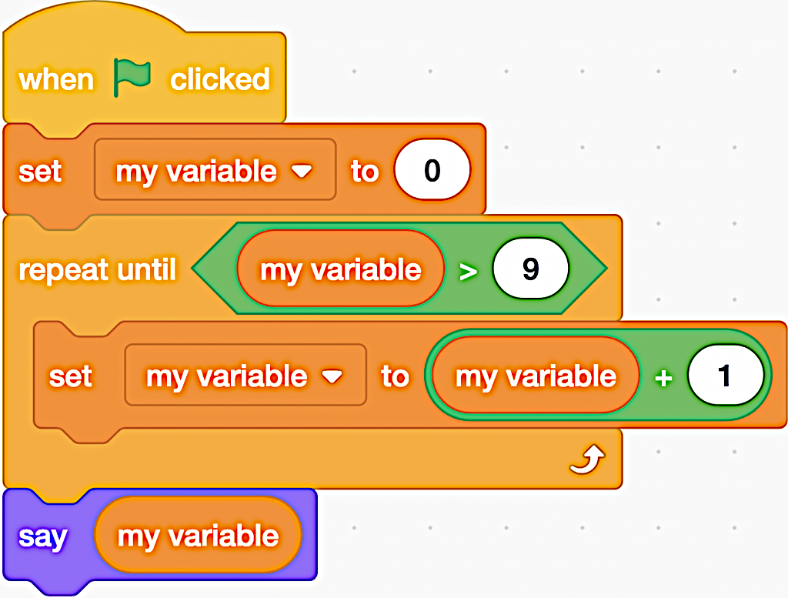
Richard Millwood:
How do we speak a computer program?
http://blog.richardmillwood.net
Try speaking this computer program out loud to a friend and ask them to write down the words you say.
In speaking it, how did you make clear that the ‘say my variable’ piece was outside the ‘repeat until my variable greater than nine’ piece?

Slide 49
Mike Skells (Morgan Stanley)
3 min
Morgan Stanley supporting local schools
16

Slide 50
Scope of school involvement
Driven by the individual schools
  After school revision classes and clubs
  Timetabled classroom lessons
  Talks at subject options evenings
  School Assemblies
  Careers talks
  Tour at MS offices for over 200 Computer Science students
  GCSE
  A Level
  Mentoring

Slide 51
Volunteering in numbers
Usually one session every one or two weeks per volunteer
One volunteer to 3-4 students
> 2000 hours in 2018
Expecting ~4000 hours n 2019
Mixture of experienced volunteers (MDs, EDs, VPs) and new graduates, Industrial Placement students, and interns

Slide 52
The Program – Summary
Volunteering initiative to teach Computer Science in schools
Running for 4 years in London (started in EAI)
Involvement with six local schools/colleges in Tower Hamlets:
  George Green
  Central Foundation
  East London Science School
  New City College
  Sir John Cass's Foundation
  St Paul’s Way Trust

Slide 53
Initial Objectives
Improve results in Computer Science GCSE
Raise awareness of Computer Science as a career option
Provide more appropriate outlet for our skills

Slide 54
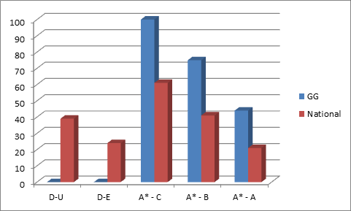
Outcomes *
Note - these are small samples and statistical invalid, so consider it as interesting
Consistent improvement in results at George Green (not all down to us ☺)
Measurable below national average before involvement
2016 - 25% above national average
2017 - 32% above national average
2018 Data is harder to present with more schools. Every result above national average, for each school, and each grade
2017

Slide 55
Current Objectives
Improve results in Computer Science GCSE and A level
Raise awareness, and facilitate Computer Science as a career option
Provide more appropriate outlet for our skills
Broaden the talent pool for recruitment
Company wide
  Cross divisional
  Cross region

Slide 56
(Personal) Targets
Target 5000 hours by year end, In London
10 Secondary (or tertiary) schools in London
Complete the circle
  By 2025 for students we have taught
    Employ 5 in London
    25 possible future employees
Make the program infrastructural, like GOSH
  Seed sister programs (New York, Shanghai, Montreal)
  Cross divisional

Slide 57
Miles Berry (University of Roehampton)
3 min
NCCE CPD
17

Slide 58
Wendy MacLeod (BCS)
3 min
CAS News
18

Slide 59
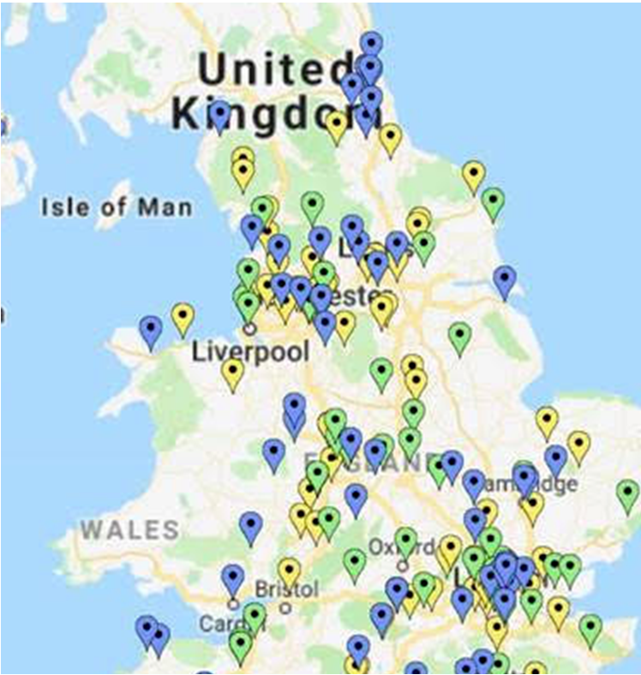
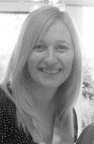
Who am I and what is my role?
Wendy MacLeod
CAS Community
Outreach Manager
(London & East of England)
wendy.macleod@bcs.uk
@wendymacleod3
07967 440163
Notes:
Veronica – Carlisle to Newcastle to York to Leeds to Blackpool

Slide 60
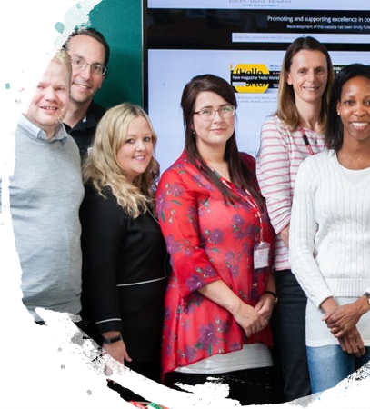
London CAS Communities (22)
Barking & Dagenham Mixed
Barnet & Enfield Primary
Bexleyheath Secondary
Brent Mixed
Bromley & Hayes Primary
Croydon Secondary
Ealing Secondary
Hammersmith Mixed
Haringey Mixed
Harrow Secondary
Kidbrooke Primary
Lambeth Primary
Lewisham Mixed
London Queen Marys
Northwood Secondary
Orpington & Bromley Secondary
Tower Hamlets Mixed
Vauxhall Primary
Wandsworth Primary
Westminster Primary
Westminster Secondary
Whyteleafe Primary
Notes:
Veronica – Carlisle to Newcastle to York to Leeds to Blackpool

Slide 61
Thank you for coming – What next?
A level – to review coursework
NCCE
TechPathways, LGFL, the CLCs, Ada, 3BM etc
Gaps – CoPs - local planning/ moderation?
CAS London Conference

Slide 62

Requested for the
CAS London
2020 conference!
February

Slide 63
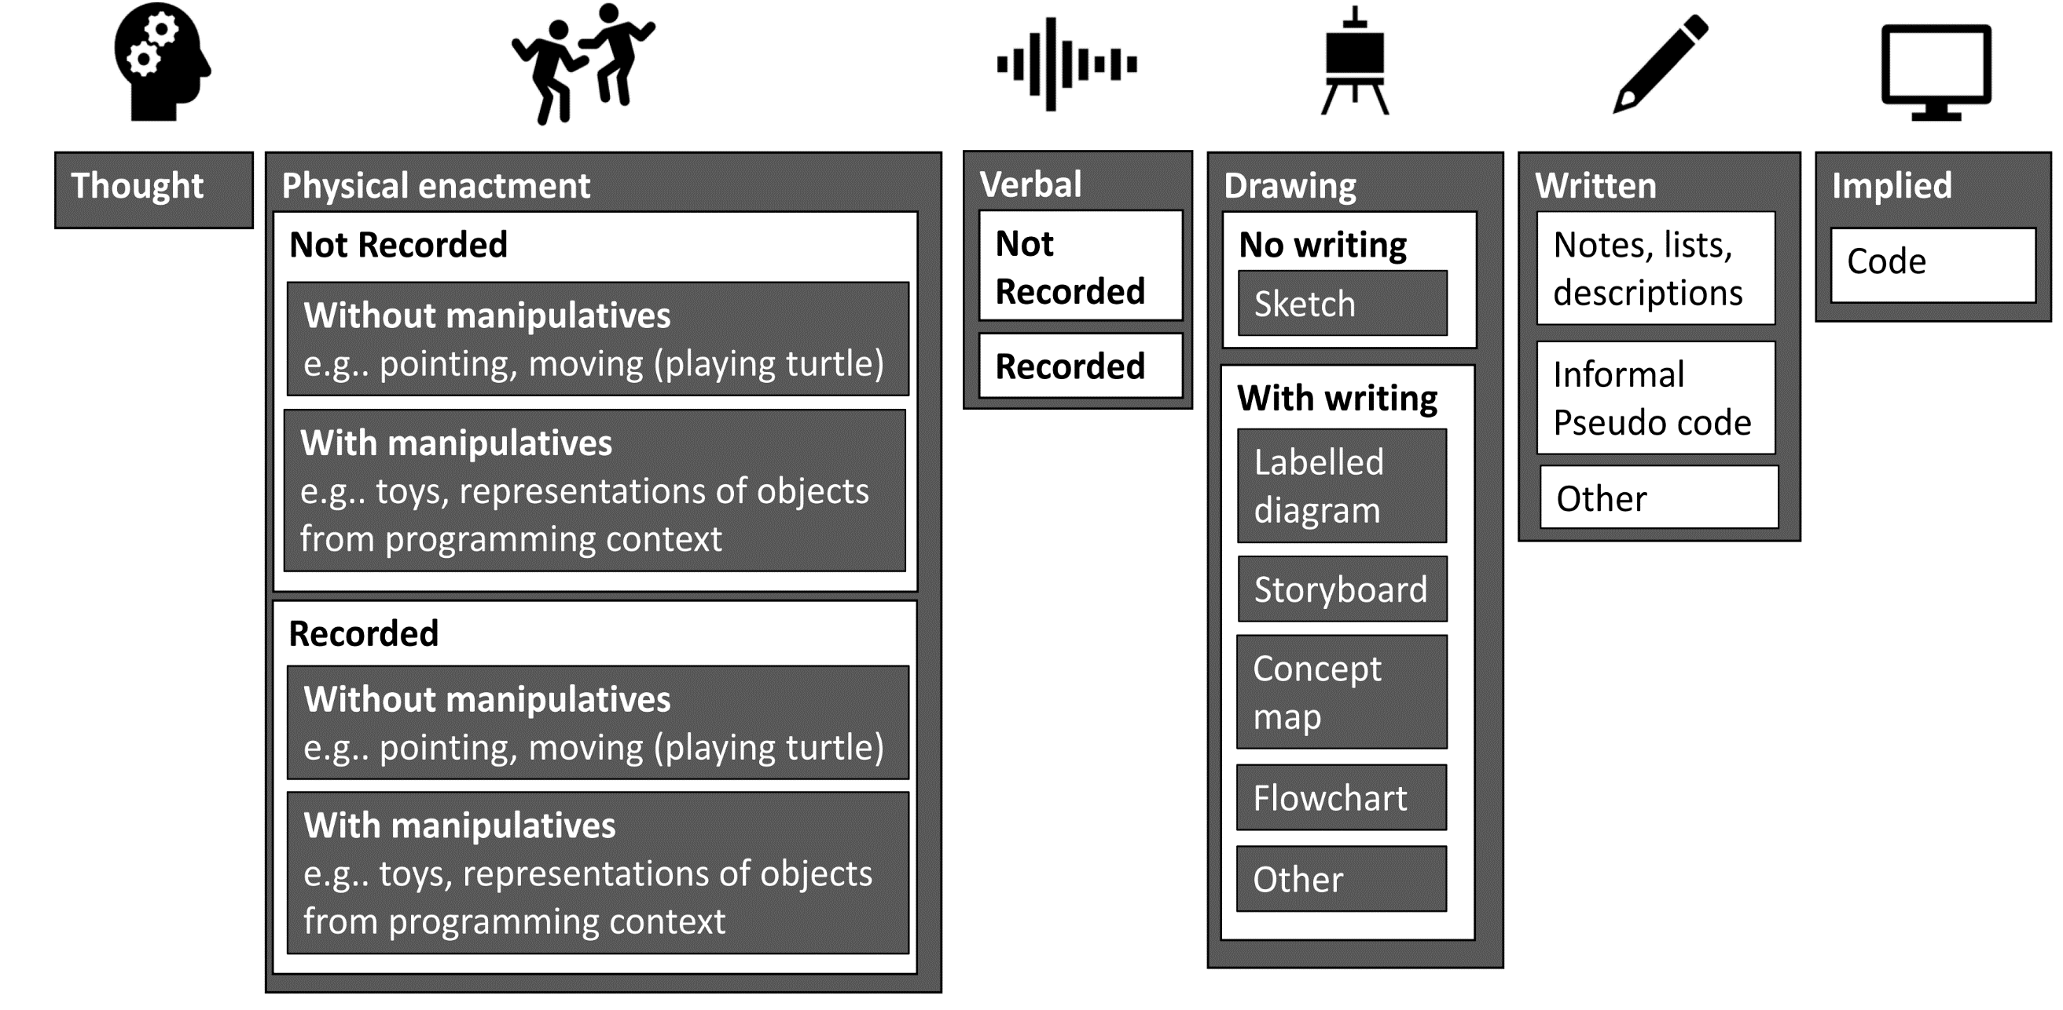
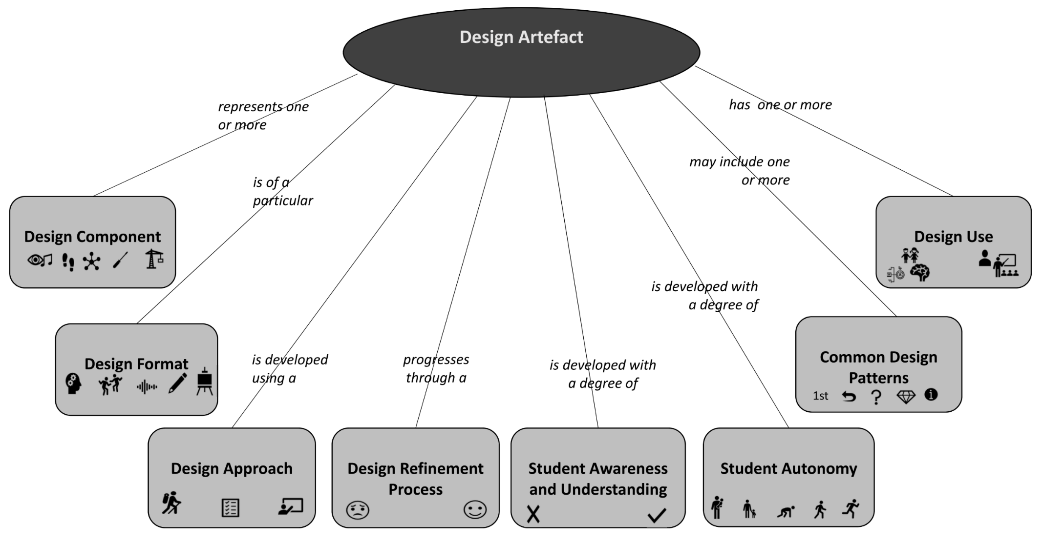
Research - Design Toolkit – Call for Participants
Aspects of the
Design Artefact

Slide 64
What you wanted to look at
A Level A Level Coursework approaches
  Propose – A level meet up? What is the right time.
The 2022 GCSE Computer Science Programming Exam Should we even be considering paper based exams at all?
  Conference discussion – John Woolard ‘discussion’
Quick summative assessment options – several talks…
New Edtech strategy https://www.alt.ac.uk/news/all_news/department-education-publishes-new-edtech-strategy
  Copies
Notes:
Biruk A level
A level coursework approaches Colin
2022 CS exam – should we consider paper based sara
Summartive assessment
Ed tech strategy Darren

