Slide 1
GCSE / A-Level computer science teaching engagement
Mike Skells

Slide 2
The Program – Summary
Volunteering initiative to teach Computer Science in schools
Running for 4 years in London (started in EAI)
Involvement with six local schools/colleges in Tower Hamlets:
  George Green
  Central Foundation
  East London Science School
  New City College
  Sir John Cass's Foundation
  St Paul’s Way Trust

Slide 3
Initial Objectives
Improve results in Computer Science GCSE
Raise awareness of Computer Science as a career option
Provide more appropriate outlet for our skills

Slide 4
Current Objectives
Improve results in Computer Science GCSE and A level
Raise awareness, and facilitate Computer Science as a career option
Provide more appropriate outlet for our skills
Broaden the talent pool for recruitment
Company wide
  Cross divisional
  Cross region

Slide 5
Volunteering in numbers
Usually one session every one or two weeks per volunteer
One volunteer to 3-4 students
> 2000 hours in 2018
Expecting ~4000 hours n 2019
Mixture of experienced volunteers (MDs, EDs, VPs) and new graduates, Industrial Placement students, and interns

Slide 6
(Personal) Targets
Target 5000 hours by year end, In London
10 Secondary (or tertiary) schools in London
Complete the circle
  By 2025 for students we have taught
    Employ 5 in London
    25 possible future employees
Make the program infrastructural, like GOSH
  Seed sister programs (New York, Shanghai, Montreal)
  Cross divisional

Slide 7
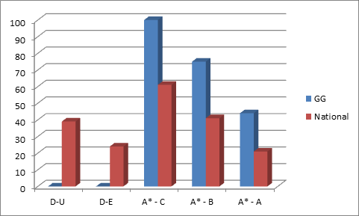
Outcomes *
Note - these are small samples and statistical invalid, so consider it as interesting
Consistent improvement in results at George Green (not all down to us ☺)
Measurable below national average before involvement
2016 - 25% above national average
2017 - 32% above national average
2018 Data is harder to present with more schools. Every result above national average, for each school, and each grade
2017

Slide 8
Scope of school involvement
Driven by the individual schools
  After school revision classes and clubs
  Timetabled classroom lessons
  Talks at subject options evenings
  School Assemblies
  Careers talks
  Tour at MS offices for over 200 Computer Science students
  GCSE
  A Level
  Mentoring

