Slide 1

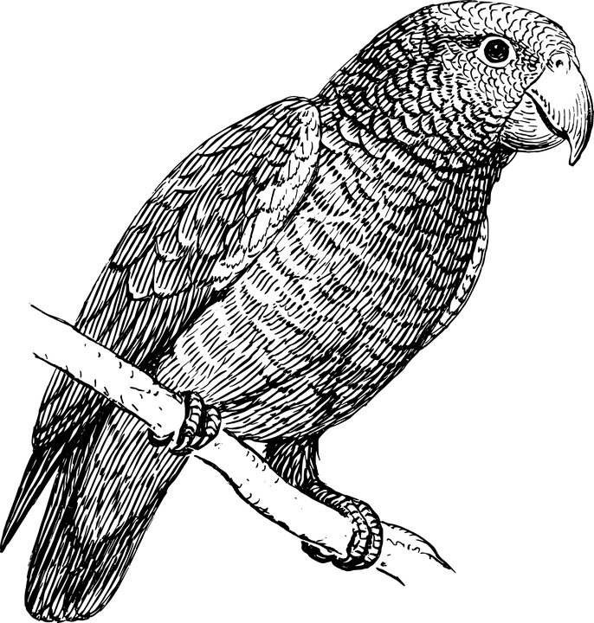

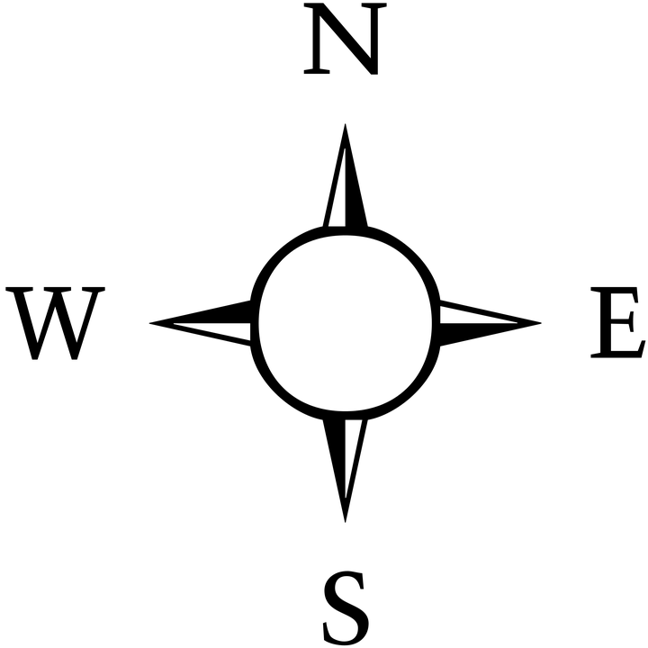

The Island of Squaregridia
The Island of Squaregridia
A1
A2
A3
A4
A1
A2
A3
A4
Treasure
Treasure
B1
B2
B3
B4
B1
B2
B3
B4
Trap
(parrots)
Trap
(parrots)
Trap
(family of tigers)
Trap
(family of tigers)
C1
C2
C3
C4
C1
C2
C3
C4
D1
D2
D3
D4
D1
D2
D3
D4
Trap
(pirates)
Trap
(pirates)
START
START
The Island of Squaregridia
The Island of Squaregridia
A1
A2
A3
A4
A1
A2
A3
A4
Treasure
Treasure
B1
B2
B3
B4
B1
B2
B3
B4
Trap
(parrots)
Trap
(parrots)
Trap
(family of tigers)
Trap
(family of tigers)
C1
C2
C3
C4
C1
C2
C3
C4
D1
D2
D3
D4
D1
D2
D3
D4
Trap
(pirates)
Trap
(pirates)
START
START
Notes:
file 1: Squaregridia mapped.pptx

Slide 2
Suggested solutions
The Island of Squaregridia
The Island of Squaregridia
A1
A2
A3
A4
A1
A2
A3
A4
Treasure
Treasure
B1
B2
B3
B4
B1
B2
B3
B4
Trap
(parrots)
Trap
(parrots)
Trap
(family of tigers)
Trap
(family of tigers)
C1
C2
C3
C4
C1
C2
C3
C4
D1
D2
D3
D4
D1
D2
D3
D4
Trap
(pirates)
Trap
(pirates)
START
START
Instructions
Move UP one, RIGHT one, RIGHT one, UP one, UP one, RIGHT one – if correct, dig!
(Or UP = North / RIGHT = East)
OR
Move UP one, RIGHT two,
UP two, RIGHT one – if correct, dig.
(Or UP = North / RIGHT = East)
Instructions
Move UP one, UP one, UP one, move RIGHT one, RIGHT one, RIGHT one – if correct, dig!
(Or UP = North / RIGHT = East)
OR
Move UP three, move RIGHT three – if correct, dig.
(Or UP = North / RIGHT = East)
Notes:
file 2: Squaregridia routes.pptx (for colour printers, or for use on screen)

Slide 3
Suggested solutions
The Island of Squaregridia
The Island of Squaregridia
A1
A2
A3
A4
A1
A2
A3
A4
Treasure
Treasure
B1
B2
B3
B4
B1
B2
B3
B4
Trap
(parrots)
Trap
(parrots)
Trap
(family of tigers)
Trap
(family of tigers)
C1
C2
C3
C4
C1
C2
C3
C4
D1
D2
D3
D4
D1
D2
D3
D4
Trap
(pirates)
Trap
(pirates)
START
START
Instructions
Move UP one, RIGHT one, RIGHT one, UP one, UP one, RIGHT one – if correct, dig!
(Or UP = North / RIGHT = East)
OR
Move UP one, RIGHT two,
UP two, RIGHT one – if correct, dig.
(Or UP = North / RIGHT = East)
Instructions
Move UP one, UP one, UP one, move RIGHT one, RIGHT one, RIGHT one – if correct, dig!
(Or UP = North / RIGHT = East)
OR
Move UP three, move RIGHT three – if correct, dig.
(Or UP = North / RIGHT = East)
Notes:
file 2: Squaregridia routes.pptx (for black and white printers)

Slide 4
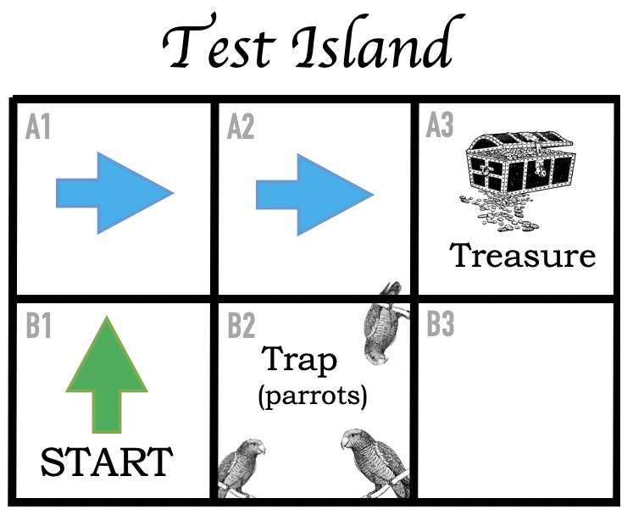
Instructions
Move UP one, RIGHT one, RIGHT one – dig.
OR
Move NORTH one, EAST one, EAST one – dig.
OR
Move UP (NORTH) one, RIGHT (EAST) two – dig.
Notes:
“Test Island” – for explaining (1) how to work out a route and (2) ways of giving instructions for someone to follow the route.
For use on-screen or on colour printers

Slide 5
Instructions
Move UP one, RIGHT one, RIGHT one – dig.
OR
Move NORTH one, EAST one, EAST one – dig.
OR
Move UP (NORTH) one, RIGHT (EAST) two – dig.
Notes:
“Test Island” – for explaining (1) how to work out a route and (2) ways of giving instructions for someone to follow the route.
For black and white printers

Slide 6
The Island of Squaregridia
The Island of Squaregridia
A1
A2
A3
A4
A1
A2
A3
A4
B1
B2
B3
B4
B1
B2
B3
B4
C1
C2
C3
C4
C1
C2
C3
C4
D1
D2
D3
D4
D1
D2
D3
D4
START
START
Squaregridia
The Island of Squaregridia
The Island of Squaregridia
A1
A2
A3
A4
A1
A2
A3
A4
B1
B2
B3
B4
B1
B2
B3
B4
C1
C2
C3
C4
C1
C2
C3
C4
D1
D2
D3
D4
D1
D2
D3
D4
START
START
Notes:
Blank island maps of Squaregridia with START square included

Slide 7
The Island of Blanksquaresia
The Island of Blanksquaresia
A1
A2
A3
A4
A1
A2
A3
A4
B1
B2
B3
B4
B1
B2
B3
B4
C1
C2
C3
C4
C1
C2
C3
C4
D1
D2
D3
D4
D1
D2
D3
D4
Blanksquaresia
The Island of Blanksquaresia
The Island of Blanksquaresia
A1
A2
A3
A4
A1
A2
A3
A4
B1
B2
B3
B4
B1
B2
B3
B4
C1
C2
C3
C4
C1
C2
C3
C4
D1
D2
D3
D4
D1
D2
D3
D4
Notes:
Completely blank maps of Blanksquaresia

