Slide 1
Design Toolkit
Using design in primary programming projects
Research – Toolkit Pilot
Jane Waite
All resources available at
https://teachinglondoncomputing.org/research_primaryprogdesigntoolkit_pilot/
@janewaite @cas_London_crc

Slide 2
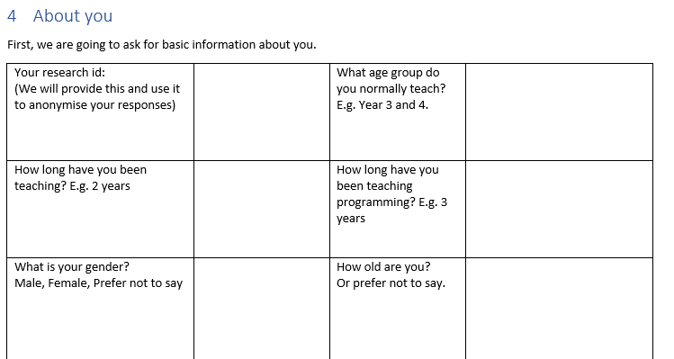
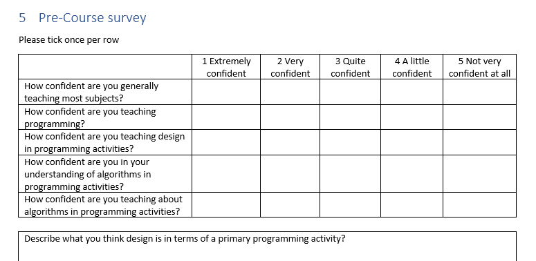
In your booklet please complete the
Page 4 & 5
About you and Pre-course survey on Page 4 & 5

Slide 3
Objectives of this session
Introduce the research – and ask you to take part
Use the toolkit (and review it as we go along)
    a barefoot programming activity
    your own programming activity
We won’t finish today – but we have an online follow-up

Slide 4
Phase 1 Interviews
(5 teachers, 50 pupils)
How is design being used in programming classes and planning in other subjects?
Phase 2 Survey
(207 teachers)
Are the findings from Phase 1 seen in a wider group of teachers?
Phase 3 Focus groups
(30-50 teachers)
Can we develop a design framework to support teachers .
(Pilot – today)
Research plan

Slide 5
Research findings – Phase 1
Interesting uses of design
Synergies with teaching writing
Confusion over what an algorithm is

Slide 6
Research findings – Phase 2
Design for programming
  is as useful as
Planning in writing
BUT
is not used as much

Slide 7
Difficulties of using design
Pupil resistance to design
Lack of time to do design
Lack of pupil expertise in design
Conflicting pedagogy choices and lack of suitable resources
Lack of teacher expertise in design
Confusion of what an algorithm is
Research findings Phase 2
Phase 3 will start to address

Slide 8
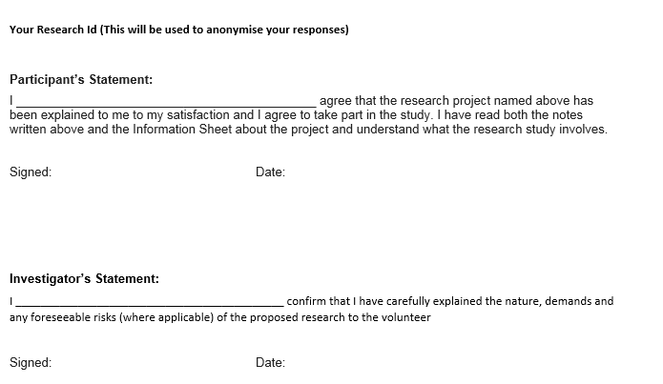
If you would like to take part in phase 3 of the research
Pilot 001
LAST PAGE OF THE TOOLKIT
YOUR NAME
Your signature
28/6/2019
Jane Waite
J Waite
28/6/2019

Slide 9
Using the toolkit
Page 6
Complete “the about your activity” section
(If you did not bring your own activity – pair up and use one with a partner or use the Code.org Year 3 project)

Slide 10
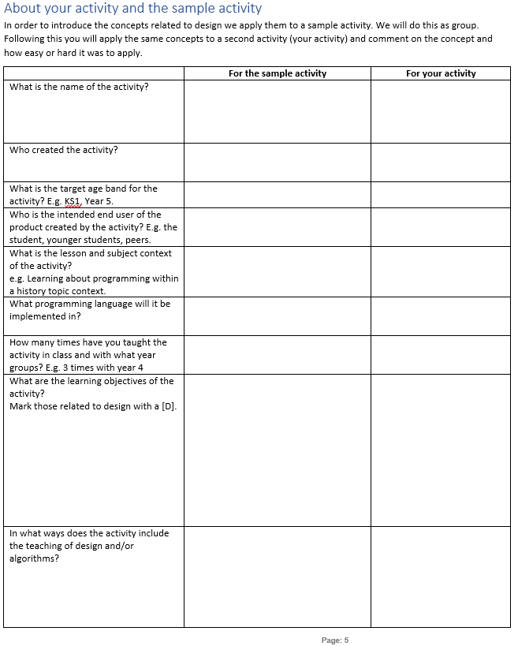
Page 6
Viking raid
Barefoot
Year 4-6
Pupils
History - Vikings
Scratch

Slide 11
Page 6
Never
I can write a program with a sequence of instructions
A design is modelled to pupils, including creating an algorithm and using it. Pupils create their own design and algorithm. They use it to implement their code. They check back to the algorithm at the end for both assessment and to review what an algorithm is

Slide 12
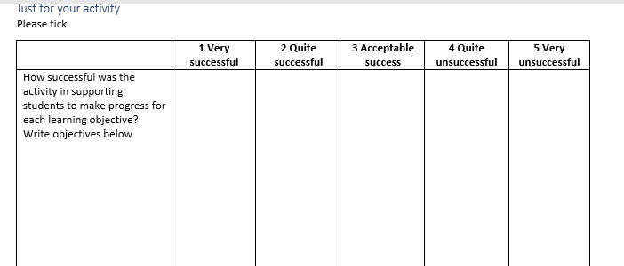
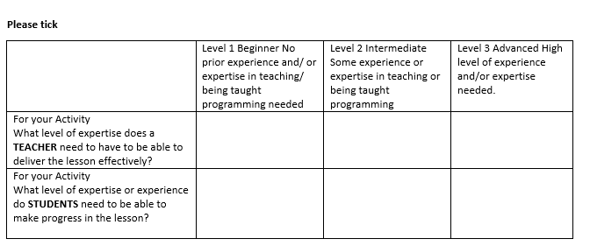
Page 6

Slide 13
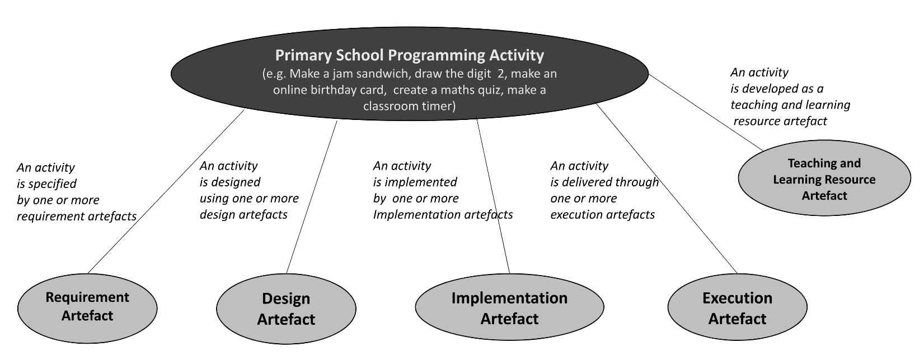
Artefacts of an Activity
Notes:
Have started to gather a number of these already – such as data about the teaching and learning aspects of the activity, the implelementation (programming language) and now going to capture one important aspect of the requirement artefact – the genre. (DON’T SAY WHY)

Slide 14
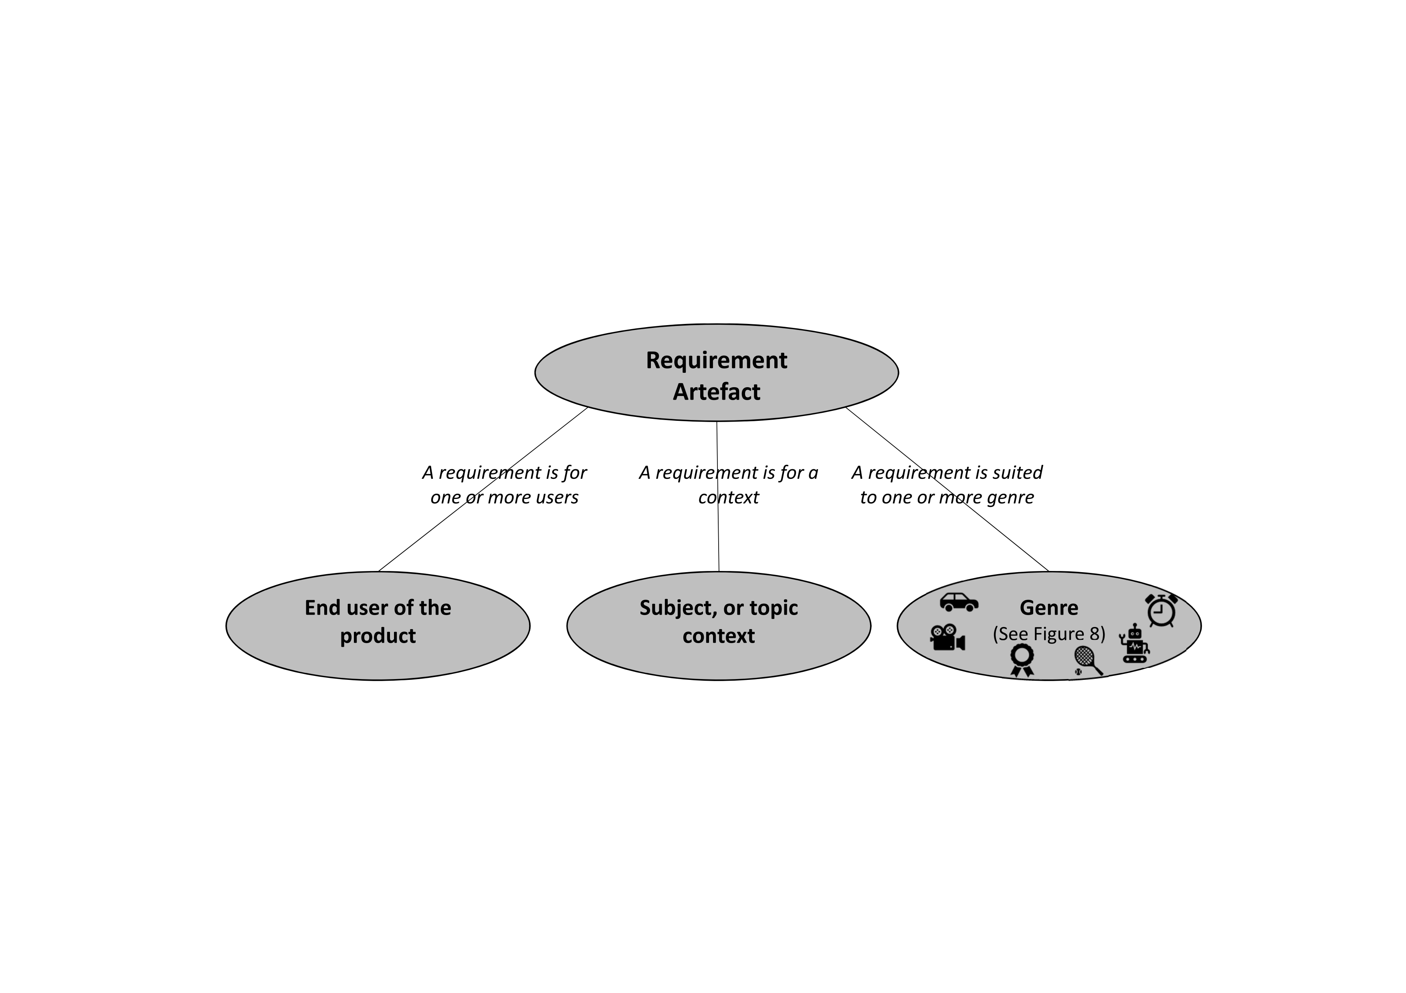

Slide 15






Project genres
 | Genre | Example
 | Route based | e.g. programming a programmable toy to navigate through a maze, programming an online character to move from one location to another
 | Animations | e.g. programming a simple sequence of changes in backgrounds, character appearance characteristics
 | Quizzes | e.g. programming the display of questions, input of answers, evaluation of responses and associated scores
 | Games & simulations | e.g. programming a set of responses to user input
 | Physical computing | e.g. any of the other genre but with a physical computing aspect, such as a external sensor for an input, or an output of a motor movement or light
 | Tools or aids | e.g. programming a set of responses to user input which create outputs that provide a tool or aid, such as a timer, a calculator or synonym sentence maker

Slide 16
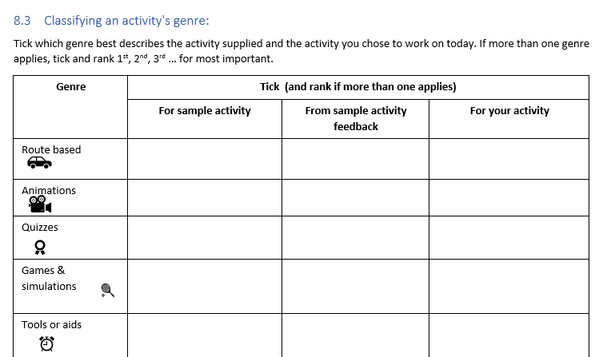
Page 10
✓ 1st
✓ 2nd
✓

Slide 17
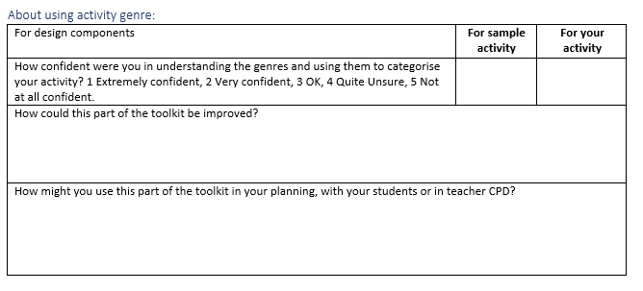
Page 10
3
xxxxx
xxxxx

Slide 18
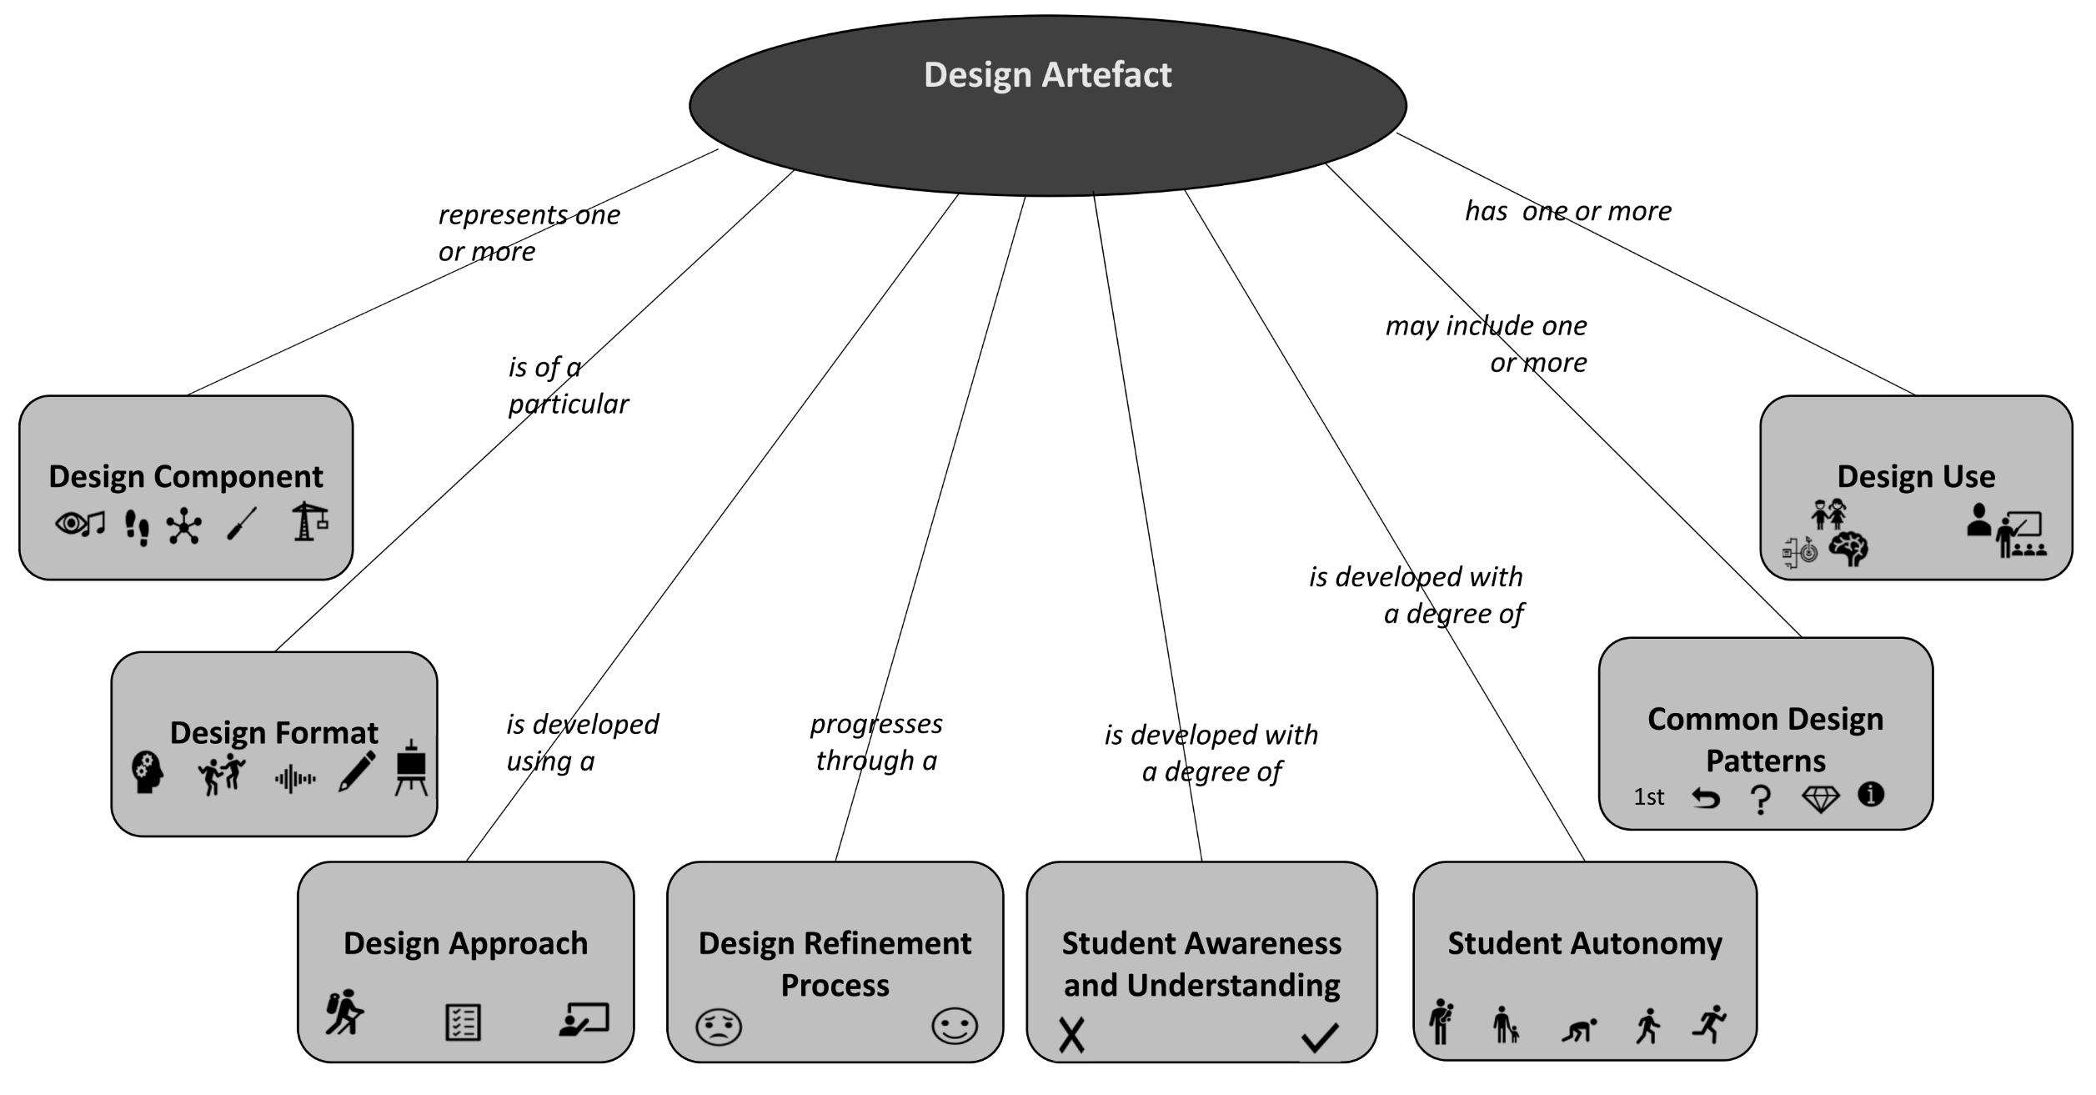
Aspects of the
Design Artefact

Slide 19
Design Components

Slide 20
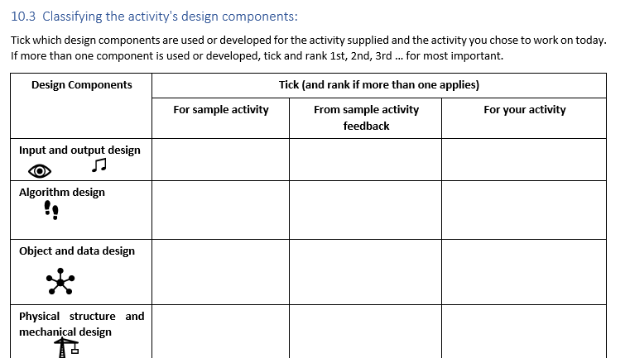
Page 13
✓2nd
✓ 1st
✓2nd

Slide 21
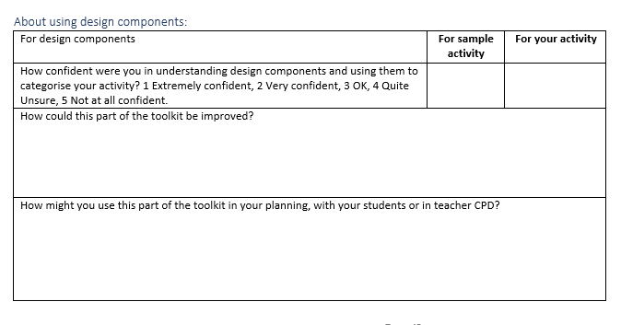
Page 13
1
xxxxx
xxxxx

Slide 22
Aspects of the
Design Artefact

Slide 23
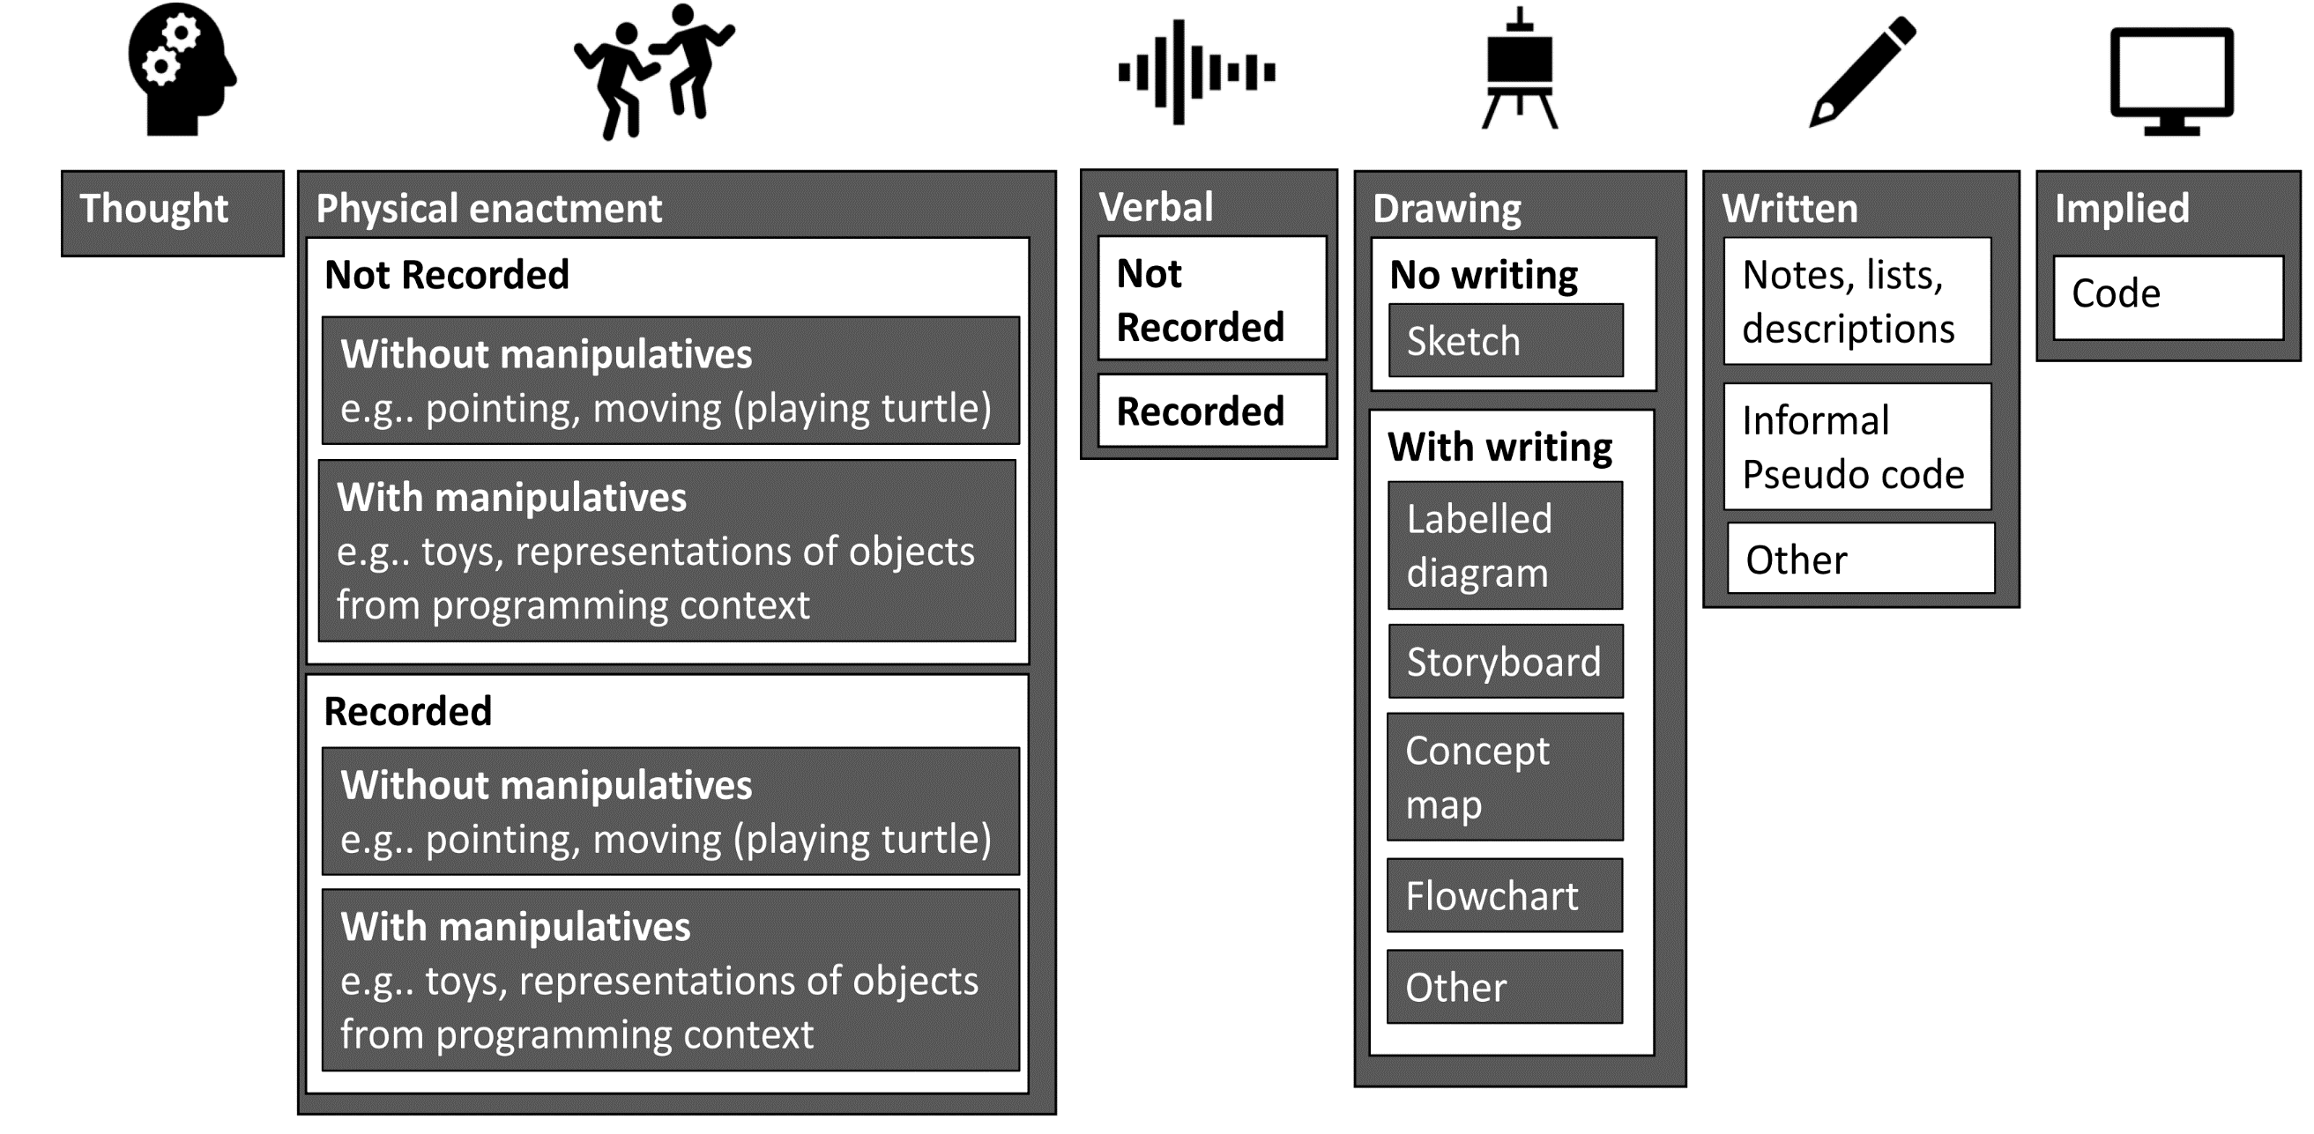
Design Formats

Slide 24
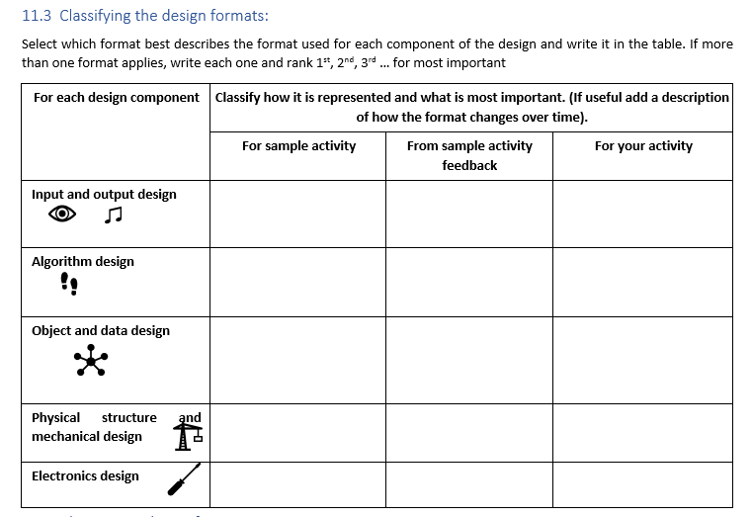
Page 15
Implied Code 2nd
Storyboard 3rd
Storyboard 1st
Implied Code 2nd
Storyboard 3rd

Slide 25
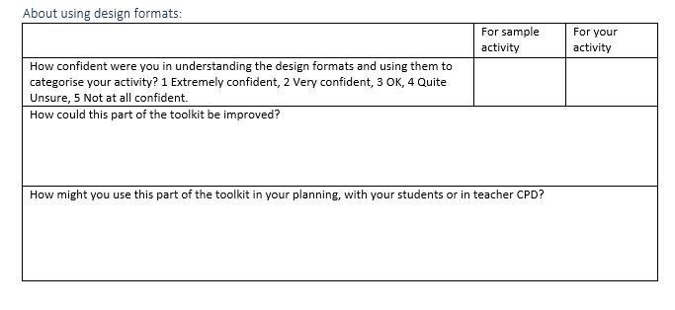
Page 15
2
xxxxx
xxxxx

Slide 26
Aspects of the
Design Artefact

Slide 27
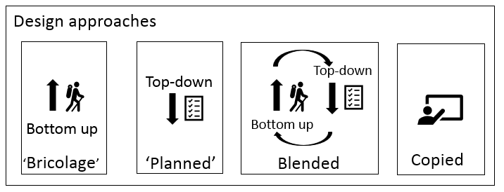
Design Approaches

Slide 28
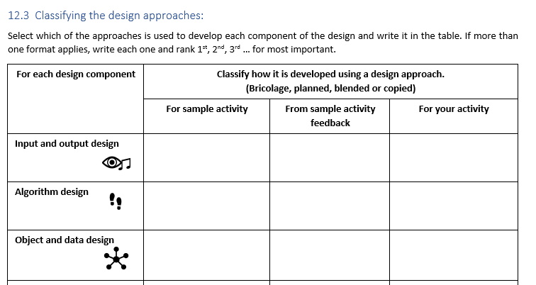
Page 17
Copied 2nd
Planned 1st
Copied 2nd

Slide 29
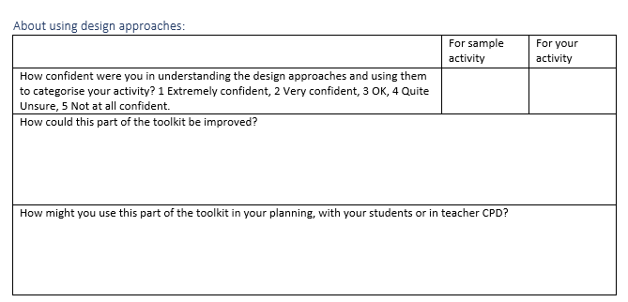
Page 17
1
xxxxx
xxxxx

Slide 30
Aspects of the
Design Artefact

Slide 31
Representations of algorithms
An algorithm must be unambiguous
An algorithm’s representation is likely to be ambiguous during design
Ambiguity due to design format
Ambiguity during design process

Slide 32
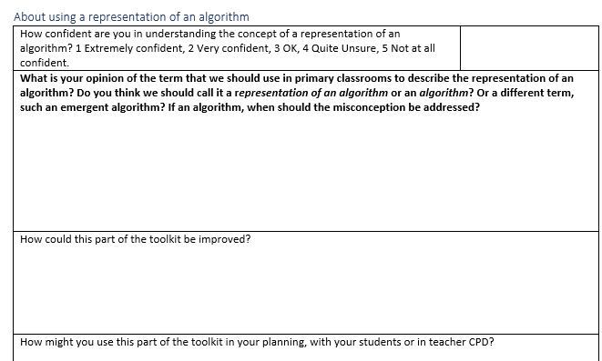
Page 19
4

Slide 33
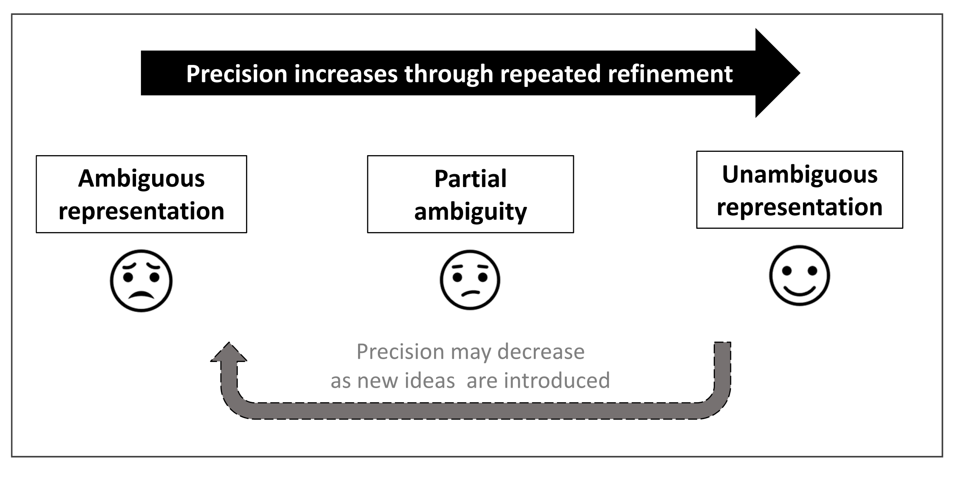
Design Refinement Process

Slide 34
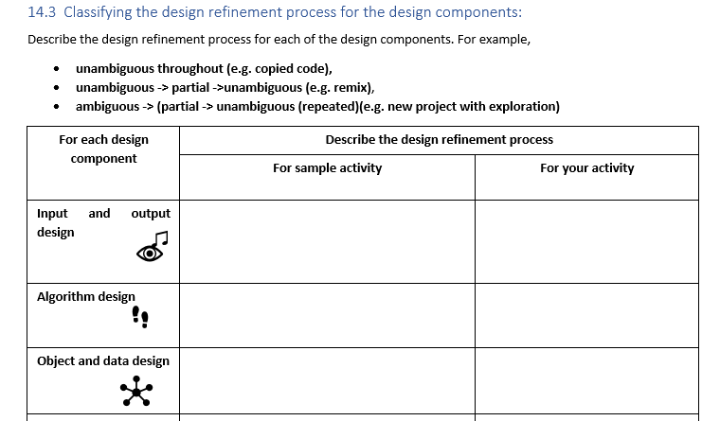
Page 21
unambiguous throughout (copied images)
unambiguous -> partial ->unambiguous (remix)
unambiguous throughout (copied objects)

Slide 35
Aspects of the
Design Artefact

Slide 36
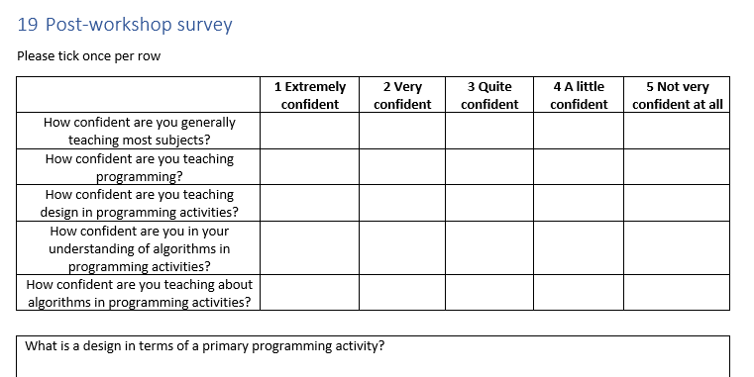
Post-workshop survey
Page 30
Please complete post workshop survey
Make sure this is post workshop not post booklet

Slide 37
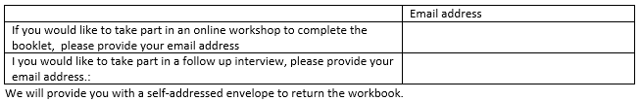
Next steps
Page 30
Thank you for taking part in our pilot
If you would like to complete the rest of the toolkit with us we will be running online sessions, please sign up on the post workshop survey

Slide 38
Would it be useful if the toolkit then
Suggested improvements for your planning?
  Learning activities
  Assessment activities
  Design examples?

Slide 39
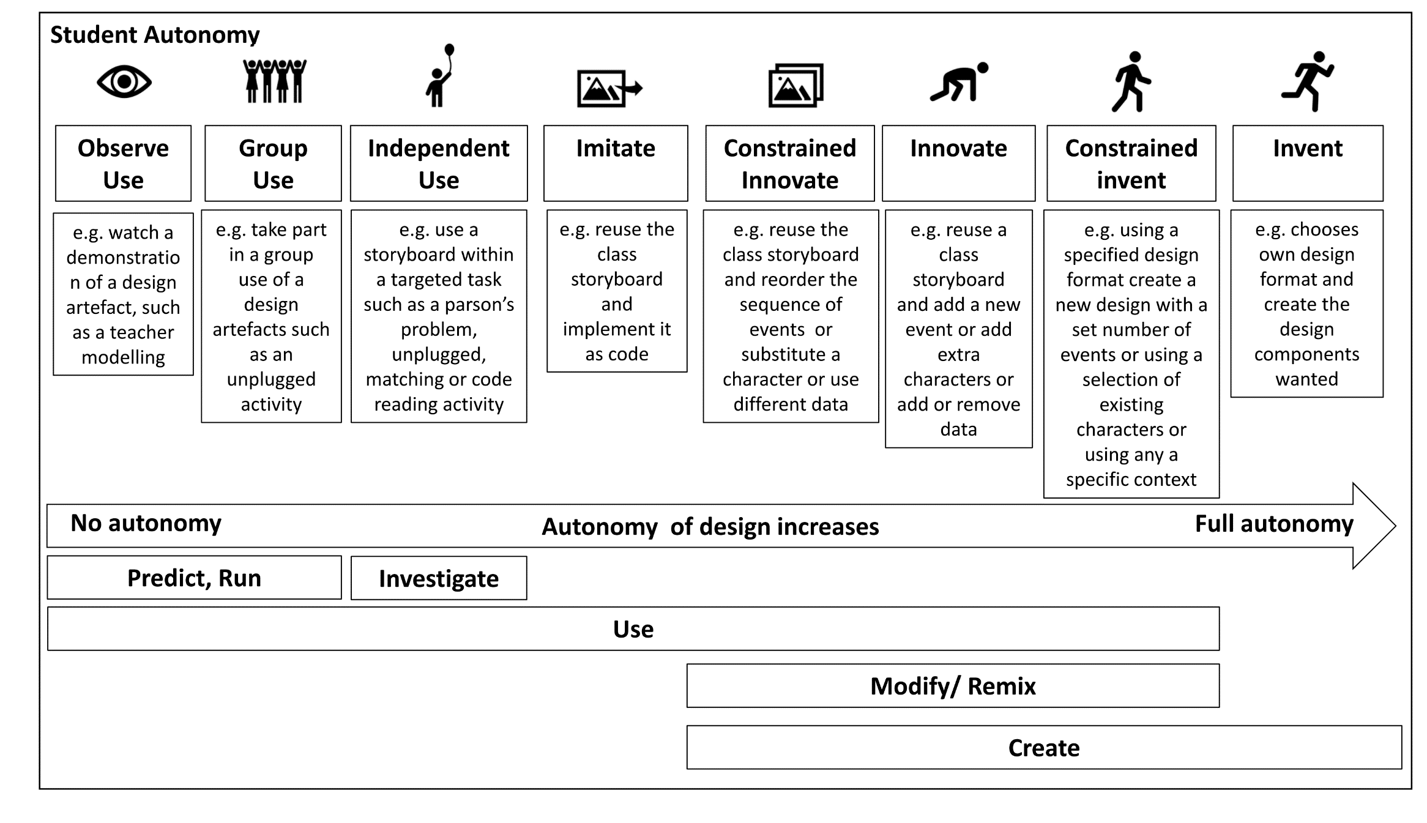
Student autonomy

Slide 40
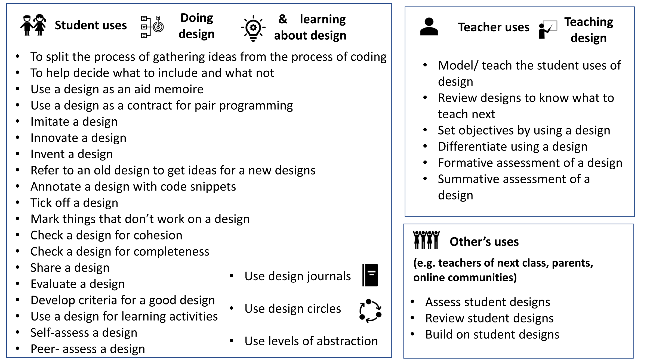
Design Uses

Slide 41
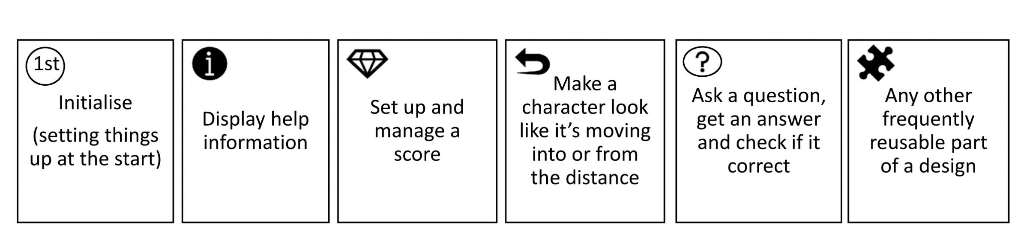
Design Patterns

Slide 42
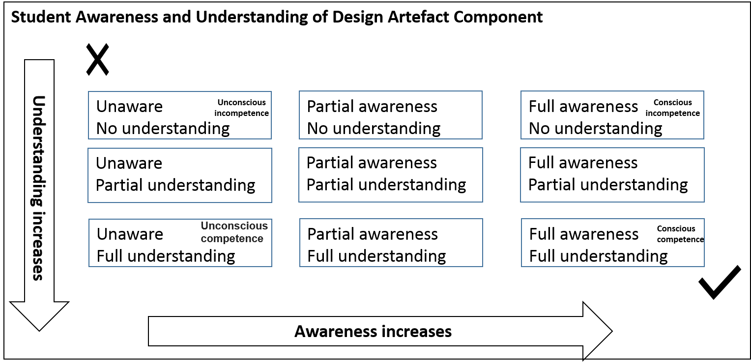
Student Awareness and Understanding

