Slide 1
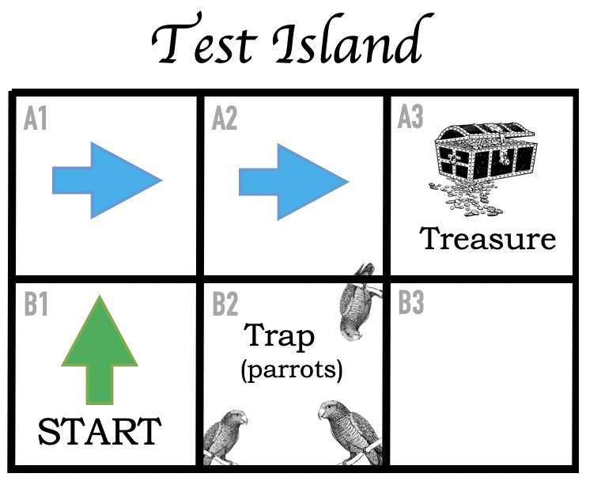

Instructions
Move UP one, RIGHT one, RIGHT one – dig.
OR
Move NORTH one, EAST one, EAST one – dig.
OR
Move UP (NORTH) one, RIGHT (EAST) two – dig.
Notes:
File 3: Test Island – for explaining (1) how to work out a route and (2) ways of giving instructions for someone to follow the route.
For use on-screen or on colour printers

Slide 2
Instructions
Move UP one, RIGHT one, RIGHT one – dig.
OR
Move NORTH one, EAST one, EAST one – dig.
OR
Move UP (NORTH) one, RIGHT (EAST) two – dig.
Notes:
File 3: Test Island – for explaining (1) how to work out a route and (2) ways of giving instructions for someone to follow the route.
For black and white printers

