Slide 1

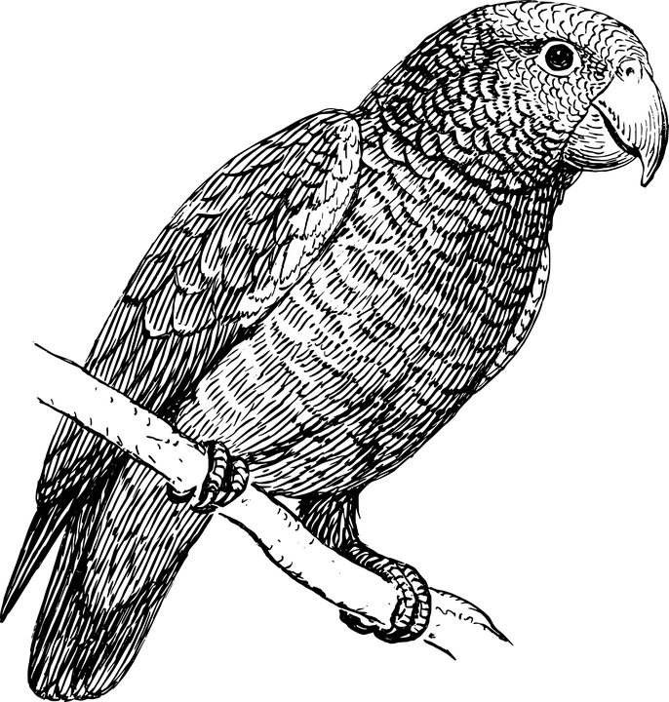

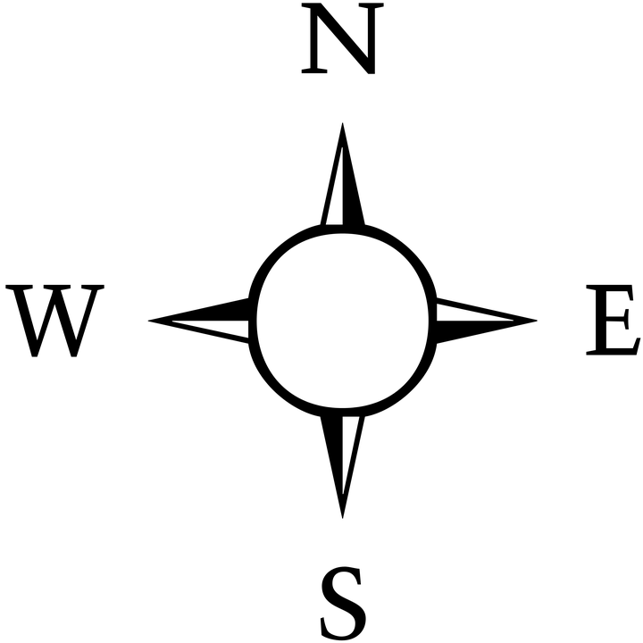

Suggested solutions
The Island of Squaregridia
The Island of Squaregridia
A1
A2
A3
A4
A1
A2
A3
A4
Treasure
Treasure
B1
B2
B3
B4
B1
B2
B3
B4
Trap
(parrots)
Trap
(parrots)
Trap
(family of tigers)
Trap
(family of tigers)
C1
C2
C3
C4
C1
C2
C3
C4
D1
D2
D3
D4
D1
D2
D3
D4
Trap
(pirates)
Trap
(pirates)
START
START
Instructions
Move UP one, RIGHT one, RIGHT one, UP one, UP one, RIGHT one – if correct, dig!
(Or UP = North / RIGHT = East)
OR
Move UP one, RIGHT two,
UP two, RIGHT one – if correct, dig.
(Or UP = North / RIGHT = East)
Instructions
Move UP one, UP one, UP one, move RIGHT one, RIGHT one, RIGHT one – if correct, dig!
(Or UP = North / RIGHT = East)
OR
Move UP three, move RIGHT three – if correct, dig.
(Or UP = North / RIGHT = East)
Notes:
file 2: Squaregridia routes.pptx (for colour printers, or for use on screen)

Slide 2
Suggested solutions
The Island of Squaregridia
The Island of Squaregridia
A1
A2
A3
A4
A1
A2
A3
A4
Treasure
Treasure
B1
B2
B3
B4
B1
B2
B3
B4
Trap
(parrots)
Trap
(parrots)
Trap
(family of tigers)
Trap
(family of tigers)
C1
C2
C3
C4
C1
C2
C3
C4
D1
D2
D3
D4
D1
D2
D3
D4
Trap
(pirates)
Trap
(pirates)
START
START
Instructions
Move UP one, RIGHT one, RIGHT one, UP one, UP one, RIGHT one – if correct, dig!
(Or UP = North / RIGHT = East)
OR
Move UP one, RIGHT two,
UP two, RIGHT one – if correct, dig.
(Or UP = North / RIGHT = East)
Instructions
Move UP one, UP one, UP one, move RIGHT one, RIGHT one, RIGHT one – if correct, dig!
(Or UP = North / RIGHT = East)
OR
Move UP three, move RIGHT three – if correct, dig.
(Or UP = North / RIGHT = East)
Notes:
file 2: Squaregridia routes.pptx (for black and white printers)

