Slide 1
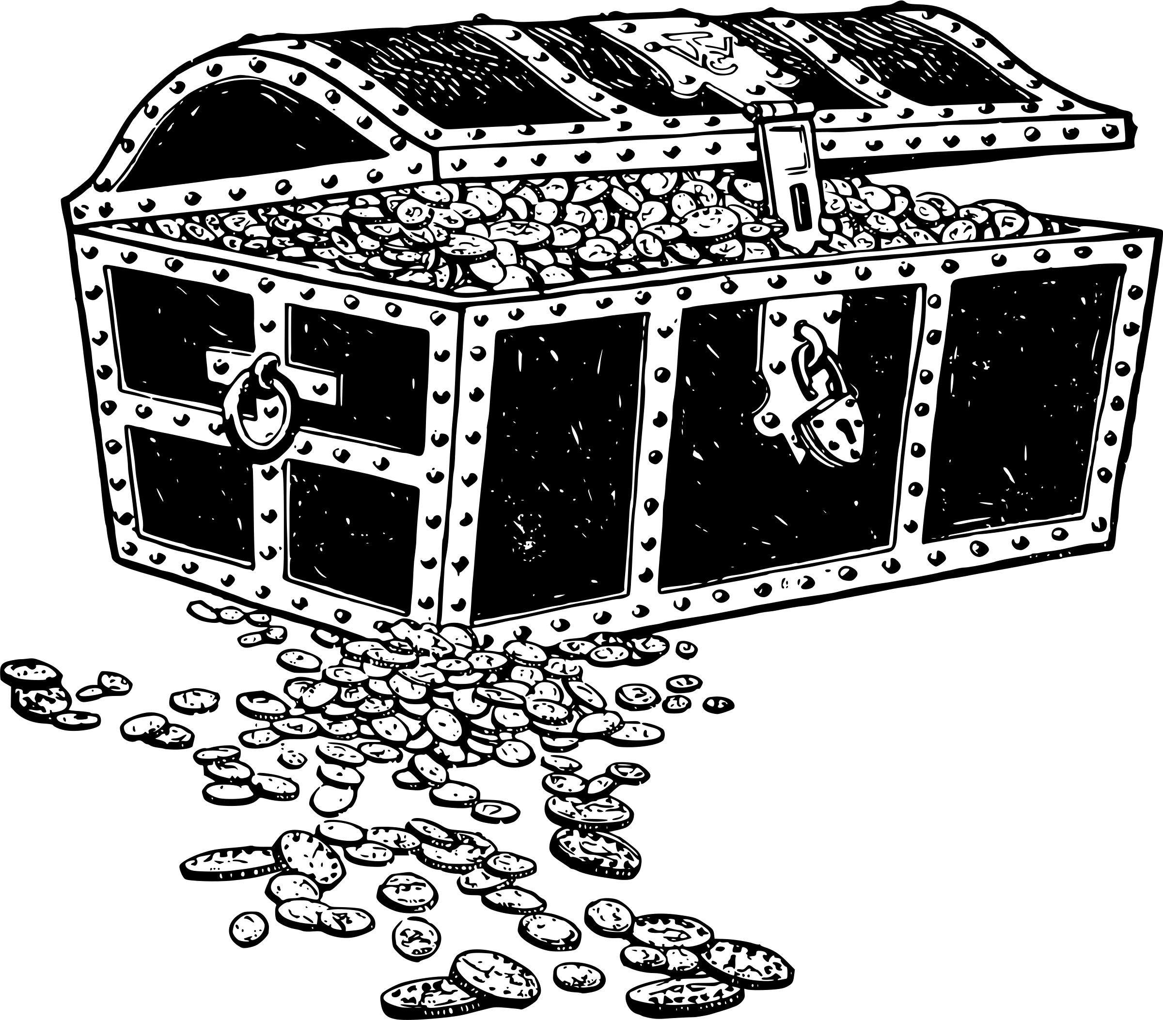
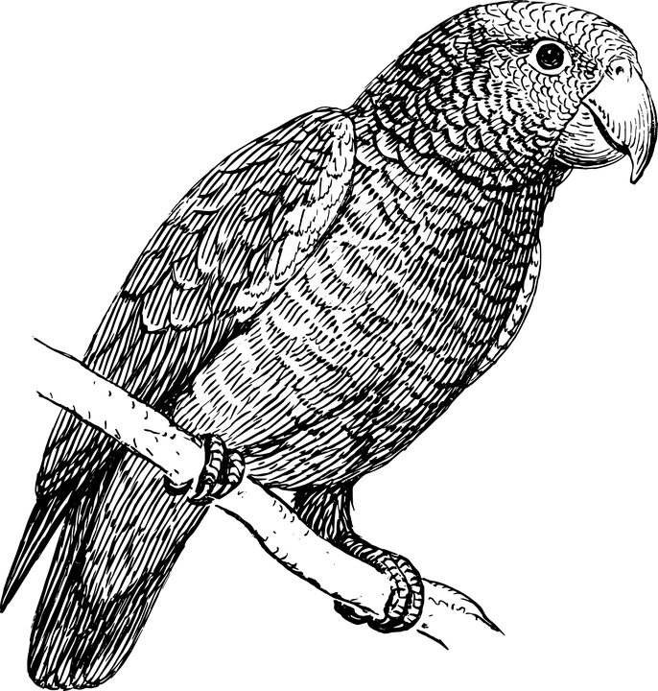

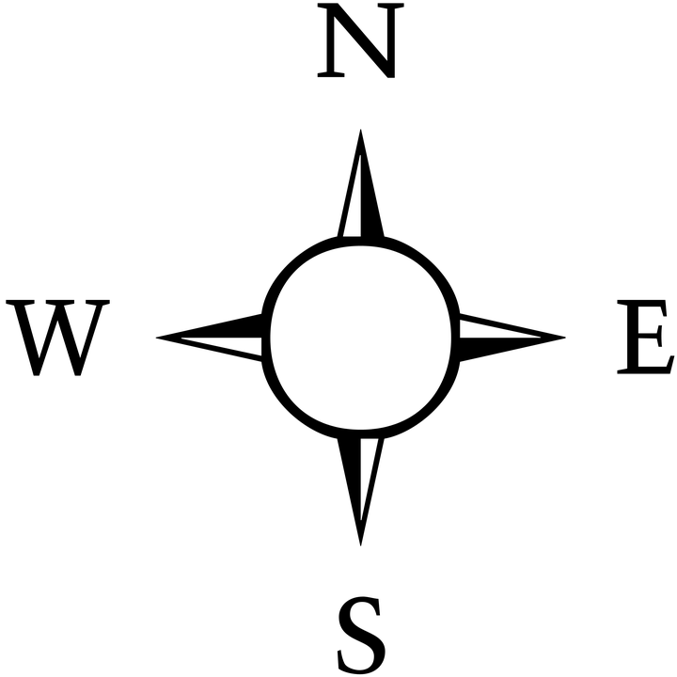

The Island of Squaregridia
The Island of Squaregridia
A1
A2
A3
A4
A1
A2
A3
A4
Treasure
Treasure
B1
B2
B3
B4
B1
B2
B3
B4
Trap
(parrots)
Trap
(parrots)
Trap
(family of tigers)
Trap
(family of tigers)
C1
C2
C3
C4
C1
C2
C3
C4
D1
D2
D3
D4
D1
D2
D3
D4
Trap
(pirates)
Trap
(pirates)
START
START
The Island of Squaregridia
The Island of Squaregridia
A1
A2
A3
A4
A1
A2
A3
A4
Treasure
Treasure
B1
B2
B3
B4
B1
B2
B3
B4
Trap
(parrots)
Trap
(parrots)
Trap
(family of tigers)
Trap
(family of tigers)
C1
C2
C3
C4
C1
C2
C3
C4
D1
D2
D3
D4
D1
D2
D3
D4
Trap
(pirates)
Trap
(pirates)
START
START
Notes:
file 1: Squaregridia mapped.pptx

