Slide 1
Planning & Assessment
Islington computing leads
Jane Waite

Slide 2
Katy game me a problem to help with
Handout 1
Teachers are finding assessment of computing difficult.
Can we find out what aspects and how to help.

Slide 3
Approach
Handout 1
Ask you what is most difficult
Provide a means to review assessment for computing - PCK
Evaluate computing planning and assessment using PCK
Gather and suggest assessment approaches and how these can be supported.

Slide 4
Is assessment more difficult:
For IT, DL or CS?
For a particular year group?
Formative or summative?
Lets vote!
Notes:
Why more difficult than other subjects – lets unpick

Slide 5
The area of assessment I find most difficult is
  Learning objectives - knowing what to assess
  Learning objectives - knowing what ‘good’ looks like
  Techniques for assessment – knowing how to assess
  Giving feedback on what is next - knowing about progression misconceptions and how children learn
Notes:
Why more difficult than other subjects – lets unpick

Slide 6



@cas_certificate
In order to teach computing…
Pedagogical Knowledge
Content Knowledge
Computational
Thinking
Information Technology
Pedagogical Content Knowledge
PCK
planning, progression, assessment, relationships, interventions, differentiation, inclusion, relevance, feedback, questioning, scaffolding, visualisations, active learning, direct teaching, discovery learning, resources…
Computer Science
Digital Literacy
Adapted version of pedagogical content knowledge (PCK) (Shulman, 1986)
Notes:
What are the 4 elements of PCK?

Slide 7
How children learn (HOL)
(motivation, barriers to learning, differentiation, progression, Blooms, Solo)
Instructional
Approaches
(IA)
Lets be very specific -
using the Islington SOW,
for your year group,
Red/Amber/Green your confidence for each of the PCK elements
Curriculum goals
Learning objectives
(LO)
Assessment activities
PCK
Assessment approaches (AA) (formative/summative) (peer, self)
(Based on Pedagogical Content Knowledge (Shulman, 1986))
Notes:
Learning objectives

Slide 8
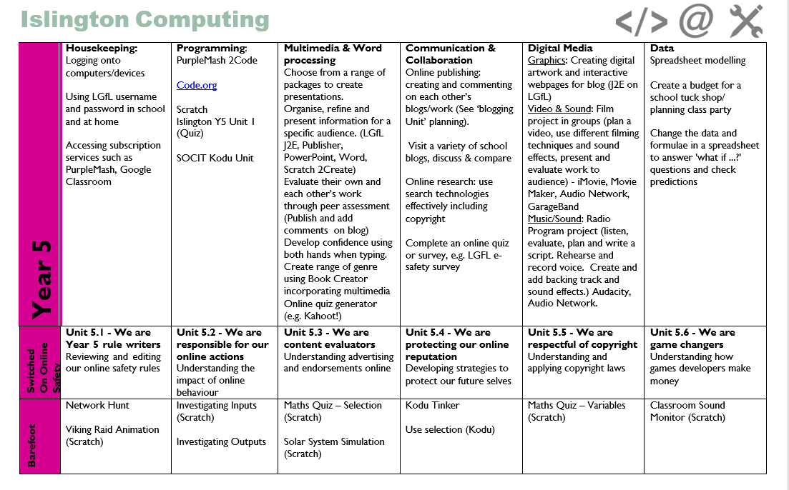
LO HCL AA
LO HCL AA
LO HCL AA
LO HCL AA
LO HCL AA
LO HCL AA
LO HCL AA
LO HCL AA
LO HCL AA
LO HCL AA
LO HCL AA
LO HCL AA
LO HCL AA
LO HCL AA
LO HCL AA
LO HCL AA
LO HCL AA
LO HCL AA

Slide 9
How children learn (HOL)
(motivation, barriers to learning, differentiation, progression, Blooms, Solo)
Spot patterns! Where is the problem?
Instructional
Approaches
(IA)
Curriculum goals
Learning objectives
(LO)
Assessment activities
Assessment approaches (AA) (formative/summative) (peer, self)
(Based on Pedagogical Content Knowledge (Shulman, 1986))
Notes:
Learning objectives

Slide 10
Assessment approaches
How do you assess? What support do you need?

Slide 11
Assessment Approaches
Approach | Supported by
Direct questions | Key Questions
Observations | Checklists (assessment grids) ✓
Assess work | Example material to compare to (met-, met, met+)
Quizzes/Tests | Sample answers/ differentiated versions
End of topic tasks | Assessment grids ✓ Moderation opportunities
Peer/Self assessment | Pupil I can statements Pupil booklets ✓ I can cards✓
Which do you use?
What do you need help with?
What is missing?

Slide 12
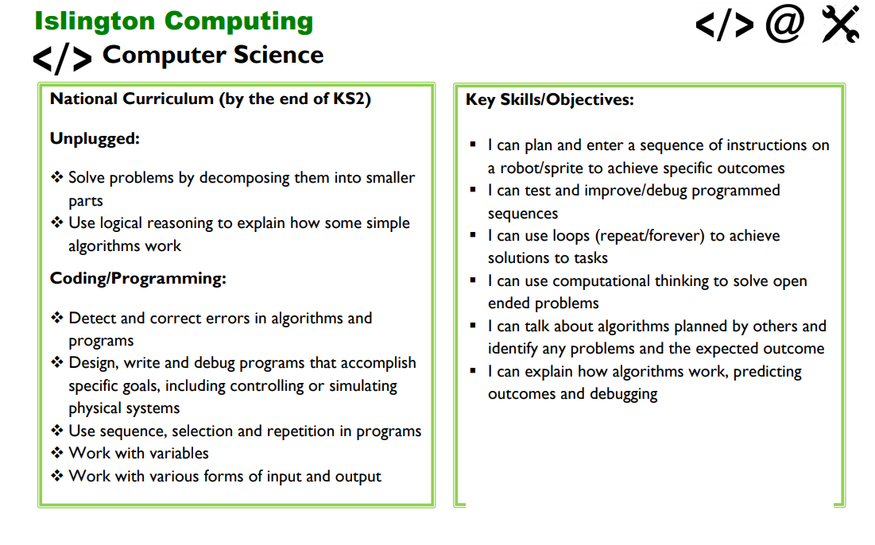
Are the booklets working?
If not why?

Slide 13

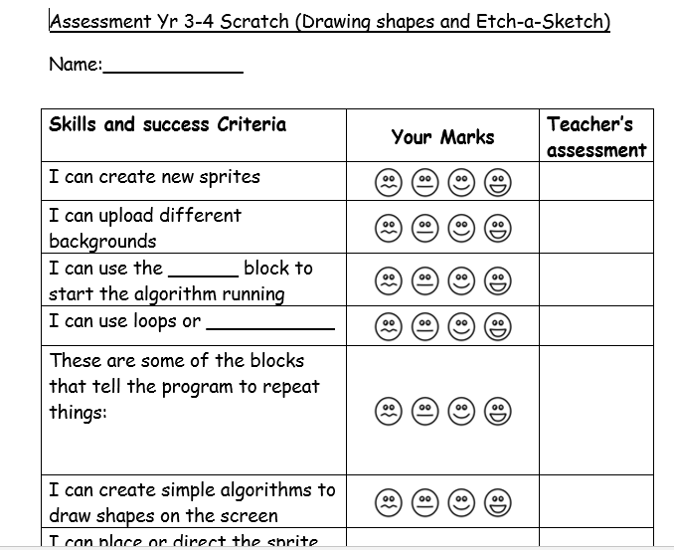
Are the self assessment cards working?
If not why?

Slide 14
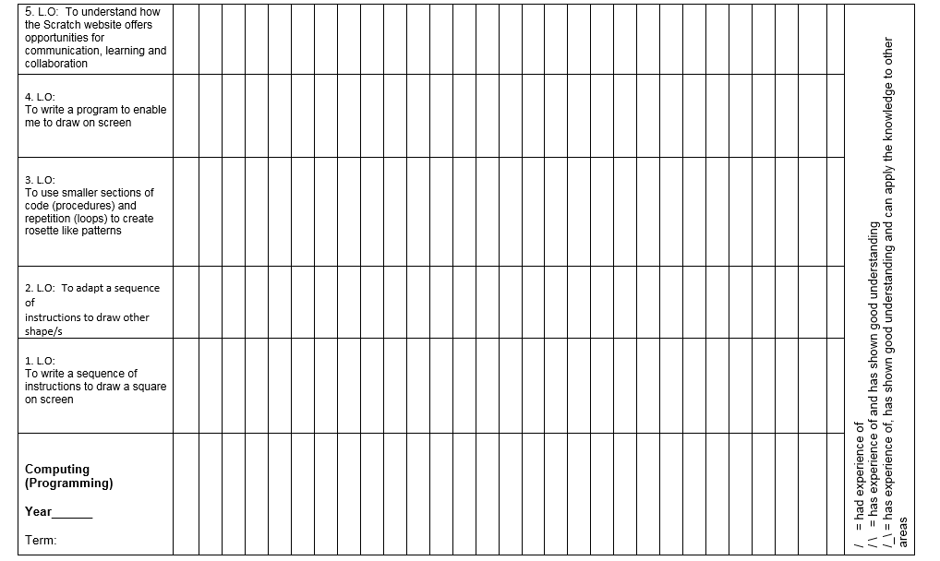
Are the checklists working
If not why?

Slide 15
Approach
Handout 1
Ask you what is most difficult
Provide a means to review assessment for computing - PCK
Evaluate computing planning and assessment using PCK
Gather and suggest assessment approaches and how these can be supported.

Slide 16
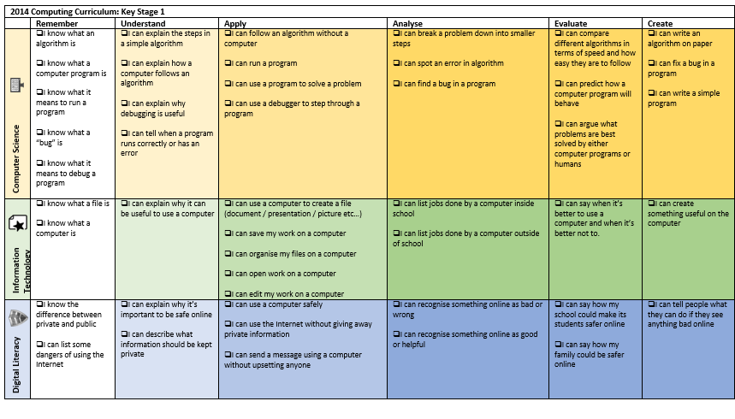
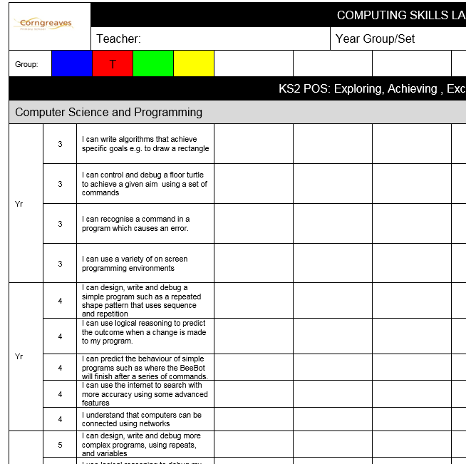
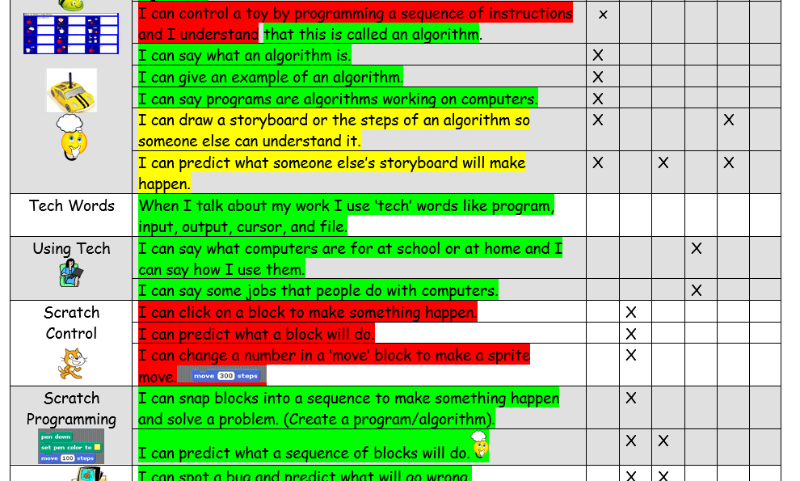
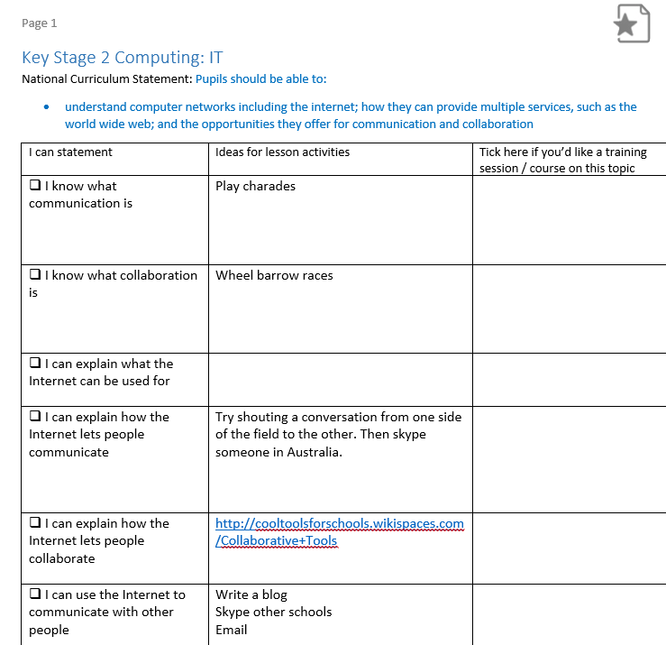
Other people’s approaches
Notes:
Pete Dring me and others

Slide 17
Learning objectives

Slide 18
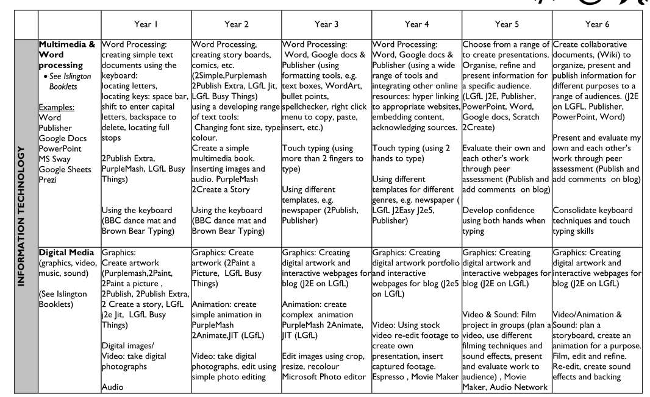

Slide 19
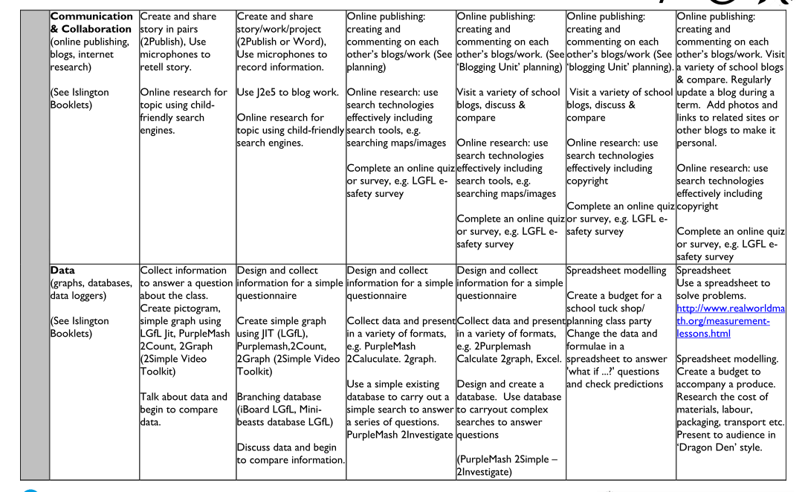
Digital Literacy

Slide 20
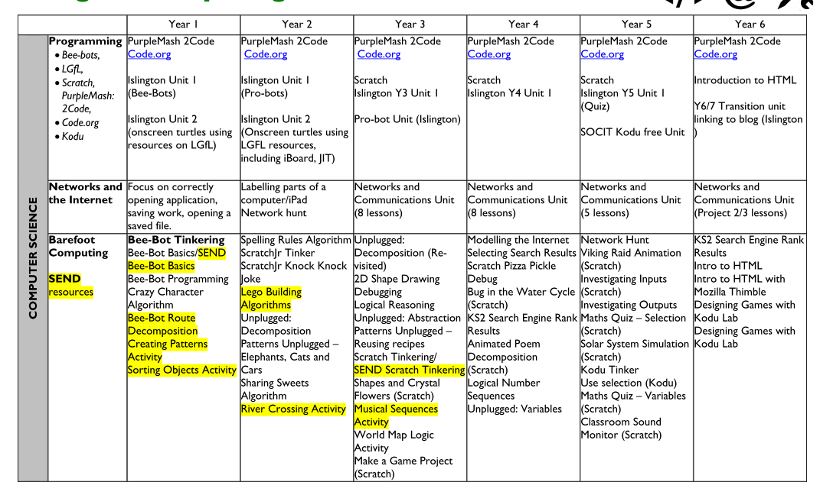

Slide 21
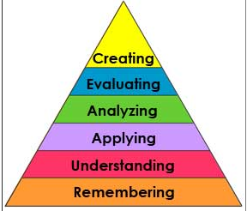
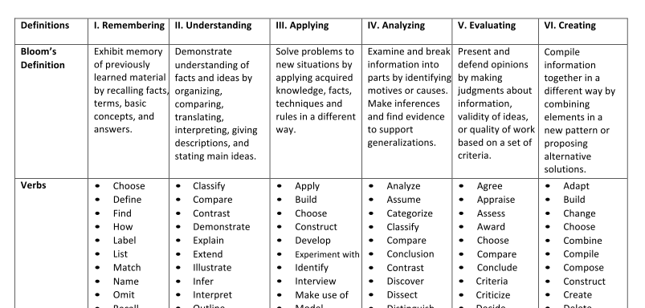
Bloom’s Taxonomy
Bloom, 1956
Anderson & Krathwohl, 2001

Slide 22
Programming assessment approaches
Making judgments based on evidence
( observations, questions, self-assessment, products…)
Integrated tasks
Reading code
Debugging
Changing code
Make new designs
Review and mark designs and code
Review and mark design journals (online or hard copy)
Pupil presentations (how do you mark?)
Record peer/self assessment based on a checklist/‘rubric’
Assessment tasks
Quizzes/Tests (Bebras/DQ etc)
End of topic tasks
Direct questions
Debugging tasks
Parson’s problems
Dr Scratch
Reading code tasks e.g. snippet work - compare code, explain code
Making judgments against an understanding of progression of learning objectives
(knowledge, skills, understanding)

Slide 23
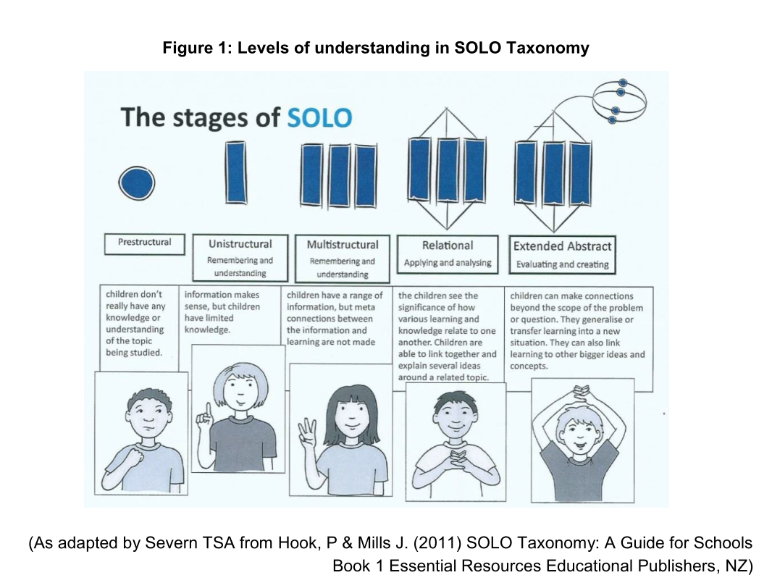
Solo Taxonomy

Slide 24
Semantic Waves
Semantic Density
Relates to: meaning
From technical (packed) to everyday meanings
Semantic Gravity
Relates to: context
From theory to practical/personal contexts

Slide 25
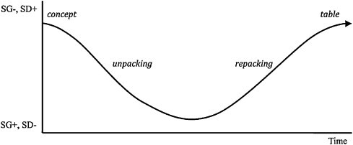
Semantic Waves
Example of a semantic wave in Biology teaching (Maton, 2013)
Density – meaning – from technical (packed) to everyday meaning
Gravity – context - from theory to practical/personal context

