Slide 2
Days outline
10:45 to 11:00 | Arrival, registration
11:00 to 11:10 | Housekeeping, What is TechPathways? Introductions
11:10 to 12:00 | Tiny toys (Ready-built software: demo and explore)
12:00 to 12:45 | Lunch - Bring your own or e.g. Sainsbury’s opposite QMUL
12:45 to 1:45 | Processing (Visual coding: demo and explore)
1:45 to 2:30 | What CPD do you need? Who, when, where, what and how?
2:30 to 3:00 | Break - Grab a coffee e.g. Starbucks
3:00 to 4:00 | Art and Design Association update and future planning meeting

Slide 3
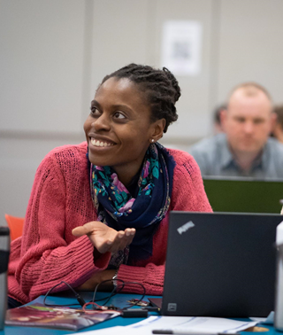
What is TechPathways London?
Funded by the Mayor of London
Partnership between Queen Mary, University of London and London CLC
Free CPD for educators on using digital technologies with 11-24 year olds
Short breath courses and depth courses
Strong links to industry, research led
Online resources (e.g. unconscious bias course and careers information)

Slide 4
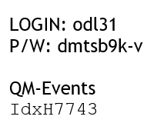
https://teachinglondoncomputing.org/artdesignmeeting/
Each of you has a PC login and password
For everyone
Wifi login and password

Slide 5
What CPD do you need?
1. Survey (10 mins) https://tinyurl.com/QMULArt
2. Who, when, where, what and how?
(35 mins activity)

Slide 6
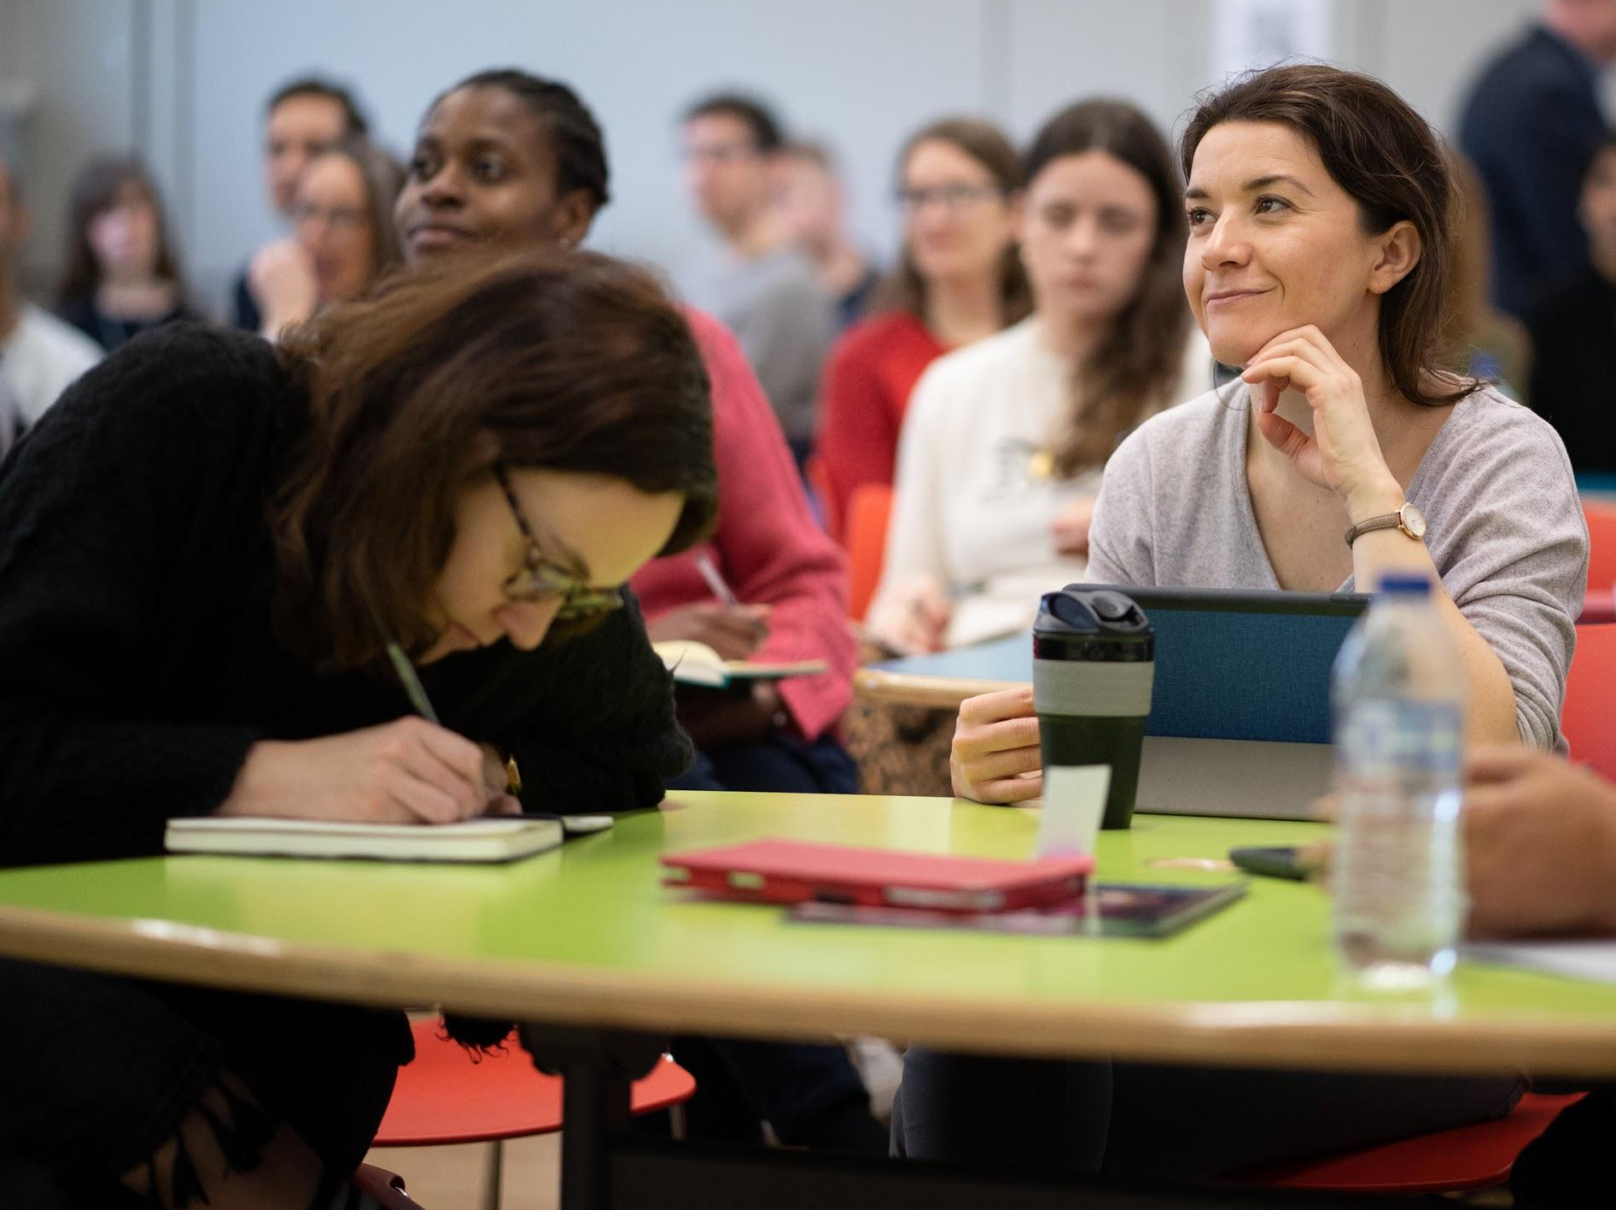
Keep in touch
Website & Newsletter sign-up: techpathways.london
Twitter:
@TechPathwaysLdn
@TeachingLdnComputing

