Slide 1
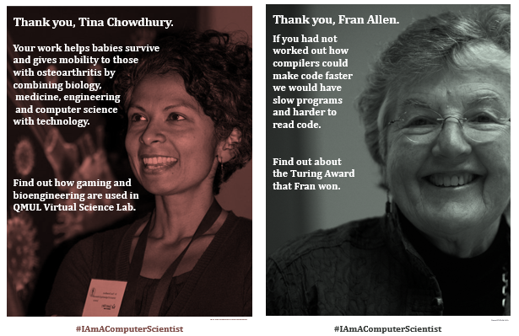
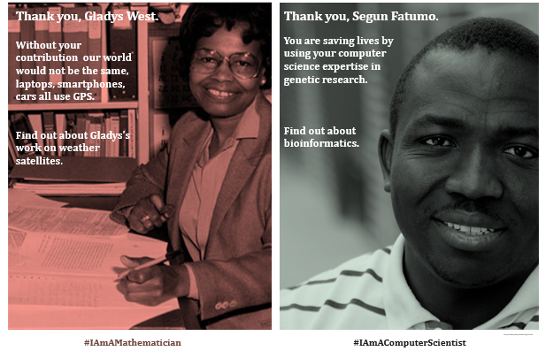
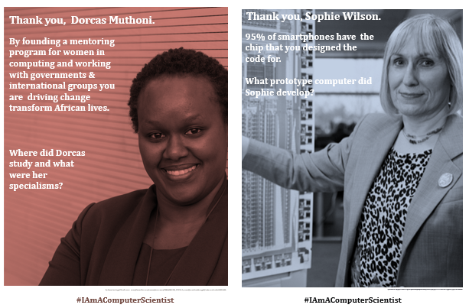
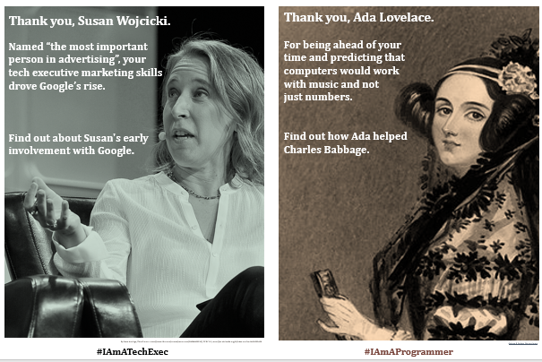
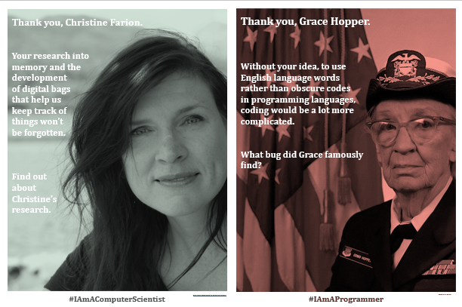
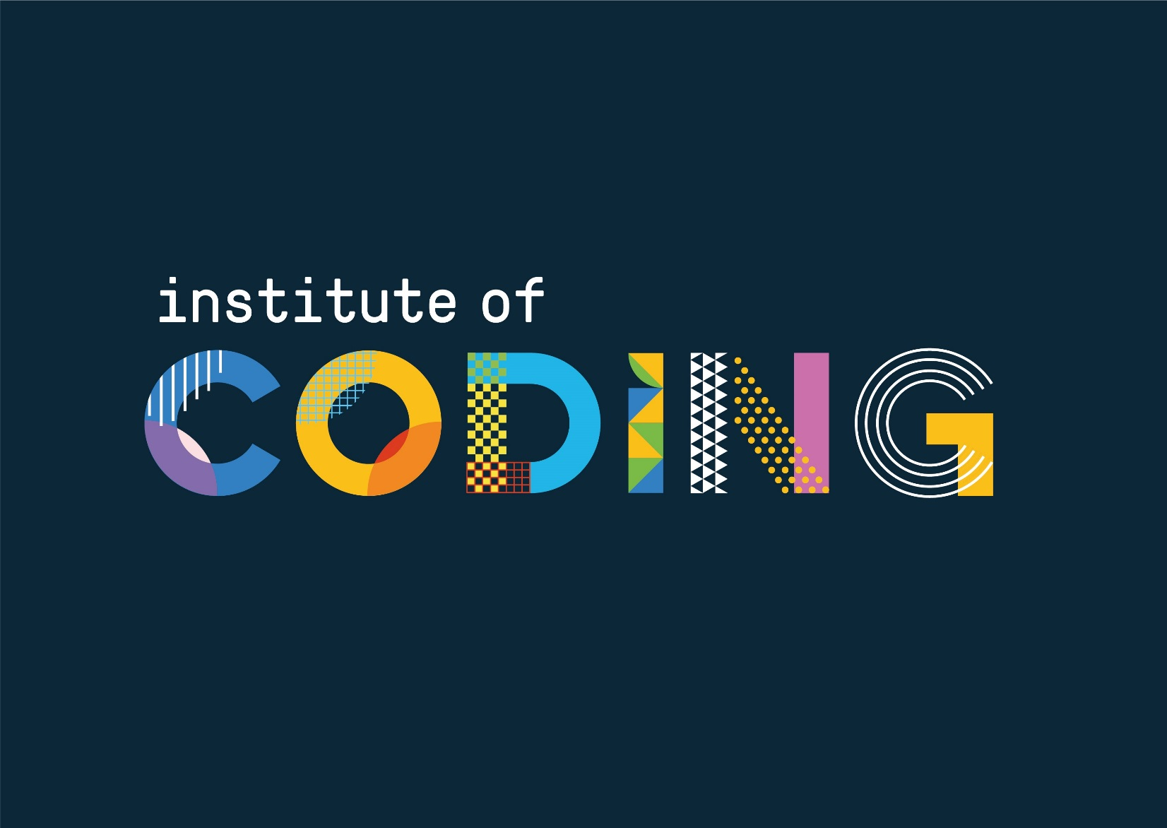


Diversity in Computing
Computer Science is for all
How can you make a difference?
www.cs4fn.org/diversity

Slide 2
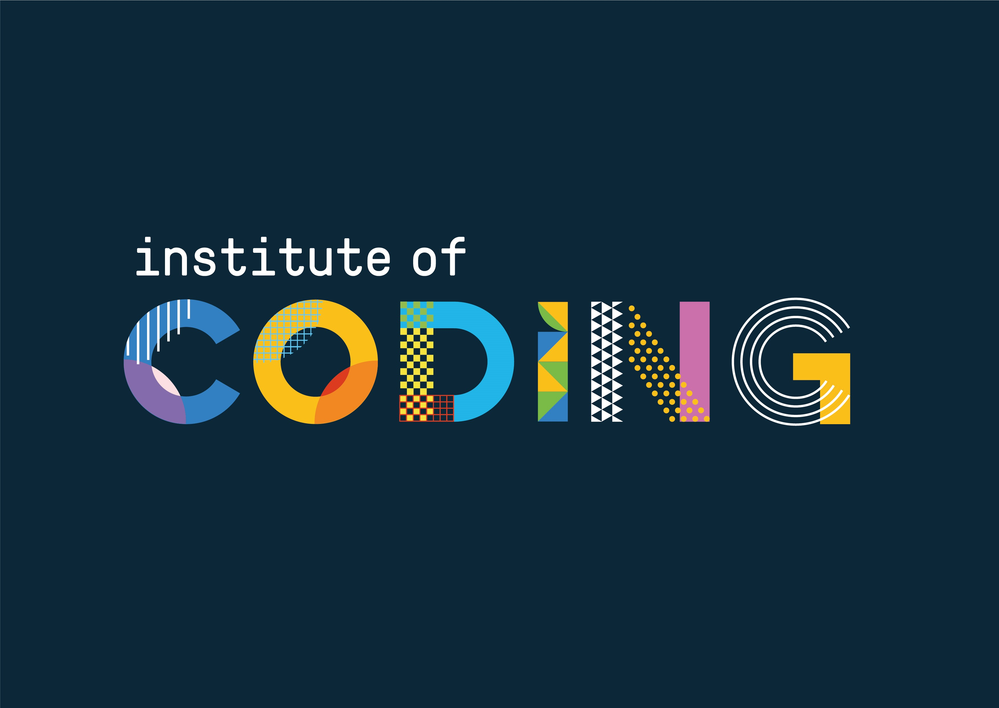

Slide 3
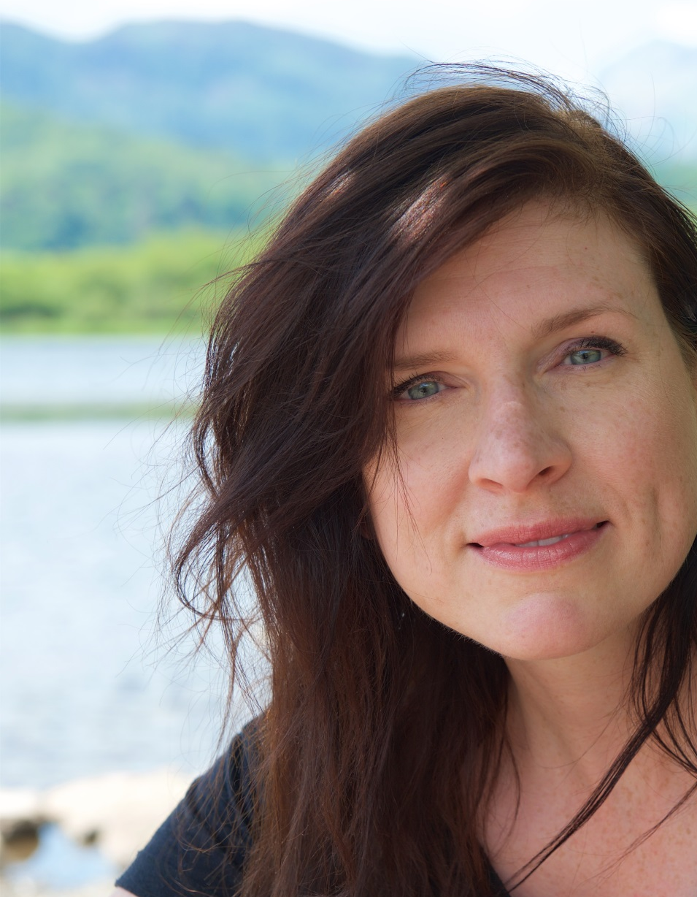
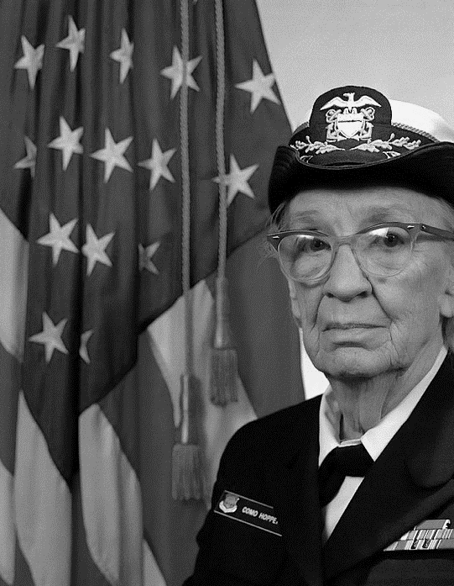
Thank you, Christine Farion.
Your research into
memory and the
development
of digital bags
that help us
keep track of
things won’t
be forgotten.
Find out
about
Christine’s
research.
Thank you, Grace Hopper.
Without your idea, to use English language words
rather than obscure codes
in programming languages, coding would be a lot more complicated.
What bug did Grace famously find?
#IAmAComputerScientist
With kind permission of Christine Farion.
#IAmAProgrammer
James S. Davis

Slide 4
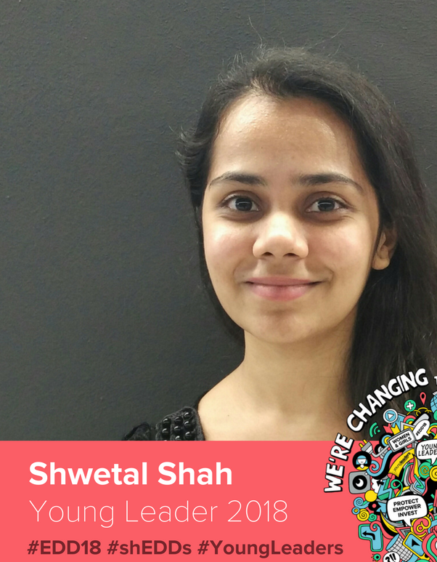
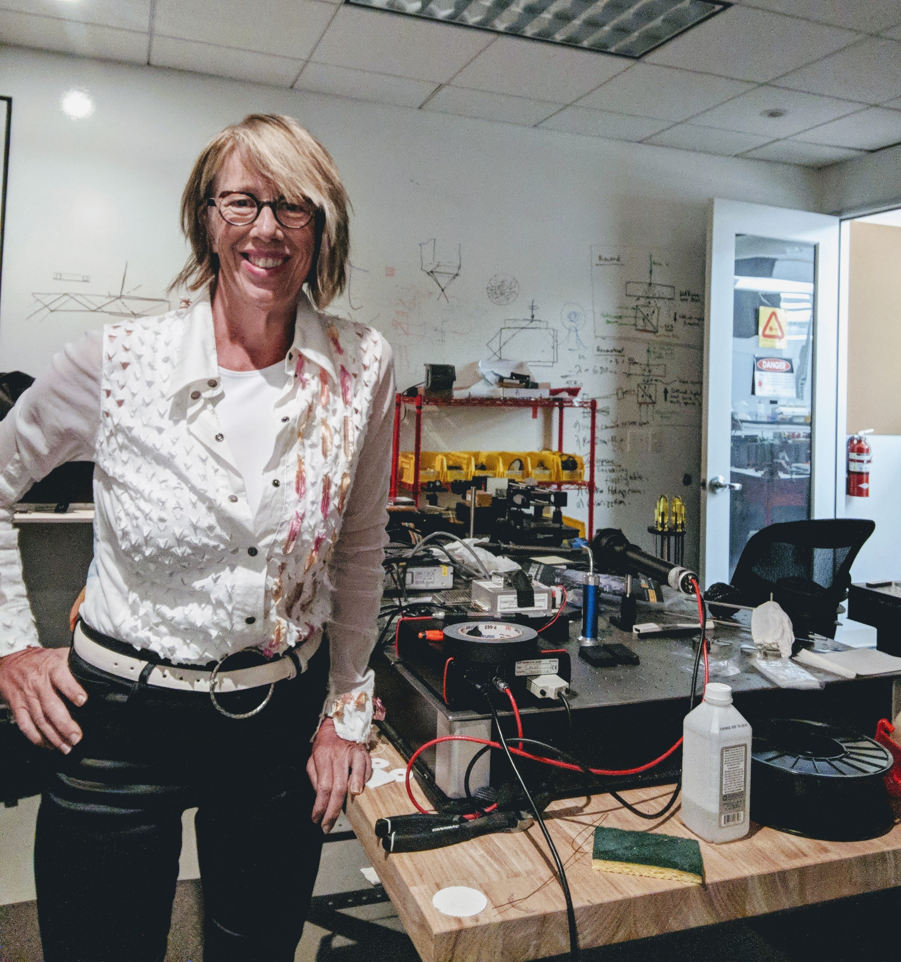
Thank you, Shwetal Shah.
For representing young
women in technology
with governments
and multinationals
and championing
creativity in
computing.
What cat-themed game
that teaches programming
did Shwetal work on?
Thank you, Mary Lou Jepsen.
Your inventions in displays and imaging are all around us, head mounted displays, live walls, VR and holography.
Find out about Mary Lou’s work at Google, Facebook, MIT and her own companies.
#IAmADigitalActivist
With kind permission of Shwetal Shah
#IAmAComputerScientist
By Maryloujepsen - Own work, Public Domain, https://commons.wikimedia.org/w/index.php?curid=71035848

Slide 5
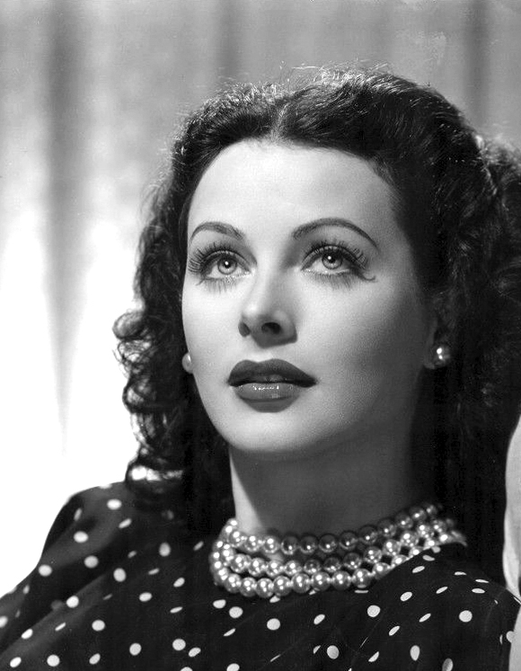
Thank you, Hedy Lamarr.
Who should be on our diversity posters?
Tweet #CSDiversity @QMEECS ‏@csf4n @IoCoding to nominate people who have contributed to computer science.
We would not have Bluetooth or WIFI if it was not for your invention of frequency hopping.
What else
was Hedy
famous
for?
With kind permission on John Henry Thompson
#IAmAnInventor
Photo provided by kind permission John Henry Thompson

Slide 7
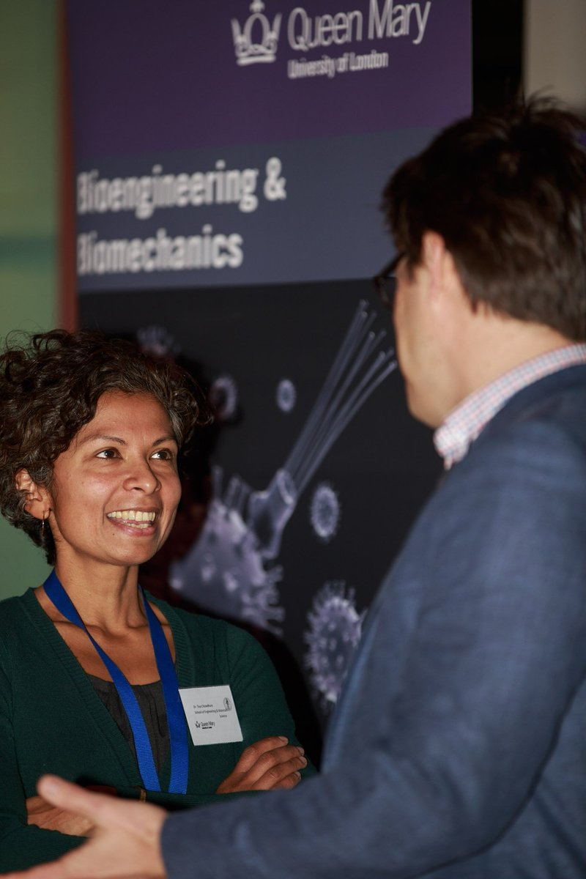
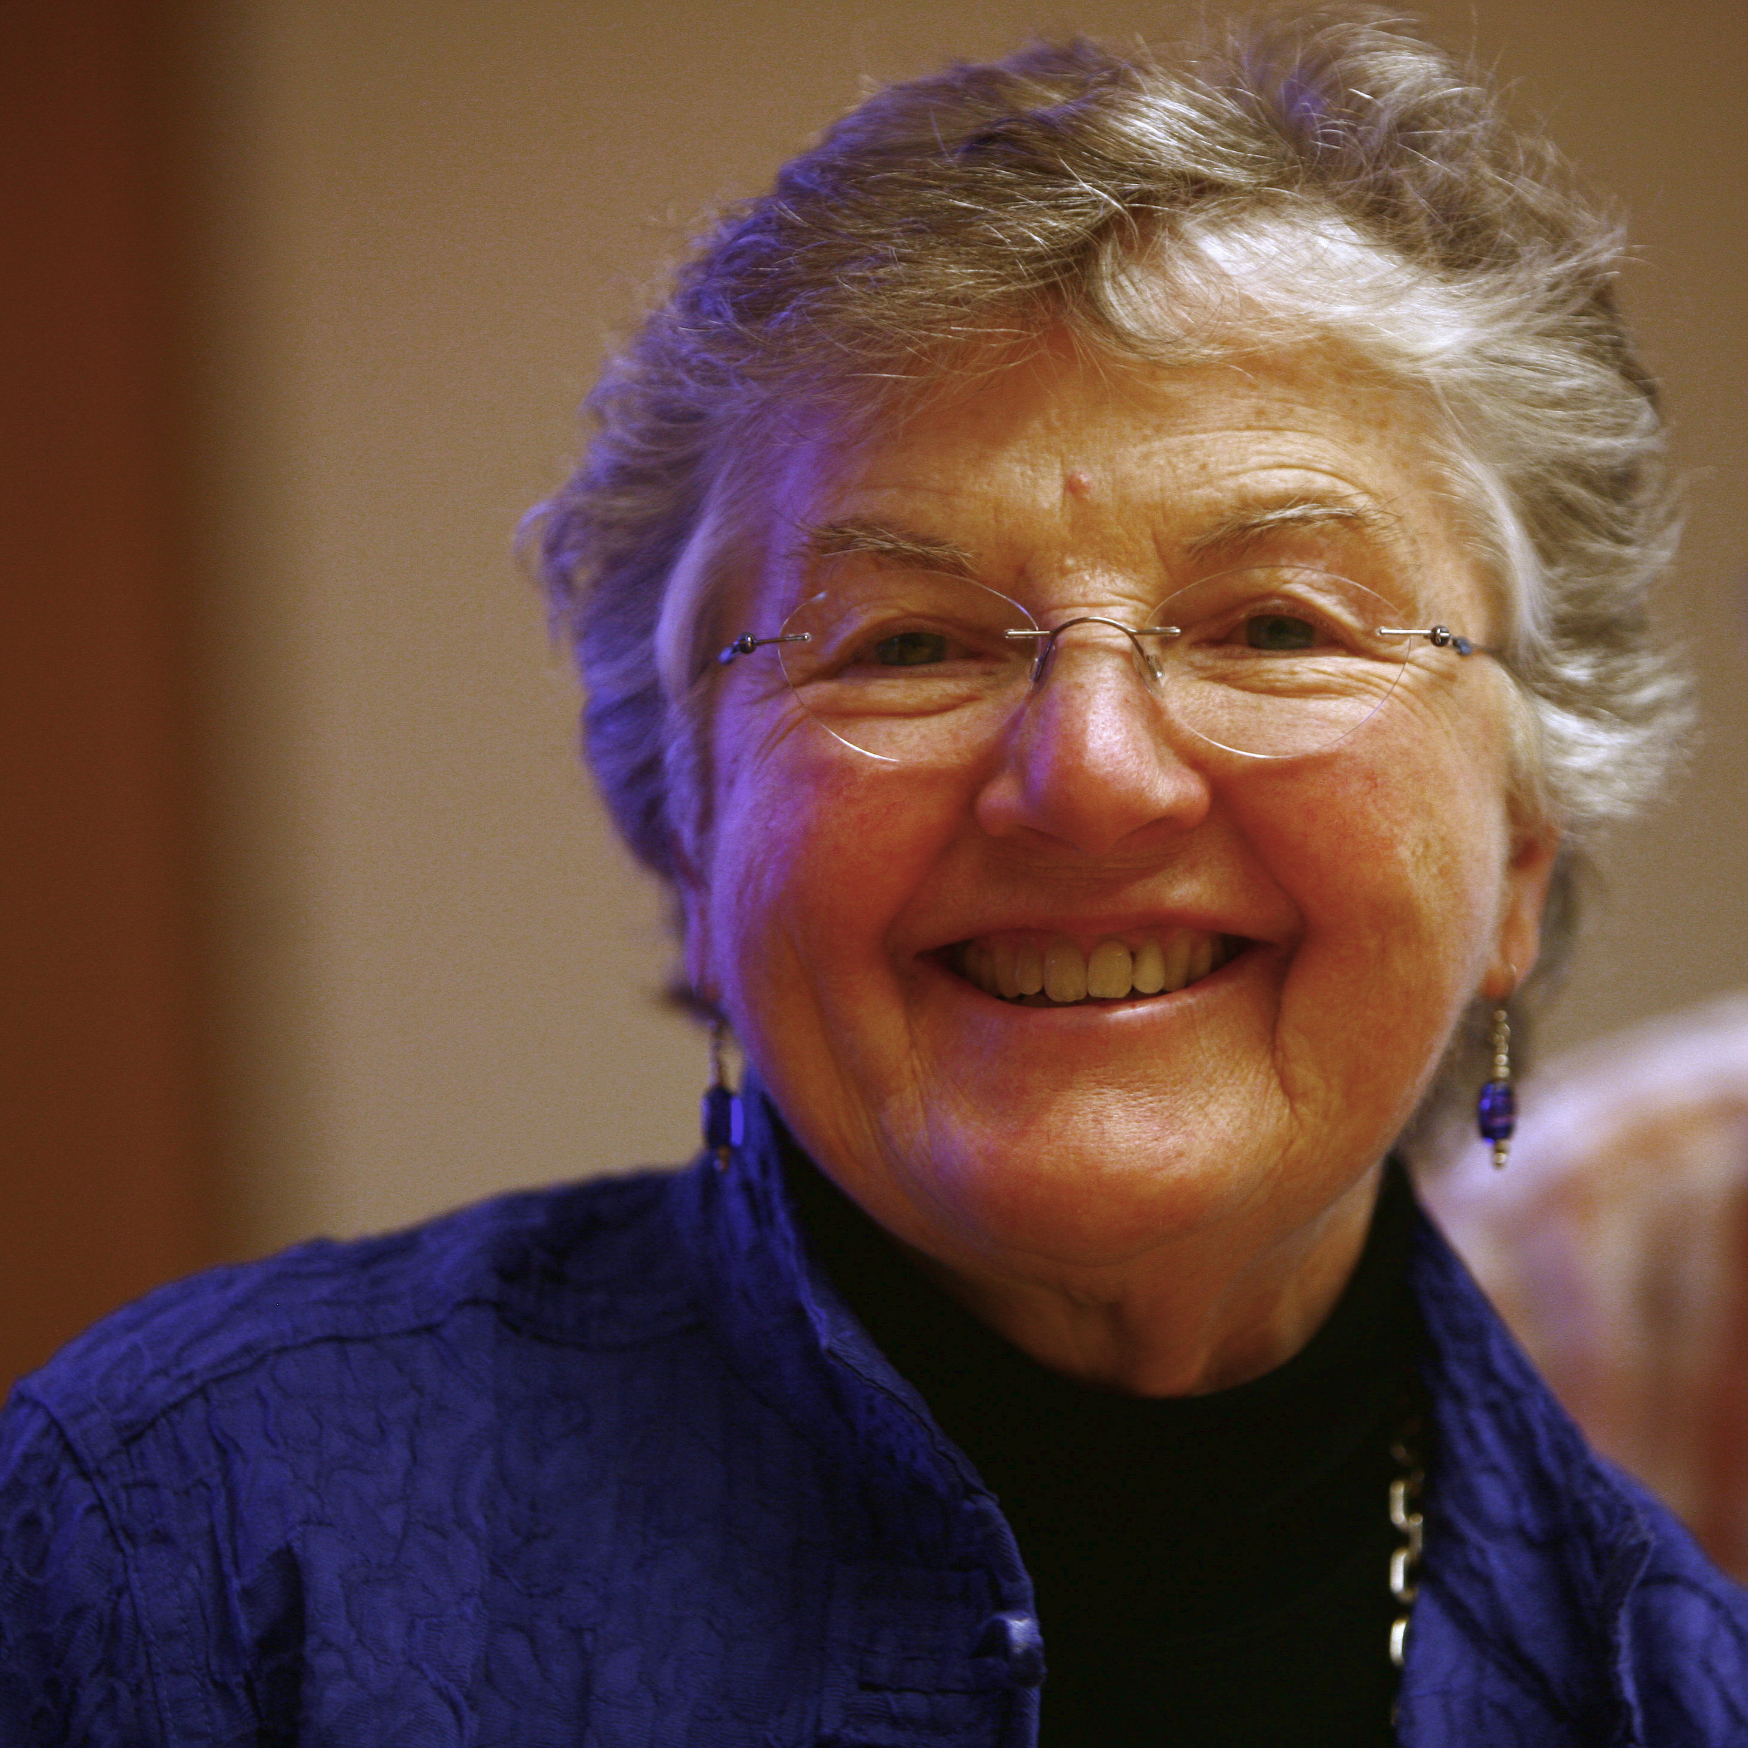
Thank you, Tina Chowdhury.
Your work helps babies survive
and gives mobility to those with osteoarthritis by combining biology,
medicine, engineering
and computer science
with technology.
Find out how gaming and bioengineering are used in QMUL Virtual Science Lab.
Thank you, Fran Allen.
If you had not worked out how compilers could make code faster we would have slow programs and harder to read code.
Find out about the Turing Award that Fran won.
#IAmAComputerScientist
With kind permission of Tina Chowdhury
#IAmAComputerScientist
Rama CC BY-SA 2.0 fr

Slide 8
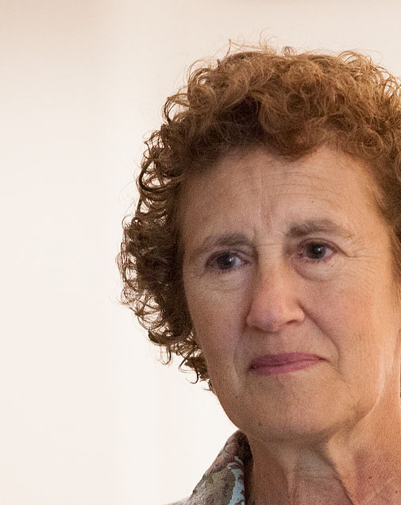
Thank you Barbara Liskov.
Thank you, Juliana Rotich.
You design programming languages.
We would not
have Object
Oriented
Programming
(OOP)
without you.
Congratulations
on the Turing
Award.
Find out about OOP.
You co-developed a platform that saves lives and supports democracy across the world.
Find out who provides the data
for Ushahidi.
Kenneth C. Zirkel CC BY-SA 3.0
By usbotschaftberlin - Family photo of the panelists before the discussion at the W20 Conference, Public Domain, https://commons.wikimedia.org/w/index.php?curid=67607408
#IDesignProgrammingLanguages
#IAmAComputerScientist

Slide 9
Diversity in Computing
Computer Science is for all
How can you make a difference?
www.cs4fn.org/diversity

Slide 11
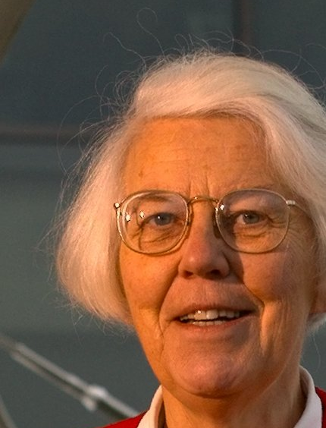
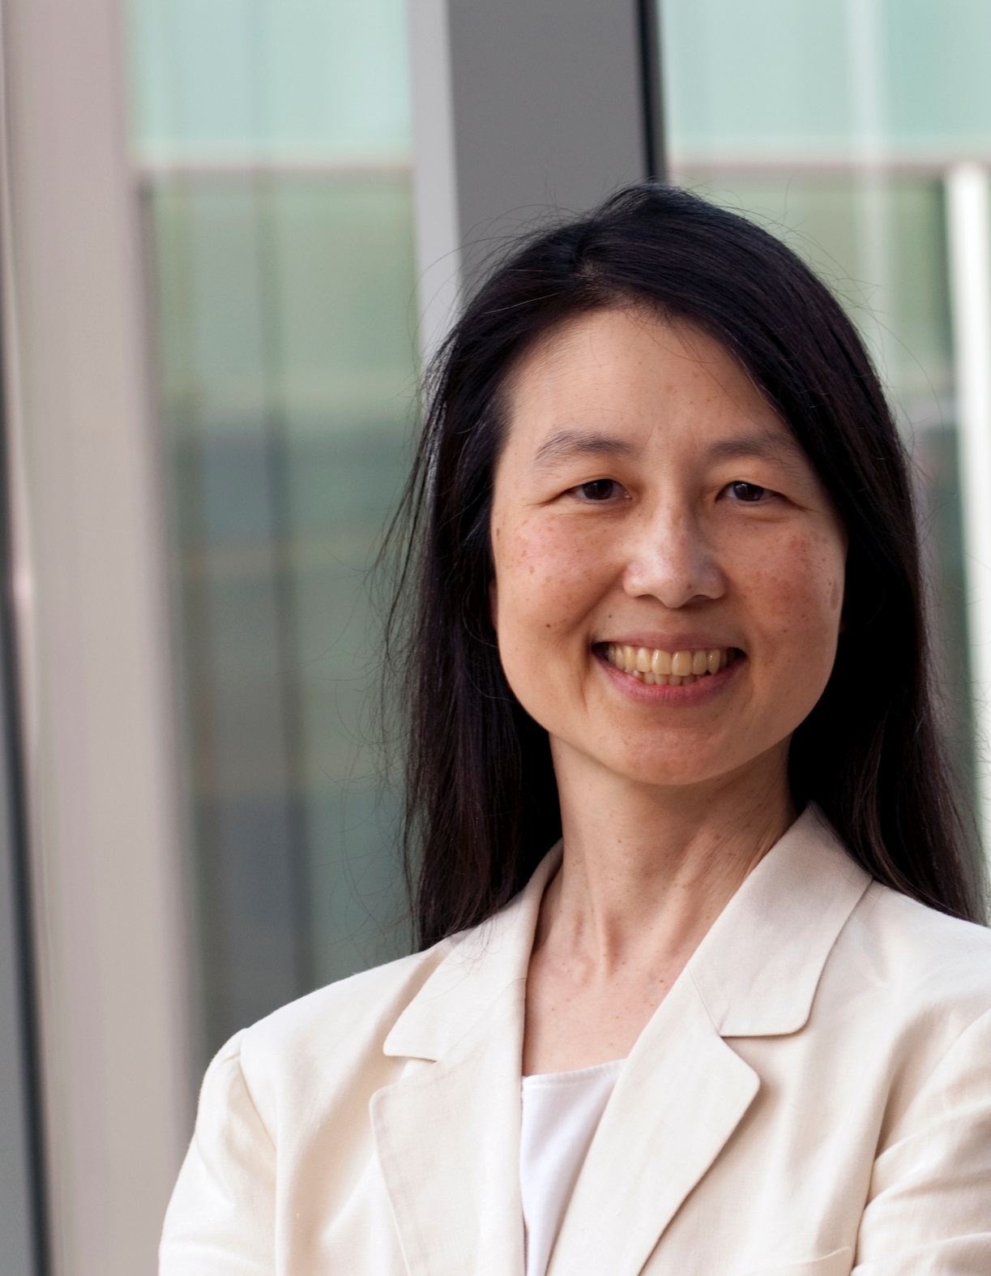
Thank you, Karen Spärck Jones.
Thank you, Jeannette Wing.
For putting Computational
Thinking on the map.
How abstract is that?
Find out about
decomposition
and algorithmic
thinking.
For THE ALGORITHM that search engines use to help us retrieve what is most relevant.
What is Karen’s
famous quote about men and computing?
#IAmAComputerScientist
University of Cambridge CC BY 2.5
#IAmAComputerScientist
Columbia University

Slide 12
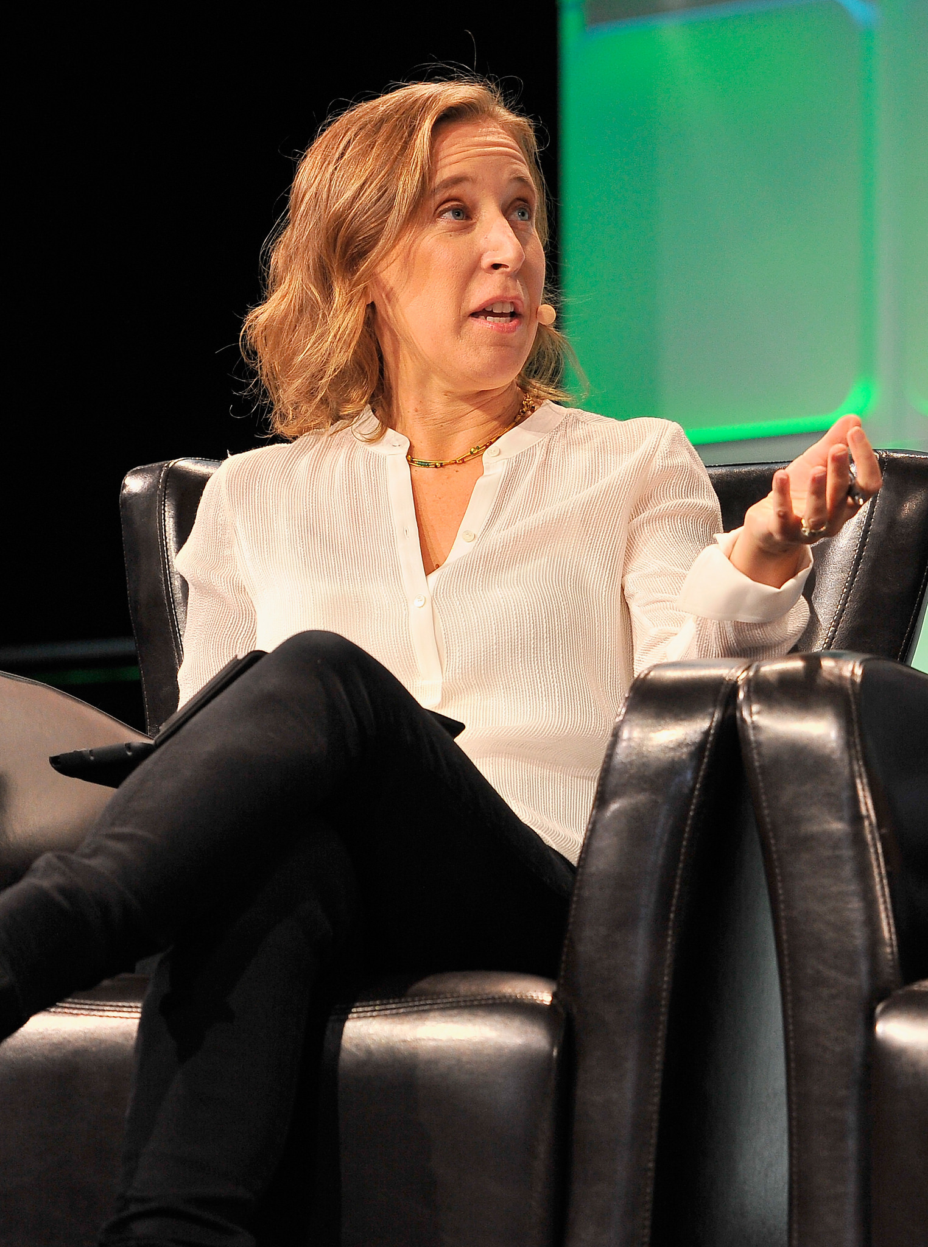
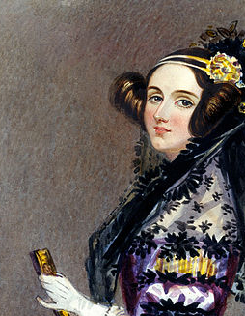
Thank you, Susan Wojcicki.
Thank you, Ada Lovelace.
For being ahead of your
time and predicting that
computers would work
with music and not
just numbers.
Find out how Ada helped
Charles Babbage.
Named “the most important person in advertising”, your tech executive marketing skills drove Google’s rise.
Find out about Susan's early involvement with Google.
By Steve Jennings / TechCrunch - https://www.flickr.com/photos/techcrunch/29684662515/, CC BY 2.0, https://en.wikipedia.org/w/index.php?curid=56232436
Science & Society Picture Library
#IAmATechExec
#IAmAProgrammer

Slide 13
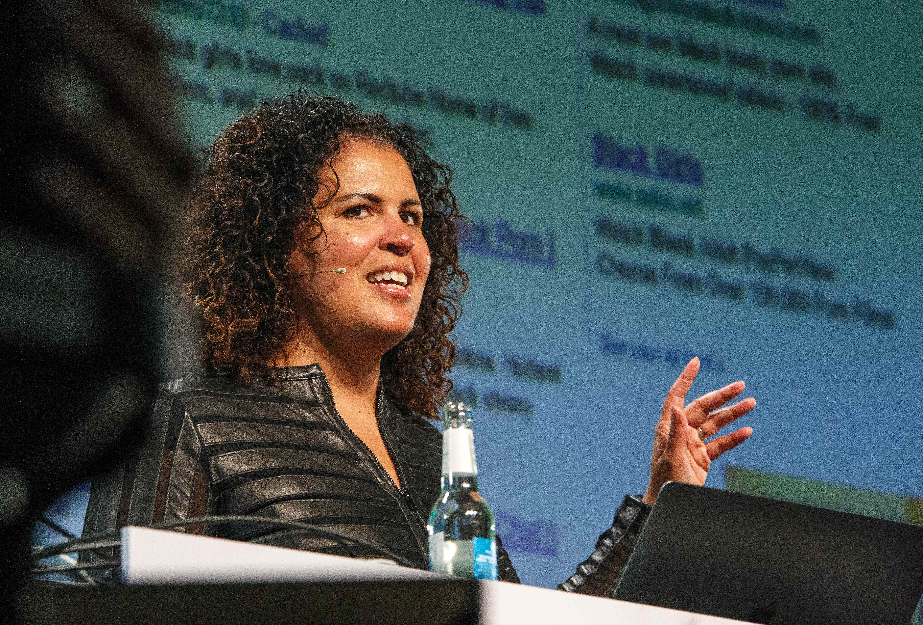
Thank you, Safiya Umoja Noble.
Who should be on our diversity posters?
Tweet #CSDiversity @QMEECS ‏@csf4n @IoCoding to nominate people who have contributed to computer science.
Your work on ethics and the design of digital media platforms reminds us that search engines can reinforce racism and that algorithms can have gender bias.
Find out about data science and ethics.
#IAmADigitalResearcher
https://www.flickr.com/photos/re-publica/41809675342/ Attribution-ShareAlike 2.0 Generic (CC BY-SA 2.0)

Slide 15
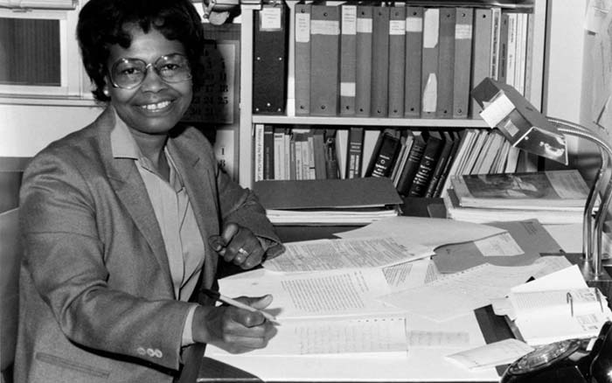
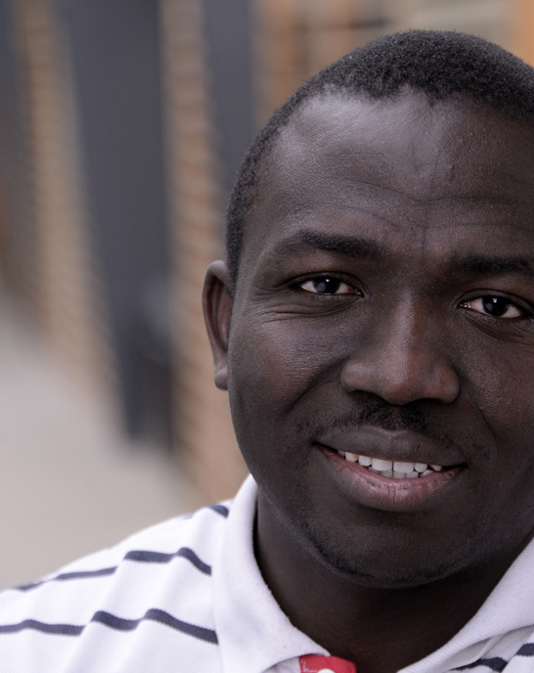
Thank you, Gladys West.
Thank you, Segun Fatumo.
Without your contribution our world would not be the same, laptops, smartphones, cars all use GPS.
Find out about Gladys’s work on weather satellites..
You are saving lives by using your computer science expertise in genetic research.
Find out about bioinformatics.
#IAmAMathematician
#IAmAComputerScientist
Photo provided by kind permission of Segun Fatumo.

Slide 16
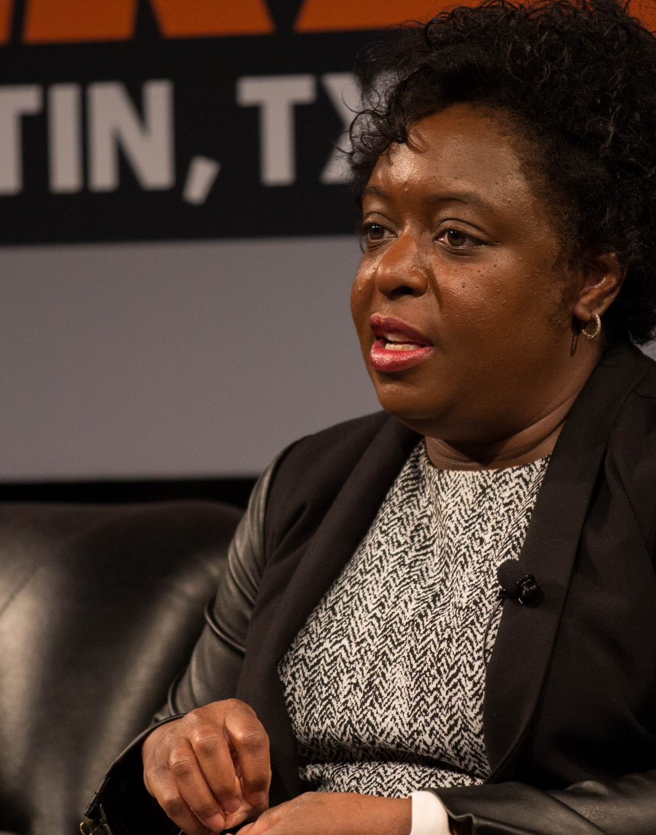
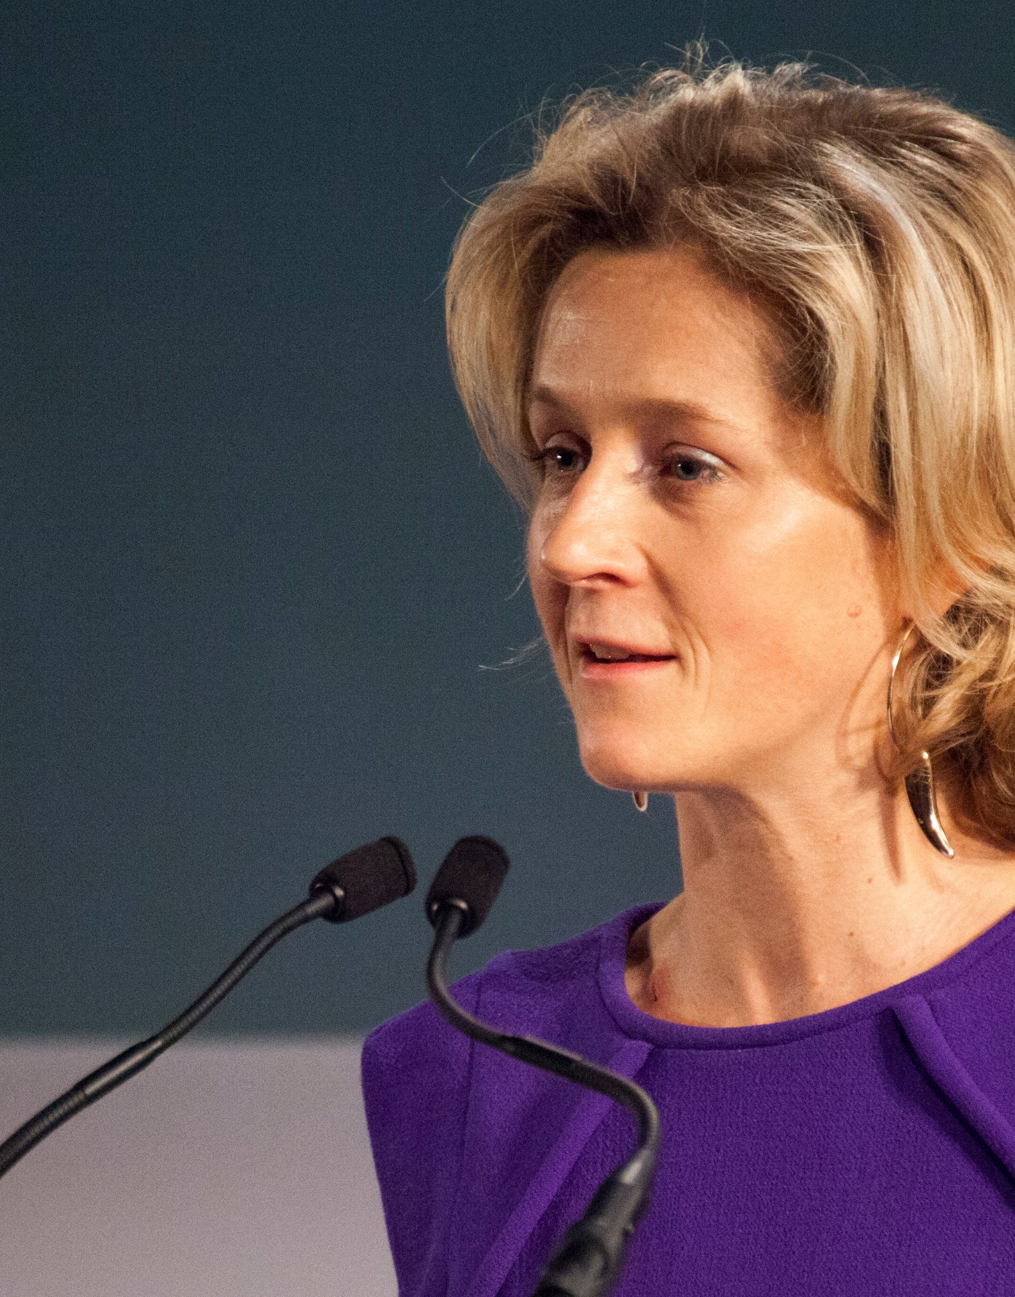
Thank you, Kimberly Bryant.
Thank you, Martha Lane Fox (CBE).
Appointed as the youngest female member of the House of Lords as the Digital Inclusion Champion, you campaign for responsible technology.
Find out what website Martha co-founded.
As an electronics engineer who also worked in pharmaceuticals & biotech, you figured we needed action for tech inclusion and created a non profit foundation.
What is the name of the foundation that
Kimberly set up?
#IAmAnElectronicsEngineer
By Ståle Grut / nrkbeta - Kimberly Bryant, Black Girls Code @ SXSW 2016, CC BY-SA 2.0, https://commons.wikimedia.org/w/index.php?curid=47848267
By gdsteam - https://www.flickr.com/photos/gdsteam/12208228633/, CC BY 2.0, https://commons.wikimedia.org/w/index.php?curid=66248604
#IAmADigitalActivitst

Slide 17
Diversity in Computing
Computer Science is for all
How can you make a difference?
www.cs4fn.org/diversity

Slide 19
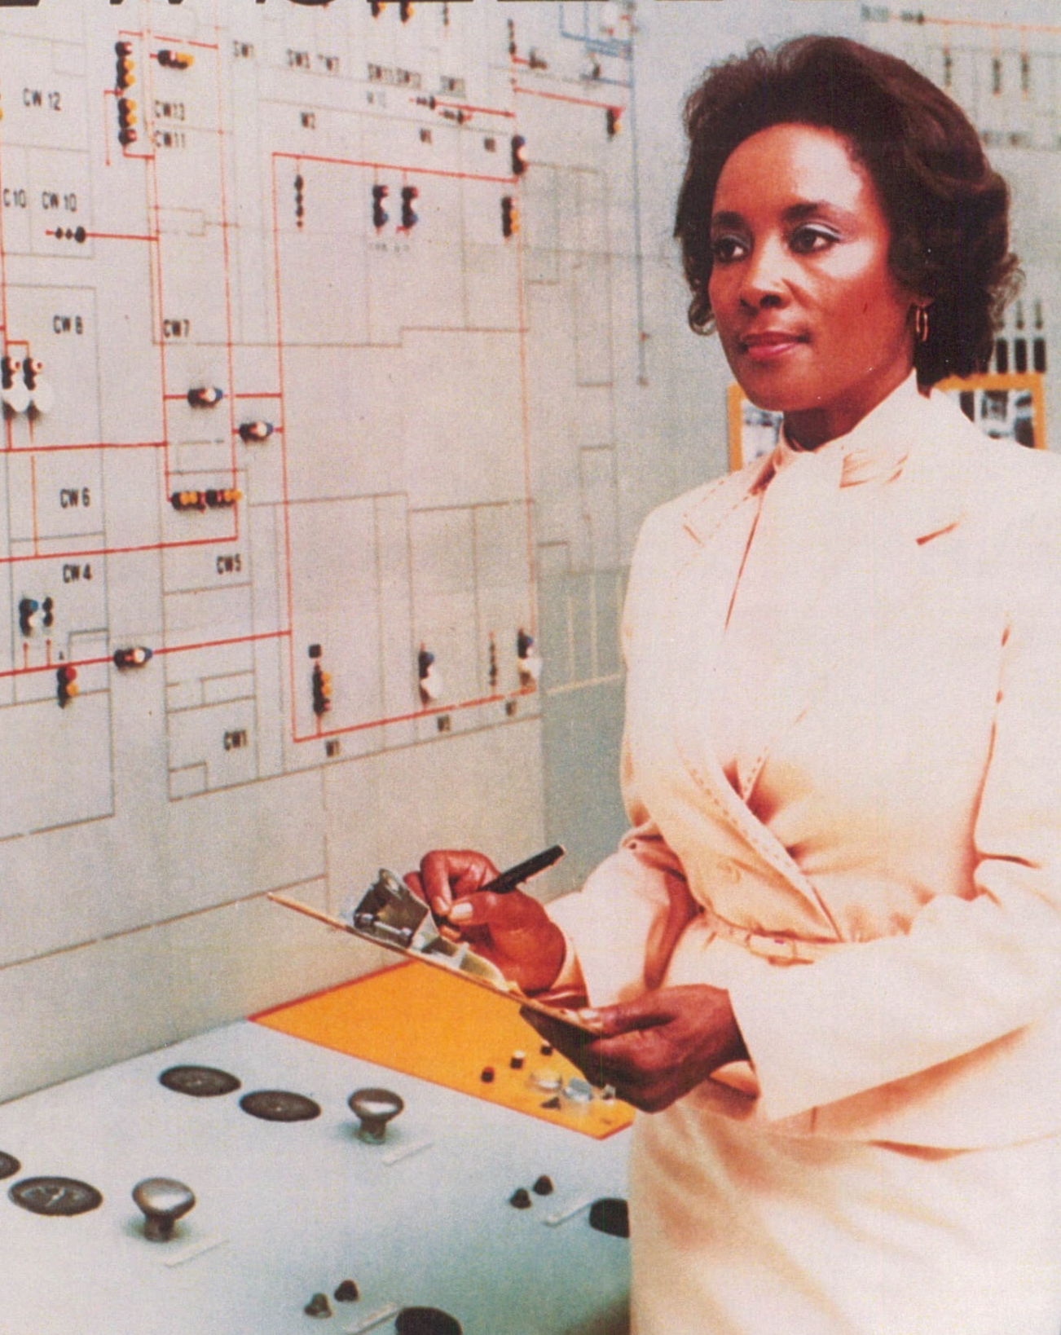
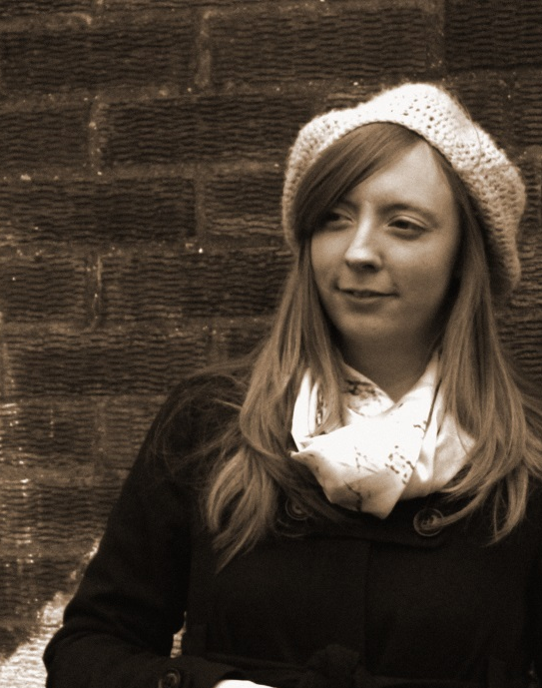
Thank you, Annie Easley.
Thank you, Carrie Anne Philbin.
As a pioneering computer
science teacher and
Raspberry Pi Director
you have championed
inclusion and diversity
in computing education.
Find out about the
Geek Gurl Diaries.
Your code was used to fly rockets and laid the foundations for space shuttle launches.
Find out about Annie’s
work in the 1960’s
#IAmAComputer Scientist
By NASA Science and Engineering Newsletter - Fagowees, Public Domain, https://commons.wikimedia.org/w/index.php?curid=30060646
#IAmAComputer Scientist
With kind permission of Carrie Anne Philbin
Notes:
.

Slide 20
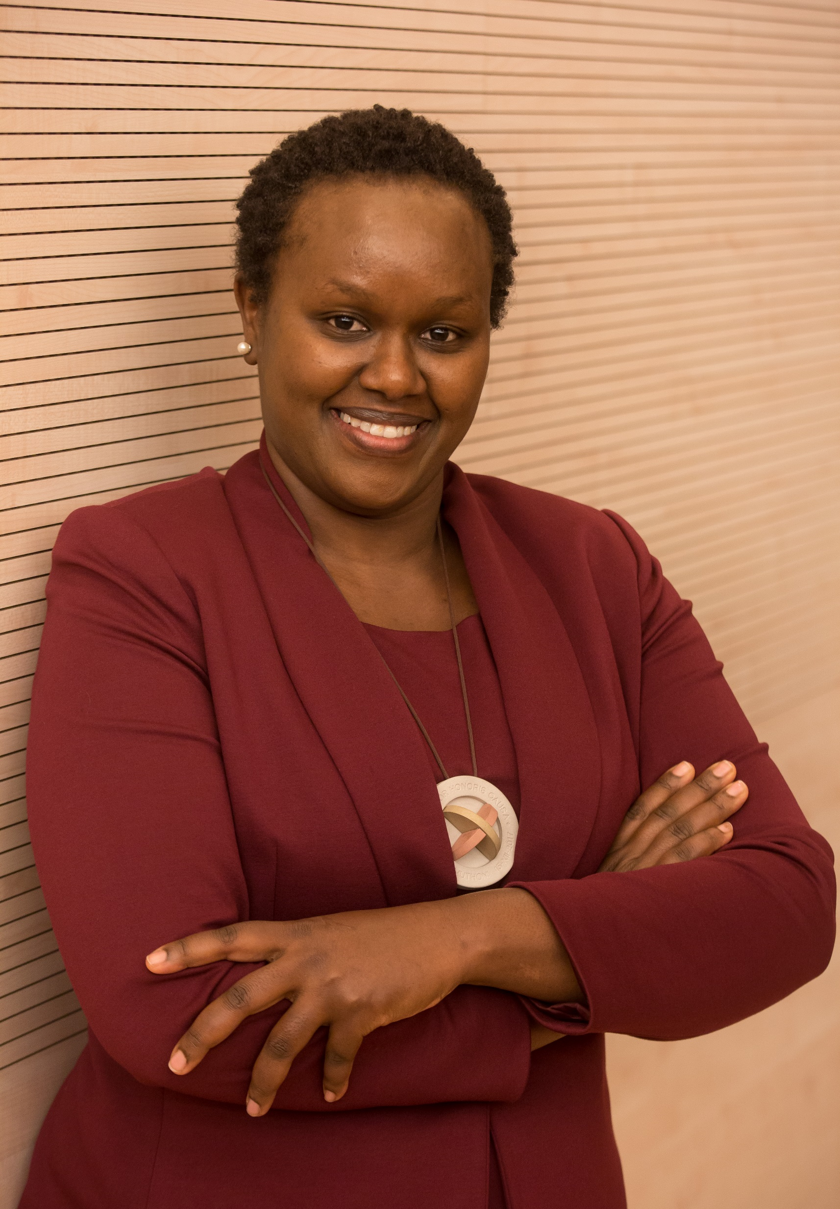
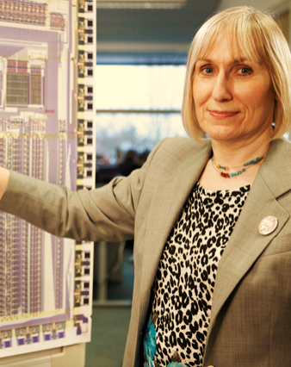
Thank you, Dorcas Muthoni.
Thank you, Sophie Wilson.
By founding a mentoring program for women in computing and working with governments & international groups you are driving change transform African lives.
Where did Dorcas
study and what
were her
specialisms?
95% of smartphones have the chip that you designed the code for.
What prototype computer did Sophie develop?
By Steve Jennings / TechCrunch - https://www.flickr.com/photos/techcrunch/29684662515/, CC BY 2.0, https://en.wikipedia.org/w/index.php?curid=56232436
By Chris Monk - https://www.flickr.com/photos/101251639@N02/9669448671, CC BY 2.0, https://commons.wikimedia.org/w/index.php?curid=68622523
#IAmAComputerScientist
#IAmAComputerScientist

Slide 21
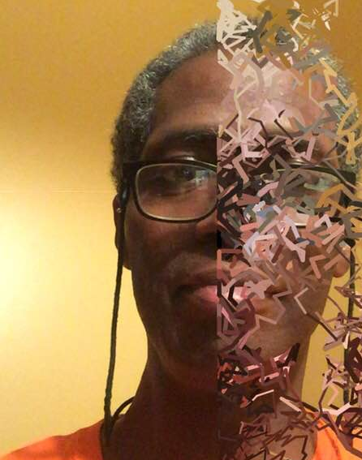
Thank you, John Henry Thompson.
Who should be on our diversity posters?
Tweet #CSDiversity @QMEECS ‏@csf4n @IoCoding to nominate people who have contributed to computer science.
You developed a programming language that displays images - Lingo.
This work has helped combine art and tech in web design, animation, graphics and video games.
Try a drawing app or processing.js
http://www.johnhenrythompson.com
#IAmAnInventor
#IAmAComputerScientist
Photo provided by kind permission John Henry Thompson
With kind permission on John Henry Thompson

Slide 23
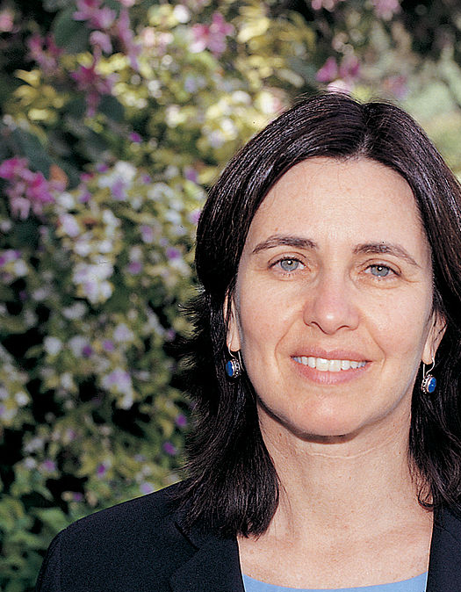
Thank you, Shafi Goldwasser.
Without your work on algorithms and maths used in encryption
we would not be as safe online.
Congratulations on
the Turing Award.
Find out about the
ball method of
explaining zero
knowledge proofs.
Thank you, Evelyn Boyd Granville.
Your maths & computing
work on aviation &
Space programs
helped catapult
rockets to the moon.
What job brought you back down to earth?
This photo was provided courtesy of the National Visionary Leadership Project.
#IAmAComputerScientist
Weizmann Institute of Science
#IAmAMathematician

Slide 24
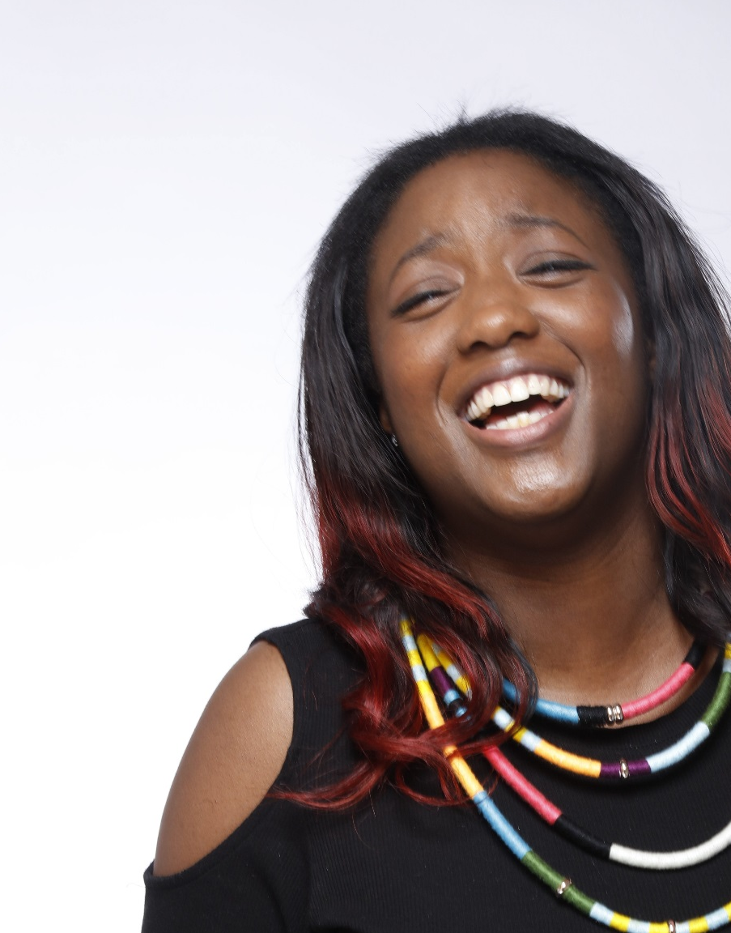
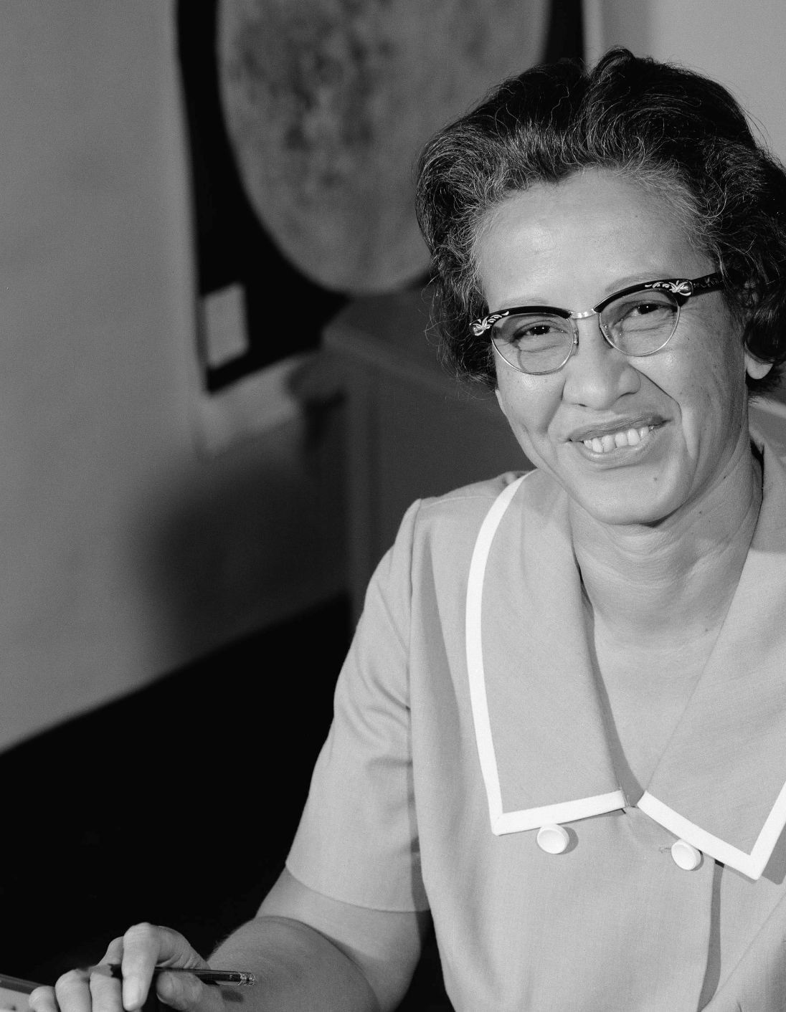
Thank you, Anne-Marie Imafidon.
You have created a social
enterprise which runs
hackathons,
mentoring and
an online platform.
Find out about
the Stemettes.
Thank you, Katherine Johnson.
You computed launch windows, emergency return paths and worked on the Space Shuttle program & Mission to Mars plans.
Congratulations on the Presidential Medal of Freedom.
Find out what John Glenn needed Katherine to do before his 1962 mission.
#IAmAComputerScientist
With kind permission of Anne-Marie Imafidon
By NASA; restored by Adam Cuerden - http://www.nasa.gov/sites/default/files/thumbnails/image/1966-l-06717.jpeg, Public Domain, https://commons.wikimedia.org/w/index.php?curid=47431407
#IAmAMathematician

Slide 25
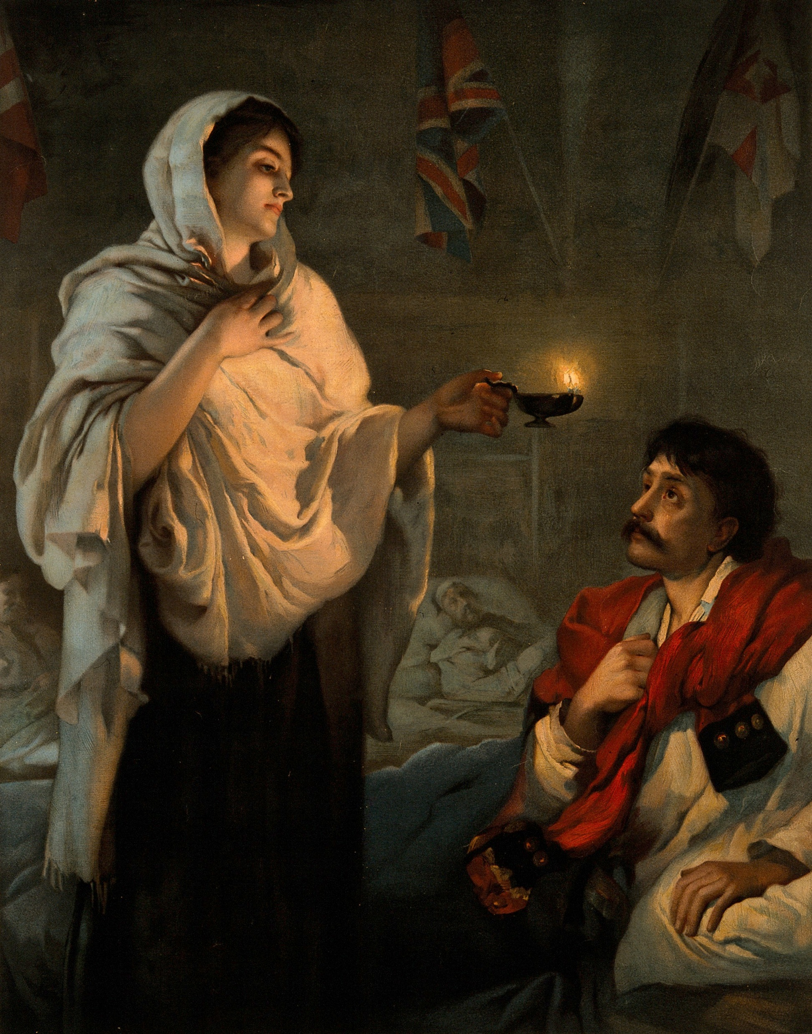
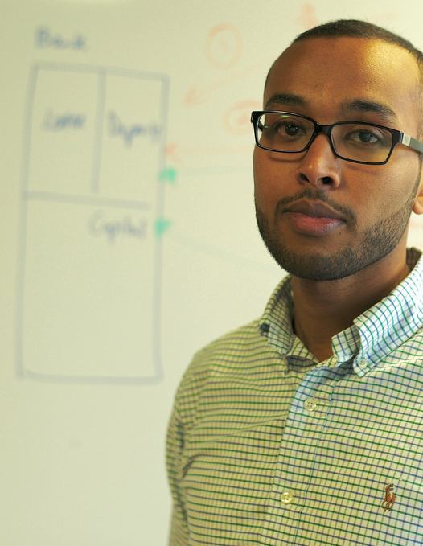
Thank you, Florence Nightingale.
Thank you, Abdigani Diriye.
Your work on data mining and visualising information help us see things more clearly.
Find out about Abdigani’s Somali and Somaliland boot camps.
For persuading Parliament to save lives by creating
infographics that could
not be ignored.
Find out what the infographics were about
and make your own.
After Henrietta Rae - https://wellcomeimages.org/indexplus/image/V0006579.htmlWellcome Collection gallery (2018-03-29): https://wellcomecollection.org/works/zggypp55 CC-BY-4.0, Public Domain, https://commons.wikimedia.org/w/index.php?curid=31233676
#IAmAComputerScientist
Photo provided by kind permission of Abdigani Diriye
#IAmADataVisualisationAnalyst

