Slide 1



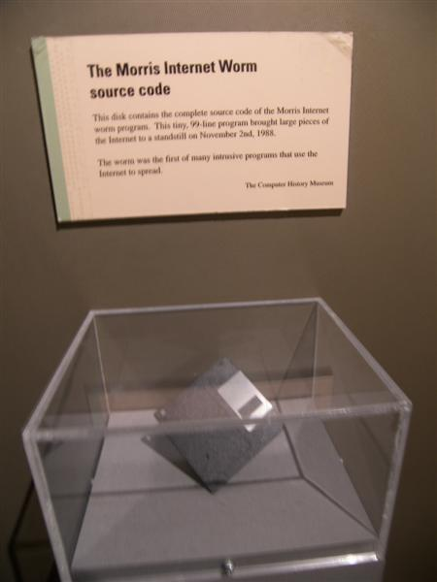
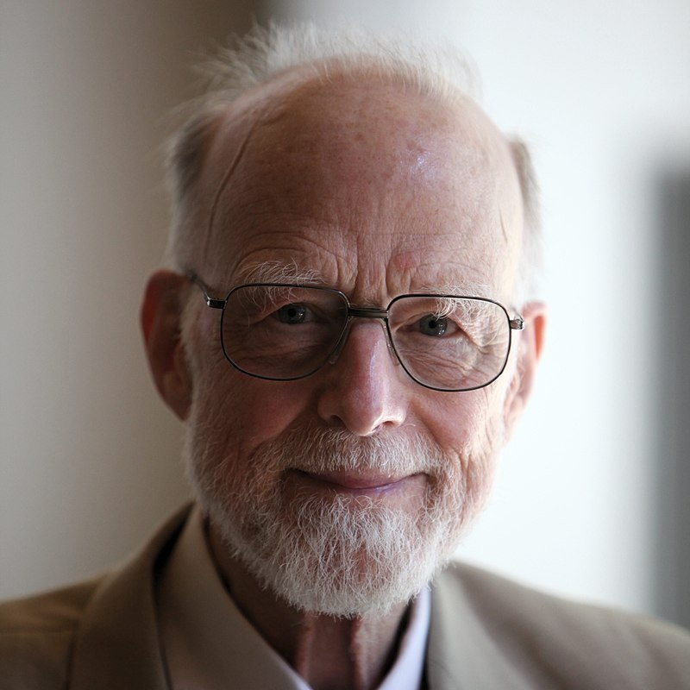

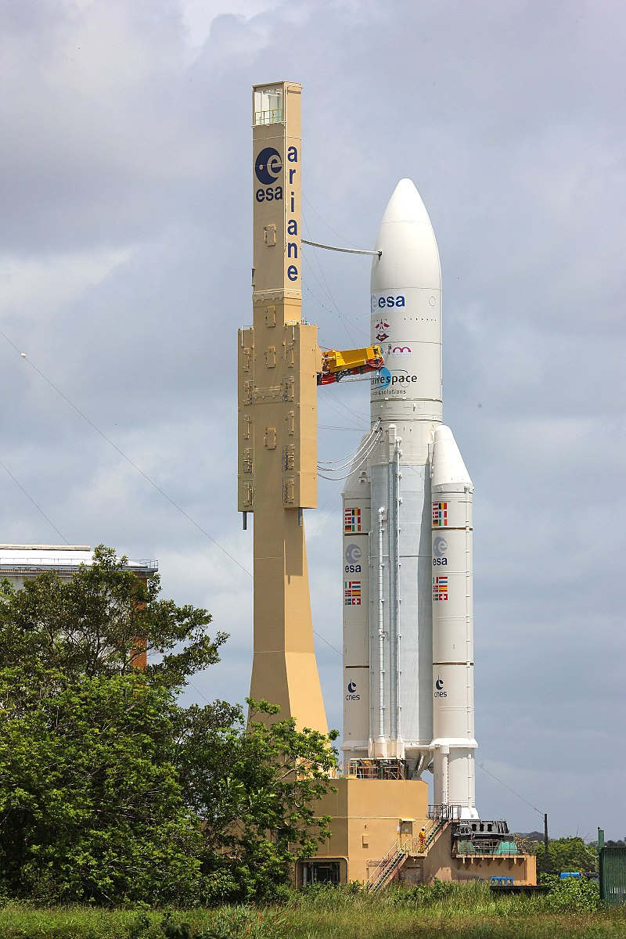

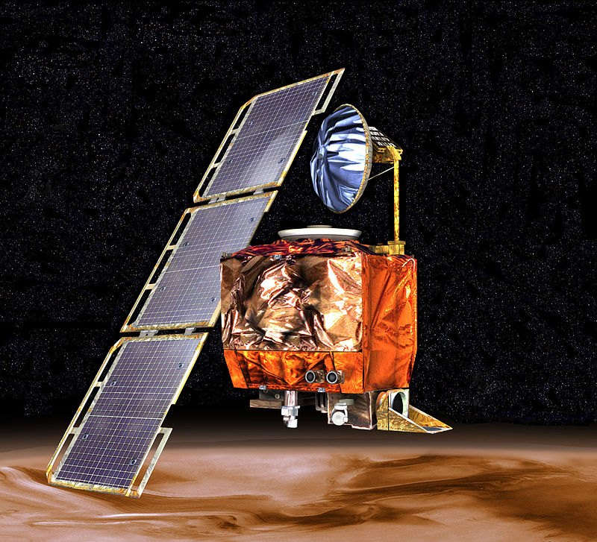
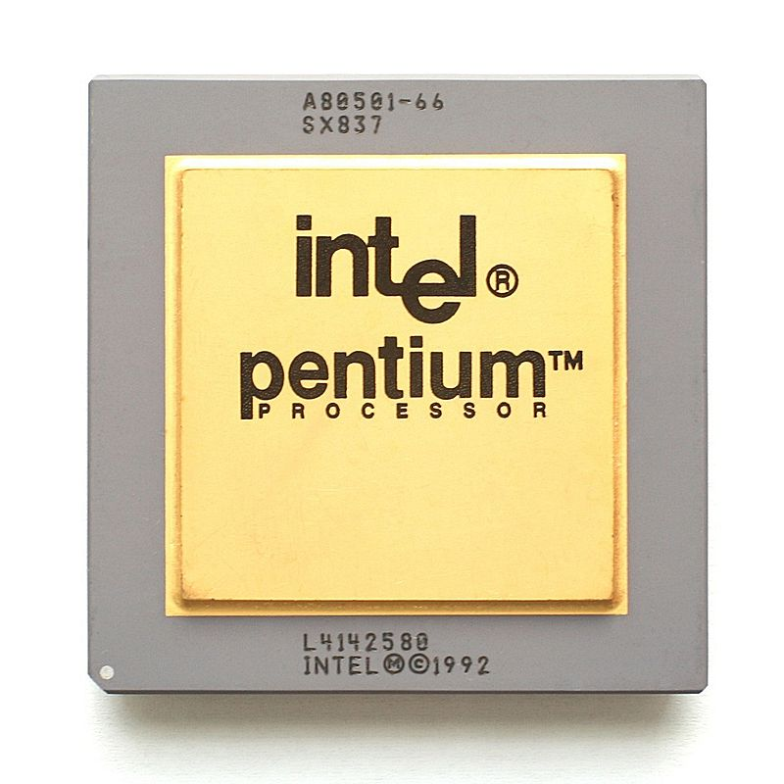

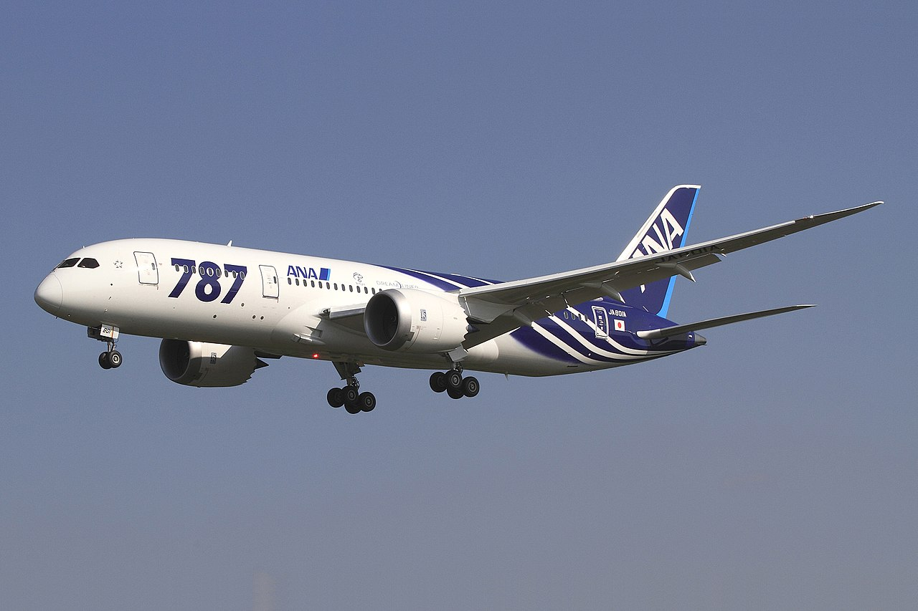
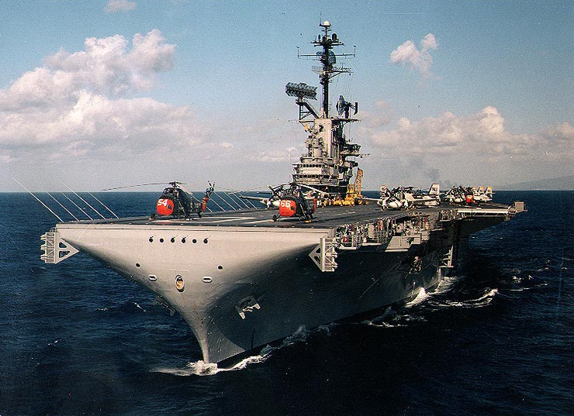
The Top 10 bugs
www.cs4fn.org/bugs/

Slide 2
BUG 10: Divide by Zero
  The USS Yorktown
  heralded a new generation of “smart” ship. Its propulsion system failed leaving it "dead in the water” for 3 hours after it tried to divide by zero crashing every computer on the ship’s network.

Slide 3
BUG 9: Arithmetic Overflow
Keep adding to an integer variable and you run out of bits. Suddenly you have a small number not the bigger one expected.
This was one bug in the Therac-25 radiation therapy machine that killed patients.
The Boeing 787 Dreamliner had the same problem. Fly for more than 248 days and it would switch off.
CC BY-SA 3.0

Slide 4
BUG 8: Timing problems
  AT&T lost $60 million the day the phones died (all of them). It was a result of changing a few lines of working code. Things happened too fast for the program. The telephone switches reset but were told they needed to reset again before they’d finished, … and so on.

Slide 5
BUG 6.99999989:
Wrong numbers in a lookup table
Intel’s Pentium chip turned out not to be able to divide properly. It was due to a wrong entry in a lookup table. Intel set aside $475 million to cover replacing the flawed processors. Some chips were turned in to key rings.
Konstantin Lanzet CC BY-SA 3.0

Slide 6
BUG 6: Wrong units
  The Mars Climate Orbiter spent 10 months getting to Mars …where it promptly disintegrated. It passed too close to the planet’s atmosphere. The programmers assumed numbers were in pound-force seconds when they were actually in newton-seconds.

Slide 7
BUG 5: Non-terminating loop
The spinning pizza of death is common. Your computer claims to be working hard, and puts up a progress symbol like a spinning wheel…forever. There are lots of ways that this happens. The simple version is that the program has entered a loop in a way that means the test to continue is never false.

Slide 8
BUG 4: Storing a big number in a small space
  The first Ariane 5 rocket exploded at a cost of $500 million 40s after lift-off. Despite $7 billion spent on the rocket, the program stored a 64 bit floating point number in to a variable that could only hold a 16 bit integer.
DLR German Aerospace Center CC BY 2.0

Slide 9
BUG 3: Memory leak
  Memory leaks (forgetting to free up space when done with) are responsible for many computer problems. The Firefox browser had one. It was infamous because Firefox (implausibly) claimed their program had no memory leaks.
The Mozilla Foundation CC BY 3.0

Slide 10
BUG 2: Following a null pointer
Tony Hoare who invented the null pointer (a pointer that points nowhere) called it his “billion-dollar” mistake because programmers struggle to cope with it. Null pointer bugs crash computers, give hackers ways in and generally cause chaos.
Photograph by Rama, Wikimedia Commons, Cc-by-sa-2.0-fr

Slide 11
BUG 1: Buffer overflow
The Morris Worm, an early Internet worm, came close to shutting down the Internet. It used a buffer overflow bug in network software to move from computer to computer shutting them down.
Go Card USA from Boston, USA: CC BY-SA 2.0

Slide 12
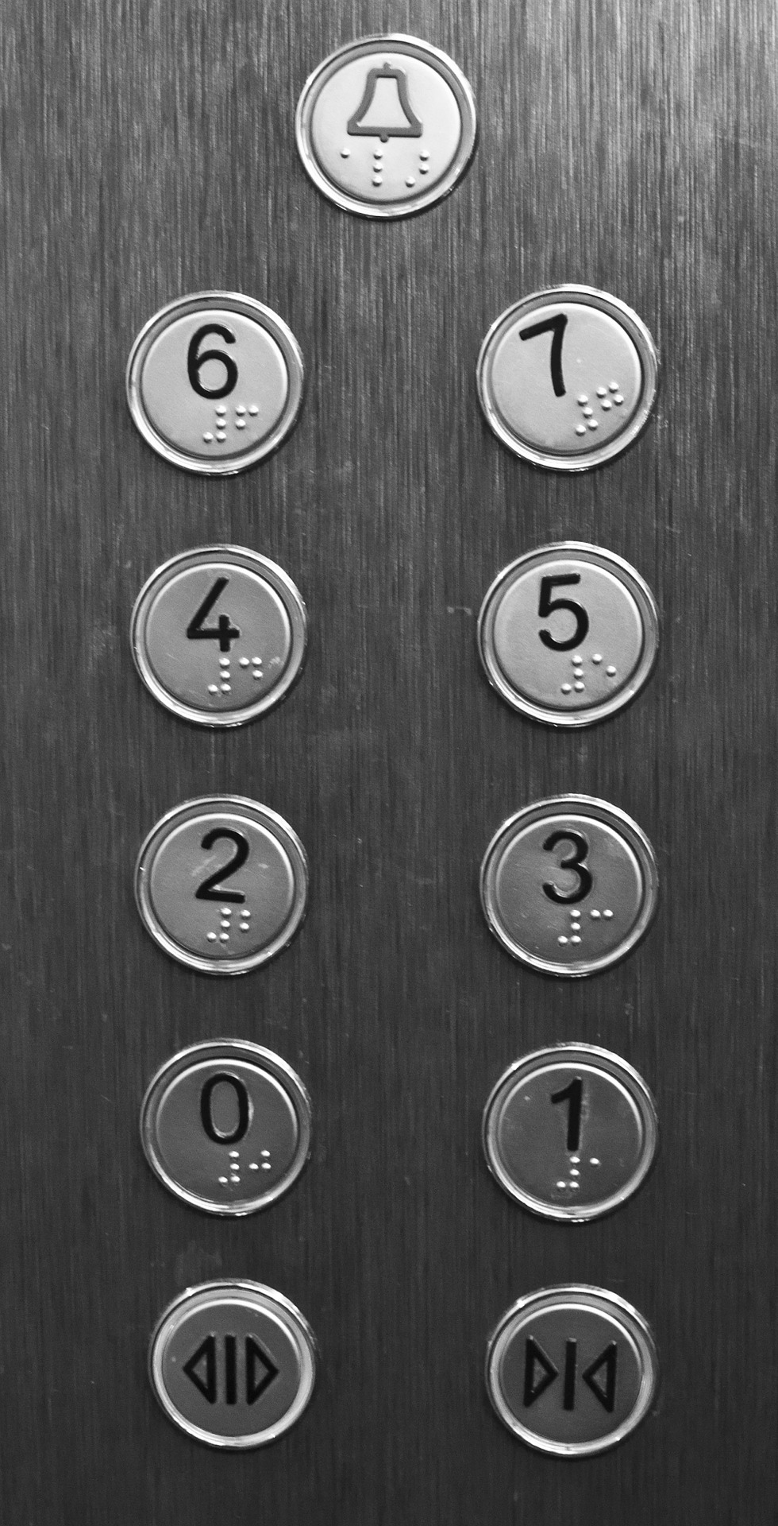
BUG 0: Running off the end of an array
Arrays in many languages start from position 0. This means the last position is one less than the length of the array. Get it wrong… as every novice programmer does at some point … and you run off the end.
Oddly (in Europe), we have no problem in a lift pressing 1 to go to the second floor up.
In other situations, count from 0 and you do one too many things.

Slide 13
Download these slides from
teachinglondoncomputing.org/bugs/

