Slide 1



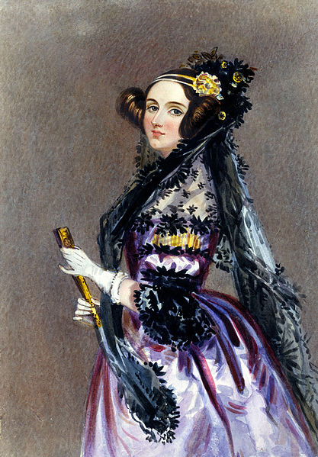
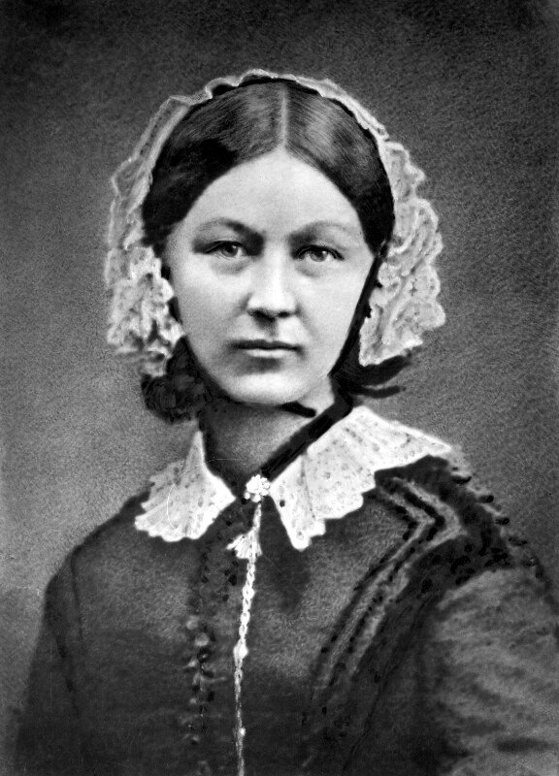
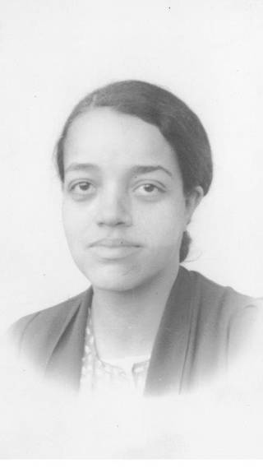
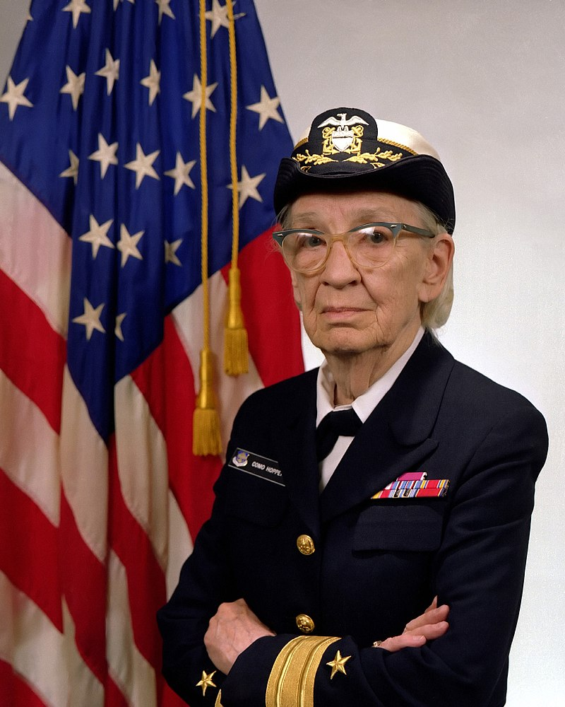
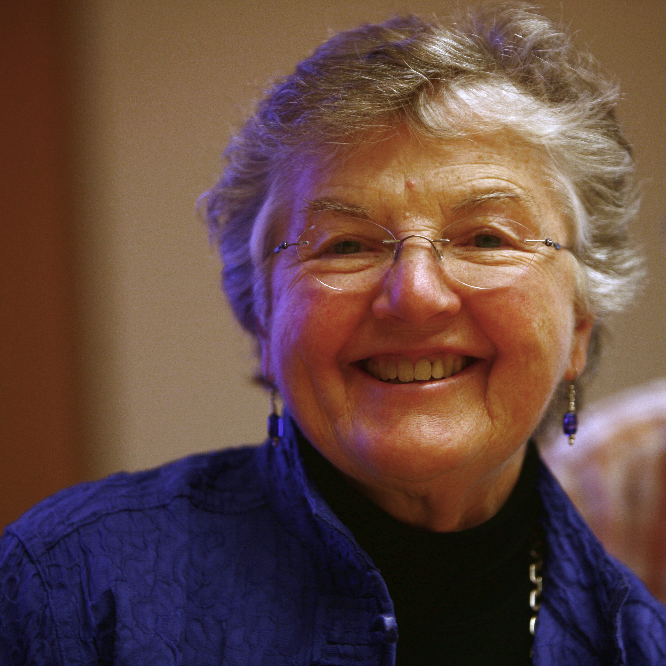
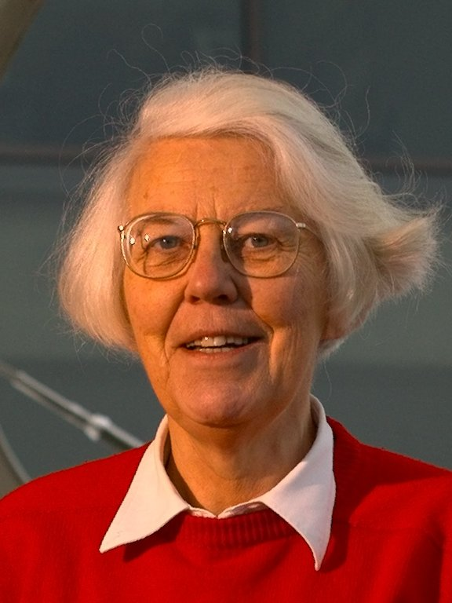
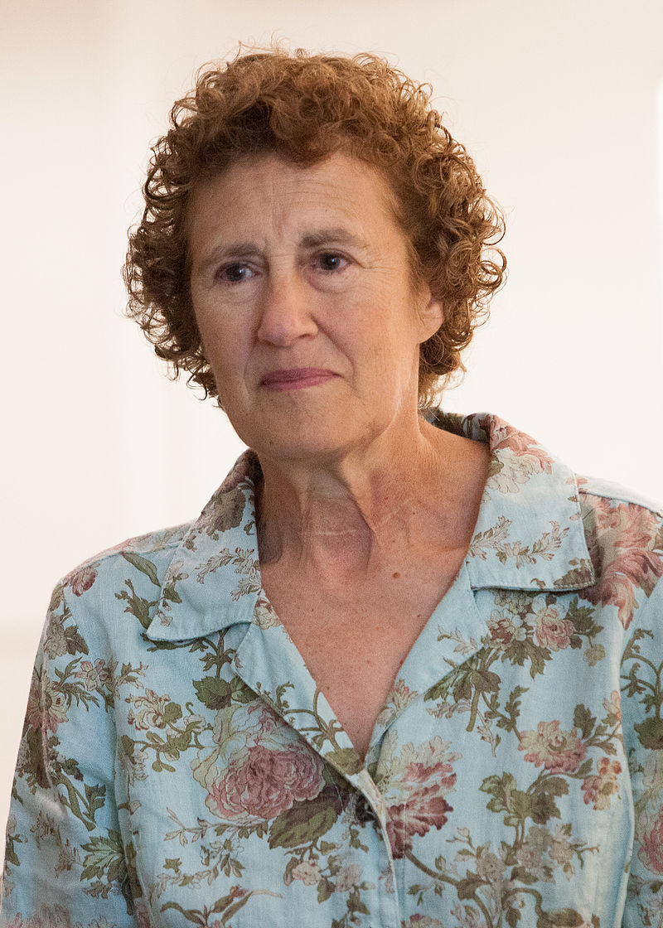
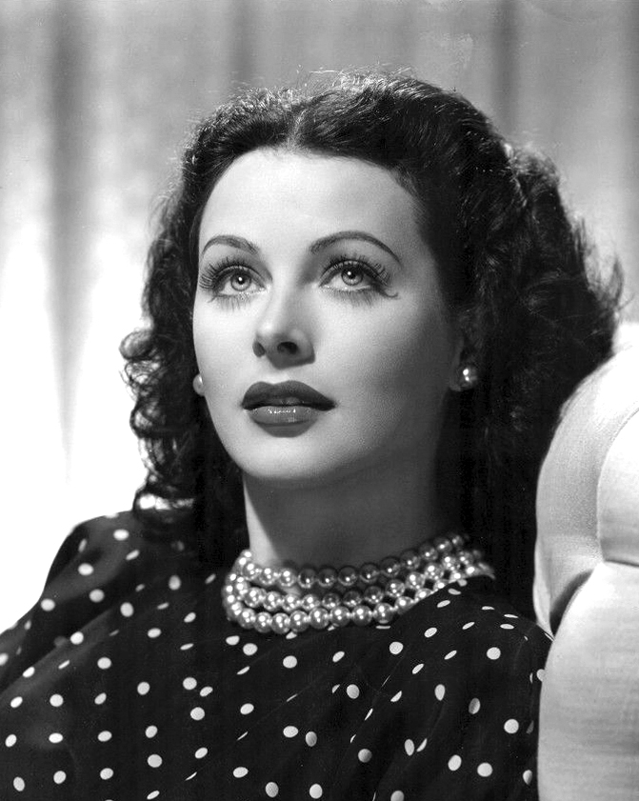
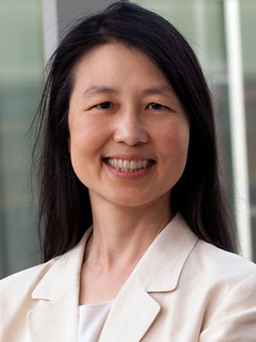
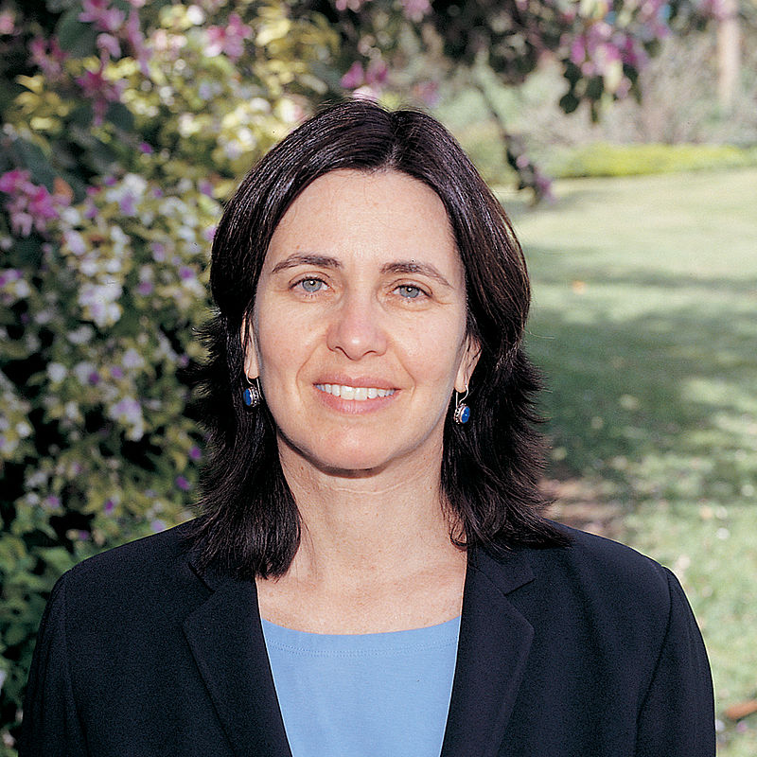
10 Female Computing Stars Through the Decades
www.cs4fn.org/women/

Slide 2
10 Female Computing Stars Through the Decades
1840s
Ada Lovelace points out that once other things, like music, are represented by numbers computers can be much more than just calculators.
Science & Society Picture Library

Slide 3
10 Female Computing Stars Through the Decades
1850s
Florence Nightingale
is the first person to combine lots of data with good ways of presenting all those numbers so the patterns can be seen. She successfully uses it to convince politicians to take action over deaths in hospital due to poor cleanliness.
Henry Hering (1814-1893) - National Portrait Gallery, London

Slide 4
10 Female Computing Stars Through the Decades
1940s
Dorothy Vaughan starts work at NACA (later NASA) as a human computer. Breaking down barriers, she becomes the first
African-American
manager and oversees the change to electronic computers. Her team’s work underpin the design of aircraft and the space programme.
Vaughan Family

Slide 5
10 Female Computing Stars Through the Decades
1950s
Grace Hopper suggests programming should be done using english words rather than obscure codes or numbers, then writes the first compiler to make it a reality.
James S. Davis

Slide 6
10 Female Computing Stars Through the Decades
1960s
Fran Allen sets out a clear foundation for the way compilers can improve programs written in high level languages, so that the resulting code is faster but does the same as the original. She wins a Turing Award.
Rama CC BY-SA 2.0 fr

Slide 7
10 Female Computing Stars Through the Decades
10 Female Computing Stars Through the Decades
1970s
Karen Spärck Jones invents an algorithm to decide which documents are most relevant. Variations form the core of most search engines. Points out “Computing is too important to leave to men”.
University of Cambridge CC BY 2.5

Slide 8
10 Female Computing Stars Through the Decades
10 Female Computing Stars Through the Decades
1980s
Barbara Liskov develops programming languages. Argus is the first to support writing distributed programs. CLU includes ideas that ultimately lead to object-oriented programming. She wins a Turing Award.
Kenneth C. Zirkel CC BY-SA 3.0

Slide 9
10 Female Computing Stars Through the Decades
10 Female Computing Stars Through the Decades
1990s
Hedy Lamarr receives the Electronic Frontier Foundation Pioneer Award. During WWII she co-invented frequency hopping: constantly jumping from one frequency to another. Not taken up till the 1960s, this underlies today’s mobile technology.

Slide 10
10 Female Computing Stars Through the Decades
10 Female Computing Stars Through the Decades
2000s
Jeannette Wing promotes the idea of computational thinking as the key problem solving skill set of computer scientists. It is now taught in schools worldwide.
Columbia University

Slide 11
10 Female Computing Stars Through the Decades
10 Female Computing Stars Through the Decades
2010s
Shafi Goldwasser wins a Turing Award. She co-invented zero knowledge proofs: a way to show a claim being made is true without giving away any more information. This matters in the digital world to ensure people are honest without giving up privacy.
Weizmann Institute of Science

Slide 12
… and men too
Of course men occasionally helped too!
The best computer science and innovation arise when the best people of whatever gender, culture, sexuality, ethnicity and background work together.

Slide 13
For lots more great female computer scientists visit
www.cs4fn.org/women/
Download these slides from teachinglondoncomputing.org/women/

