Slide 1
Teach A level Computing:
Algorithms and Data
Structures
Eliot Williams
@MrEliotWilliams

Slide 2
Course Outline
1 | Representations of data structures: Arrays, tuples, Stacks, Queues,Lists
2 | Recursive Algorithms
3 | Searching and Sorting
4 | Hashing and Dictionaries, Graphs and Trees
5 | Depth and breadth first searching ; tree traversals

Slide 3
http://www.aqa.org.uk/subjects/computer-science-and-it/as-and-a-level/computer-science-7516-7517/subject-content-a-level/fundamentals-of-algorithms

Slide 4
Graphs

Slide 5

What is a graph
A
Edge
D
Some resources may refer to nodes and arcs…..
Vertex
Vertex
Edge
Edge
Edge
Edge
E
Vertex
Edge
Vertex
B
C
Vertex
Edge

Slide 6
Terminology
A graph can have cycles (loops)
A weighted graph has a value on the edge
A directed graph has arrows to indicate direction
A multigraph has multiple edges connecting the same vertices
A tree is a type of graph where…
  All vertices are connected
  The graph is undirected
  There are no cycles

Slide 7
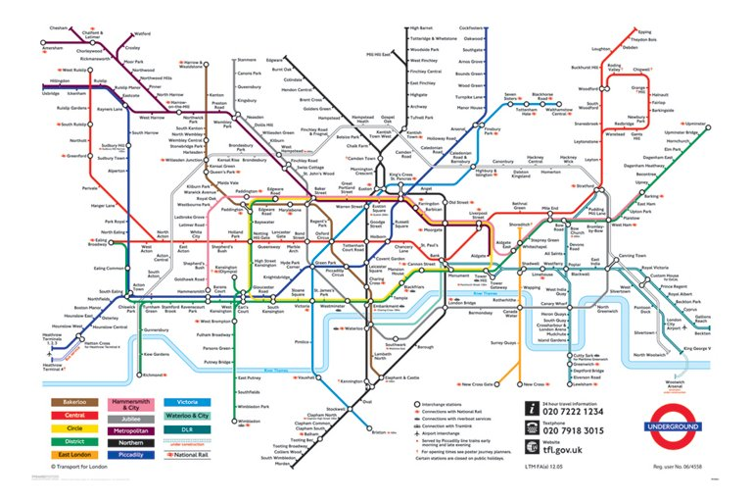
Uses of graphs
Route planning and maps
Web page links
Social media connections & trends
Underground tube links
…. etc

Slide 8

Representing graphs
Graphs need to be processed by computer programs:
    Adjacency matrix
    Adjacency list

Slide 9

Adjacency Matrix
(Undirected)
If two vertices are connected then a 1 is place in two positions in the matrix:
    Find the row for the first vertex, move to the cell in this row which is in the column for the second vertex
    Find the row for the second vertex, move to the cell in this row which is in the column for the first vertex
1
3
5
2
4
 | 1 | 2 | 3 | 4 | 5
1 | 0 | 1 | 1 | 1 | 0
2 | 1 | 0 | 0 | 1 | 0
3 | 1 | 0 | 0 | 1 | 1
4 | 1 | 1 | 1 | 0 | 1
5 | 0 | 0 | 1 | 1 | 0

Slide 10
Adjacency Matrix
(Directed)
Positioning of 1s does not have to be symmetrical
1
4
2
3
 | 1 | 2 | 3 | 4
1 | 0 | 1 | 1 | 1
2 | 0 | 0 | 1 | 1
3 | 0 | 0 | 0 | 0
4 | 0 | 0 | 1 | 0

Slide 11
Adjacency List
Undirected Graph:
Specifies the vertices that are adjacent to each vertex of the graph
1
3
5
2
4
Vertex | Adjacent Vertices
1 | 2,3,4
2 | 1,4
3 | 1,4,5
4 | 1,2,3,5
5 | 3,4

Slide 12
Adjacency List
Directed Graph:
    Must reflect direction of edges
    Adjacent vertices are called terminal vertices
    Terminal vertices are adjacent to the initial vertex
1
4
2
3
InitialVertex | Terminal Vertices
1 | 2,3,4
2 | 3,4
3
4 | 3

Slide 13
Labelled Graph
Adjacency Matrix
 | 1 | 2 | 3
1 | ∞ | 25 | 0
2 | ∞ | ∞ | 45
3 | ∞ | ∞ | ∞
Adjacency List
2
Initial Vertex | Terminal Vertices
1 | 2,25;3,0
2 | 3,45
3
25
45
1
3
0

Slide 14
When to use adjacency matrices and lists
  Matrix
    Use when there are many vertex pairs connected by edges
    Indicates edge exists with one access
  List
    Use if the graph is sparse (not as many edges)

Slide 15
Activity 1.1 & 1.2
Which is harder and why?

Slide 16
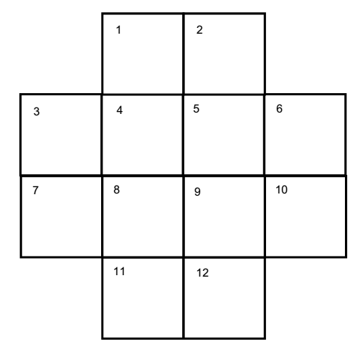

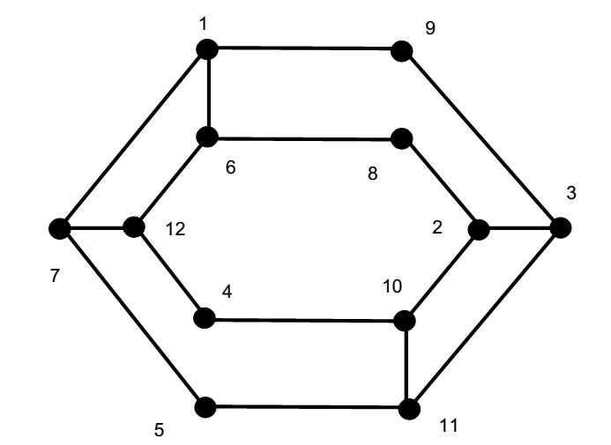

The Knights Tour Graph
Hotel
Science Museum
Cathedral
Castle
Toy Shop
Aquarium
Warship
Zoo
Wax Works
Art Gallery
Park
Big Wheel
Notes:
Here is the graph for the Knights Tour for students to check theirs against.
They may have a different layout, but arranging it in this way should make something obvious. Do they notice anything about the graph?
(click)
It is identical to the London Tour Guide problem!

Slide 17
Exercise 2: A Puzzle
Boris, Ben, Bob, Bess, Beth and Bill are waiting in a doctor’s surgery. Looking around the room, each of them sees that they know some of the other people in the room. Ben knows five of the other people sitting in the room, Bob knows four of the others, Beth and Bill both know three of the others, Bess knows two of the others and Boris only knows one of the other people. Who knows who in the waiting room?
Solve the puzzle (in pairs) by drawing a graph
(this is a good starter exercise)

Slide 18
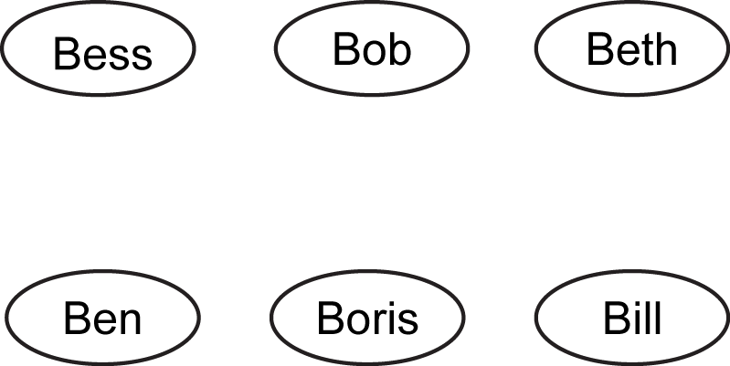
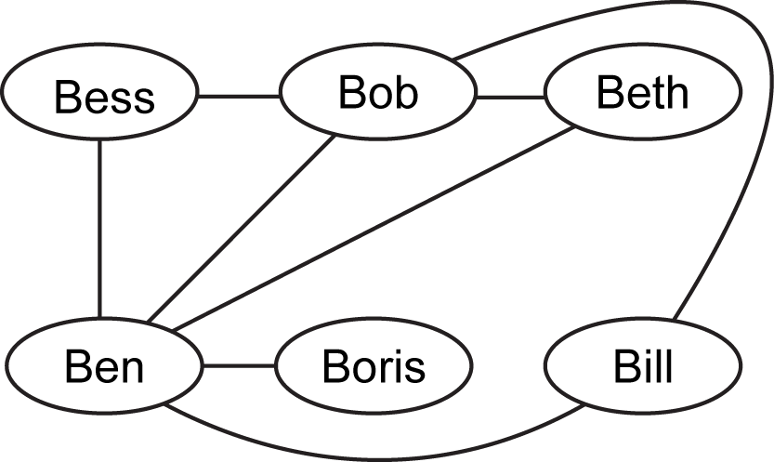

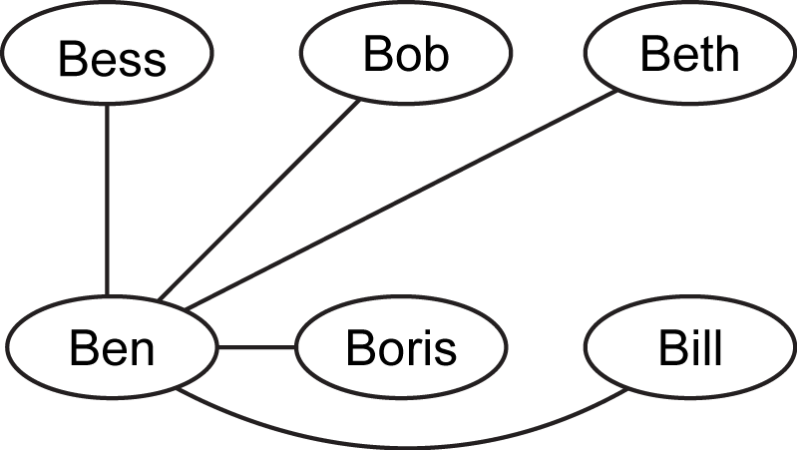
waiting room.
Step 3
Now Boris only knows one other person – we can now tell that this is Ben. Bob knows four other people in the room; we know one of these is Ben and we know that Boris is not one of them so Bob must also know Beth, Bess and Bill. Draw edges representing these vertices.
Step 1
Represent each of the people as a vertex.
Step 2
Ben knows five of the other people in the room; this means that he knows all the others so draw edges connecting him to the other vertices.
Step 4
Bess only knows two other people; we can see from our graph that they are Ben and Bob. Bill and Beth both know three other people. From our graph, we can see that they both know Ben and Bob. They do not know Boris or Bess, therefore they must know each other. Draw the edge representing this relationship and the graph has now been completed and shows us who knows who in the waiting room

Slide 19
Connectivity
Many applications of graphs involve getting from one vertex to another: e.g.
    Finding the shortest route between two places
    Finding the route out of a maze
A graph is connected if there is a path between each pair of vertices
Otherwise the graph is said to be disconnected

Slide 20
Trees
Rooted Tree
Has one vertex that has been designated as the root
Every edge is directed away from the root
All vertices are connected
The graph is undirected
There are no cycles
Binary Tree
If each node in the tree has a maximum of two children then it is called a binary tree

Slide 21
Binary Search Tree
Sorted Binary Tree:
  left sub-tree contains only nodes with values less than the node’s
  right sub-tree contains only nodes with values greater than the node’s
  both left and right sub-trees are binary search trees

Slide 22
Binary Tree Traversal
Pre order (visit,left, right)
[A, B, C]
In order (left visit right)
[B,A,C]
Post order ( left, right visit)
  [B,C A]
A
B
C

Slide 23
Pre order Binary Tree Traversal
Def pre(tree,start):
Visit node(print?)
If node to the left of start:
then dft left
If node to the right of start:
then dft right
A B D E C F
A
B
C
D
E
F

Slide 24
Exercise 3.1
Complete the Skelton for the pre-order Tree traversal
3.2 and 3.3
Extend with a post and in -order

Slide 25
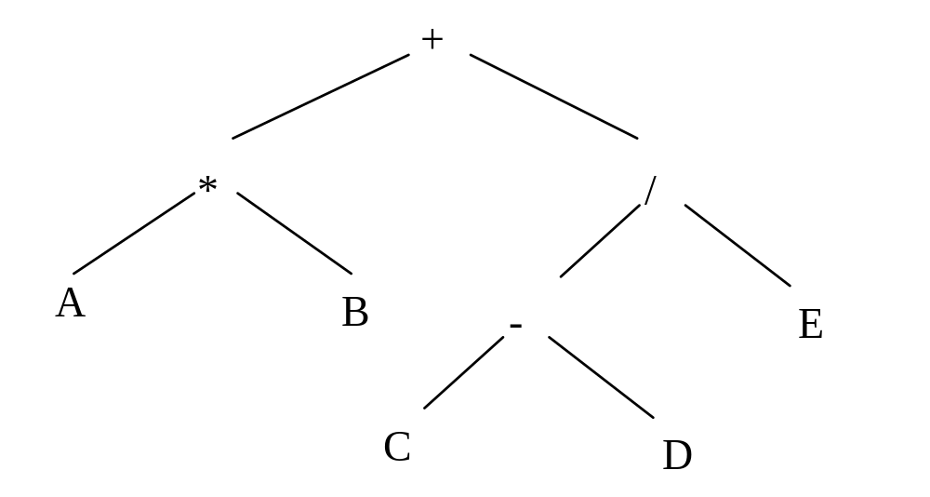
Exercise 4: More traversals
An algebraic expression is represented by the following binary tree.
Show the output produced if the tree is traversed using:
pre-order traversal
in-order traversal
post-order traversal
+ * A B ? – C D E
A * B + C – D / E
A B * C D - E / +

Slide 26
Example Binary Search Tree
  Search algorithms for a BST are very efficient
0 | 1 | 2 | 3 | 4 | 5 | 6
5 | 1 | 3 | 7 | 6 | 4 | 8
5
1
7
3
6
8
4

Slide 27
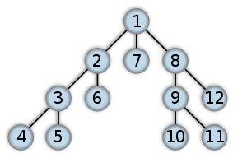
Depth First Traversal
https://commons.wikimedia.org/wiki/File:Depth-first-tree.svg
Standard Algorithm for searching trees
The Depth First Search (DFS), follows a chain of vertices until it cannot go further, at which point it backs up.
This is a pre order traversal
def dfspreorder(tree,start):
if start in tree:
print(start)
branches=tree[start]
#print(branches)
for i in range(0,len(branches)):
dfspreorder(tree,branches[i])
This can also been done post order so would output 4,5,3,6,2 in the diagram this will involve a stack!

Slide 28

Breadth First Traversal
Standard Algorithm for searching trees
The Breadth First Search (BFS) visits all neighbours of each vertex before moving on to another vertex.
Breadth-First-Search(Graph, root):
create empty set S
create empty queue Q
root.parent = NIL
add root to S
Q.enqueue(root)
while Q is not empty:
current = Q.dequeue()
if current is the goal:
return current
for each node n that is adjacent to current: if n is not in S:
add n to S
n.parent = current
Q.enqueue(n)

Slide 29
Breadth vs depth
You met Sam at a friends party and didn’t get a number
You know they must be friends with someone at the party to have been there
To find Sam Do you depth first or breadth first search your facebook friend?

Slide 30
DFS
must see whole tree anyway
you know d, the level of the answer
don't care if the answer is closest to root
BFS
  answer is close to the root
  you want the answer that is closest to the root
  have multiple cores/processors
  will always find the answer in finite time…..
Will also find you the shortest path to your destination (least number of edges)

Slide 31
Connectivity
Many applications of graphs involve getting from one vertex to another: e.g.
    Finding the shortest route between two places
    Finding the route out of a maze

Slide 32
Connectivity
A graph is connected if there is a path between each pair of vertices
Else the graph is said to be disconnected

Slide 33

Paths
Sequence of edge that begins at a vertex of a graph and travels from vertex to vertex along the edges of the graph
http://oracleofbacon.org

Slide 34
Dijkstra's (Shortest Path)

Slide 35
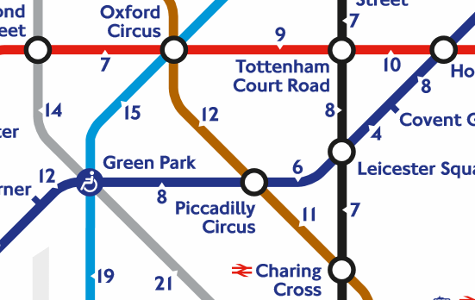
Tueb failure….We need to walk from Bond street to Leicester Square to meet our date….
7
9
10
15
8
8
14
12
6
4
8
7
11

Slide 36
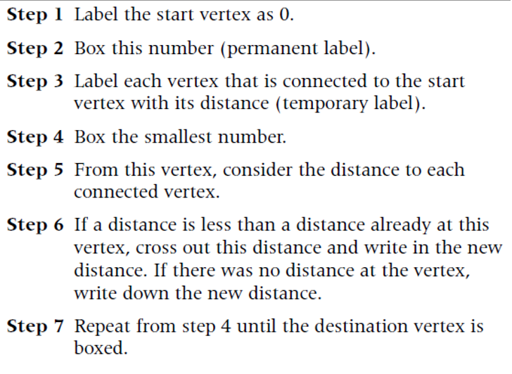
0
7
9
10
15
8
8
14
12
6
4
8
7
11

Slide 37
Look at all unvisited neighbours of the current node and work out the tentative distance from the start
7
7
9
10
15
8
8
14
12
6
4
14
8
7
11

Slide 38
Choose the unvisited node with the lowest tentative distance (Oxford Circus)
Calculate tentative distance to all its neighbours and replace if lower
Green Park is not updated as its tentative distance via Oxford circus is 22 and its current tentative distance is 14
Mark the current node as visited
Store the neighbouring node with the lowest distance
Oxford Circus
7
7
16
9
10
15
8
8
14
12
6
4
Green Park
14
8
19
7
11

Slide 39
Choose the unvisited node with the lowest tentative distance (Green Park)
Calculate tentative distance to all its neighbours and replace if lower
No changes….
Mark the current node as visited
Store the neighbouring node with the lowest distance
7
7
16
9
10
15
8
8
14
12
6
4
14
8
19
Green Park
7
11

Slide 40
Choose the unvisited node with the lowest tentative distance (16 – Tottenham Court Road)
Calculate tentative distance to all its neighbours and replace if lower
Mark the current node as visited
Store the neighbouring node with the lowest distance
7
7
16
26
9
10
15
8
8
14
12
24
6
4
14
8
19
7
11

Slide 41
Choose the unvisited node with the lowest tentative distance (19 – Piccadilly Circus)
Calculate tentative distance to all its neighbours and replace if lower
(19+6=25 so Leicester Square not updated)
Mark the current node as visited & Store the neighbouring node with the lowest distance
7
7
16
26
9
10
15
8
8
14
12
24
6
4
14
8
19
7
11
30

Slide 42
Choose the unvisited node with the lowest tentative distance (24 – Piccadilly Circus)
In CS we are trying to find the shortest path to this point so we just need to find the neighbour with the lowest tentative distance
We can then follow the shortest route back that we have stored…
(mathematicians may be used to continuing to find the minimal spanning tree)
7
7
16
26
9
10
15
8
8
14
12
24
6
4
14
8
19
7
11
30

Slide 43
Exercise 5
Also
Interactive example here
http://optlab-server.sce.carleton.ca/POAnimations2007/DijkstrasAlgo.html

Slide 44
Comparing Search Algorithms
Breadth First search – Explores equally in all directions
Dijkstra's Algorithm
  Favours shorter(cheaper/quicker) paths.
  calculates the distance from the start point.
A*- modification of Dijkstra’s algorithm
  prioritises paths in the direction the goal
  Uses the sum of distance from start and estimated distance from goal..

Slide 45
Taking this further….
http://www.redblobgames.com/pathfinding/a-star/introduction.html
http://www.redblobgames.com/pathfinding/a-star/implementation.html
Computerphile – A star Search Algorithm
https://youtu.be/ySN5Wnu88nE
Maze Solving
https://youtu.be/rop0W4QDOUI

Slide 46
Homework & Certificates
No homework
No certificates today
Final homework deadline this time next week
  (please email me if you are planning on completing the homework)

