Slide 1
Teaching Primary Computing
Diving Deep into Programming
Session 9
Planning

Slide 2
Course outline
Day 1 | Pedagogy, Sequence, Repetition
Day 2 | Selection, Variables, Make your own blocks
Day 3 | Control/Physical Computing, Assessment, Progression & Differentiation, Planning

Slide 3
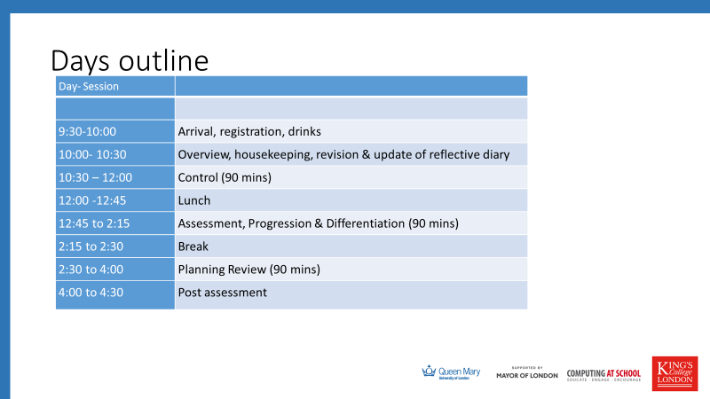

Slide 4
Objectives of this session
Increase understanding of planning particularly looking at
What influences us when we set lesson plan objectives
What other countries are including in emerging curricula
Scaffolding approaches incorporated in my own planning
Levels of abstraction incorporated in my own planning
Detailed progression of objectives in my own planning
RAG

Slide 5
What influences the setting of objectives?
What is missing from the following slide?
What is the best of breed? For each area?

Slide 6
Lesson plan objectives influenced by
Or we find a great activity and see what it might teach?
Program of study requirements (high level content)
  Sequence, selection, repetition etc. Computational thinking. Design and write programs.
How children learn to program (theories and models)
  Level of abstraction , Computational Thinking, Progression!!
How we teach programming (approaches & techniques)
  Scaffolding Copy code-> tinkering. Pupil contribution. Genre e.g. route based, animation, quiz, game, physical computing, simulation (e.g. Maths modelling).
Specific children’s needs
  SEND, gender, cultural, access to kit at home, previous knowledge and experience (ready to learn), interests etc.
Software and hardware available or chosen
  Block based, text or hybrid, tablets or PCs, reliability of kit, ease of installing software
Topic chosen (context)
  Cross-curricula or one-off.
Teacher expertise & CONFIDENCE
Notes:
JW Take ideas first then show

Slide 7
Looking at other curriculums/ SOW
USA - Massachusetts
Scotland
USA CSTA
New Zealand
Kibo
English Curriculum /Progression pathways
Look at one of these and report back to the whole group compare to our curriculum and progression pathways.

Slide 8
Reviewing planning
Review your planning for Scaffolding approaches (20 mins)
Review your planning for Design and LOA (20 mins)
Review your planning for objectives using the learning trajectories we created this morning(20 mins)

Slide 9
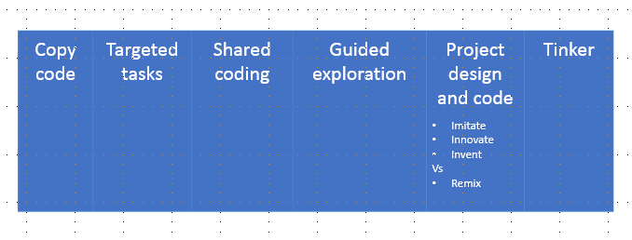
Review planning
Annotate your planning with the approaches used e.g. copy code, targeted task etc
Work out what is your most common approach.
Work out your ‘scaffolding path’.
Share with your team and discuss what might you change?
Remix
Imitate (copy design)
Innovate (change)
Invent (new design)
Notes:
JW
(Read predict, compare code, fix buggy code etc)
Live coding, Think aloud, cognitive apprenticeship)
(Limited commands/ clearly defined goal/remixing)

Slide 10
 | Lesson 1 | Lesson 2 | Lesson 3 | Lesson 4 | Lesson 5
Copy code | X | X | X | X
Targeted Task
Live Coding | X | X | X | X
Guided exploration
Project |  |  |  |  | X CREATE
Tinkering | X

Slide 11


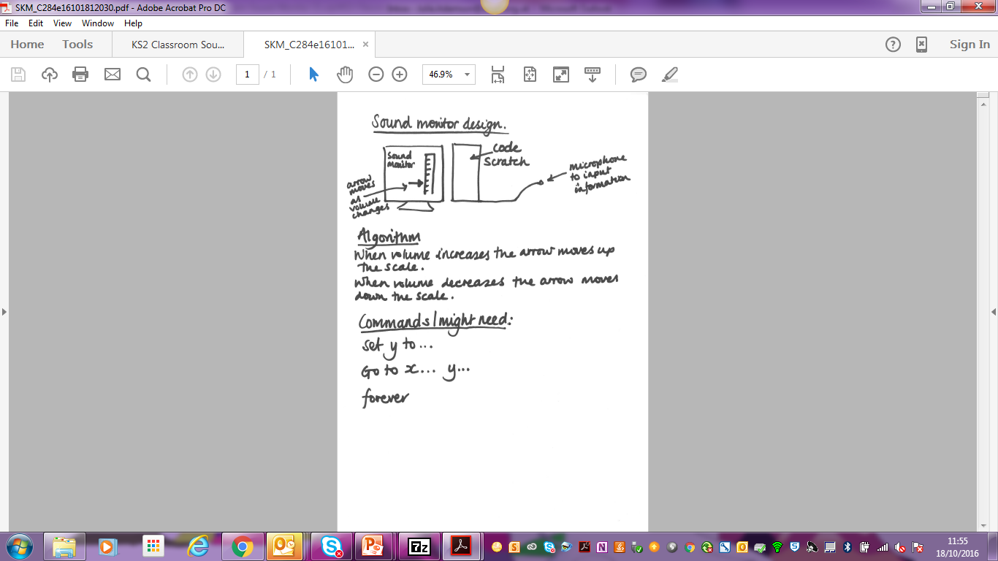
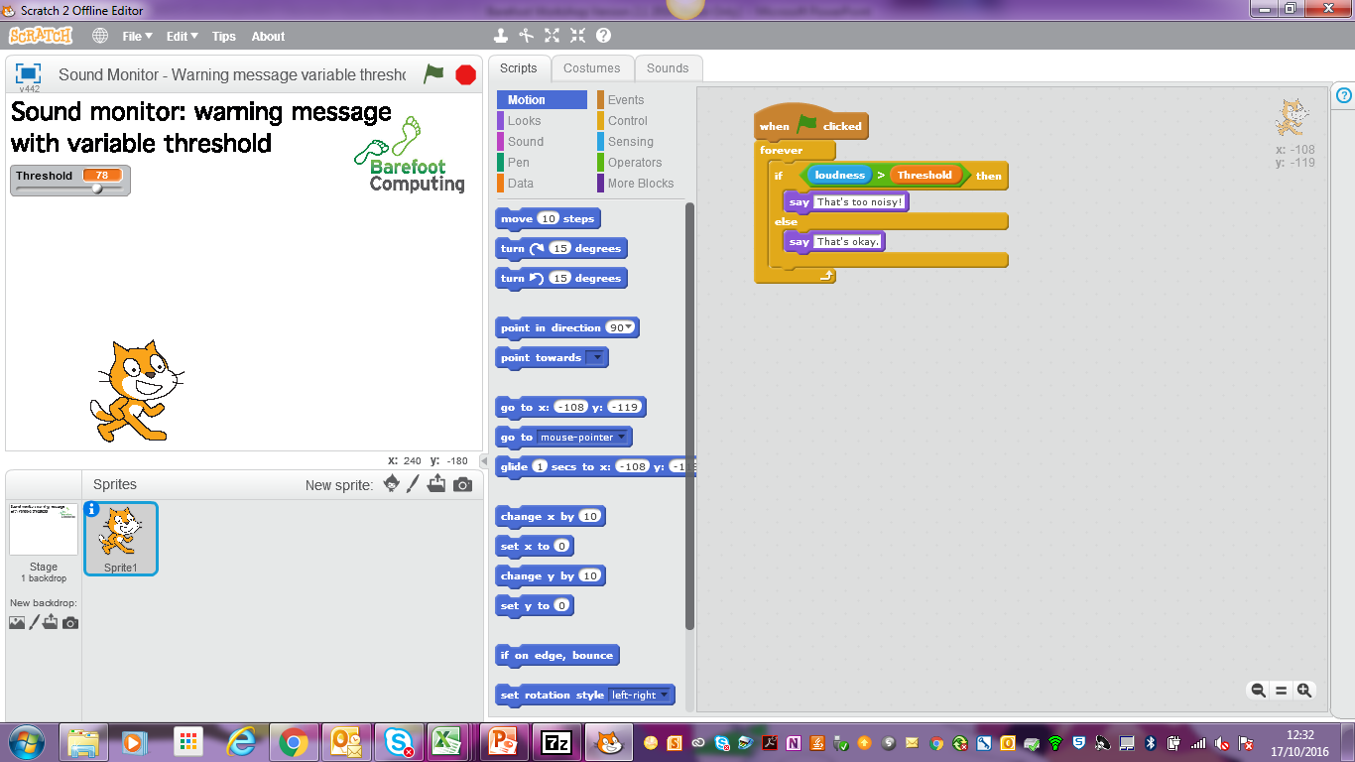
Programming Process
Use computational thinking to analyse the problem and design a solution, including creating an algorithm
Implement these ideas in a programming language on a computer: coding.
Programming
Notes:
JW

Slide 12
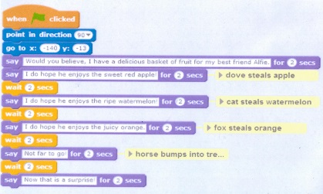

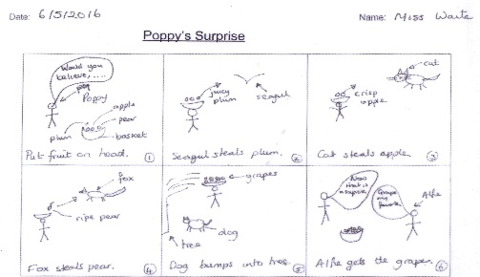
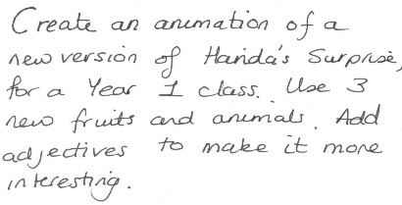
Make a list of all the words to describe these things (and count how many words)…
A
B
C
D
Notes:
JW Irrespective of the approach taken – what would you call these?

Slide 13

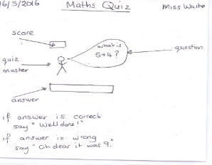
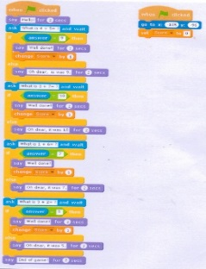

Task (problem)
Algorithm
Code
Running the code
Notes:
JW

Slide 14
Levels of abstraction
1. Task
2. Design – Algorithm
Annotate you planning with level of abstraction each activity works at.
Are you mostly working at one level?
Work out what is your most common approach.
Work out your level of abstraction path.
Share with your team and discuss what might you change?
3. Code
4. Running the code
Armoni, M. 2013. On Teaching Abstraction in Computer Science to Novices.
Based on Perrenet, J. et al. 2005. Exploring students’ understanding of the concept of algorithm: levels of abstraction.
Design added and numbering changed to Cutts format by Waite et al 2016.

Slide 15
 | Lesson 1 | Lesson 2 | Lesson 3 | Lesson 4 | Lesson 5
Copy code | X | X | X | X
Targeted Task
Live Coding | X | X | X | X
Guided exploration
Project |  |  |  |  | X CREATE
Tinkering | X
 | Lesson 1 | Lesson 2 | Lesson 3 | Lesson 4 | Lesson 5
Task | X | X | X | X | X
Design/Algorithm |  |  |  |  | X
Code | X | X | X | X | X
Running the code | X | X | X | X | X

Slide 16

Compare to your SOW
This Photo by Unknown Author is licensed under CC BY-NC-ND
USA - Massachusetts
Scotland
USA CSTA
Australian
The trajectories we created
Annotate your planning with objectives you might magpie
Annotate your planning with ideas you might magpie.
Make a list of things you have but are missing from the other curricula
Share with your team and discuss what might you change?

Slide 17
Objectives of this session
Increase understanding of planning particularly looking at
What influences us when we set lesson plan objectives
What other countries are including in emerging curricula
Scaffolding approaches incorporated in my own planning
Levels of abstraction incorporated in my own planning
Detailed progression of objectives in my own planning
RAG

Slide 18
Questions – what next

Slide 19
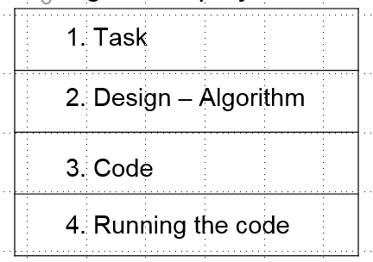
Homework
Review your planning for levels of abstraction and scaffolding.

Slide 20
Research
1 Pre-assessment (online survey)
2 Post-assessment (online survey)
3 Focus groups (group interviews)
https://goo.gl/forms/9hzkzBMC81eBRl8u2 orange now on design
https://goo.gl/forms/J6fMnrDOvEphkdH23 (dark grey in 2 weeks)

Slide 21
Levels of Abstraction
What has worked in class?
What has not worked in class?
How can design be used?

Slide 22
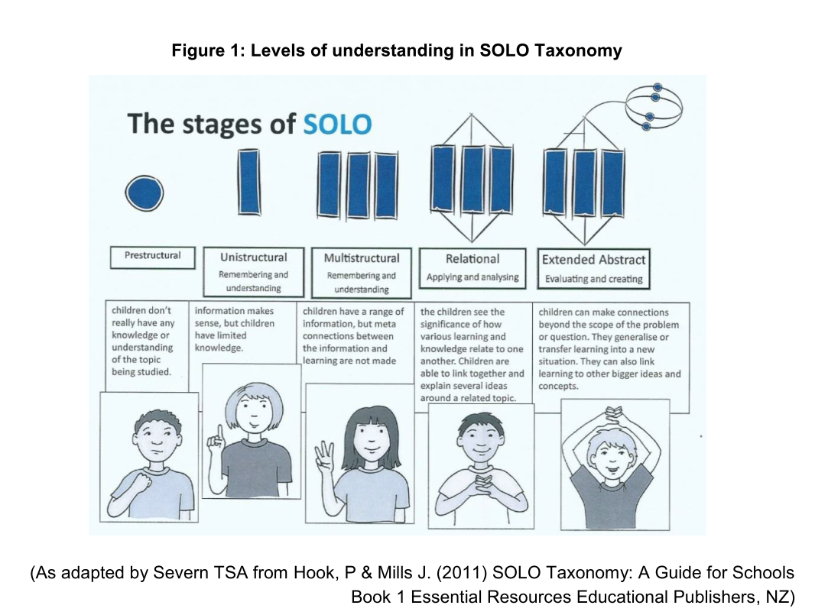
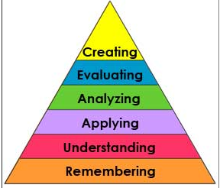
Progression – theory – general progression
Bloom et al 1956

