Slide 1
Teaching Primary Computing
Diving Deep into Programming
Session 8
Assessment, Progression & Differentiation

Slide 2
Course outline
Day 1 | Pedagogy, Sequence, Repetition
Day 2 | Selection, Variables, Make your own blocks
Day 3 | Control/Physical Computing, Assessment, Progression & Differentiation, Planning

Slide 3
Days outline
Day- Session
9:30-10:00 | Arrival, registration, drinks
10:00- 10:30 | Overview, housekeeping, revision & update of reflective diary
10:30 – 12:00 | Control (90 mins)
12:00 -12:45 | Lunch
12:45 to 2:15 | Assessment, Progression & Differentiation (90 mins)
2:15 to 2:30 | Break
2:30 to 4:00 | Planning Review (90 mins)
4:00 to 4:30 | Post assessment

Slide 4
Objectives of this session
Increase understanding of assessment, differentiation & progression specifically:
Forms of assessment for programming
Progression in programming
Approaches for differentiation for programming
RAG

Slide 5
Assessment
Why do we assess?
When do we assess?
How do we assess?
What do we assess?
What artefacts can we assess?

Slide 6
Assessment activities
Read the assessment working group paper. How does this compare to our ideas? Add to the A3 sheets? (5mins)
2. Compare the ELIM progression statements to the Rising Star assessment books. Do they match? Feedback to group. (15 mins)
OR
3. Can you make a detail progression for one or more of these?
Sequence
Repetition
Selection
Variables
Procedures
Compare your progression to Rich et al and Jane’s crazy ideas & compare to your SOW. (30 mins)
Where does quality code/bad smells come in?
4. Undo the progression of the Hard/Easy Maths quiz. (10 mins)

Slide 7
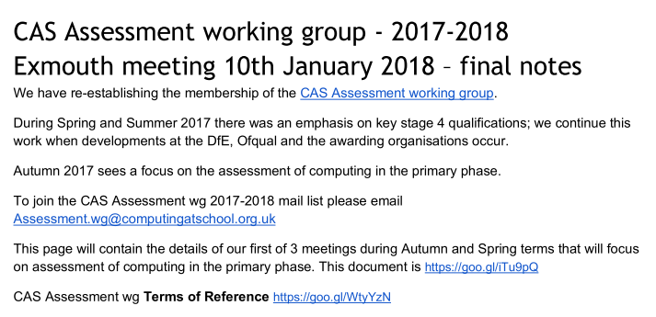
Assessment
Read at the CAS Assessment Group Paper
How could you use the recommendations in your classroom?

Slide 8
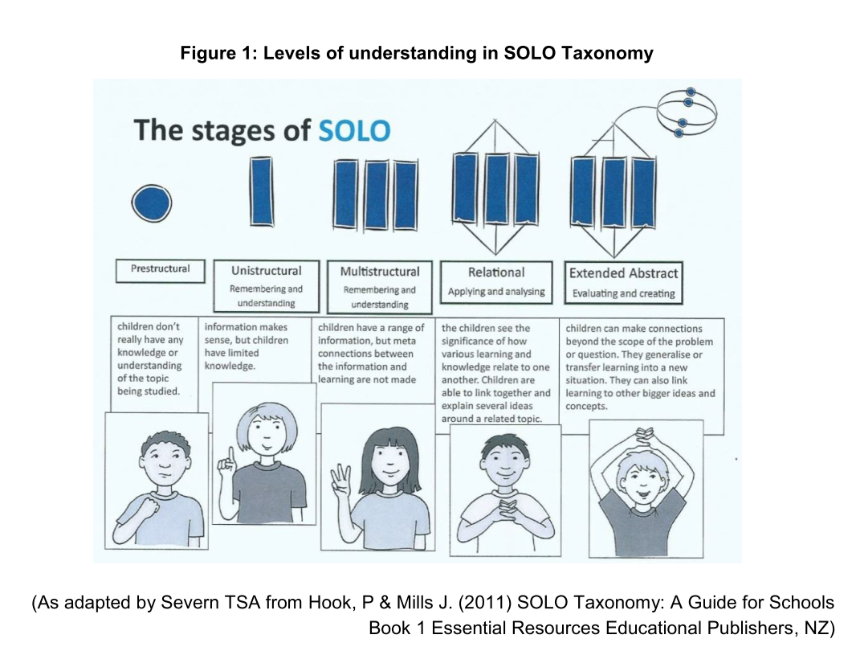
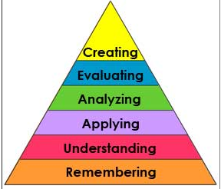
Progression – theory – general progression
Bloom et al 1956

Slide 9
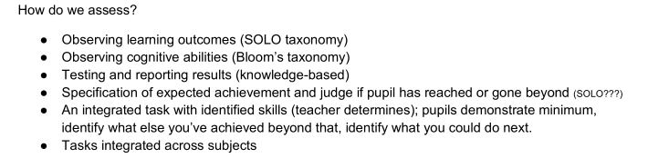
Assessment
Find the section
I am not sure that SOLO is different to Blooms…

Slide 10
Assessment
Making judgments based on triangulated evidence
On what kids do, say, make, think …
We gather evidence through observations, questions, self-/peer assessment, products made… during …
Integrated teaching tasks
Reading code
Debugging
Changing code
Make new designs
Review and mark designs and code
Review and mark design journals (online or hard copy)
Pupil presentations (how do you mark?)
Record peer/self assessment based on a checklist/‘rubric’
Assessment tasks (and teaching tasks too?)
Quizzes/Tests (Bebras/DQ etc)
End of topic tasks
Direct questions
Debugging tasks
Parson’s problems
Dr Scratch
Reading code tasks e.g. snippet work - compare code, explain code
Making judgments against an understanding of progression of learning objectives
(knowledge, skills, understanding…)

Slide 11
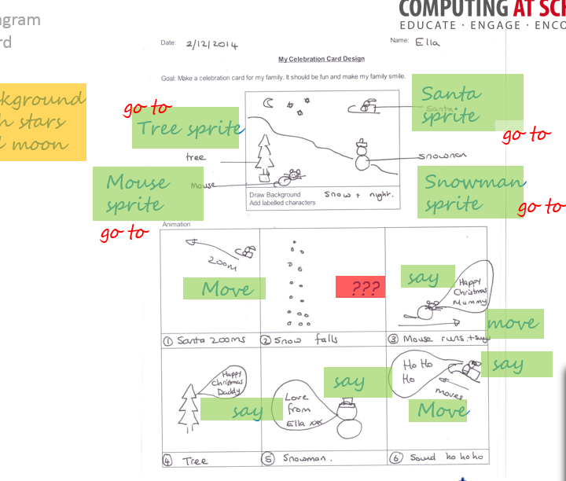
Design as a work artefact
Making judgments based on evidence
Making judgments against an understanding of progression of learning objectives
Within Integrated tasks
Creation of designs
Annotation of designs
Changes to design
Use of design
Review/ evaluation of design
Self assessment of design
Peer assessment of design
Within assessment tasks (tests)
Tasks with design in them
May reveal
use of decomposition, abstraction, algorithmic thinking, logical reasoning
knowledge of programming commands, programming constructs, programming concepts
understanding of design process.
Used as
Work artefact
Context for questioning
Context for observing

Slide 12
Unpicking Progression
What pathway, objectives mapping do you use to underpin you teaching, learning and assessment of programming?
Where did it come from.
How might you change it given the course?

Slide 13
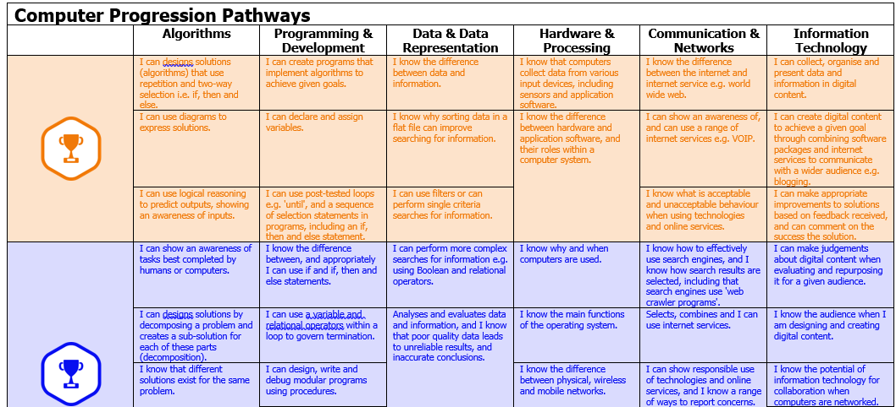
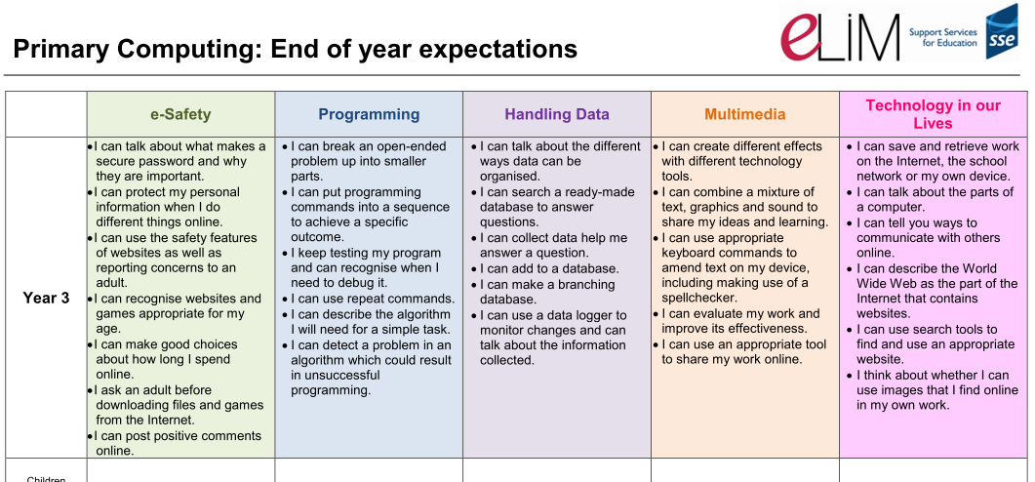
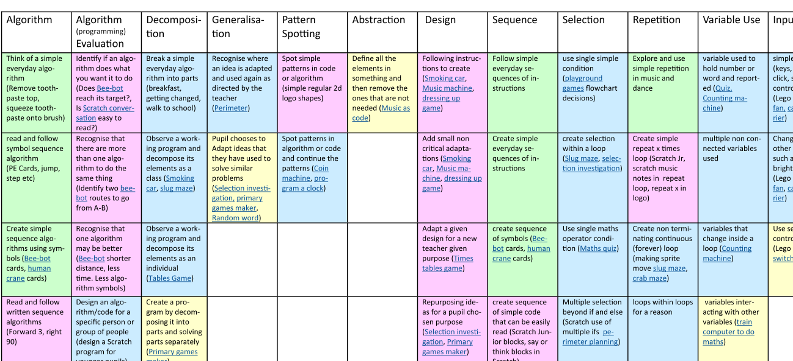
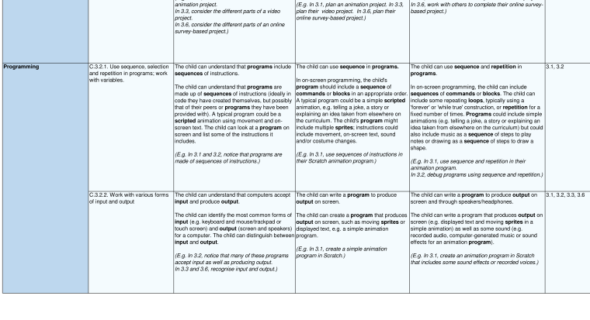
Mark Dorling
ELiM
Phil Bagge
Rising Stars

Slide 14
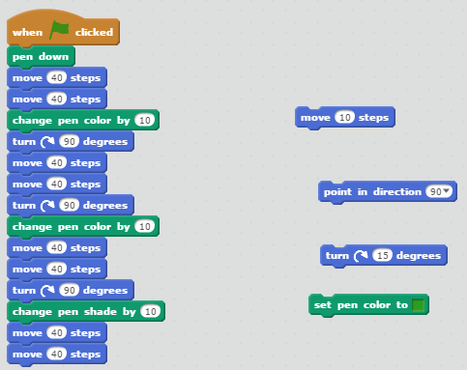
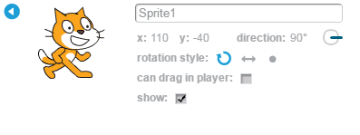
Bad smells
Handout 2
https://scratch.mit.edu/projects/164525941/

Slide 15
What might we call?
Code that
does not
do what we want.
Code that ‘does what we want’.
High Quality Code
Smelly Code
‘Correct’ Code
Buggy Code
Elegant Code
‘Correct Code’ - Grain of correctness
Evaluation. What is correct? What is quality? What is progression?

Slide 16
Which relate to smells, bugs, progress
What year group might you teach these to?
Have you:
1. Cleaned up your scripting area?
2. Cleaned up unused sprites?
3. Cleaned up unused costumes?
4. Removed code that you could combine e.g. move 3 move 5?
5. Renamed your sprites, backgrounds etc so it is easy to know what they do?
6. Made sure your code does what you/ your user wanted/designed?
7. Created a start up ‘make your own block’ for every sprite?
8. Used a loop rather than repeated code?
9 .Used a procedure to decompose your code into parts that are then easy to understand & change?
10. Used a procedure to reuse some code?
Notes:
How would you create your checklist so that learners use and own it? How would it change over time? How could it be used for differentiation, self assessment, progression?

Slide 17
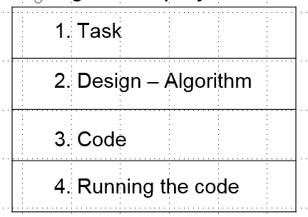

Sequence - progression?
Switch background + no sprites
Single Sprite
- no concurrency & no coordination
Multiple Sprites
- concurrency & no coordination
Multiple Sprites
- concurrency - use time to manage coordination
Use design annotations and ragging rather than copy code to scaffold independence?
Multiple Sprites
- concurrency - use broadcast to manage coordination
Multiple Sprites
- concurrency - use broadcast & wait to manage coordination
Multiple Sprites
- concurrency - use variables to manage coordination

Slide 18
Everyday
Computational thinking
Programming
The order in which instructions are carried out can affect the outcome (1,S)
Computers have a default order of execution so order matters in programming (7,S)
Intermediate
Advanced
Different sets of instructions can produce the same outcome. (1,S)
Some commands modify the default order of execution altering when and which instructions are executed (7,S)
Order
Beginning
Creating working programs requires considering both appropriate commands and their order (4,S)
Precise instructions are more likely to produce the intended outcome than general ones. (3,S)
Precision and completeness are important when writing instructions in advance (7,S)
Computers require precise instructions using limited commands (3,S)
The position of a new command can affect outcomes (2,S)
Programs are made by assembling instructions from a limited set. (1,S)
Precision
Key
(Rich et al. 2017)
Necessary
Consensus goal (n, S/T)
n = number of concepts coalesced
S = evidence that students able to engage with the learning goal
T= theory based goal
Unplugged
Plugged
Helpful

Slide 19
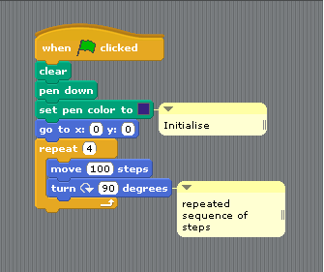
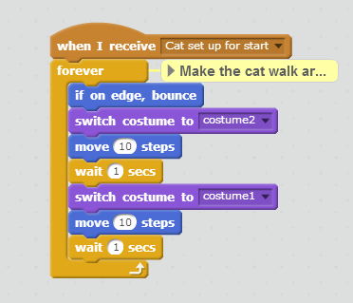
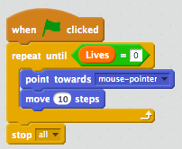
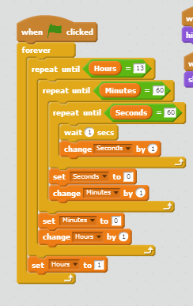
Repetition - progression?
Repeat n times
Forever (can be simple or complex - depends on use - spiral progression)
Repeat until (requires boolean and could use input)
Use design annotations rather than copy code to scaffold independence
and ragging
In other programming languages...
for loops / while loop

Slide 20
Everyday
Computational thinking
Programming
Intermediate
Advanced
Repetition can go on for ever or stop. (5,S)
Different kinds of tasks require different kinds of repetition(7,S)
Variables can be used to control the number of repetitions (1,S)
Programs use conditions to end loops (7,S)
Repeating things can have a cumulative effect (4,T)
Different kinds of repetition have different commands (8,S)
Beginning
Some tasks involve repeating actions (4,T)
Instructions like ‘Step 3 times’ do the same thing as step, step, step (4,T)
Computers use repeat commands (19,S)
Loops can be nested to accomplish complex tasks (2,T)
(Rich et al. 2017)
Key
Necessary
Consensus goal (n, S/T)
n = number of concepts coalesced
S = evidence that students able to engage with the learning goal
T= theory based goal
Unplugged
Plugged
Helpful
Notes:
Entirely used heuristics (they made it up for the ordering)

Slide 21
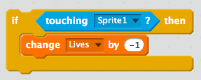
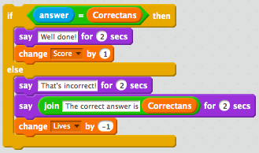
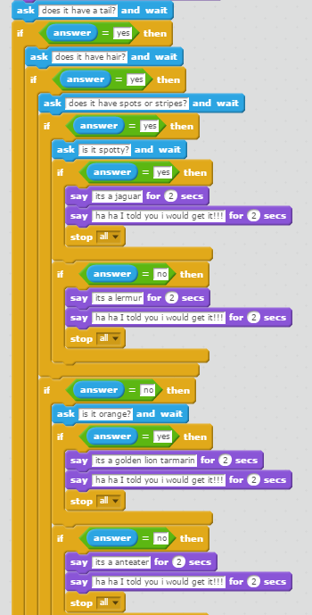
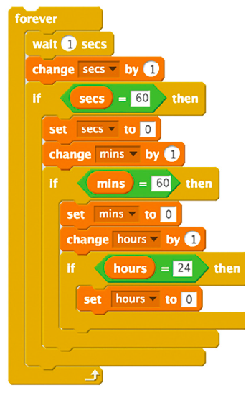
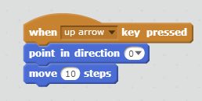
Selection - progression?
If then
If then else
Nested
Event handling/ Forever/ Conditional loops?
Use design annotations rather than copy code to scaffold independence
and ragging
In other programming languages...

Slide 22
Everyday
Computational thinking
Programming
Advanced
A Boolean is a variable that can be true or false (4,S)
Logical operators can be used to combine conditions (5,S)
Intermediate
Sometimes multiple conditions must be considered (3,S)
Conditionals can overlap and more than one can apply (2,S)
Beginning
Computers require all actions to be specified (4,S)
A condition is something that can be true or false (3,S)
Each of two states of a condition may have its own action (4,S)
A conditional connects a condition to an outcome (11,S)
Conditional statements can be combined in several ways (2,S)
Conditional statements can create branches in the flow of execution (7,S)
Conditional statements are computer commands to evaluate conditions and complete connected actions (18,S)
Actions often result from specific causes. (2,T)
(Rich et al. 2017)
Key
Necessary
Consensus goal (n, S/T)
n = number of concepts coalesced
S = evidence that students able to engage with the learning goal
T= theory based goal
Unplugged
Plugged
Helpful
Notes:
Entirely used heuristics (they made it up for the ordering)

Slide 23
Progression in variables (ideas to spark discussion only)
Animations/stories
Quizzes
Games
Context
Simulations
Physical computing e.g. Makey, makey, Lego Wedo, Picoboard, TTS controller/LED etc….
Use variable to: Display a value that changes during the program e.g. score/lives
Use variable to: Facilitate user to control an aspect of a program e.g. difficulty/ speed/size/colour
Use variable to: Control internal working of the program e.g. difficulty level
Use
Knows what a variable is, can predict what variables will do, can change code with variables, can add a variable….
Can create a variable
Can initialise a variable
Can update variables
Can use variables
Can exhaustively test variables
Independance

Slide 24
Progression in make your own blocks and lists
Animations/stories
Quizzes
Games
Context
Simulations
Physical computing e.g. Makey, makey, Lego Wedo, Picoboard, TTS controller/LED etc….
Make your own block for simple games, for initialisation etc
Suggests using make your own blocks to reuse code, make code readable.
Knows what one is, can predict what it does , can change code with them , can add them .
Lists for simple random selection activities
Lists for simple matching activities
For handling data – arrays – Snap/Python
Independance

Slide 25
Un-progress the implementation of this design!
Gradually remove progression from the implementation of this design.
The code is shown on the next 2 pages or look online.
https://scratch.mit.edu/projects/207255264/
The task for this program is : Make a quiz that asks a few questions.
The design is :
Ask for the user name and whether they want an easy or hard quiz.
If the say they want easy questions ask several easy questions and add 1 to the score when the player gets a correct answer but take a point away when they get it wrong. Show the correct answer if they get it right or wrong.
Do the same for the hard questions.
At the end, show the player how many points they got and include their name and whether they did the easy or hard quiz.

Slide 26
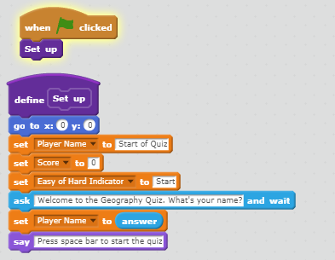
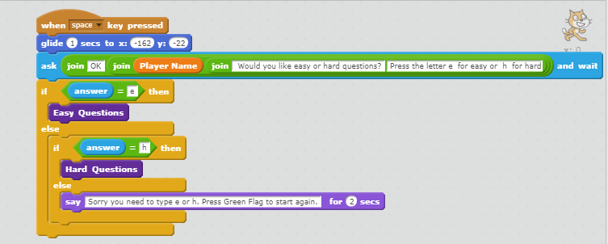
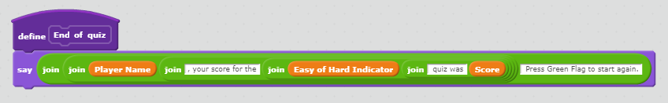

Slide 27
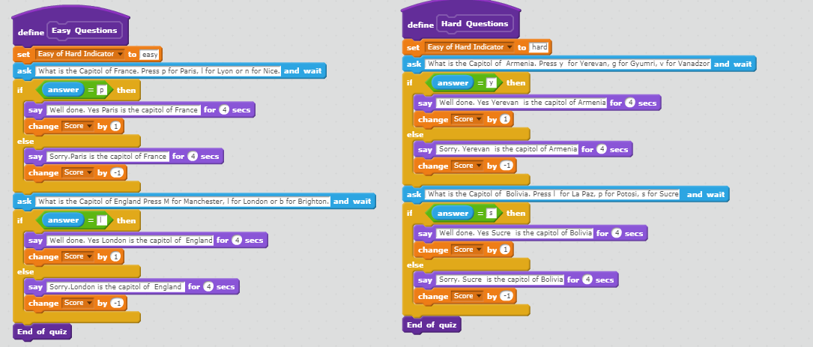

Slide 28
Progression
Progression is dependant on lesson plan objectives
Are lesson plan objectives the same across our plans?
What factors influence the creation of lesson plan objectives?
For the next session.
Notes:
JW Take ideas first then show

Slide 29
Differentiation
What forms of differentiation do you use for programming work?
How is this the same or different to non computing related work?
What are the biggest challenges for differentiation?
What is the relationship between differentiation, scaffolding and progression?

Slide 30
Differentiation
Differentiation requires assessment, understanding of progression and an appreciation of possible barriers to learning.
Differentiate by
  By task
  By outcome
  By support – grouping, resources, pace, scaffolding, questioning
Reasons to differentiate
Ready to learn, EAL/SEND, Interest?

Slide 31
Objectives of this session
Increase understanding of assessment, differentiation & progression specifically:
Forms of assessment for programming
Progression in programming
Approaches for differentiation for programming
RAG

Slide 32
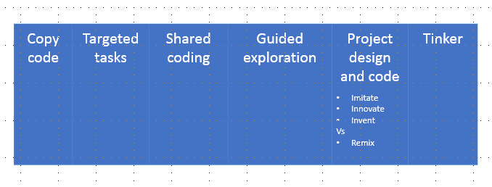
Homework
Review your planning for levels of abstraction and scaffolding.

