Slide 1
Teaching Primary Computing
Diving Deep into Programming
Day 3
Overview and housekeeping

Slide 2
Course outline
Day 1 | Pedagogy, Sequence, Repetition
Day 2 | Selection, Variables, Make your own blocks
Day 3 | Control/Physical Computing, Assessment, Progression & Differentiation, Planning

Slide 3
Days outline
Day- Session
9:30-10:00 | Arrival, registration, drinks
10:00- 10:30 | Overview, housekeeping, revision & update of reflective diary
10:30 – 12:00 | Control (90 mins)
12:00 -12:45 | Lunch
12:45 to 2:15 | Assessment, Progression & Differentiation (90 mins)
2:15 to 2:30 | Break
2:30 to 4:00 | Planning Review (90 mins)
4:00 to 4:30 | Post assessment

Slide 4
Usernames, passwords and link page
Short cuts to the google doc cohort 4
https://docs.google.com/document/d/1FWB3U5lKEraNZUSXzvhpLnNUfrahf9gALBGyTa5074U/edit#heading=h.75hkyu3le4bz
TLC webpage
https://teachinglondoncomputing.org/ddpp/
And reflective diary cohort 4
https://docs.google.com/document/d/11D98ddc0l7LseWLoEDD8dsaXM4xUFLQwPhEyUD9Fmqc/edit#heading=h.m6z12hsla3v9
Password
tlcddpp

Slide 5
Usernames, passwords and link page
Short cuts to the google doc and
https://docs.google.com/document/d/1ytNw3DJzkTPRn6IIWtd03M_DjrYQiviP1xpagGifldU/edit#heading=h.87gs5u2kpncu
TLC webpage
https://teachinglondoncomputing.org/ddpp/ddpp-cohort-2/
And reflective diary
https://docs.google.com/document/d/1jmjElqb35e8jxQoOkyE0LdwC6JrsJ9RzE0sF4lj7ry4/edit#heading=h.q525715xbajw
Password
tlcddpp

Slide 6
Usernames, passwords and link page
Kings Username | Password | Diving deep delegate number
A12345 | xyz | 1 | Your name
Short cut on your desk top
https://docs.google.com/document/d/127q3RqdDwG-5KqA6v0hf7epwsRd04bl8hT0AQguXrVc/edit
Or http://teachinglondoncomputing.org/ddpp
Password
tlcddpp

Slide 7
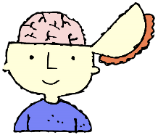



In order to teach programming…
@cas_certificate
Pedagogical Content Knowledge
(PCK)
Content Knowledge
Pedagogical Knowledge
Software
planning, progression, assessment, relationships, interventions, differentiation, inclusion, relevance, feedback, questioning, scaffolding, visualisations, active learning, direct teaching, discovery learning, resources…
Computational
Thinking
Sequence
Repetition …
Data types
Programming
concepts/features
Adapted version of pedagogical content knowledge (PCK) (Shulman, 1986)

Slide 8
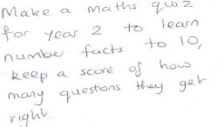
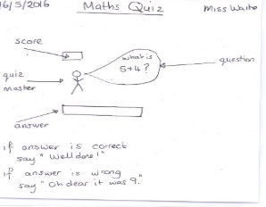
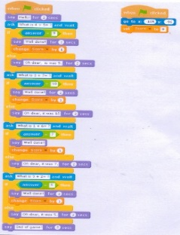
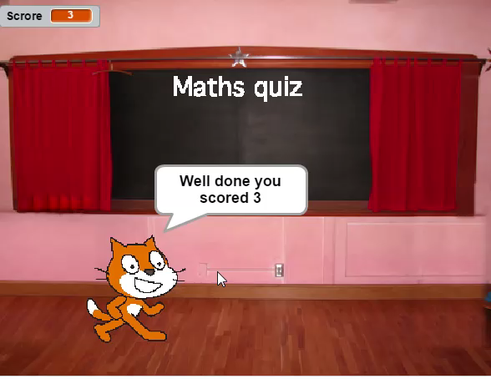

Slide 9
Levels of abstraction
Task
Design (including algorithms)
Code
Running the code
(Waite, Curzon, Sentence and Marsh, 2011)

Slide 10
Scaffolding
Copy code | Targeted tasks | Shared coding | Guided exploration | Project design and code | Tinker
Imitate
Innovate
Invent
Vs
Remix
Compare to other subjects.
Notes:
(Read predict, compare code, fix buggy code etc)
Live coding, Think aloud, cognitive apprenticeship)
(Limited commands/ clearly defined goal/remixing)

Slide 11
What did you try?
What did you try in school as a result of the last workshop?
What worked well?
What did not work so well?
What are you going to do next?
WHAT WOULD YOU LIKE TO SEE FROM GUIDANCE ON USING DESIGN?
Please update your reflective diary
https://docs.google.com/document/d/11D98ddc0l7LseWLoEDD8dsaXM4xUFLQwPhEyUD9Fmqc/edit#heading=h.m6z12hsla3v9
And we will share too.

Slide 12
Teaching Primary Computing
Diving Deep into Programming
Session 7
Control

Slide 13
Objectives of this session
Increase understanding of control specifically:
Vocabulary associated with control and the control model
Examples of real world and school control (including physical devices)
Using design to represent control
Progression of control
Pedagogy for teaching control
RAG

Slide 14
Control
What is a control?
Name some examples of control. Real world and in school.
How might control be represented by pupils as an algorithm /design?
What techniques/ commands are often used to implement (code) control?
How do you teach control?
What might the progression of these implementations be?

Slide 15
Science, DT and Computing
Activity 4
 | Science - Electricity | DT | Computing
Year 4 | construct a simple series electrical circuit, identifying and naming its basic parts, including cells, wires, bulbs, switches and buzzers identify whether or not a lamp will light in a simple series circuit, based on whether or not the lamp is part of a complete loop with a battery recognise that a switch opens and closes a circuit and associate this with whether or not a lamp lights in a simple series circuit recognise some common conductors and insulators, and associate metals with being good conductors | How simple electrical circuits and components can be used to create functional products How to program a computer to control their products (split by data.org) | Design, write and debug programs that accomplish specific goals, including controlling physical systems Use sequence, selection and repetition in programs Work with variables and various forms of input and output
Year 6 | compare and give reasons for variations in how components function, including the brightness of bulbs, the loudness of buzzers and the on/off position of switches | How more complex electrical circuits and components can be used to create functional products How to program a computer to monitor changes in the environment and control their products
Notes:
Find the terms related to control – inputs, outputs. Write them on postit notes. Can you create a model or diagram relating these objects.

Slide 16
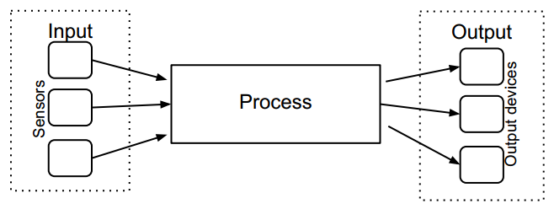
Science, DT and Computing
Physical systems (Computing POS) = Functional Product (DT POS) = Circuit (Science POS)
Input (Computing POS)
Switches (Science POS)
Components (DT & Science POS)
Monitor (DT POS)
Output(Computing POS)
Bulbs, lamp, buzzers (Science POS)
Components (DT POS)
Control (Computing & DT)
A circuit (Science POS)
or a program (Computing POS)
which runs on a
processor (on a computer or microcontroller)
(Component (Science & DT POS))
Fabricated parts
Fabricated parts
Physical systems include a process which is a hard wired circuit or a program which runs on a processor (on a computer or microcontroller) which monitors or controls inputs and outputs. The inputs and outputs are electronic components which work with fabricated parts (mechanical and user interface).
Designs perhaps include: algorithm design; data structure design; user interface design; electronic component design; fabrication/mechanical design - however some of these are perhaps not design choices but implementation choices.
With thanks to Phil Bagge on ideas here

Slide 17
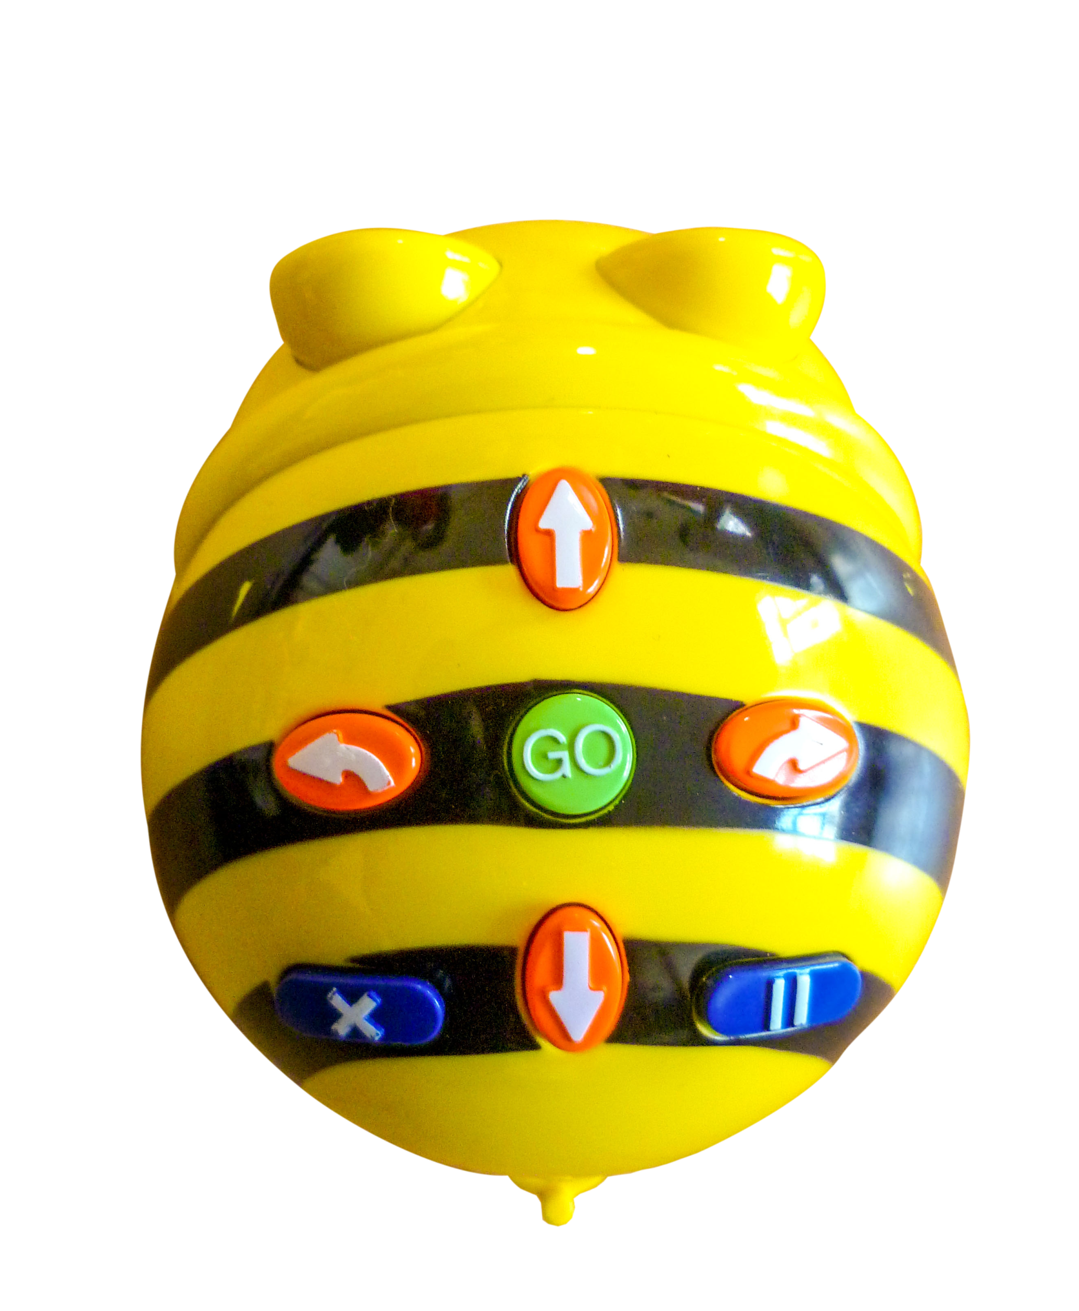

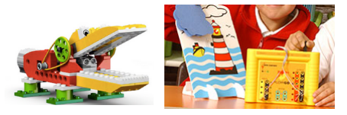
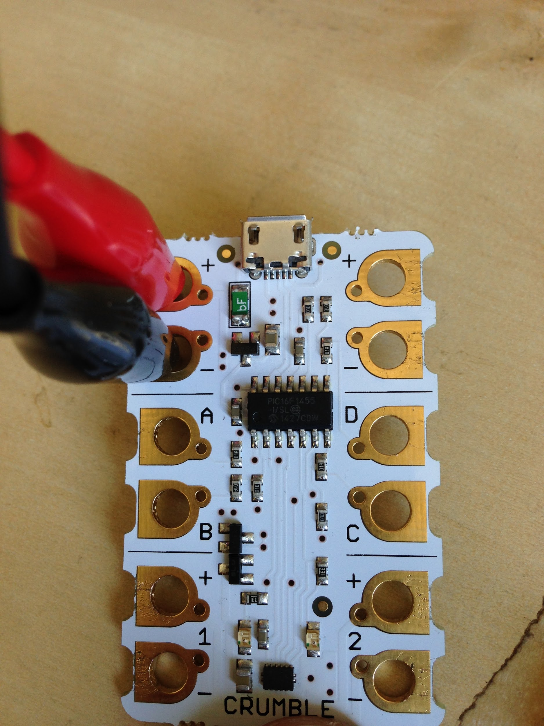
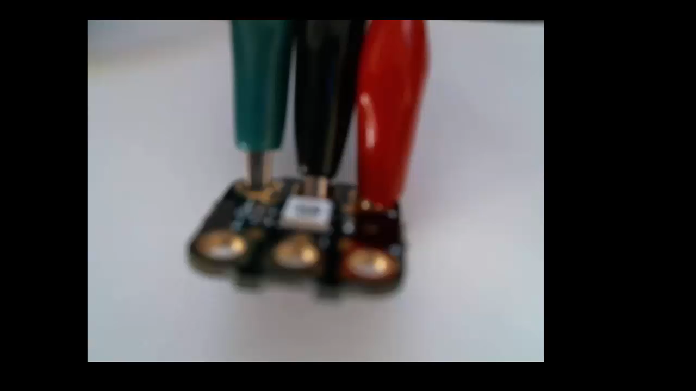
Control
Control is making instructions that change the physical world
and in KS2 it includes using sensors to influence what needs to be done.
KS1
What is a control?

Slide 18
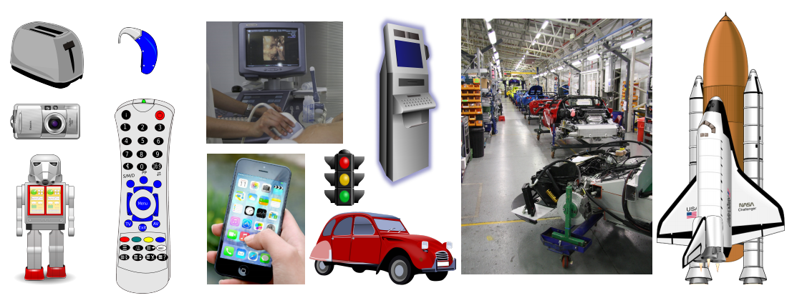
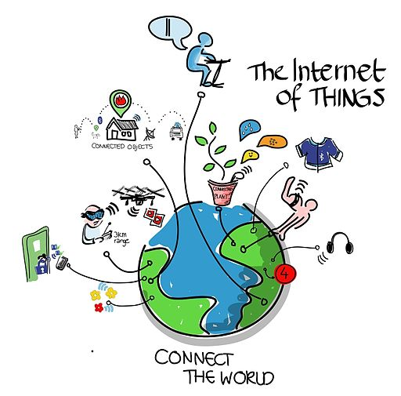
Control
2. Name some examples of control?
Real world

Slide 19
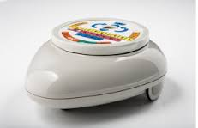
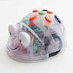
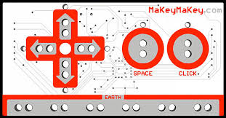
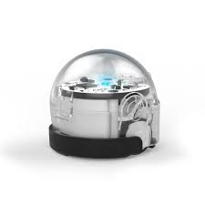
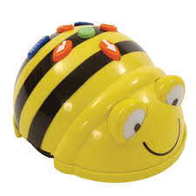
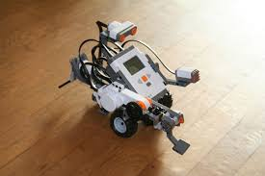
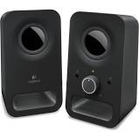
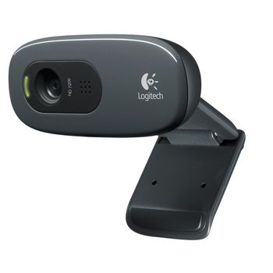
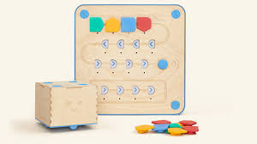

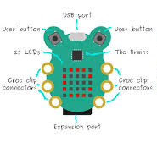
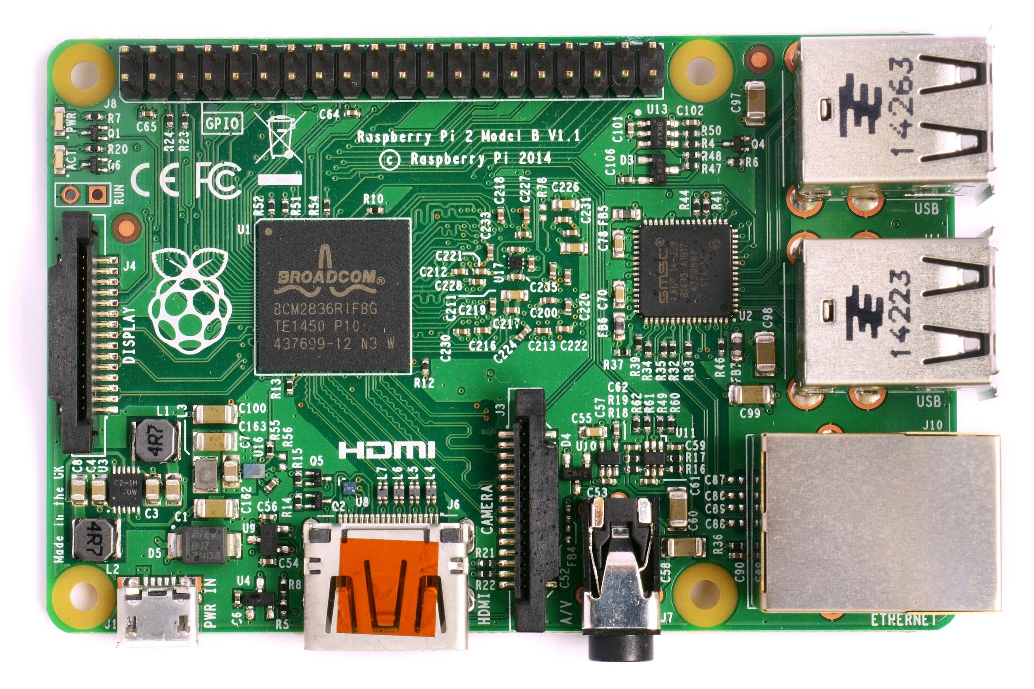
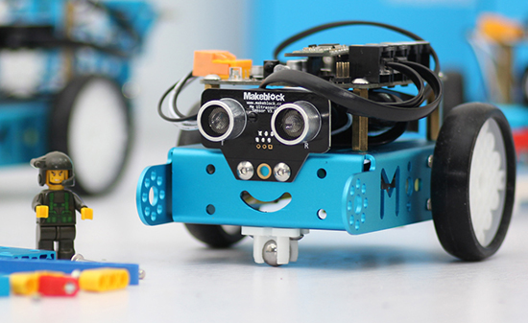
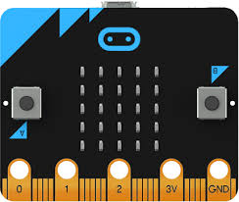
A
C
D
B
F
H
E
G
I
J
K
L
M

Slide 20
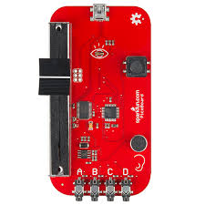
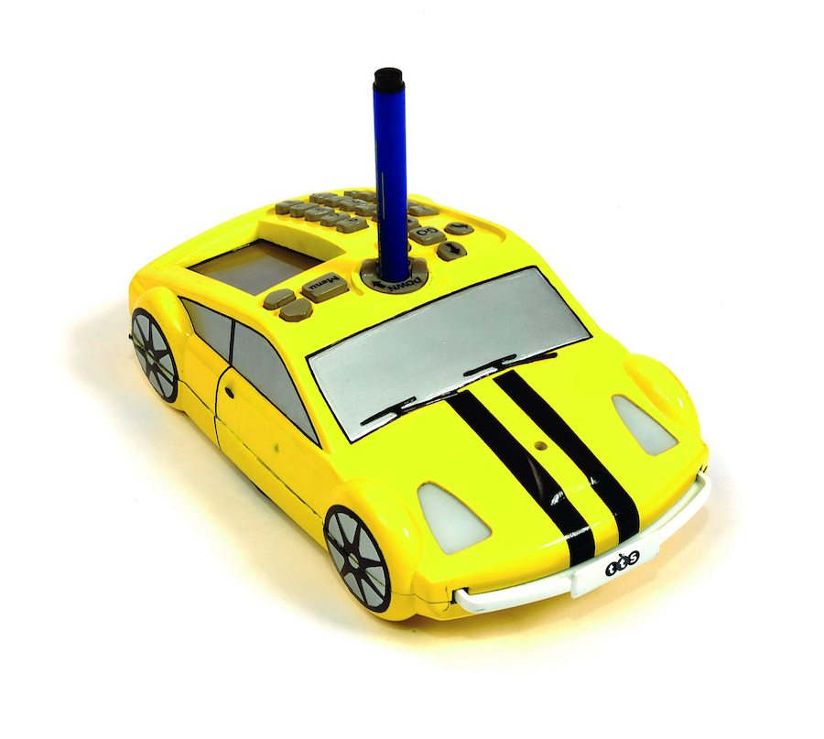
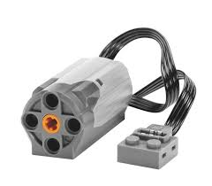
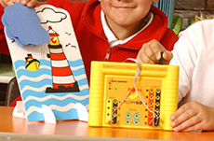
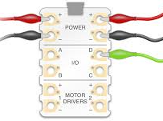
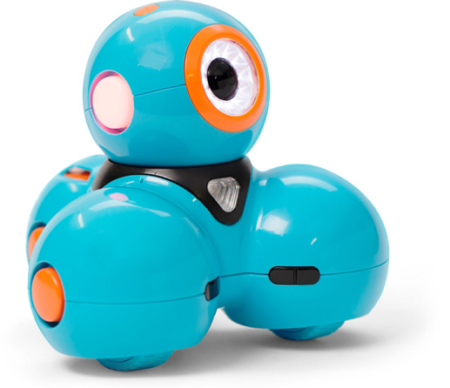
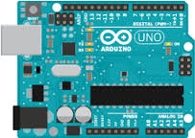
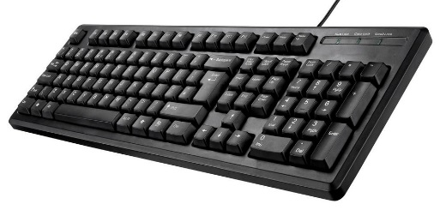
N
O
P
Q
T
U
R
S
Step 1 Name the items (please don’t write on the cards).
Step 2 Group the items by
  group 1 Microcontrollers,
  group 2 programmed on a separate device,
  group 3 tangible interface (programmed on the device)
Step 3 Which have inputs and which have outputs or both
Step 4 In each group order by ‘progression’

Slide 21
N
O
P
Q
T
U
R
S

Slide 22
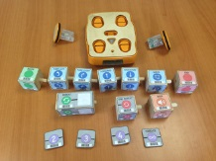
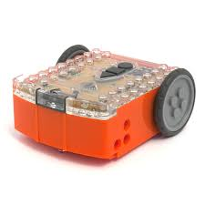
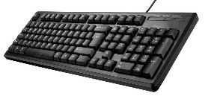

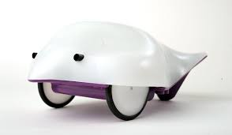
Include a tangible interfaces that PROGRAMS the device
Devices that are programmed on a separate device
Microcontrollers
Yr R & KS1
KS3/4/5
KS2
What makes a robot a robot?

Slide 23
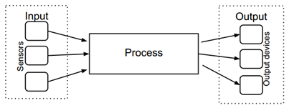
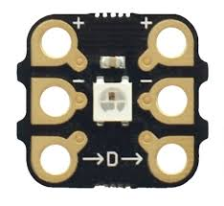
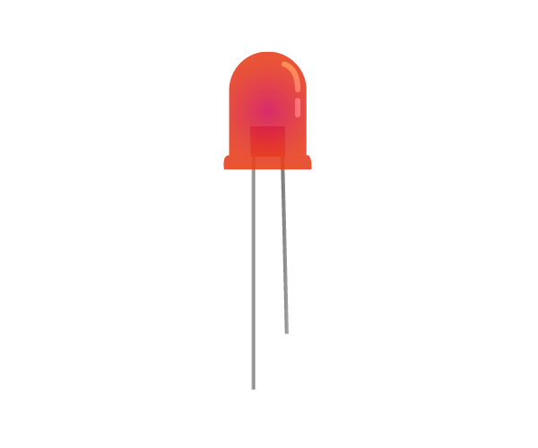
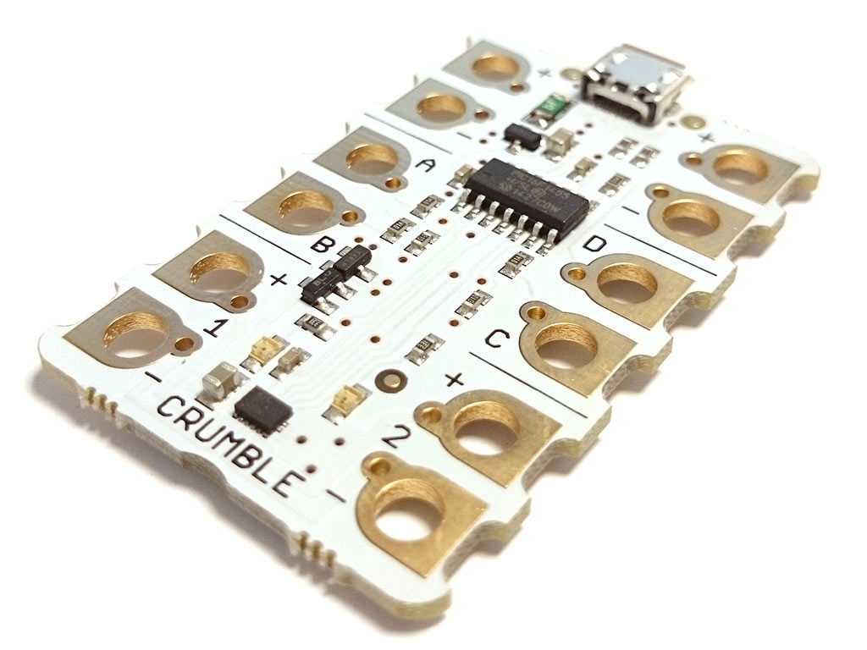
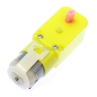
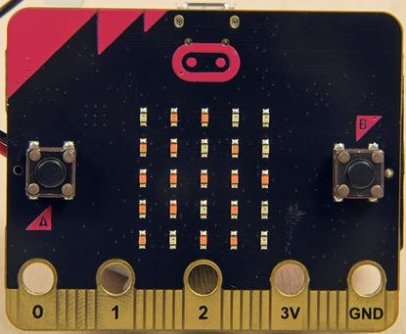
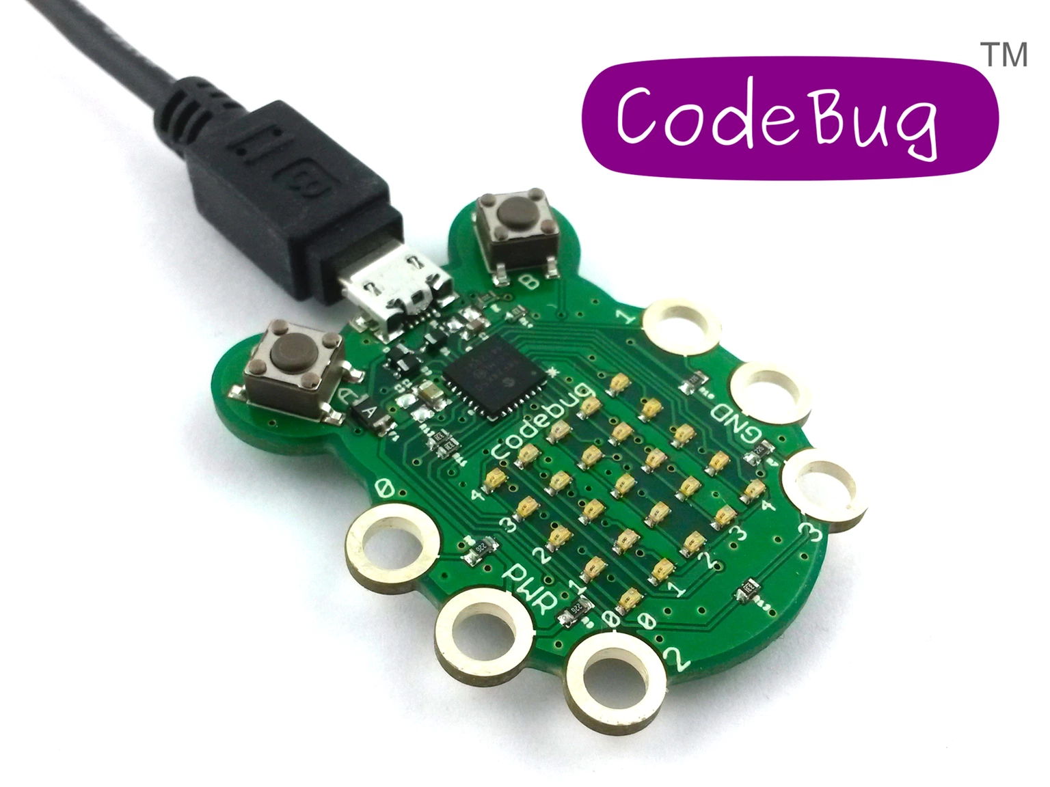
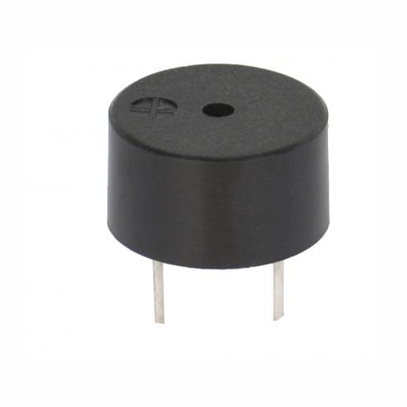
Concepts and Vocabulary
Output
Input
Sensors
Microcontroller
Light - Sparkle, Led
Movement - motor
Sound - buzzer
Button or toggle switch
LDR - light dependent resistor (light sensor)
Tilt switch
Distance sensor
….

Slide 24
Concepts and Vocabulary
Programmable device
Including a tangible interface to program it
Output
Input - Sensors
Button or toggle switch
LDR - light dependent resistor (light sensor)
Tilt switch
Distance sensor
Light
Movement
Sound

Slide 25
Concepts and Vocabulary
Programmable device
That is programmed on a separate device
Output
Input - Sensors
Button or toggle switch
LDR - light dependent resistor (light sensor)
Tilt switch
Distance sensor
Light
Movement
Sound

Slide 26

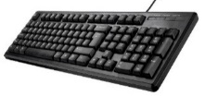
Concepts and Vocabulary
Computer
With input and output ‘peripherals’
Output
Input - Sensors
Button or toggle switch
LDR - light dependent resistor (light sensor)
Tilt switch
Distance sensor
Light
Movement
Sound

Slide 27

Interlude….
When you are teaching control do you draw attention to the inputs and outputs?
Why not?
What are we teaching with the devices?
Could we teach the requirements of the POS with only?
Why don’t we?

Slide 28
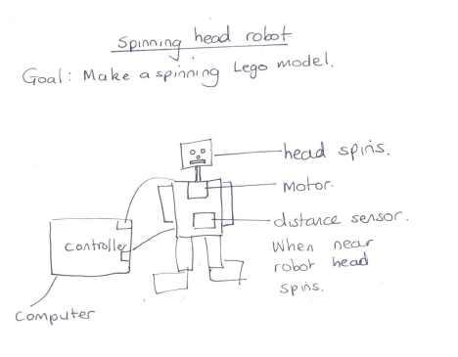
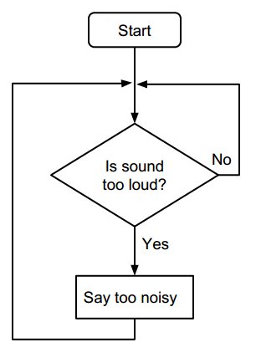
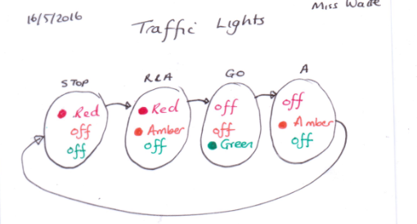
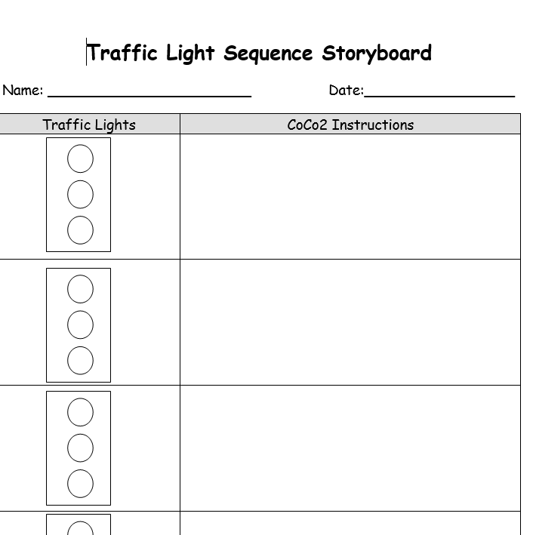
Control
Do you have better examples?
3. How might control be represented by pupils as an algorithm /design?

Slide 29


Control
4. What techniques/ commands are often used to implement (code) variables?
Predict what this code will do.
Say what are the inputs and what are the outputs.
Predict what code has been used.
https://scratch.mit.edu/projects/97038386/#player
Scratch control code 1 guess what code is used
https://scratch.mit.edu/projects/97039379/
Scratch control code 2 guess what code has been used

Slide 30
Control
Add your name to the table in the google doc
Try some of the options.
Make a note in the table of advantages and disadvantages of each instructional approach.
name | Option 1 Innovate (project) | Option 2 Copy Code | Option 3 Predict/Run/Investigate | Option 4 Guided discovery | Option 5 Evaluation

Slide 31
Control
Option 1
What code do you think you would need?
Build it!
Sound monitor algorithm
If quiet say that is ok
else say that is too noisy

Slide 32

Control
Option 2
Copy this code.
Well done you have made a sound monitor.

Slide 33

Control
Option 3
Predict what this code will do
2 Run it https://scratch.mit.edu/projects/36133098/
3. Investigate the values 3 and 167.

Slide 34

Control
Option 4
Explore these commands
Can you make a sound monitor that
Implements this algorithm?
Sound monitor algorithm
If noisy say that’s too noisy
https://scratch.mit.edu/projects/181940153/#player

Slide 35
Control
Option 5
Look at the code in these programs in this studio, which is the best sound monitor? Why? Explain to the group the difference between the sound monitors.
https://scratch.mit.edu/studios/701450/
Barefoot classroom sound monitor

Slide 36

Control
4. How might you teach control?
Hardware that can be connected to Scratch
https://creative-computing.appspot.com/videos - sensing 2
http://code-it.co.uk/crumble/crumble
http://barefootcas.org.uk/programme-of-study/control-physical-systems/ks2-classroom-sound-monitor-activity/

Slide 37


Notes:
https://www.youtube.com/v/nVyTTv6AqFk
https://www.youtube.com/v/rfQqh7iCcOU

Slide 38





Example School Projects
Wearables
Props for assemblies
Display resources
Gifts - Flower wheel
Robots
Fairgrounds
Night lights ...
Notes:
slide objective: Now people have an idea of how things go together some of them may want to try othe projects or continue with existing ones
Explain they have 15 minutes

Slide 39












Things have moved on https://twitter.com/RedfernElec
MRELSECLASS .com
Ontario,
Canada

Slide 40





https://twitter.com/RedfernElec
Mike Cargill
STEM
Gemma Taylor STEM
Brighton University students

Slide 41

Follow these instructions and create a buggy.
Notes:
Firstly we need to wire up. Your wire colors will be different.

Slide 42


Use these commands to Make 1 motor move Make it turn on and off Change direction/speed Give your partner a challenge and get them to code it.
Notes:
Firstly we need to wire up. Your wire colors will be different.

Slide 43

Find out what these components do! Try them out. Make a project.
Notes:
Firstly we need to wire up. Your wire colors will be different.

Slide 44

Pedagogy
What approach do you use? Discuss in pairs
Copy code | Targeted tasks (e.g. read code + predict, fix buggy code, compare code etc…) | Shared coding Demo followed by…. | Guided exploration Make 1 motor move Make it turn on and off Change direction/speed Give your partner a challenge and get them to code it. | Design and build a project | Tinker - no guidance

Slide 45



Pedagogy with physical
Copy code
Read code - predict output
Run code - predict algorithm or code
Tinker - build logical reasoning and consolidate
Shared programming
Guided exploration – help cards, useful commands
Fix buggy code (make buggy code)
Pair programming
Purposeful makes (with audience and rubrics for AfL)
Plan before you program - incorporate designs (reduces cognitive load, manages process of making, differentiates between algorithm and code)
Cross curricular

Slide 46






Top-down or bottom-up to programming
Add, remix, change code
Run it
(Bers et al 2010)
A ‘top-down’ approach
A ‘bottom-up’, tinkering approach
Notes:
JW

Slide 47
Progression - ideas
After year 4 science - electricity - circuits
After year 4 computing - Scratch - sequence and repetition
Within a DT/Computing project (6 Weeks unit)
  Familiarise with crumble software - control one output - a light (sparkle or LED)
  Explore sequence (including on/off/ varying colours and times)
  Add a second light
  Introduce repetition
  Make a simple project with light output e.g. a memory game, a flag quiz,
  Introduce an input (e.g. a light sensitive diode, or on/off switch, tilt switch, strip of copper to complete the circuit (slug tape))
  Make a simple project with an input and light output
e.g. a Christmas card, a stay safe garment, an interactive map, a prop for a play, an augmented book, a halloween decoration, a tilt sensor game.

Slide 48
Progression
After year 6 science - electricity - variation
After year 5 computing - scratch - selection
Within a DT/Computing project (6 Weeks unit)
  Revisit crumble software - control lights using sequence and repetition
  Introduce output - motors
  Explore speed, direction, on/off
  Make a simple project with motor output using e.g. nodding head, decoration
  Introduce an input (e.g. a light sensitive diode, or on/off switch, tilt switch)
  Make a project with inputs, motors and lights outputs (and possibly sound)
E.g. a moving prop for a display (John C’s advertisements), a music machine(John C), make a mini fairground (Peter Gaynord), a vehicle, an artificial hand (STEM), a robotic nocturnal animal, a mini town/room (Helena Cheung), a paper aeroplane launcher (Phil Bagge)

Slide 49










Progression in Control (ideas only)
Animations/stories --------------------------------> simulations ---> interactive simulations
Context
Quizzes
Games
Design & Tech project - user/purpose/functionality/inovation/design descions/authenticity
Computational Thinking… abstraction, decomposition, pattern, algorithmic thinking...
Software
Hardware
Makey, makey, Lego Wedo, Picoboard, Crumble, TTS controller/LED etc, Pi, Arduino…
Visual or Text - Scratch, Lego, Python...
Input focus
Input and Output
Feedback
Inputs/ Outputs
Output focus
Knows what a control is, can predict what control programs will do, can change control projects, can create a control project….
Independance

Slide 50


Homework
Review your planning for using control.
What type of physical control devices are you using?
Does it have a tangible interface, sensing input and/or controlling output and in what form?
What made you chose these devices?
What are you trying to teach? (Selection/ Sequence/Repetition/Variables/Concurrency/ Input/Output/ D&T/Science etc)
What scaffolding do you use for the activities?
What level of abstraction are you working at for the different activities?
What computational thinking is being developed in each of your activities?

Slide 51
Objectives of this session
Increase understanding of control specifically:
Vocabulary associated with control and the control model
Examples of real world and school control (including physical devices)
Using design to represent control
Progression of control
Pedagogy for teaching control
RAG

Slide 52


Control
What is feedback? (KS3)

