Slide 1
Teach A level Computing:
Algorithms and Data
Structures
Eliot Williams
@MrEliotWilliams

Slide 2
Course Outline
1 | Representations of data structures: Arrays, tuples, Stacks, Queues,Lists
2 | Recursive Algorithms
3 | Searching and Sorting - EW will be late!
4 | Hashing and Dictionaries, Graphs and Trees
5 | Depth and breadth first searching ; tree traversals

Slide 3
Finding things quickly

Slide 4
Hash functions tells us where in the entry to look. And so instead of having to look through the whole index, the hash function will tell us where that entry belongs.
hash
index
data

Slide 5
Thinking about hash functions
we have b buckets in our hash table,
and we have n items, and we should assume that n is much greater than b
(more items than buckets)
What properties should the hash function have?
[ ] Output a unique number between 0 and n-1
[ ] Output a number between 0 and b-1
[ ] Map approximately n/b keywords to bucket 0
[ ] Map approximately n/b keywords to bucker b-1
[ ] Map more keywords to bucket 0 than to bucket 1
data
hash
index
Notes:
The answer is, all choices are true except for the first one.

Slide 6
Defining a hash function
string
Hash function
a number between
0 and b-1
b

Slide 7
Exercise1.1: Bad hash
string
Bad Hash function
a number between
0 and b-1
b
Define a procedure badHash
that has two input parameters
  A string representing the data item
  The number of buckets
It should return a bucket based on the first letter in the keyword.
  modulo the number of buckets!

Slide 8
Bad hash
def badhash(word,buckets):
return ord(word[0])%buckets

Slide 9
Exercise 1.2:Why is bad hash bad?
[ ] It takes too long to compute
[ ] It produces an error for one input keyword
[ ] If the keywords are distributed like words in English, some buckets will get too many words
[ ] If the number of buckets is large, some buckets will not get any keywords
Notes:
[ ] It takes too long to compute
[x] It produces an error for one input keyword
[x] If the keywords are distributed like words in English, some buckets will get too
many words
[x] If the number of buckets is large, some buckets will not get any keywords

Slide 10
Testing hash quality
Notes:
So

Slide 11
Bad hash
For SIR ARTHUR CONAN DOYLE’S “A Scandal in Bohemia” the distribution of words to buckets from Badhash is

Slide 12
Exercise 1.3:Better hash
To ensure a more even distribution we don’t want all the words beginning with the same letter to end up in the same bucket.
How could we do this

Slide 13
Bad vs better hash

Slide 14
Perfect hash function
A perfect hash function distributes keys evenly across all the buckets.
Which of the following will leave the expected look up time for a given keyword essentially unchanged.
[ ] Double number of keywords, same # of buckets
[ ] Same number of keywords, double # of buckets
[ ] Double number of keywords, double # of buckets
[ ] Halve number of keywords, same # of buckets
[ ] Halve number of keywords, halve # of buckets
Notes:
[ ] Double number of keywords, same # of buckets
[ ] Same number of keywords, double # of buckets
[x] Double number of keywords, double # of buckets
[ ] Halve number of keywords, same # of buckets
[x] Halve number of keywords, halve # of buckets
if we double the number of keywords and keep the same number of buckets,
that's going to get slower because the number of keywords per bucket will approximately double
If we keep the same number of keywords, but double the number of buckets, well then it's going to
actually get faster. We'll have the same number of keywords, double the number of buckets. So, this
value will be approximately half of what it was before

Slide 15
Key words
Hash table:
The table gets its name from the method used to determine the row to use. The hash value generated by applying the hash function to the key is the table index where the record should be stored if the row is free.
Hash function:
Is a function H, applied to a key k, which generates a hash value H(k) of range smaller than the domain of values of k.

Slide 16
Hash value:
is the value generated by the application of the hash function to the key. This value can be used as the hash table index where the key and any associated data can be stored if this table location is free.
Hash key:
is the key that the hash function is applied to
Hashing:
The process of applying a hash function to a key to generate a hash value

Slide 17
Entering and retrieving data into a hashtable
Exercise 1.4
Implementing a hashtable based system

Slide 18
Given a (8-digit) ULN number k, its hash value H(k) is calculated as follows using the hash
function H, where
H(k) = k Mod b

Slide 19
Thinking about collisions
A collision occurs when two or more different keys hash to the same value
Collisions can be resolved in two ways:
1 open addressing/closed hashing Store the record in the “next available” location in the table,
2 open hashing Store a pointer in each table location that points to a list of records that have all collided at this table location otherwise set the pointer value to null.

Slide 20
Dictionaries in python
french ={'name':'nomme','horse':'cheval'}
French['name'] would return 'nomme'
Now do exercise 2 :simple dictionary tasks!

Slide 21
Graphs

Slide 22
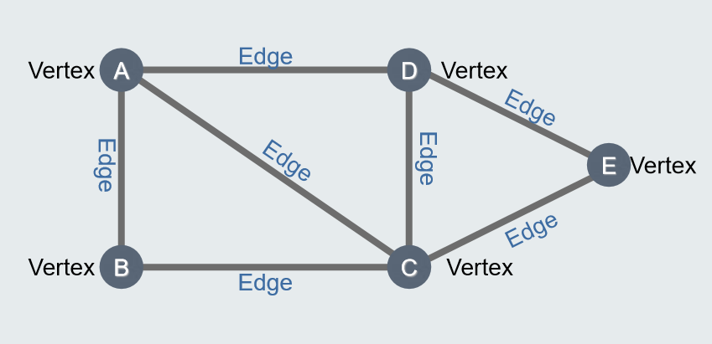
What is a graph

Slide 23
Terminology
A graph can have cycles (loops)
A weighted graph has a value on the edge
A directed graph has arrows to indicate direction
A multigraph has multiple edges connecting the same vertices
A tree is a type of graph where…
  All vertices are connected
  The graph is undirected
  There are no cycles

