Slide 1
Teach A level Computing:
Algorithms and Data
Structures
Eliot Williams
@MrEliotWilliams

Slide 2
Course Outline
1 | Representations of data structures: Arrays, tuples, Stacks, Queues,Lists
2 | Recursive Algorithms ( & lists as we didn’t quite get there last time…)
3 | Searching and Sorting - EW will be late!
4 | Hashing and Dictionaries, Graphs and Trees
5 | Depth and breadth first searching ; tree traversals

Slide 3
Procedures
To write recursive programs we need a good understanding of procedures

Slide 4
Why Procedures?
Code organisation
  Procedures allow code to be organised in parts
  Top-down development
Code reuse
  The library
  Procedures with parameters: existing code, your data
Recursion

Slide 5
Procedures & Functions
Procedures:
  0 or more inputs
  0 or more outputs
  Side effects (print statements, global variables etc)
Functions
  1 or more inputs
  1 output
  No side effects

Slide 6
Creating a procedure in python
Name
def fun1(p):
p = p + 1
return p
a = 1
b = fun1(a)
print("argument a =", a)
print("return value b =", b)
Parameter
Return expression
Function call
Argument
What is the result?
Is variable a changed?

Slide 7
Procedures Call Tree
One function calls another
main
def doub(p):
return p*2
def quad(p):
d = doub(p)
return doub(d)
n = int(input("Number: "))
print("4 x", n, "=", quad(n))
call
return
quad
call
return
doub

Slide 8
Procedures Scope
Scope: dictionary of variables
p → integer (6)
def doub(p):
return p*2
def quad(p):
d = doub(p)
return doub(d)
n = int(input("Number: "))
print("4 x", n, "=", quad(n))
p → integer (3)
d → integer (6)
n → integer (3)
doub → … code
quad → … code

Slide 9
Pass by reference or by value
def fun1(thelist):
thelist.append(41)
myl = [2,3,4]
fun1(myl)
print("myl =", myl)
Just like assignment a list:
… variable refers to the list
… parameter refers to the list
No global: reference is read
Any mutable object will will behave this way…….
What is the result?
Is the list variable a changed?

Slide 10
big
Define a function big that takes 2 inputs and returns the biggest!
def big(a,b):
if
print(big(2,3))
print(big(4,4))

Slide 11
big
Define a function big that takes 2 inputs and returns the biggest!
def big(a,b):
if a>b:
return a
return b
print(big(2,3))
print(big(4,4))

Slide 12
big3
def big(a,b):
if a>b:
return a
return b
def big3(a,b,c):
if a>b:
if a>c:
return a
else:
return c
else:
if b>c:
return b
else:
return c
def big3(a,b,c):
d=big(a,b)
return big(d,c)

Slide 13
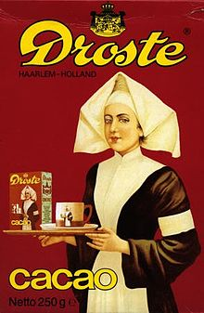
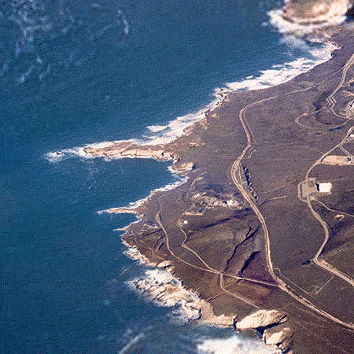
Recursion
Recursion

Slide 14
Recursion
Recursion in computer science is a method where the solution to a problem depends on solutions to smaller instances of the same problem (as opposed to iteration).^{[1]} The approach can be applied to many types of problems, and recursion is one of the central ideas of computer science.^{[2]}

Slide 15
What do you need to write every possible computer program…..
Complex question – Babbage's analytical Engine had:
  The arithmetic functions +, −, × where − indicates "proper" subtraction x − y = 0 if y ≥ x
  Any sequence of operations is an operation
  Iteration of an operation (repeating n times an operation P)
  Conditional iteration (repeating n times an operation P conditional on the "success" of test T)
  Conditional transfer (i.e. conditional "goto").
Another answer is procedures, simple arithmetic with the comparisons, and "if" statements

Slide 16
Predict & Explain what will this do
import turtle
myTurtle = turtle.Turtle()
myWindow = turtle.Screen()
def foo(bar):
if bar > 0:
myTurtle.forward(bar)
myTurtle.right(90)
foo(bar-5)
foo(100)
myWindow.exitonclick()

Slide 17
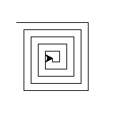
Our first Example - Spiral
import turtle
myTurtle = turtle.Turtle()
myWindow = turtle.Screen()
def spiral(side):
if side > 0:
myTurtle.forward(side)
myTurtle.right(90)
spiral(side-5)
spiral(100)
myWindow.exitonclick()

Slide 18
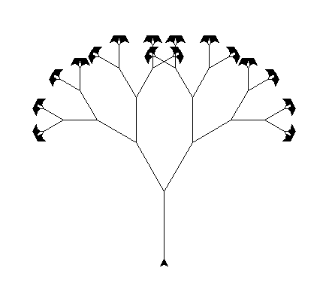
Modify
Change the angle between the branches
Change the thickness of the branches so that as the branchLen gets smaller, the line gets thinner.
Change the colour of the branches so that they start brown and as the branchLen gets very short it is green.
Change the recursive call branchLen so that instead of always subtracting the same amount you subtract a random amount in some range
Hints:
turtle.width(width)
turtle.color(“blue”)

Slide 19
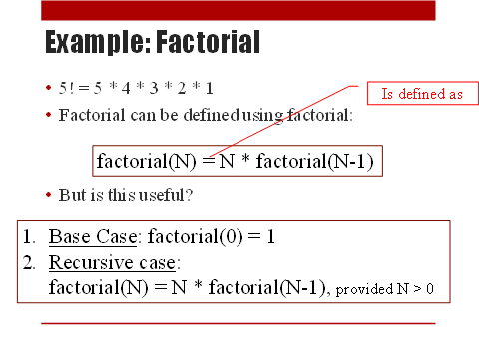
Our first recursive program: Factorial
In my opinion number sequences tend to be too complex for a first example
Recursion is a threshold concept
  New concept
  Different way of thinking about repetition
  New terminology
We want to keep it simple at first
  Cognitive load theory

Slide 20
Our first recursive program
def wibbler():
print("wibble“)
return wibbler()
wibbler()
#whats going to happen?
what's going to happen?
Does this work like a loop?
What type of loop does it work like?

Slide 21
A slight modification
def wibbler(n):
print("Wibble",n)
return wibbler(n+1)
print(wibbler(1))
How many times does it run?

Slide 22
An improved wibbler……
def wibbler(n):
if (n>0):
print ("wibble")
return wibbler(n-1)
wibbler(3)
What’s going to happen
What loop structure is this like?

Slide 23
What's the difference?
def wibbler(n):
if (n>0):
print ("wibble")
return wibbler(n-1)
def wibble(n):
if (n==1):
return ("wibble")
return ("wibble "+wibble(n-1))

Slide 24
What's the difference?
def wibbler(n):
if (n>0):
print ("wibble")
return wibbler(n-1)
wibbler(3)
def wibble(n):
if (n==1):
return ("wibble")
return ("wibble "+wibble(n-1))
print(wibble(3))

Slide 25
def wibble(n):
if (n==1):
return ("wibble")
return ("wibble "+wibble(n-1))
Define something in terms of itself
  Recursive Case –simplifies the problem and moves towards the base case with a recursive call
  Base Case –smallest instance (You may need more than one base case)
Base Case – stop condition
Recursive Case

Slide 26
Task - allstar
Given a string, compute recursively a new string where all the adjacent chars are now separated by a "*".
allStar("hello") → "h*e*l*l*o"
allStar("ab") → "a*b"
allStar("a")→"a"
Identify a way to break a problem up recursively….
Look for a Recursive Case and a Base Case
def allStar(string):
if (??????):
return ???????
return (?????????????)

Slide 27
Task time
Reverse

Slide 28
What's going on………………………….
A child couldn't sleep, so her mother told her a story about a little frog,
  who couldn't sleep, so the frog's mother told her a story about a little bear,
    who couldn't sleep, so the bear's mother told her a story about a little weasel...
      who fell asleep
    and the little bear fell asleep;
  and the little frog fell asleep;
and the child fell asleep.

Slide 29
Factorial revisted
f(n)=n*f(n-1)
f(0)=1
f(4)=4*f(3)
f(3)=3*3
f(3)=3*f(2)
f(2)=2*f(1)
f(1)=1*f(0)=1

Slide 30
Factorial revisted
f(n)=n*f(n-1)
f(0)=1
f(4)=4*f(3)
f(3)=3*3
f(3)=3*f(2)
f(2)=2*1

Slide 31
Factorial revisted
f(n)=n*f(n-1)
f(0)=1
f(4)=4*f(3)
f(3)=3*3
f(3)=3*f(2)
f(2)=2

Slide 32
Factorial revisted
f(n)=n*f(n-1)
f(0)=1
f(4)=4*f(3)
f(3)=3*3
f(3)=3*2

Slide 33
Factorial revisted
f(n)=n*f(n-1)
f(0)=1
f(4)=4*f(3)
f(3)=3*3
f(3)=6

Slide 34
Factorial revisited
f(n)=n*f(n-1)
f(0)=1
f(4)=4*6

Slide 35
Factorial revisted
f(n)=n*f(n-1)
f(0)=1
f(4)=24

Slide 36
Why use recursion
Recursion is a method of solving problems based on the divide and conquer mentality
Sometimes its easier to solve think of a problem in terms of itself
Q: Does using recursion usually make your code faster?
A: No.
Q: Does using recursion usually use less memory?
A: No.
Q: Then why use recursion?
A: It sometimes makes your code much simpler!

Slide 37
Predict-Explain-Modify-Create
Predict – given a working program, what do you think it will do? (at a high level of abstraction)
Run – run it and test your prediction
Explain/Articulate – get into the nitty gritty. What does each line of code mean? (low level of abstraction). Lots of activities here: trace, annotate, explain, talk about, identify parts, etc….
Modify – edit the program to make it do different things (high and low levels of abstraction) Design/Create – design a new program that uses the same nitty gritty but that solves a new problem.

Slide 38
Linked Lists
An implementation of the list abstractions

Slide 39
Linked List Concept
b
c
d
e
f
front
back
Each entry has
  A value
  A pointer to the next entry
Keep a pointer to the front entry
The pointer of the last entry is None

Slide 40
We could represent this in python by
list=[['James',2],['Bob',0],['Sarah',-1]]
startpos=1
length=3
We would need procedures to
find a values position
Find an pointers position
Add
Delete (and update the previous pointer – using find a pointer)
Print in order
Insert a new value

Slide 41
Exercise
b
c
d
e
f
front
back
Redraw list after:
  appending a new entry at the end
  inserting before entry zero
  inserting before entry 3

Slide 42
Linked List Index
myList.index(i)
Count along the list to entry i
Return the value
pointer = front
count = 0
while count < i:
pointer ← next of current entry
count = count + 1
return the value of current entry

Slide 43
Linked List Update
myList.update(idx, newValue)
Count along the list to entry index
Replace value with new value
pointer = front
count = 0
while count < idx:
pointer ← next of currentEntry
count = count = 1
currentEntry.value = newValue

Slide 44
Linked List Insert
myList.insert(idx, newValue)
Count along the list to entry idx-1
Insert a new entry
  Next pointer of current entry points to new entry
  Next pointer of new entry points to following entry

