Slide 1
Teaching Primary Computing
Diving Deep into Programming
Session 4
Selection

Slide 2
Course outline
Day 1 | Pedagogy, Sequence, Repetition
Day 2 | Selection, Variables, Make your own blocks
Day 3 | Control/Physical Computing Planning & Assessment

Slide 3
Days outline
Day- Session
9:45- 10:00 | Arrival, registration, drinks
10:00- 10:30 | Overview, housekeeping, research & review
10:30- 12:00 | Selection
12:00 – 1:00 | Early Lunch
1:00 – 2:30 | Variables
2:30 – 2:45 | Break
2:45 – 4:15 | Make your own blocks
4:15- 4:30 | Q & A/ Homework
4:30 finish
Notes:
Original – correct timings

Slide 4
Usernames, passwords and link page
Short cut on your desk top
Or http://teachinglondoncomputing.org/ddpp
And your cohort and day
Password
tlcddpp

Slide 5
What did you try?
What did you try in school as a result of the last workshop?
What worked well?
What did not work so well?
What are you going to do next?

Slide 6
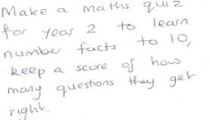
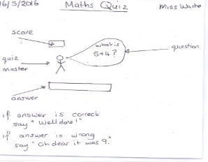
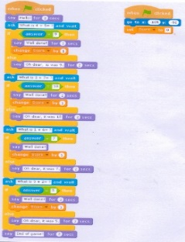
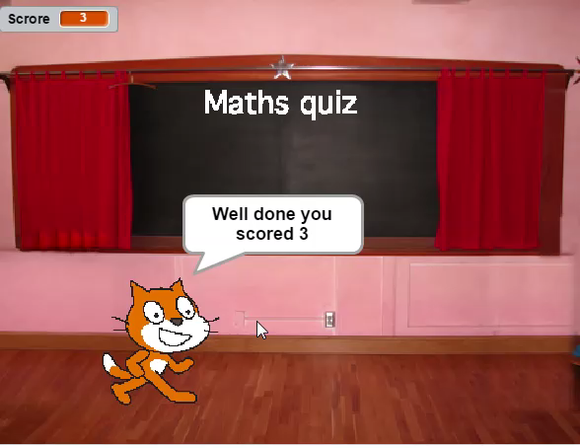

Slide 7
Levels of abstraction
Task
Design (including algorithms)
Code
Running the code
(Waite, Curzon, Sentence and Marsh, 2011)

Slide 8
Scaffolding
Copy code | Targeted tasks | Shared coding | Guided exploration | Project design and code | Tinker
Imitate
Innovate
Invent
Vs
Remix
Compare to other subjects.
Notes:
(Read predict, compare code, fix buggy code etc)
Live coding, Think aloud, cognitive apprenticeship)
(Limited commands/ clearly defined goal/remixing)

Slide 9
Objectives of this session
Increase understanding of selection specifically:
Different forms of selection
Using design to represent selection
Progression of selection
Event handling and other programming paradigms
RAG

Slide 10
Selection
What is a selection?
What are the different types of a selection?
How might we represent an algorithm with selection?
What techniques/ commands are often used to implement (code) selection?
What might the progression of these implementations be?
How do you teach selection?

Slide 11
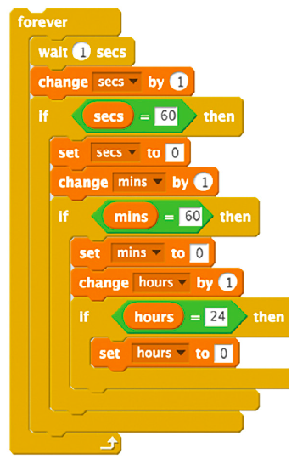
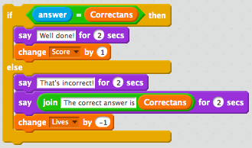
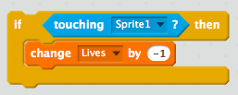
Selection
Selection is the programming structure through which a computer executes one or other set of instructions according to whether a particular condition is met or not.
conditional control
What is selection?
What other terms are sometimes used to describe selection?
What are the different types of selection?
Notice the dark orange commands!
nested selection
If then
If then else

Slide 12
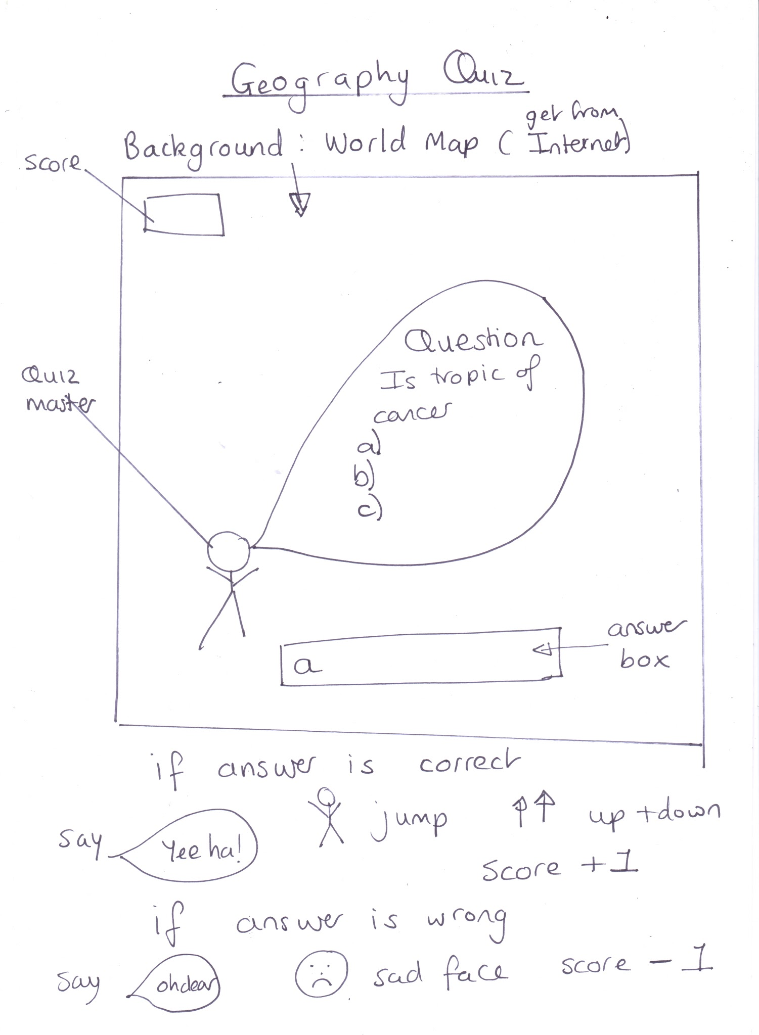
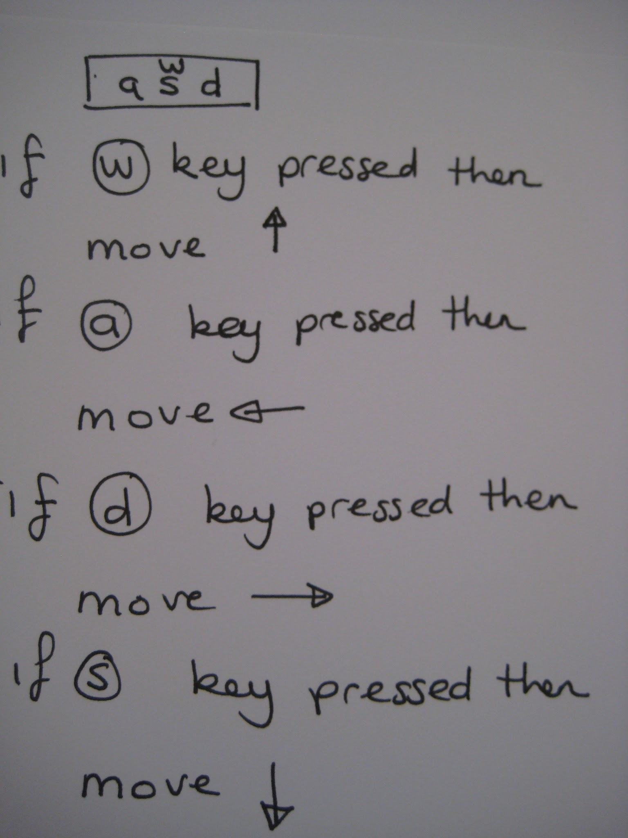
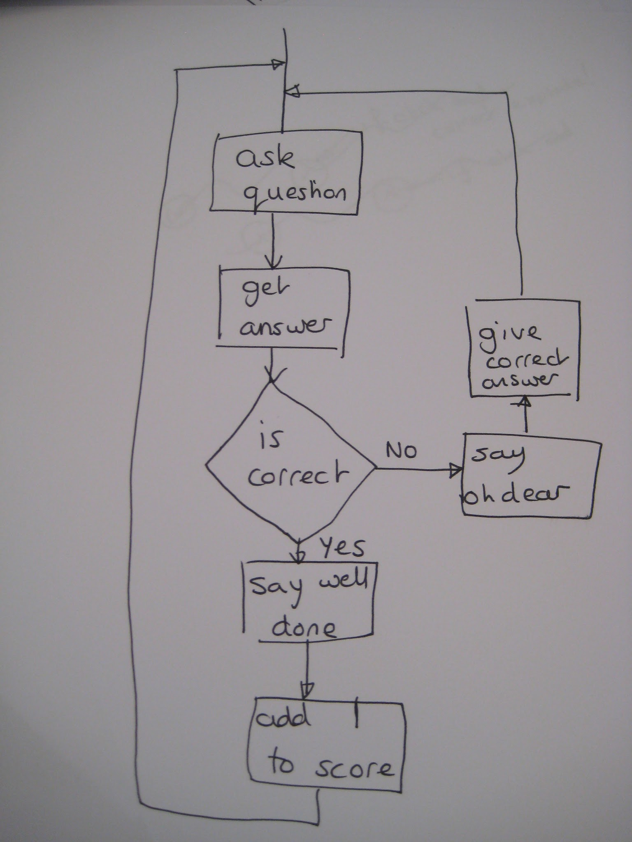
Selection
4. How might selection be represented by pupils as an algorithm /design?

Slide 13
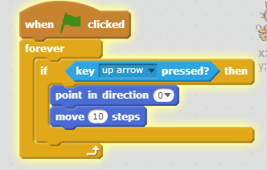
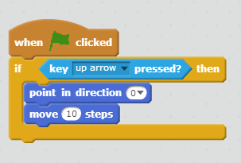
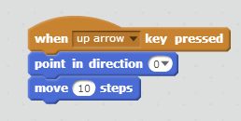
Selection
PRIMM
5. What techniques/ commands are often used to implement (code) selection?
Is this the only or best way to implement this?
https://scratch.mit.edu/projects/167435363/#player
What alternative might there be?

Slide 14
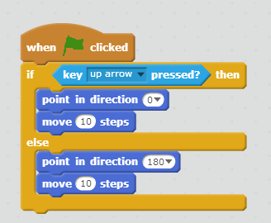
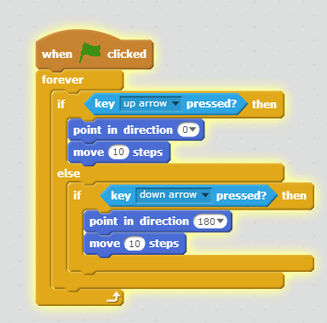
Selection
Predict what this code might do.
Would this solve it?
https://scratch.mit.edu/projects/167435909/#player

Slide 15
Selection to control movement
Buggy code - running code level first
Use the code ‘Exploring selection with fruit drawing’ to explore selection.
Run the program. Predict what code might be used before you look inside.
Read the code. Predict again.
Run again.
Debug the code. (How do you know what it should do?)
Consider which might be the 'best way' to code the algorithm?
Moving my sprite algorithm
if up arrow pressed move
If down arrow pressed move
if left arrow pressed move
if right arrow pressed move
https://scratch.mit.edu/projects/95267347/#player

Slide 16
Levels of abstraction
Task
Design (including algorithms)
Code
Running the code
Copy code | Targeted tasks | Shared coding | Guided exploration | Project design and code | Tinker
Imitate
Innovate
Invent
Vs
Remix

Slide 17
Buggy code - running code level first
What might the advantages/disadvantages be of
Just showing your class the banana code straight away and not showing any other implementations?
Showing them each implementation in turn?
Showing them all the examples all at once?
Reading examples first or modelling writing code first?
Getting them to debug first?
Predict what code might be used before you look inside.

Slide 18
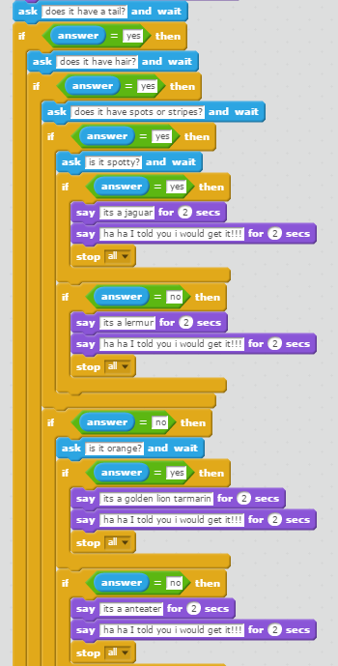
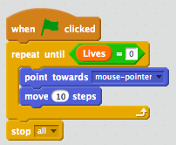
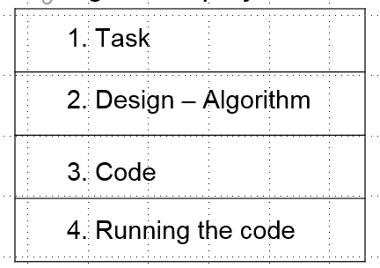
Selection - progression?
If then
If then else
Nested
Event handling/ Forever/ Conditional loops?
Use design annotations rather than copy code to scaffold independence
and ragging
In other programming languages...

Slide 19
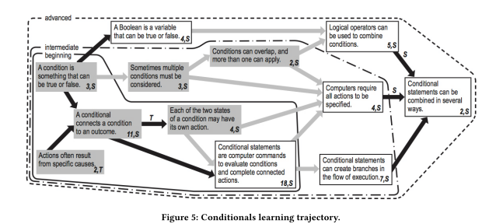
Grey means unplugged
Black line means previous box was necessary to next box, grey means helpful

Slide 20


Programming languages
@cas_certificate
What is a programming language
Name some different types and some examples of each type
When might each type be introduced in primary/secondary/FE...?
5 mins to discuss your ideas and then come back to the group to share.

Slide 21
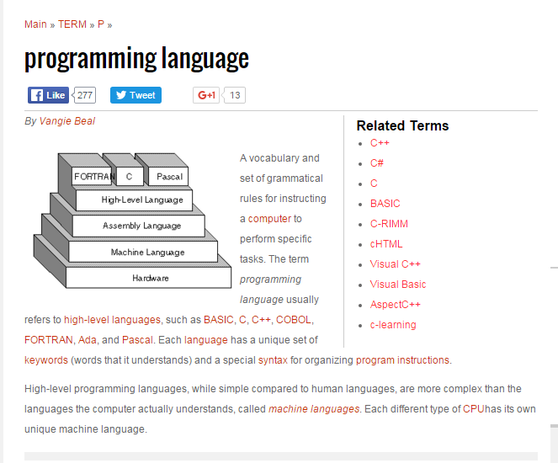
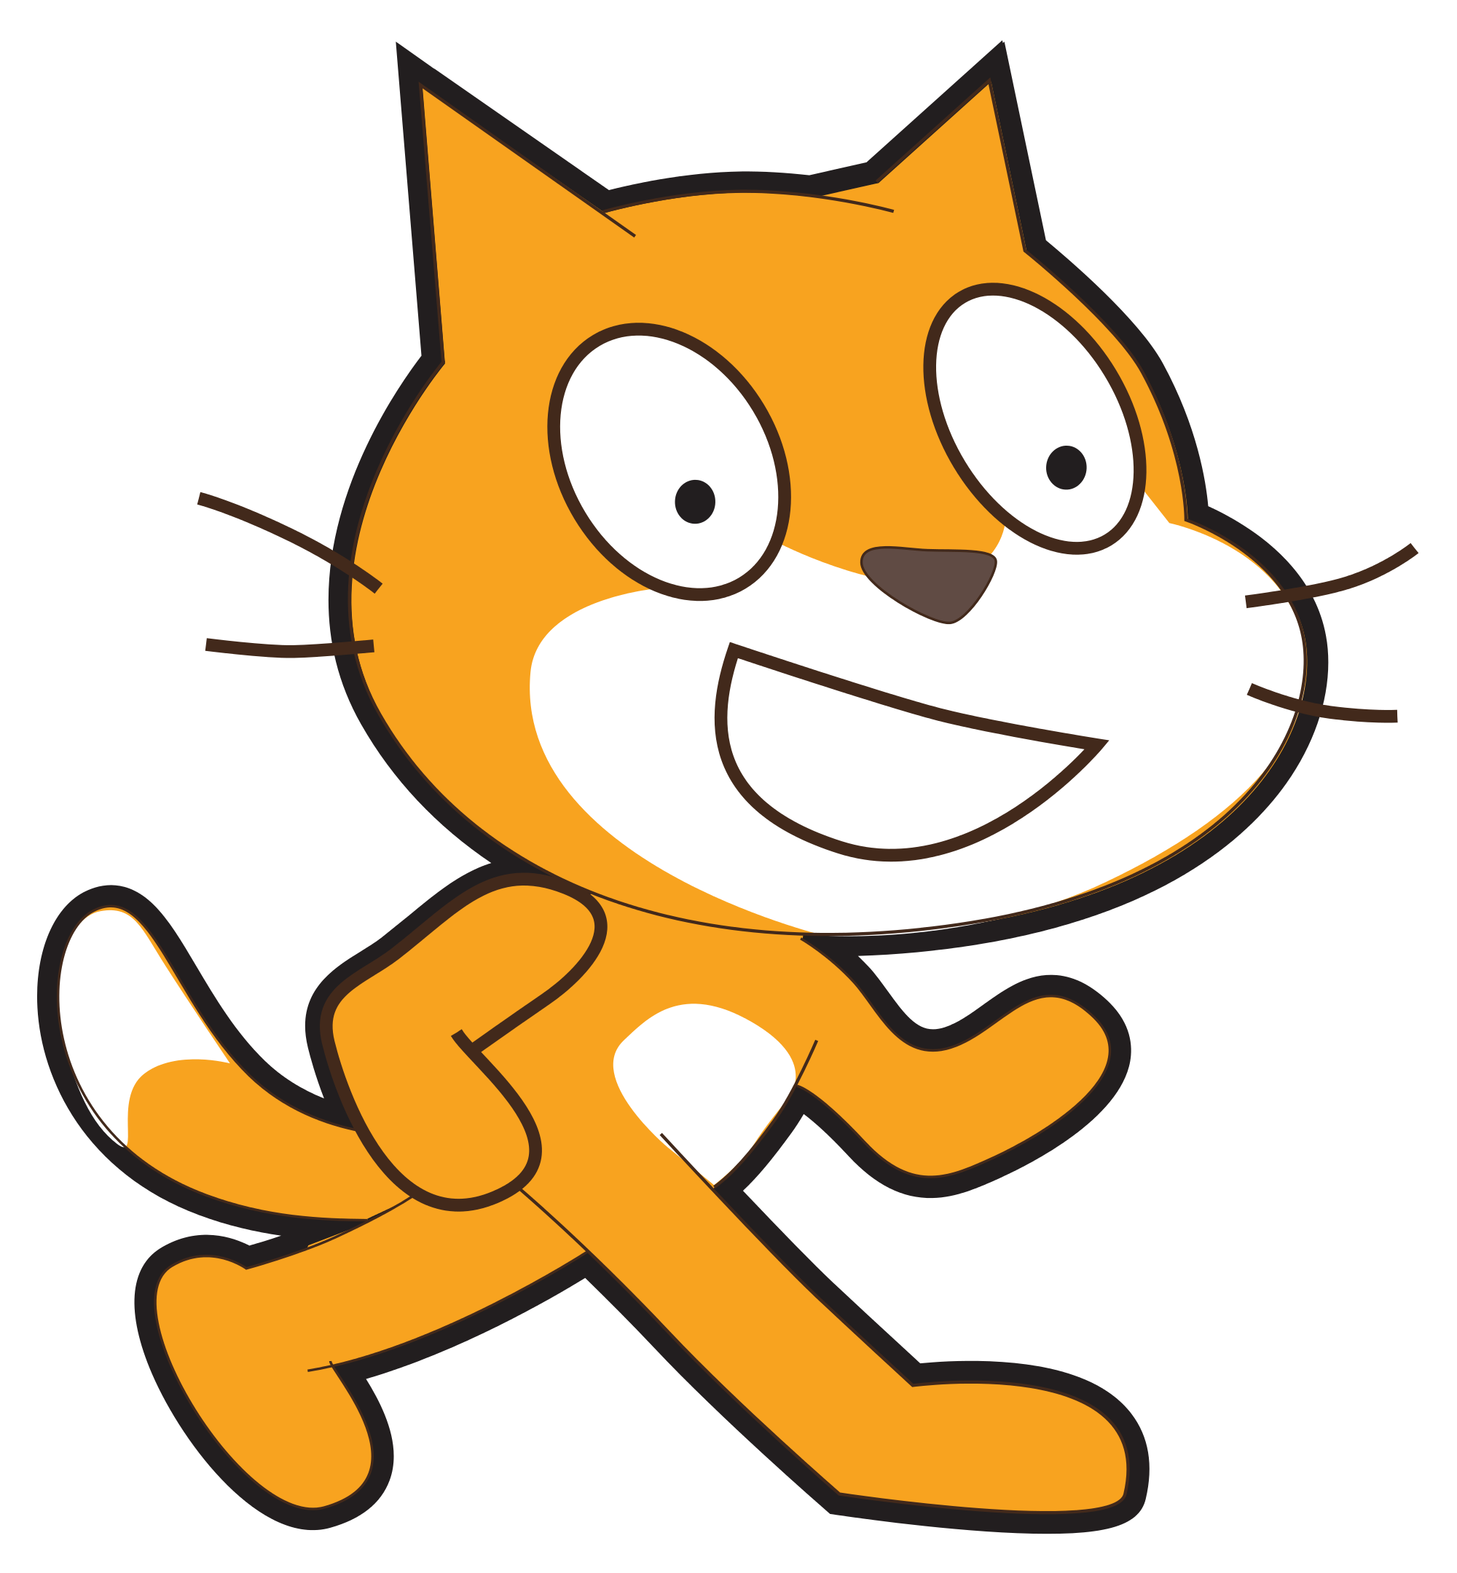
Programming languages
What is a programming language
A programming language is a formal constructed language designed to communicate instructions to a machine, particularly a computer. Programming languages can be used to create programs to control the behavior of a machine or to express algorithms.
https://en.wikipedia.org/wiki/Programming_language
What kind of PL is Scratch?
Lifelong Kindergarten
https://llk.media.mit.edu/projects/783/
Webopedia
Notes:
Draw attention to the parallels with literacy - highlight - vocabulary, grammatical rules. unique set of keywords syntax high level.
Scratch - high level visual/block based languages created for educational use by The lifelong Kindergarden at MIT media labs. Mitch Resnick/Karen Brennan

Slide 22
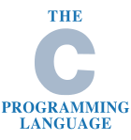






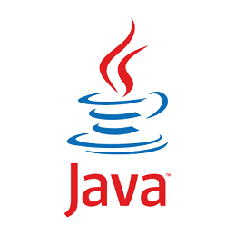



Programming languages (ideas - not fixed!)
Scratch programming for Part 2 of BCS Primary Certificate
@cas_certificate
2. Name some different types 3. When might these be introduced in education?
Programmable Toy/ Directional / Control /Educational
(functional)
Visual / Block based
Educational (event based)
Text - based
Industry
Text - based
Educational
Scripting/ Wepage design
Education/Industry
OO - Object Oriented
Education/Industy
Primary ->
Secondary/ FE ->
Notes:
Webpage design environments and languages (sometimes termed scripting languages)
Paragdigm - style of structure of a programing language
Imperative (step based algorithms) - procedural

Slide 23
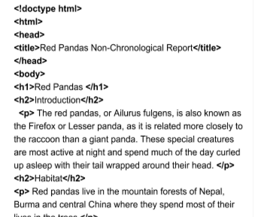
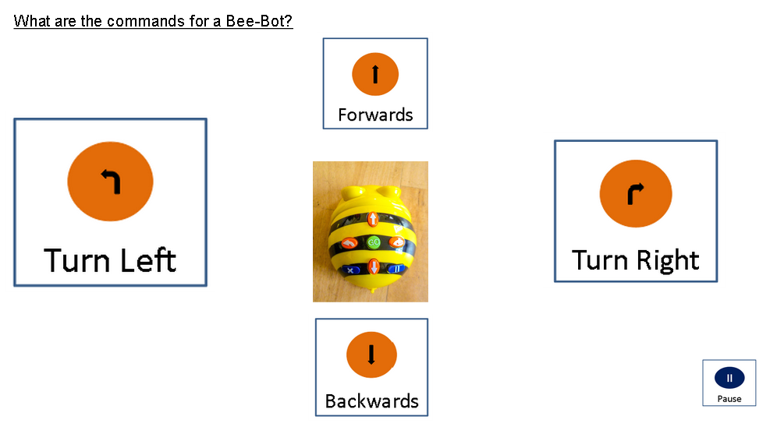

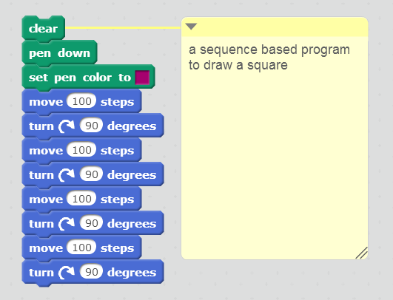
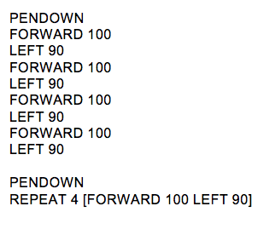
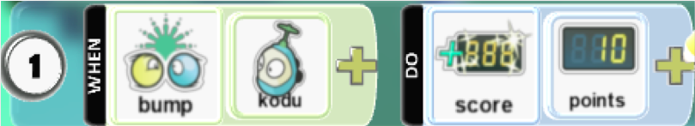

Programming languages
A
B
C
D
E
F
G
Name these programming language.
What type are they?
Notes:
Which one is not a programming language?

Slide 24
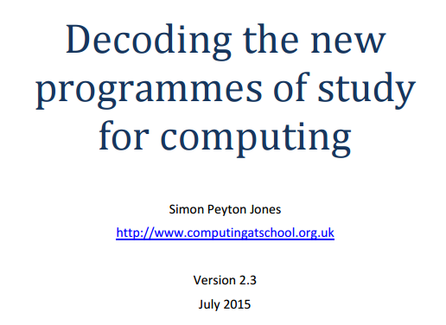
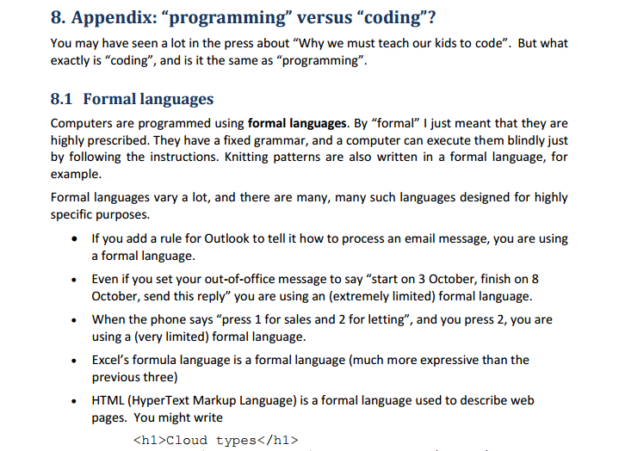
Programming languages
@cas_certificate
If you want to find out more...
https://scratch.mit.edu/info/research/
Barefoot programming concept document and video
http://community.computingatschool.org.uk/resources/2936
Notes:
Which one is not a programming language?

Slide 25
Programming languages
You do not need to know these terms - but may come across them...
You do not need to know about the following in Paradigms...
Imperative
Declarative
Universal/
Turing complete
Procedural
Functional
Notes:
Paragdigm - style of structure of a programing language
Imperative (step based algorithms) - procedural
Declarative - (formal logic) - functional no state change e.g. SQL , Lisp, Haskell (without side effects)
Universal - anything can be computed
HTML is the language of the web
http://codepen.io/ - a browser based coding environment to help teach HTML, CSS and Javascript (sign up)
http://dabblet.com/ - a very basic browser based coding environment to help teach HTML, CSS and Javascript (free)
ThreeJS: http://threejsplaygnd.brangerbriz.net/ Gorgeous! (free)
Scratch
Python
Ruby, Smallbasic, Java, LMC

Slide 26
Programming paradigms
What are the different paradigms?
Event based https://www.youtube.com/watch?v=u0WV9shCoak&feature=youtu.be
Procedural
http://study.com/academy/lesson/object-oriented-programming-vs-procedural-programming.html
Object oriented
Notes:
Fortran, Cobol, C Procedural
C# Java, PearlPython OO
nstructor: Paul ZandbergenPaul has a PhD from the University of British Columbia and has taught Geographic Information Systems, statistics and computer programming for 15 years.
There are several alternative approaches to the programming process. Two of the most important approaches are procedural programming and object-oriented programming. Learn about the differences between these two approaches in this video lesson.
Programming Paradigms
Programming is a creative process carried out by programmers to instruct a computer on how to do a task. A program is a set of instructions that tells a computer what to do in order to come up with a solution to a particular problem. There are a number of alternative approaches to the programming process, referred to as programming paradigms. Different paradigms represent fundamentally different approaches to building solutions to specific types of problems using programming. Most programming languages fall under one paradigm, but some languages have elements of multiple paradigms. Two of the most important programming paradigms are the procedural paradigm and the object-oriented paradigm. Let's look at each of these in a bit more detail.
Procedural Programming
Procedural programming uses a list of instructions to tell the computer what to do step-by-step. Procedural programming relies on - you guessed it - procedures, also known as routines or subroutines. A procedure contains a series of computational steps to be carried out. Procedural programming is also referred to as imperative programming. Procedural programming languages are also known as top-down languages.
Procedural programming is intuitive in the sense that it is very similar to how you would expect a program to work. If you want a computer to do something, you should provide step-by-step instructions on how to do it. It is, therefore, no surprise that most of the early programming languages are all procedural. Examples of procedural languages include Fortran, COBOL and C, which have been around since the 1960s and 70s.
Object-Oriented Programming
Object-oriented programming, or OOP, is an approach to problem-solving where all computations are carried out using objects. An object is a component of a program that knows how to perform certain actions and how to interact with other elements of the program. Objects are the basic units of object-oriented programming. A simple example of an object would be a person. Logically, you would expect a person to have a name. This would be considered a property of the person. You would also expect a person to be able to do something, such as walking. This would be considered a method of the person.
A method in object-oriented programming is like a procedure in procedural programming. The key difference here is that the method is part of an object. In object-oriented programming, you organize your code by creating objects, and then you can give those objects properties and you can make them do certain things.
A key aspect of object-oriented programming is the use of classes. A class is a blueprint of an object. You can think of a class as a concept and the object as the embodiment of that concept. So, let's say you want to use a person in your program. You want to be able to describe the person and have the person do something. A class called 'person' would provide a blueprint for what a person looks like and what a person can do. Examples of object-oriented languages include C#, Java, Perl and Python.
Key Differences
One of the most important characteristics of procedural programming is that it relies on procedures that operate on data - these are two separate concepts. In object-oriented programming, these two concepts are bundled into objects. This makes it possible to create more complicated behavior with less code. The use of objects also makes it possible to reuse code. Once you have created an object with more complex behavior, you can use it anywhere in your code.
Let's look at a simple example of this. You want to write a program that plays a song. Your band playing the song will have four members, and you start off by giving each of them a name:
myband = ('John,' 'Paul,' 'George,' 'Ringo')
Now that you have your band, it's time to pick the song:
mysong = 'Yellow Submarine'

Slide 27
Objectives of this session
Increase understanding of selection specifically:
Different forms of selection
Using design to represent selection
Progression of selection
Event handling and other programming paradigms

