Slide 1
Teaching Primary Computing
Diving Deep into Programming
Session 5
Variables

Slide 2
Course outline
Day 1 | Pedagogy, Sequence, Repetition
Day 2 | Selection, Variables, Make your own blocks
Day 3 | Control/Physical Computing Planning & Assessment

Slide 3
Days outline
Day- Session
9:00- 9:30 | Arrival, registration, drinks
9:30-10:00 | Overview, housekeeping, research & review
10:00- 10:30 | How did it LOA go?
10:30 – 12:00 | Selection
12:00 -1:00 | Lunch
1:00 to 2:30 | Variables
2:30 to 3:00 | Break
3:00 to 4:30 | Make your own blocks and lists
4:30 – 5:00 | Homework

Slide 4
Objectives of this session
Increase understanding of variables specifically:
What is a variable
  analogy misconceptions
  initialisation
  data types
  data structures
  scope
Using design to represent variables
Progression of variables
Roles of variables

Slide 5
Variables
What is a variable?
How do you teach variables - what analogy do you use – what misconceptions are associated with this approach?
What are data types, data structures and what is scope?
How might we represent a variable in a design or algorithm?
What techniques/ commands are often used to implement (code) variables?
What might the progression of these variables be?
What are the roles of variables?

Slide 6
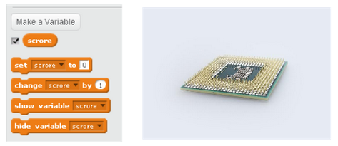


Variables
A variable is a simple way of storing one piece of information somewhere in the computer’s memory whilst a program is running, and getting that information back later.
What is a variable?
Programs store, retrieve or change the value of a variable.

Slide 7
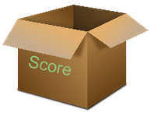
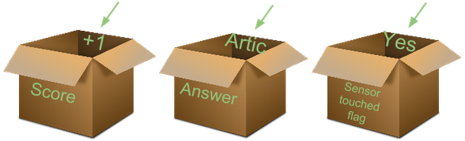
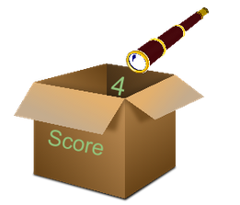
Variables
Box analogy
Create a variable (declare) - make and label the box.
Set values, store values, change values, update values
put values in the box.
What misconception can pupils have about this step?
Select, retrieve, get values
look in the box.
2 How do you teach variables- what analogy do you use – what misconceptions are associated with this?

Slide 8
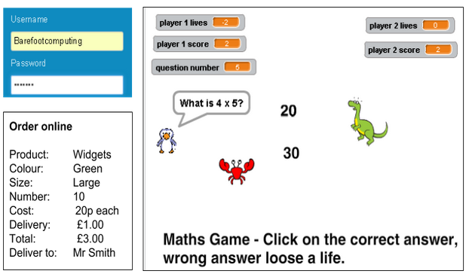
Variables
Data types: numbers, text, yes/no...
Data structures: variables, arrays, ordered lists, tables, graphs.
Scope: local, global
3. What are data types, data structures and what is scope?

Slide 9
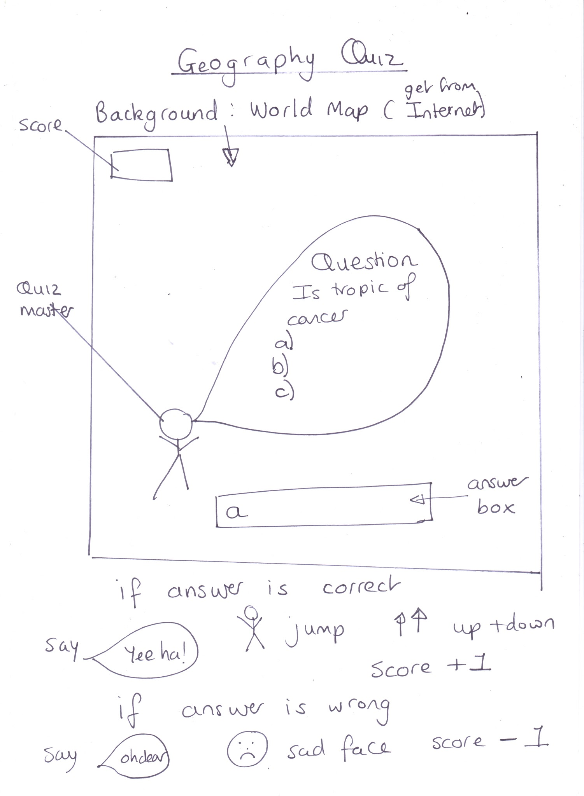
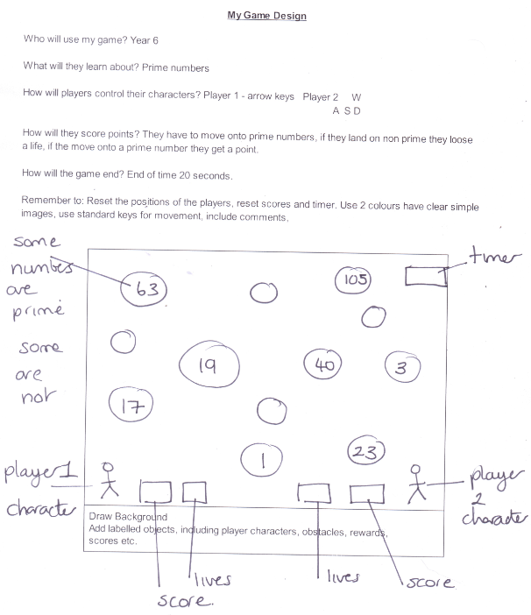
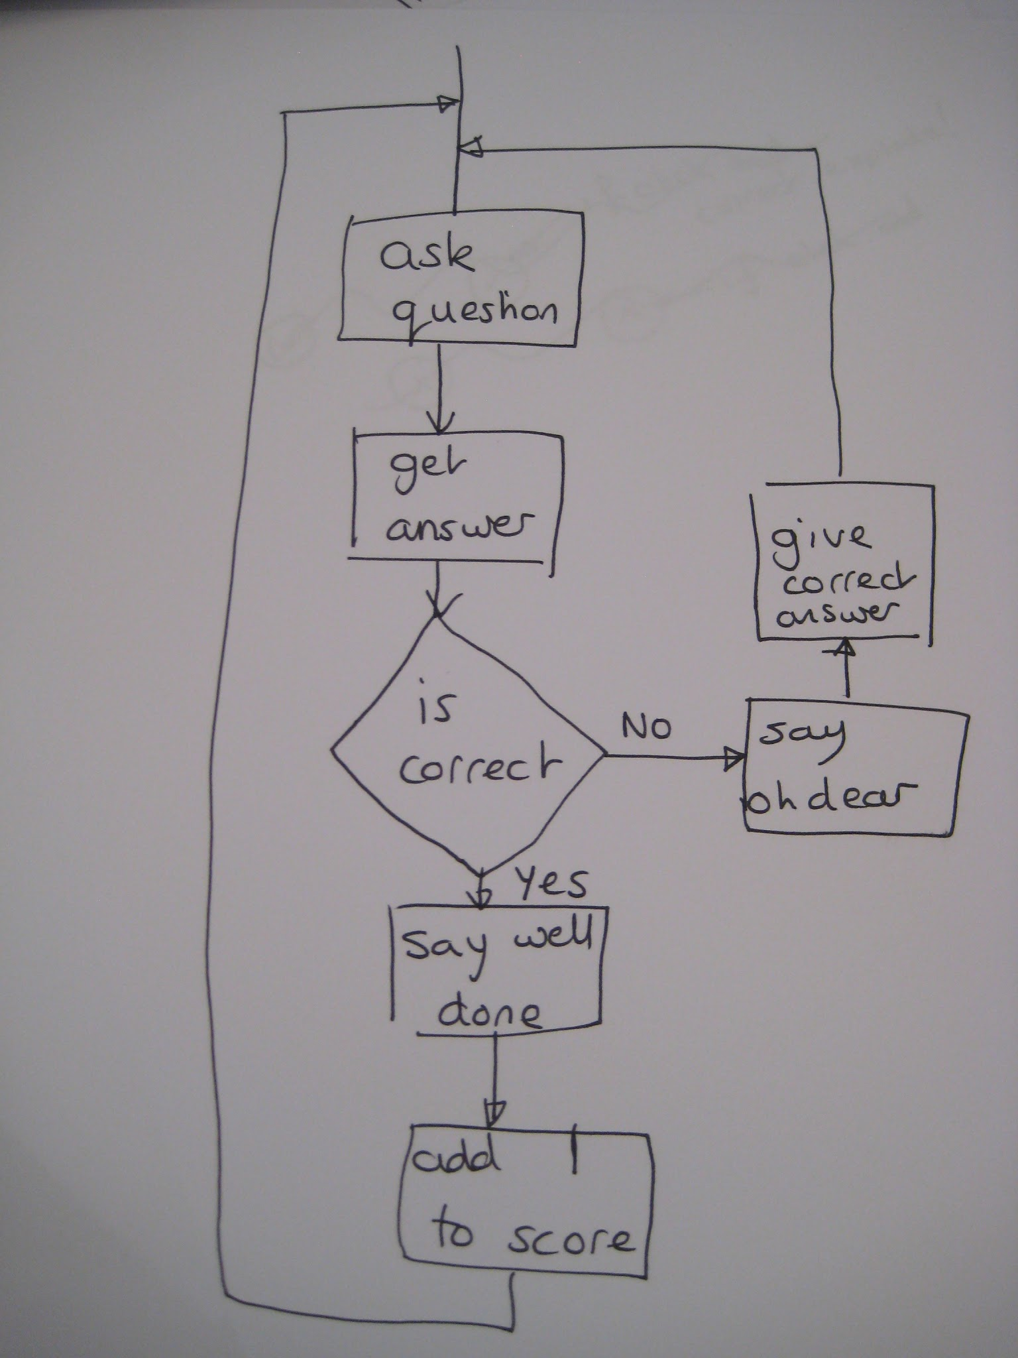
Variables
Do you have better examples?
4. How might variables be represented by pupils as an algorithm /design?
variable
variable
Variable algorithm
variable
variable
Variable algorithm

Slide 10
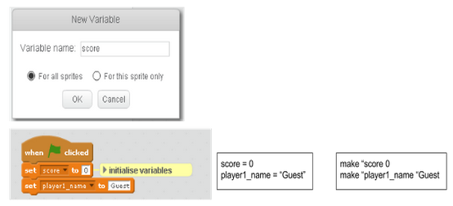
Variables
5. What techniques/ commands are often used to implement (code) variables?

Slide 11
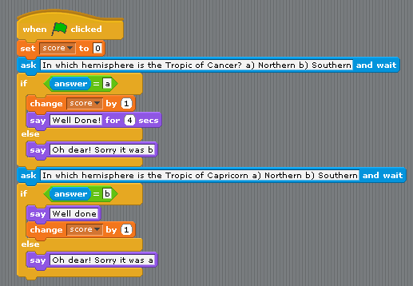
Variables
5. What techniques/ commands are often used to implement (code) variables?

Slide 12


Variables
5. What techniques/ commands are often used to implement (code) variables?
Why is this so important?

Slide 13
Variables to gather and display a value
Activity 1
Live coding
Score algorithm
Set to 0 at the start
Add 1 when answer is correct
Take away 1 if wrong
At the end show a ‘Well done’ message with the score but if they got less than 5 points say ‘Oh dear’
Add a score to your quiz.
Where will you set/reset it?
Why display it throughout the quiz?
Can you break your quiz?
Test data
text,control characters, numbers (+,-,0)
null value
Maximum/minimum values
(How can you record your tests?)
If you did not create a quiz - use this one to get you started.
https://scratch.mit.edu/projects/167162449/

Slide 14
Variables for users to control aspects of program
Activity 2
Guided exploration
Explore this program.
https://scratch.mit.edu/projects/167543312/
What have you discovered?
Why did I include certain things?
What did I want you to learn?

Slide 15
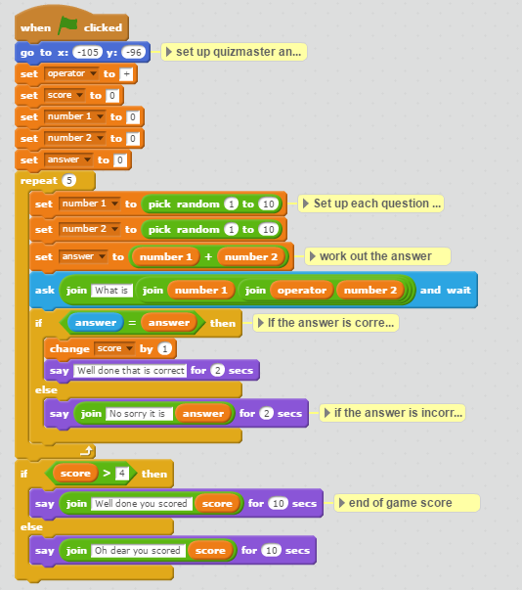
Variables - to control a program to increase efficiency/reuse/understanding
Activity 3a/b
Exemplar code - predict
and remix
Problem
Make a number bond to 20 quiz for a year 2 class to practise there mental maths.
Quiz algorithm
Ask 4 addition questions where the total is less than 20.
If the answer is correct add 1 to the score, but if it is wrong say ‘Sorry the answer was..’
At the end give the player their total score.
Using variables for other roles.
In this maths quiz how have variables been used? Why?
Predict what the code will do
Run it. Were you correct?
Remix the code
  Add 4 subtraction questions
  Add 4 multiplication questions
What will you do for the end of game message?
Extension: Compare the cat and bat code.
https://scratch.mit.edu/projects/96144555/

Slide 16
Variables - to control the flow of program
Activity 4a/4b
Exemplar code and predict and
Comparison (targeted task)
How can variables be used to control flow?
Look at the two programs
Maths quiz easy hard (1) https://scratch.mit.edu/projects/167515468/
Maths quiz easy hard (2)
https://scratch.mit.edu/projects/167515528/#player
Predict first what each program will do before you run them.
What has been added to control how easy or hard the quiz is?
What do you think to the differences?
What is the impact of make your own blocks?
Problem
Make a number bond to 20 quiz for a year 2 class to practise there mental maths.
Let the user control how easy or hard the questions are.

Slide 17
Progression in variables (ideas to spark discussion only)
Animations/stories
Quizzes
Games
Context
Simulations
Physical computing e.g. Makey, makey, Lego Wedo, Picoboard, TTS controller/LED etc….
Use variable to: Display a value that changes during the program e.g. score/lives
Use variable to: Facilitate user to control an aspect of a program e.g. difficulty/ speed/size/colour
Use variable to: Control internal working of the program e.g. difficulty level
Use
Knows what a variable is, can predict what variables will do, can change code with variables, can add a variable….
Can create a variable
Can initialise a variable
Can update variables
Can use variables
Can exhaustively test variables
Independance

Slide 18
The role of variables.
Use variable to: Display a value that changes during the program e.g. score/lives
(or over time – cloud variables)
Use variable to: Facilitate user to control an aspect of a program e.g. difficulty/ speed/size/colour
Use variable to: Control internal working of the program e.g. difficulty level
Gatherer – e.g. score
Transformation – e.g. sum answer
A flag or choice – e.g. hard or easy choice, task complete yes/no
Most wanted holder – e.g. best score
Fixed value – e.g. number of questions
Temporary – like Scratch answer
Most recent answer – the last value in a succession
Follower - based on another variable
Organizer - to do with reorganised arrays
Stepper – to control a loop

Slide 19
Objectives of this session
Increase understanding of variables specifically:
What is a variable
  analogy misconceptions
  initialisation
  data types
  data structures
  scope
Using design to represent variables
Progression of variables
Roles of variables

Slide 20
Levels of abstraction
Task
Design (including algorithms)
Code
Running the code
Copy code | Targeted tasks | Shared coding | Guided exploration | Project design and code | Tinker
Imitate
Innovate
Invent
Vs
Remix

