Slide 1
Object Oriented Programming in A Level
Session 5: Polymorphism and Review

Slide 2
Course
Outline
Session | Topics
1 | Use of objects and methods Decomposition and abstraction Aims of learning OOP
2 | Declaring classes Attributes, methods and the constructor
3 | Composition (or Interaction) of classes Classes diagrams; visibility
4 | Inheritance and overriding More class diagrams
5 | Polymorphism and overloading Teaching issues Review and practical examples

Slide 3
Session Aim and Outline
Aims
Outline
Recap week 4
How overriding works
  Concept of polymorphism
OOP in Java
  Practical exercise
OOP Concepts beyond Python
Pseudocode
OOP Misconceptions
Summary
Deeper understanding of overriding
Understand OOP concepts not (well) shown in Python
Critically evaluate a suggested decomposition of concepts and misconceptions

Slide 4
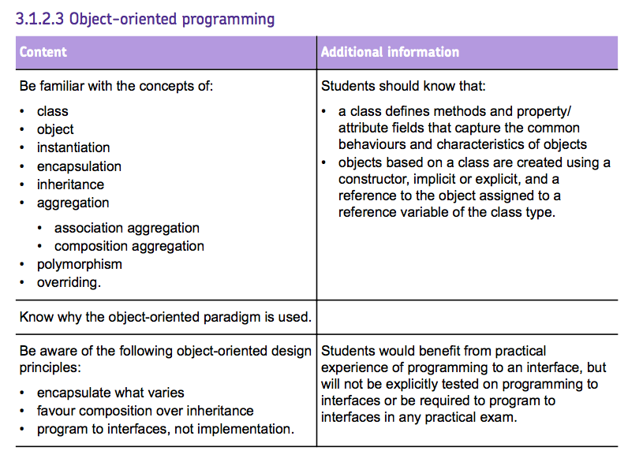
Specification check
AQA

Slide 5
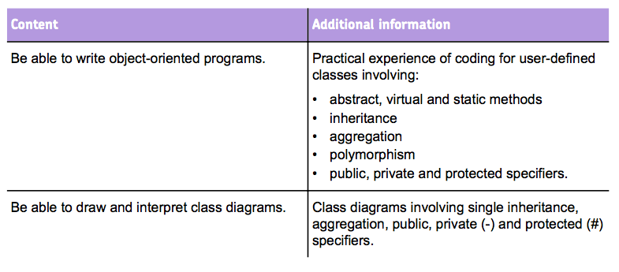
Specification check – AQA

Slide 6
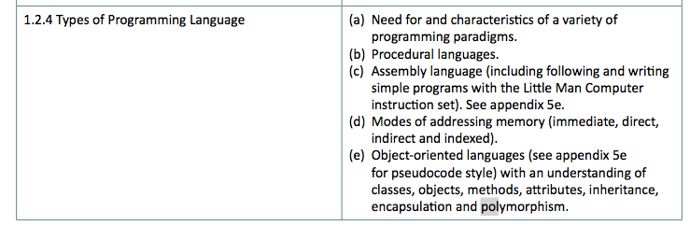
Specification Check – OCR
Overriding not mentioned explicitly: polymorphism is

Slide 7
Recap of Week 4

Slide 8
Class Diagrams
Person
-firstName
-lastName
-email
+fullName
A person has a first and last name and an email. We know how to get the full name of person
A teacher is a kind of person, with a job title and department
tutor
Pupil
Teacher
-keyStage
-department
-jobTitle
A pupil is a kind of person, at some KS. A pupil has a tutor, who is Teacher

Slide 9
Words
Person
Pupil is a subclass (or subtype or child) of Person
Person is the super-class (or super-type or parent) of Pupil
Pupil extends Person
Pupil inherits from Person
Pupil is a specialisation of Person
Pupil is a kind of Person
Pupil

Slide 10
Sub Class Declaration
Person
Name of parent class
-firstName
-lastName
-email
+fullName
Use super() to run constructor of parent class
Always start with this
class Teacher(Person):
def __init__(self,f,l,e,d,j):
super().__init__(f,l,e)
self.department = d
self.jobTitle = j
tutor
class Pupil(Person):
def __init__(self,f,l,e,k):
super().__init__(f,l,e)
self.keyStage = k
self.tutor = None
def setTutor(self, t):
self.tutor = t
Pupil
Teacher
-keyStage
-department
-jobTitle

Slide 11
Inheritance Summary
Attributes
  The subclass can add new attributes
  The attributes of the super-class also exist
Methods
  The subclass can add new methods
  The methods of the super-class also exist BUT
  … the sub-class can change their behaviour
Python: half-truths

Slide 12
Overriding
Use super() to run method from parent class (optional)
Person
-firstName
-lastName
-email
+fullName
class Teacher(Person):
...
def fullName(self):
fn = super().fullName()
fn += ", Title: " + self.jobTitle
return fn
tutor
Pupil
-keyStage
class Pupil(Person):
...
def fullName(self):
fn = super().fullName()
fn += ", " + self.keyStage
return fn
Teacher
-department
-jobTitle

Slide 13
How Overloading Works
The Idea of Polymorphism

Slide 14
Animal Description
Suppose this is a MarineMammal
hasFur, canSwim overidden
getSize, getLegs inherited
In Animal
def getDescription(self):
s = "The " + self.name + " has the following characteristics:\n”
s = s + ("\n It can swim" if self.canSwim() else "\n It cannot swim")
s = s + ("\n It has fur" if self.hasFur() else "\n It does not have fur")
s = s + "\n It has " + str(self.legs) + " legs”
s = s + "; it is " + self.size
s = s + ("\n It eats meat" if self.meat else "\n It does not eat meat")
return s
Which implementation?
This is called ’dynamic dispatch’: at each call, the implementation is chosen using the class of the object.

Slide 15
How Does Overriding Work?
class A:
def whoAmI(self):
return "A"
class B(A):
def whoAmI(self):
return "B"
class C:
def whoAmI(self):
return "C"
Method called depends on the object’s class
Python
  Looks back up the class hierarchy
  … starting from the object’s class
  … to find the first definition of a method
If ‘a’ is of class B, then "B" is printed
as = list of A, B or C
for a in as:
print(a.whoAmI())

Slide 16
Polymorphism
Any subclass of Person … including new ones
General definition:
  Code that is able to work with values of different types is polymorphic
In OOP:
  Code that works with objects of different classes
  … achieved by overriding
Example
  Arrays in many languages
  Arithmetic: +, -, *
… this code is polymorphic
people = list of Person
for p in people:
print(p.fullName())
Terry Smith, email: tsmith@gmail, Title: Computing Teacher
Paul Morris, email: p.morris12@school.org, KS3

Slide 17
OOP in Java
A language with declarations

Slide 18
Python versus Java
No declarations
Values are typed
  Variable types are dynamic
Run time type checking
Syntax with indentation
Permissive philosophy
Declarations
Static typing of variables
Compile time type checking
Syntax with braces { }
Rigid philosophy

Slide 19
Declarations: Java Example
Access modifiers (visibility)
Private to class
Public: outside class
public class Person {
private String lastName ;
private String firstName ;
private String email ;
public Person(String f,
String l, String e) {
firstName = f ;
lastName = l ;
email = e ;
}
public String getName() {
String fn = "" ;
fn = fn + firstName
+ " " + lastName ;
return fn ;
}
public String fullName() {
String fn = getName() ;
fn = fn + ", email: ”
+ email ;
return fn ;
}
}
No ‘self’ (‘this’ available when needed)
Constructor name is class name

Slide 20
public class Pupil extends Person {
private Teacher tutor ;
private int keyStage ;
public Pupil(String f, String l,
String e, int k) {
super(f, l, e) ;
keyStage = k ;
tutor = null ;
}
public void setTutor(Teacher t) {
tutor = t ;
}
...
}
Inheritance
Super class constructor call
Method from super class
public String fullName() {
String fn = super.fullName() ;
fn = fn + ", KS:" + keyStage ;
if (tutor != null) {
fn = fn + " with tutor "
+ tutor.getName() ;
}
return fn ;
}

Slide 21
public class Teacher extends Person {
private String jobTitle ;
private String department ;
public Teacher(String f, String l, String e,
String j, String d) {
super(f, l, e);
jobTitle = j ;
department = d ;
}
public String fullName() {
String fn = super.fullName() ;
fn = fn + ", title:" + jobTitle ;
return fn ;
}
}

Slide 22
Practical Break

Slide 23
OOP Concepts Beyond Python

Slide 24
Concepts Beyond Python
Access (or visibility) control
  Private: only visible inside the class
  Public: visible outside. Part of the interface.
Checking the use of overriding
Virtual and abstract method
Overloading

Slide 25
Checking Overriding
class Idea:
def __init__(self, a, b):
self. a = a
self. b = b
def add(self):
return self.a + self.b
class Bad(Idea):
def __init__(self, a, b):
super().__init__(a, b)
def add(self, c):
return self.a + 2 * c
i = Idea(1, 2)
b = Bad(3, 4)
print(i.add()) # ok --> 3
print(b.add(5)) # ok --> 13
print(b.add())
# problem: not longer polymorphic
The overridden method should have the same parameters
It is not checked in Python

Slide 26
Virtual and Abstract
Virtual method
  A method that can be overridden
  In Python all methods are virtual
Abstract method
  A method that must be overridden – no implementation
  In Python: good practice to define all methods in superclass, but not required
class A:
# Would be abstract
def m(self, i):
pass
class B (A) :
def m(self, i):
return i**3

Slide 27
Overloading
General use
  Meaning depends on context
  Example: + operator in Python is overloaded
Shortage of operator symbols!!
  Some languages allow users to overloading operators
  Disadvantage: program harder to read
OOP use
  Class has many methods with same name
  … Including constructors
  Distinguished by parameter types
Not possible in Python

Slide 28
OOP Pseudocode
From OCR: Halfway between Java and Python

Slide 29
OCR OOP Pseudo Code – Methods and Attributes
Access
  Assumed to be public
  Where relevant, denoted by the keywords: public and private.
Methods
  Always be instance methods
  Static methods not covered
  Called using object.method
  private attempts = 3
  public procedure setAttempts(number)
  attempts=number
  endprocedure
  private function getAttempts()
  return attempts
  endfunction
  player.setAttempts(5)
  print(player.getAttempts())

Slide 30
OCR OOP Pseudo Code – Constructors & Inheritance
Constructors
  Procedures with the name new.
Inheritance is denoted by the inherits keyword
Superclass methods called with the keyword super
  super.methodName
  (parameters)
  constructor super.new()
class Pet
private name
public procedure new(givenName)
name=givenName
endprocedure
endclass
class Dog inherits Pet
private breed
public procedure new(givenName, givenBreed)
super.new(givenName)
breed=givenBreed
endprocedure
endclass

Slide 31
OCR OOP Pseudo Code – Creating an Instance
To create an instance of an object, use:
  objectName = new className(parameters)
  myDog = new Dog(“Fido”, “Scottish Terrier”)

Slide 32
OCR OOP Pseudo Code – Characteristics
Declaration of fields (attributes)
  … but no types
Distinguish between functions and procedures
Public and private applied to
  Fields
  Functions and procedure
Keyword ‘inherits’
Keyword ‘super’
Omissions: ‘self’ or ‘this’

Slide 33
OOP Concepts and Miscomprehensions

Slide 34
OOP
Concepts
Concept | Details
Basic mechanics | Calling a method of an object Class as a template for data Class as a collection of methods
Constructors | Definition and use
Interaction | Object as a value (variable, list item, …) Object as an attribute value (has-a relationship) Object passed as a parameter
Abstraction and modelling | Class as a domain concept Methods (and constructor) have parameters
Inheritance | Superclass and subclasses Constructor called using super() Method inherited or overridden
Prerequisite knowledge: functions & parameters
Prerequisite knowledge: basic mechanisms

Slide 35
Misconception | Possible Evidence
Attributes in the wrong scope | Omission of self (assignment or use)
Confusion between class and object | No objects created Only one instance Inheritance rather than instance
Confusion between class and attribute | Many classes – all simple
Objects only contain data | No encapsulation Only get and set methods
Objects do not interact | All code in single class Classes defined but not imported Objects not used as attributes Objects never passed as parameters
Believing objects are copied not shared | Unnecessary copying Unexpected sharing
Also lack of prerequisite knowledge: functions & parameters

Slide 36
Practical Break

Slide 37
Review of Teacher / Form / Test / Mark Homework

Slide 38
Test
Mark
-topic
-max
1 awarded *
-score
A test is set for a form
A form can have several tests
Mark is awarded for a test
Mark is achieved by a pupil
*
achieved
1
*
setFor
1
Pupil
Form
1 in *
-name
-age
-roomNumber
1
teaches
1
Teacher
-name

Slide 39
Steps
Declare classes with attributes
Design an API (for use in a user interface)
Decompose each API call into methods on each class

Slide 40
Step 1: Fields
  class Test:
  def __init__(self, topic, maxM):
  self.topic = topic
  self.maxM = maxM
  self.marks = []
  class Mark:
  def __init__(self, test, pupil, score):
  self.test = test
  self.pupil = pupil
  self.score = score
  pupil.addMark(self)

Slide 41
API
(Public) functions provided by class to help us get stuff done
… Used in a user interface
More ‘internal’ functions (roughly: private ones)
Function | Method Name | In Class
Add a pupil | addPupil() | Form
Details of form | getDetails() | Form
List of pupils | listRoll() | Form

Slide 42
Testing (without a User Interface)
  t2 = Teacher("Mrs Brown")
  year2 = Form(t2)
  year2.setRoom("Ada 2")
  p1 = Pupil("Andy")
  p2 = Pupil("Bert")
  year1.addPupil(p1)
  year1.addPupil(p2)
  p5 = Pupil("Elsie")
  p6 = Pupil("Fran")
  year2.addPupil(p5)
  year2.addPupil(p6)
  print(year1.getDetails())
  num, report = year1.listRoll()
  print(report)
  print(year2.getDetails())
  num, report = year2.listRoll()
  print(report)

Slide 43
Method addTest of Form
form.addTest(topic, maxMark)
  Call Test() constructor
  Add to list of tests in form
Class | Responsibility
Test | Create a new test
Form | Append to list
  def addTest(self, tTopic, tMax):
  t = Test(tTopic, tMax)
  self.tests.append(t)
  return t

Slide 44
Method listRoll of Form
  def listRoll(self):
  if len(self.pupils) == 0:
  return (0, "No pupils")
  fl = "”
  count = 0
  for p in self.pupils:
  count += 1
  fl = fl + str(count) + \
  ": " + p.getDetails() + \
  "\n”
  return (count, fl)
Form.listRoll()
  Calls pupil.getDetails() for each pupil
Class | Responsibility
Form | Go through list of pupils
Pupil | Provide details of this pupil

Slide 45
API – Additional Methods for Tests
Function | Method Name | In Class
Create a test | addTest(subject, mark) | Form
Add mark (A) | addMark(mark, pupil) | Test
Add mark (B) | addMark(mark, test) | Pupil
Report test results (for all pupils) | results() | Test
Report pupil results (for all tests) | results() | Pupil

Slide 46
Practical Break

Slide 47
Discussion: Issues for Teaching OOP at A Level

Slide 48
Last Words
Please complete feedback – link on page
Flyer for robotics talk
Sign up for interest in student placement

