Slide 1
Object Oriented Programming in A Level
Session 4: Subclasses and Inheritance

Slide 2
Course
Outline
Session | Topics
1 | Use of objects and methods Decomposition and abstraction Aims of learning OOP
2 | Declaring classes Attributes, methods and the constructor
3 | Composition (or Interaction) of classes Classes diagrams; visibility
4 | Inheritance and overriding More class diagrams
5 | Polymorphism and overloading Teaching issues Review and practical examples

Slide 3
Session Aim and Outline
Aims
Outline
Understand the inheritance relationship between classes
Be able to define a subclass
Be able to show inheritance in UML class diagrams
Recap week 3
Review of homework
Inheritance: UML and code
Practical break
  Review of 20Q example
Discussion: Reuse and Decomposition
Practical break
  Enhancing 20Q
Summary

Slide 4
Recap of Week 3
Decomposition into classes → classes interact
  Object as an attribute
  Object passed as a parameter
  … object returned
UML class diagrams
  Show relationships between classes
  Analysis and design
  Composition: a whole-part relationship
Interaction is hard to understand at first

Slide 5
Program Structure versus Design Style
Pseudo
initialise x
for every x
find
print
If & loops
x =
while x > :
y =
print
Flow
x = 3
x>
print
Functions
main
Function def
init
process
save
Function def
Call Graph
Main program
Initialise vars
Call functions
input
…
Town
Classes & objects
Friend
name
location
getDirect
setRating
class Friend:
def __init__()
def m1(a, b):
name
phone num
setNumber
sendText
class Town:
def __init__()
def m1(a, b):
Class Diagram
Main program
Create obj
Call methods

Slide 6
Program Structure versus Design Style
If & loops
x =
while x > :
y =
print
Program grows more complex in structure
Simpler elements remain
  If & loop → part of function
  Method → part of class
Functions
Function def
Function def
Main program
Initialise vars
Call functions
Classes & objects
class Friend:
def __init__()
def m1(a, b):
class Town:
def __init__()
def m1(a, b):
Main program
Create obj
Call methods

Slide 7
Program Structure versus Design Style
Pseudo
initialise x
for every x
find
print
Design becomes more abstract
  Between problem and solution
Concrete design still may be needed
Design notations only show some information
x = 3
Flow
x>
print
main
init
process
save
Call Graph
input
…
Town
Friend
name
location
getDirect
setRating
name
phone num
setNumber
sendText
Class Diagram

Slide 8
Review of Homework

Slide 9
Test
Mark
-topic
-max
1 awarded *
-score
A test is set for a form
A form can have several tests
Mark is awarded for a test
Mark is achieved by a pupil
*
achieved
1
*
setFor
1
Pupil
Form
1 in *
-name
-age
-roomNumber
1
teaches
1
Teacher
-name

Slide 10
Introducing Inheritance

Slide 11
Problem
How do we prevent duplication of code?
Functions
  Name: the code has a name so it can be (re)used
  Parameters: the code is adapted with parameters, so it is reusable in a new context
Classes: what if two classes are similar?
  Some attributes the same
  Some methods similar
Also need to use and adapt classes
  Use: inheritance
  Adapt: overriding

Slide 12
Class Diagrams
Person
-firstName
-lastName
-email
+fullName
A person has a first and last name and an email. We know how to get the full name of person
A teacher is a kind of person, with a job title and department
tutor
Pupil
Teacher
-keyStage
-department
-jobTitle
A pupil is a kind of person, at some KS. A pupil has a tutor, who is Teacher

Slide 13
Words
Person
Pupil is a subclass (or subtype or child) of Person
Person is the super-class (or super-type or parent) of Pupil
Pupil extends Person
Pupil inherits from Person
Pupil is a specialisation of Person
Pupil is a kind of Person
Pupil

Slide 14
Quiz: Class Diagrams
Person
-firstName
-lastName
-email
+fullName
Does a teacher have a job title?
Do all people have a department?
Does a pupil have an email?
Does a pupil have a department?
Can a pupil be a tutor?
Give an example of inheritance
Give an example of association
tutor
Pupil
Teacher
-keyStage
-department
-jobTitle

Slide 15
Class Declaration
Person
-firstName
-lastName
-email
+fullName
class Person:
def __init__(self,f,l,e):
self.firstName = f
self.lastName = l
self.email = e
def fullName(self):
fn = self.firstName + " "
fn += self.lastName
fn += ", email: "
fn += self.email
return fn
tutor
Pupil
Teacher
-keyStage
-department
-jobTitle

Slide 16
Sub Class Declaration
Person
Name of parent class
-firstName
-lastName
-email
+fullName
Use super() to run constructor of parent class
Always start with this
class Teacher(Person):
def __init__(self,f,l,e,d,j):
super().__init__(f,l,e)
self.department = d
self.jobTitle = j
tutor
class Pupil(Person):
def __init__(self,f,l,e,k):
super().__init__(f,l,e)
self.keyStage = k
self.tutor = None
def setTutor(self, t):
self.tutor = t
Pupil
Teacher
-keyStage
-department
-jobTitle

Slide 17
Inheritance Summary
Attributes
  The subclass can add new attributes
  The attributes of the super-class also exist
Methods
  The subclass can add new methods
  The methods of the super-class also exist BUT
  … the sub-class can change their behaviour
Python: half-truths

Slide 18
Overriding
Changing the behaviour of a method in a sub-class

Slide 19
Overriding
Person
-firstName
-lastName
-email
+fullName
What is the full name of a Teacher?
  Every person has a fullName
  Behaviour inherited from Person
  We want different behaviour in the two subclasses
tutor
Pupil
-keyStage
terry = Teacher("Terry","Smith",
"tsmith@gmail","ICT",
"Computing Teacher")
paul = Pupil("Paul","Morris",
"p.morris12@school.org","KS3")
Paul Morris, email: p.morris12@school.org, KS3
Terry Smith, email: tsmith@gmail,
Title: Computing Teacher
Teacher
-department
-jobTitle

Slide 20
Overriding
Use super() to run method from parent class (optional)
Person
-firstName
-lastName
-email
+fullName
class Teacher(Person):
...
def fullName(self):
fn = super().fullName()
fn += ", Title: " + self.jobTitle
return fn
tutor
Pupil
-keyStage
class Pupil(Person):
...
def fullName(self):
fn = super().fullName()
fn += ", " + self.keyStage
return fn
Teacher
-department
-jobTitle

Slide 21
Further Topics (Next Week)
More on overriding
  What must stay the same / can change
  Abstract methods and classes
Checking between class and sub-class
What is polymorphism and how does it work?
What is overloading?

Slide 22
Activity sheet: 20Q
20Q classic version: One player chooses a secret object. The other player has 20 questions to guess the object
This version: the computer has:
a (small) fixed set of objects (which are animals)
a fixed set of questions with an answer for each object
The game is played:
the computer chooses on of the objects – a secret
… and displays the possible objects and the questions
the player chooses a question and gets the answer
after a number of questions, the player must guess … If the guess is wrong, the correct answer is displayed
DEMONSTRATION

Slide 23
Activity Sheet 20Q:
Exercise 1
Exercise 1: run and review provided code

Slide 24
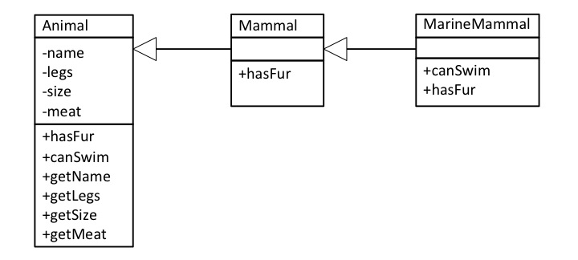
Class Diagram
The Animal subclasses

Slide 25
Overriding and Inheritance
Methods: Implemented, inherited or overridden
Method | Classes
 | Animal | Mammal | MarineMammal
hasFur | Implemented | Overridden | Overridden
canSwim | Implemented | Inherited | Overridden
getSize | Implemented | Inherited | Inherited
getLegs | Implemented | Inherited | Inherited

Slide 26
Overriding and Inheritance
Explain the way that:
  The function canSwim() returns a different value for a Tiger and a Dolphin
  The function getSize() returns a different value for a Tiger and Badger
The method canSwim() returns a different value in Tiger and Dolphin because Tiger is a Mammal wheras Dolphin is a MarineMammal. The canSwim() method is overridden in the MarineMammal class to return true.
The method getSize() accesses the value of the size attribute which is set in the constructor of the Animal (and all its subclasses). The getSize() method is not overridden: the implementation in the Animal class is inherited by all the subclasses. Instead, the two Mammals have different size values given in the call to the constructor.

Slide 27
Discussion: OOP and Computation Thinking
What Computational Thinking Words Describe OOP?

Slide 28
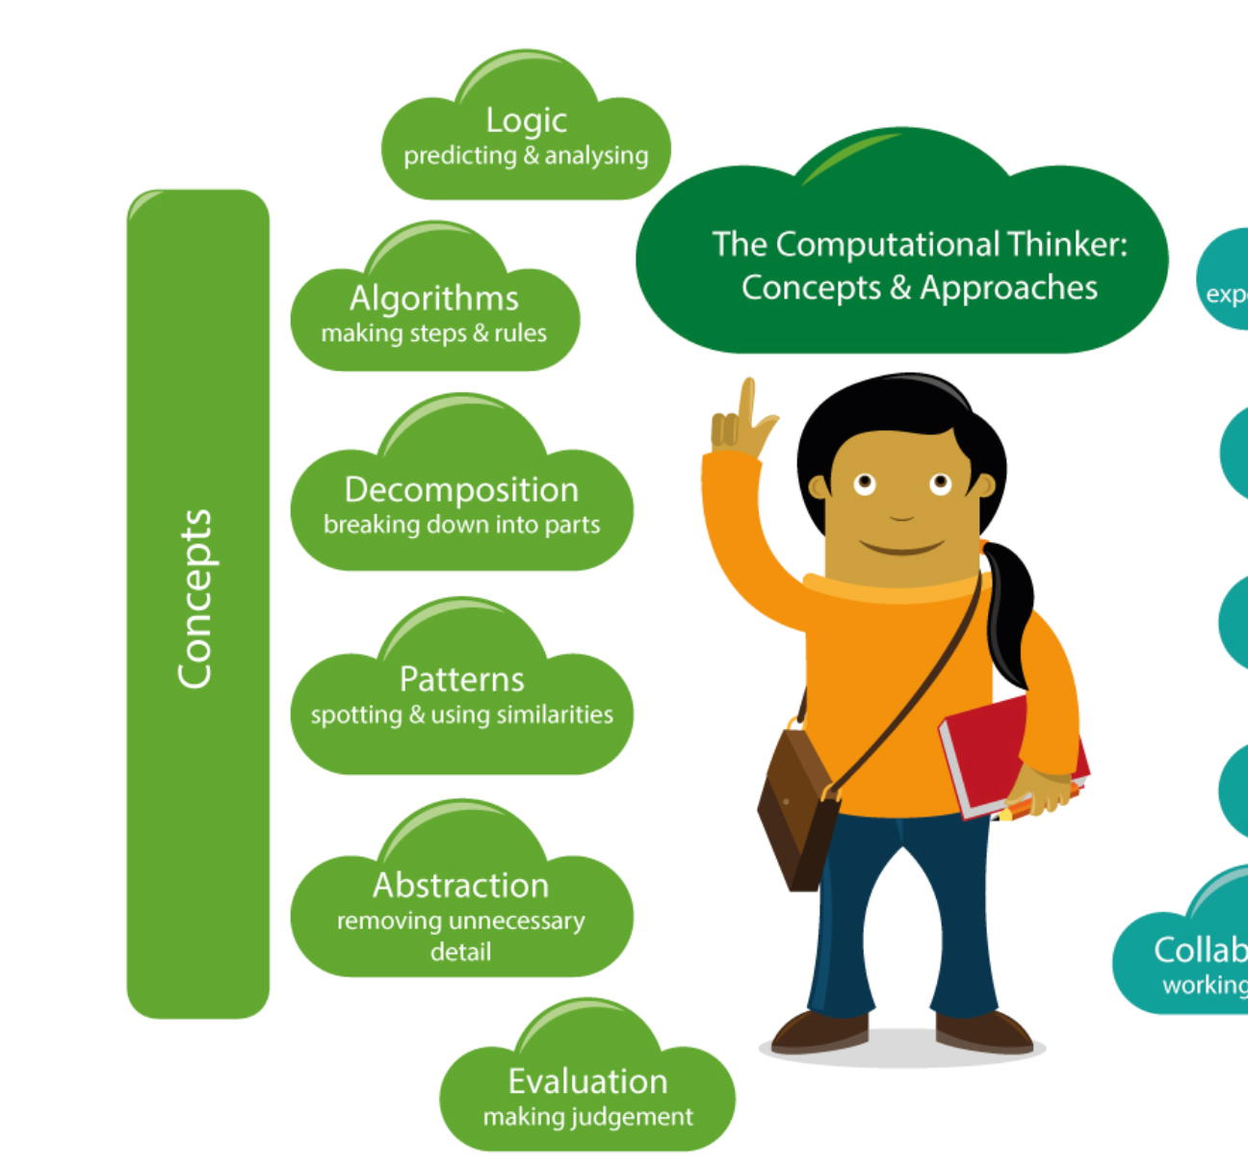
OO and CT
Decomposition
  Program made up of classes
  … objects work together
Abstraction
  Class represent an abstraction
  Super-class abstract common behaviour
Patterns
  Inheritance and over-riding
  Patterns of classes
Other words
  Generalisation
  Reuse
From https://barefootcas.org.uk/barefoot-primary-computing-resources/concepts/computational-thinking/

Slide 29
Activity Sheet 20Q:
More Exercises

Slide 30
Concepts and Summary

Slide 31
OOP
Concepts
Concept | Details
Basic mechanics | Calling a method of an object Class as a template for data Class as a collection of methods
Constructors | Definition and use
Interaction | Object as a value (variable, list item, …) Object as an attribute value (has-a relationship) Object passed as a parameter
Abstraction and modelling | Class as a domain concept Methods (and constructor) have parameters
Inheritance | Superclass and subclasses Constructor called using super() Method inherited or overridden
Prerequisite knowledge: functions & parameters
Prerequisite knowledge: basic mechanisms

Slide 32
Summary
Classes overlap?
  Abstract (or generalise) common behaviour in a superclass
  Specialise in sub-classes
A subclass
  Add attributes (or methods)
  Overrides methods
Always call the constructor

Slide 33
Introduction to Homework

Slide 34
Homework
Task 1
  No more animals!
  Create a new 20Q topic.
  Suggest base on code for Tasks 1-3
Task 2
  Bring the animals back!
  Use the Task 4 code to combine your new topic with animals
  Randomly choose a topic

