Slide 1
Object Oriented Programming in A Level
Session 3: Combining Classes and OO Analysis

Slide 2
Course
Outline
Session | Topics
1 | Use of objects and methods Decomposition and abstraction Aims of learning OOP
2 | Declaring classes Attributes, methods and the constructor
3 | Composition (or Interaction) of classes Classes diagrams; visibility
4 | Inheritance, overriding and polymorphism More class diagrams
5 | Teaching issues Review and practical examples

Slide 3
Recap of Week 2
Creating classes
Class in a file
Class has methods
  Self parameter
  … the object on which method is called
Class has attributes
  Initialised not declared (in Python)
Constructor
  Special name __init__
  Used to create objects
No new syntax this week
Consequence of existing ideas

Slide 4
Two Perspectives on a Class
Perspective 1
A box with buttons (functions or operations or methods)
Perspective 2
A box containing data
(variables, attributes or fields
A class is a template
class
Parameters
class
def f1
def f1
Return
value
data
def f2
def f2

Slide 5
Data Hiding (Encapsulation)
Different ways to represent complex data
Example: shopping list
  List of pairs: (item string, amount integer)
  Dictionary: map from item to amount required
Data hiding principle: the user should not know the representation
  It may change
  Instead, provide functions (or ‘operations’)
More Words
Function: Python has these
Method: word from OOP theory; some functions are methods
Operation: this word is used in OO analysis

Slide 6
Session Aim and Outline
Aims
Outline
Understand the different ways classes interact
Be able to use UML class diagram for modelling and design
Be able to write OO programs with several classes
Pictures of classes – UML
Practical break [short]
  Finding classes – analysis
Discussion: What is Design?
Objects as attributes
Practical break [longer]
  Programming
More UML
Concepts and syllabus – discussion

Slide 7
Drawing Pictures of Classes
UML Class Diagrams
Introduction to Object-Oriented Analysis using UML
What is UML?

Slide 8
Picture of Classes
Infomation hiding:
Hide the attributes
Use the operations
A class has
  A name
  Attributes (i.e. variables)
  Operations (i.e. methods)
Friend
Class name
name
phone number
setNumber
sendText
Attributes
Operations

Slide 9
Object: An Instance of a Class
A class is a template
An object is a particular instance of a class
  Different data (attribute values)
  Same code
alice: Friend
bob: Friend
name = "Alice"
phone number = 123
name = "Bob"
phone number = 456

Slide 10
Role of (UML) Class Diagrams
Class diagram models a problem
Class diagram describes a program
class name
attribute1
attribut2
method1
method2
Program Code
Problem

Slide 11
Practical Break
Identify the classes and attributes in the following example
Draw pictures of the classes
Each form has a teachers and a classroom. The pupils are divided between the forms, so that everyone is in exactly one form. The pupil's age at the start of the academic year is recorded.

Slide 12
Discussion: What is Design?
If you a designing a program what will you produce?

Slide 13
Program Structure versus Design Style
Pseudo
initialise x
for every x
find
print
If & loops
x =
while x > :
y =
print
Flow
x = 3
x>
print
Functions
main
Function def
init
process
save
Function def
Call Graph
Main program
Initialise vars
Call functions
input
…
Town
Classes & objects
Friend
name
location
getDirect
setRating
class Friend:
def __init__()
def m1(a, b):
name
phone num
setNumber
sendText
class Town:
def __init__()
def m1(a, b):
Class Diagram
Main program
Create obj
Call methods

Slide 14
Program Structure versus Design Style
If & loops
x =
while x > :
y =
print
Program grows more complex in structure
Simpler elements remain
  If & loop → part of function
  Method → part of class
Functions
Function def
Function def
Main program
Initialise vars
Call functions
Classes & objects
class Friend:
def __init__()
def m1(a, b):
class Town:
def __init__()
def m1(a, b):
Main program
Create obj
Call methods

Slide 15
Program Structure versus Design Style
Pseudo
initialise x
for every x
find
print
Design becomes more abstract
  Between problem and solution
Concert design may be needed
Design notations only show some information
x = 3
Flow
x>
print
main
init
process
save
Call Graph
input
…
Town
Friend
name
location
getDirect
setRating
name
phone num
setNumber
sendText
Class Diagram

Slide 16
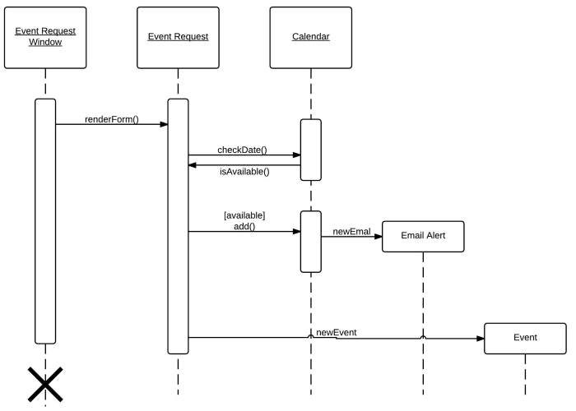
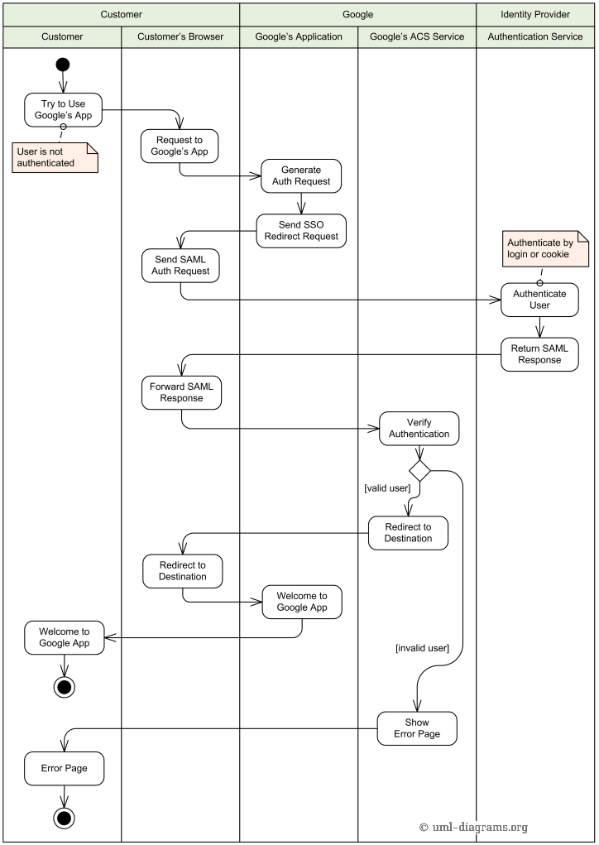
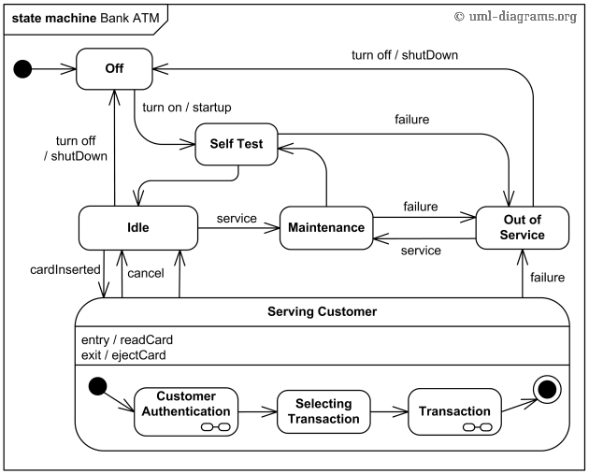
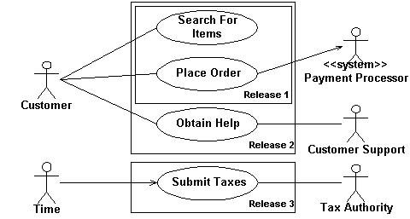
What is UML?
Unified Modelling Language
  Diagram language for analysis and design
  Many diagram types
Less popular than it was

Slide 17
Objects as Attributes
Objects of one class can be the value of an attribute in another class

Slide 18
What is a Pupil in a Form?
An attributes: the form has many pupils
A class: a Pupil has attributes
Relationship: Pupil in a Form
Form
Pupil
teacherName
roomNumber
1 in *
name
age
Form as many pupils
Pupil in one Form

Slide 19
Basic Declarations
class Pupil:
def __init__(self, name):
self.name = name
self.age = -1
def getName(self):
return self.name
def setAge(self, age):
self.age = age
def getAge(self):
return self.age
from Pupil import Pupil
class Form:
def __init__(self, teacher):
self.teacher = teacher
self.room = None
self.pupils = []

Slide 20
Adding and Listing
Enhance basic declaration
  Add a pupil to a form
  List pupils in form
Example of use
from Form import Form
f = Form("Mr Smith")
f.addNewPupil()
f.addNewPupil()
print(f.listRoll())
Pupil name> Andy
Pupil age (or RTN)> 4
Pupil name> Billy
Pupil age (or RTN)> 5
Andy
Billy
Output
testForm.py

Slide 21
Listing Pupils
List names of pupils in form
def listRoll(self):
fl = ""
for p in self.pupils:
fl = fl + p.getName() + "\n"
return fl
p is a Pupil object
Call Pupil method on p
Return string

Slide 22
Adding a Pupil
in Form Class
Add a Pupil object
Get pupil details
Create object
… add
def addPupil(self, p):
self.pupils.append(p)
p is a Pupil object
Append method of list
in Form Class
def addNewPupil(self):
pName = input("Pupil name> ")
if len(pName) == 0:
return
p = Pupil(pName)
pAge = input("Pupil age (or RTN)> ")
if len(pAge) > 0:
p.setAge(int(pAge))
self.addPupil(p)
Skip if name empty
Skip if age empty
Method of Pupil
Method of Form

Slide 23
Finding a Pupil
Find a pupil
  Returns an object
Is it a copy?
Algorithm?
# Find a pupil by name
def findPupil(self, name):
for p in self.pupils:
if p.getName() == name:
return p
return None
p is a Pupil object
Get name of p
Return object

Slide 24
Practical Break
Enhance the Form

Slide 25
Limitation of Form / Pupil Example
Database-like example
  Obvious classes and attributes
  Application about information storage and retrieval
Useful to learn about how classes interaction
Not realistic software design
Not challenging problem analysis (choosing classes)

Slide 26
More UML
Relationships between classes
Visibility

Slide 27
Knows-About or Has-A Relationship
A Form contains many Pupils
Pupils are in a Form
Visibility
  Private: ‘-’
  Public: ‘+’
Form
Pupil
-teacherName
-roomNumber
1 in *
-name
-age
+addNewPupil
+addPupil
+listRoll
+findPupil
+getAge
+setAge
+getName

Slide 28
Association, Aggregation and Composition
Association: a relationship between classes (not inheritance)
Aggregation: part-of e.g. a wheel is part of a car
Composition: non-shared aggregation
A
A
Composition
B
B
Aggregation

Slide 29
Concepts and Syllabus Check
What we learnt?
Are these concepts important?

Slide 30
OOP
Concepts
Concept | Details
Basic mechanics | Calling a method of an object Class as a template for data Class as a collection of methods
Constructors | Definition and use
Interaction | Object as a value (variable, list item, …) Object as an attribute value (has-a relationship) Object passed as a parameter
Abstraction and modelling | Class as a domain concept Methods (and constructor) have parameters
Inheritance | Superclass and subclasses Constructor called using super() Method inherited or overridden
Prerequisite knowledge: functions & parameters
Prerequisite knowledge: basic mechanisms

Slide 31
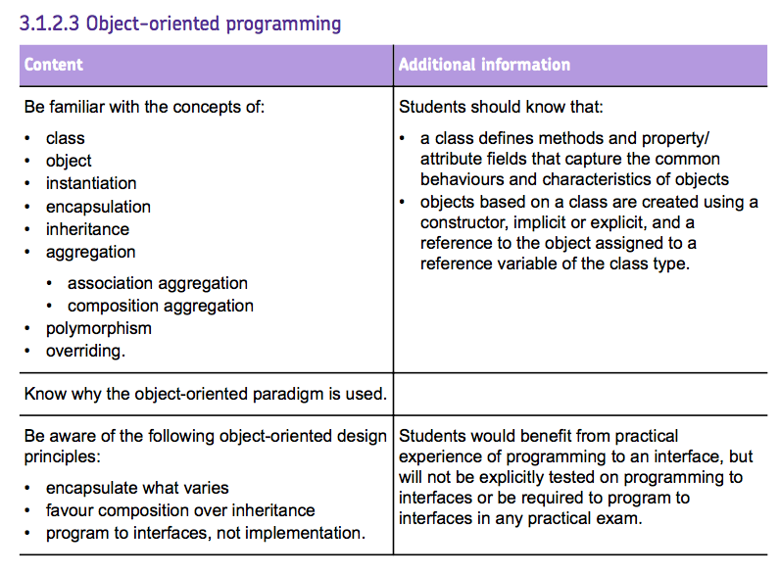
Specification check
AQA

Slide 32
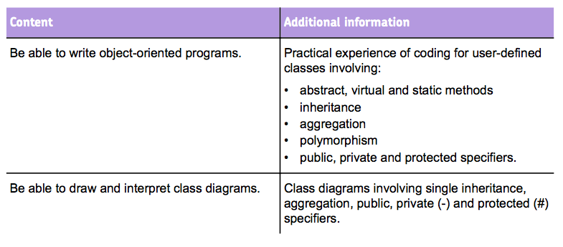
Specification check – AQA

Slide 33
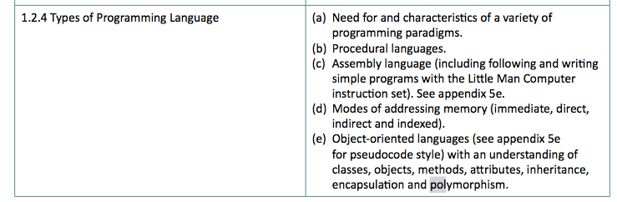
Specification Check – OCR

Slide 34
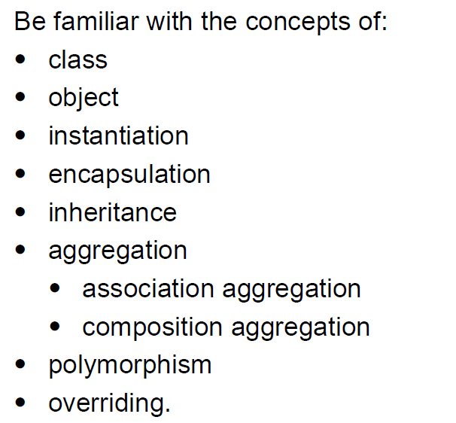
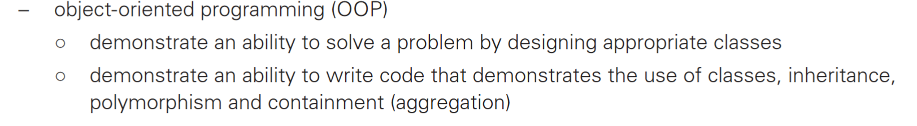
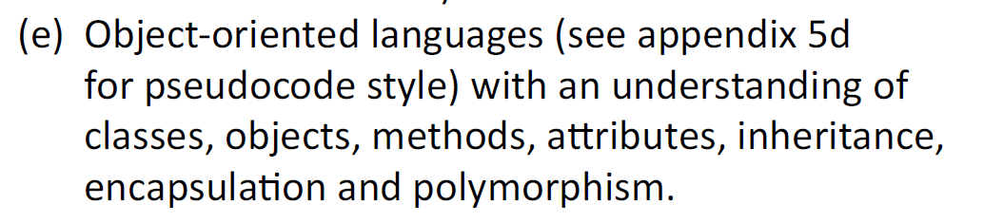
Specification check
From AQA
From CIE
From OCR
( plus other details … )

Slide 35
Discussion
Why not inheritance first?
  Inheritance is more prominent in syllabus
  Should it be covered first?
Are the interaction concepts required at A level?
  Certainly needed of real use of OOP

Slide 36
Introduction to Homework
Enhance the form example
Apply same concepts with more classes

Slide 37
Test
Mark
-topic
-max
1 awarded *
-score
A test is set for a form
A form can have several tests
Mark is awarded for a test
Mark is achieved by a pupil
*
achieved
1
*
setFor
1
Pupil
Form
1 in *
-name
-age
-roomNumber
1
teaches
1
Teacher
-name

Slide 38
Summary and Route Map

Slide 39
Summary
Route Map
Decomposition into classes → classes interact
  Object as an attribute
  Object passed as a parameter
  … object returned
UML class diagrams
  Show relationships between classes
  Analysis and design
Interaction is had to understand at first
Inheritance as a new relationship between classes
  New syntax, vocabulary and concepts
  Only important in some OOP applications
Extend UML class diagrams for inheritance

