Slide 1
Object Oriented Programming in A Level
Session 2: Class Declaration

Slide 2
Course
Outline
Session | Topics
1 | Use of objects and methods Decomposition and abstraction Aims of learning OOP
2 | Declaring classes Attributes, methods and the constructor
3 | Composition of classes Classes diagrams; visibility
4 | Inheritance, overriding and polymorphism More class diagrams
5 | Teaching issues Review and practical examples

Slide 3
Recap of Week 1
Explored ideas of abstraction and decomposition
  Many mechanisms for decomposition – e.g. functions, modules, classes
  Decomposition needs practice – more than just learning the mechanisms
  Guidance: decompose using abstractions
Emphasis on continuity of OOP
File: example of an abstractions
  Hides information (e.g. location on disk)
File: example of using objects
  Create an object – e.g. open function
  Act on object – e.g. write method
Where objects / classes come from?
How do I declare my own classes?

Slide 4
Person versus Nearly Person
Method / Example | Description
Person("John") | Constructor for Person
p.setJob("brickie") | Set the job the person does
p.setLocation("Sutton") | Set the place
p.setDriver(False) | Set the driving status
p.describe() | Return a report string
Two implementations of an abstraction
  OOP, using a class
  Non-OOP, functions in a module
Method / Example | Description
newPerson("John") | Constructor for Person
setJob(p, "brickie") | Set the job the person does
setLocation(p, "Sutton") | Set the place
setDriver(p, False) | Set the driving status
describe(p) | Return a report string

Slide 5
Session Aim and Outline
Aims
Outline
Understand the difference between classes and objects
Be able to write simple class declarations, with constructor
Understand the difference between objects and attributes
Recap modules and files
Declaring classes and methods
Discussion: Python Pro/Cons
Constructors and fields
Discussion: are classes easy to find?
Collecting objects

Slide 6
Recap: Modules and Import
Organising a Python Program into Files

Slide 7
Python Modules
A module is a file containing function definitions (and statements)
If you import the module you can use the functions
Module name is file name
def f(name):
return "hello "+ name
def g(i):
return i+1
File lib.py
Import
Prefix
import lib
print(lib.f("bill"))

Slide 8
Import As
Module name prefix can be avoided
Import only some definitions
def f(name):
return "hello "+ name
def g(i):
return i+1
File lib.py
Import without prefix
No Prefix
from lib import f
print(lib("bill"))

Slide 9
The Person ‘Class’
Provide a Person class to use
… discuss implementation later

Slide 10
The Person Class
Method / Example | Description
p = Person | Construct a new person
p.setName("Bill") | Set the person name
p.setJob("brickie") | Set the job the person does
p.describe() | Return a report string
(Initially without
constructor)
File name is
class name
class Person:
# Initially, there is no constructor
def setName(self, name):
self.name = name
def setJob(self, job):
self.job = job
def describe(self):
s = "{0} works as a {1}"
return s.format(self.name, self.job)
File Person.py

Slide 11
Defining a Method in a Class
class Person:
# Initially, no constructor
def setName(self, name):
self.name = name
def setJob(self, job):
self.job = job
Two parameters
Parameter 1
Parameter 2
person-ex1.py
from Person import Person
p = Person()
p.setName("Bill")
p.setJob("plumber")
print(p.describe())
Name within the object
Import: from file import classname

Slide 12
Self
class Person:
# Initially, no constructor
def setName(self, name):
self.name = name
Self is NOT a keyword
ALWAYS use 'self'
To set a name in an object of the Person class ….
… set the ‘name’ field (or attribute) of the object ….
… to the value given as a parameter

Slide 13
Attribute Getters and Setters
We can have a method
  To set an attribute
  To get the value of an attribute
WARNING
  Do not always need getters and setters
  Not a good way to create abstractions
class Person:
# No constructor
def setName(self, name):
self.name = name
def getName(self):
return self.name

Slide 14
Practical Break
Task 1: Enhance the Person Class
Task 2: Create a new Pet Class

Slide 15
Discussion: What Are the Pros/Cons for Python for Teaching?
We teach programming principles
... we work with specific language

Slide 16
Constructor
Before we can ‘act’ on an object
PROBLEM
  New person is empty
  Error if we describe
This is a default constructor: it is created automatically
from Person import Person
p = Person()
p.setName("Bill")
p.setJob("plumber")
print(p.describe())

Slide 17
Defining a Constructor
class Person:
def __init__(self, n):
self.name = n
def getName(self):
return self.name
Constructor
Has a special name
May have parameters
Don’t forget ‘self’
Constructor name
Constructor parameter

Slide 18
Attributes – Good Practice
Attributes are not declared
  In Python, nothing is!
Good practice to initialise all attributes in the constructor
  Getters do not fail
  Clear what the attributes are
  Do not add more
class Person:
def __init__(n):
self.name = n
self.job = "unknown"
self.location = "unknown"
def getName(self):
return self.name
def getJob(self):
return self.job
def getLocation(self):
return self.location

Slide 19
Python Issues for Teaching OOP
Usual OOP
Python
The attributes are declared
A class has a fixed set of attributes
Attributes can be hidden: access only by methods
Nothing is declared
Attributes appear when assigned to
Hiding is not enforced
Use Python to teach OOP
Avoid some Python tricks
Use only a subset
… explain later

Slide 20
Practical Break
Task 3: Add a constructor
Task 4: Add getters

Slide 21
Finding Classes
Are classes ‘obvious’?

Slide 22
Two Examples: Find the Class, Object, Attributes
I have a red Ford car. It is a hatchback with 4 doors and 1600cc. Luckily it is petrol not diesel. I prefer manual gearbox. My wife has a blue Merc: a coupe with 2 doors and no space in the back. It is not very practical but she says that a 2.5litre engine feels good and the automatic gearbox makes it easy to drive.
Have you seen the latest model from Jaguar, the XK5? You would never have guessed that it’s a hybrid. I think that Charlie has a silver one. Anne has a new car too, a Merc T2000, also in silver. I am not sure which is better: I like the look of the Merc but of course the Jag uses less fuel – up to 65 mpg. Bill has one with the self-driving features added – pricey, but he says it makes t much easier, given what a bad driver he is.

Slide 23
Discussion: Finding Classes
Is the distinction between class, object and attribute obvious in real-world?

Slide 24
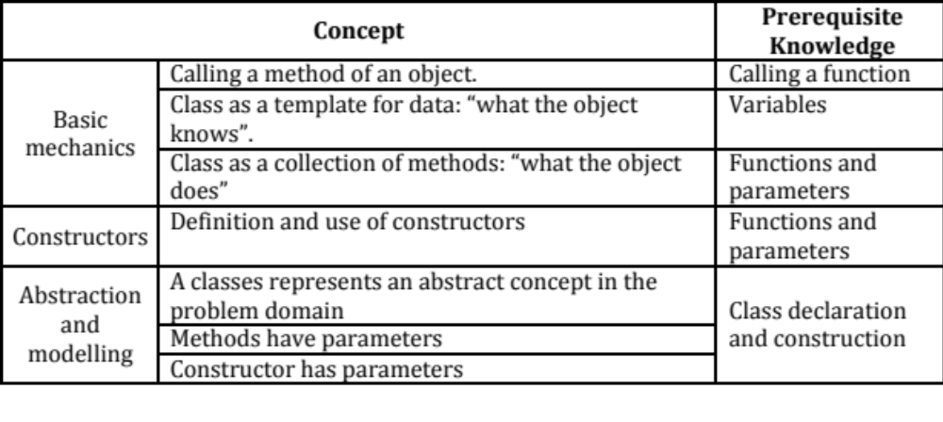
Concepts

Slide 25
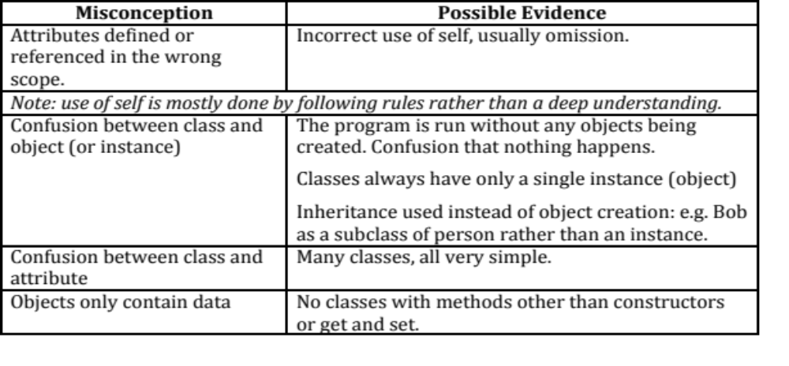
Potential Misunderstandings

Slide 26
Collecting Objects
We can put objects in lists
Must have the correct mental model for assignment

Slide 27
Collecting Object Example
from Person import Person
people = []
bill = Person("Bill")
people.append(bill)
clare = Person("Clare")
people.append(clare)
Create a list of people
Create two Person objects
Add to list

Slide 28
Collecting Object Example
from Person import Person
people = []
bill = Person("Bill")
people.append(bill)
clare = Person("Clare")
people.append(clare)
bill.setJob("plumber")
clare.setJob("programmer")
Create a list of people
Create two Person objects
Add to list
Does this work?
Why no need to add to list again?

Slide 29
Understanding Python Assignment
Copy
  Variable has value
  Assignment copies value
Reference
  Variable has reference
  Assignment copies reference
References → sharing
In Python
  All variables are references
  But no difference when immutable
people = [ , ]
name = Bill
job = plumber
name = Clare
job = programmer
bill =
clare =

Slide 30
Introduction to Homework

Slide 31
Care of Cats
Cats eat, sleep and (sometimes) purr
Choose a cat:
1: Paws
2: Whiskers
Cat number> 1
[P]at, [F]eed, [S]leep, [C]heck> p
Purrrrrrrr!
Choose a cat:
1: Paws
2: Whiskers
Cat number> 1
[P]at, [F]eed, [S]leep, [C]heck> p
Paws is tired. SCRATCHES you
Choose a cat:
1: Paws
2: Whiskers
Cat number> 1
[P]at, [F]eed, [S]leep, [C]heck> s
Paws goes to sleep
Choose a cat:
1: Paws
2: Whiskers
Cat number> 2
[P]at, [F]eed, [S]leep, [C]heck> p
Whiskers is tired. SCRATCHES you
Choose a cat:
1: Paws
2: Whiskers
Cat number> 2
[P]at, [F]eed, [S]leep, [C]heck> s
Whiskers goes to sleep
Choose a cat:
1: Paws
2: Whiskers
Cat number> 1
[P]at, [F]eed, [S]leep, [C]heck> c
Paws is asleep
Choose a cat:
1: Paws
2: Whiskers
Cat number> 1
[P]at, [F]eed, [S]leep, [C]heck> p
You have woken Paws
Paws is hungry. BITES you
Choose a cat:
1: Paws
2: Whiskers
Cat number> 2
[P]at, [F]eed, [S]leep, [C]heck> f
YOU ARE STUPID! Can't you see Whiskers is asleep
Choose a cat:
1: Paws
2: Whiskers
Cat number>

Slide 32
Cat Rules
A Cat Can | When
Eat | When it is awake
Sleep | When it is awake
Pat (i.e. be patted) | Anytime. If it is asleep, it wakes up. If it is hungry, it bites you; if it is tired it scratches you. Otherwise it purrrrrrs
be tired | If it has been awake for longer than it’s last sleep
be hungry | If it has not been fed for a while

Slide 33
Issues and Suggestions
Passage of Time
  Behaviour depends on time (tired, hungry)
  Time variable in interface – incremented on every interaction
  Cat methods have time parameter
  Cat class has some time attributes – e.g. time last woke up
Two files
  Cat class and interface
Develop incrementally
  Optional starter provide
  Add features
More features – get more cats

Slide 34
Summary

Slide 35
Summary
We can create new classes
  Methods
  Constructor and attributes
Python issues: nothing declared
  Enabled us to treat constructors second
Collecting objects
  It works
  … need to understand assignment and references

