Slide 1
Object Oriented Programming in A Level
Session 1: Introduction and Motivation

Slide 2
Session Aim and Outline
Outline
Aims
Using classes: Text Files
Discussion: Information Hiding
Reflection : Decomposition and Abstraction
Discussion: Learning to Use Functions
Using classes: The Person Class
Reflection: How versus Why
Person with / without classes
Discussion: Do We Need to Know?
Understand the use of classes
  Be aware of the classes we already use
Be able to motivate the use of classes and objects
Be able to explain OOP in relations Abstraction and Decomposition

Slide 3
Text Files
An example of classes and object that are familiar

Slide 4
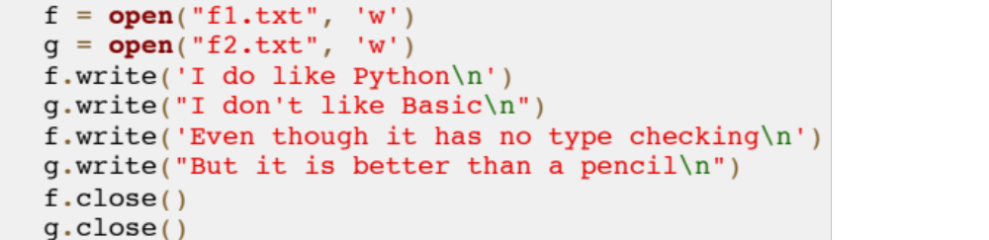
The File Object
This is variable. What is the type of its value?
Familiar
code?
What does
the code
do?
fileWrite.py
Write method: i) which file is written to? ii) what is written?

Slide 5
Objects and Methods
Name | Type | Description
f | Variable; object of ‘File’ class | A text file on disk
write | Method of ‘File’ class | Write a string to file
close | Method of ‘File’ class | Close the file
open | Function | Create a ‘File’ object from an existing or new file

Slide 6
Discussion: Abstraction and ‘Information Hiding’
What is in the File Object? I.e. What information is (probably) being hidden?
  This is an Operating System question
Why is it better to hide this information?
A good abstraction hides information that is not needed (here)

Slide 7
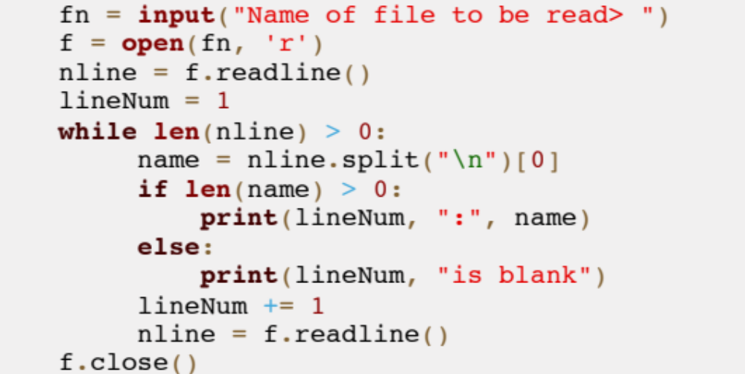
The File Object – Reading
Example of reading from a file
fileRead.py
Input a string
Use the string as a file name
Read a line: zero length at EOF
Discard the newline: split is a method of the String class

Slide 8
Summary: Familiar Objects
Text files and strings are example of familiar objects
  Library contains methods
Representation is hidden
Method act (read or update) on objects
The string is an object too!!!
f.write("this is a string")
The object to be acted on
A second parameter: the string to write
The method: implements the action

Slide 9
Practical Break – Task 1 (& Task 2)
Compete a table of identifiers
Name | Type
fn | Is it an object? Is it a method?
f
open
nline
lineNum
len
….
fileRead.py

Slide 10
Reflection: Abstraction and Decomposition
Motivation: What are we trying to achieve with classes?

Slide 11
Liskov and Guttag 1986 – Decomposition
A very small program consisting of no more than a few hundred lines can be implemented as a single monolithic unit.
As the size of the program increases however such a monolithic structure is no longer reasonable because the code becomes difficult to understand.
Instead the program must be decomposed into a number of independent small programs called modules that together provide the desired function.
… how to decompose large programming problems into small ones … what kinds of modules are most useful … [how] modules can be combined to solve the original problem

Slide 12
Liskov and Guttag 1986 – Decomposition
Our goal in decomposing a program is to create modules that are themselves small programs that interact with one another in simple well defined ways.
If we achieve this goal, different people will be able to to work on different modules independently …
In addition during program modification and maintenance it will be possible to modify some of the modules without affecting all of the others
Furthermore, [some] problems are difficult to decompose properly. The most common problem is creating individual components that … do not combine to solve the original problem.

Slide 13
Liskov and Guttag 1986 – Abstraction
Abstraction is a way to do decomposition productively by changing the level of detail to be considered
When we abstract from a problem we agree to ignore certain details in an effort to convert the original problem to a simpler one.
The paradigm of abstracting and then decomposing is typical of the program design process. Decomposition is used to break software into components that can be combined to solve the original problem; abstractions assist in making a good choice of components.
We alternate between the two processes until we have reduced the original problem to a set of problems we already know how to solve.

Slide 14
Discussion: Teaching Functional Decomposition
You have already learnt about functions
  How they work
  How to use them
Is it easy or hard to learn about functions?
  What aspects are easier?
  What aspects are harder?

Slide 15
The Person ‘Class’
Provide a Person class to use
… discuss implementation later

Slide 16
Using a Person Abstraction
We are running an agency. A person has:
  A name, a location, a job and can/cannot drive
  This is an Abstraction – suitable for Context
Here is a use:
Import the declarations
agency.py
from Person import *
jo = Person("Jo")
bert = Person("Bert")
bert.setJob("plumber")
bert.setLocation("Pinner")
bert.setDriver(True)
print(bert.describe())
print(jo.describe())
Create Person: Special ‘constructor’ function
Methods to update the ‘attributes’
Methods gives a description

Slide 17
Using a Person Abstraction
We are running an agency. A person has:
  A name, a location, a job and can/cannot drive
  This is an Abstraction – suitable for Context
Method / Example | Description
Person("John") | Constructor for Person
p.setJob("brickie") | Set the job the person does
p.setLocation("Sutton") | Set the place where they are based
p.setDriver(False) | Set the driving status
p.describe() | Return a report string

Slide 18
Practical Break
Task 3: Better Agency

Slide 19
Reflection: How versus Why
Understand the aims of teaching OOP

Slide 20
Two Different Aims for Learning OOP
How
Why
How to use classes
  Create a new object
  Use objects as variables (e.g. in a list)
How to create (declare) new classes
  Add method and attributes
  … and constructors
How to create sub-classes (inheritance)
Decomposing a problem using classes
  Which classes to use?
  What makes a good class?
How to do good abstractions
  Analysis of the problem
How classes can interact
  Software design

Slide 21
Person Abstraction without a Class
OOP is not mysterious
… similar things can already be done

Slide 22
Nearly Person
def newPerson(name):
return (name,None,None,None)
def setJob(p, job):
return (p[0], job, p[2], p[3])
def setLocation(p, location):
return (p[0], p[1], location, p[3])
def setDriver(p, driver):
return (p[0], p[1], p[2], driver)
Represent Person as a Tuple
Method / Example | Description
newPerson("John") | Constructor for Person
setJob(p, "brickie") | Set the job the person does
setLocation(p, "Sutton") | Set the place
setDriver(p, False) | Set the driving status
describe(p) | Return a report string

Slide 23
Nearly Person
def describe(p):
l = p[2] # location
if l == None:
l = "unknown"
j = p[1] # job
if j == None:
j = "unknown"
if p[3] == None: # driver
d = "may be a driver"
elif p[3]:
d = "is a driver"
else:
d = "is not a driver"
return p[0] + " lives in " + l + \
", works as " + j + " and " + d
Represent Person as a Tuple
Method / Example | Description
newPerson("John") | Constructor for Person
setJob(p, "brickie") | Set the job the person does
setLocation(p, "Sutton") | Set the place
setDriver(p, False) | Set the driving status
describe(p) | Return a report string

Slide 24
Person versus Nearly Person
Method / Example | Description
Person("John") | Constructor for Person
p.setJob("brickie") | Set the job the person does
p.setLocation("Sutton") | Set the place
p.setDriver(False) | Set the driving status
p.describe() | Return a report string
Compare
  OOP, using class
  Non-OOP, using tuple
Method / Example | Description
newPerson("John") | Constructor for Person
setJob(p, "brickie") | Set the job the person does
setLocation(p, "Sutton") | Set the place
setDriver(p, False) | Set the driving status
describe(p) | Return a report string

Slide 25
Practical Break
Task 4: Agency for Nearly Person

Slide 26
Class Declaration
def newPerson(name):
return (name,None,None,None)
def setJob(p, job):
return (p[0], job, p[2], p[3])
def setLocation(p, loc):
return (p[0], p[1], loc, p[3])
class Person:
def __init__(self, name):
self.name = name
self.job = None
self.location = None
self.drives = None
def setJob(self, job):
self.job = job
def setLocation(self, loc):
self.location = loc

Slide 27
Discussion: Is It Important to Know Why?
Understand the aims of teaching OOP

Slide 28
Discussion
Does it matter to know why we learn OOP?
  It is in the syllabus
Is motivation a) important b) real?
  Does the analogy with learning functions more real?
Is it useful to distinguish different aims in learning OOP?

Slide 29
Course Outline
Exam board syllabus
Topics to cover

Slide 30
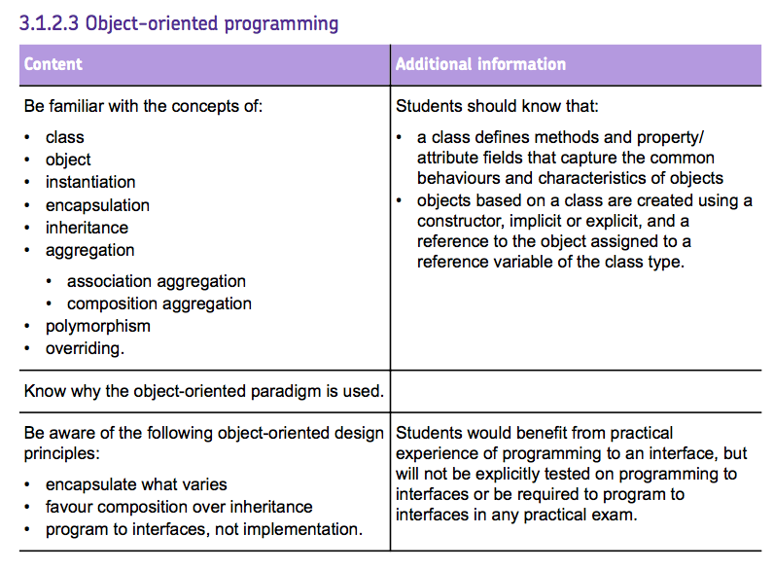
Specification check
AQA

Slide 31
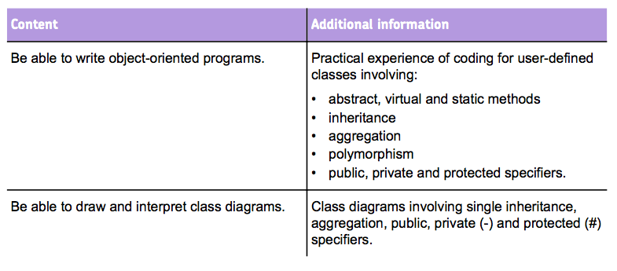
Specification check – AQA

Slide 32
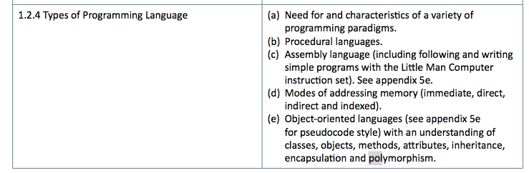
Specification Check – OCR

Slide 33
Course
Outline
Session | Topics
1 | Use of objects and methods Decomposition and abstraction Aims of learning OOP
2 | Declaring classes Attributes, methods and the constructor
3 | Composition of classes Classes diagrams; visibility
4 | Inheritance, overriding and polymorphism More class diagrams
5 | Teaching issues Review and practical examples
Recap functions ?
Vital prerequisite

Slide 34
Summary

Slide 35
Summary
Emphasis continuity between OOP and previous programming
  Use of objects and methods explained
  Abstractions implemented using functions
Program decomposition; problem abstraction
  Distinguish between learning syntax and
  … practicing abstraction and program design
OOP is a new solution to the goal of decomposition using abstraction
  Comparison with use of functions

