Slide 1
Teaching Primary Computing
Diving Deep into Programming
Session 6
Make your own blocks and lists

Slide 2
Course outline
Day 1 | Pedagogy, Sequence, Repetition
Day 2 | Selection, Variables, Make your own blocks and lists
Day 3 | Control/Physical Computing Planning & Assessment

Slide 3
Days outline
Day- Session
9:00- 9:30 | Arrival, registration, drinks
9:30-10:00 | Overview, housekeeping, research & review
10:00- 10:30 | How did it LOA go?
10:30 – 12:00 | Selection
12:00 -1:00 | Lunch
1:00 to 2:30 | Variables
2:30 to 3:00 | Break
3:00 to 4:30 | Make your own blocks & Lists
4:30 – 5:00 | Homework

Slide 4
Objectives of this session
Increase understanding of make your own blocks and lists specifically:
What is a procedure – make your own block
What is a list
Using design to represent procedures/make your own block and lists
Progression of procedures and lists

Slide 5
Make your own blocks and lists
When might running code and predicting what code is used be useful in progression?
(Assessment or learning something new or consolidation or other?)
Instead here – there are code examples for you to read and predict and buggy code for you to fix.
BOTH pedagogy might force READ/Trace/Predict and hopefully UNDERSTAND rather than copy code. WHEN MIGHT THIS GO WRONG – what might the impact be on learners?
Code to predict/read and modify | Code to predict/ read and fix - buggy code
https://scratch.mit.edu/projects/98664570/ | https://scratch.mit.edu/projects/98664691
https://scratch.mit.edu/projects/98664744/ | https://scratch.mit.edu/projects/98664866/
https://scratch.mit.edu/projects/98664903/ | https://scratch.mit.edu/projects/98664969/

Slide 6
Make your own blocks and lists
Pedagogy
Why have I used reading code and fixing buggy code to show you about lists and make your own blocks?
Progression
Would you use the same activity with children to teach about BOTH blocks and lists for the first time?
CPD
Why have I done this with you?
How do you feel about the lack of direct explanation and direct teaching?

Slide 7
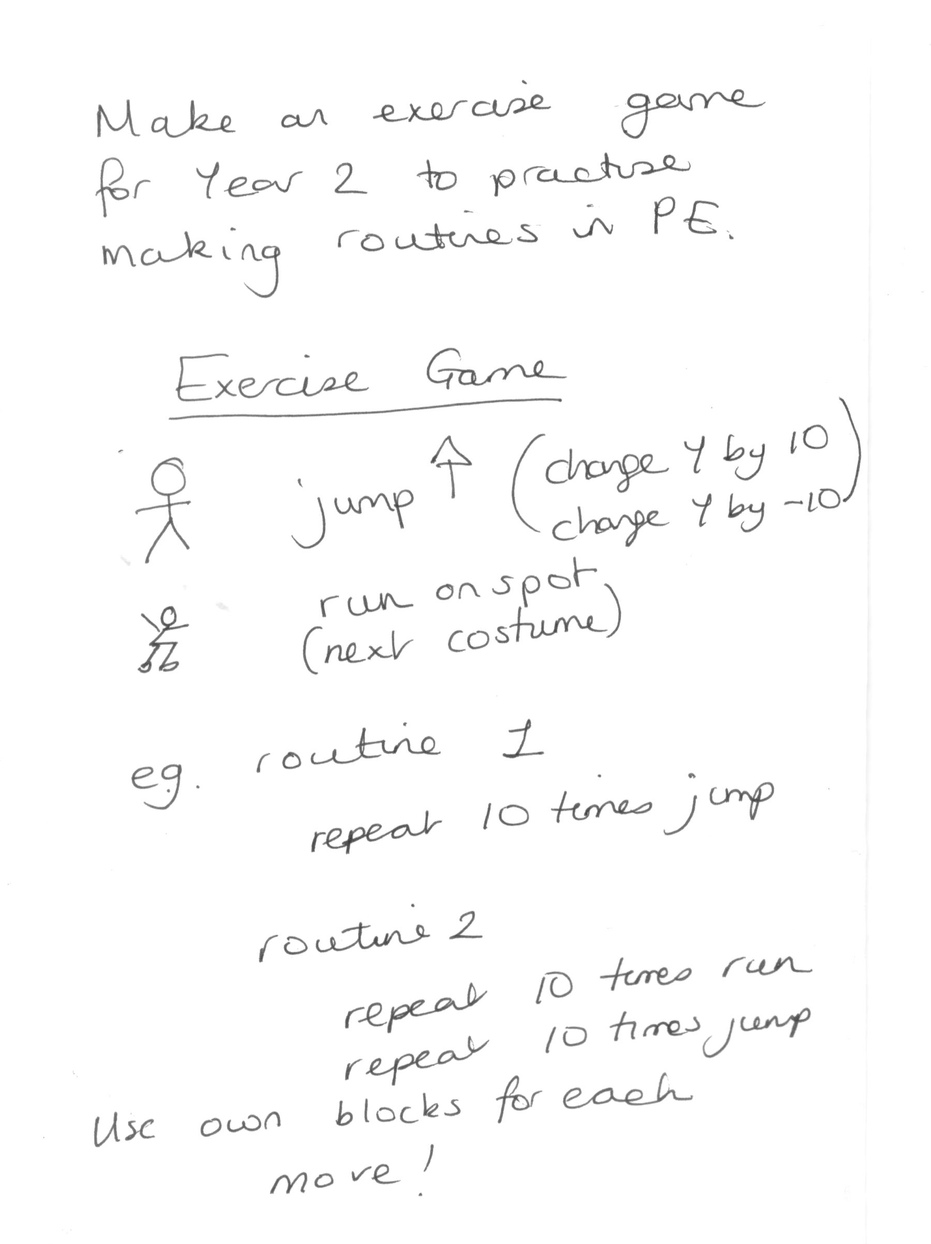
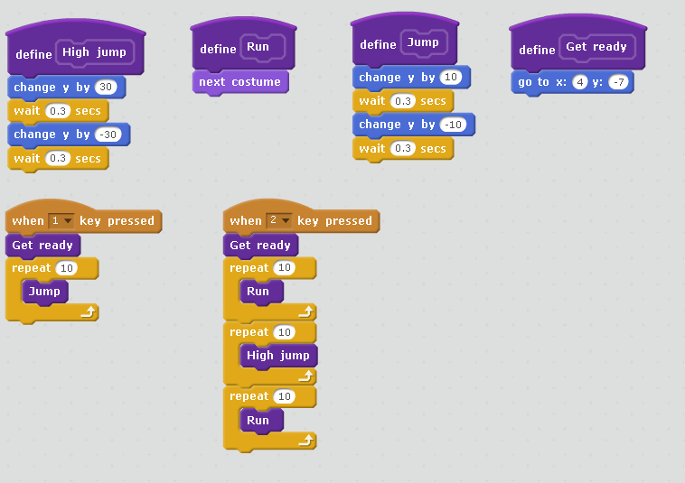
Using design to represent procedures/make your own block and lists
Live coding

Slide 8
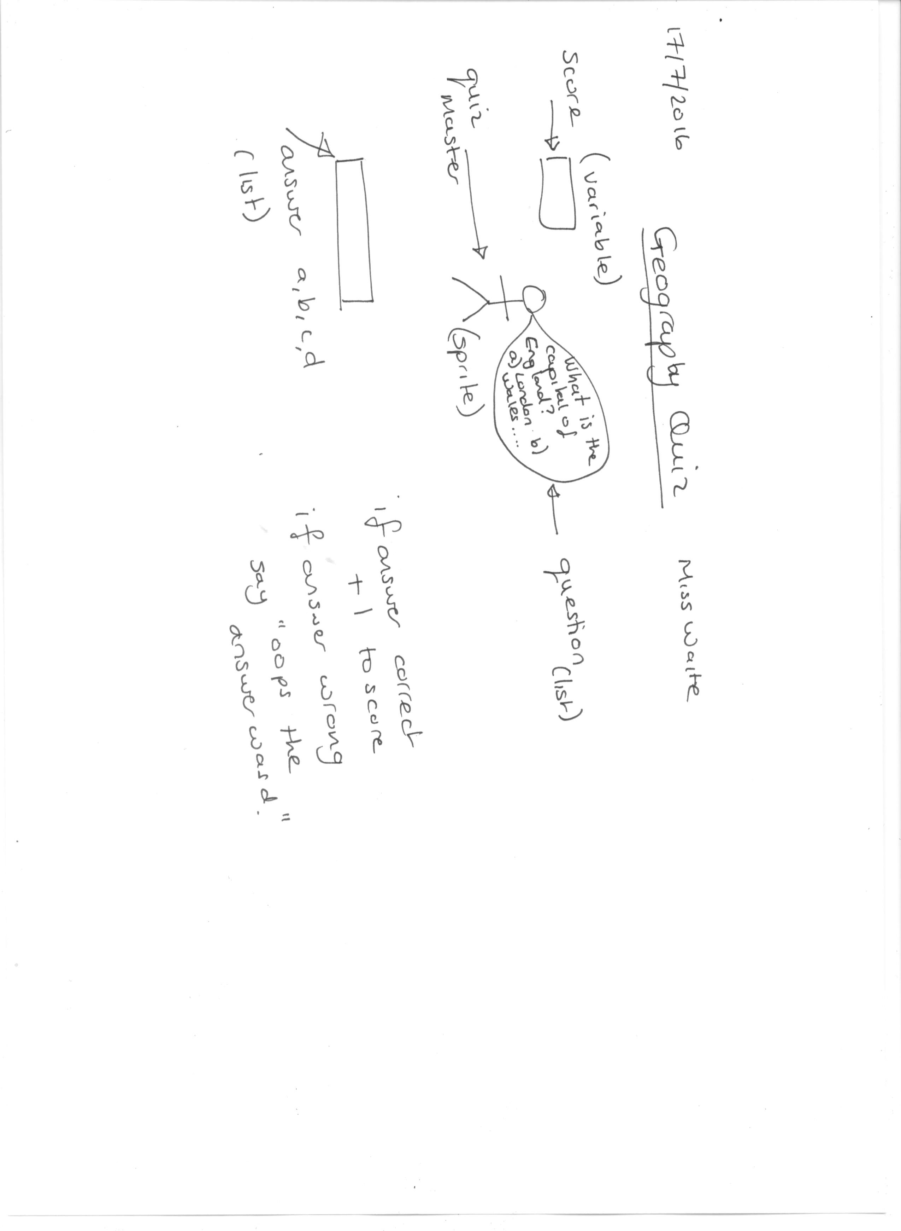
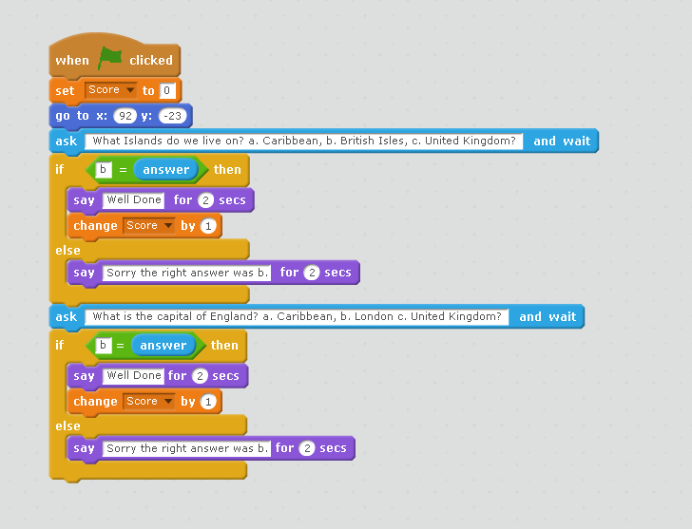
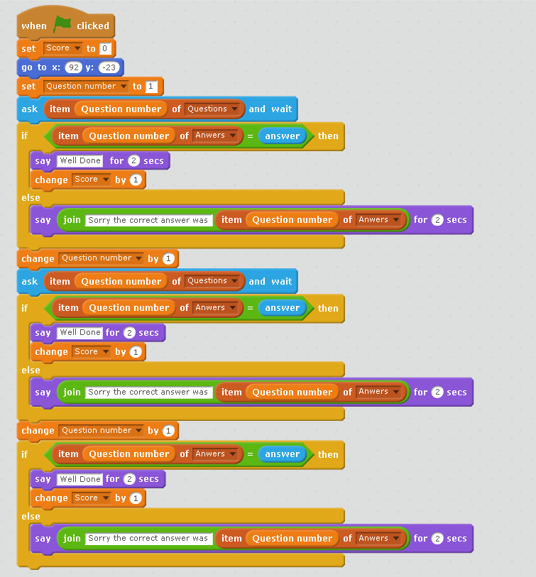
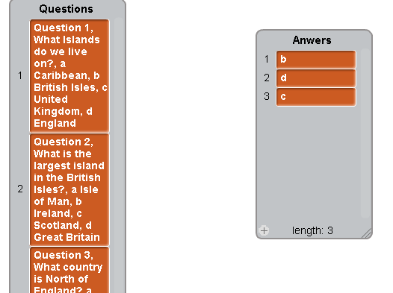
Using design to represent procedures/make your own block and lists

Slide 9
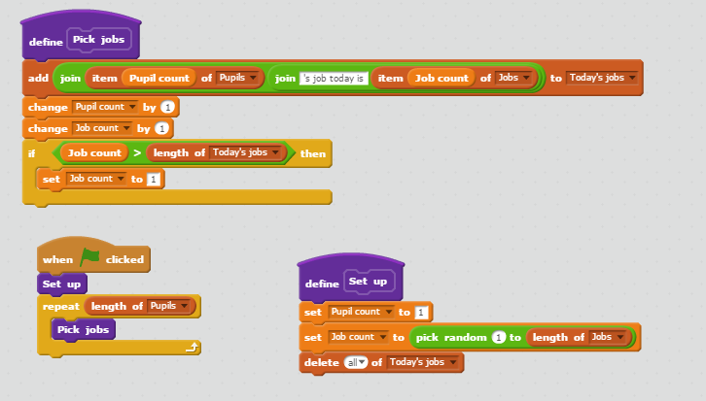
Using design to represent procedures/make your own block and lists
Job picker
Allocate jobs to pupils each day
Algorithm
For each pupil name
allocate a job randomly.
Make three lists
One for the names, one for the jobs and one for the job list.
Add the names and jobs by hand.
Write code for each pupil in the list picks a job for them.
https://scratch.mit.edu/projects/167562917/#player
Based on Phil Bagge’s job picker, based on Mr Lockyer’s idea!

Slide 10
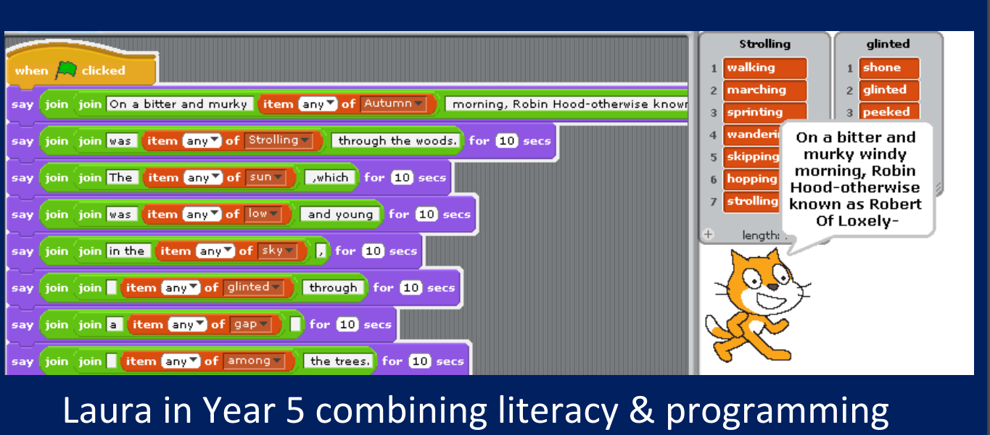

Slide 11
Live coding
Task
Make a simple fortune teller that predicts you will find something unusual.
Lets create the design together.
I am going to cover
A gradually building up complexity and testing as I go.
Making mistakes – resiliency (use of list block)
Adding to a list
Not deleting from the list for initialisation

Slide 12
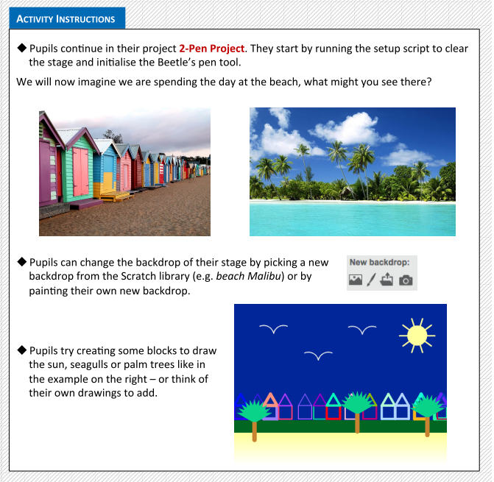
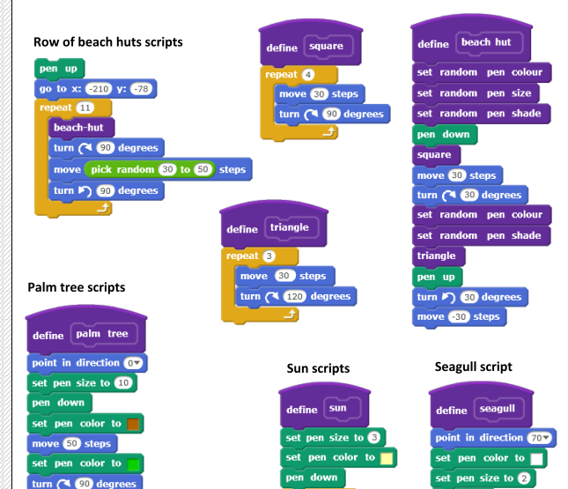
Approaches to teaching own blocks
https://www.ucl.ac.uk/ioe/research/projects/scratchmaths/curriculum-materials/module-2-beetle-geometry/files/SM_Y5_Module_2_Teacher_Materials.pdf
Copy code | Targeted tasks | Shared programming | Guided exploration | Design and code a project | Tinker
Notes:
This is the end assessment activity – and the level of code that we are looking for, well named user created blocks, using a range of pen command, move commands, repeats showing an understanding of shape, use of coordinates, positive and negative … How might we teach this

Slide 13
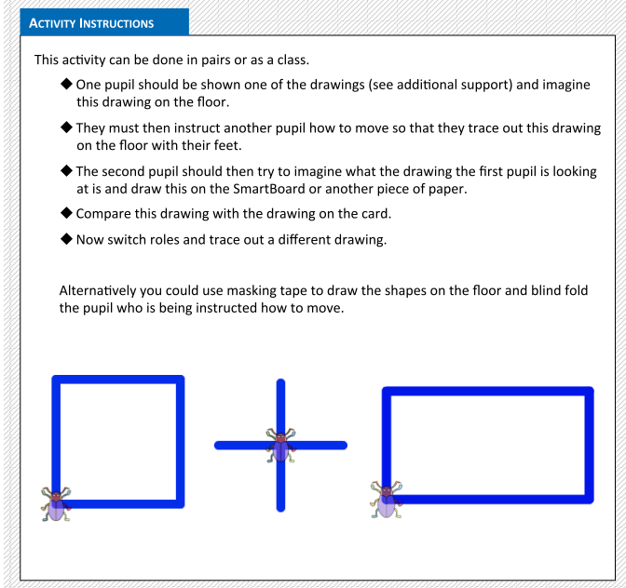
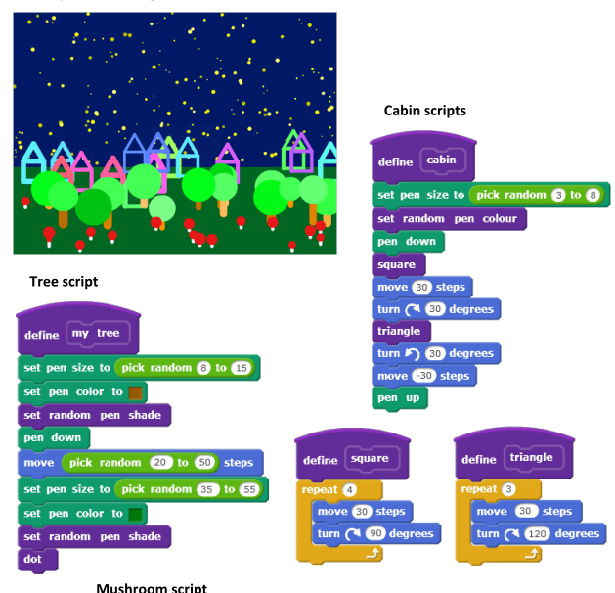
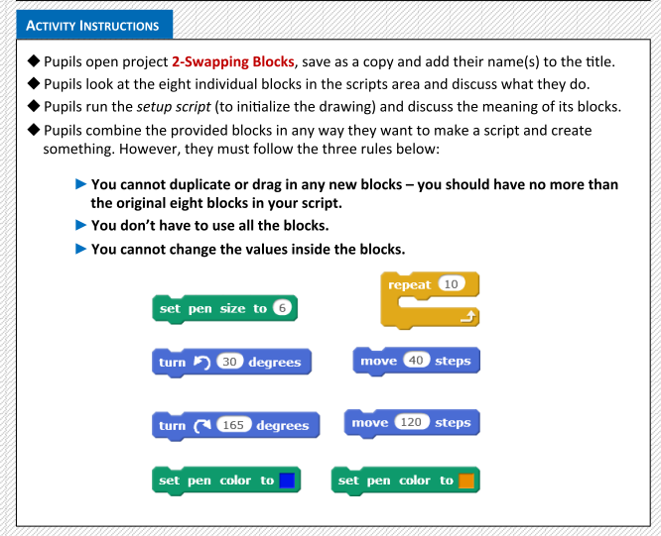
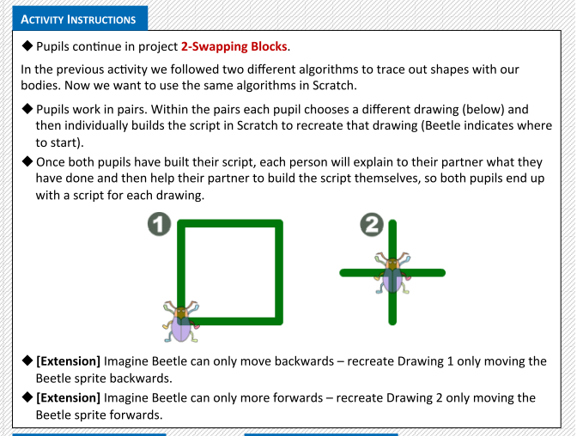
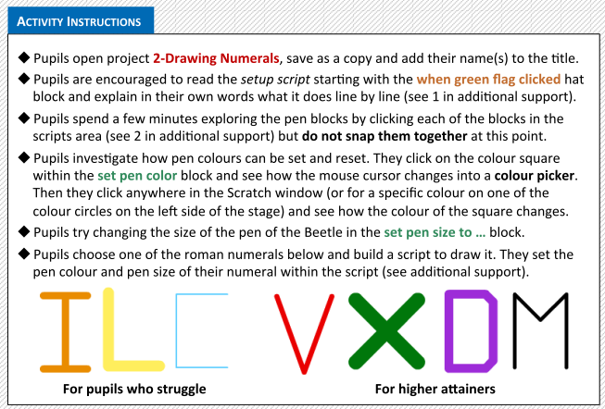
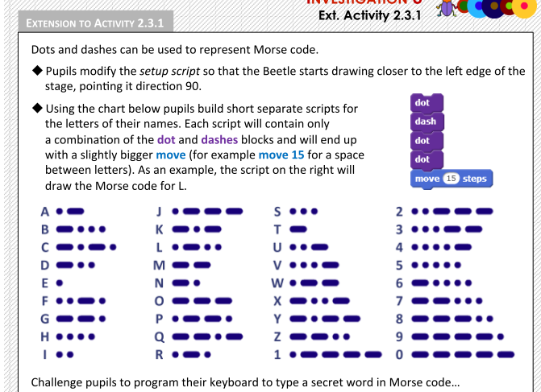
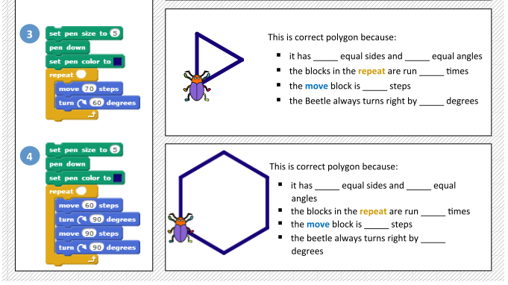
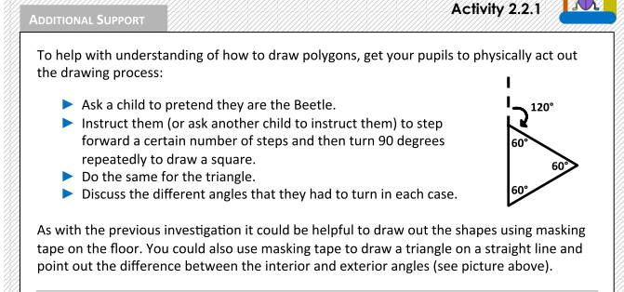
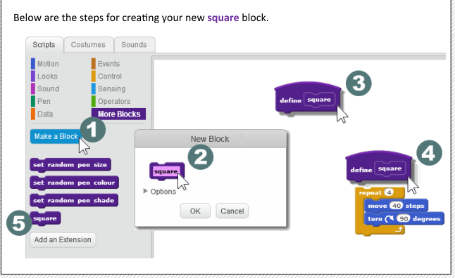
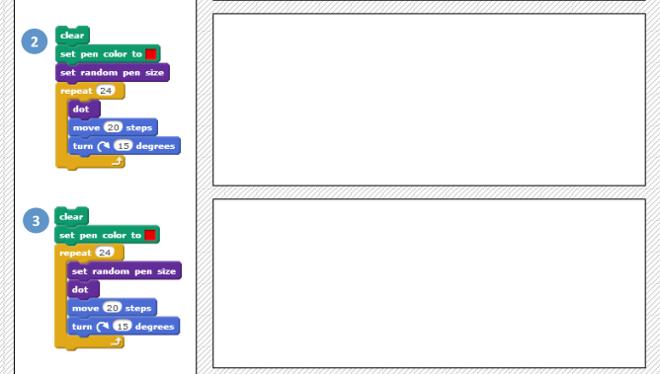
Many different types of lesson activities – with progression along the way leading to a creative open project.
Module 2 beetle
Notes:
Explain how the next module carefully scaffolds children to gain a whole host of skills so that in the end they can undertake a creative project. But the objective is to learn along the way, and in the end they will be independent as the create a beautiful screen.
Can you jot down for me the types of activities…
Initialisation and limited commands
Maximum steps
Playing Beetle – unplugged
Group work (different shapes/teach)
Playing Beetle – polygons
Assessment – fill in number
More blocks – direct teaching
Morse code
Back to a paper based test and tracing
All leading to an open creative project

Slide 14
Approaches to teaching own blocks
https://www.ucl.ac.uk/ioe/research/projects/scratchmaths/curriculum-materials/module-2-beetle-geometry/files/SM_Y5_Module_2_Teacher_Materials.pdf
Copy code | Targeted tasks | Shared programming | Guided exploration | Design and code a project | Tinker
Notes:
This is the end assessment activity – and the level of code that we are looking for, well named user created blocks, using a range of pen command, move commands, repeats showing an understanding of shape, use of coordinates, positive and negative … How might we teach this

Slide 15
Progression in make your own blocks and lists
Animations/stories
Quizzes
Games
Context
Simulations
Physical computing e.g. Makey, makey, Lego Wedo, Picoboard, TTS controller/LED etc….
Make your own block for simple games, for initialisation etc
Suggests using make your own blocks to reuse code, make code readable.
Knows what one is, can predict what it does , can change code with them , can add them .
Lists for simple random selection activities
Lists for simple matching activities
For handling data – arrays – Snap/Python
Independance

Slide 16
Objectives of this session
Increase understanding of make your own blocks and lists specifically:
What is a procedure – make your own block
What is a list
Using design to represent procedures/make your own block and lists
Progression of procedures and lists

Slide 17
Levels of abstraction
Task
Design (including algorithms)
Code
Running the code
Copy code | Targeted tasks | Shared coding | Guided exploration | Project design and code | Tinker
Imitate
Innovate
Invent
Vs
Remix

