Slide 1
Object-oriented programming
Session 5
Overriding and Polymorphism

Slide 2
Session 5 Aims
Recap: class diagrams
  Class diagrams for analysing problems
  Class diagrams for designing programs
Understand overriding
  Sub-classes have different behaviour
Understand polymorphism
  Programs that work for data of many types
Consolidate understanding of inheritance and overriding using an extended example

Slide 3
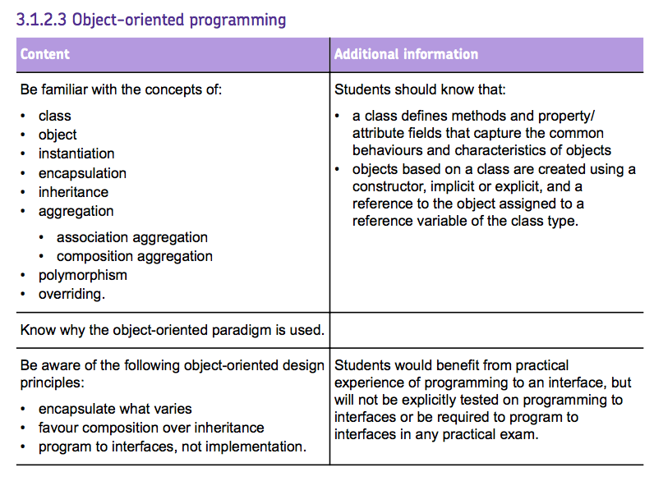
Specification check
AQA

Slide 4
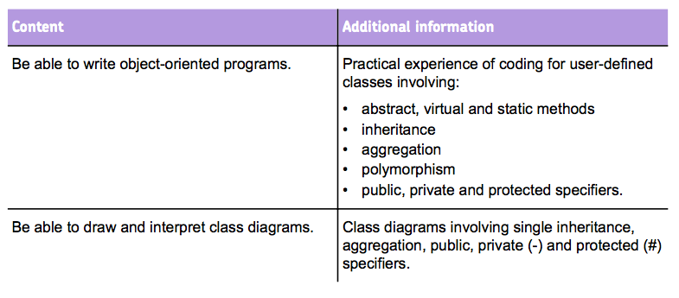
Specification check – AQA

Slide 5
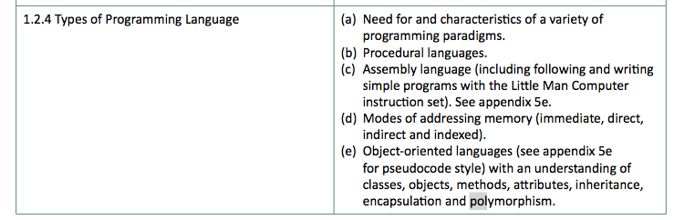
Specification Check – OCR
Overriding not mentioned explicitly: polymorphism is

Slide 6
Recap: Class Diagram
Class diagram models a problem
Class diagram describes a program
class name
attribute1
attribut2
method1
method2
Program Code
Problem

Slide 7
Recap: Class Diagrams
Person
-firstName
-lastName
-email
+fullName
A person has a first and last name and an email. We know how to get the full name of person
A teacher is a kind of person, with a job title and department
tutor
Pupil
Teacher
-keyStage
-department
-jobTitle
A pupil is a kind of person, at some KS. A pupil has a tutor, who is Teacher

Slide 8
Quiz: Class Diagrams
Person
-firstName
-lastName
-email
+fullName
Does a teacher have a job title?
Do all people have a department?
Does a pupil have an email?
Does a pupil have a department?
Can a pupil be a tutor?
Give an example of inheritance
Give an example of association
tutor
Pupil
Teacher
-keyStage
-department
-jobTitle

Slide 9
Recap: Class Diagrams
Person
-firstName
-lastName
-email
+fullName
class Person:
def __init__(self,f,l,e):
self.firstName = f
self.lastName = l
self.email = e
def fullName(self):
fn = self.firstName + " "
fn += self.lastName
fn += ", email: "
fn += self.email
return fn
tutor
Pupil
Teacher
-keyStage
-department
-jobTitle

Slide 10
Recap: Class Diagrams
Person
Class diagram describes the domain
Class diagram designs the code
-firstName
-lastName
-email
+fullName
class Teacher(Person):
def __init__(self,f,l,e,d,j):
super().__init__(f,l,e)
self.department = d
self.jobTitle = j
tutor
class Pupil(Person):
def __init__(self,f,l,e,k):
super().__init__(f,l,e)
self.keyStage = k
self.tutor = None
def setTutor(self, t):
self.tutor = t
Pupil
Teacher
-keyStage
-department
-jobTitle

Slide 11
Overriding and Polymorphism

Slide 12
Overriding
Person
-firstName
-lastName
-email
+fullName
What is the full name of a Teacher?
  Every person has a fullName
  Behaviour inherited from Person
  We want different behaviour in the two subclasses
tutor
Pupil
-keyStage
terry = Teacher("Terry","Smith",
"tsmith@gmail","ICT",
"Computing Teacher")
paul = Pupil("Paul","Morris",
"p.morris12@school.org","KS3")
Paul Morris, email: p.morris12@school.org, KS3
Terry Smith, email: tsmith@gmail,
Title: Computing Teacher
Teacher
-department
-jobTitle

Slide 13
Overriding
Use super() to run method from parent class
Person
-firstName
-lastName
-email
+fullName
class Teacher(Person):
...
def fullName(self):
fn = super().fullName()
fn += ", Title: " + self.jobTitle
return fn
tutor
Pupil
-keyStage
class Pupil(Person):
...
def fullName(self):
fn = super().fullName()
fn += ", " + self.keyStage
return fn
Teacher
-department
-jobTitle

Slide 14
Polymorphism
Any subclass of Person … including new ones
General definition:
  Code that is able to work with values of different types is polymorphic
In OOP:
  Code that works with objects of different classes
  … achieved by overriding
Example
  Arrays in many languages
  Arithmetic: +, -, *
… this code is polymorphic
people = list of Person
for p in people:
print(p.fullName())
Terry Smith, email: tsmith@gmail, Title: Computing Teacher
Paul Morris, email: p.morris12@school.org, KS3

Slide 15
How Does Polymorphism Work?
class A:
def whoAmI(self):
return "A"
class B(A):
def whoAmI(self):
return "B"
class C:
def whoAmI(self):
return "C"
Method called depends on the object’s class
Python
  Looks back up the class hierarchy
  … starting from the object’s class
  … to find the first definition of a method
If ‘a’ is of class B, then "B" is printed
as = list of A, B or C
for a in as:
print(a.whoAmI())

Slide 16
Concepts Beyond Python
Other languages check the use of overriding
  Types of parameters must be same
  No checking in Python
Virtual method
  A method that can be overridden
  In Python all methods are virtual
Abstract method
  A method that must be overridden – no implementation
  In Python: good practice to definition method in superclass
Exam Question: OCR 2010 –F453 – UML Diagram

Slide 17
Activity sheet: 20Q
20Q classic version: One player chooses a secret object. The other player has 20 questions to guess the object
This version: the computer has:
a (small) fixed set of objects
a fixed set of questions with an answer for each object
The game is played:
the computer chooses on of the objects – a secret
… and displays the possible objects and the questions
the player chooses a question and gets the answer
after a number of questions, the player must guess … If the guess is wrong, the correct answer is displayed

Slide 18
Activity sheet: 20Q
Topic: This simple version of 20Q works best when the objects from a specified general topic or area.
The example code is for animals.
The organisation of the code does not depend very much on the area chosen. You can change from animals to another topic, such as sports, music genre, football players, great operas …
DEMONSTRATION

Slide 19
Activity Sheet: 20Q
Exercise 1: run and review provided code
Exercise 2: simple change: 1 method
Exercise 3: add animals: multiple steps
Advanced exercise 4: modules – each class in separate file
Advanced exercise 5: non-OOP implementation, compare with OOP
Advanced exercise 6: more classes

Slide 20
Exercise 1: Some Answers
Methods omitted:
getName, getLegs,…
Method | Class
 | Animal | Mammal | Marine Mammal
hasFur | Implement | Override | Override
canSwim | Implement | Inherit | Override
getSize | Implement | Inherit | Inherit
getLegs | Implement | Inherit | Inherit
Animal
-name
-legs
-size
-meat
+hasFur
+canSwim
Mammal
MarineMammal
+hasFur
+canSwim
+hasFur

Slide 21
Let us continue after break

Slide 22
Summary of OOP

Slide 23
OOP
Concepts
Concept | Details
Basic mechanics | Calling a method of an object Class as a template for data Class as a collection of methods
Constructors | Definition and use
Interaction | Object as a value (variable, list item, …) Object as an attribute value (has-a relationship) Object passed as a parameter
Abstraction and modelling | Class as a domain concept Methods (and constructor) have parameters
Inheritance | Superclass and subclasses Constructor called using super() Method inherited or overridden
Prerequisite knowledge: functions & parameters
Prerequisite knowledge: basic mechanisms

Slide 24
Misconception | Possible Evidence
Attributes in the wrong scope | Omission of self (assignment or use)
Confusion between class and object | No objects created Only one instance Inheritance rather than instance
Confusion between class and attribute | Many classes – all simple
Objects only contain data | No encapsulation Only get and set methods
Objects do not interact | All code in single class Classes defined but not imported Objects not used as attributes Objects never passed as parameters
Believing objects are copied not shared | Unnecessary copying Unexpected sharing
Prerequisite knowledge: functions & parameters

