Slide 1
Object-oriented programming
Session 4
Class Diagrams, Composition and Aggregation

Slide 2
Course Outline
Week No | Understanding | Developing programming skills
Week-1 | Week 1 – Introduction to Classes and Objects | Week 1 – OOP Programming basics
Week-2 | Week 2 – Variables and objects, Python Modules | Week 2- Creating and using Python modules
Week-3 | Week 3 – Inheritance | Week 3 – Programming using Inheritance
Week-4 | Week 4 – Class Diagrams | Week 4 – Composition and Aggregation
Week-5 | Week 5 - Polymorphism | Week 5 - Consolidation

Slide 3
Session 4 Outline
To be able to read and draw class diagrams
To understand the difference between private, public and protected attributes
To be able to implement a “has-a” relationship (aggregation/ composition)
To understand the encapsulation principle
To consolidate understanding of inheritance

Slide 4
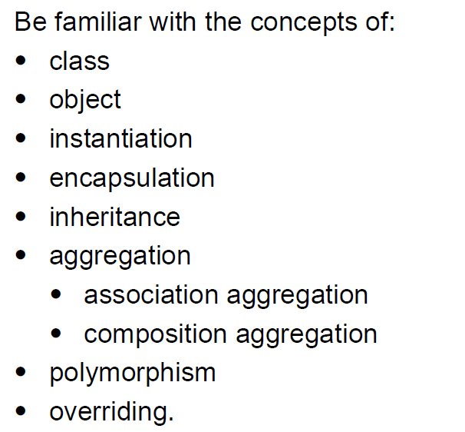
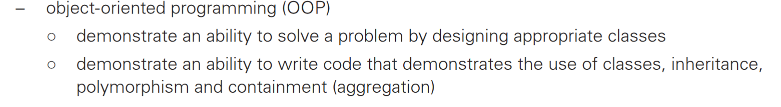
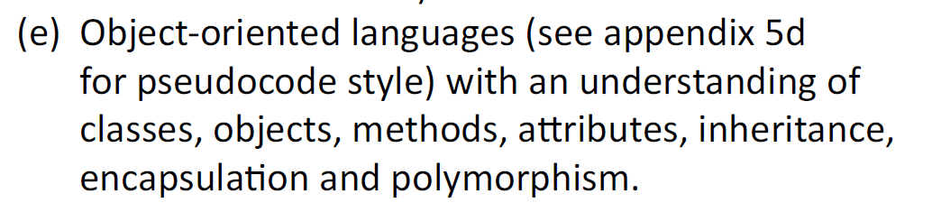
Specification check
From AQA
From CIE
From OCR
( plus other details … )

Slide 5
Recap: Inheritance
One class can inherit methods and variables from another class
This is called inheritance
For example, in a system for a school, there may be a Student class and a Staff class (enabling you to create Student and Staff objects)
There also may be TeachingStaff, SupportStaff, ManagementStaff classes.
These could inherit methods and variables from the Staff object.
In this case Staff is the super class and TeachingStaff is the sub class (or child class)

Slide 6
Private, public & protected
Theoretically, the parts of a class declaration are declared to be
    private OR
    public
a private section for the state (member data – ie attributes)
a public section for the behaviour(operations, member functions)
The keywords “private” and “public” control the accessibility of the member data and functions
Private or protected attributes cannot be accessed outside of the class
Public methods can be accessed outside the class
Private and public are not implemented in Python but are needed for examination answers
Notes:
In other OOP languages
A private member is only accessible within the same class as it is declared.
A protected member is accessible within all classes in the same package and within subclasses in other packages.
A public member is accessible to all classes

Slide 7
Encapsulation
This is an important principle of OOP, associated with abstraction or information hiding
Encapsulation means that the internal representation of an object cannot be seen from outside of the object’s definition
It is achieved by making attributes private (or protected).
The attributes are only accessed through methods (public)
Get and set methods are written to access the data
This protects the object from being changed in an irregular way and allows groups of developers to all access the same class, via the methods.

Slide 8
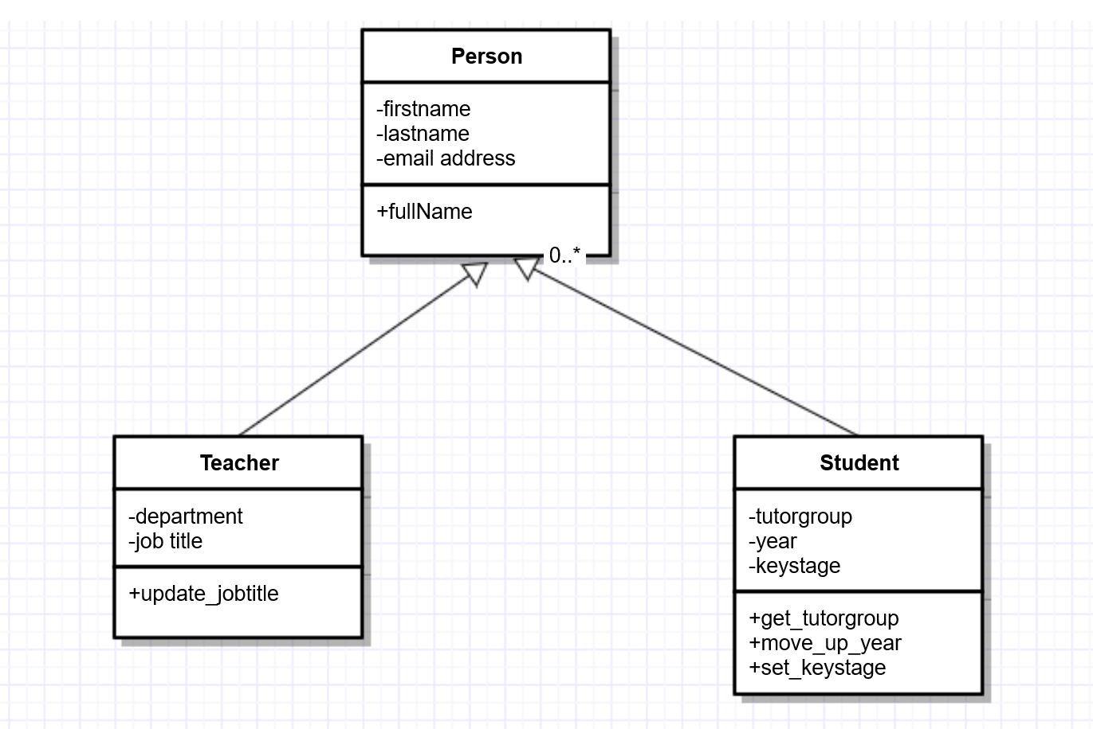
Class Diagrams
class name
attributes
methods
- private
+ public

Slide 9
Composition and aggregation contd
Composition is where one object is composed (or made up of) two or more existing objects and is entirely dependent on those objects for its own existence (from Hodder AQA materials)
Association aggregation is where an object is made up of one or more objects but is not entirely dependent on those objects for its own existence (from Hodder’s AQA materials)
For example, a teaching group is made up of students: this is aggregation as the students will belong to other teaching groups too.
A teaching group also has to have a teacher. This can be argued to be the stronger case of composition.

Slide 10
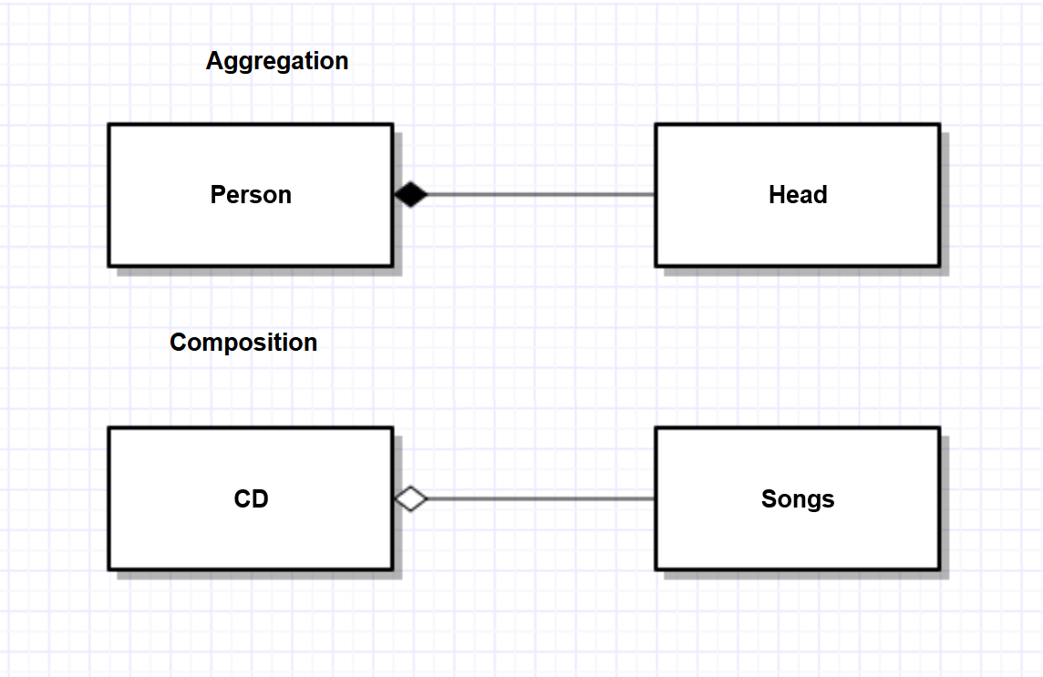
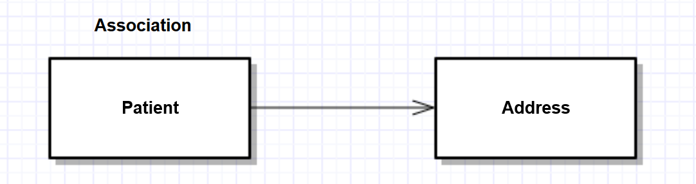
Composition & Aggregation (association)
Composition and aggregation are both “has-a” relationships that can be hard to distinguish.
The strongest relationship is composition, then aggregation and then association. AQA talk about all three in their resources but the spec mentions composition aggregation and association aggregation.

Slide 11
Activity 1
Edit the class diagram to include a Teaching group – add the attributes name, room number and subject and student_list and two methods to a) add a student to the teaching group and b) return the room number, name and subject of the teaching group
Composition aggregation (for AQA examinations)
Association aggregation (for AQA examinations)

Slide 12
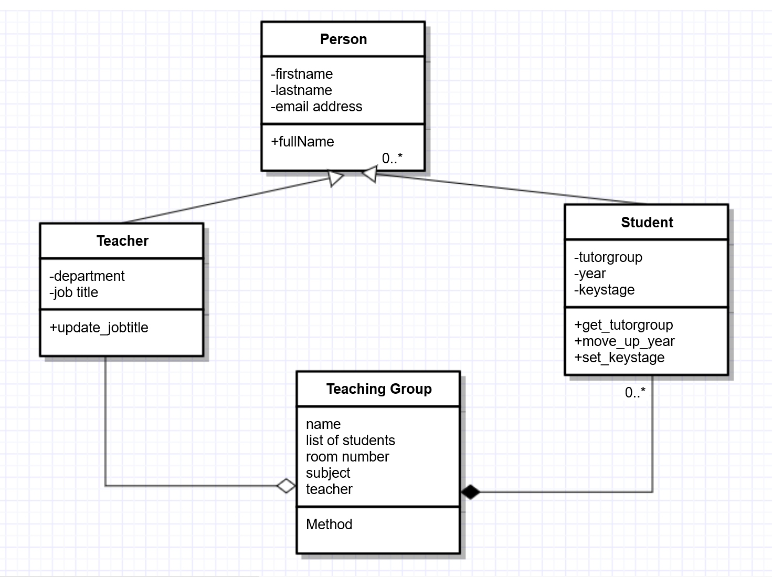
Possible answer
Gliffy can be used to create Class Diagrams (14 day free trial) – or just do them in powerpoint

Slide 13
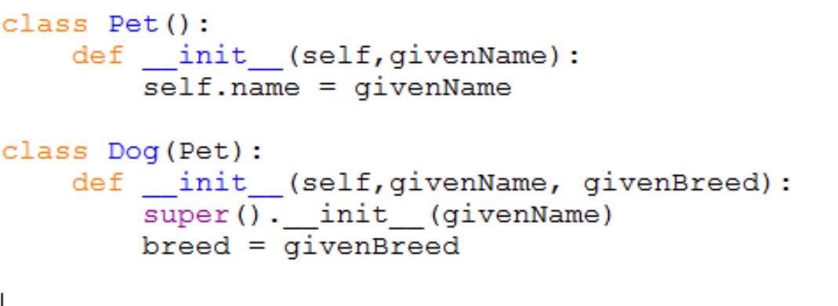
Difference between Python & pseudocode
Python
Pseudocode (exam questions)
class Pet
private name
public procedure new(givenName) name=givenName
endprocedure
endclass
class Dog inherits Pet
private breed
public procedure new(givenName, givenBreed)
super.new(givenName)
breed=givenBreed
endprocedure
endclass
Note that Python does not mention private and public
This is OCR pseudocode but they are all similar

Slide 14
Activity: Past paper question
Answer examination question
June 2015 AQA Comp 3
See handout
Draw an inheritance diagram
Write a class definition in pseudocode

Slide 15
Let us continue after break

