Slide 1
Object-oriented programming
Session 3
Inheritance

Slide 2
Course Outline
Week No | Understanding | Developing programming skills
Week-1 | Week 1 – Introduction to Classes and Objects | Week 1 – OOP Programming basics
Week-2 | Week 2 – Variables and objects, Python Modules | Week 2- Creating and using Python modules
Week-3 | Week 3 – Inheritance | Week 3 – Programming using Inheritance
Week-4 | Week 4 – Polymorphism and Overriding | Week 4 – Programming using different kinds of Polymorphism
Week-5 | Week 5 - Consolidation | Week 5 - Consolidation

Slide 3
Session 3 Outline
To understand the inheritance relationship
Create and use inheritance
Examples Used:
  Person
  Students
  Teacher
  HOD

Slide 4
Recap: Classes and Objects
OOP attempts to simulate the real world by means of objects which have characteristics and functions
A class is a combination of variables, called attributes, and procedures, called methods, forming a self-contained programming entity
An object is one instance of the class definition.
The class definition is the blueprint or template that we use
Classes are accessed via their methods, not directly.
This means that OOP classes can be reused in many different programs without us needing to know how they work.

Slide 5

Class example : video
Properties (attributes)
Title
Year
Certificate
Genre
VideoID
HirePrice
Methods (procedures)
GetVideoDetails
UpdateHirePrice
SetGenre
Video

Slide 6

Object example : car
Properties
Make
Model
Mpg
Engine size
Year of reg
Mileage
Car Reg
Methods (procedures)
GetCarDetails
UpdateMileage
CalculateAge
Car

Slide 7
Python Standard practice
Include the constructor __init__ () for all classes
In every class all methods other than the constructor will return a value
All input statements will be used outside the class and the values will be passed as parameters when instantiating.

Slide 8
Inheritance
One class can inherit methods and variables from another class
This is called inheritance
For example, in a system for a school, there may be a Student class and a Staff class (enabling you to create Student and Staff objects)
There also may be TeachingStaff, SupportStaff, ManagementStaff classes.
These could inherit methods and variables from the Staff object.
In this case Staff is the super class and TeachingStaff is the sub class (or child class)

Slide 9
Inheritance
Attributes: name, address, email
Staff
Please complete diagram exercises
TeachingStaff
SupportStaff
Attributes as above PLUS department, gradelevel, contact hours
ManagementStaff

Slide 10
Inheritance
Inheritance: In OOP inheritance is the process whereby a class inherits methods and attributes from a base/parent/superclass.
A class which inherits from a superclass is called a subclass or child class. Inheriting class may override some of the methods and attributes and may also have extra methods/ attributes on its own.
Composition : We can consider composition when we look at polymorphism (week 4)

Slide 11
Inheritance in Python
Before writing classes in Python, ensure that you have written all the methods and attributes you will need on paper.
An example: a Student is a type of Person so can inherit from the Person class
Attributes and methods in red are inherited
so don’t need to be repeated.
Class | Attributes | Methods
Person | firstname, lastname, email | Fullname
Student | Firstname, lastname, email, tutor group, year group | Studentdetails Fullname

Slide 12
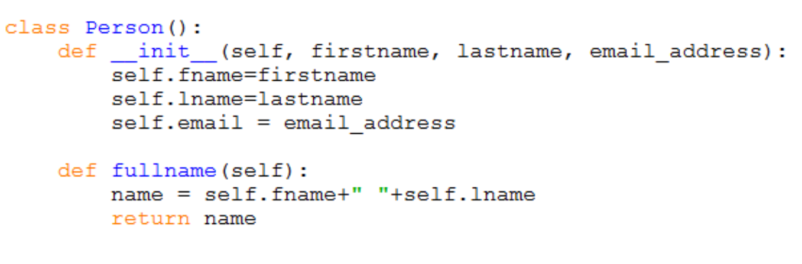
Person and Student class
Q: write the code to create an actual person called Cristiano Ronaldo with the email address cronaldo@gmail.com
A: person1 = Person(“Cristiano”, “Ronaldo”, cronaldo@gmail.com)

Slide 13
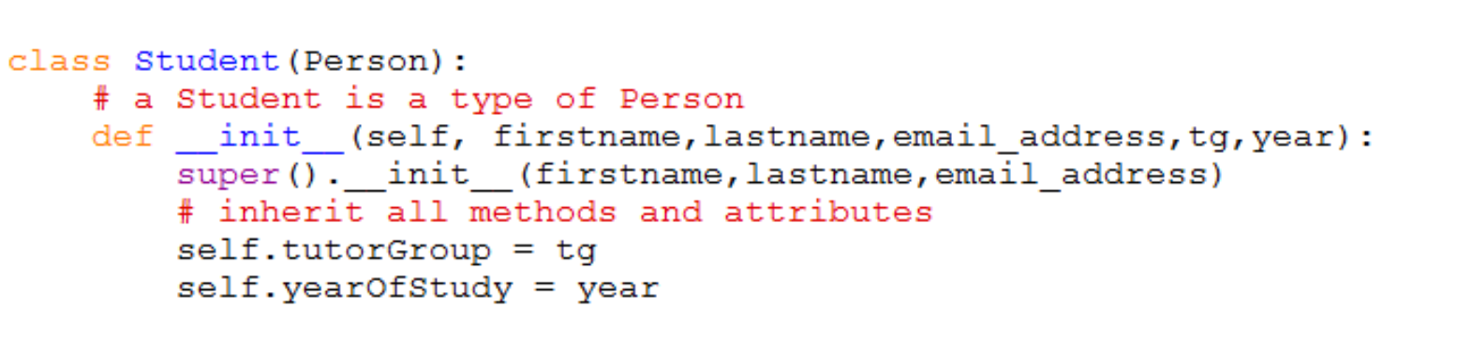
Person and Student Classes
The sub-class Student is defined as follows:
The Superclass is given in brackets – eg class Student(Person)
The line of code super().__init__(firstname,lastname,email_address) is included in the constructor
Please work on Activity1

Slide 14
More classes in this example
Work in pairs to identify attributes and methods for these classes– Activity -2
Sub classes : Teacher , HOD both inherit methods and attributes from Person superclass.
Attributes and methods in red are inherited so don’t need
to be repeated.
Class | Attributes | Methods
Person | firstname, lastname, email | Fullname
Student | Firstname, lastname, email, tutor group, year group | Studentdetails Fullname
Teacher
HOD

Slide 15
Let us continue after break

