Slide 1
Teach A-Level Computer Science:
Object-Oriented Programming in Python
Session 2
Theory: Variables, objects and Modules
Practical: Creating and using Python modules

Slide 2
Course Outline
Week No | Understanding computers (5:30– 6:30) | Developing programming skills (7:00 -8:00)
Week-1 | Week 1 – Introduction to Classes and Objects | Week 1 – OOP Programming basics
Week-2 | Week 2 – Variables and objects, Python Modules | Week 2- Creating and using Python modules
Week-3 | Week 3 – Encapsulation and Inheritance | Week 3 – Programming using Inheritance Composition vs Inheritance
Week-4 | Week 4 - Polymorphism | Week 4 – Different kinds of Polymorphism
Week-5 | Week 5 - Consolidation | Week 5 - Consolidation

Slide 3
Session -2 Outline
Variables and Objects
Understanding why we use Python Modules
Creating and importing Python modules
Example1: Shopping list
Example2: Student report

Slide 4
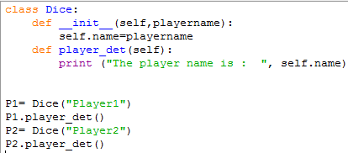

Variables and Objects
Are variables and objects the same? Variables we use do not contain any objects but they are pointers to objects in memory. Let us look at an example to understand this.
Points to memory location of an object
denotes both the objects are part of Dice class

Slide 5
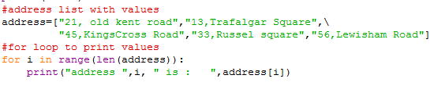

Understanding the use of 1D Python list

Slide 6



Understanding the use of 2D python list

Slide 7
Python Modules
Python module is a single Python file that can contain executable statements, classes, attributes as well as methods. Definitions from a module can be imported into other modules or into the main module. Let us use an example to understand this.
Invoice Main Module
Products and prices
Customer details and payment method

Slide 8
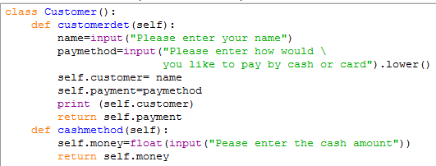
Creating our First module
customerdetails.py is our first module has
  Class Customer
  Methods customerdet and cashmethod
  Attributes self.customer,self.payment and self.money
Activity1: Worksheet page1

Slide 9
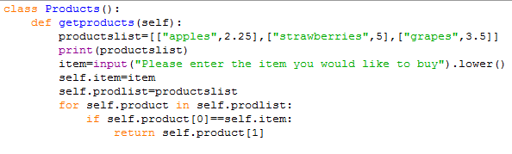
Creating our Second module
productsnew.py is our second module has
  Class Products
  Methods getproducts()
  Attributes (self.prodlist, self.product and self.item)
Activity2: Worksheet page2

Slide 10
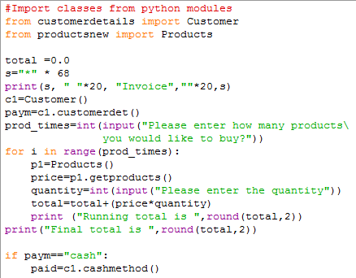
Creating our main program
from filename import class
invoicenew.py
Activity 3: Worksheet page 3

Slide 11
Let us continue after break

