Slide 1
Teach A-Level Computer Science:
Object-Oriented Programming in Python
Session 1
Introduction
Theory: Classes and Objects
Practical: OOP programming basics in Python

Slide 2
Course Outline
Week No | Understanding computers (5:30– 6:30) | Developing programming skills (7:00 -8:00)
Week-1 | Week 1 – Introduction to Classes and Objects | Week 1 – OOP Programming basics
Week-2 | Week 2 – Encapsulation and introduction to python modules | Week 2- Variables and objects, OOP Programming using python modules
Week-3 | Week 3 – Understanding Inheritance and composition | Week 3 – Programming using Inheritance Composition vs Inheritance
Week-4 | Week 4 - Polymorphism | Week 4 – Different kinds of Polymorphism
Week-5 | Week 5 - Consolidation | Week 5 - Consolidation

Slide 3
Session -1 Outline
Introduction to Class and objects
Python built-in objects
Introduction to user defined class and object
Understanding the use of self and __init__ method
Multiple instances

Slide 4
What is OOP?
Abstraction: Abstraction is the process of creating a general idea(model) of the problem by removing specific details that will not help to solve the problems.
Object Oriented Programming is all about abstractions.
OOP reduces the complexity of the problem by grouping the functions and variables together.
Data hiding refers to hiding representation details from users.
characteristics/variables/attributes
behaviour/functions/methods
OCR and Eduqas → methods and attributes , AQA → methods and property/attribute fields

Slide 5
Classes and Objects
Class is the blueprint or template for creating definition of objects
Classes will have a class name, attributes and methods
Objects are instances of class and the process of creating objects from classes is called instantiation
Let us look at an example of mobile phone class
Task1:
Discuss in pairs what could be attributes and methods of mobile phones class.
Mobile Phones
class
iPhone
object1
Samsung Galaxy
object2
Sony Xperia
object 3
Example answers:
Attributes→ size, colour, model etc.
Methods→ calling, locking , security

Slide 6
Example of Python built-in Objects
Python lists
A specific named list is an example of a built-in Python object. For example Colours list will be used to store different colours (attributes) as a single container and it also has methods that we use to manipulate items inside that list.
Remember these methods cannot be used on any other attributes outside that list.
Task2 : Worksheet (Page1)
Colours List
(Attributes)
“Red”
“Green”
“Blue”
“Orange”
“Purple”
“Black”
“Yellow”
append()
sort()
clear()
copy()
reverse()
Methods

Slide 7
Python Conventions
Capitalise your class names
_ _ → Double underscore for Python special methods. e.g. __init__
self parameter to reference an object at runtime
An attribute with a leading underscore is reserved for use within that class.

Slide 8

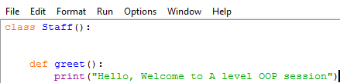
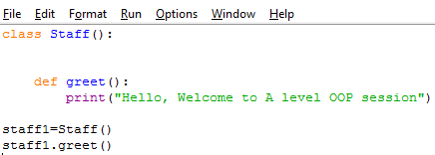
User Defined Classes and Objects
To define our own class we use the keyword class
Example1: Let us create a definition for Staff object
Step1: Create a class Staff
Step2: Let us define a method
greet () for this class
Outside Class:
Step3: Let us create an object from class Staff() (Instantiation)
Now run the program and see what happens
Notes:
Python will use our class Staff() to create a new instance of staff. staff1 is the variable used to make a reference to the first instance of class Staff(). Now we can use staff1 to call all methods defined in class Staff()

Slide 9
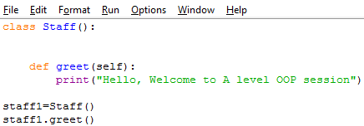

Use of self
.self is a reference to the object so let us modify the code by adding self to make it work
So when we use staff1.greet() self inside the function will point to the same object.
class Staff():
def greet(self):

Slide 10
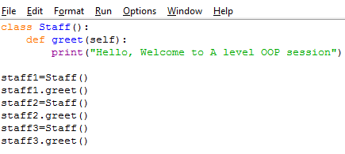
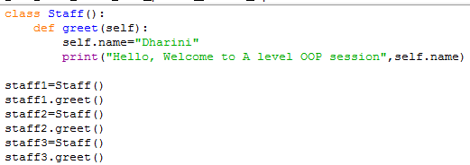
Multiple Instances
We would like to personalise the welcome message for different people
We can create multiple objects from the same class
Do you think this is an efficient method?

Slide 11
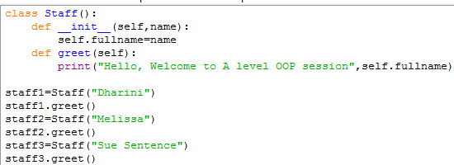
Python __init__ method
.
Every OOP language uses special methods called Constructors to construct and initialise an object with specific attributes
Python does not include constructors but uses a special method __init__ for initialising an object and is invoked when you instantiate an object
Python special methods wouldn’t allow you to interact directly but is invoked implicitly
Python special methods always start with
__(double underscore)
Tasks 3, 4 and 5: Worksheet (Page1)
Staff
‘Sue Sentence’
greet()
Staff
‘Melissa’
greet()
Staff
‘Dharini’
greet()
Notes:
Instantiation refers to the process of crating an instance of a class.

Slide 12
Let us continue after break

