Slide 1
Teaching Computing to GCSE
Session 8
Theory: High and Low Level Languages
Practical: File Handling and CSV Files

Slide 2
Specification Content (OCR)
Characteristics and purpose of different levels of programming language, including low level languages.
The purpose of translators.
The characteristics of an assembler, a compiler and an interpreter.

Slide 3
Specification Content (AQA)
Know that there are different levels of programming language: Low-level language, High-level language.
Explain the main differences between low-level and high-level languages.
Know that machine code and assembly language are considered to be low-level languages and explain the differences between them.
Understand that ultimately all programming code written in high-level or assembly languages must be translated into machine code.
Understand that machine code is expressed in binary and is specific to a processor or family of processors.
Understand the advantages and disadvantages of low-level language programming compared with high-level language programming.
Understand that there are three common types of program translator: interpreter, compiler, assembler.
Explain the main differences between these three types of translator.
Understand when it would be appropriate to use each type of translator.

Slide 4
Specification Content (Edexcel)
Understand what is meant by high-level and low-level programming languages and understand their suitability for a particular task.
Understand what is meant by an assembler, a compiler and an interpreter when translating programming languages and know the advantages and disadvantages of each.

Slide 5
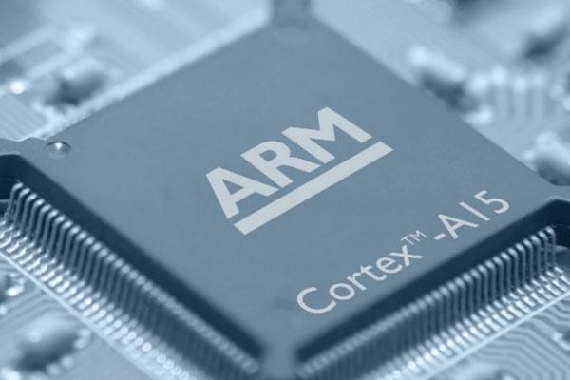
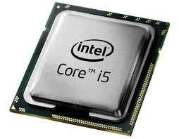

Processor Families
There are two main families of processor, each family has a different instruction set.
X86/x64 Family
ARM Family

Slide 6
Machine Code
Each type of CPU is designed to carry out a set of specific instructions, this is known as the instruction set. Each instruction is represented by a binary number. This is called machine code.
It is hard for humans to read and write machine code so assembly language was developed to make it easier.
Machine Code | Assembly Language
1110 0011 1010 0000 0000 0000 0000 0010 | MOV R0, #2
1110 0010 0100 0011 0001 0000 0000 1010 | SUB R1, R3, #10
1110 0000 1000 0000 0000 0000 0000 0001 | ADD R0, R0, R1
1110 0000 0000 0011 0000 0101 1001 0100 | MUL R3, R4, R5

Slide 7
Assembly Language
Assembly language uses codes called mnemonics to represent each machine code operation. For example SUB is used to represent the subtract operation.
There is a one-to-one relationship between each assembly language instruction and the corresponding machine code instruction. This means each assembly language instruction is translated into one machine code instruction.
Both assembly language and machine code are known as low-level languages. Low-level languages allow direct control over the operation of the CPU.

Slide 8

High-Level Languages
Although assembly language is easier to read and write than machine code it is still very time consuming to write programs with.
High-level languages were designed to solve this problem, they use a syntax that is much closer to written English.
Each high-level language instruction is translated into multiple machine code instructions.
Python is an example of a high-level language.

Slide 9
Activity 1
Use the text in the notes section of this slide to complete the table.
Instruction | Language | Language Type
sum = num1 + num2
ADD R0, R0, R1
1111000011110000
Notes:
High-level
Assembly
Low-level
Python
Machine code
Low-level

Slide 10
Translators
The CPU can only execute instructions in machine code, therefore assembly language and high-level language instructions must be translated. For this we use a translator.
There are three types of translator:
Translator Type | Used For | Description
Assembler | Assembly Language Programs | Translates programs written in assembly language into machine code.
Compiler | High-Level Language Programs | Translates the entire program into machine code in one go.
Interpreter | High-Level Language Programs | Translates each instruction one line at a time and executes it before translating the next instruction.

Slide 11
Activity 2
Carry out some research to find some examples of interpreted and compiled programming languages.
Interpreted Languages | Compiled Languages

Slide 12
Activity 3
Use the text in the notes section of this slide to complete the comparison table:
Interpreted Languages | Compiled Languages
Notes:
Can be faster to debug because you don’t have to wait for the whole program to be translated before it starts to run. Errors are reported as they are found.
Programs may run more quickly because the entire program is translated to machine code before it runs. It only needs to be translated once for each platform.
Can be slower to debug because you have to wait for the whole program to be translated before it starts to run. Errors are reported as a single list at the end of the translation process.
The same program can run on multiple platforms as long as the interpreter is installed.
Programs may run more slowly because each line of code must be translated before it executes each time the program runs.
The program will only run on the platform it was compiled for, a different version of the program needs to be compiled for each platform.

Slide 13
Benefits of Low-Level Languages
Most software is not written in a low-level language because:
It takes longer to develop
It is not portable between different types of processor.
But low-level languages are useful because:
It enables programmers to write very efficient, performance-critical code
It gives you a clear understanding of how the CPU works
It can be used to debug code that isn’t working as expected.

Slide 14
Activity 4
Performance critical code is often written in a low-level language, for example where lives are at stake. Think of some examples of software that is performance critical and non-performance critical.
Performance Critical | Non-Performance Critical

Slide 15
Little Man Computer
At GCSE level students aren’t required to read and write assembly language (unless following the Eduqas specification), but it can be a good way of stretching the more able students.
Little Man Computer is a simulated CPU with a simplified instruction designed to help students learn how the CPU and assembly language work.
A web based version of the simulator can be found here:
https://peterhigginson.co.uk/LMC/

Slide 16
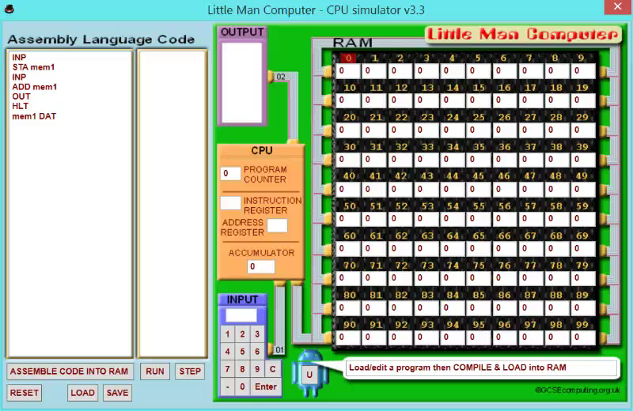
Extension
Learn more about the Little Man Computer by following this tutorial.

Slide 17
Break
After the break we will look at file handling and CSV files.

