Slide 1
Teaching Computing to GCSE
Session 4
Theory: The Internet and Protocols
Practical: Tracing and Pseudocode

Slide 2
Specification Content (1)
OCR
Types of networks: LAN, WAN
Factors that affect the performance of networks
The different roles of computers in a client-server and a peer-to-peer network
The hardware needed to connect stand-alone computers into a LAN: wireless access points, routers/switches/NIC, transmission media
The internet as a worldwide collection of computer networks: DNS, hosting, the cloud
The concept of virtual networks
Star and mesh topologies
Wifi – frequency and channels, encryption
Ethernet
The uses of IP addressing, MAC addressing, and protocols including TCP/IP, HTTP, HTTPS, FTP, POP, IMAP, SMTP
The concept of layers
Packet switching

Slide 3
Specification Content (2)
AQA
Define what a computer system is
Discuss the benefits and risks of computer networks
Describe the main types of computer network including: PAN, LAN, WAN
Understand that networks can be wired or wireless
Discuss the benefits and risks of wireless networks as opposed to wired networks
Explain the following common network topologies: star, bus
Define the term ‘network protocol’
Explain the purpose and use of common network protocols including: Ethernet, Wi-Fi, TCP, UDP, IP, HTTP, HTTPS,FTP, SMTP, IMAP
Describe the 4 layer TCP/IP model
Understand that the HTTP, HTTPS, SMTP, IMAP and FTP protocols operate at the application layer.
Understand that the TCP and UDP protocols operate at the transport layer.
Understand that the IP protocol operates at the network layer.

Slide 4
Specification Content (3)
Edexcel
Understand why computers are connected in a network
Understand the different types of networks (LAN, WAN) and usage models (client-server, peer-to-peer)
Understand wired and wireless connectivity
Understand that network data speeds are measured in bits per second (Mbps, Gbps)
Understand the role and need for network protocols (Ethernet, Wi-Fi, TCP/IP, HTTP, HTTPS, FTP, POP3, SMTP, IMAP)
Understand that data can be transmitted in packets using layered protocol stacks
Understand the characteristic of network topologies (bus, ring, star, mesh).

Slide 5
Types of Network
Computer networks are categorised according to their geographic coverage.
Type of Network | Description | Example
Wide Area Network (WAN) | Connect computers over a large area such as a town, city or country. | Company creating a private WAN to connect different parts of their business securely.
Local Area Network (LAN) | Connect computers over a building or a site. | School network.
Personal Area Network (PAN) | Connect the computers or devices used by one person. | Bluetooth headset connected to a mobile phone.

Slide 6
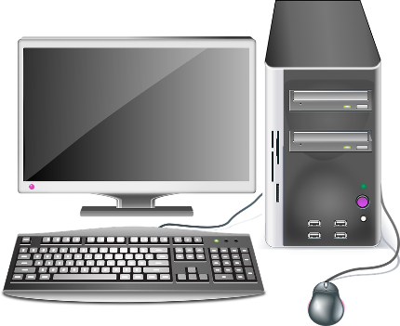
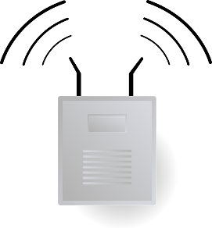
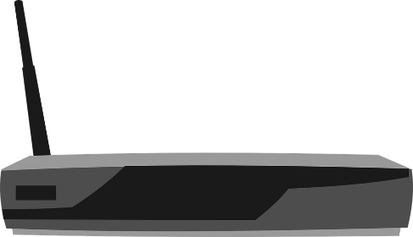
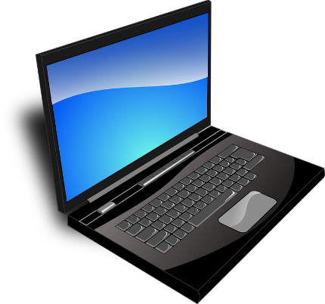
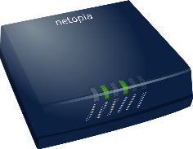
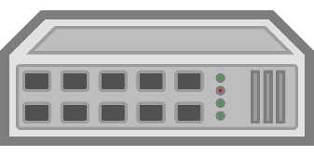
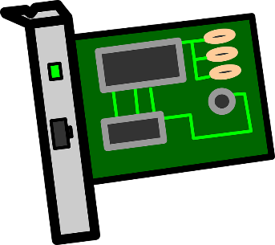
Example LAN
A wireless access point is used to enable devices to connect to a LAN wirelessly.
Routers are used to connect a LAN to another network, for example the Internet.
The Internet
A switch is used to connect the devices in a LAN together.
In homes the switch, router and wireless access point are often combined into one device called a wireless router.
Each device needs a network interface card (NIC) to connect to a LAN. Most devices have these built in.

Slide 7
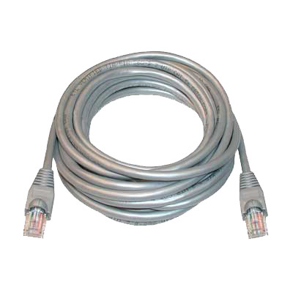
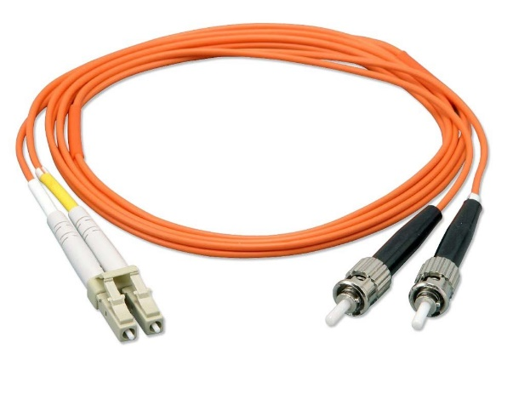
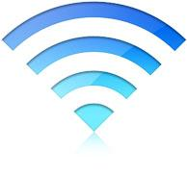
Transmission Media
There are three main types of media that are used to connect computers together in a network.
Copper Cable
Fibre Optic Cable
Wireless

Slide 8
Peer-to-Peer and Client-Server Models
Networks can also be categorised by the role computers play in them.
Peer-to-Peer
Client-Server
The simplest type of network, each computer is equal. Computers share information and resources with each other.
One central computer called a server shares files and resources with the other on the network computers known as clients.

Slide 9
Topologies
The term topology refers to the way in which devices are connected in a network. The table below summarises the different network topologies.
Topology | Description
Bus | Single main cable to which computers are connected.
Ring | All computers are connected in a circle.
Star | All computers have their own link to a central computer.
Mesh | Where each computer can connect to multiple computers.

Slide 10
Activity 1
This activity will demonstrate a fun way of teaching topologies.

Slide 11
Activity 2
This table is designed to summarise the advantages and disadvantages of each topology. Use the text in the notes section to complete it.
Topology | Advantages | Disadvantages
Bus
Ring
Star
Mesh
Notes:
Easy to install
Cheap – doesn’t need much cable
Expensive – there is a separate connection between every computer and the central device.
Unreliable - If the main cable fails the whole network goes down.
Network collisions – packets can travel in both directions.
Relatively easy to install
Relatively cheap – doesn’t need much cable
No network collisions – packets travel in one direction.
Unreliable - If the main cable fails the whole network goes down.
Reliable – if one connection goes down the rest of the network will be unaffected.
Very reliable - if one of the connection goes down there will be a backup.
Very expensive - there are multiple connections between every device.

Slide 12
Network Addressing
Like a house, every device on a network needs a unique address to ensure that data reaches the correct destination.
A MAC address is a unique number written into the network card, appears as six pairs of hexadecimal characters.
Each device connected to a network is also assigned an IP address.
Unlike a MAC address, an IP address is not pre-set and can be changed.
00:10:5A:44:12:B5

Slide 13
The Internet and the WWW
The Internet is a vast collection of interconnected networks spread across the world.
The World Wide Web is a huge collection of webpages stored on web servers that can be accessed through the Internet.
The act of a web server making webpages available via the Internet is known as hosting.

Slide 14
DNS
The Domain Name System (DNS) is designed to match up a user-friendly domain name like ‘facebook.com’ to an IP address.
A device can send a request to the DNS server for an address and the DNS server will reply with an IP address. The device can then use this IP address as their destination.

Slide 15
Activity 3
The table below should show a list of IP addresses and corresponding domain names. You need to complete it, use http://ipinfo.info/html/ip_checker.php to help you.
IP Address | Domain Name
172.217.25.228
31.13.74.36
 | www.kcl.ac.uk
 | www.qmul.ac.uk

Slide 16
Ethernet
Ethernet is a group of networking technologies that are used in most wired networks such as LANs and WANs.
Transmission media used in Ethernet networks include copper and fibre-optic cables.

Slide 17
WiFi
WiFi or Wireless Fidelity is the technology used in wireless networks.
WiFi uses radio waves to transmit information. The frequency ranges 2.4 GHz and 5 GHz are reserved for WiFi to avoid interference with devices that use different wireless technologies.
Each frequency range is split into a set of channels. WiFi networks that are near to each other should operate on different channels in order to avoid interference.

Slide 18

Packet Switching
In modern networks data is split into chunks called packets before they are sent.
Each packet is sent separately and will follow the best route at that time, this means packets may take different routes. This process is known as packet switching.

Slide 19
Activity 4
Protocol | Description
TCP
IP
UDP
HTTP
HTTPS
FTP
POP3
IMAP
SMTP
A protocol is a set of rules that devices on a network follow in order to communicate.
Complete this table using the text in the notes section of the slide.
Notes:
Used to access emails from the mail server, they remain on the server unless manually deleted.
An encrypted version of HTTP.
Sends data as a stream of packets to the target device. There is no error correction which makes it faster, good for video streaming.
Used to retrieve emails from the mail server, they are deleted once downloaded.
Establishes a reliable connection between devices and ensures packets are received without errors.
Used to send emails.
Responsible for routing packets to the correct destination.
Used to exchange files over the internet.
Defines how web pages are transmitted and displayed in web browsers.

Slide 20

TCP/IP Model
Network functionality is often split into layers to make it easier to understand.
The TCP/IP model is made up of four layers, packets travel through them when sent and received.
The HTTP, HTTPS, SMTP, IMAP and FTP protocols operate at this layer.
Application Layer
Application Layer
The TCP and UDP protocols operate at this layer.
Transport Layer
Transport Layer
Internet Layer
Internet Layer
The IP protocol operates at this layer.
Network Layer
Network Layer
Transmission Media

Slide 21



The Cloud
More and more services such as data storage and applications are being moved into the cloud.
The cloud is simply a set of data centres around the world that offer services that can be accessed via the Internet and a web browser.
These services can be accessed using any computer connected to the Internet.

Slide 22
Virtual Networks
There are two main types of virtual network:
Type | Description | Example
VLAN (Virtual Local Area Network) | Uses software to divide a physical LAN into smaller networks. | A company wanting each department to operate on a separate network.
VPN (Virtual Private Network) | Uses existing infrastructure and encryption to create a virtual link between separate physical networks. | A company with offices in multiple countries want to link their networks together via the Internet.

Slide 23
Break
After the break we will look at tracing and pseudocode.

