Slide 1
Teaching Computing to GCSE
Session 3
Theory: CPU Architecture
Practical: 1 & 2D Arrays/Lists

Slide 2
Specification Content
OCR
The purpose of the CPU
Von Neumann Architecture: MAR, MDR, Program Counter, Accumulator
Common CPU components and their function: ALU, CU, Cache
The function of the CPU as fetch and execute instructions stored in memory
How common characteristics of CPUs affect their performance: Clock Speed, Cache Size, Number of Cores
AQA
Explain the Von Neumann Architecture
Explain the role and operation of main memory and following major components of a CPU: ALU, CU, Clock, Bus
Explain the effect of the following on the performance of the CPU: Clock Speed, Number of Cores, Cache Size, Cache Type
Understand and explain the Fetch-Execute Cycle
Edexcel
Understand the function of the hardware components of a computer system (CPU, main memory, secondary storage, input and output devices) and how they work together.
Understand the concept of a stored program and the role of the components of the CPU (CU, ALU, Registers, Clock, Buses) in the fetch-execute-decode cycle.

Slide 3
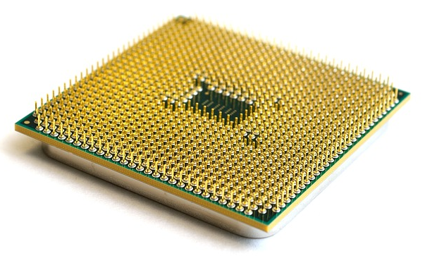
The CPU
The CPU or Central Processing Unit is responsible for carrying out the instructions that make up computer programs.

Slide 4
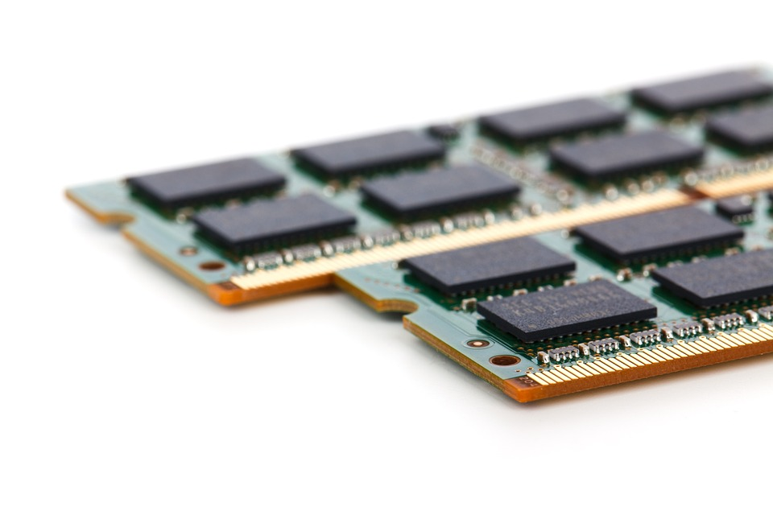
Stored Program Concept
The program instructions for the first computers were stored on punched tape, which had to be fed into the computer when needed.
Later the computers were developed that stored instructions electronically in internal memory.
This is known as the stored program concept.

Slide 5
CPU Components
Manages execution of instructions by sending control signals to other parts of the CPU.
Main Memory
Registers
Control Unit
Temporary storage locations within the CPU.
Wires that are used to transfer data between components.
ALU
Arithmetic and Logic Unit – carries out arithmetic and logical operations.

Slide 6
Registers
Main Memory
Control Unit
PC
Program Counter – holds the memory address of the next instruction.
Memory Address Register – holds the memory address of either the next piece of data to be read or the next instruction.
MAR
ACC
Accumulator – holds the results of calculations carried out by the ALU
MDR
ALU
Memory Data Register – holds the data or instruction retrieved from main memory.

Slide 7
Activity 1
There are three different buses that are used to transfer different types of data between components. Use the descriptions in the notes section at the bottom of this slide to complete the table.
Bus | Description
Address Bus
Data Bus
Control Bus
Notes:
Carries control signals from the control unit to the other components in the CPU.
Carries the memory address of the next instruction or piece of data to be fetched from RAM.
Carries data and instructions between the different components (including RAM).

Slide 8
Fetch-Execute Cycle
As soon as a computer is turned on it starts fetching instructions from memory, decoding them and executing them.
This process is repeated continuously, therefore it is known as the Fetch-Execute Cycle.
Fetch
Decode
Execute

Slide 9
Fetch-Execute Cycle Example
Main Memory
Address | Data
0 | ADD 4
1
2
3
4
Control Unit
PC
0
0
1
ADD 4
MAR
Address Bus
0
0
ACC
Control Bus
MDR
Data Bus
ADD 4
ALU
4

Slide 10
Activity 2
Place the stages of the fetch-execute cycle in the correct order:
The instruction is decoded.
The decoded instruction is executed.
The Program Counter is incremented.
The address of the next instruction to be fetched is place in the MAR.
The instruction is fetched from memory and placed in the MDR.

Slide 11
Von Neumann Architecture
In 1945 John Von Neumann described a model for a stored program computer that became known as the Von Neumann Architecture.
The CPUs in most modern computers are based on this architecture.
It uses one memory for both data and instructions.
It executes one instruction at a time using the fetch-execute cycle.
Main Memory
Registers
Control Unit
ALU

Slide 12
Cache
Cache is special type of fast memory that sits between the CPU and Main Memory.
It is used to store frequently used data and instructions, this saves the CPU having to repeatedly access Main Memory.
This can improve performance as it is quicker to access Cache than to access Main Memory.

Slide 13
Cache Levels
Main Memory
Registers
Control Unit
L2 / L3
Cache
Level 2 and 3 Cache – sits between the CPU and Main Memory, slower and larger than L1.
L1
Cache
Level 1 Cache – inside the CPU, fastest but also smallest.
ALU

Slide 14
Cores
Modern CPUs feature multiple processing units (cores) on the same chip.
This enables CPUs to carry out multiple instructions at the same time (one per core).
Core 1
Core 2
Core 3
Core 4

Slide 15
Activity 3
This table is designed to summarise the factors that impact on CPU performance, complete it using the text in the notes section.
Clock Speed | Cache Size | Number of Cores
Notes:
The larger this is the more frequently used instructions can be stored, this improves performance as it is faster to access than main memory.
Not all programs are written to take advantage of these.
The number of Fetch-Execute cycles a CPU can perform per second is measured in Hertz (Hz).
L1 is faster than L2/L3, therefore a larger L1 would have a bigger impact on performance.
The higher this is, the more instructions the CPU can execute out per second.
The more of these there are, the more instructions can be executed at the same time.

Slide 16
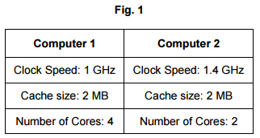
Activity 4
Answer this exam question:
Ann wants to purchase a new computer and is looking at two models. The specification of the CPU in each computer is shown in Fig. 1.
When running a 3D flight simulator, Computer 1 is likely to run faster than Computer 2. Using the information in Fig. 1, identify one reason for this. (1)
Source: OCR GCSE Computer Science (9-1) Component 1 Sample Paper

Slide 17
Activity 5
Answer these exam questions:
Explain one reason why the cache size affects the performance of the CPU. (2)
Identify four events that take place during the fetch-execute cycle. (4)
Source: OCR GCSE Computer Science (9-1) Component 1 Sample Paper

Slide 18
Break
After the break we will look at 1 and 2D Arrays / Lists.

