Slide 1
Teaching Computing to GCSE
Session 2
Theory: Truth Tables / Logic Diagrams
Practical: For and While Loops

Slide 2
Specification Content
OCR
Simple logic diagrams using the operations AND, OR and NOT
Truth tables
Combining Boolean operators using AND, OR and NOT to two levels
Applying logical operators in appropriate truth tables to solve problems.
AQA
Be able to construct truth tables for the following logic gates: NOT, AND, OR
Construct truth tables for simple logic circuits
Interpret the results of simple truth tables
Create, modify and interpret simple logic circuit diagrams.
Edexcel
Be able to construct truth tables for a given logic statement (AND, OR, NOT)
Be able to produce logic statements for a given problem.

Slide 3
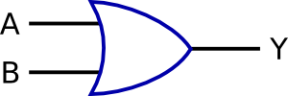


Starter
Match the symbol and description to the logic gate:
Gate | Symbol | Description
NOT
AND
OR
Outputs 1 if both of the inputs are 1.
Outputs 1 if one or both of the inputs is 1.
Reverses the input.

Slide 4
What’s the Output?
A
1
C
0
0
1
?
1
?
1
1
B
1
D
0
1
?
0
?
1
1
1
1

Slide 5
Combining Logic Gates
We combine logic gates in order to build logic circuits.
For example:

Slide 6
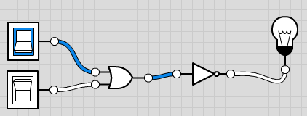
Activity 1
Predict what you think the outputs of these logic diagrams will be:
Build these circuits in the logic.ly simulator to test your predictions. An example of the first circuit is show here:
0
1
Prediction:
1
1
0
1
Prediction:
1
1

Slide 7
Truth Tables Recap
All the possible outcomes of a logic diagram or logic statement can be represented using a truth table.
Examples:
OR Gate
AND Gate
Input 1 | Input 2 | Output
FALSE | FALSE | FALSE
FALSE | TRUE | FALSE
TRUE | FALSE | FALSE
TRUE | TRUE | TRUE
Input 1 | Input 2 | Output
FALSE | FALSE | FALSE
FALSE | TRUE | TRUE
TRUE | FALSE | TRUE
TRUE | TRUE | TRUE
Input 1 | Input 2 | Output
0 | 0 | 0
0 | 1 | 0
1 | 0 | 0
1 | 1 | 1
Input 1 | Input 2 | Output
0 | 0 | 0
0 | 1 | 1
1 | 0 | 1
1 | 1 | 1

Slide 8
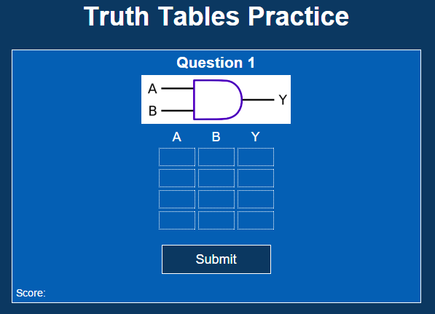
Activity 2
Complete this interactive truth tables activity:

Slide 9
Intermediate Results
Often truth tables include additional columns to show intermediate results.
X
A | B | X | Y
0 | 0 | 0 | 1
0 | 1 | 0 | 1
1 | 0 | 0 | 1
1 | 1 | 1 | 0

Slide 10
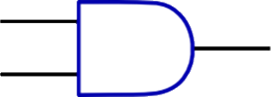
Activity 3
Complete the truth table for this logic diagram:
A
X
Y
Z
B
A | B | X | Y | Z
0 | 0
0 | 1
1 | 0
1 | 1

Slide 11
Logic Statements
Logic diagrams can also be represented using logic statements.
For example the logic statement for this logic diagram would be:
A AND B is placed in brackets with NOT before it to show that the output of the AND gate is passed through a NOT gate.
Y = NOT(A OR B)

Slide 12
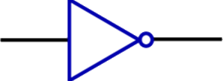
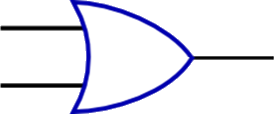
Activity 3a
Create a logic diagram to represent the logic statement shown below:
Y = NOT(A AND B)

Slide 13
Activity 3b
Create a logic diagram to represent the logic statement shown below:
Y = (NOT A) AND B

Slide 14
Activity 3c
Write the logic statement to represent the logic diagram shown below:
Logic statement:

Slide 15
Activity 3d
Write the logic statement to represent the logic diagram shown below:
C
D
Logic statement:

Slide 16
Scenarios (1)
Sometimes students may be asked to produce a logic statement for a specific scenario.
Example
A car alarm (A) is set off if a window (W) is broken or if it senses something moving (M) inside the car, and if the alarm is on (O) .
Give the logic statement the microcontroller uses to determine if the car alarm should be sounded.
A = (W OR M) AND O

Slide 17
Scenarios (2)
Students may also be asked to produce a logic diagram for a specific scenario.
A = (W OR M) AND O
W
M
A
O

Slide 18
Scenarios (3)
Students could also be asked to produce a truth table for a logic statement that relates to a specific scenario.
A = (W OR M) AND O
INPUTS |  |  | OUTPUT
W | M | O | A
0 | 0 | 0 | 0
0 | 0 | 1 | 0
0 | 1 | 0 | 0
1 | 1 | 1 | 1
1 | 0 | 0 | 0
1 | 0 | 1 | 1
1 | 1 | 0 | 0
1 | 1 | 1 | 1

Slide 19
Activity 4a
Write the logic statement for this scenario:
An automated weather station monitors rain fall (R), wind speed (S) and temperature (T). It generates a warning (W) if any of the readings are outside set limits.
Logic statement:

Slide 20
Activity 4b
Complete the logic diagram for the logic statement you created in activity 4a:
Logic diagram:
R
S
W
T

Slide 21
Activity 4c
Complete the truth table for the logic diagram you created in activity 4b:
INPUTS |  |  | OUTPUT
R | S | T | W

Slide 22
Break
After the break we will look at For and While loops in Python.

