Slide 1
Teaching KS3 Computing
Session 4
Theory: Boolean logic AND/OR/NOT
Practical: Introducing loops

Slide 2
Today’s session
5:00 – 6:00
Understanding logical operators and why they are important
6.00 – 7.00
Programming with loops - iteration

Slide 3
Recap so far

Slide 4
Recap so far
Programming side of course
Using turtle graphics in Python
Sequence
Functions – writing and calling
If statements
Input and output – print and input()
Theory side of course
Algorithms unplugged
Binary numbers 0 – 1
Hexadecimal numbers 0 – F
Bits and Bytes
Homework – discuss in pairs what you have been working on.
Revise the last two week’s work on binary numbers, storing text, hexadecimal numbers etc. Come up with a lesson plan that you think would be appropriate for one of your KS3 classes with a mixture of unplugged and paper exercises.
Work through the exercises in the Python handout and try to finish them all.

Slide 5
National curriculum at KS3
understand simple Boolean logic [for example, AND, OR and NOT] and some of its uses in circuits and programming;

Slide 6
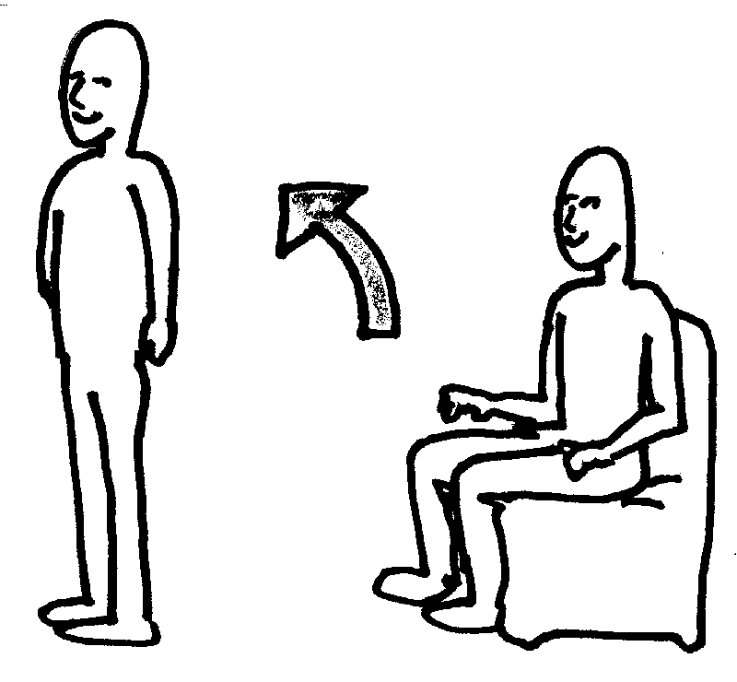
Activity 1: Boolean operators
Follow the instructions!

Slide 7
Boolean operators
AND
  Gives a TRUE result if both INPUTS are TRUE
  Otherwise gives a FALSE result
OR
  Gives a TRUE result if one or both INPUTS are TRUE
  Otherwise gives a FALSE result
NOT
  Gives a TRUE result if the (one) INPUT is FALSE
  Gives a FALSE result if the (one) INPUT is TRUE

Slide 8
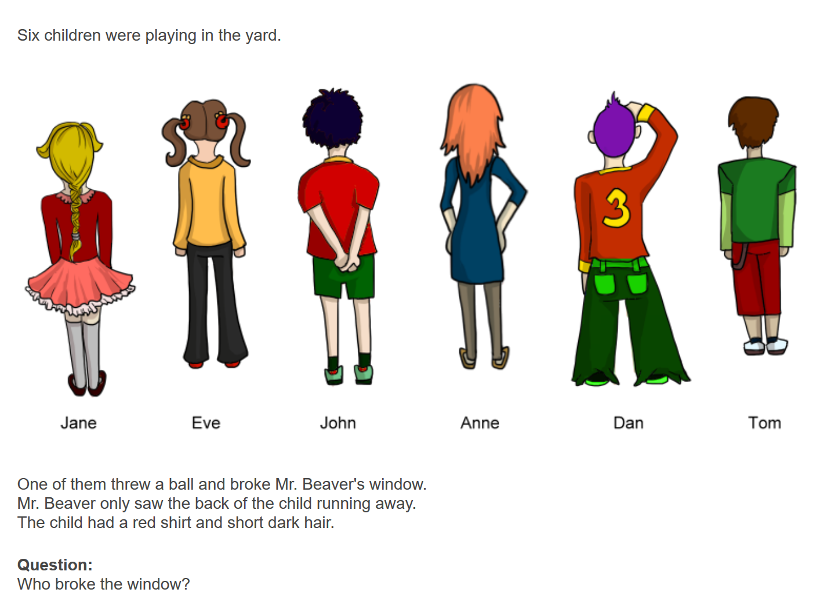
Puzzle 1: Broken window (Bebras 2016)
.
How do you solve this?
Write out this problem as a Boolean expression

Slide 9
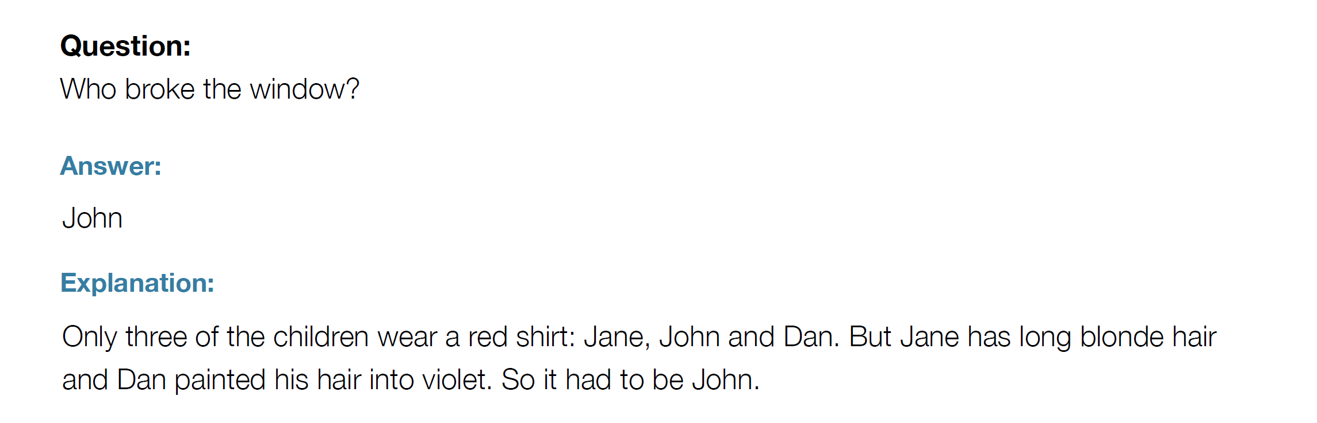
Puzzle 1 Answer
Boolean Expression
Has red shirt AND Has short hair AND Has dark hair

Slide 10
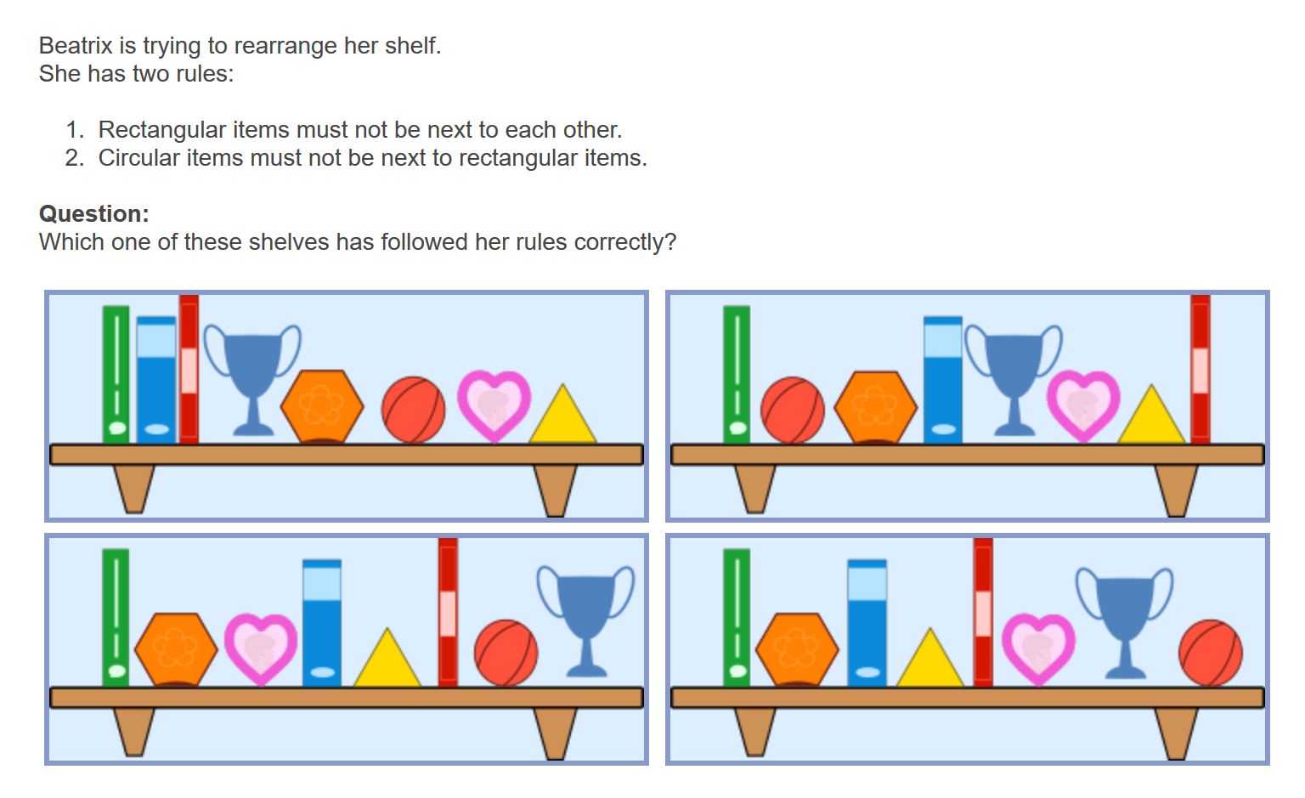
Puzzle 2: Shelf Sort (Bebras 2016)

Slide 11
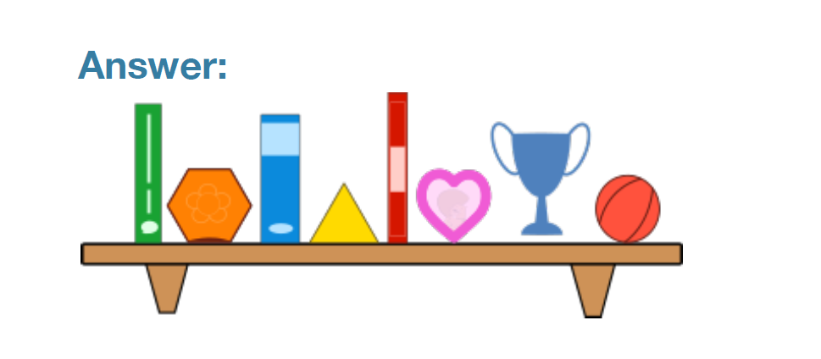
Puzzle 2 Answer
Here two rules are being applied
If (rectangle next to rectangle) OR (circular next to rectangle) then shelf is incorrect
This can also be written as:
If (rectangle NOT next to rectangle) AND (circular NOT next to rectangle) then shelf is correct

Slide 12
Logical operators
We can use Python logical operators to work with ….
== is equal to
!= is not equal to
> is greater than
< is less than
>= is greater than or equal to
<= is less than or equal to

Slide 13
Activity 2: Using operators
Try the worksheet questions 1-3
Extension – exercises 4-6

Slide 14
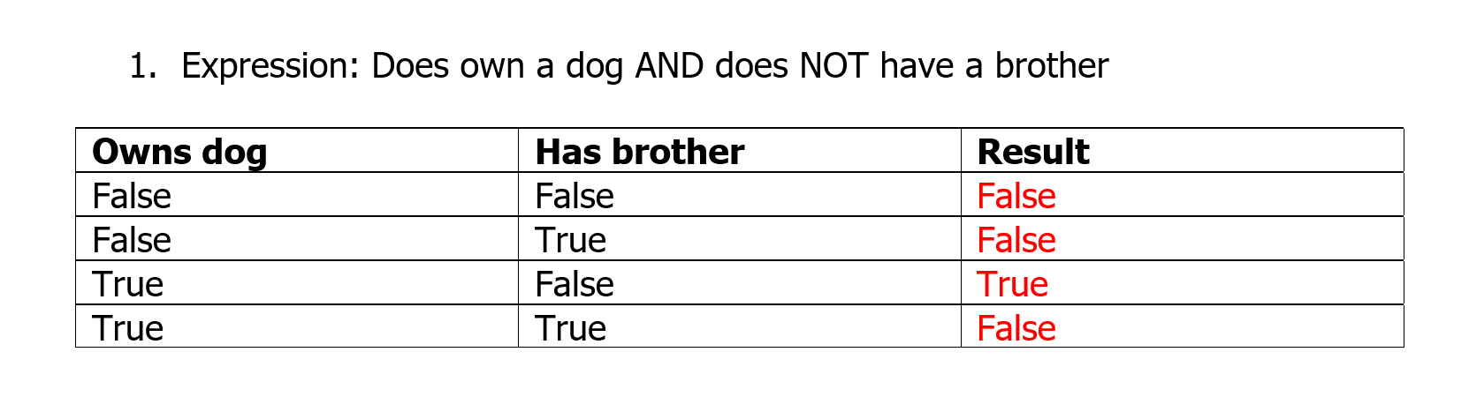
Activity 2 Answers

Slide 15
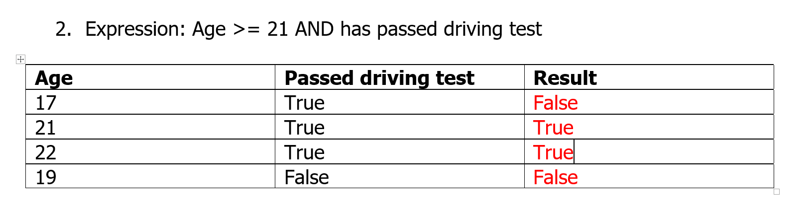
Activity 2 answers

Slide 16
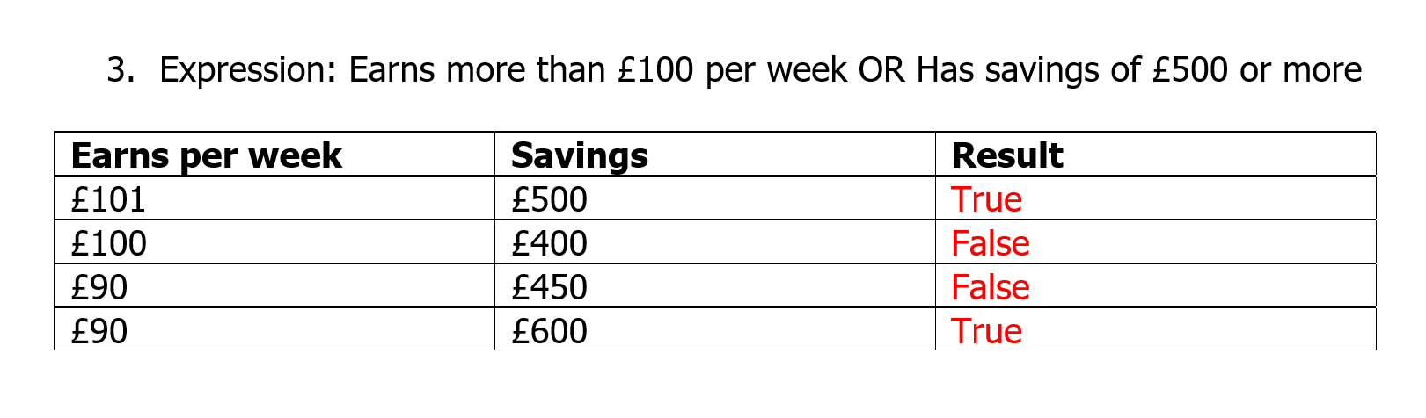
Activity 2 answers

Slide 17
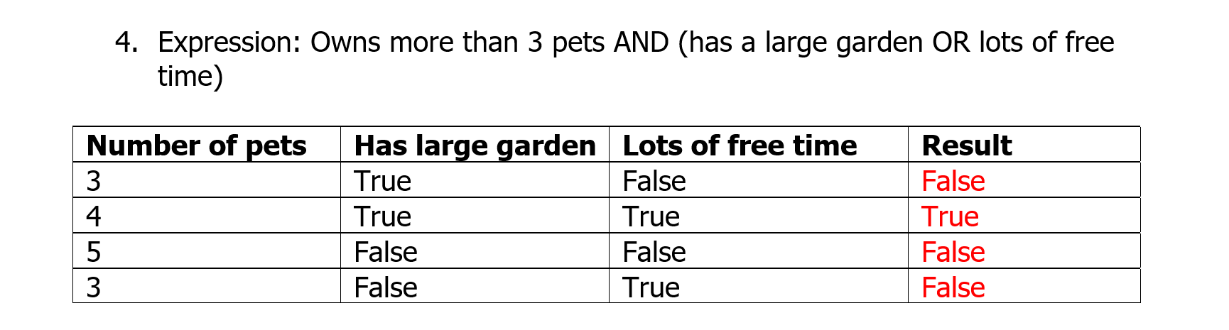
Activity 2 answers

Slide 18
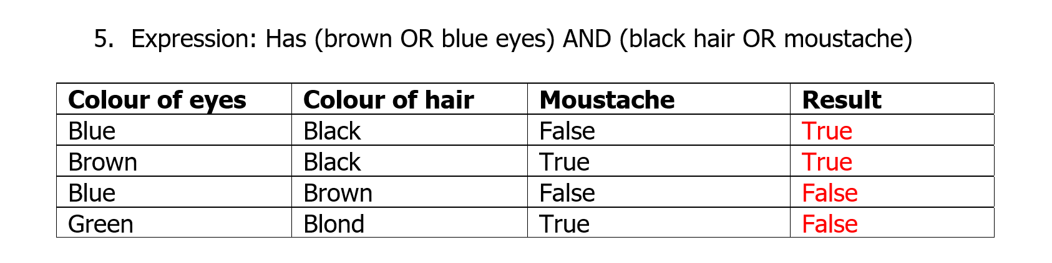
Activity 2 answers

Slide 19
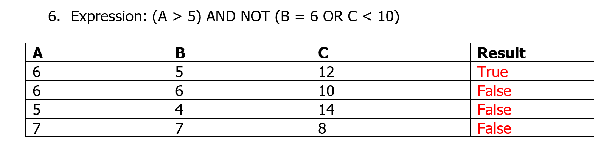
Activity 2 answers

Slide 20
Activity 3: Who am I game?
Half of you have been given a card to fill in when you entered the room.
These are now going to be shuffled and distributed to others in the class who are going to try and work out whose card is which!
Question | Answer
What is your shoe size?
Do you have brown eyes?
What Zone do you live in (7 if outside)
Do you travel to work/school by underground?
What is the last digit of your mobile number?
One other fact about you that is not visible (eg I am a good skier)
Guessers: you should take it in turns to ask a question to the whole group, e.g.:
“Raise your hand if your shoe size is 9 or less and you live in Zone 3.
The winner is the “guesser” who can first correctly identify who their card has been written by

Slide 21
Moving on …
Blue eyes | Black shoes | Output
False | False | False
False | True | False
True | False | False
True | True | True
Towards the end of KS3 you can introduce more notation in the form of truth tables and logic circuits
AND
AND
Blue eyes?
True or False
Black shoes?
Our original example
AND
Input 1
True or False
Input 2

Slide 22
Moving on …
Blue eyes | Black shoes | Output
False | False | False
False | True | True
True | False | True
True | True | True
Towards the end of KS3 you can introduce more notation in the form of truth tables and logic circuits
OR
Blue eyes?
OR
True or False
Black shoes?
Our original example
Input 1
True or False
OR
Input 2

Slide 23
Moving on …
Black shoes? | Output
False | True
True | False
Towards the end of KS3 you can introduce more notation in the form of truth tables and logic circuits
NOT
NOT
True or False
Black shoes?
Our original example
NOT
True or False
Input 1

Slide 24
Summary
At KS3 students should understand AND, OR and NOT, even in some complex expressions
Towards the end of KS3 they can be introduced to how Boolean expressions can be represented as circuits or truth tables
They should also be able to use AND, OR and NOT in their programs, for example in IF statements

Slide 25
Break

