Slide 1
Teaching KS3 Computing
Session 4
Theory: Boolean logic AND/OR/NOT
Practical: Introducing loops

Slide 2
Today’s session
5:00 – 6:00
Understanding logical operators and why they are important
6.00 – 7.00
Programming with loops - iteration

Slide 3
Recap so far

Slide 4
Recap so far
Programming side of course
Using turtle graphics in Python
Sequence
Functions – writing and calling
If statements
Input and output – print and input()
Theory side of course
Algorithms unplugged
Binary numbers 0 – 1
Hexadecimal numbers 0 – F
Bits and Bytes
Homework – discuss in pairs what you have been working on.
Revise the last two week’s work on binary numbers, storing text, hexadecimal numbers etc. Come up with a lesson plan that you think would be appropriate for one of your KS3 classes with a mixture of unplugged and paper exercises.
Work through the exercises in the Python handout and try to finish them all.

Slide 5
National curriculum at KS3
understand simple Boolean logic [for example, AND, OR and NOT] and some of its uses in circuits and programming;

Slide 6
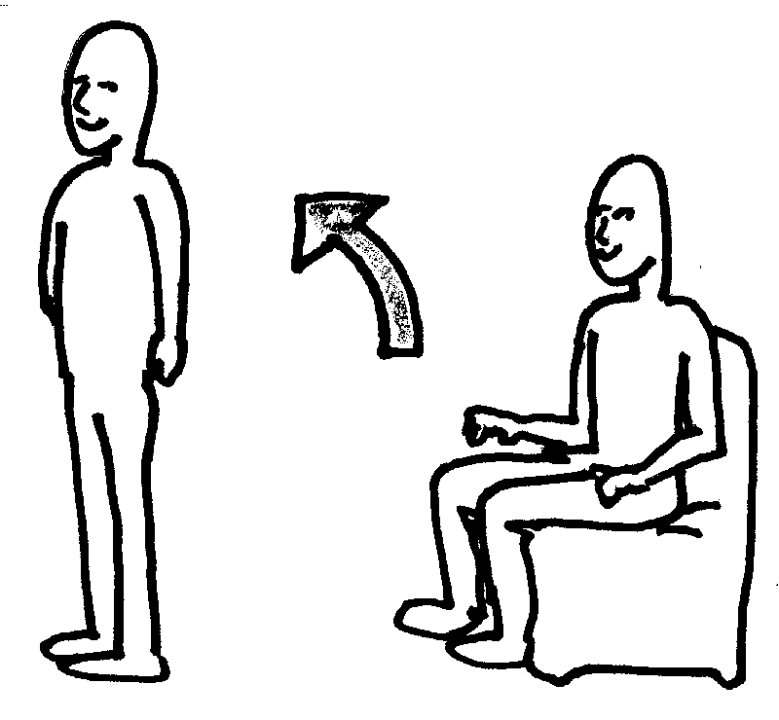
Activity 1: Boolean operators
Follow the instructions!

Slide 7
Boolean operators
AND
  Gives a TRUE result if both INPUTS are TRUE
  Otherwise gives a FALSE result
OR
  Gives a TRUE result if one or both INPUTS are TRUE
  Otherwise gives a FALSE result
NOT
  Gives a TRUE result if the (one) INPUT is FALSE
  Gives a FALSE result if the (one) INPUT is TRUE

Slide 8
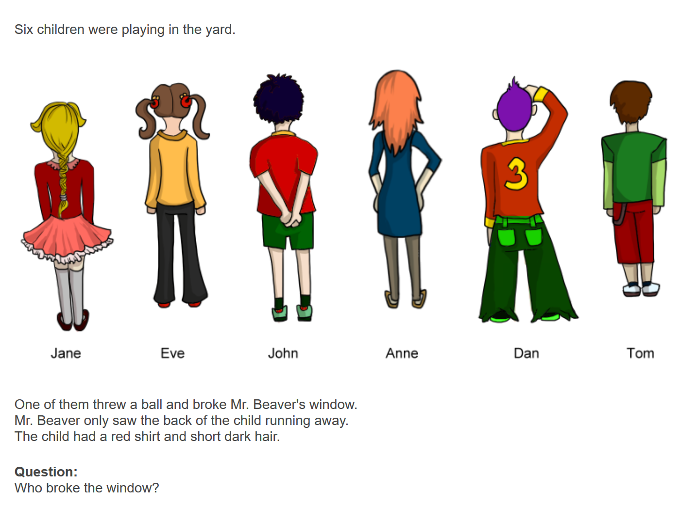
Puzzle 1: Broken window (Bebras 2016)
.
How do you solve this?
Write out this problem as a Boolean expression

Slide 9
Puzzle 1 Answer
Hidden from uploaded presentation

Slide 10
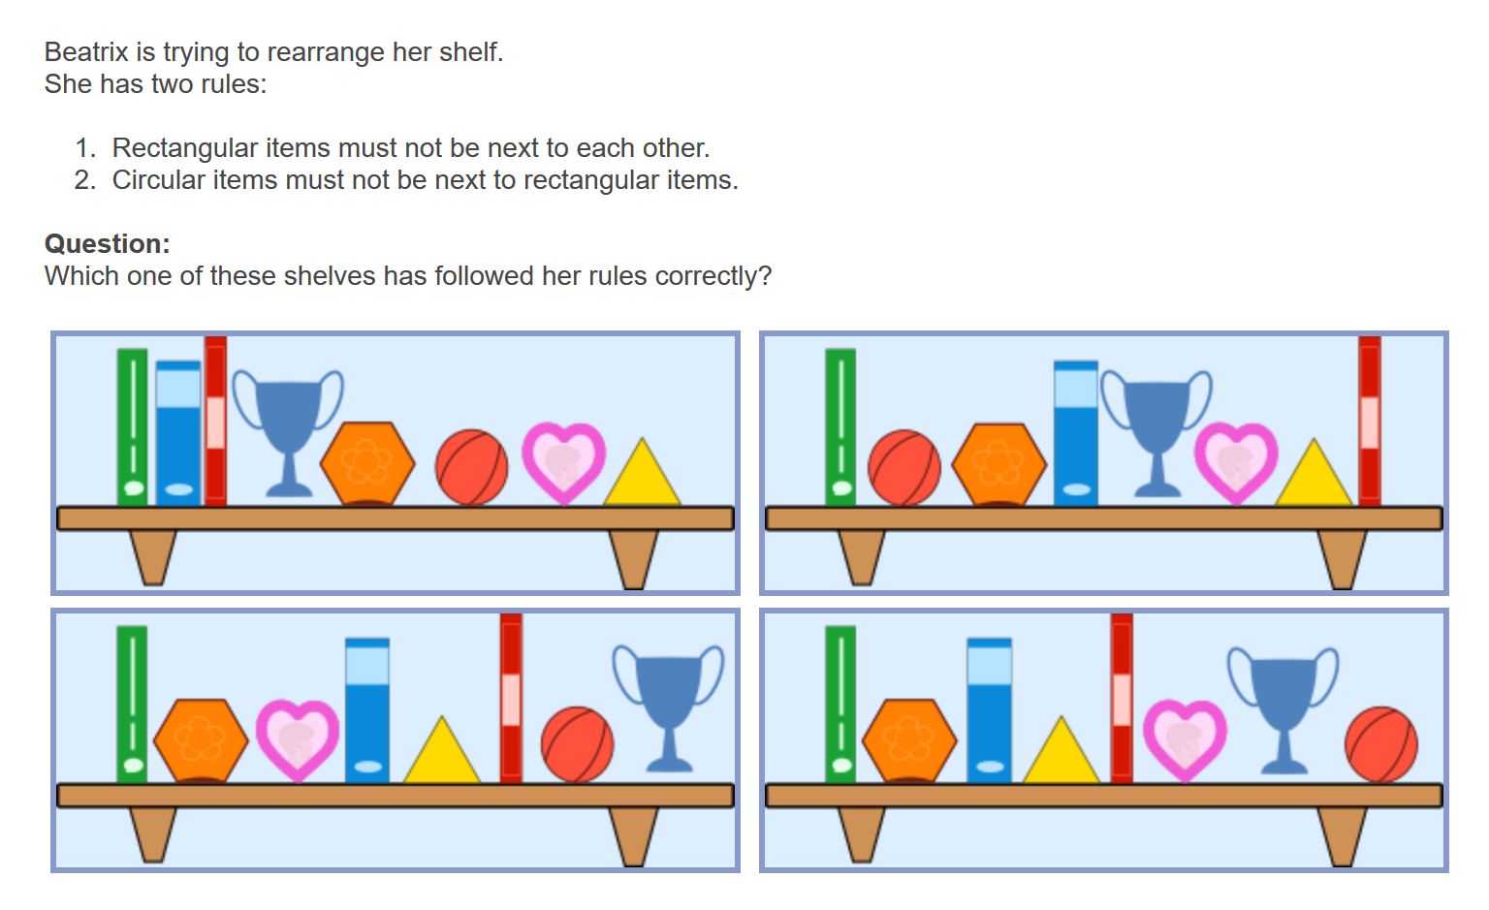
Puzzle 2: Shelf Sort (Bebras 2016)
How do you solve this?
Write out this problem as a Boolean expression

Slide 11
Puzzle 2 Answer
Hidden from uploaded presentation

Slide 12
Logical operators
We can use Python logical operators to work with ….
== is equal to
!= is not equal to
> is greater than
< is less than
>= is greater than or equal to
<= is less than or equal to

Slide 13
Activity 2: Using operators
Try the worksheet questions 1-3
Extension – exercises 4-6

Slide 14
Activity 2 Answers
Hidden from uploaded presentation

Slide 15
Activity 3: Who am I?
Half of you have been given a card to fill in when you entered the room. These are now going to be shuffled and distributed to others in the class who are going to try and work out which is whose card.
Question | Answer
What is your shoe size?
Do you have brown eyes?
What Zone do you live in (7 if outside)
Do you travel to work/school by underground?
Do you have black hair?
What is the last digit of your mobile number?
One other fact about you that is not visible (eg I am a good skier)

Slide 16
Moving on …
Blue eyes | Black shoes | Output
False | False | False
False | True | False
True | False | False
True | True | True
Towards the end of KS3 you can introduce more notation in the form of truth tables and logic circuits
AND
AND
Blue eyes?
True or False
Black shoes?
Our original example
AND
Input 1
True or False
Input 2

Slide 17
Moving on …
Blue eyes | Black shoes | Output
False | False | False
False | True | True
True | False | True
True | True | True
Towards the end of KS3 you can introduce more notation in the form of truth tables and logic circuits
OR
Blue eyes?
True or False
Black shoes?
Our original example
Input 1
True or False
Input 2

Slide 18
Moving on …
Black shoes? | Output
False | True
True | False
Towards the end of KS3 you can introduce more notation in the form of truth tables and logic circuits
NOT
NOT
True or False
Black shoes?
Our original example
NOT
True or False
Input 1

Slide 19
Break

