Slide 1
Teaching Computing to KS3
Session 1
Introduction
Theory: Algorithms
Practical: Starting out in Python

Slide 2
Course outline
Week No | Understanding computers (5:00 – 6:00) | Developing programming skills (6:00 – 7:00)
23rd January | Algorithms | Python: Turtle Graphics
30th January | Binary numbers | Python: Turtles & Functions
6th February | More on binary numbers | Python: If statements
20th February | Boolean logic | Python: Loops
27th February | Representing sound and images | Problem-solving in Python (and Scratch)
6th March | How the computer works | Problem-solving in Python (and Scratch)
13th March | More about the computer | Problem-solving in Python (and Scratch)
20th March | Python Easy Gui and Consolidation

Slide 3
What is computational thinking?
Computational thinking is recognised as a key skill set for all 21st-century learners – whether they intend to continue with computing science or not. It involves viewing the world through the thinking practices that software developers use to write programs.
5 main areas:
seeing a problem and its solution at many levels of detail (abstraction)
thinking about tasks as a series of steps (algorithms)
understanding that solving a large problem will involve breaking it down into a set of smaller problems (decomposition)
appreciating that a new problem is likely to be related to other problems the learner has already solved (pattern recognition)
realising that a solution to a problem may be made to solve a whole range of related problems (generalisation).

Slide 4
Curriculum links
KS3
understand several key algorithms that reflect computational thinking [for example, ones for sorting and searching]; use logical reasoning to compare the utility of alternative algorithms for the same problem
And what goes before?
  KS1
  understand what algorithms are; how they are implemented as programs on digital devices; and that programs execute by following precise and unambiguous instructions
  KS2
  use logical reasoning to explain how some simple algorithms work and to detect and correct errors in algorithms and programs

Slide 5
Key features of computers
Computers are deterministic: they do what you tell them to do. This is news to many, who think of them as pure magic.
Computers are precise: they do exactly what you tell them to do.
Computers can therefore be understood; they are just machines with logical working.

Slide 6
What is the similarity between these?
Cooking recipe
Downloading software or music
Car repair manual
Setting up a music playlist
Knitting pattern
Calling a friend on the phone
Sheet music
Notes:
They are, or involve, lists/sequences of instructions
The instructions are either explicit, maybe in different forms (recipe, repair manual, knitting pattern, sheet music) or implicit (calling a friend on the phone)
In fact, pretty well EVERYTHING we do can be written as some form of steps/instructions

Slide 7
Algorithms
An algorithm is a sequence of instructions
Solving a problem involves breaking it down into tasks and being able to describe steps to solve each aspect of the task.

Slide 8
Activity 1: Algorithm exercise – follow exactly!!
Draw a diagonal line
Draw another diagonal line connected to the top of the first one
Draw a straight line from the point where the diagonal lines meet
Draw a horizontal line over the straight line
At the bottom of the straight line, draw a curvy line
Draw a diagonal line from the bottom of the first diagonal to the straight line
Draw a diagonal line from the bottom of the second diagonal to the straight line
Notes:
Only need to use this slide if they don't have the hand-out.

Slide 9
How did the pictures turn out?
Compare your picture with others' pictures…
  Were they different?
  Why?
  What was difficult about following the instructions
  What was missing from the instructions?
  Can you improve on these instructions?
Notes:
Bring out detail, correctness, ambiguity

Slide 10
Follow-up task: Design an algorithm
The task/problem:
  make a shape out of paper – one sheet of A4
Write the algorithm
  Write a set of instructions that explains how to make a paper shape from 1 sheet of A4 paper
Test it
  Try out– does it work?
  Note: follow your instructions as closely as possible
  Adjust the instructions if necessary
Notes:
*** Need three sheets of scrap paper per person (1 for their shape, 1 to write instructions for making it, and 1 for making their partner's shape).
Leave it vague as to exactly what the shape is. The automatic thing is a plane – but try not to say this and see if folk will come up with other shapes.
If the pupils are stuck, then prompt them – e.g. fan, fortune teller, water bomb, plane.
Do this as three very separate steps: Make the thing first, then write the instructions, then test.

Slide 11
Follow-up task: Following an algorithm
Hide your shape
Get into pairs
  by teaming up with someone on the opposite side of the room
  move to sit together
  Do not show them your paper shape – hide it!!
Swap algorithm/instructions with your partner
Follow your partner's instructions to create their paper shape
Compare shapes
  how similar is each 'pair' of shapes?
  what advice can you give on how to improve the instructions?
Notes:
Be sure to get the pupils to hide their own shape
Make sure it is with a partner on the other side of the room – so that they didn't see it beforehand.
Note the value of watching their partner follow their own instructions is so that they can see where these are incorrect or ambiguous

Slide 12
What do we know about algorithms?
What are the key characteristics of a “good” algorithm? Why are they hard to develop?
  Must be unambiguous
  Must be correct
  Must be at the right level of detail
Also, what did can be learned about problems we pick?
  too large sometimes?
Notes:
The level of detail is interesting, and merits some discussion – for example, one could say "fold the sheet in half" or something much more longwinded such as "take two adjacent corners and fold over so they match with the other two corners, and then press the paper flat" (aargh, not good either, but roughly there!)
You can discuss some of the hard problems – timetabling, travelling salesman etc

Slide 13
Activity 2: An algorithm for noughts and crosses
In pairs, play noughts and crosses with one player using the algorithm on the handout exactly.
Does the person with the algorithm win?

Slide 14
Activity 3: Cup robotics

Slide 15
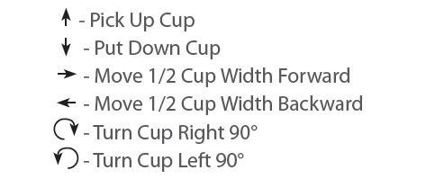
Symbols

Slide 16

Example – with 3 cups in a stack

Slide 17

You should get

Slide 18
Now try ..
Select one of the pictures to write instructions for
Write instructions ONLY using the symbols given
Swap with another group and see if your instructions work!

Slide 19
Task: Paper Cup Activity
Key Lesson Vocabulary:
Algorithm -
  A series of instructions on how to accomplish a task
Coding -
  Transforming actions into a symbolic language
Debugging -
  Finding and fixing issues in code
Function -
  A piece of code that can be called over and over

Slide 20
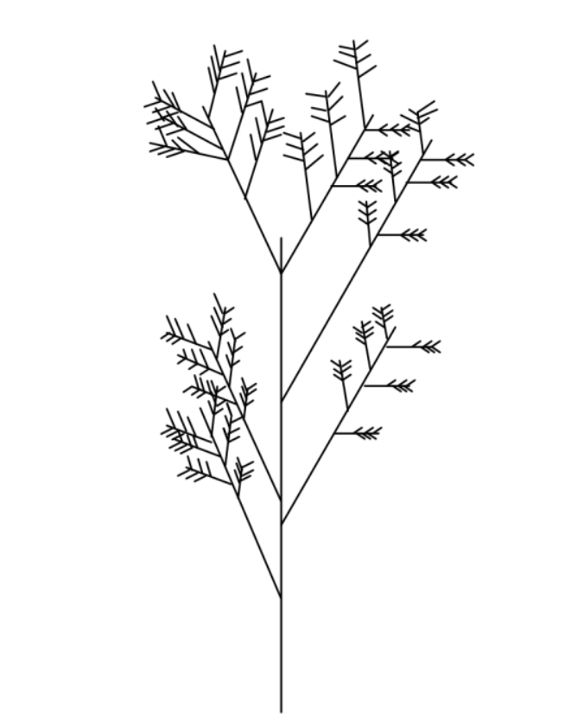
Activity 4: Algorithmic Doodle Art
Use the handout here.
Here is an example Doodle Algorithm. What does it look like?
Start by drawing a single straight vertical line
DoodleDraw from that line as follows.
To DoodleDraw from a given line:
1. Draw 3 shorter lines at an angle in the top two-thirds of the line on its left side.
2. Draw 3 shorter lines at an angle in the top two-thirds of the line on its right side.
3. Choose a new existing line and DoodleDraw from that line

Slide 21
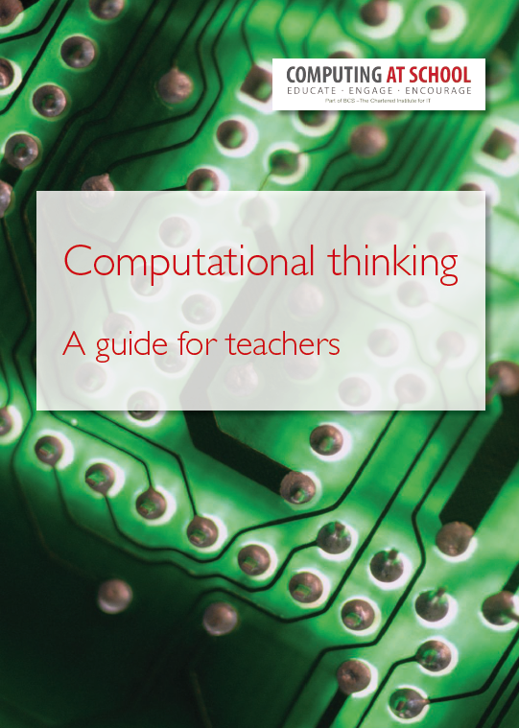
Consolidation and homework
These activities show different ways of introducing aspects of algorithmic thinking to students
What are the skills involved?
Homework:
Try out one of the activities introduced here or one of the activities in the next two slides and report back next week
Download here

Slide 22
Algorithmic thinking - examples
Writing instructions that if followed in a given order (sequences) achieve a desired effect;
Writing instructions that use arithmetic and logical operations to achieve a desired effect;
Writing instructions that store, move and manipulate data to achieve a desired effect; (variables and assignment)
Writing instructions that choose between different constituent instructions(selection) to achieve a desired effect;
Writing instructions that repeat groups of constituent instructions (loops/iteration) to achieve a desired effect;
Grouping and naming a collection of instructions that do a well-defined task to make a new instruction (subroutines, procedures, functions, methods);

Slide 23
Algorithmic thinking - examples
Writing instructions that involve subroutines use copies of themselves to achieve a desired effect (recursion);
Using a standard notation to represent each of the above;
Creating algorithms to test a hypothesis;
Creating algorithms that give good, though not always the best, solutions (heuristics);
Creating algorithmic descriptions of real world processes so as to better understand them (computational modelling);
Designing algorithmic solutions that take into account the abilities, limitations and desires of the people who will use them;

Slide 24
Further skills to learn - algorithms
There are lots of good activities that illustrate the point that algorithms need to be precise
As well as understanding that algorithms should be finite and precise, we also need to develop these skills:
  Debugging algorithms
  Designing algorithms
  Executing algorithms
  Tracing algorithms
  Automating (programming) algorithms

Slide 25
Next …. after a short break … programming
Questions for the break
What is the relationship between algorithms and programming?
Why learn to program?
To be revisited after break

