Slide 1

A Level Computer Science
Topic 9: Data Structures
Teaching London Computing
William Marsh
School of Electronic Engineering and Computer Science
Queen Mary University of London

Slide 2
Aims
Where do lists and dictionaries come from?
Understand the problem
Introduce the following data structures
  Linked list
  Binary search tree
  Hash sets
  Graphs

Slide 3
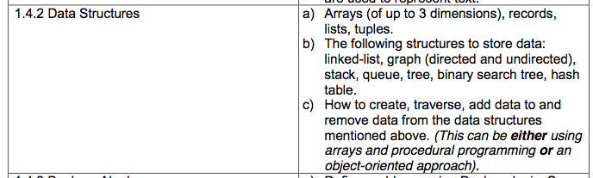
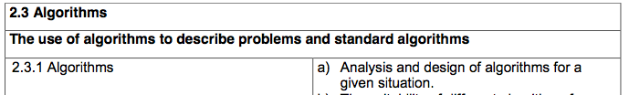
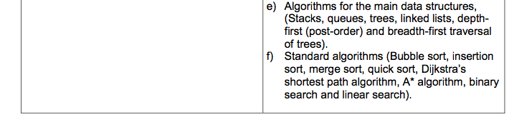
Syllabus – OCR

Slide 4
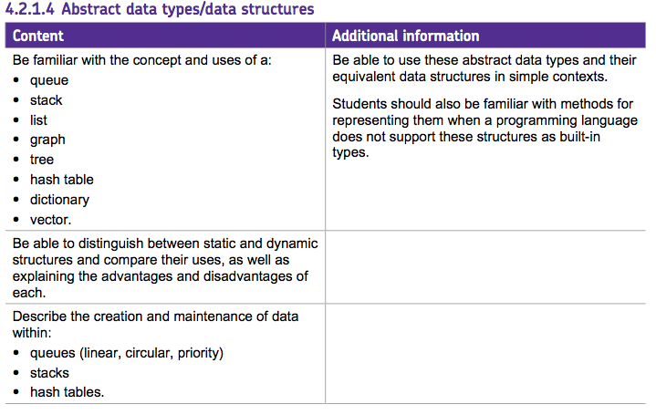
Syllabus – AQA

Slide 5
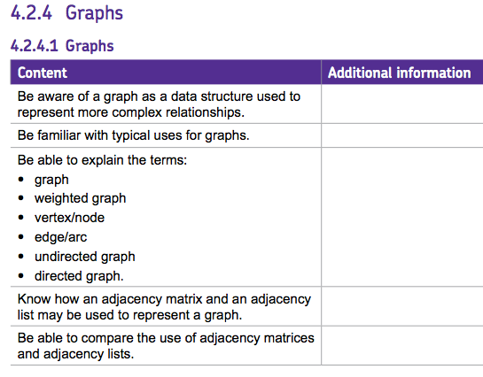
Syllabus – AQA

Slide 6
Data Structures?
“I will, in fact, claim that the difference between a bad programmer and a good one is whether he considers his code or his data structures more important. Bad programmers worry about the code. Good programmers worry about data structures and their relationships.”
Linus Torvalds, 2006

Slide 7
Problem: Arrays → Lists
Abstractions

Slide 8
Abstraction v Implementation
List abstraction
  Grows and shrinks – insert, remove
  Index into – lst[n]
Stack abstraction (plate stack)
  Push, pop
  Simpler than list, as only access ‘top’
Many possible implementations of each abstraction
  Trade-offs

Slide 9
Stack Operations
pop and push
push(10)
a=pop()
a==10
top
top
top
10

Slide 10
Exercise 1.2
Operations on a stack

Slide 11
Lists in Arrays
0 1 2 3 4 5 6 7 8 9
17 31 52 19 41 34 76 11 28 92
The array cannot grow
To insert, we have to shuffle along
Indexing is quick
Because indexing is quick, there are implementations based on arrays in lists

Slide 12
Aside: Array and LMC
n
. . . . . .
Address of A
Address of array – A – is address of entry 0
Address of A[n] is is A + n
Real computers
  Have registers for addresses
  Do arithmetic on addresses

Slide 13
Set & Map Abstractions
Set
  Membership
  Insert
  Remove
Dictionary (Map)
  Keys are like a set – value attached to each key
  ... Set operations
  Lookup value is similar to membership
Key Value

Slide 14
Linked Lists
An implementation of the list abstractions

Slide 15
Linked List Concept
b
c
d
e
f
front
back
Each entry has
  A value
  A pointer to the next entry
Keep a pointer to the front entry
The pointer of the last entry is None

Slide 16
Linked List Index
myList.index(i)
Count along the list to entry i
Return the value
pointer = front
count = 0
while count < i:
pointer ← next of current entry
count = count + 1
return the value of current entry

Slide 17
Linked List Update
myList.update(idx, newValue)
Count along the list to entry index
Replace value with new value
pointer = front
count = 0
while count < idx:
pointer ← next of currentEntry
count = count = 1
currentEntry.value = newValue

Slide 18
Linked List Insert
myList.insert(idx, newValue)
Count along the list to entry idx-1
Insert a new entry
  Next pointer of current entry points to new entry
  Next pointer of new entry points to following entry

Slide 19
Exercise
b
c
d
e
f
front
back
Redraw list after:
  appending a new entry at the end
  inserting before entry zero
  inserting before entry 3

Slide 20
Exercises 2.1 – 2.3
Linked list

Slide 21
Linked List Code
class List:
def __init__(self):
self.length = 0
self.first = None
def append(self, value):
entry = Entry(value)
if self.first == None :
self.first = entry
return
p = self.first
q = p.getNext()
while q != None:
p = q
q = p.getNext()
p.setNext(entry)
def index(self, i):
count = 0
p = self.first
while count < i:
p = p.getNext()
count = count + 1
return p.getValue()
class Entry:
def __init__(self, v):
self.value = v
self.next = None
def setValue(self, v):
self.value = v
def getValue(self):
return self.value
def setNext(self, n):
self.next = n
def getNext(self):
return self.next

Slide 22
Complexity of Linked List
Indexing is linear: O(n)
  c.f. array index is O(1)
  need to do better!
Often need to visit every entry in the list
  e.g. sum, search
  This is O(n²) if we use indexing
  Easy to improve this by keeping track of place in list
Search is O(n)

Slide 23
Binary Trees
A more complex linked structure

Slide 24
Introduction
Many uses of (binary) tree
Key ideas
  Linked data structure with 2 (or more) links (c.f. linked list)
  Rules for organising tree
Binary search tree
Other uses
  Heaps
  Syntax trees

Slide 25
Binary Search Tree
Root
47
Left child
Right child
21
52
Leaf
11
28
51
66
All elements to the left of any node are < than all elements to the right

Slide 26
Exercise: Put The Element In
17, 19, 28, 33, 42, 45, 48

Slide 27
Search
47
21
52
11
28
51
66
Binary search
E.g. if target is 28:
  28 < 47 – go left
  28 > 21 – go right
What is the complexity of searching a binary tree?

Slide 28
Binary Tree Search
Recursive algorithms
Find-recursive(key, node): // call initially with node = root
if node == None or node.key == key then
return node
else if key < node.key then
return Find-recursive(key, node.left)
else
return Find-recursive(key, node.right)

Slide 29
Balance and Complexity
Complexity depends on balance
  Left and right sub-trees (nearly) same size
  Tree no deeper than it need be
52
47
21
11
51
21
52
47
11
28
51
Not balanced
28
Balanced

Slide 30
Tree Traversal
In-order
  Traverse the left subtree.
  Visit the root.
  Traverse the right subtree.
Order of visiting nodes in tree
1
2
5
4
3
4
6
7
2
6
Pre-order
  Visit the root.
  Traverse the left subtree.
  Traverse the right subtree.
1
3
5
7

Slide 31
Exercises 3.1 – 3.3
Binary trees

Slide 32
Hash Sets

Slide 33
Insight
Array are fast – indexing O(1)
Map a string to an int, use as an array index
hash() in Python
  Any hashable type can be a dictionary key
Ideally, should spread strings out

Slide 34
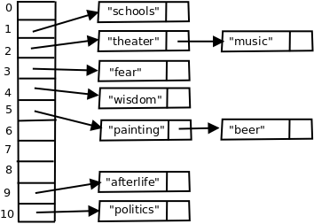
Hash Table (Set)
Look for string S in array at:
  hash(S) % size
Collision
  Two items share a hash
  Linked list of items with same size
Array length > number of items
Array sized increased if table

Slide 35
Many Other Uses of Hashing
Cryptography
Checking downloads – checksum
Checking for changes

Slide 36
Exercise
Try Python hash function on strings and on other values
Can you hash e.g. a person object?

Slide 37
Graphs

Slide 38
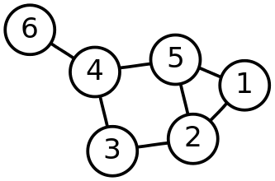
Graph
Many problems can be represented by graphs
  Network connections
  Web links
  ...
Graphs have
  Nodes and edges
Edges can be directed or undirected
Edges can be labelled

Slide 39
Graph v Trees
Only one path between two nodes in a tree
Graph may have
  Many paths
  Cycles (loops)

Slide 40
Graph Traversal
Depth first traversal
  Visit children,
  ... then siblings
Breadth first traversal
  Visit siblings before children
Algorithms similar to trees traversal, but harder (because of cycles)

Slide 41
Graph Algorithms
Shortest paths
  Final short path through graph with not-negative edge weight
  Routing in networks
  Polynomial
Longest paths – travelling salesman
  Intractable

Slide 42
Graph Representations
2-D table of weights
Adjacency list
  1-D array of lists of neighbours

Slide 43
Exercise 4.1
Show how maze can represented by a graph
Maze solved by finding (shortest) path from start to finish

Slide 44
Exercise 4.1
02
01
02
01
13
13
14
31
14
30
35
36
30
31
35
36
41
42
43
41
42
43
55
56
50
55
56
50
64
65
66
64
65
66

Slide 45
Exercise 5.2
Represent graph as
  Adjacency list
  A 2-D array (table)

Slide 46
Summary
Python has lists and dictionaries built in
Data structures to implement these
  Linked data structures
  Hashing: magic

