Slide 1

A Level Computer Science
Topic 7: OS and Running a Program
Teaching London Computing
William Marsh
School of Electronic Engineering and Computer Science
Queen Mary University of London

Slide 2
Aims
Recap Operating Systems
Compiling and linking
From LMC to an OS
  Challenges of running programs
  Processes
  Memory management

Slide 3
Recap: What’s an OS?

Slide 4

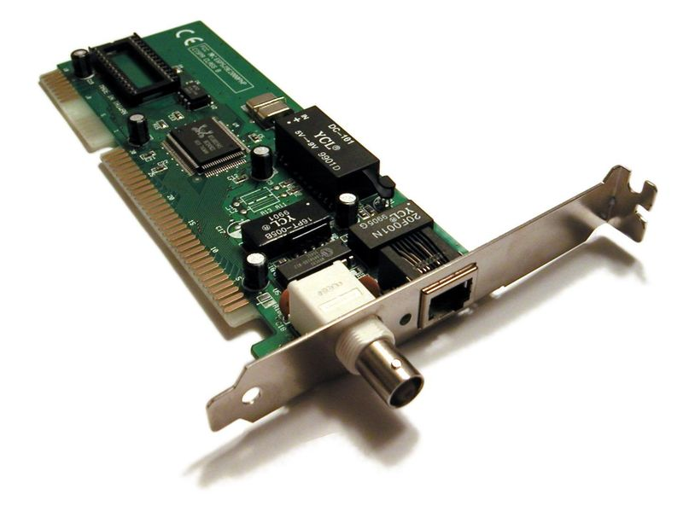
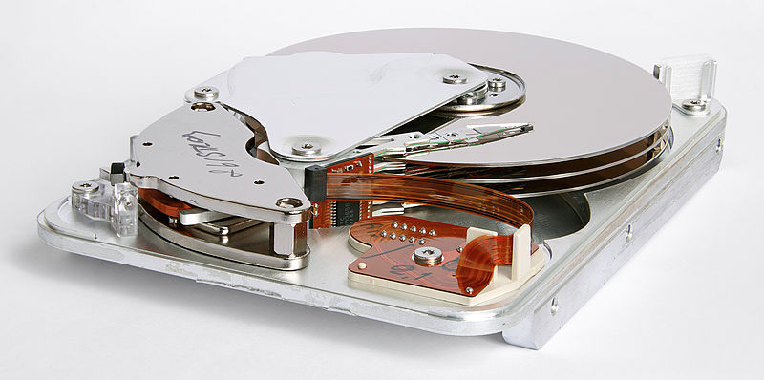
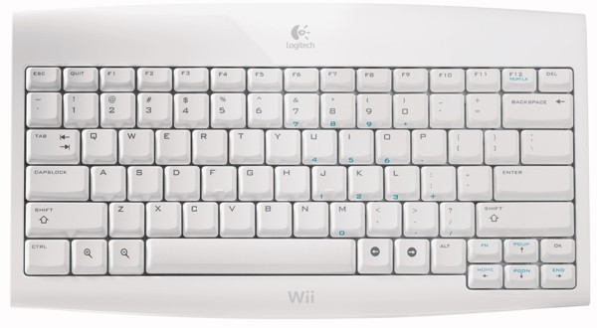
OS Handlers Interfaces
I/O devices
  Keyboard
  Monitor
  Network
  Disk
File system
User interface
ISA bus Ethernet card

Slide 5
System Calls
The OS is a program
  Other programs use OS functions
Some examples using Python
import os, sys
print("OS name:", os.name)
print("Platform:", sys.platform)
print("Process id:", os.getpid())
print("User id:", os.getuid())
print("File meta data:", os.stat("os1.py"))
print("Current directory", os.getcwd())
os.chdir("..")
print("Current directory", os.getcwd())
for root, dirs, files in os.walk('.'):
if len(dirs) > 0 :
print(root, "contains directories:", dirs)

Slide 6
Recall LMC
Variables
  Instruction contain the address of data
Branches
  Instructions contain address of instructions
LDA y
ADD z
STA x
HLT
But do we know where everything is?
x
y
z

Slide 7
Challenges Beyond LMC
Computer runs many programs
  Applications
  Interfaces to device – e.g. networks, keyboard
Many programs share memory
  Which memory locations free?
  How much memory needed?
Programs are incomplete!
  Only the OS knows how to do I/O
  Applications interface to OS

Slide 8
Overview of Solutions
Compiler does not generate a complete program
  Linker combines parts
  Loader places it in memory
OS manages processes and interrupts
  Interrupt handlers respond to I/O events
  Applications run in processes
  Scheduler juggles processes
Processor and OS Manage Memory
  Memory organised in pages
  Addresses are translated
  Pages come and go

Slide 9
Options for Practical Work

Slide 10
Challenge and Options
Pupils think that GUI is the Computer
… or
Microsoft + IT manager want to keep it like that
Raspberry Pi: e.g. headless
  See e.g. https://www.youtube.com/watch?v=Ioih6MHNNqc
Virtual machine
  Local or Web-based e.g. c9.io
Where?

Slide 11
Comparison
Raspberry Pi
Virtual Machine
Hard to set up without interacting with network
Clear what is happening
Easy to manage once setup
Available to pupils
Local
  Moderately clear
  Some management issues
Web based
  Easy to deliver
  Potential confusion
  … especially if s/w IDE
Is practical work important for OS?

Slide 12
Exercise: Set Up c9.io
Cloud Nine is a web-based s/w development environment
  command line programs
  web programs
Create a free account on c9.io
Need access to an email account
Create a basic project (see exercise sheet)

Slide 13
Exercise 1.1- 1.6 Command Line
Use the command line to
  Look at files
  Create files and directories
  Run programs

Slide 14
Compiling and Linking
Problem 1: compiler does not generate a complete program

Slide 15
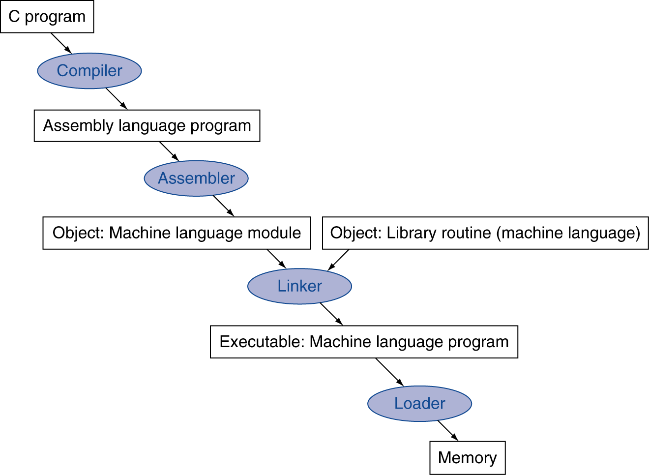
Program Translation

Slide 16
Assembly & Object Code
Assembly code
  Textual representation of machine code
  Produced by compiler
Object code
  Binary representation
  Produced by assembler
Normally compiler and assembler combined

Slide 17
Example C Program
#include <stdio.h>
#include <stdlib.h>
int main (int argc, const char *argv[]) {
// check for argument
if (argc < 2) {
return 1 ;
}
// convert argument
int num = atoi(argv[1]);
printf("%d\n", num+1);
return 0 ;
}

Slide 18
11:main.c **** int num = atoi(argv[1]);
36 .loc 1 12 0
37 001c 488B45E0 movq -32(%rbp), %rax
38 0020 4883C008 addq $8, %rax
39 0024 488B00 movq (%rax), %rax
40 0027 4889C7 movq %rax, %rdi
41 002a E8000000 call atoi
41 00
42 002f 8945FC movl %eax, -4(%rbp)
12:main.c **** printf("%d\n", num+1);
43 .loc 1 13 0
44 0032 8B45FC movl -4(%rbp), %eax
45 0035 8D5001 leal 1(%rax), %edx
46 0038 B8000000 movl $.LC0, %eax
46 00
47 003d 89D6 movl %edx, %esi
48 003f 4889C7 movq %rax, %rdi
49 0042 B8000000 movl $0, %eax
49 00
50 0047 E8000000 call printf
Directive
Assembly Instruction
Machine Instruction
Address
Symbol

Slide 19
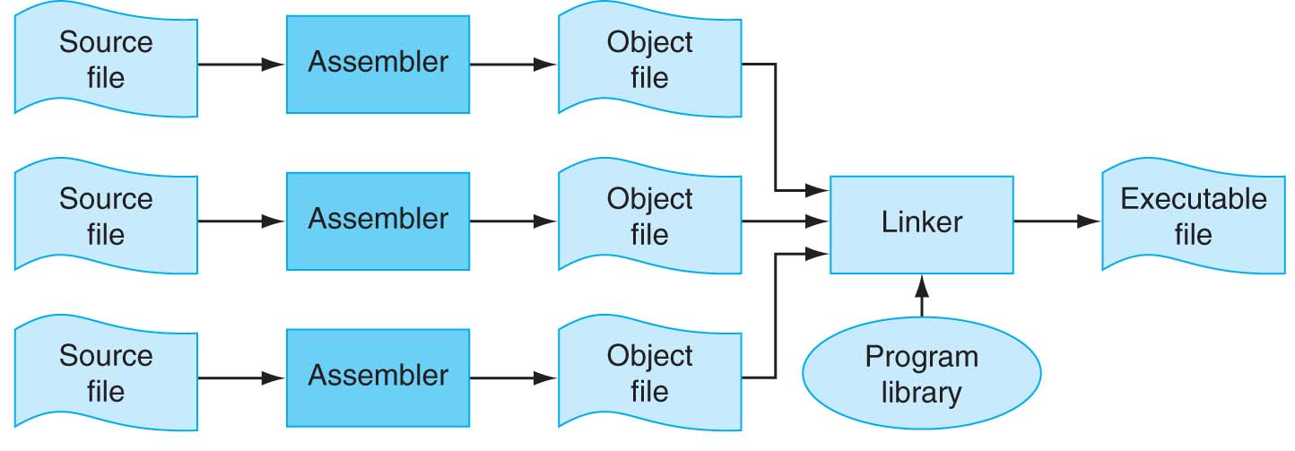
Separate Compilation
No need to compile all code at once
  Library code
  Separate files
Linker combines the object files

Slide 20
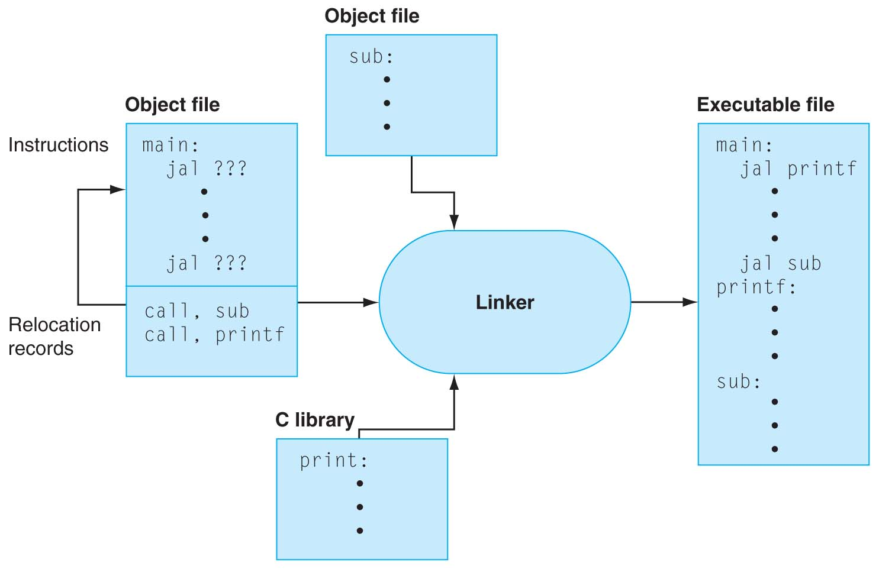
Linker Stitches Files Together
Searches object files and libraries for non-local symbols
Resolves references in different files
Combines them
into a single
executable file

Slide 21
Disassembly: objdump
Compare
// check for argument
if (argc < 2) {
return 1 ;
}
Jump
Jump (to end)
0000000000400504 <main>:
400504: 55 push %rbp
400505: 48 89 e5 mov %rsp,%rbp
400508: 48 83 ec 20 sub $0x20,%rsp
40050c: 89 7d ec mov %edi,-0x14(%rbp)
40050f: 48 89 75 e0 mov %rsi,-0x20(%rbp)
400513: 83 7d ec 01 cmpl $0x1,-0x14(%rbp)
400517: 7f 07 jg 400520 <main+0x1c>
400519: b8 01 00 00 00 mov $0x1,%eax
40051e: eb 35 jmp 400555 <main+0x51>

Slide 22
Disassembly: objdump
Unresolved jump
0000000000400504 <main>:
...
400520: 48 8b 45 e0 mov -0x20(%rbp),%rax
400524: 48 83 c0 08 add $0x8,%rax
400528: 48 8b 00 mov (%rax),%rax
40052b: 48 89 c7 mov %rax,%rdi
40052e: e8 dd fe ff ff callq 400410 <atoi@plt>
400533: 89 45 fc mov %eax,-0x4(%rbp)
400536: 8b 45 fc mov -0x4(%rbp),%eax
400539: 8d 50 01 lea 0x1(%rax),%edx
40053c: b8 58 06 40 00 mov $0x400658,%eax
400541: 89 d6 mov %edx,%esi
400543: 48 89 c7 mov %rax,%rdi
400546: b8 00 00 00 00 mov $0x0,%eax
40054b: e8 a0 fe ff ff callq 4003f0 <printf@plt>
400550: b8 00 00 00 00 mov $0x0,%eax
400555: c9 leaveq
400556: c3 retq

Slide 23
Loading a Program
Load from image file on disk into memory
  Read header to determine sizes
  Allocates space in memory
  Copy text and initialized data into memory
  Set up arguments on stack
  Initialize registers
  Jump to startup routine
  … and calls main
  When main returns, do “exit” systems call
Loader also does dynamic linking

Slide 24
Summary
Compiled programs are incomplete
Linker adds libraries
… but linked programs are incomplete too
Loader resolves references to shared libraries (dynamic linking)
Still to solve:
How can several programs run at once?
How can programs move around in memory?

Slide 25
Exercise 2.1 – 2.4
Use the online VM to compile a C program and understand
  Libraries
  Linking

Slide 26
Processes & Interrupts
Lots of stuff happening at once!

Slide 27

Interrupts
I/O device speed varies
How many CPU clock cycles per keystroke?
How to avoid CPU waiting for I/O?
Interrupt
  Signal from outside the CPU
  … changes the program

Slide 28
Processes
An instance of a program running
  Process has memory
  Process does I/O
Processes are created by other processes
Multiple processes
  Avoid waiting for I/O – better throughput
  User can listen to music while coding
One process protected from another
  Looping program?
  Blue screen?

Slide 29
Inside the Computer
Interrupt handler
  Responds to I/O
Libraries
  Shared between programs
Processes
  Instances of a program running
OS Kernel
  Keeps track!
OS kernel
Shared lib
Shared lib
Int handler
Int handler
P1
P2
P3

Slide 30
How Many Programs Run at Once?
Uniprocessor – only one really
  Illusion of multiple processes
  … juggling
Multiprocessors – several programs at once
  … still requires juggling
Concurrency v parallelism
  Parallel programming: use multiple processors to go faster e.g. weather forecast
  Concurrency: play music while editing

Slide 31
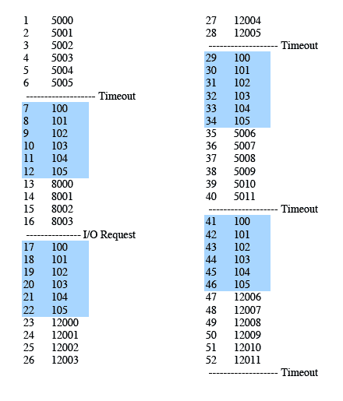
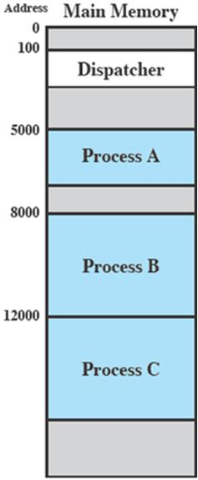
Trace: CPU Point of View
Process A
Dispatcher
Timeout
Timeout
Dispatcher
I/O
Process A
Process B
Dispatcher
Timeout
Dispatcher
Process C
Process C
Notes:
Animated slide
Explain the scenario then click for the animation
The shaded areas represent code executed by the dispatcher.
The same sequence of instructions is executed by the dispatcher in each instance because the same functionality of the dispatcher is being executed.
We assume that the OS only allows a process to continue execution for a maximum of six instruction cycles, after which it is interrupted; this prevents any single process from monopolizing processor time.
Animate here
The first six instructions of process A are executed, followed by a time-out and the execution of some code in the dispatcher, which executes six instructions before turning control to process B2.
After four instructions are executed, process B requests an I/O action for which it must wait. Therefore, the processor stops executing process B and moves on, via the dispatcher, to process C.
After a time-out, the processor moves back to process A. When this process times out, process B is still waiting for the
I/O operation to complete, so the dispatcher moves on to process C again.

Slide 32
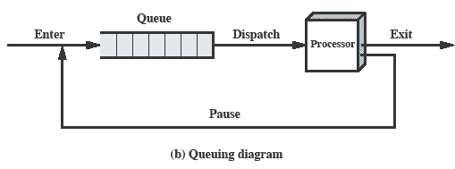
Scheduler
Queue of processes ready to run
  Other processes waiting for an I/O
Which one to run next?
  Don’t want the music to stop

Slide 33
Summary
Many user processes sharing the computer
  Music and coding
  Multiple users
OS has a scheduler to switch between processes
Processes are protected from each other
  Ok if your program loops

Slide 34
Memory Management
Lots of processes in memory

Slide 35
Memory Management Problem
How much memory?
  Process may need more or less memory
Where in memory?
  Processes come and go – where is space
  Program must work in any location
Solutions
  Paged memory
  Address translation

Slide 36
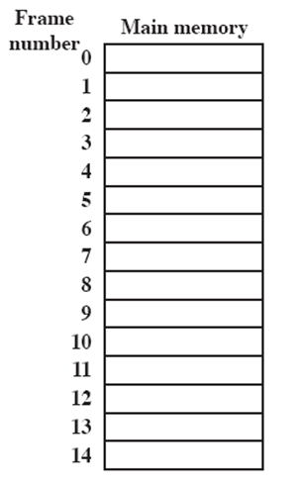
Processes, Pages and Frames
Program memory divided into pages
Computer memory divided into frames
Pages allocated to frames
Page table
  List of frames used by each process
A.0
A.1
A.2
A.3
B.0
D.0
B.1
D.1
B.2
D.2
C.0
C.1
C.2
C.3
D.3
D.4
Notes:
Animated slide
System with a number of frames allocated
Process A, stored on disk, consists of four pages. When it comes time to load this process, the operating system finds four free frames and loads the four pages of process A into the four frames.
Process B, consisting of three pages, and process C, consisting of four pages, are subsequently loaded.
Then process B is suspended and is swapped out of main memory.
Later, all of the processes in main memory are blocked, and the operating system needs to bring in a new process, process D, which consists of five pages. The Operating System loads the pages into the available frames and updates the page table

Slide 37
Paged Memory
Good for using memory efficiently
New problem
  Machine code addresses are all wrong!
Solution
  Translate address
  Logical (virtual) address → Physical address
  Each time memory is accessed

Slide 38
Address Translation
Compiler assumes that program will run in its own computer
  Logical addresses
Each memory access translated
  Memory management unit (MMU) in CPU
  Replaces top bits of address: page → frame
MSB
Page number
Offset in page
LSB
20 bits
12 bits

Slide 39
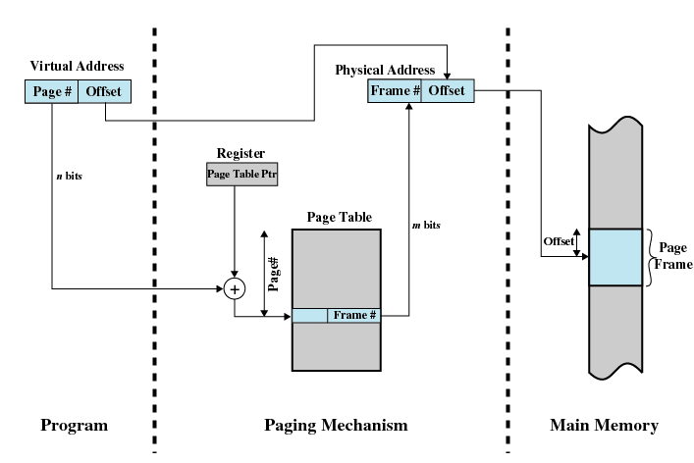
Address Translation

Slide 40
Virtual Memory
Not all pages in memory at all
Total number of pages may exceed available memory
Some pages temporarily stored in a page file on disk

Slide 41
Summary
Program compiled to assuming own computer
Programs allocated memory in pages
Pages move around: on and off disk
Mechanisms
  Page table – where is each page?
  Address translation – page → frame
  Virtual memory

Slide 42
Exercise 3.1 – 3.4
Look at processes and memory using c9

Slide 43
Summary

Slide 44
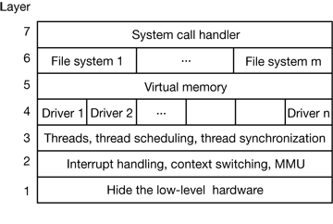
Operating System Structure
Principles
  Operating system calls user programs
  Kernel: control what runs
  Library of system calls
  Services
Kernel
  Able to use all
  processor
  instruction &
  registers

Slide 45
OS is about Illusions
Several programs are running simultaneously
  The computer switches from one to another
My program has all the memory
  The memory is shared between programs
Disk is organised in files
  The disk has blocks; the OS maps file names to blocks
Storage devices work the same
  Files may be arranged differently on magnetic, flash and optical drives
OS creates an ‘ideal’ computer from a real one

